Slide 1
Chapter 19
Organic Chemistry
Slides to accompany Organic and Biochemistry Supplement to Enhanced Introductory College Chemistry by Gregory Anderson, Caryn Fahey, Jen Booth, Adrienne Richards, Samantha Sullivan Sauer, and David Wegman
Slide design and template by Revathi Mahadevan
Except where otherwise noted, images, tables & diagrams are reused from Organic and Biochemistry Supplement to Enhanced Introductory College Chemistry
Slides are licensed under CC-BY 4.0, Except while otherwise noted

Slide 2
Figure 19.0a
Figure 19.0a. All organic compounds contain carbon and most are formed by living things, although they are also formed by geological and artificial processes. (credits left: modification of work by Jon Sullivan, PDM; left middle: modification of work by Deb Tremper, PDM; right middle: modification of work by annszyp, CC BY 2.0; right: modification of work by George Shuklin, PDM)

Slide 3
Table 19.0a
Table 19.0a. General Contrasting Properties and Examples of Organic and Inorganic Compounds
Organic | Hexane | Inorganic | NaCl
low melting points | −95°C | high melting points | 801°C
low boiling points | 69°C | high boiling points | 1,413°C
low solubility in water; high solubility in nonpolar solvents | insoluble in water; soluble in gasoline | greater solubility in water; low solubility in nonpolar solvents | soluble in water; insoluble in gasoline
flammable | highly flammable | nonflammable | nonflammable
aqueous solutions do not conduct electricity | nonconductive | aqueous solutions conduct electricity | conductive in aqueous solution
exhibit covalent bonding | covalent bonds | exhibit ionic bonding | ionic bonds
Table source: "12.1: Organic Chemistry" In Basics of GOB (Ball et al.), CC BY-NC-SA 4.0.

Slide 4
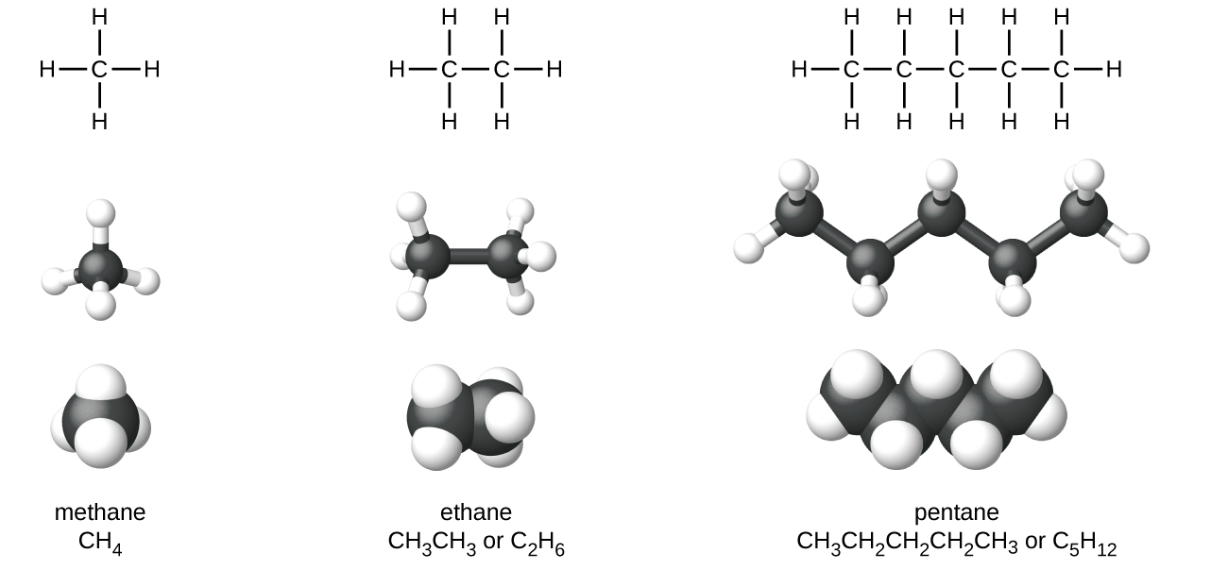
Figure 19.1a
Figure 19.1a. Pictured are the expanded structural formulas, ball-and-stick models, and space-filling models for molecules of methane, ethane, and pentane. Below the chemical names methane, ethane and pentane represent the condensed structural formulas. (credit: Chemistry (OpenStax), CC BY 4.0).

Slide 5
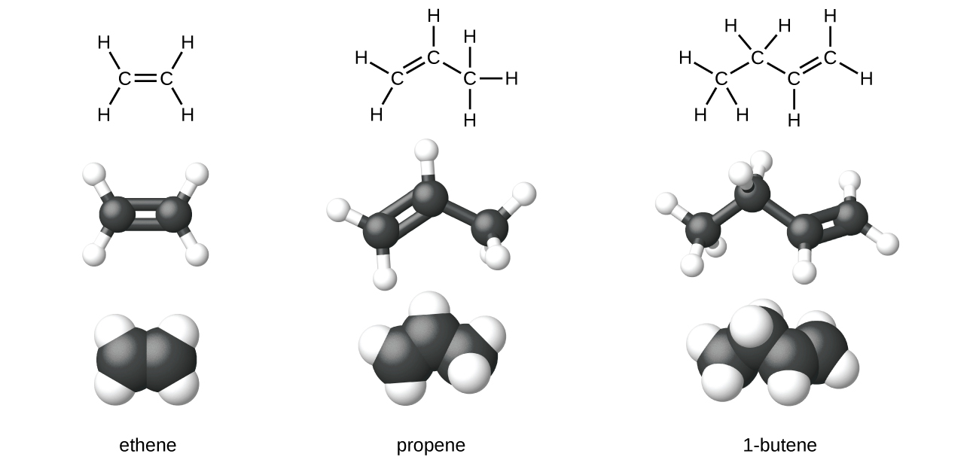
Figure 19.1b
Figure 19.1b. The expanded molecular structures, ball-and-stick structures, and space-filling models for the alkenes ethene, propene, and 1-butene are shown (credit: Chemistry (OpenStax), CC BY 4.0).

Slide 6
Figure 19.1c
Figure 19.1c. The expanded structural formula of ethyne (acetylene) (credit: Chemistry (OpenStax), CC BY 4.0).

Slide 7
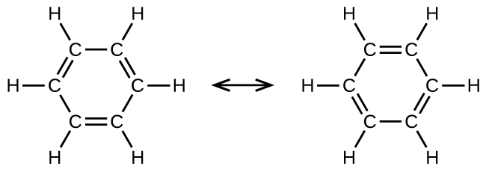
Figure 19.1d
Figure 19.1d. The ring structure of benzene, the simplest aromatic compound. (credit: Chemistry (OpenStax), CC BY 4.0).

Slide 8
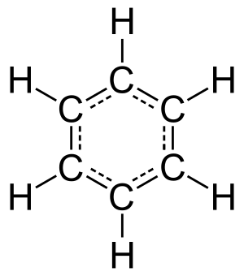
Figure 19.1e
Figure 19.1e. This condensed formula shows the unique bonding structure of benzene (credit: Image by Jynto, PDM).

Slide 9
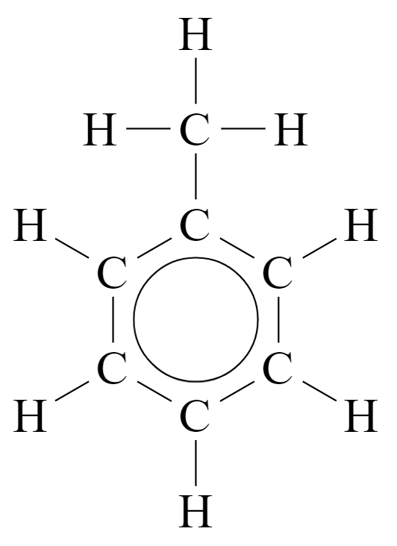
Figure 19.1f
Figure 19.1f. Toluene represents a typical example of substituted benzene derivative (credit: Image by Jarozwj, PDM)

Slide 10
Figure 19.2a
Figure 19.2a. The formation of ethanol derived by the fermentation of yeast and sugars (credit: Chemistry (OpenStax), CC BY 4.0).

Slide 11
Figure 19.2b
Figure 19.2b. Ethanol produced by the addition of water with ethylene in the presence of an acid (credit: Chemistry (OpenStax), CC BY 4.0).

Slide 12
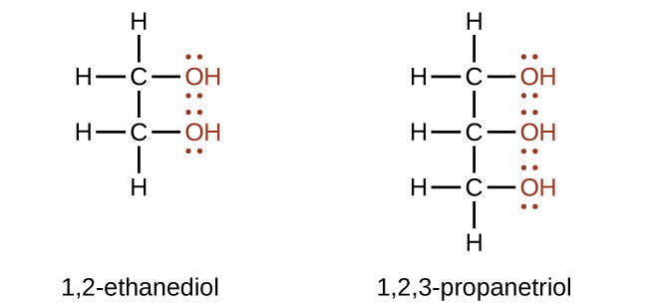
Figure 19.2c
Figure 19.2c. Alcohols containing more than one hydroxyl group such as 1,2-ethanediol and 1,2,3-propanetriol (credit: Chemistry (OpenStax), CC BY 4.0).

Slide 13
Figure 19.2d
Figure 19.2d. An example of an ether, ethylmethyl ether (credit: Chemistry (OpenStax), CC BY 4.0).

Slide 14
Figure 19.2e
Figure 19.2e. The production of diethyl ether from two molecules of ethanol (credit: Chemistry (OpenStax), CC BY 4.0).

Slide 15
Figure 19.3a
Figure 19.3a. The carbonyl group (credit: Chemistry (OpenStax), CC BY 4.0).

Slide 16
Figure 19.3b
Figure 19.3b. TThe carbonyl group represented in an aldehyde and a ketone (credit: Chemistry (OpenStax), CC BY 4.0).

Slide 17
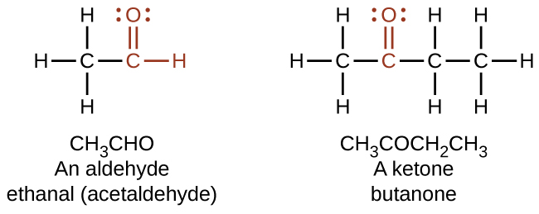
Figure 19.3c
Figure 19.3c. The aldehyde is represented as –CHO whereas a ketone is represented as –C(O)– or –CO– (credit: Chemistry (OpenStax), CC BY 4.0).

Slide 18
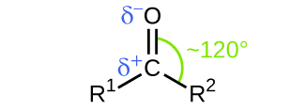
Figure 19.3d
Figure 19.3d. The carbonyl group is polar, and the geometry of the bonds around the central carbon is trigonal planar (credit: Chemistry (OpenStax), CC BY 4.0).

Slide 19
Figure 19.3e
Figure 19.3e. The formation of the carbonyl group (credit: Chemistry (OpenStax), CC BY 4.0).

Slide 20
Figure 19.3f
Figure 19.3f. The formation of an aldehyde from the oxidation of an alcohol (credit: Chemistry (OpenStax), CC BY 4.0).

Slide 21
Figure 19.3g
Figure 19.3g. The formation of a ketone from the oxidation of an alcohol (credit: Chemistry (OpenStax), CC BY 4.0).

Slide 22
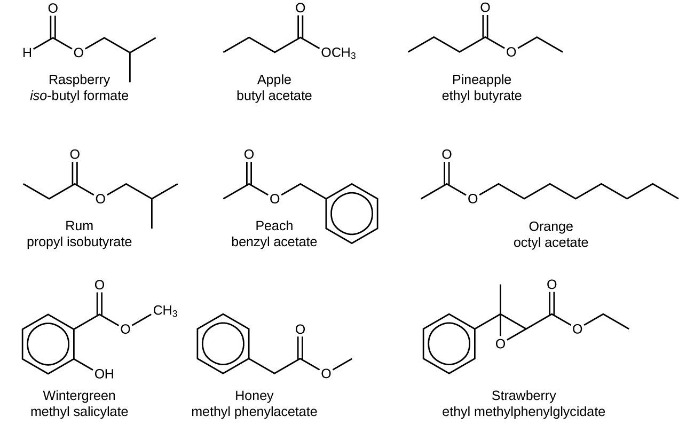
Figure 19.3h
Figure 19.3h. Esters are responsible for the odours associated with various plants and their fruits (credit: Chemistry (OpenStax), CC BY 4.0).

Slide 23
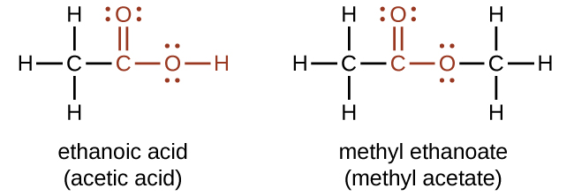
Figure 19.3i
Figure 19.3i. The functional groups for an acid and for an ester are shown in red in these formulas (credit: Chemistry (OpenStax), CC BY 4.0).

Slide 24
Figure 19.4a
Figure 19.4a. The simplest amines: methyl amine, dimethyl amine and trimethyl amine (credit: Chemistry (OpenStax), CC BY 4.0).

Slide 25
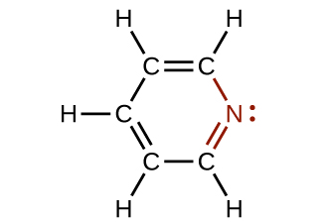
Figure 19.4b
Figure 19.4b. The illustration shows one of the resonance structures of pyridine (credit: Chemistry (OpenStax), CC BY 4.0).

Slide 26
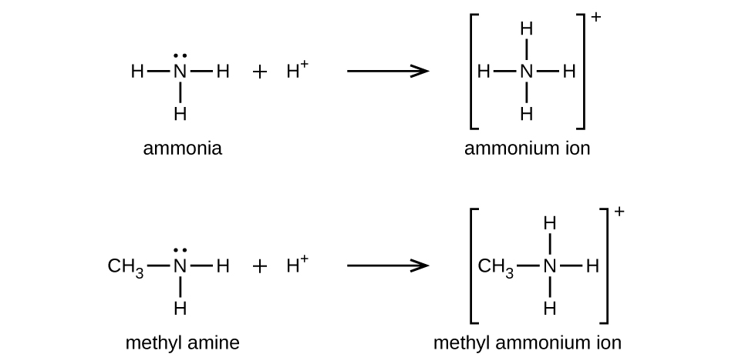
Figure 19.4c
Figure 19.4c. Methyl amine, an example, to demonstrate how amines are weak bases similar to ammonia (credit: Chemistry (OpenStax), CC BY 4.0).

Slide 27
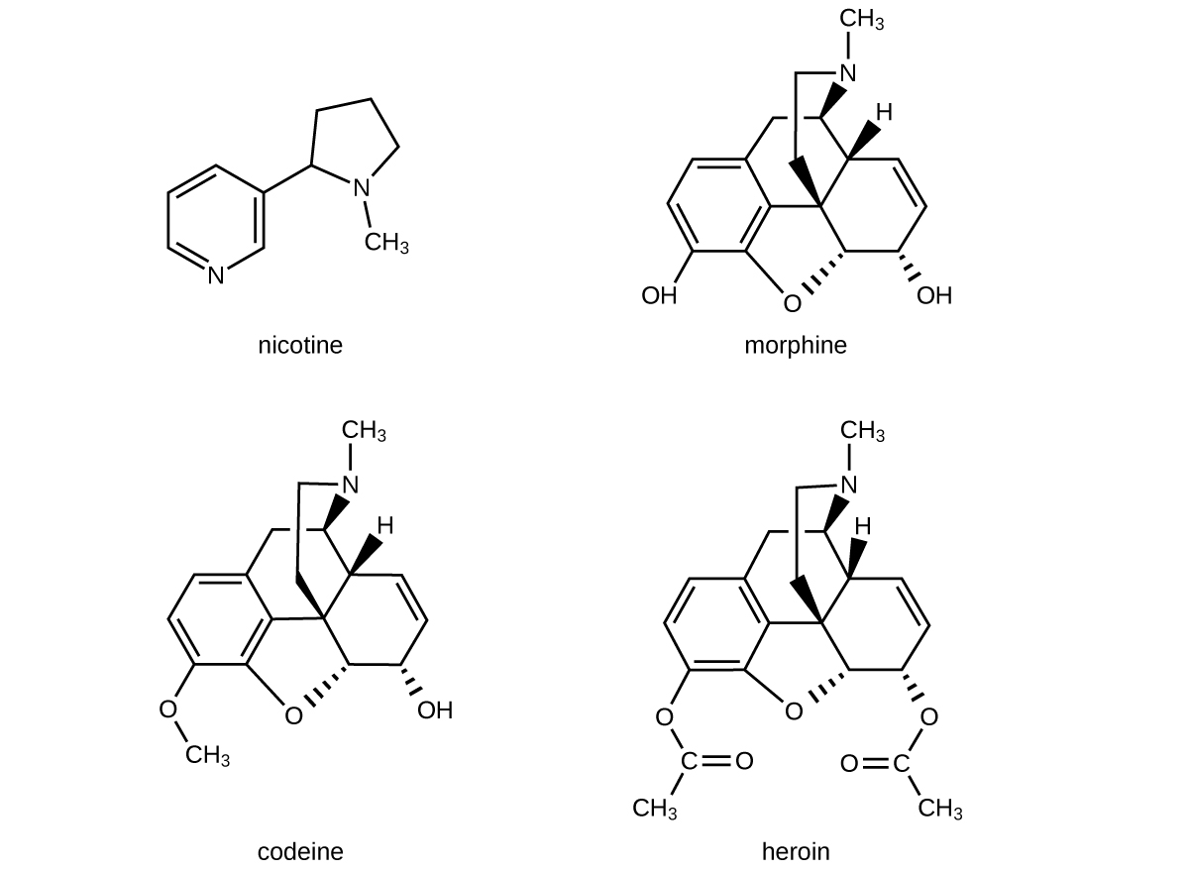
Figure 19.4d
Figure 19.4d. The structural images of drugs include nicotine, morphine, codeine, and heroin (credit: Chemistry (OpenStax), CC BY 4.0).

Slide 28
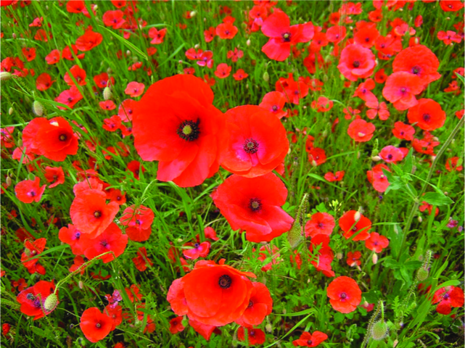
Figure 19.4e
Figure 19.4e. Poppies can be used in the production of opium, a plant latex that contains morphine from which other opiates, such as heroin, can be synthesized (credit: Karen Roe, Chemistry (Open Stax), CC BY 4.0).

Slide 29
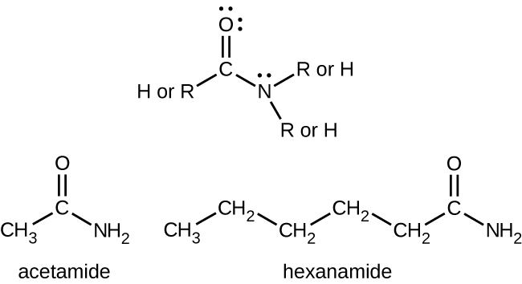
Figure 19.4f
Figure 19.4f. Examples of amides acetamide (bottom left) and hexanamide (bottom right) with the top structure representing the amide functional group (credit: Chemistry (Open Stax), CC BY 4.0).

Slide 30
Figure 19.4g
Figure 19.4g. The reaction between a carboxylic acid and an amine produces an amide and water (credit: Chemistry (Open Stax), CC BY 4.0).

Slide 31
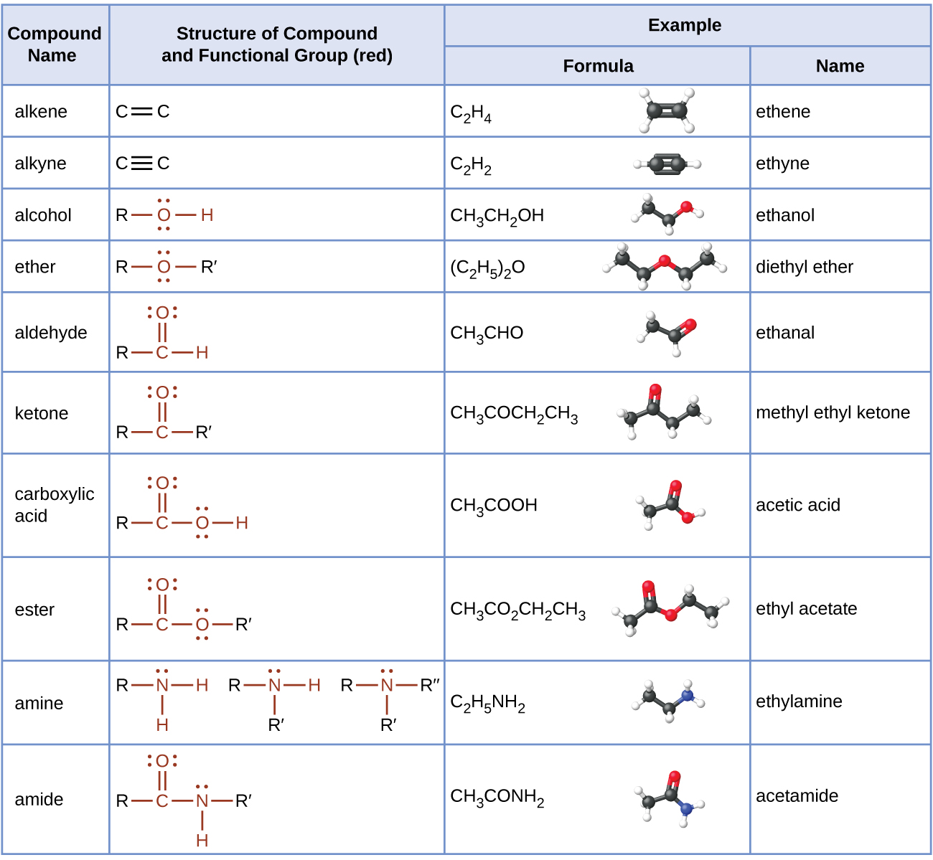
Table 19.5a
Table 19.5a. Summary of the Classification of Organic Compounds
Source: Summary of the Classification of Organic Compounds. (credit: Chemistry (OpenStax), CC BY 4.0).

Slide 32
Figure 19.6a
Figure 19.6a. Addition reaction of ethylene with HBr. (credit: Organic Chemistry (OpenStax), CC BY NC SA 4.0).

Slide 33
Figure 19.6b
Figure 19.6b. Addition reaction of acetylene with bromine. (credit: Organic Chemistry (OpenStax), CC BY NC SA 4.0).

Slide 34
Figure 19.6c
Figure 19.6c. Elimination reaction of ethanol to yield ethylene and water. (credit: Organic Chemistry (OpenStax), CC BY NC SA 4.0).

Slide 35
Figure 19.6d
Figure 19.6d. Substitution reaction of methyl acetate and water yielding acetic acid and methanol. (credit: Organic Chemistry (OpenStax), CC BY NC SA 4.0).

Slide 36
Figure 19.6e
Figure 19.6e. Substitution reaction between ethane and chlorine to yield chloroethane and HCl. (credit: Chemistry (OpenStax), CC BY 4.0).

Slide 37
Figure 19.6f
Figure 19.6f. Rearrangement reaction where dihydroxyacetone phosphate is converted to its constitutional isomer glyceraldehyde 3-phosphate (credit: Organic Chemistry (OpenStax), CC BY NC SA 4.0).

Slide 38
Figure 19.6g
Figure 19.6g. Oxidation of ethane to carbon dioxide. (credit: Samantha Sullivan Sauer / Biovia Draw, CC BY-NC-SA 4.0)

Slide 39
Figure 19.6h
Figure 19.6h. Reduction of carbon dioxide to ethane (Chen et al, 2015). (Image credit: Samantha Sullivan Sauer / Biovia Draw, CC BY-NC-SA 4.0.

Slide 40
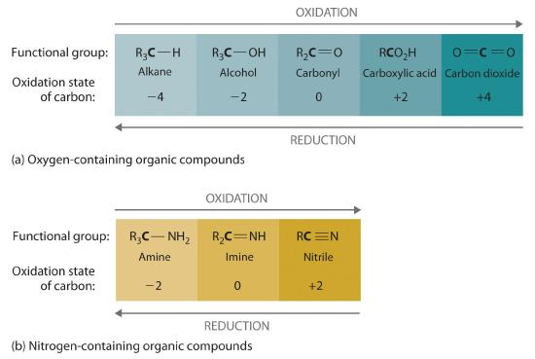
Figure 19.6i
Figure 19.6i. The Oxidation State of Carbon in Oxygen- and Nitrogen-Containing Functional Groups (a) In a hydrocarbon, oxidation is indicated by an increase in the number of oxygen atoms or carbon–oxygen bonds or a decrease in the number of hydrogen atoms. (b) In nitrogen-containing compounds, the number of carbon–nitrogen bonds changes with the oxidation state of carbon. (credit: General Chem: Principles, Patterns, and Applications (Averill), CC BY-NC-SA 3.0).

Slide 41
Figure 19.6j
Figure 19.6j. The electrophilic addition of a HBr to 2-butene. (credit: General Chem: Principles, Patterns, and Applications (Averill), CC BY-NC-SA 3.0).

Slide 42
Figure 19.6k
Figure 19.6k. The unsymmetrical and symmetrical bond breaking showing the full headed and half-headed arrows respectively. (credit: Organic Chemistry (OpenStax), CC BY NC SA 4.0).

Slide 43
Figure 19.6l
Figure 19.6l. The unsymmetrical and symmetrical bond formations (credit: Organic Chemistry (OpenStax), CC BY NC SA 4.0).

Slide 44
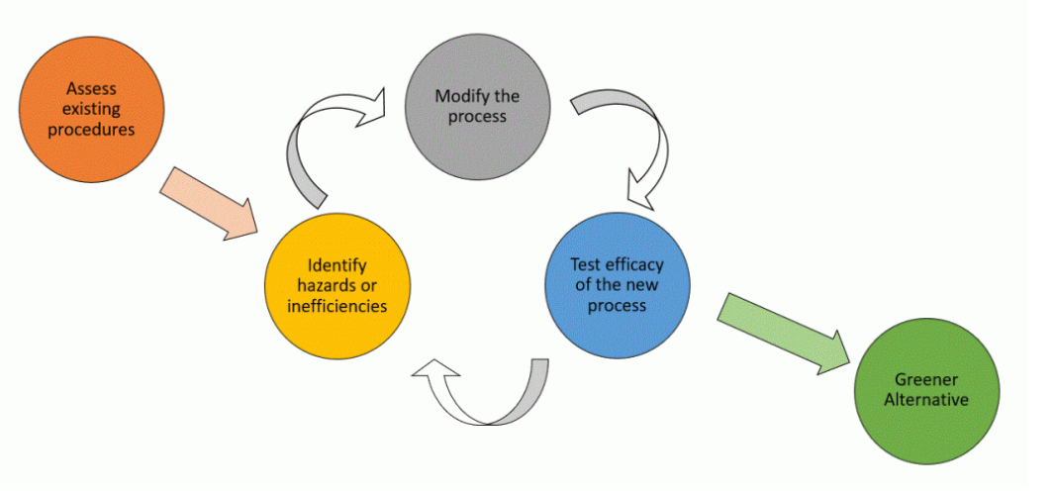
Figure 19.7a
Figure 19.7a. The process of greening a chemical process.

