Slide 1
Cities and Communities
Connecting Ontario Cities and Indigenous Communities to the Canadian Engineering Grand Challenges (CEGC)

Slide 2
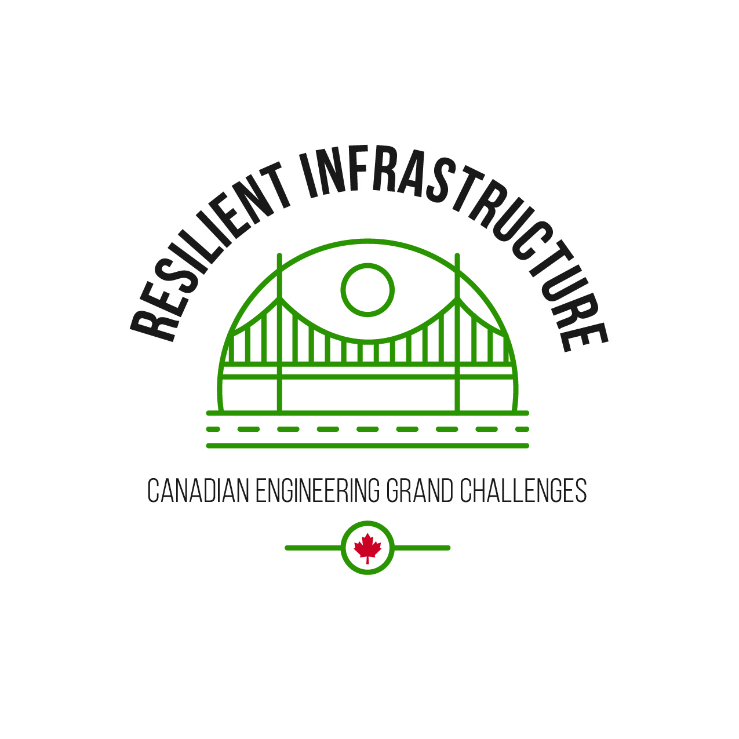
What are the Canadian Engineering Grand Challenges?
The Canadian Engineering Grand Challenges (CEGCs) capture the United Nations 17 Sustainable Development Goals (SDGs) in a way that is uniquely contextualized to Canada. This “grand challenge” approach is intended to focus and inspire the engineering profession, and to provide a context for Canadian engineering educators to prepare engineering students with the necessary leadership and sociotechnical skills to address and solve these large complex challenges and facilitate impactful change.
The six Challenges are:
CEGC 1: Resilient infrastructure
CEGC 2: Access to affordable, reliable, and sustainable energy
CEGC 3: Access to safe water in all communities
CEGC 4: Inclusive, safe, and sustainable cities
CEGC 5: Inclusive and sustainable industrialization
CEGC 6: Access to affordable and inclusive STEM education

Slide 3
Inclusive STEM Education
Fort Severn First Nation
Toronto

Slide 4
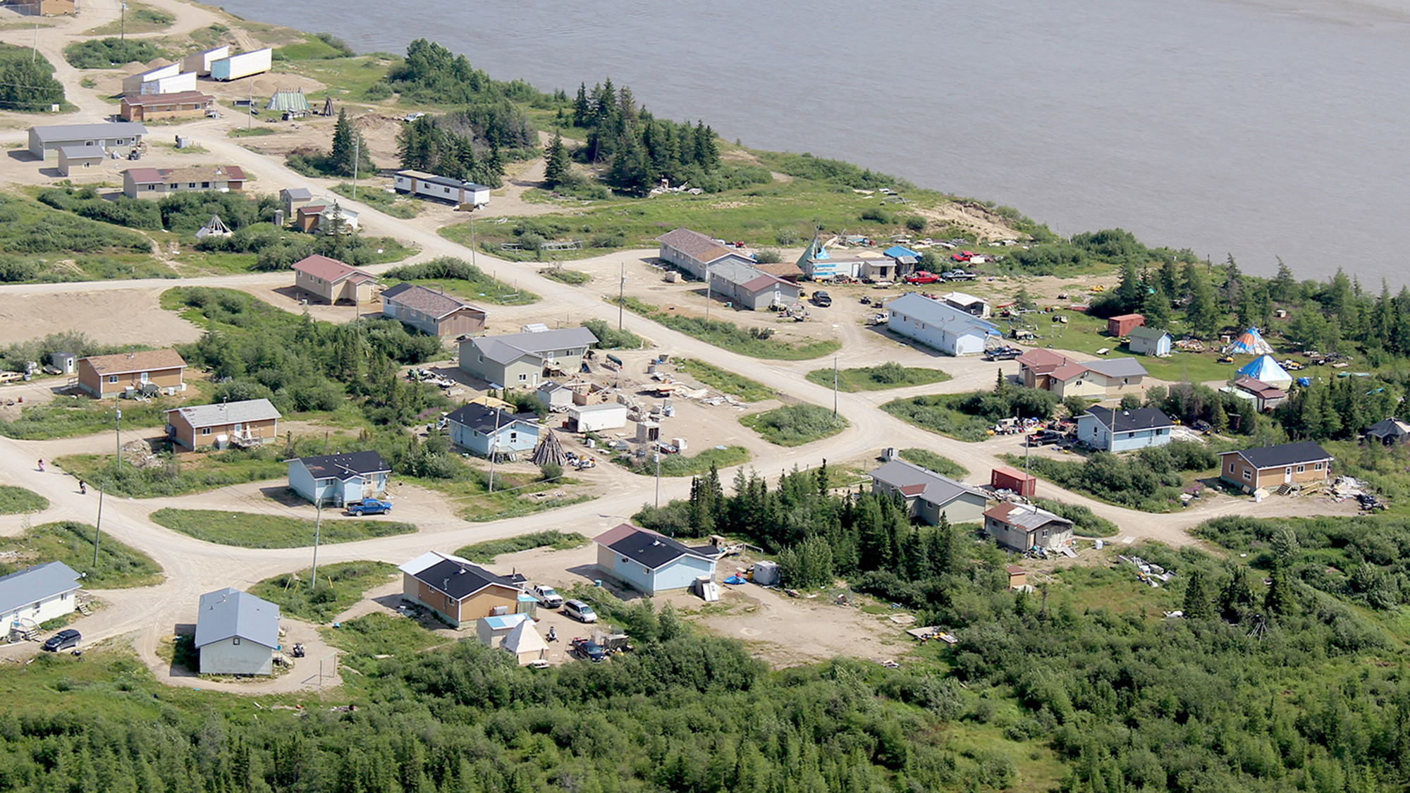
A community in the Midst of Forest and Water
Fort Severn First Nation is a Cree community located 5 miles from the coast of Hudson Bay, on Treaty 9. Fort Severn’s traditional name is Wasaho, which is a word describing the bend in the river Severn where the community is located. The community is a fly-in community only accessible year round by air and during winter by ice roads (Teach for Canada). According to Census 2021, the population was 364 people (Statistics Canada, 2021).
FORT SEVERN FIRST NATION
Notes:
Teach for Canada, (https://teachforcanada.ca/en/wp-content/uploads/2017/09/Fort-Severn-WEB.pdf)

Slide 5
The community has major financial needs to maintain the operation of its onsite primary and secondary education offerings. The Wasaho Cree Nation School, built in 2016, offers primary education (Teach for Canada). It has ongoing issues with shortage of functioning computers, poor classroom equipment and the lack of support for technology use. The community continues to lobby for adequate funding and support for technology in the school. "Another challenge is that the Internet is very slow in the school, making it difficult and time consuming to download educational programs. Secondary education is available with the Keewaytinook Internet High School (KiHS) located in a small building providing distance learning for residents (Keewaytinook Internet High School). It is a program that allows students to stay in their home while taking high school courses accredited by the Ontario Ministry of Education. The KiHS students are more focused when remaining in the community and maintaining connections with their parents, families and home life than students who leave Fort Severn to attend high school in Sioux Lookout or Thunder Bay. All the courses are delivered online and so the students need to have ICT skills to do their work. Through their KiHS education, the students develop a high level of ICT skills. Challenge for KiHS in Fort Severn is limited bandwidth and the lack of up-to-date computers affecting the education provided in the community. to address the needs for improved internet access, a project is in the works to bring reliable and faster internet access to the community (KNET).
FORT SEVERN FIRST NATION
Notes:
Fort Severn, education. [online] https://fortsevernfn.ca/living/education/

Slide 6
City of Toronto: Diversity and Education
The City of Toronto was home to approximately 2.8 million people in 2021 (Statistics Canada, 2021). It has four school boards, one of them is the Toronto District School Board (TDSB) which serves approximately 230,000 students (Toronto District School Board, 2024). The TDSB is one of the most diverse school board across Canada with 26 % of its students born outside Canada (Toronto District School Board, 2024).
TORONTO
Notes:
Teach for Canada, (https://teachforcanada.ca/en/wp-content/uploads/2017/09/Fort-Severn-WEB.pdf)

Slide 7
The racial diversity of the students in the TDSB is illustrated by the 2017 Student and Parent Census where Black students make up 11%, White students represent 29%, South Asian students represent 22% and East Asian students represent 14% of the total student population. The distinct educational profile and outcomes of Black students in the TDSB was analyzed by James and Turner (2017). Their analysis indicates that the level of study of the 2006-2011 cohort grade 9 and grade 10 students was Academic for 53% of Black students compared to 81% for White students and 80% for other Racialized students. Academic “courses” are said to be the most academically challenging and are required for University Preparedness courses taken in Grades 11 and 12. This program of study is required if the student intends to apply to university. In contrast, the Applied level was 39 % for Black students compared to 16% for White students and 18% for other Racialized students. The Applied courses prepare students for College Preparedness courses in grade 11 and 12 to enter college after high school. The 2006-2011 cohort showed other differences in post secondary education (PSE) choices. The proportion of students with confirmation in Ontario University was 25% (Black students); 60% (other Racialized students); 47% (White students). In contrast the proportion of students with confirmation in Ontario Colleges was 21% (Black students); 14% (other Racialized students); 14% (White students). The proportion of students that did not apply to PSE was 43% (Black students); 17% (other Racialized students); 26% (White students). The lower proportion of Black students selecting Academic level courses in grade 9 and 10 will reduce their opportunity in applying for university and in selecting STEM programs.
TORONTO
Notes:
Fort Severn, education. [online] https://fortsevernfn.ca/living/education/

