Slide 1
Cities and Communities
Connecting Ontario Cities and Indigenous Communities to the Canadian Engineering Grand Challenges

Slide 2
What are the Canadian Engineering Grand Challenges?
The Canadian Engineering Grand Challenges (CEGCs) capture the United Nations 17 Sustainable Development Goals (SDGs) in a way that is uniquely contextualized to Canada. This “grand challenge” approach is intended to focus and inspire the engineering profession, and to provide a context for Canadian engineering educators to prepare engineering students with the necessary leadership and sociotechnical skills to address and solve these large complex challenges and facilitate impactful change.
The six Challenges are:
CEGC 1: Resilient infrastructure
CEGC 2: Access to affordable, reliable, and sustainable energy
CEGC 3: Access to safe water in all communities
CEGC 4: Inclusive, safe, and sustainable cities
CEGC 5: Inclusive and sustainable industrialization
CEGC 6: Access to affordable and inclusive STEM education

Slide 3
Sustainable Industrialization
Ohsweken
Carleton Place

Slide 4
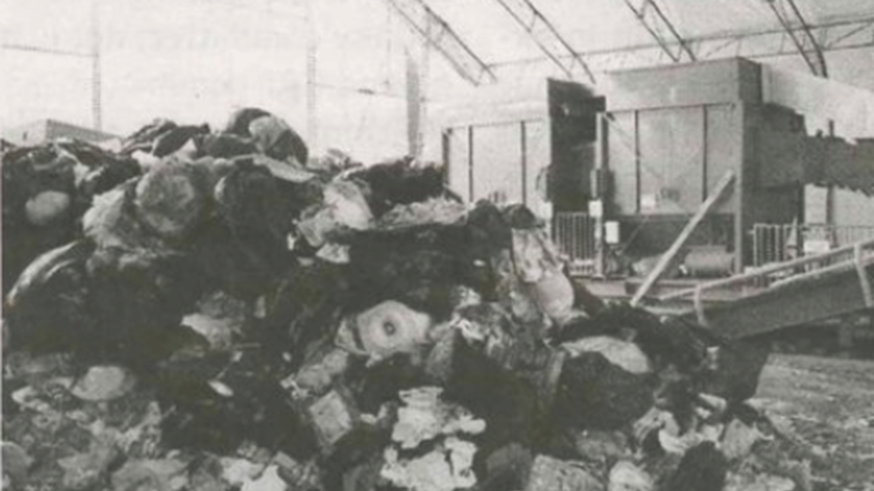
A Community Addressing their Waste Management
Ohsweken is a community, with a population of 1,500 people, located on the Six Nations reserve south of Hamilton (Groat, 2020). The Six Nations reserve, with a population of 12,892 people, has a landfill that services their population (Groat, 2020).
OHSWEKEN
Notes:
Emma Moorhouse
Brigham, K. (2018, July 14). How San Francisco sends less trash to the landfill than any other major U.S. city. CNBC. https:// www.cnbc.com/2018/07/13/how-san-francisco-became-a- global-leader-in-waste-management.html.
Census profile: San Francisco, CA. Census Reporter. (2019). https://censusreporter.org/profiles/16000US0667000-san- francisco-ca/.
Green, J. (2015, March 16). Six Nations garbage incinerator pours 200x Ontario limit of pollutants into air | CBC News. CBCnews. https://www.cbc.ca/news/canada/hamilton/ headlines/six-nations-incinerator-polluting-at-up-to-200-times- ontario-limits-1.2931215.
Groat, C. (2020, February 18). Six Nations of the Grand River. The Canadian Encyclopedia. https:// www.thecanadianencyclopedia.ca/en/article/six-nations-of- the-grand-river.
Huang, S. (2014, June 13). $4.8M waste disposal machine wreaks havoc in Six Nations. CBCnews. https://www.cbc.ca/ news/canada/hamilton/headlines/protest-halts-six-nations- incinerator-trial-as-waste-crisis-continues-1.2671144.
Landfill Site Incinerator Sitting Idle, Council Wants Action by Chase Jarrett is licensed under CC BY-NC-ND 4.0 "Landfill Site Incinerator Sitting Idle, Council Wants Action": Six Nations Public Library-Digital Archive (vitacollections.ca)
San Francisco Recycling Center by Benjamin Pender is licensed under CC BY-NC 2.0 https://www.flickr.com/photos/ 70721148@N00/2290992293/in/ photolist-4urWc8-4urXGH-4urYBt-4uvZEC-4uw3cU-4QJf3b-4Z 7FMx-5pPwDX-5MoQGs-69z88D-69z9mk-6nyr8r-6nyre8-6nCz gL-6nCzio-6rPccF-6rTkef-72xPZx-73DhGY-7b3iuk-7bpEve-8g WXbF-fJULjD-7Y5BzB-bPYZKP-9C2FCn-9C1bQp-9C44DU- bPYZNX-dJbhBj-85S7gE-bPYZMH-9BXjWe-9vLACW-bPYZJF- eU1uu1-dJbbd7-dJb1AC-dJ5rSZ-dJb4nG-dJaZ3h-dJ5ute- dJb86U-dJb7KJ-dJb2E1-dJb6Vf-dJb8TQ-dJaXs5-fKMSLf- fKvvEX-fKwBaz

Slide 5
The landfill reached its capacity in 2006 at twice the expected rate and much earlier than planned. It has remained in use by piling waste on top of the full landfill (Huang, 2014). The landfill does not have a lining such that the liquids produced by the waste are permeating in the surrounding soil. The community has been looking for a solution to their waste management needs. The solution was an incinerator that promised zero emissions. A five-month long trial operation of the incinerator emitted dioxins and furans at 200 times the Ontario limits, lead and cadmium at 25 times the Ontario limits and above standard levels of carbon monoxide and nitric oxide (Green, 2015). The trial run was interrupted due to a community lead protest requesting the shutdown of the incinerator due to the emissions, odour, and concerns about the health of the residents (Huang, 2014). In 2019, the government of Canada together with the Six Nations, agreed to build a transfer station for the management of residential waste and recyclables and close the landfill (Government of Canada, 2019).
OHSWEKEN

Slide 6
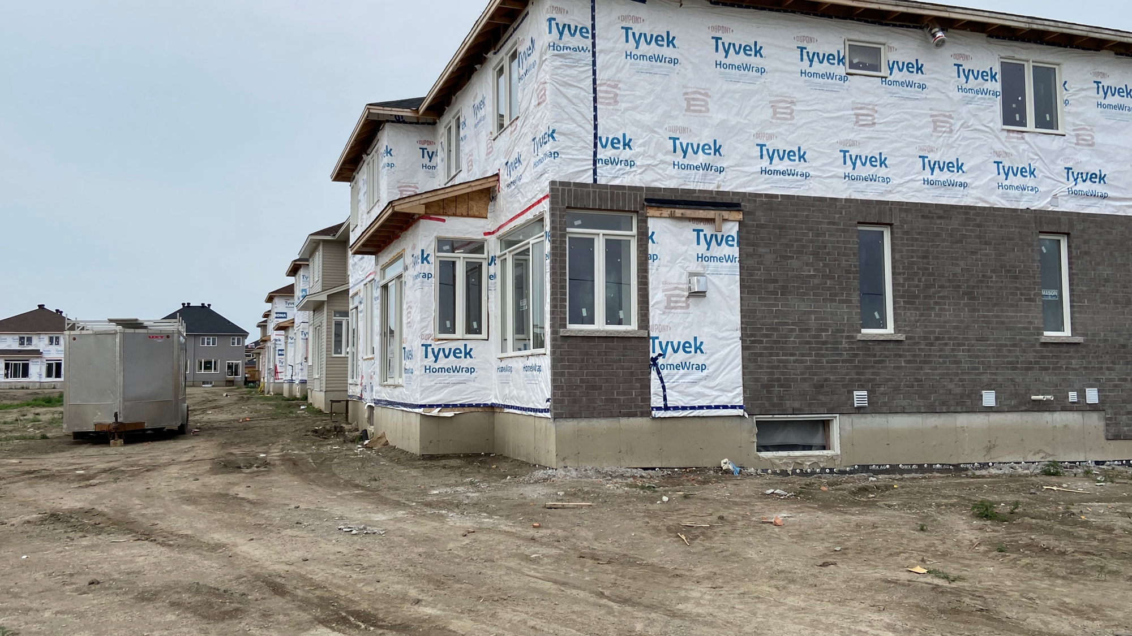
Concrete, CO2, and Climate Change
Carleton Place is a rapidly growing town with a population of 12,517 in 2021 (Statistics Canada, 2023) located on the outskirts of Ottawa.
CARLETON PLACE
Notes:
Emma Moorhouse
Brigham, K. (2018, July 14). How San Francisco sends less trash to the landfill than any other major U.S. city. CNBC. https:// www.cnbc.com/2018/07/13/how-san-francisco-became-a- global-leader-in-waste-management.html.
Census profile: San Francisco, CA. Census Reporter. (2019). https://censusreporter.org/profiles/16000US0667000-san- francisco-ca/.
Green, J. (2015, March 16). Six Nations garbage incinerator pours 200x Ontario limit of pollutants into air | CBC News. CBCnews. https://www.cbc.ca/news/canada/hamilton/ headlines/six-nations-incinerator-polluting-at-up-to-200-times- ontario-limits-1.2931215.
Groat, C. (2020, February 18). Six Nations of the Grand River. The Canadian Encyclopedia. https:// www.thecanadianencyclopedia.ca/en/article/six-nations-of- the-grand-river.
Huang, S. (2014, June 13). $4.8M waste disposal machine wreaks havoc in Six Nations. CBCnews. https://www.cbc.ca/ news/canada/hamilton/headlines/protest-halts-six-nations- incinerator-trial-as-waste-crisis-continues-1.2671144.
Landfill Site Incinerator Sitting Idle, Council Wants Action by Chase Jarrett is licensed under CC BY-NC-ND 4.0 "Landfill Site Incinerator Sitting Idle, Council Wants Action": Six Nations Public Library-Digital Archive (vitacollections.ca)
San Francisco Recycling Center by Benjamin Pender is licensed under CC BY-NC 2.0 https://www.flickr.com/photos/ 70721148@N00/2290992293/in/ photolist-4urWc8-4urXGH-4urYBt-4uvZEC-4uw3cU-4QJf3b-4Z 7FMx-5pPwDX-5MoQGs-69z88D-69z9mk-6nyr8r-6nyre8-6nCz gL-6nCzio-6rPccF-6rTkef-72xPZx-73DhGY-7b3iuk-7bpEve-8g WXbF-fJULjD-7Y5BzB-bPYZKP-9C2FCn-9C1bQp-9C44DU- bPYZNX-dJbhBj-85S7gE-bPYZMH-9BXjWe-9vLACW-bPYZJF- eU1uu1-dJbbd7-dJb1AC-dJ5rSZ-dJb4nG-dJaZ3h-dJ5ute- dJb86U-dJb7KJ-dJb2E1-dJb6Vf-dJb8TQ-dJaXs5-fKMSLf- fKvvEX-fKwBaz

Slide 7
According to an external report conducted in 2021, the municipality will need the building of new homes by 2038 to meet the projected population growth (Richards & Associates Limited, 2021). The construction of additional homes will require concrete, particularly in the foundations of the homes. Concrete, a mix of many materials, has very high GHG emissions due to its cement content (Government of Canada, 2022). The production of cement generates CO2 when combining and heating limestone, clay, and iron ore or ash to extreme temperatures using fossil fuels. New processes and technologies to reduce the GHG emissions of cement manufacture are being examined (MIT, 2021).
CARLETON PLACE

