Slide 1
Cities and Communities
Connecting Ontario Cities and Indigenous Communities to the Canadian Engineering Grand Challenges

Slide 2
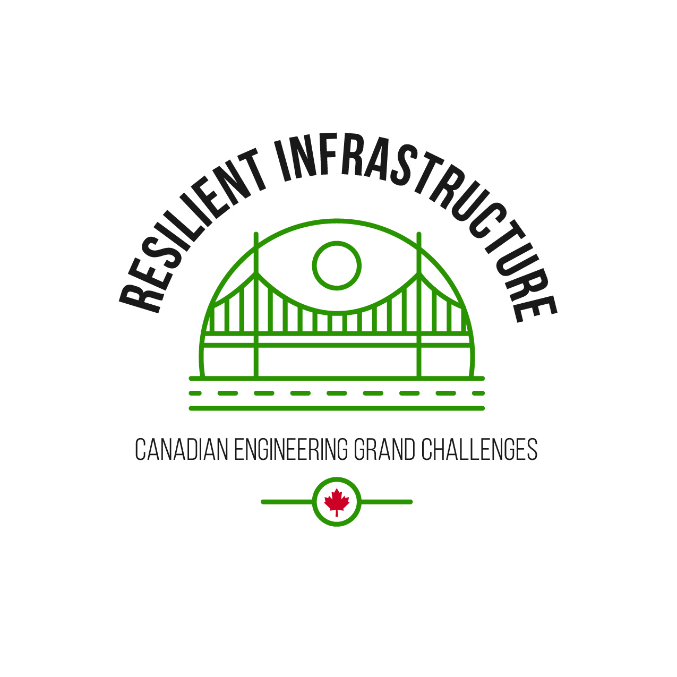
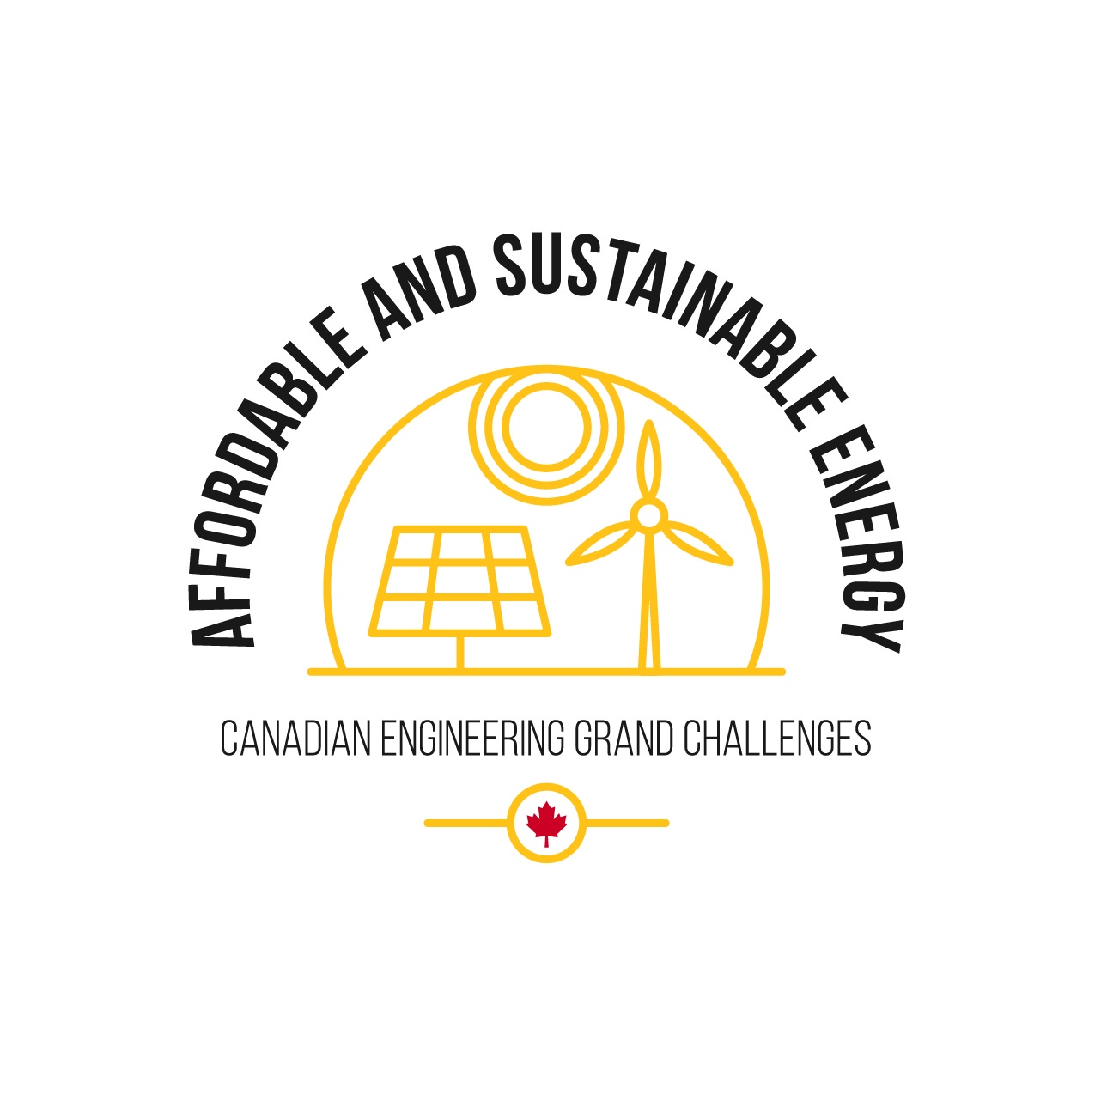
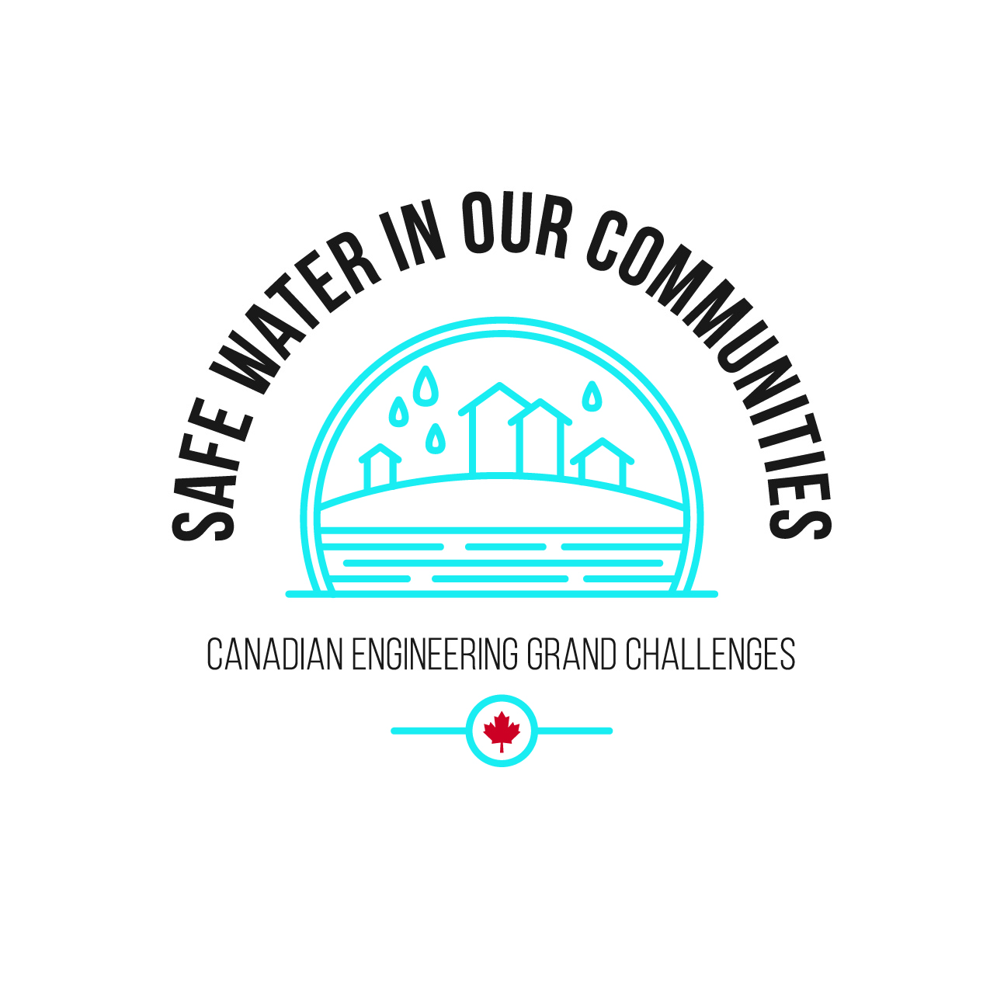
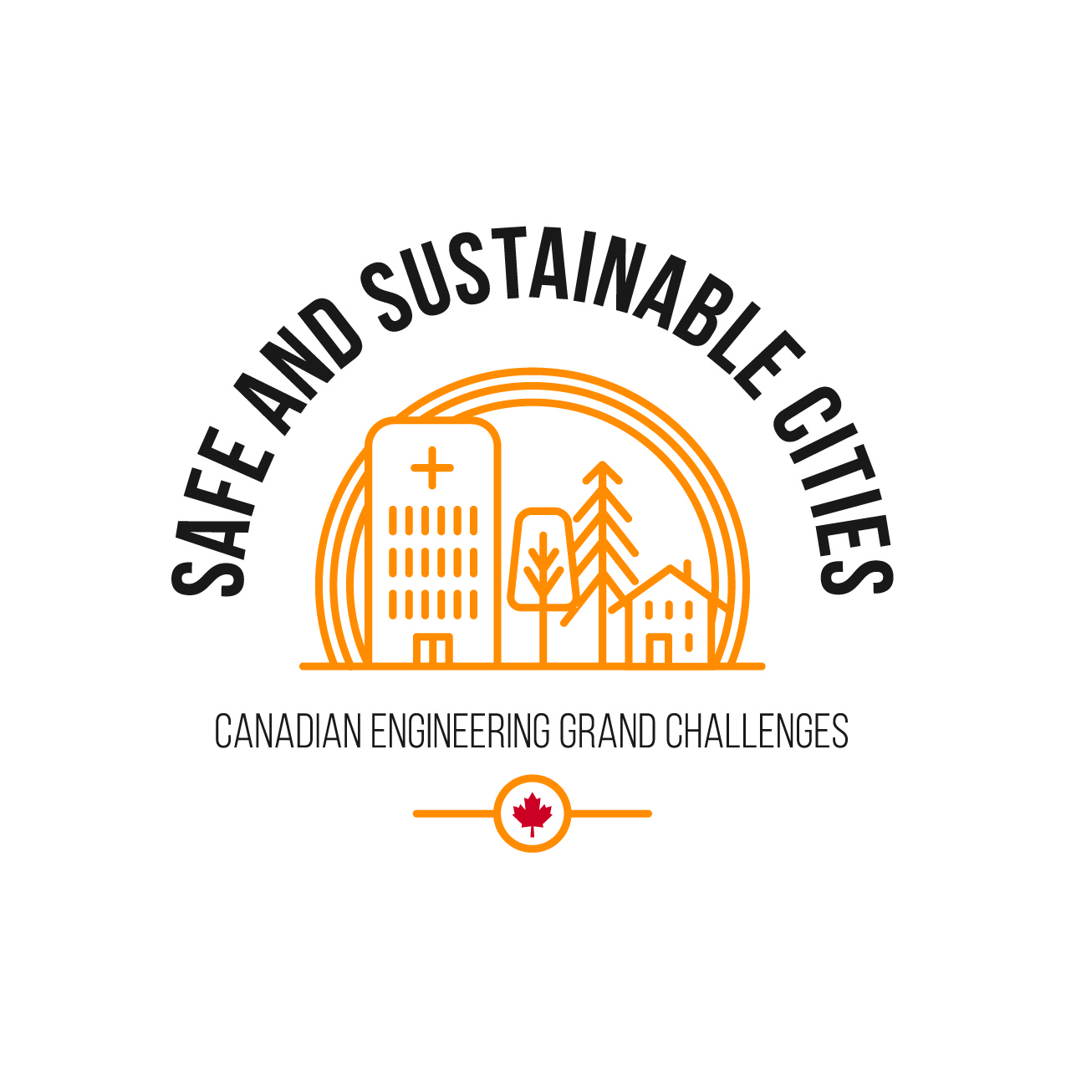
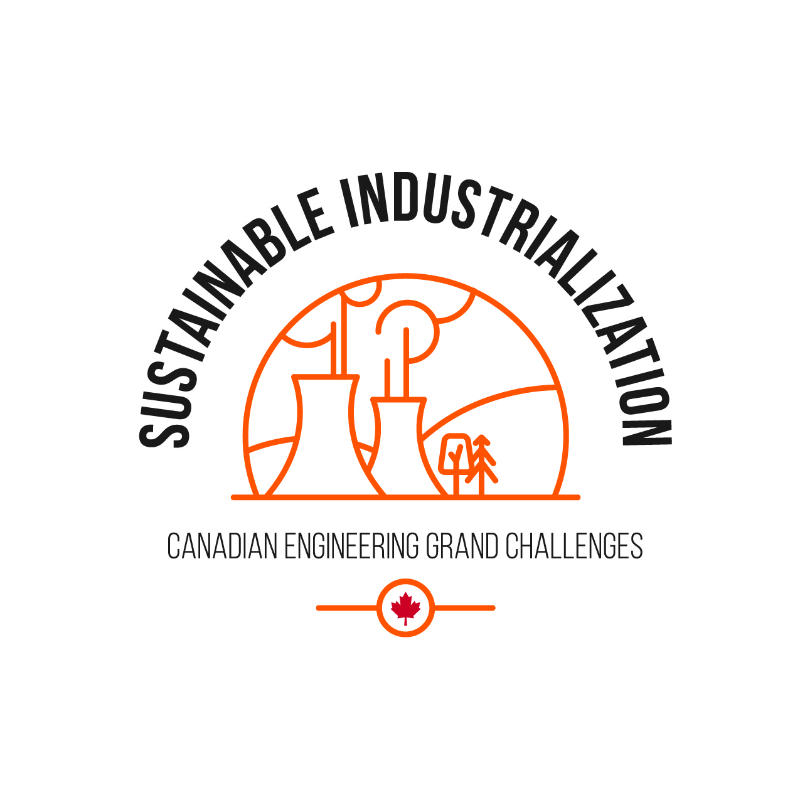
What are the Canadian Engineering Grand Challenges?
The Canadian Engineering Grand Challenges (CEGCs) capture the United Nations 17 Sustainable Development Goals (SDGs) in a way that is uniquely contextualized to Canada. This “grand challenge” approach is intended to focus and inspire the engineering profession, and to provide a context for Canadian engineering educators to prepare engineering students with the necessary leadership and sociotechnical skills to address and solve these large complex challenges and facilitate impactful change.
The six Challenges are:
CEGC 1: Resilient infrastructure
CEGC 2: Access to affordable, reliable, and sustainable energy
CEGC 3: Access to safe water in all communities
CEGC 4: Inclusive, safe, and sustainable cities
CEGC 5: Inclusive and sustainable industrialization
CEGC 6: Access to affordable and inclusive STEM education

Slide 3
Safe and Sustainable Cities
Aamjiwnaang First Nation
Toronto

Slide 4
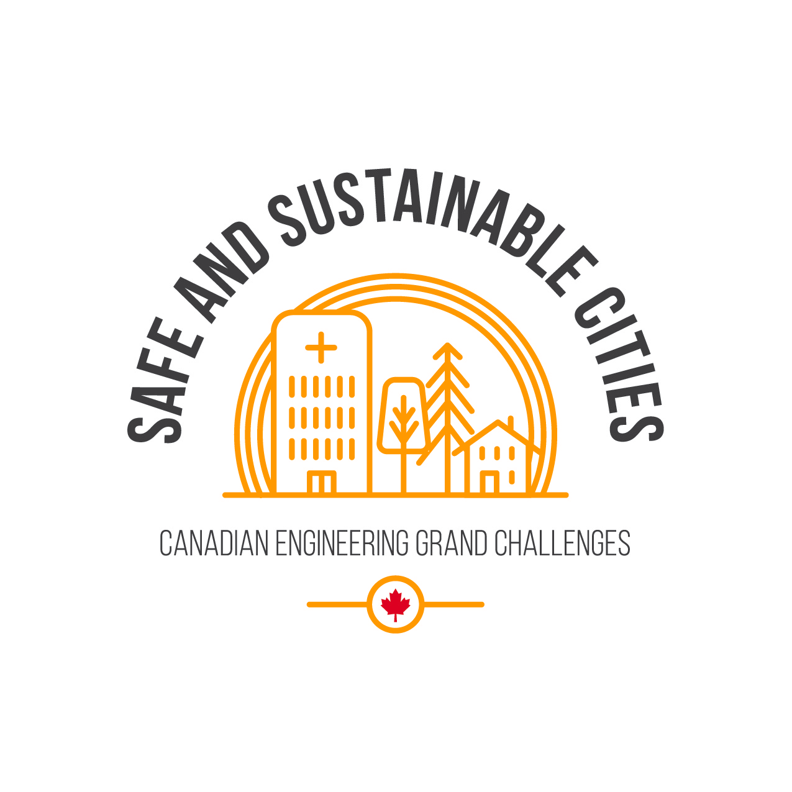
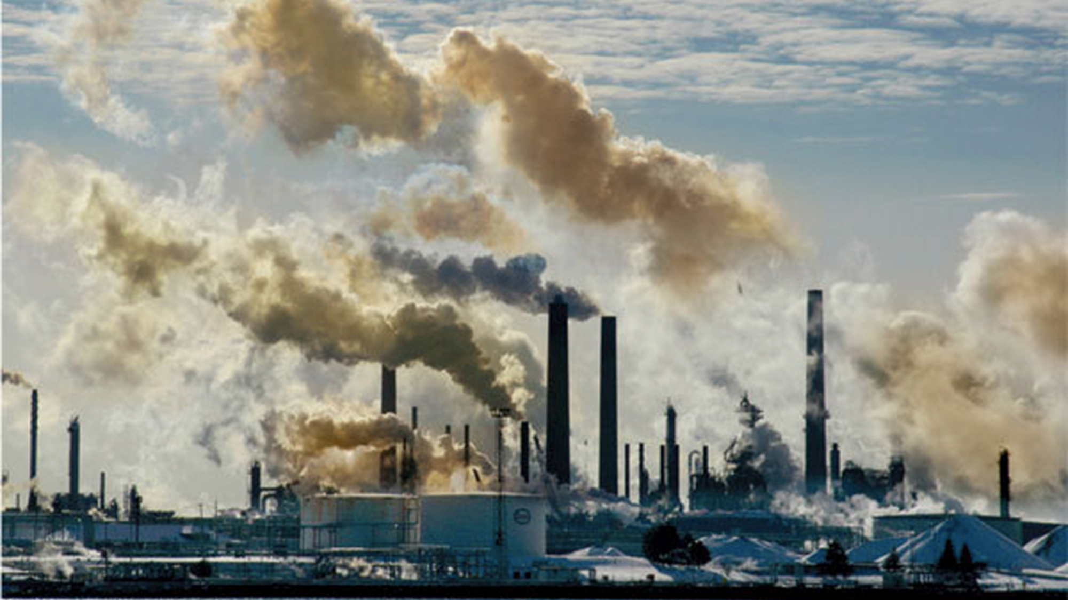
Air Quality and Health Concerns
The Aamjiwnaang First Nation (formally known as Chippewas of Sarnia) is located in the southwestern region of Ontario on the outskirt of the city of Sarnia by the St-Clair river. The name Aamjiwnaang, (pronounced am-JIN-nun) means “at the spawning stream.”
AAMJIWNAANG FIRST NATION
Notes:
Jhenyffer Mishell Villarreal Fuel
Al Jazeera English. (2012). Canada indigenous group sues over pollution [Video]. Retrieved from https:// www.youtube.com/watch?v=48c6rhwf_S8
Ecojustice. (2007). EXPOSING CANADA’S CHEMICAL VALLEY. An Investigation of Cumulative Air Pollution Emissions in the
Sarnia, Ontario Area [Ebook]. Toronto. Retrieved from https:// ecojustice.ca/wp-content/uploads/2015/09/2007-Exposing- Canadas-Chemial-Valley.pdf
Engineering Deans Canada (2019). Canadian Engineering Grand Challenges (2020-2030): Inspiring Action to improve life for Canadian and the world. Retrieved 14 June 2021, from https://engineeringdeans.ca/en/project/cegc/
Garfield, L., & Thompson, C. (2018). The world's first 'smog vacuum cleaner' can suck up air pollution and turn it into jewellery. Retrieved 14 June 2021, from https:// www.independent.co.uk/climate-change/news/smog-vacuum- cleaner-air-pollution-daan-roosegaarde-netherlands-china- poland-a8183236.html
Inaction on 'Chemical Valley' Threatens Ontario First Nation - GLOBE-Net. (2014). Retrieved 14 June 2021, from https:// globe-net.com/inaction-chemical-valley-threatens-ontario- first-nation/
Rogers, S. (n.d.). China’s Smog-Devouring Vacuum Tower Looks Crazy, But Actually Works. Retrieved 14 June 2021, from https://weburbanist.com/2016/11/23/chinas-smog- devouring-vacuum-tower-looks-crazy-but-actually-works/
Sarnia Chemicals. (2017). Sarnia chem valley [Video]. Retrieved from https://www.youtube.com/watch? v=x2j8PIuph6A
United Nations (n.d.), Sustainable Development Goals, Department of Economic and Social Affairs, Sustainable Development. Retrieved 14 June 2021, from https:// sdgs.un.org/goals
Wang, L. (2016). World’s largest smog-sucking vacuum cleaner could rid cities of pollution. Retrieved 14 June 2021, from https://inhabitat.com/worlds-largest-smog-sucking-vacuum- cleaner-could-rid-cities-of-pollution/

Slide 5
The First Nation has a population of about 2,500 Chippewa (Ojibwe) Peoples (Statistics Canada, 2018) and is adjacent to region with a long history of petrochemical activities and refineries. The proximity of these industrial activities has provided ample jobs to the First Nation but at the expense of their health. The St-Clair River has been identified by Health Canada as an area of concern within the Great Lakes region since 1987 due to higher pollution exposure and potential health risks. While there has been significant progress made over the years with the creation of monitoring programs, the reduction in the frequency of spills and with the decline in the concentration of contaminants, there remains issues to be addressed, including sediment remediation and the completion of habitat restoration. A recent study by Larsen et al (2022), in collaboration with the Aamjiwnaang First Nation, reviewed and analyzed public air quality information from 2015-2016 and 1995-96. Their analysis indicates that some known carcinogens including benzene are much higher than provincial averages which needs to be addressed.
AAMJIWNAANG FIRST NATION

Slide 6
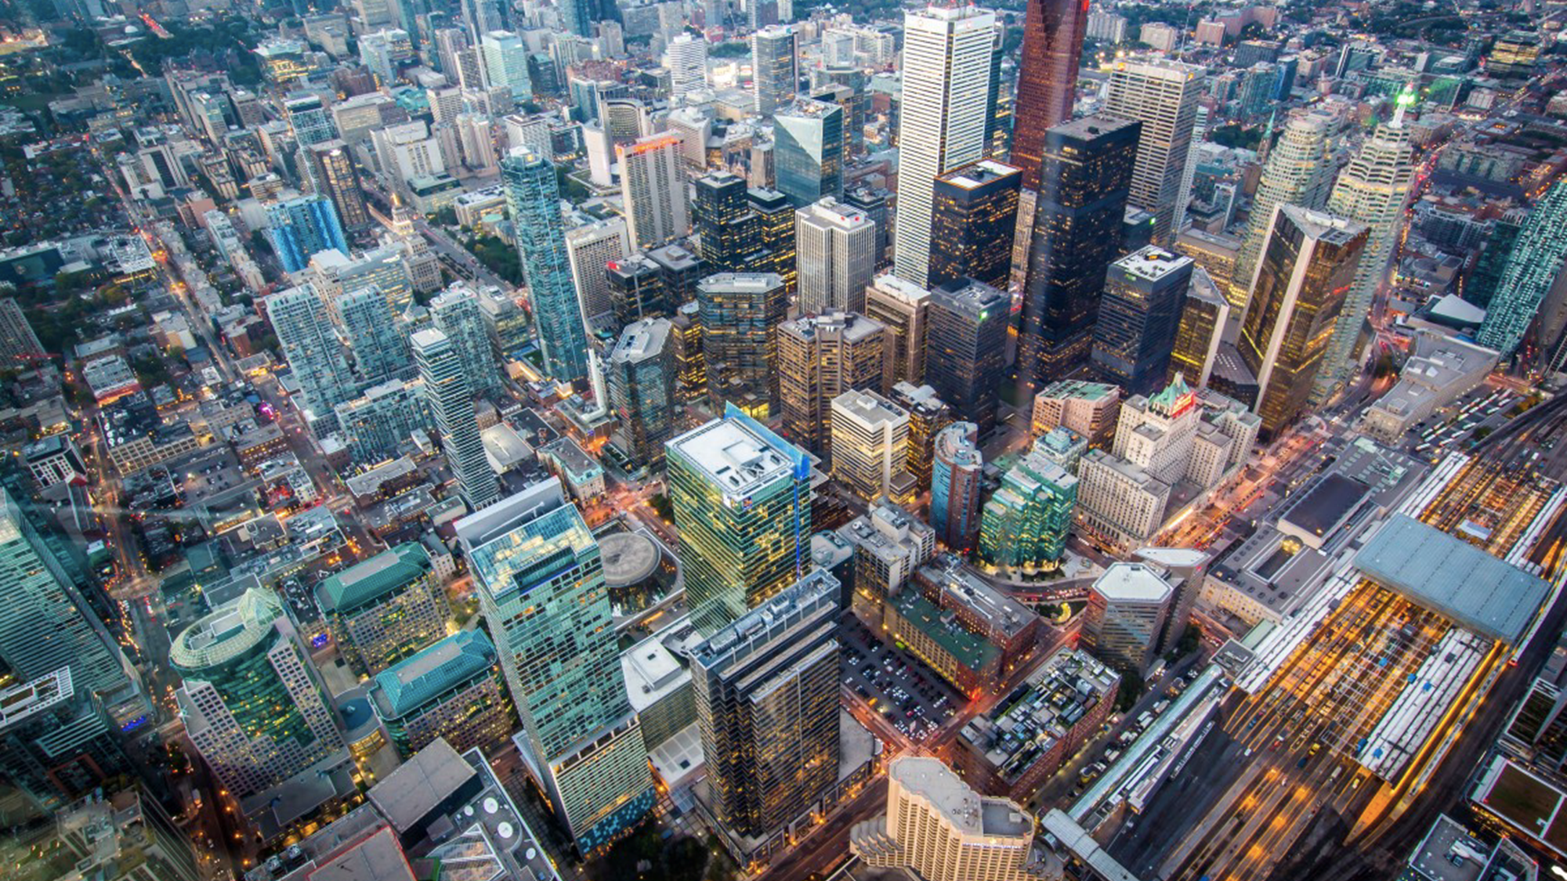
A Concrete Jungle Where Heat is Stored Up
Toronto. is Canada’s largest city with a population of approximately 2.8 million people in 2021 (Statistics Canada, 2023). It has a high density of buildings and roads with the third highest number of skyscrapers in North America (Ricci, 2020) and a whopping 5,400 kilometres of roads (City of Toronto, n.d.).
TORONTO
Notes:
Jhenyffer Mishell Villarreal Fuel
Al Jazeera English. (2012). Canada indigenous group sues over pollution [Video]. Retrieved from https:// www.youtube.com/watch?v=48c6rhwf_S8
Ecojustice. (2007). EXPOSING CANADA’S CHEMICAL VALLEY. An Investigation of Cumulative Air Pollution Emissions in the
Sarnia, Ontario Area [Ebook]. Toronto. Retrieved from https:// ecojustice.ca/wp-content/uploads/2015/09/2007-Exposing- Canadas-Chemial-Valley.pdf
Engineering Deans Canada (2019). Canadian Engineering Grand Challenges (2020-2030): Inspiring Action to improve life for Canadian and the world. Retrieved 14 June 2021, from https://engineeringdeans.ca/en/project/cegc/
Garfield, L., & Thompson, C. (2018). The world's first 'smog vacuum cleaner' can suck up air pollution and turn it into jewellery. Retrieved 14 June 2021, from https:// www.independent.co.uk/climate-change/news/smog-vacuum- cleaner-air-pollution-daan-roosegaarde-netherlands-china- poland-a8183236.html
Inaction on 'Chemical Valley' Threatens Ontario First Nation - GLOBE-Net. (2014). Retrieved 14 June 2021, from https:// globe-net.com/inaction-chemical-valley-threatens-ontario- first-nation/
Rogers, S. (n.d.). China’s Smog-Devouring Vacuum Tower Looks Crazy, But Actually Works. Retrieved 14 June 2021, from https://weburbanist.com/2016/11/23/chinas-smog- devouring-vacuum-tower-looks-crazy-but-actually-works/
Sarnia Chemicals. (2017). Sarnia chem valley [Video]. Retrieved from https://www.youtube.com/watch? v=x2j8PIuph6A
United Nations (n.d.), Sustainable Development Goals, Department of Economic and Social Affairs, Sustainable Development. Retrieved 14 June 2021, from https:// sdgs.un.org/goals
Wang, L. (2016). World’s largest smog-sucking vacuum cleaner could rid cities of pollution. Retrieved 14 June 2021, from https://inhabitat.com/worlds-largest-smog-sucking-vacuum- cleaner-could-rid-cities-of-pollution/

Slide 7
Toronto, like many other cities, suffers from what is known as the Urban Heat Island effect (Allen, 2013). The effect is prevalent in a city like Toronto leading to a “higher temperature relative to outlying areas” (US EPAa, 2024). This is because the city replaces natural landscapes with infrastructure made of materials such as concrete and asphalt which “absorb and re-emit the sun’s heat more than natural landscapes such as forests and water bodies” (US EPAb, 2024). In extreme cases, the heat can result in an additional 12 ºC (Allen, 2013). Heatwaves are getting worse and almost 120 premature deaths a year in Toronto have heat as a contributing factor (Allen, 2013). This urban heat, along with the overall increasing temperature of the planet will harm Toronto’s population and especially those in areas that do not have access to nearby parks and green areas.
TORONTO

