Slide 1
Cities and Communities
Connecting Ontario Cities and Indigenous Communities to the Canadian Engineering Grand Challenges

Slide 2
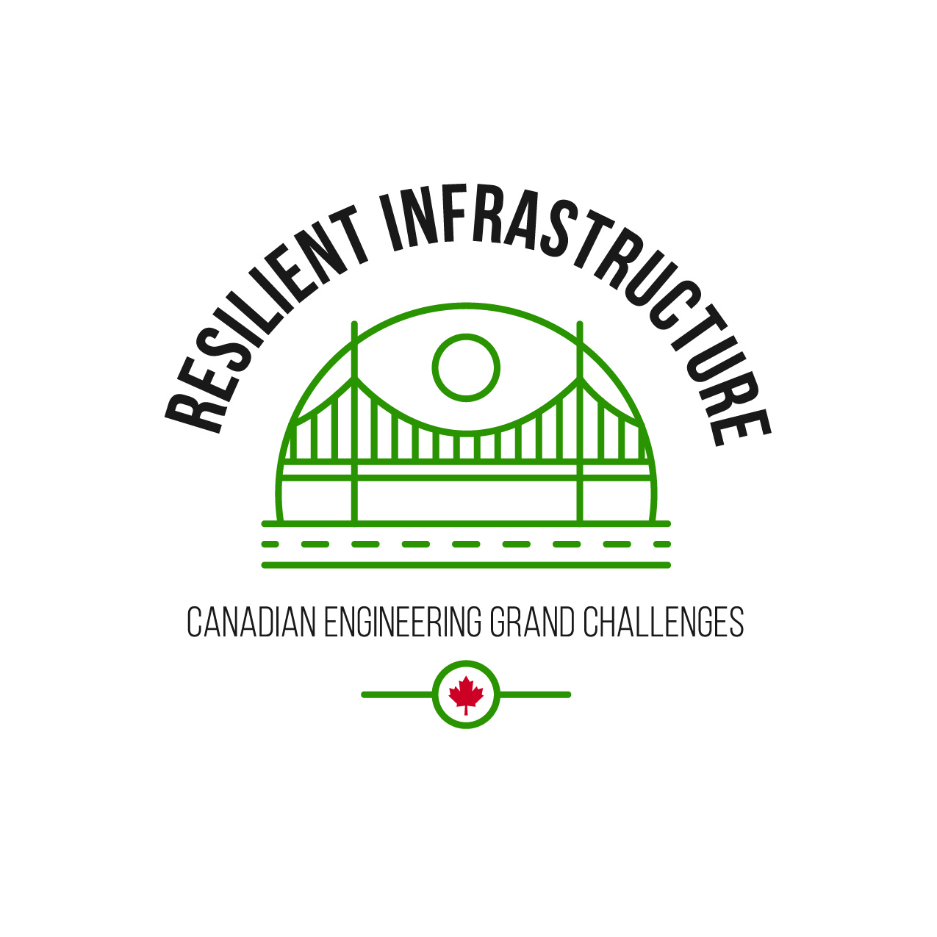
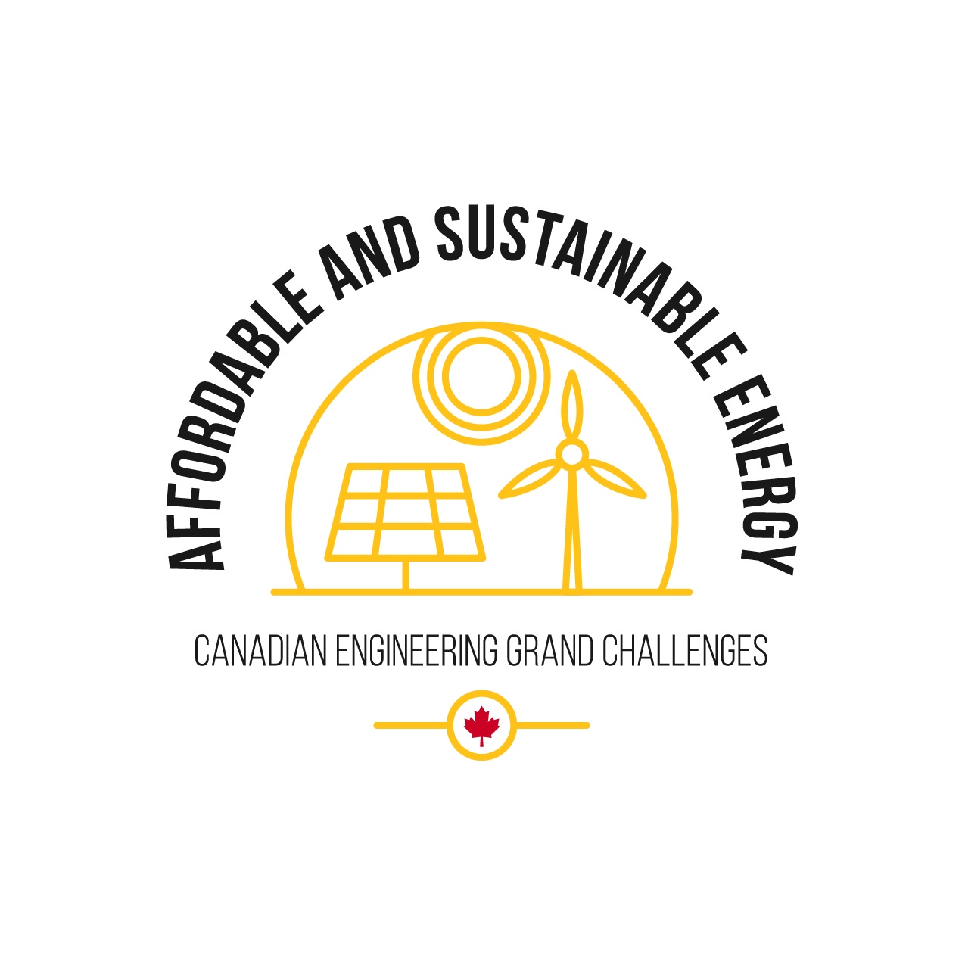
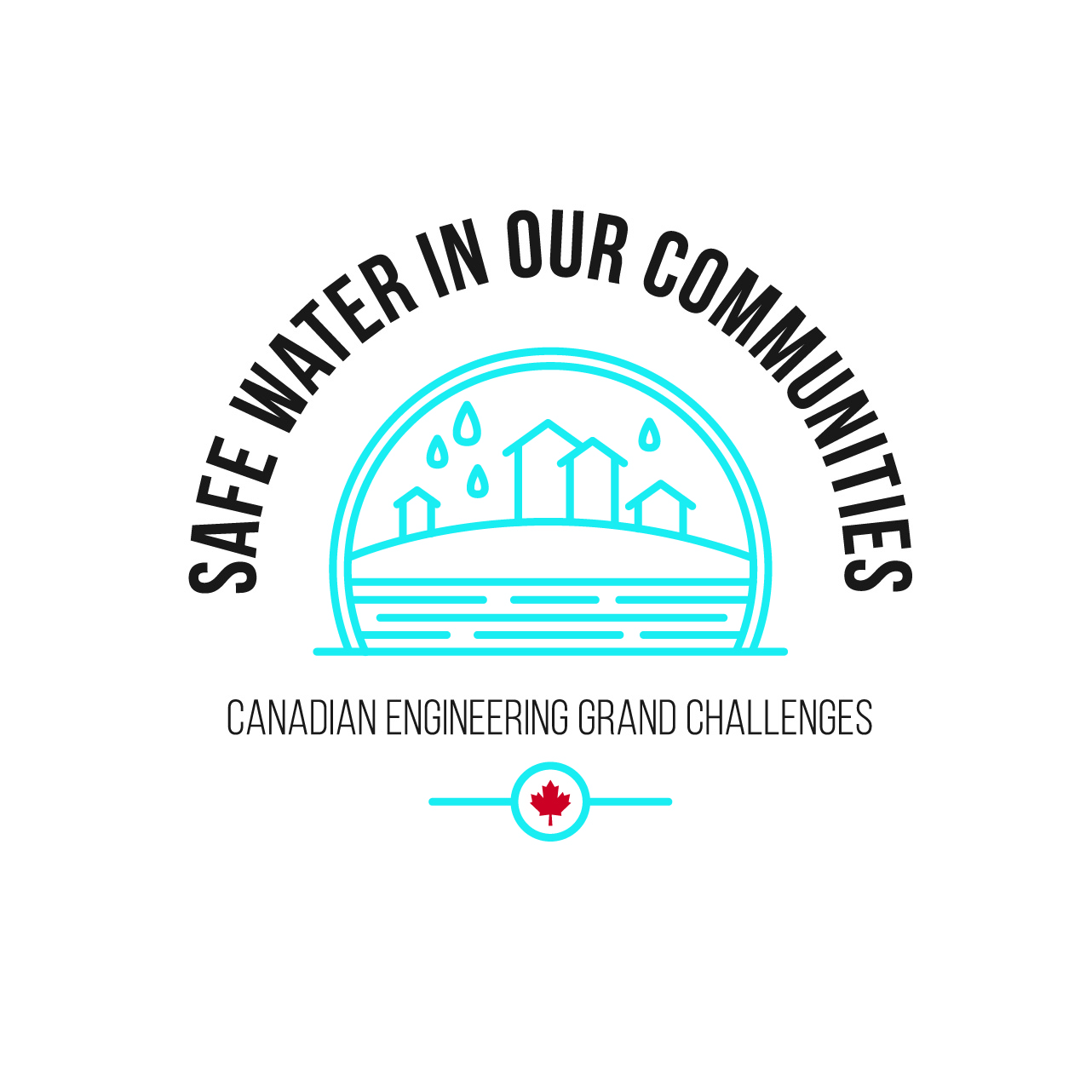
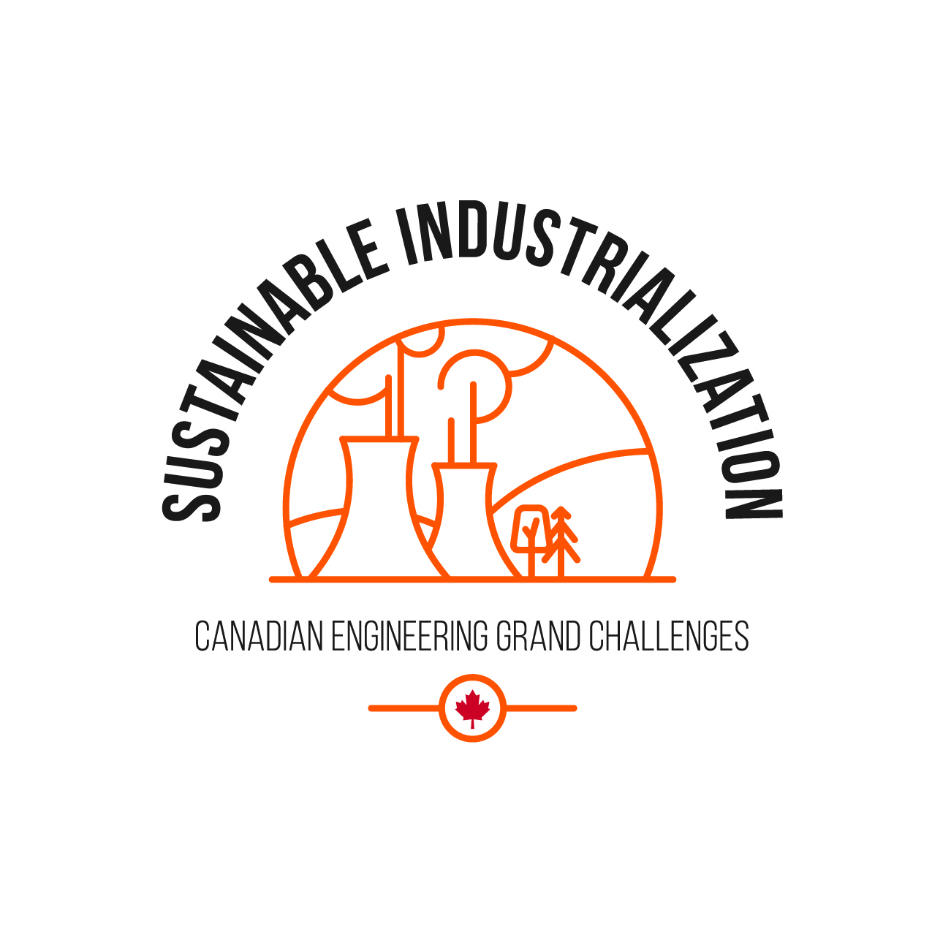
What are the Canadian Engineering Grand Challenges?
The Canadian Engineering Grand Challenges (CEGCs) capture the United Nations 17 Sustainable Development Goals (SDGs) in a way that is uniquely contextualized to Canada. This “grand challenge” approach is intended to focus and inspire the engineering profession, and to provide a context for Canadian engineering educators to prepare engineering students with the necessary leadership and sociotechnical skills to address and solve these large complex challenges and facilitate impactful change.
The six Challenges are:
CEGC 1: Resilient infrastructure
CEGC 2: Access to affordable, reliable, and sustainable energy
CEGC 3: Access to safe water in all communities
CEGC 4: Inclusive, safe, and sustainable cities
CEGC 5: Inclusive and sustainable industrialization
CEGC 6: Access to affordable and inclusive STEM education

Slide 3
Safe Water In Our Communities
Neskantaga First Nation
Toronto

Slide 4
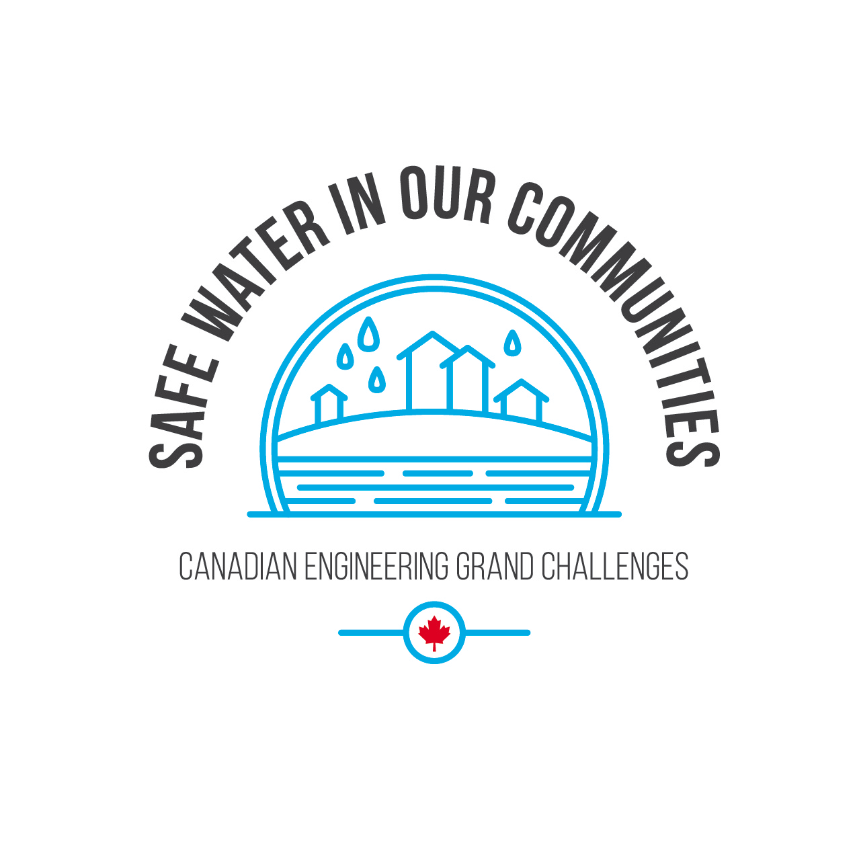
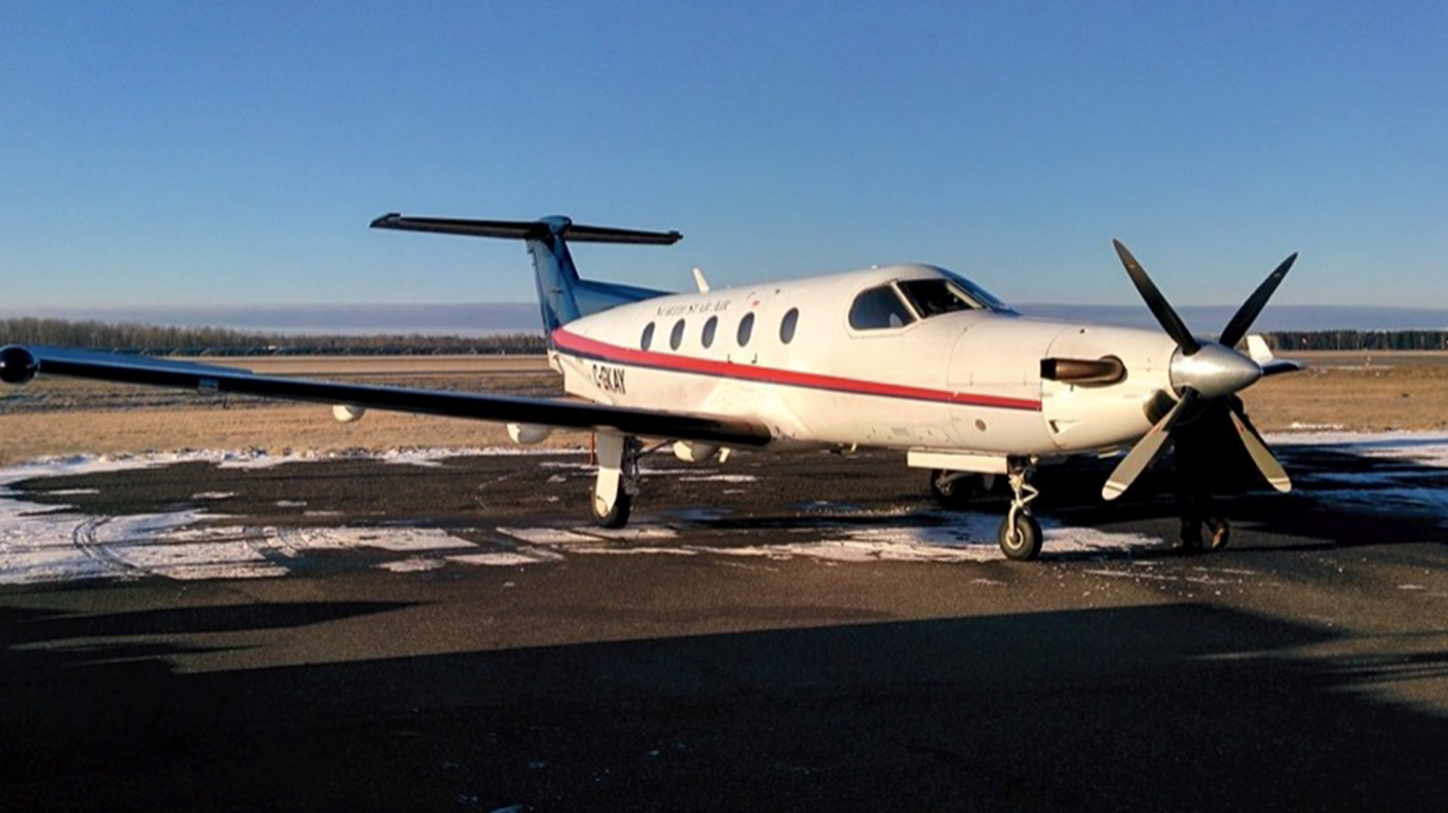
Water Crisis in Neskantaga First Nation
Canada is known for its incredible water resources. While most communities have access to safe drinking water, there are some communities without access to safe drinking water. In January 2023, there were 29 First Nation communities remaining under long-term drinking water advisory (Government of Canada, 2021).
NESKANTAGA FIRST NATION
Notes:
Nathan Lee
The Conference Board of Canada. (2013, January). Water Quality Index. https://www.conferenceboard.ca/hcp/Details/ Environment/water-quality-index.aspx.
Stefanovich, O. (2020, December 17). After evacuating twice over tainted water, Neskantaga residents plan their return home | CBC News. CBCnews. https://www.cbc.ca/news/ politics/neskantaga-plans-return-home-water- crisis-1.5840308.
Ketelaars, M. (2021, April 3). The Neskantaga Water Crisis. ArcGIS StoryMaps. https://storymaps.arcgis.com/stories/ 6aeef175dcca41d3a5dec217509e9940.
Human Rights Watch. (2020, May 27). Make it Safe. Human Rights Watch. https://www.hrw.org/report/2016/06/07/make- it-safe/canadas-obligation-end-first-nations-water-crisis.
North Western Health Unit. (n.d.). Environmental Health. Nwhu.on.ca. https://www.nwhu.on.ca/ourservices/ EnvironmentalHealth/Pages/Boil-Water-and-Drinking-Water-
Advisories.aspx#:~:text=A%20boil%20water%20advisory/ order,a%20minimum%20of%20one%20minute.
Government of Canada; Indigenous and Northern Affairs Canada. (2021, March 29). Ending long-term drinking water advisories. Retrieved from https://www.sac-isc.gc.ca/eng/ 1506514143353/1533317130660#dataset-filter.
Environmental Protection Agency. (2020, December 31). Stormwater Management and Green Infrastructure Research. EPA. https://www.epa.gov/water-research/stormwater- management-and-green-infrastructure-research.
Denchak, M. (2020, February 5). Green Infrastructure: How to Manage Water in a Sustainable Way. NRDC. https:// www.nrdc.org/stories/green-infrastructure-how-manage- water-sustainable-way.
City of Waterloo. (n.d.). Stormwater management. and drainage - City of Waterloo. https://www.waterloo.ca/en/ living/stormwater-management.aspx#.
City of Waterloo, O. D. (n.d.). Stormwater Ponds. City of Waterloo Open Data. https://data.waterloo.ca/datasets/ stormwater-ponds/explore.
Canadian Engineering Grand Challenges 2020-2030. Engineering Deans Canada. (2021, April 14). https:// engineeringdeans.ca/en/project/cegc/.
Nations, U. (n.d.). THE 17 GOALS | Sustainable Development. United Nations. https://sdgs.un.org/goals.
Reid, K. (2021, February 23). 10 worst countries for access to clean water. World Vision. https://www.worldvision.org/clean- water-news-stories/10-worst-countries-access-clean-water.

Slide 5
The Neskantaga First Nation, situated approximately 450 kilometers North of Thunder Bay, has been placed on a boil water advisory since 1995 (Government of Canada (2021), Stefanovich (2020)). Using funding from the federal government, the Neskantaga First Nation is approaching completion of a project to upgrade and build an expansion of the existing water treatment system. Remaining work focuses on finalizing the construction of the new water treatment system project and addressing technical and operational deficiencies.
NESKANTAGA FIRST NATION

Slide 6
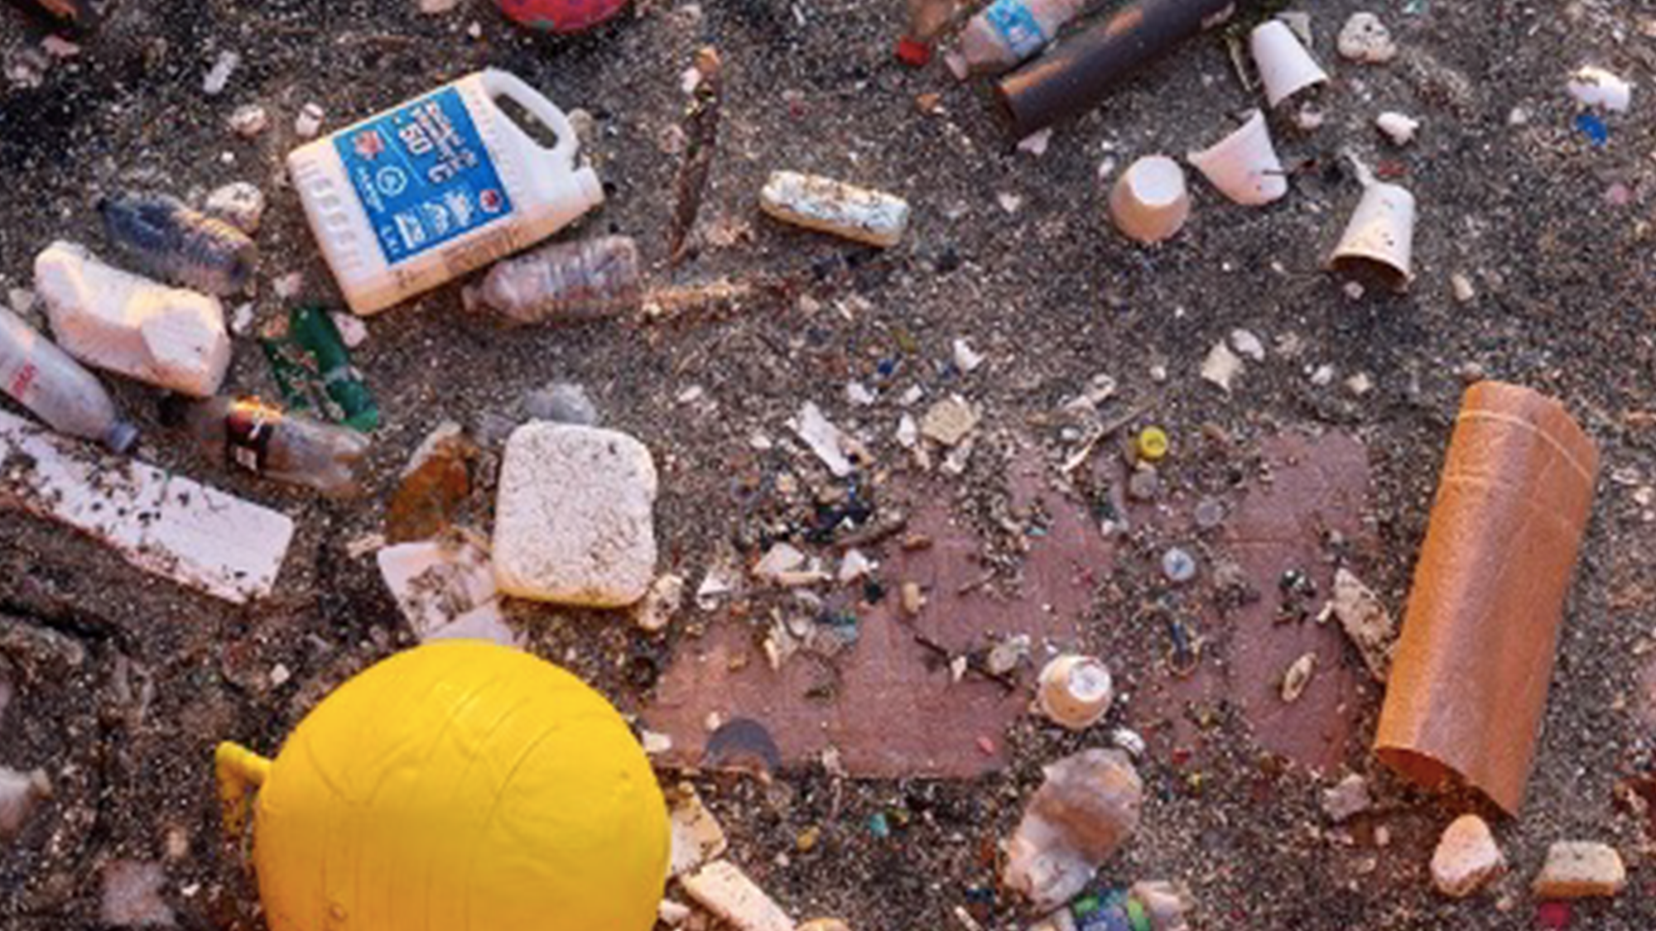
Rainfall Management
The city of Toronto, located on the shore of Lake Ontario, is the most populated city in Canada. The city possesses an outdated infrastructure which uses a combined system to handle storm water and sewage.
TORONTO
Notes:
Nathan Lee
The Conference Board of Canada. (2013, January). Water Quality Index. https://www.conferenceboard.ca/hcp/Details/ Environment/water-quality-index.aspx.
Stefanovich, O. (2020, December 17). After evacuating twice over tainted water, Neskantaga residents plan their return home | CBC News. CBCnews. https://www.cbc.ca/news/ politics/neskantaga-plans-return-home-water- crisis-1.5840308.
Ketelaars, M. (2021, April 3). The Neskantaga Water Crisis. ArcGIS StoryMaps. https://storymaps.arcgis.com/stories/ 6aeef175dcca41d3a5dec217509e9940.
Human Rights Watch. (2020, May 27). Make it Safe. Human Rights Watch. https://www.hrw.org/report/2016/06/07/make- it-safe/canadas-obligation-end-first-nations-water-crisis.
North Western Health Unit. (n.d.). Environmental Health. Nwhu.on.ca. https://www.nwhu.on.ca/ourservices/ EnvironmentalHealth/Pages/Boil-Water-and-Drinking-Water-
Advisories.aspx#:~:text=A%20boil%20water%20advisory/ order,a%20minimum%20of%20one%20minute.
Government of Canada; Indigenous and Northern Affairs Canada. (2021, March 29). Ending long-term drinking water advisories. Retrieved from https://www.sac-isc.gc.ca/eng/ 1506514143353/1533317130660#dataset-filter.
Environmental Protection Agency. (2020, December 31). Stormwater Management and Green Infrastructure Research. EPA. https://www.epa.gov/water-research/stormwater- management-and-green-infrastructure-research.
Denchak, M. (2020, February 5). Green Infrastructure: How to Manage Water in a Sustainable Way. NRDC. https:// www.nrdc.org/stories/green-infrastructure-how-manage- water-sustainable-way.
City of Waterloo. (n.d.). Stormwater management. and drainage - City of Waterloo. https://www.waterloo.ca/en/ living/stormwater-management.aspx#.
City of Waterloo, O. D. (n.d.). Stormwater Ponds. City of Waterloo Open Data. https://data.waterloo.ca/datasets/ stormwater-ponds/explore.
Canadian Engineering Grand Challenges 2020-2030. Engineering Deans Canada. (2021, April 14). https:// engineeringdeans.ca/en/project/cegc/.
Nations, U. (n.d.). THE 17 GOALS | Sustainable Development. United Nations. https://sdgs.un.org/goals.
Reid, K. (2021, February 23). 10 worst countries for access to clean water. World Vision. https://www.worldvision.org/clean- water-news-stories/10-worst-countries-access-clean-water.

Slide 7
When there are intense rainfalls, the amount of rainfalls may exceed the capacity of the system and overflow of the combined sewer system may happen where untreated sewage could be discharged into locations such as the Don River watershed and potentially in Lake Ontario (Toronto and Region Conservation Authority). The Don River watershed, which stretches almost 38 kilometers, is highly urbanized with the preponderance of paved surfaces limiting the availability of soil and vegetation to absorb additional water caused by the rainfalls. These circumstances may affect the quality of the Don river.
TORONTO

