Slide 1
Cities and Communities
Connecting Ontario Cities and Indigenous Communities to the Canadian Engineering Grand Challenges

Slide 2
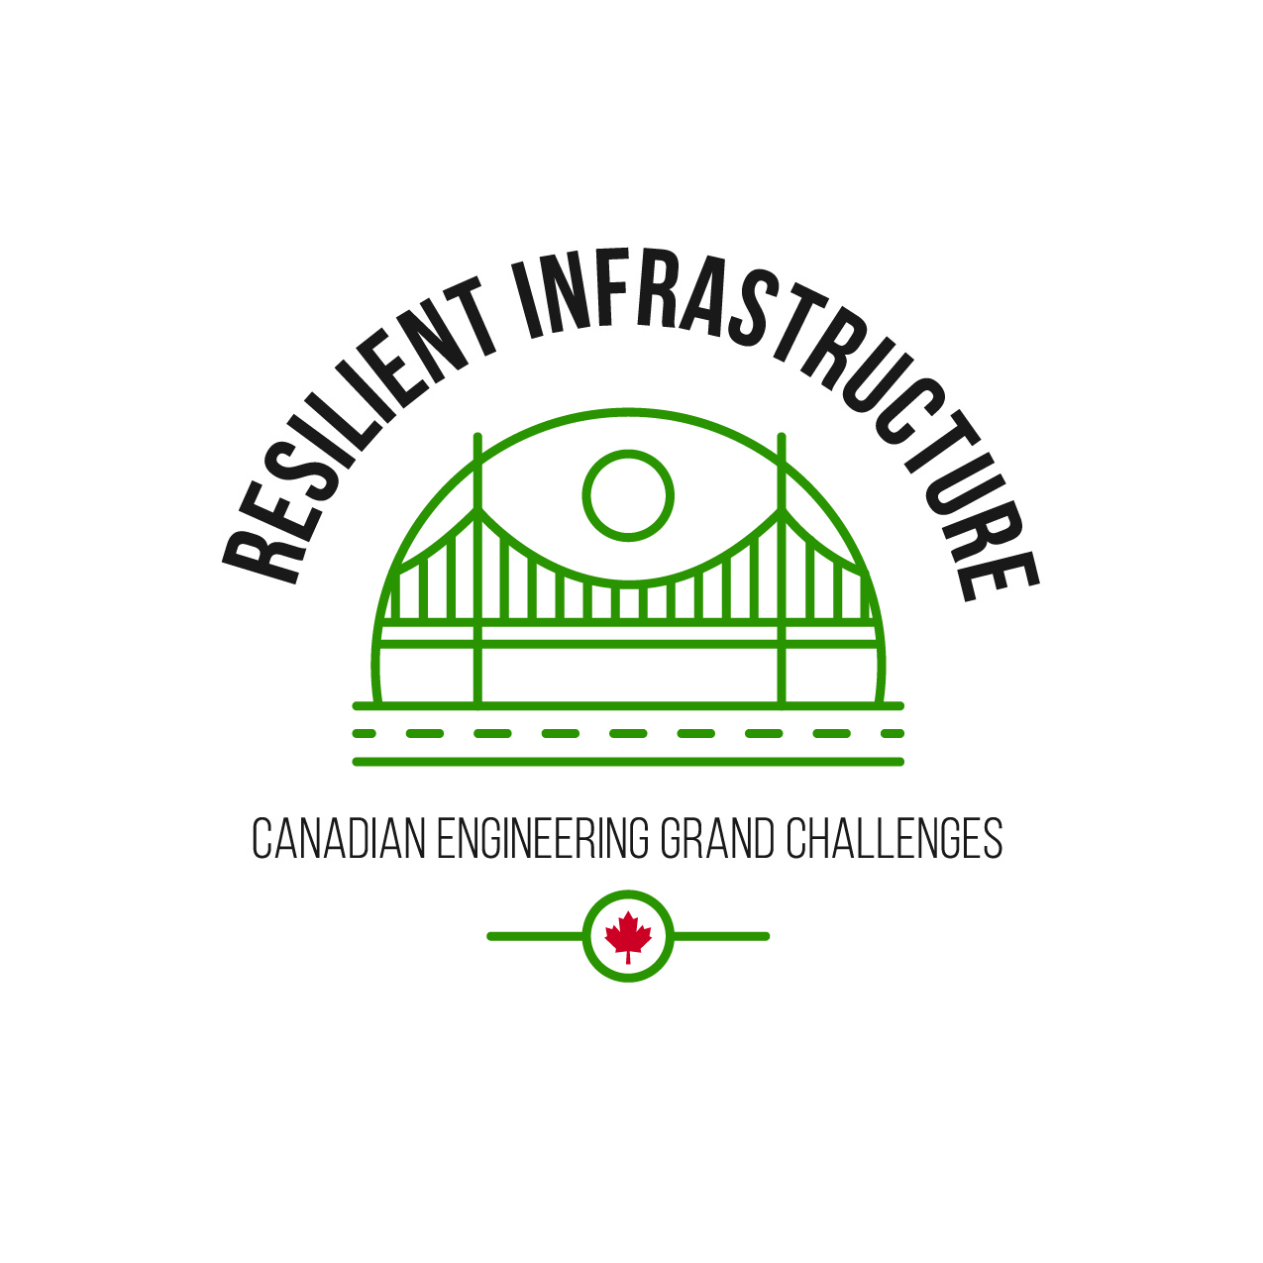
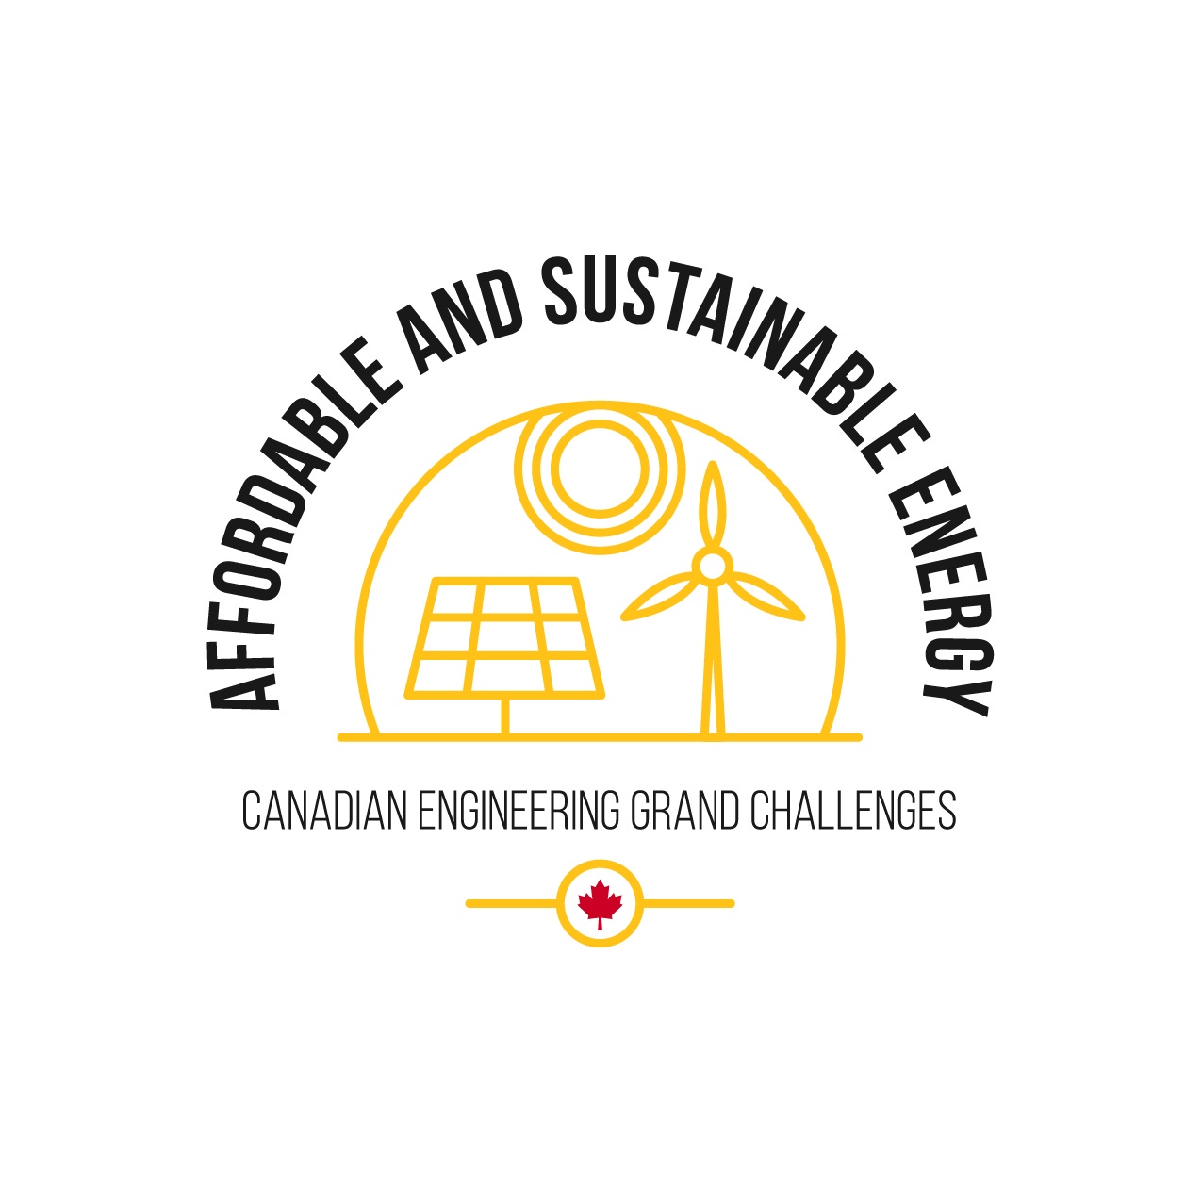
What are the Canadian Engineering Grand Challenges?
The Canadian Engineering Grand Challenges (CEGCs) capture the United Nations 17 Sustainable Development Goals (SDGs) in a way that is uniquely contextualized to Canada. This “grand challenge” approach is intended to focus and inspire the engineering profession, and to provide a context for Canadian engineering educators to prepare engineering students with the necessary leadership and sociotechnical skills to address and solve these large complex challenges and facilitate impactful change.
The six Challenges are:
CEGC 1: Resilient infrastructure
CEGC 2: Access to affordable, reliable, and sustainable energy
CEGC 3: Access to safe water in all communities
CEGC 4: Inclusive, safe, and sustainable cities
CEGC 5: Inclusive and sustainable industrialization
CEGC 6: Access to affordable and inclusive STEM education

Slide 3
Affordable and Sustainable Energy
Aamjiwnaang First Nation
Hamilton

Slide 4
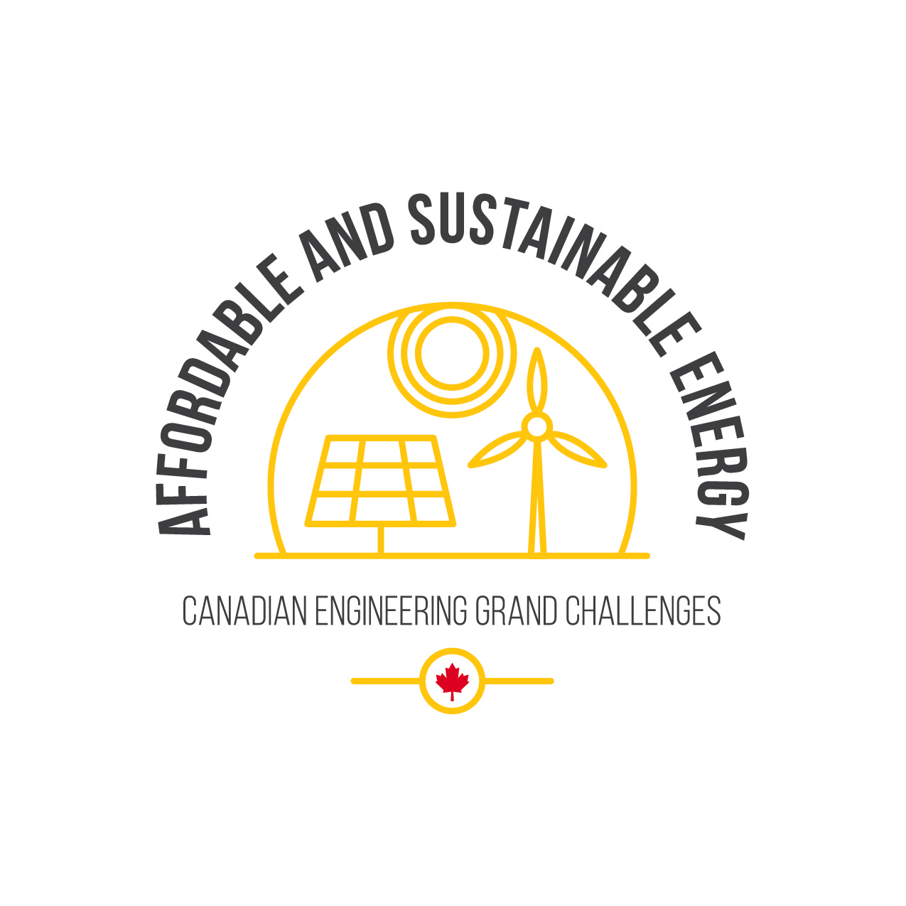
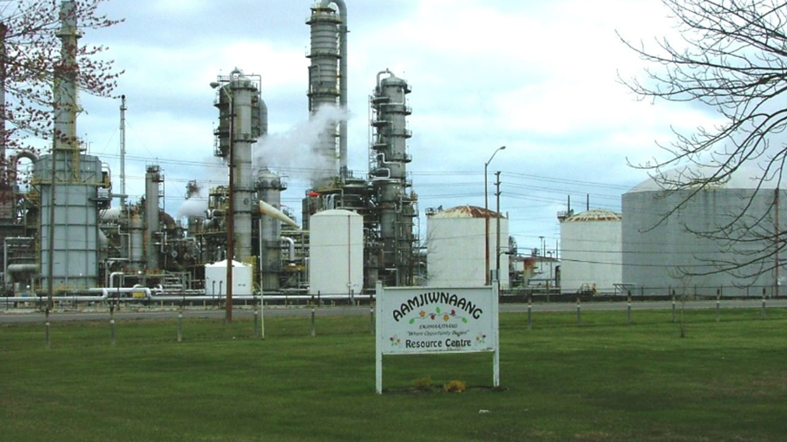
How Petrochemical Operations are Affecting a First Nation Community
The Aamjiwnaang First Nation (formally known as Chippewas of Sarnia) is a First Nation community in the southern region of Sarnia of about 2500 Chippewa (Ojibwe) Peoples (Statistics Canada, 2018). It is located adjacent to several petrochemical plants in an area also known as "the Chemical Valley”.
AAMJIWNAANG FIRST NATION
Notes:
Saranya Jeyakanthan
Photo References:
Aajimwnaang Resource Centre right next to Dow Chemical in Chemical Valley by TheKurgan licensed under CC BY-SA 3.0 https://commons.wikimedia.org/wiki/ File:Aajimwnaang_Resource_Centre_right_next_to_Dow_Che mical_in_Chemical_Valley.jpg#filelinks
Rhine Rhein Basel 2006 871 by Norbert Aepli licensed under CC BY 2.5 https://commons.wikimedia.org/wiki/ File:Rhine_Rhein_Basel_2006_871.JPG
References
Britannica, T. Editors of Encyclopaedia (2013, May 1). Basel. Encyclopedia Britannica. https://www.britannica.com/place/ Basel-Switzerland
Cantonal Office for Environment and Energy. (2017, June 19). (rep.). Report on the Implementation Status of the Measures to Adapt to the Climate Change in the Canton of Basel-Stadt (pp. 17–18).
CTVNews.ca Staff. (2011, September 26). Canada's air among the world's best: WHO report. CTVNews. https:// www.ctvnews.ca/canada-s-air-among-the-world-s-best-who- report-1.702752.
EIA. (2020, April 9). U.S. Energy Information Administration - EIA - Independent Statistics and Analysis.
Hydropower and the environment. https://www.eia.gov/ energyexplained/hydropower/hydropower-and-the- environment.php.
Engineering Deans Canada (2019). Canadian Engineering Grand Challenges (2020-2030): Inspiring action to improve life for Canadian and the world. Retrieved on July 4, 2021, from: https://engineeringdeans.ca/en/project/cegc/
IQAir. (2021, July 4). Basel Air Quality Index (AQI) and Switzerland Air Pollution: AirVisual. Basel Air Quality Index (AQI) and Switzerland Air Pollution | AirVisual. https:// www.iqair.com/ca/switzerland/basel-city/basel.
Kanton Basel-Stadt. (n.d.). Basel auf dem Weg in eine CO2- arme Zukunft. Klimaschutz Kanton Basel-Stadt. https:// www.klimaschutz.bs.ch/.
Mackenzie, C. A., Lockridge, A., & Keith, M. (2005). Declining sex ratio in a first nation community. Environmental health perspectives, 113(10), 1295–1298. https://doi.org/10.1289/ ehp.8479
Sean Craig, Carolyn Jarvis, Emma McIntosh, Sawyer Bogdan, Morgan Bocknek, & Robert Mackenzie. (2017, October 14). 'We expected cancer': Are industrial spills in Canada's 'Chemical Valley'making people sick? Global News. https:// globalnews.ca/news/3796720/sarnia-oil-industry-spills- human-impact-investigation/.
Statistics Canada. 2018. Aamjiwnaang First Nation [First Nation/Indian band or Tribal Council area], Ontario (table). Aboriginal Population Profile. 2016 Census. Statistics Canada Catalogue no. 98-510-X2016001. Ottawa. Released July 18, 2018. http://www12.statcan.gc.ca/census-recensement/2016/ dp-pd/abpopprof/index.cfm?Lang=E
United Nations (n.d.), Sustainable Development Goals, Department of Economic and Social Affairs, Sustainable Development. Retrieved on July 4, 2021, from: https:// sdgs.un.org/goals

Slide 5
The proximity of the community to petrochemical plants has significant impact on the health of the community. Since the 1990s, there has been a decline in the proportion of male births, with 33% of the birth between 1999 and 2003 were male (Mackenzie et al., 2005). The poor air quality was documented by Larsen et al (2022), indicating much higher levels than the provincial averages for six known or suspected carcinogens in 2015-2016. The government of Canada has taken measures to correct the poor air quality by issuing an order to ensure that petrochemical facilities are limiting the release of the carcinogen benzene (Government of Canada, 2024).
AAMJIWNAANG FIRST NATION

Slide 6
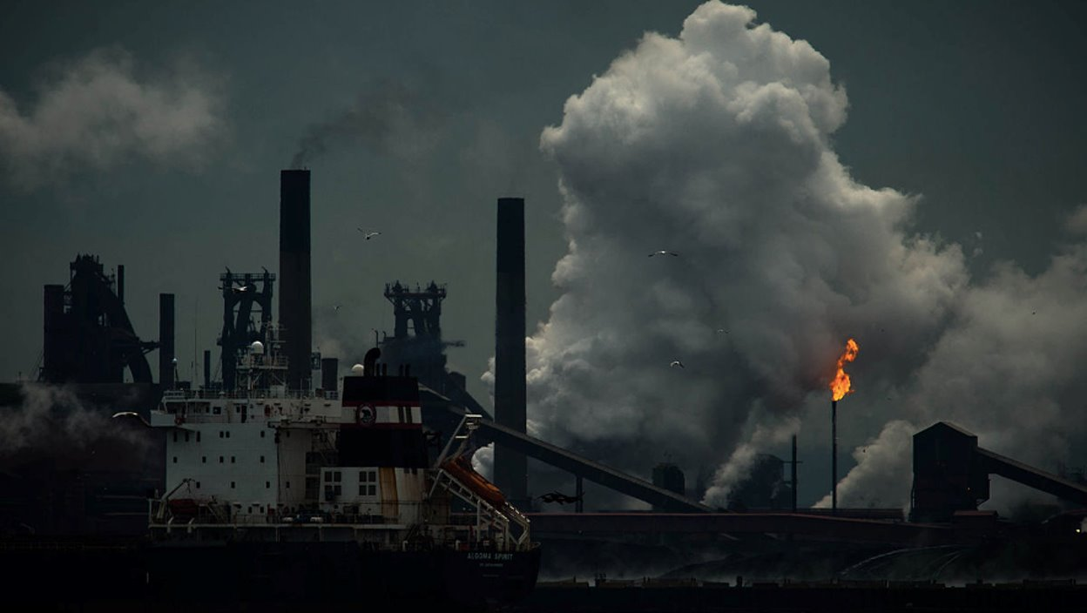
Industrial Sector of Canada Braces for Climate Change
Hamilton with a total population of 747,545 as of 2016 (Government of Canada, 2019), has the highest greenhouse gas (GHG) emissions in the Greater Toronto area with approximately 15 tonnes CO2 eq/capita, which surpasses the Region of Peel with approximately 8 tonnes CO2 eq/capita (Lu, 2017). This is explained by the significant industrial activities in Hamilton representing around 68% of all GHG emissions within the city in 2017 (Lu, 2017).
HAMILTON
Notes:
Saranya Jeyakanthan
Photo References:
Aajimwnaang Resource Centre right next to Dow Chemical in Chemical Valley by TheKurgan licensed under CC BY-SA 3.0 https://commons.wikimedia.org/wiki/ File:Aajimwnaang_Resource_Centre_right_next_to_Dow_Che mical_in_Chemical_Valley.jpg#filelinks
Rhine Rhein Basel 2006 871 by Norbert Aepli licensed under CC BY 2.5 https://commons.wikimedia.org/wiki/ File:Rhine_Rhein_Basel_2006_871.JPG
References
Britannica, T. Editors of Encyclopaedia (2013, May 1). Basel. Encyclopedia Britannica. https://www.britannica.com/place/ Basel-Switzerland
Cantonal Office for Environment and Energy. (2017, June 19). (rep.). Report on the Implementation Status of the Measures to Adapt to the Climate Change in the Canton of Basel-Stadt (pp. 17–18).
CTVNews.ca Staff. (2011, September 26). Canada's air among the world's best: WHO report. CTVNews. https:// www.ctvnews.ca/canada-s-air-among-the-world-s-best-who- report-1.702752.
EIA. (2020, April 9). U.S. Energy Information Administration - EIA - Independent Statistics and Analysis.
Hydropower and the environment. https://www.eia.gov/ energyexplained/hydropower/hydropower-and-the- environment.php.
Engineering Deans Canada (2019). Canadian Engineering Grand Challenges (2020-2030): Inspiring action to improve life for Canadian and the world. Retrieved on July 4, 2021, from: https://engineeringdeans.ca/en/project/cegc/
IQAir. (2021, July 4). Basel Air Quality Index (AQI) and Switzerland Air Pollution: AirVisual. Basel Air Quality Index (AQI) and Switzerland Air Pollution | AirVisual. https:// www.iqair.com/ca/switzerland/basel-city/basel.
Kanton Basel-Stadt. (n.d.). Basel auf dem Weg in eine CO2- arme Zukunft. Klimaschutz Kanton Basel-Stadt. https:// www.klimaschutz.bs.ch/.
Mackenzie, C. A., Lockridge, A., & Keith, M. (2005). Declining sex ratio in a first nation community. Environmental health perspectives, 113(10), 1295–1298. https://doi.org/10.1289/ ehp.8479
Sean Craig, Carolyn Jarvis, Emma McIntosh, Sawyer Bogdan, Morgan Bocknek, & Robert Mackenzie. (2017, October 14). 'We expected cancer': Are industrial spills in Canada's 'Chemical Valley'making people sick? Global News. https:// globalnews.ca/news/3796720/sarnia-oil-industry-spills- human-impact-investigation/.
Statistics Canada. 2018. Aamjiwnaang First Nation [First Nation/Indian band or Tribal Council area], Ontario (table). Aboriginal Population Profile. 2016 Census. Statistics Canada Catalogue no. 98-510-X2016001. Ottawa. Released July 18, 2018. http://www12.statcan.gc.ca/census-recensement/2016/ dp-pd/abpopprof/index.cfm?Lang=E
United Nations (n.d.), Sustainable Development Goals, Department of Economic and Social Affairs, Sustainable Development. Retrieved on July 4, 2021, from: https:// sdgs.un.org/goals

Slide 7
The city of Hamilton has set a series of objectives to reduce its GHG emissions by 20% in 2020, 50% in 2030, and 80% in 2050 with the year 2005 as the reference. GHG emissions in 2017 had decreased by approximately 33% compared to 2005 with reduction of GHG emissions in the industrial sector while GHG emissions of the commercial and transportation sectors had increased (Rankin, 2019). Thus, significant efforts from all sectors will be required to achieve the desired GHG reduction by 2050.
HAMILTON

