Slide 1
Cities and Communities
Connecting Ontario Cities and Indigenous Communities to the Canadian Engineering Grand Challenges

Slide 2
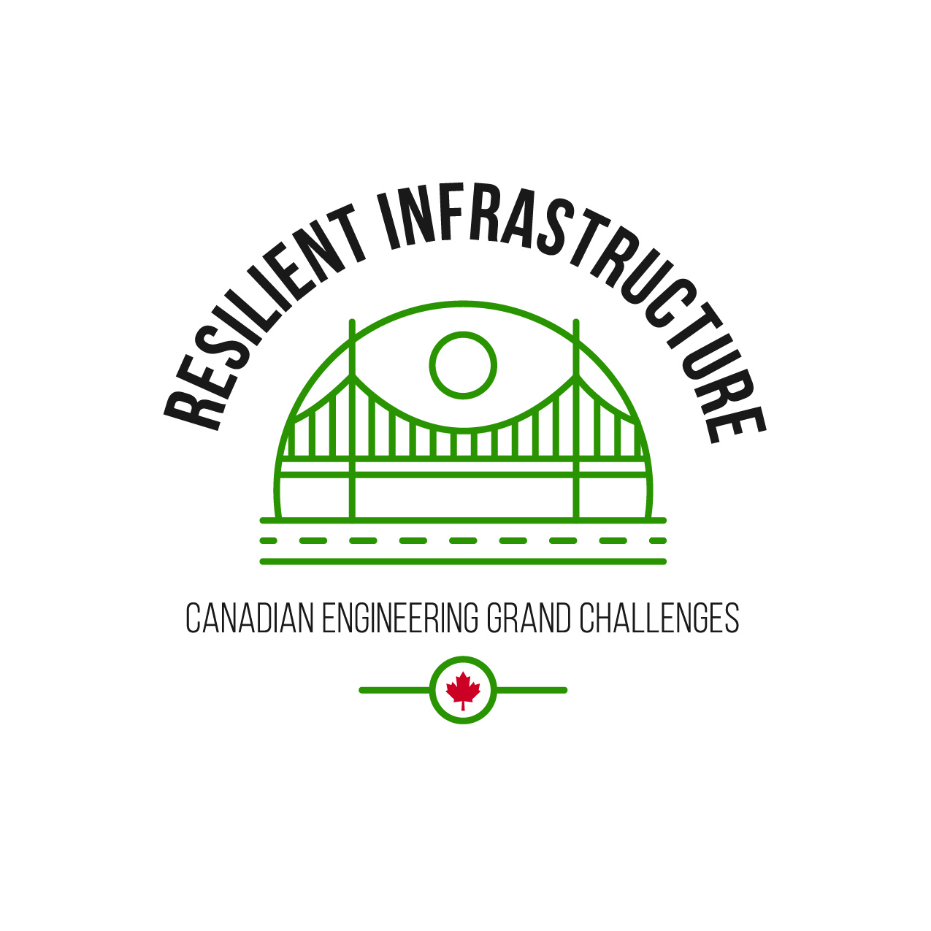
What are the Canadian Engineering Grand Challenges?
The Canadian Engineering Grand Challenges (CEGCs) capture the United Nations 17 Sustainable Development Goals (SDGs) in a way that is uniquely contextualized to Canada. This “grand challenge” approach is intended to focus and inspire the engineering profession, and to provide a context for Canadian engineering educators to prepare engineering students with the necessary leadership and sociotechnical skills to address and solve these large complex challenges and facilitate impactful change.
The six Challenges are:
CEGC 1: Resilient infrastructure
CEGC 2: Access to affordable, reliable, and sustainable energy
CEGC 3: Access to safe water in all communities
CEGC 4: Inclusive, safe, and sustainable cities
CEGC 5: Inclusive and sustainable industrialization
CEGC 6: Access to affordable and inclusive STEM education

Slide 3
Resilient Infrastructure
Marten Falls First Nation
Caledon

Slide 4
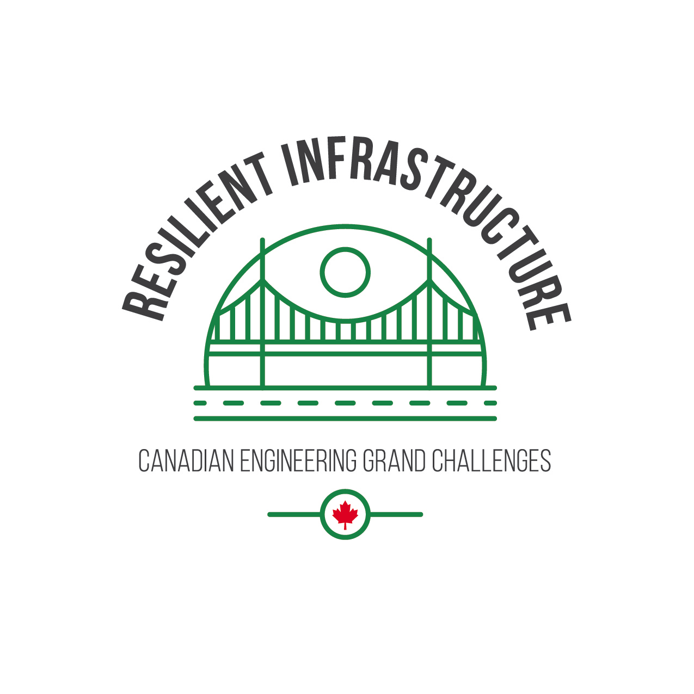
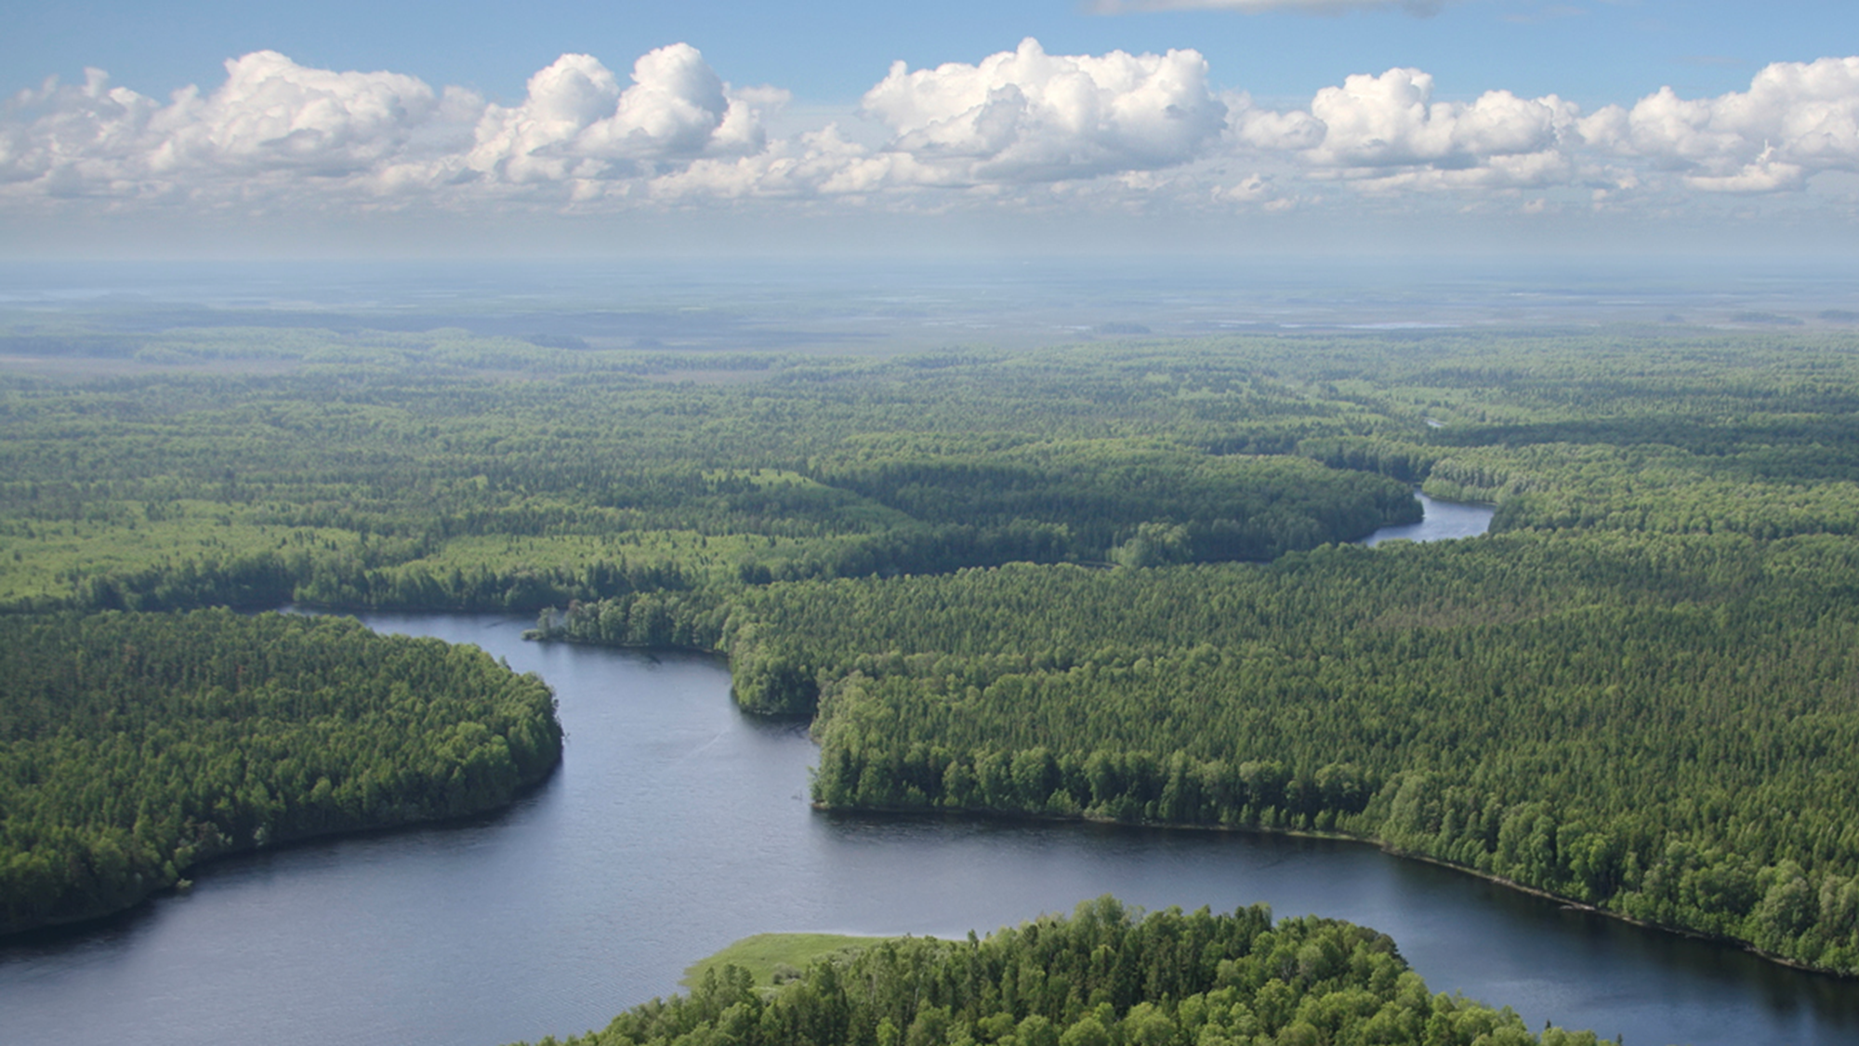
Remote Communities Access
Marten Falls First Nation is located at the junction of the Albany and Ogoki rivers, approximately 170 kilometers northeast of Nakina and approximately 400 km northeast of Thunder Bay. The total population was 853,396 on reserve and 457 off reserve as of December 2022 (Government of Canada, Crown-Indigenous Relations and Northern Affairs). It is a fly-in community with no year-round road access. The fly-in conditions of Marten Falls result in very high cost for passenger and goods transportation. The closest city which can be accessed year-round by road is Nakina.
MARTEN FALLS FIRST NATION
Notes:
Zachariah Chamas
C40 Cities. (2016). Climate Change Adaptation in Delta Cities. London: C40 Cities Climate Leadership Group.
Goderich Signal Star. (2020, August 6). Goderich Signal Star. Retrieved May 29, 2021, from Goderich Signal Star: https:// www.goderichsignalstar.com/news/local-news/high-water- levels-in-lake-huron-reach-monthly-records-in-2020
National Oceanic and Atmospheric Administration. (2020). NOAA - Greal Lakes Environment Research Laboratory. Retrieved from Great Lakes Ice Cover: https:// www.glerl.noaa.gov/data/ice/
Patowary, K. (2014, April 19). The Netherland's Impressive Storm Surge Barriers. Retrieved from Amusing Planet: https:// www.amusingplanet.com/2014/04/the-netherlands- impressive-storm-surge.html
The Coastal Centre. (2021, February). Lake Huron Water Level Updates. Retrieved May 29, 2021, from https:// www.lakehuron.ca/lake-level-updates
United Nations. (2021). Sustainable Development Goals. Retrieved from United Nations: https://sdgs.un.org/goals/ goal13

Slide 5
In the winter, the community can be accessed by winter roads when weather permits (Marten Falls First Nation Access Roads, Government of Canada). Marten Falls Community Access Road Project). Winter roads are “built over land, frozen rivers and lakes by remote communities and First Nation members to connect remote and First Nation communities in the Far North to a permanent highway or railway system. These roads exist from around mid-January until spring thaw" (Government of Ontario, Northern Ontario Winter Roads). Winter roads are affected by climate change and their conditions are variable and becoming unreliable (Marten Falls First Nation Access Roads). To address the unreliability of winter roads, Marten Falls First Nation is proposing the construction and operation, including maintenance, of an all-season multi-use community access road, approximately 190 to 230 kilometers, connecting the northern end of Painter Lake forestry road to the community of Marten Falls. As proposed, the Marten Falls Community Access Road Project will increase potential opportunities for economic development (Government of Canada, Impact Assessment Agency of Canada). On January 13, 2023, the Impact Assessment Agency of Canada has extended the three-year time limit for Marten Falls First Nation to provide the information or studies for the project's impact assessment with the new deadline as July 24, 2026 (Government of Canada, Notice of Time Limit Extension).
MARTEN FALLS FIRST NATION

Slide 6
Proposed Highway 413​
The Ontario government has proposed highway 413 that would extend from Milton to Vaughan and cut through the lower part of the municipality of Caledon. The proposed 4-6 lane highway will be 59km long with 11 interchanges to municipal roads and provide easier access to other 400 series highways (Government of Canada). The population of Caledon was approximately 76,000 people in 2021 (Statistics Canada).
CALEDON
Notes:
Zachariah Chamas
C40 Cities. (2016). Climate Change Adaptation in Delta Cities. London: C40 Cities Climate Leadership Group.
Goderich Signal Star. (2020, August 6). Goderich Signal Star. Retrieved May 29, 2021, from Goderich Signal Star: https:// www.goderichsignalstar.com/news/local-news/high-water- levels-in-lake-huron-reach-monthly-records-in-2020
National Oceanic and Atmospheric Administration. (2020). NOAA - Greal Lakes Environment Research Laboratory. Retrieved from Great Lakes Ice Cover: https:// www.glerl.noaa.gov/data/ice/
Patowary, K. (2014, April 19). The Netherland's Impressive Storm Surge Barriers. Retrieved from Amusing Planet: https:// www.amusingplanet.com/2014/04/the-netherlands- impressive-storm-surge.html
The Coastal Centre. (2021, February). Lake Huron Water Level Updates. Retrieved May 29, 2021, from https:// www.lakehuron.ca/lake-level-updates
United Nations. (2021). Sustainable Development Goals. Retrieved from United Nations: https://sdgs.un.org/goals/ goal13

Slide 7
Some of the residents of Caledon are strongly against the building of highway 413. These residents are worried about the effect of increased greenhouse gas (GHG) emissions associated with this highway, with the projected additional 17.4M tonnes of GHG by 2050 (CBC, 2021). It is unclear if highway 413 will improve congestion or if it will primarily add new cars to the road and promote urban sprawl. When analyzing the construction of the highway, the economy of the region may be improved by increasing the number of individuals moving to Caledon while impacts on the ecology, habitat, water streams and land may be significant.
CALEDON

