Slide 1
Introduction to the Canadian Engineering Grand Challenges

Slide 2
The Canadian Engineering Grand Challenges (CEGCs) are a series of Challenges compiled by Engineering Deans Canada (EDC) for Canadian engineers to strive for. The CEGCs were created with the intent of articulating the issues that Canada faces both environmentally and socially, in order to shape future engineering education, research, and outreach. In January 2016, the United Nations officially adopted the 17 Sustainable Development Goals (SDGs) as a part of the 2030 Agenda for Sustainable Development. These SDGs provide a valuable set of guidelines with which countries can create their own action plans for sustainability and inclusion.

Slide 3
From this solid foundation, the Engineering Deans Canada came together to generate six “Grand Challenges.” These Challenges represent broad, societally relevant issues with achievable outcomes for which the solution methods are not yet developed. The Challenges frame these issues as they are relevant to the world at large while focusing on expressing them in a uniquely Canadian context. The CEGCs are designed to focus Canadian engineering efforts and inspire students and professionals alike to solve these issues from an interdisciplinary approach. They bring to attention that these problems are solvable, the goals are achievable, and that engine

Slide 4
The “Grand Challenge” concept was coined by German mathematician David Hilbert in 1900 and has since been developed over the past century by a range of individuals and organizations. Many Canadian Deans felt that the Canadian engineering community needed to develop a more “Canadian” version of these challenges that reflected the unique characteristics of Canadian issues. They believed that addressing these challenges from a Canadian perspective will provide opportunities for engineering students and faculty members to engage with complex and socially motivated issues.

Slide 5
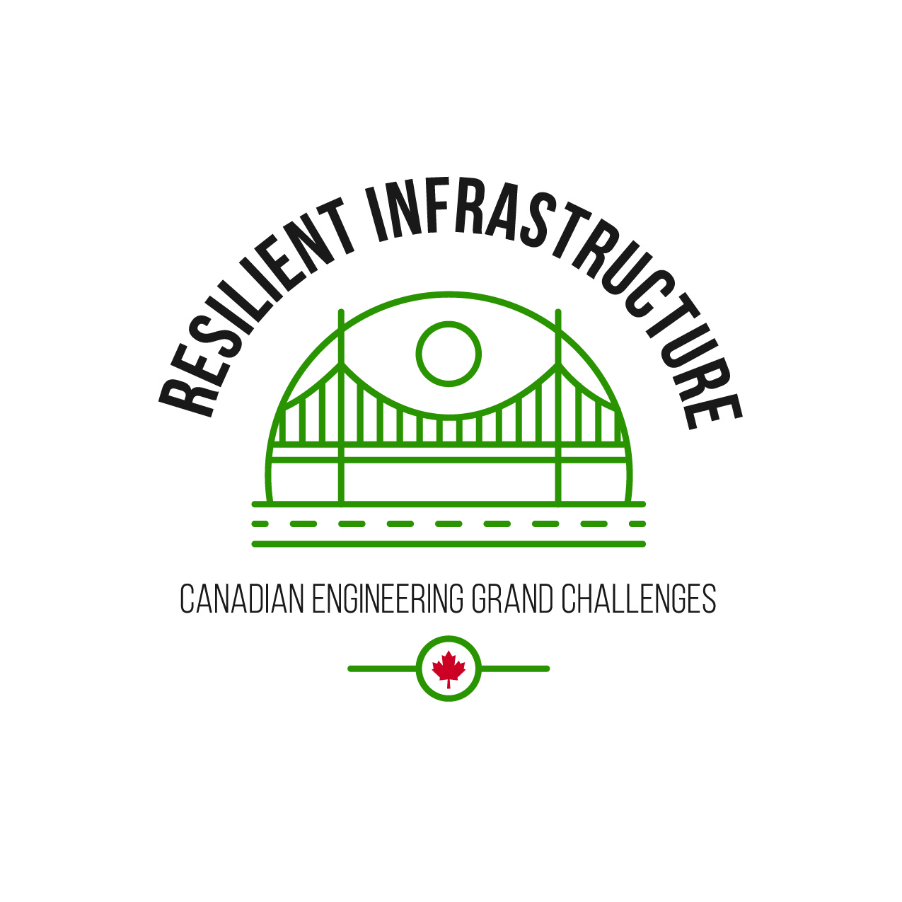
In May 2019, Engineering Deans Canada worked together to identify the challenges that best encapsulate engineering problems in our unique Canadian context and landscape. The six challenges are as follows:
CEGC 1: Resilient infrastructure
CEGC 2: Access to affordable, reliable, and sustainable energy
CEGC 3: Access to safe water in all communities
CEGC 4: Inclusive, safe, and sustainable cities
CEGC 5: Inclusive and sustainable industrialization
CEGC 6: Access to affordable and inclusive STEM education

Slide 6
For more information, watch the two videos on an Introduction to the Canadian Engineering Grand Challenges and a Description of the Six Canadian Engineering Grand Challenges.

Slide 7
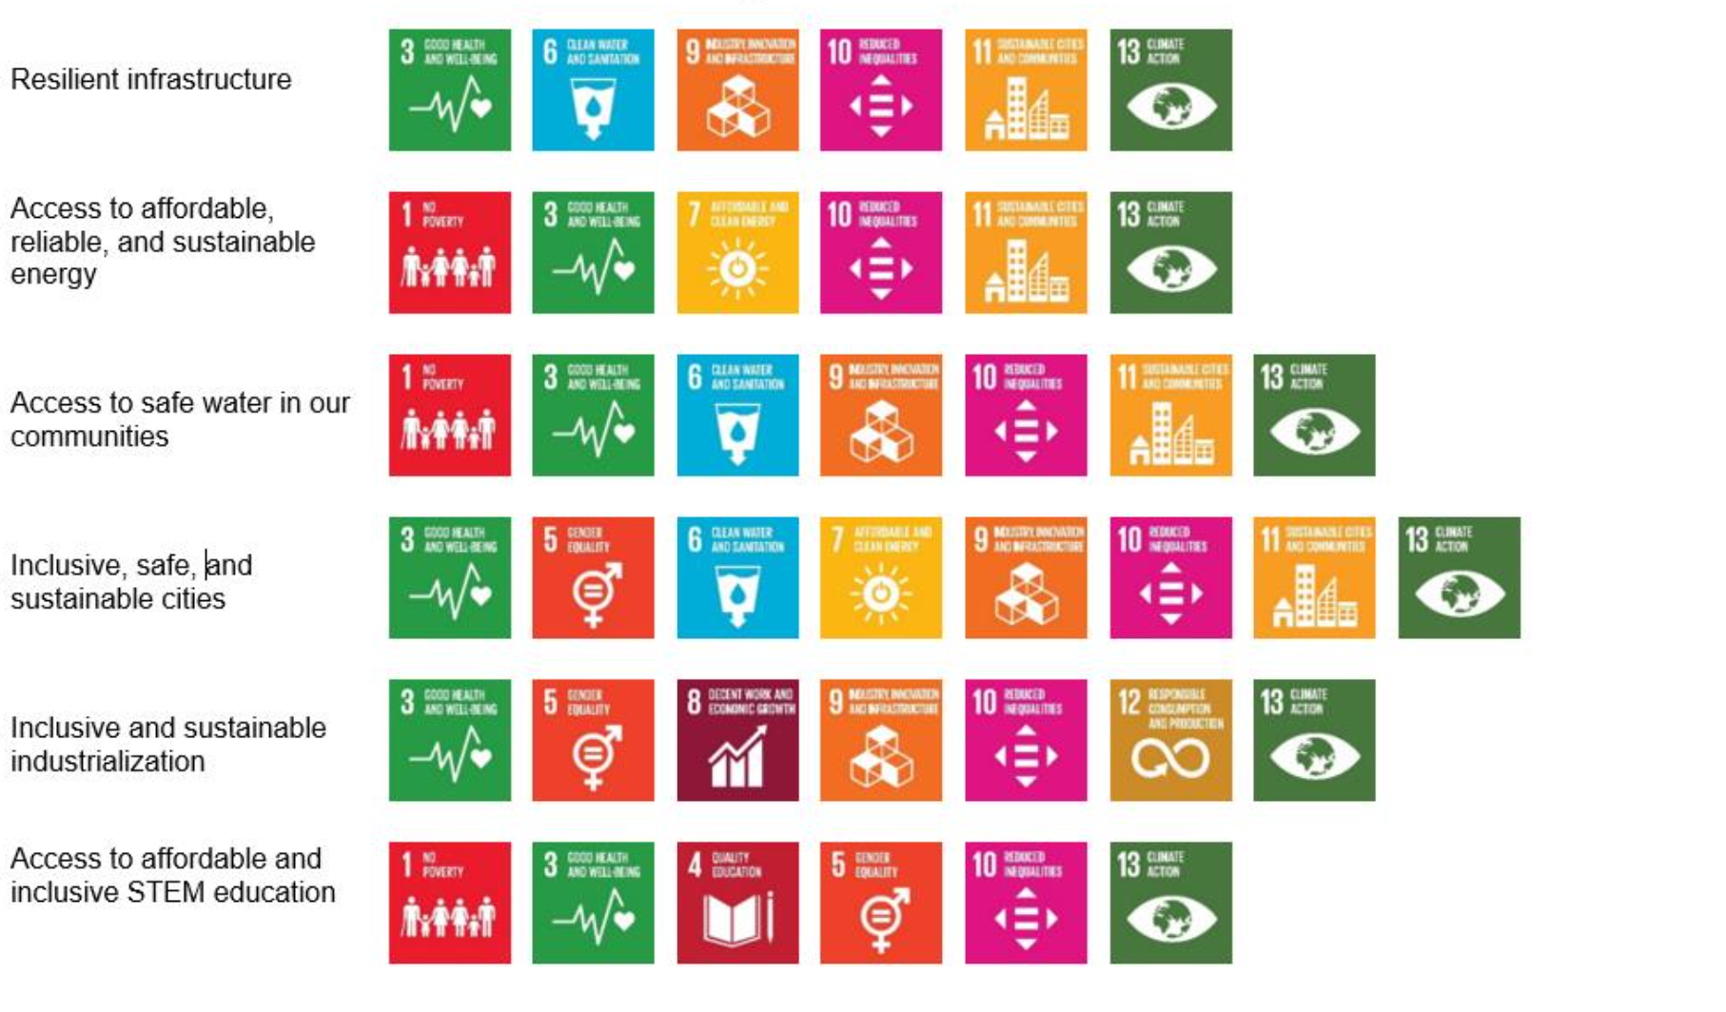
The Canadian Engineering Grand Challenges map to the Sustainable Development Goals as shown in the figure.

Slide 8
References
“Sustainable Development Goals.” World Health Organization, World Health Organization, https://sdgs.un.org/goals
“Canadian Engineering Grand Challenges 2020-2030.” Engineering Deans Canada, 14 Apr. 2021, https://engineeringdeans.ca/en/project/cegc/

