Slide 1
CEGC 5: Inclusive and Sustainable Industrialization

Slide 2
Connection to the United Nations Sustainable Development Goals

Slide 3
What is the Canadian Engineering Grand Challenge Statement?
The challenge for sustainable industrialization is to reconcile the tension between industrialization and the manufacturing of products with the need to safeguard our environment and our natural resources (EDC-DDIC, 2022).

Slide 4
High Level Overview of the Canadian Engineering Grand Challenge
Manufacturing and heavy industries are vitally important to the world economy. The existence of large-scale manufacturing allows for many of the conveniences that people take for granted in the modern world. Looking closer to home, manufacturing is one of the single largest contributors to the Canadian GDP. In 2021, it accounted for roughly two thirds of all Canada’s merchandise exports. Industry provides valuable jobs to Canadians across the country. The value of industrialization is apparent; however, much waste is produced in the process and profits are not always equitable.

Slide 5
High Level Overview of the Canadian Engineering Grand Challenge
Sustainable industrialization is the push towards industry that is not only economically successful in the long-term, but also minimizes the energy and natural resources consumed. To achieve this, the push towards a circular economy must be sustained, with the goal of zero waste or greenhouse gas emissions. Inclusive industrialization is defined by the United Nations as industrial development that offers equal opportunities and an equitable distribution of the benefits of industrialization to all stakeholders. In order to achieve the goal of both inclusive and sustainable industrialization, the engineers of today must be prepared to creatively and intelligently approach these challenges.

Slide 6
Example Connection to a Sustainable Development Goal
CEGC 5: Inclusive and Sustainable Industrialization maps to several Sustainable Development Goals, where an example of one of the connections is to SDG 12 -Responsible Consumption and Production, which has a goal to “Ensure sustainable consumption and production patterns” (United Nations, 2023).

Slide 7
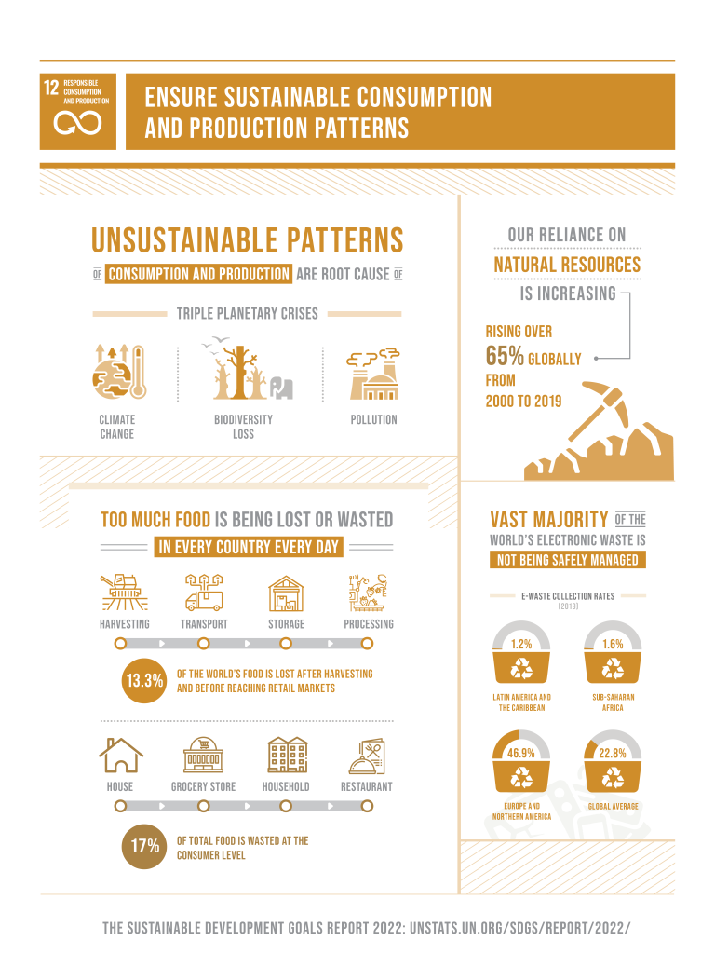
Keywords: industrialization, circular economy, equitable distribution, eco-design, life cycle analysis, extended producer responsibility

Slide 8
Status of the Challenge Globally
While strides have been made to reduce emissions from industrial activities in some countries, there are still many countries throughout the world that emit harmful levels of greenhouse gas emissions. Waste from manufactured products has formed two large collections of marine debris known as the Great Pacific Garbage Patch which are still growing. Natural resources continue to be consumed at an unsustainable rate.

Slide 9
Status of the Challenge in Canada
Economics and Inclusivity
Manufacturing is one of the single largest contributors to the Canadian GDP. It currently accounts for 68% of all Canada’s merchandise exports and provides over 1.7 million jobs to Canadians across the country (Canadian Manufacturing Sector Gateway, 2021). The value of industrialization is apparent; however, the profits are not always equitable. Economic growth does not mean success if it amplifies inequalities. Canada currently has industrial policy and is investing public dollars, it is merely a question of whether the policy will be implemented effectively (An inclusive industrial policy for Canada, 2021).

Slide 10
Status of the Challenge in Canada
Sustainability
Industry is clearly very important to Canada; however, it comes with its own set of drawbacks for the environment. In 2020, heavy industry accounted for 10.6% of total Canadian greenhouse gas emissions. Progress has been made in recent years to reduce the emissions from industry, and 2020 was the lowest year for industry emissions in Canada since 2009 (Greenhouse Gas Emissions, 2022). Canada is also pushing towards creating a circular economy. A circular economy is one that converts waste from one application into inputs for another process. The global economy was estimated to be 6% circular in 2005 (Willi Haas, Fridolin Krausmann, Dominik Wiedenhofer, and Markus Heinz, n.d.). The current lack of a circular economy is producing industrial waste at an unsustainable rate.

Slide 11
Roadblocks to Success
Inclusive and sustainable industrialization is achievable, but there are several challenges that have barred this achievement from already being completed. From the perspective of the producer, environmental benefits do not often line up with what would be financially optimal. Lack of legislation and regulations on end-of-life responsibilities allow producers to take environmental shortcuts. Legislation also currently fails to provide incentive programs that guide sustainable economic development. Even if a producer wanted to be completely environmentally friendly, it can often be difficult. One issue is that many products are complex in both the number of materials used and in how they are integrated. This can make it challenging for products to be recycled or reused efficiently. Recycling also takes energy, meaning it still has an environmental impact. Additionally, recycling often degrades material quality. From a consumer standpoint, not everyone cares enough to recycle their used goods, and lack of understanding about recycling can lead those who do care to improperly recycle.

Slide 12
Strategies to Meet 2030 Targets
To address the challenge of practising inclusive and sustainable industrialization, Engineering Deans Canada have identified the following strategies (EDC-DDIC, 2022):
Contributing to the circular economy where waste products become input to produce other value-added products.
Improving research and teaching on eco-design as well as ways to predict or forecast when an outcome that occurs is going to be later recognized as a large problem.
Suppressing waste in all stages of industrialization and production.
Recycling and reusing products we make.
Designing for sustainability, recyclability and biodegradability of all the products we produce.

Slide 13
Strategies to Meet 2030 Targets
To address the challenge of practising inclusive and sustainable industrialization, Engineering Deans Canada have identified the following strategies (EDC-DDIC, 2022):
Including both energy and water use in life cycle analyses carried out for products.
Digitizing and collecting product use data in our daily lives and industrial practices that can be used for life cycle analysis.
Improving efficiency of resource use.
Adding extended producer responsibility for products which are manufactured and used.
Adding more legislation and regulatory frameworks to realize the implementation of all these priorities.

Slide 14
References
EDC-DDIC. (2022, May 6). Canadian Engineering Grand Challenges (2020-2030). Engineering Deans Canada. Retrieved February 23, 2023, from https://engineeringdeans.ca/en/canadian-engineering-grand-challenges-2020-2030-inspiring-action-to-improve-life-for-canadians-and-the-world/
United Nations (2023). The 17 Goals, United Nations Department of Economic and Social Affairs, Sustainable Development. Retrieved February 27, 2023, from https://sdgs.un.org/goals
Willi Haas, Fridolin Krausmann, Dominik Wiedenhofer, and Markus Heinz. (n.d.) How Circular is the Global Economy? An Assessment of Material Flows, Waste Production, and Recycling in the European Union and the World in 2005, Journal of Industrial Ecology, Vol 19, No. 5, 2015, 765-777. https://onlinelibrary.wiley.com/doi/full/10.1111/jiec.12244

