Slide 1
South Africa: Realities of a New Democracy
Sally Hooper ©Copyright (2013) all rights reserved.

Slide 2
Research Question
From the community’s perspective, does this small space--an early childhood education and care centre in an emerging democracy--offer opportunities for participation in and enhancement of democratic life?

Slide 3
Research Goals
Through a qualitative research approach, the aims of this study were
to uncover meanings others have about their world (Creswell, 2007)
to hear “their side of the story in their own words” (Dei, 2008)
to address “the need . . . to heed the voices emerging from the South (Crossley & Wason, 2003)

Slide 4
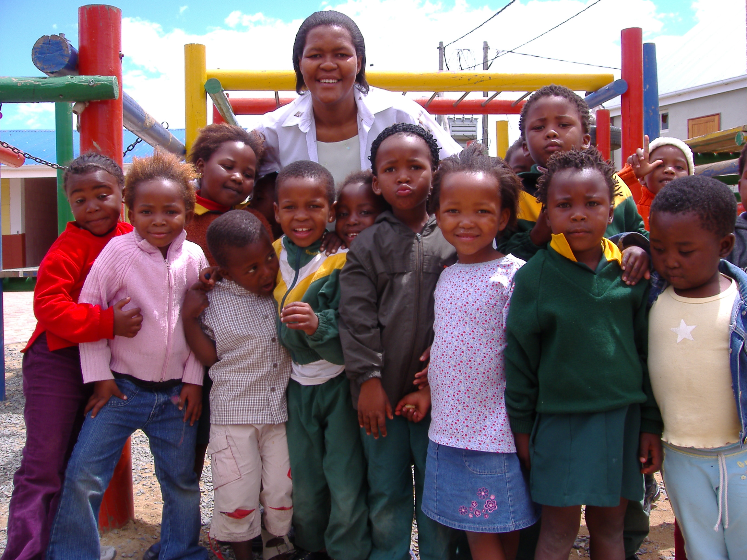
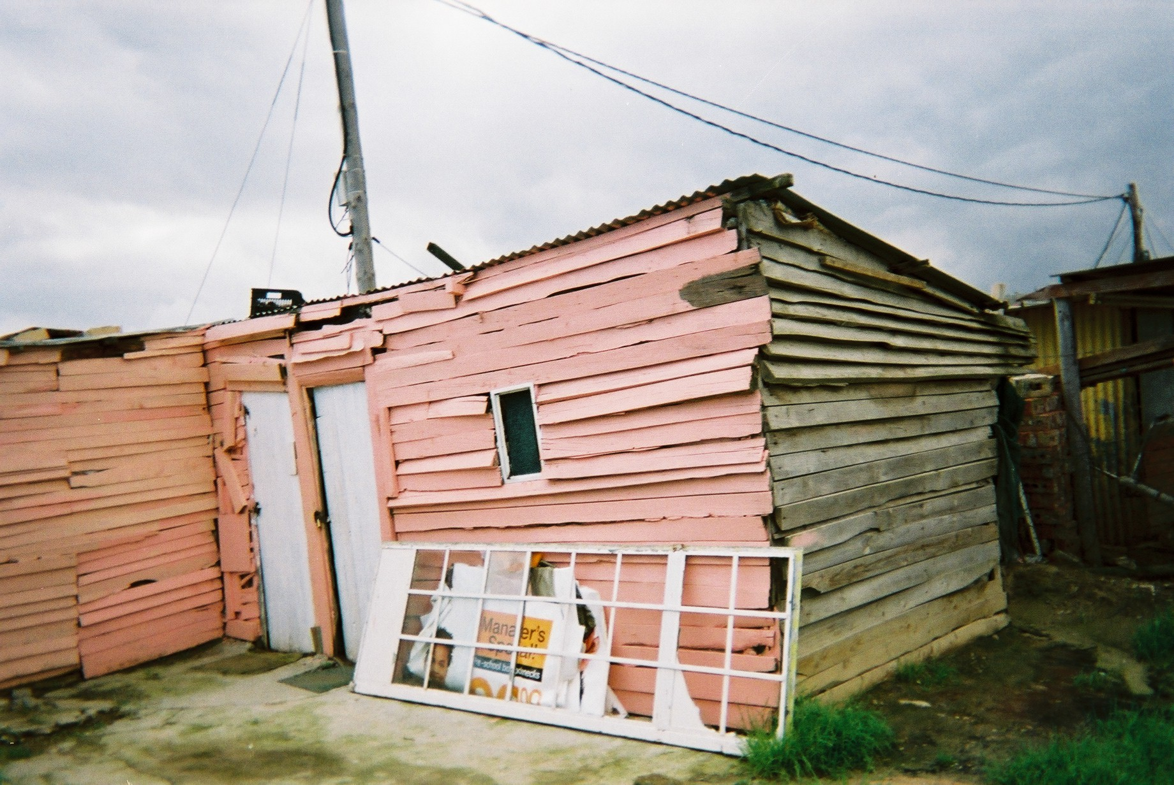
Research Site:
A Pre-School in a Township
on the Cape Flats
‘Formal’ houses built in townships after 1994
To alleviate housing shortages, shacks still exist in townships
A teacher and pre-school children

Slide 5
South Africa: The Legacy of Apartheid
South Africa, a middle income country, has a sophisticated infrastructure, a well developed private sector, and stable macro economy, but the majority suffer from continuing inequalities:
income
access to quality education
employment opportunities
access to quality health care
Notes:
Post colonial lens: The experience of colonization needs to be re-narrated from the viewpoint of the colonized, recognizing the impact of colonization on people’s identities, cultures, claims to indigenous knowledge, their experiences of racism, and the ongoing effects of a relationship built on oppression and violation of basic human dignity,
While the pre-colonial past cannot be recreated, the inequities of the past need to be identified in order for peoples to discover how they may potentially be change agents in their own future destinies (Odora Hoppers, 2004; Preece, 2009).
POPULATION: over 50 million
Children aged 0 to 13 years constitute almost 30% of the population; 3.5 million orphans
INCOME: 35% of the population lives on less than $2.50 a day
SA has experienced a decline in poverty largely as a result of a significant income transfer program – 14 million recipients of income support
EMPLOYMENT: Unemployment hovers around 25%. An exceptionally large number of non-working people depend on each employed person.
EDUCATION - Adult literacy 89%
Life expectance 1990 61 years
Life expectancy 2009 52 years

Slide 6
Framework for Mapping Outcomes of Community Engagement
In a meta-case analysis of 100 studies in a ten-year research program, Gaventa and Barrett (2010) map the observable effects of citizen participation.
What are indicators of change?
How can we measure success of change across different contexts?
Whose reality counts when deciding which change is most meaningful?
Notes:
DATA ANALYSIS; BARRETT & GAVENTA’S TYPOLOGY
The first outcome identified by Gaventa and Barrett (2010) is the construction of citizenship where positive outcomes include increasing knowledge, awareness of and capacity for participation, as well as a greater sense of efficacy-- a belief and confidence in one’s ability.
On the other hand, knowledge or awareness may be disempowering, exclusive, tokenistic, coerced, or rely heavily on intermediaries (e.g., professionals, local elites).
Gaventa and Barrett (2010) contend that in communities with embedded inequalities and strained social relations, citizen engagement may lead to enhanced forms of social cohesion.
A second outcome of citizenship engagement is the development cohesive communities where a sense of inclusion, dignity, and respect exist.
At the same time, networks and alliances deepen at both the personal and institutional level.
Where social dynamics are not taken into account and particular groups are excluded, participation may have little effect on genuine community cohesion.

Slide 7
Questions & Data Collection
Learning/
Citizenship
Has parental and community participation in this space fostered increased knowledge, awareness of and capacity for participation, and a sense of agency?
Decision Making
Has parental and community decision making in this space played a role the development of a cohesive community where a sense of inclusion, dignity and respect exist?
Sources of Evidence
Interviews
- parents
- members of School
Governing Body
- members of local
community
- members of
broader
community
- government officials
Observations
- Parent & SGB
meetings
Planning &
evaluation meeting
Document review
- agendas, minutes,
notes of meetings
- newsletters &
newspapers
Sources of Evidence
Interviews
- parents
- principal & school
staff
- volunteers
Observations
- parent/
teacher meetings
- classrooms
Document review
- agendas, minutes,
notes of meetings

Slide 8
Outcomes of Community Engagement in This Preschool (adapted from Gaventa & Barrett, 2010)
Increased knowledge: Adult learning within the pre-school
Parent: Now I can help my child learn.
Awareness of and capacity to participate/act
Parent: We’ve got a voice. We’ve got that right!
Greater sense of agency/efficacy
Junior Teacher: Before I found this school, I never knew how much I could do. I believe now that I have a vision of what I can do. I have passed my level 5, and I am now a teacher. I am strong and can help my children and my community.

Slide 9
Citizenship & Adult Learning
‘a safe place’
‘a place of healing’
‘before this place there was no light’

Slide 10
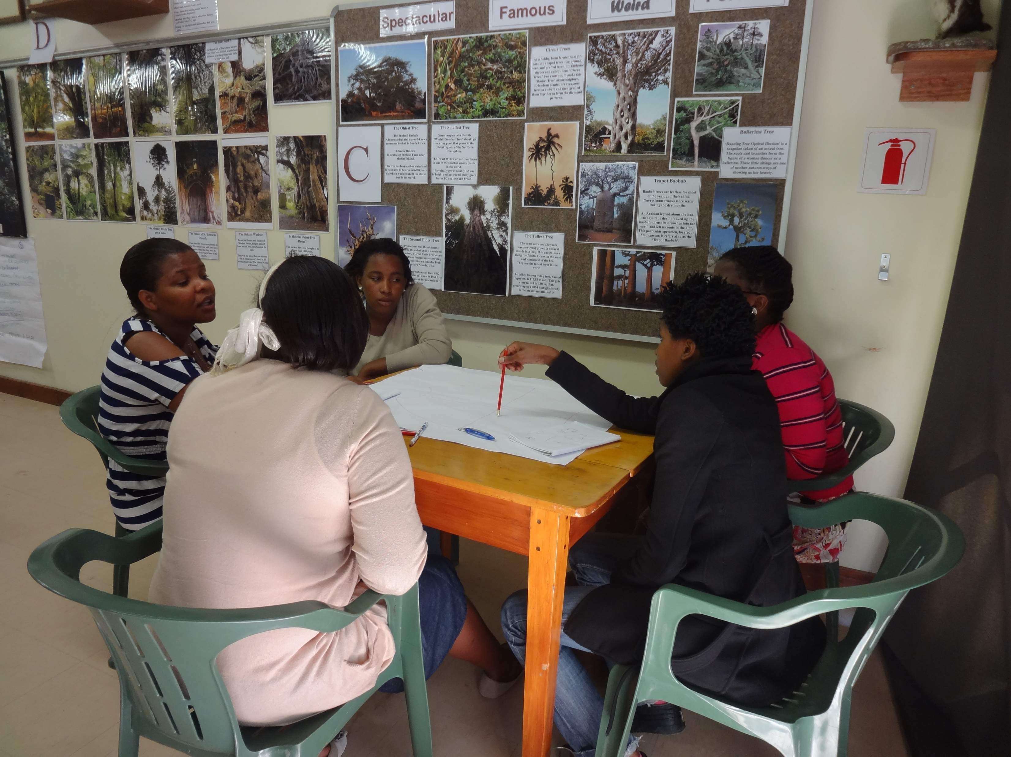
Decision Making - Sense of Agency & Dignity
Pre-school staff planning programs and budgets for the following school year

Slide 11
Conclusion
Generally, perceptions of the community were that their participation in this pre-school is resulting in changes and learning that satisfy their own needs and aspirations.
However, while this space offers opportunities for participation in the local and wider community, participants articulated their sense
of minimal improvements in their economic and social conditions, and
of their continuing limited ability to influence decisions at a regional and national level
Notes:
Differences exist between the more individualistic young people and their traditional parents. Is this a result of the attainment of freedom in 1994
My initial findings show differences between younger people and their traditional parents.
Although retaining many of the old Xhosa beliefs, the younger people understand and are attracted to western principles of material ambition and individualism that seem to make them a more confident.
How are these people adapting to the new realities of a democratic SA?
Gaventa and Barrett (2010) contend that participation in associations and social movements together is more important for positive development and democratic outcomes than had been previously understood and make a case for examining the potential role of local associations in building citizenship and gaining government responsiveness in poorer, less democratic countries of the South. GAP

Slide 12
Realization of a Community’s Dream
https://www.youtube.com/watch?v=f8NQTlGy8_8
https://www.youtube.com/watch?v=hIFZESzc2kc

Slide 13
References
Dei, G. J. S. (2008). Rethinking African education and the African indigenous system of thought. In S. N. Dlamini (ed.) New directions in African education: Challenges and possibilities (pp. 229-249). Calgary, AB: University of Calgary.
Creswell, J.W. (2007). Qualitative inquiry and research design: Choosing among five approaches (2nd ed.). Thousand Oaks, CA: Sage.
Crossley & Watson. (2003). Comparative and international research in education: Globalisation, context and difference. London and New York: Routledge Falmer.
Gaventa, J. & Barrett, G.(2010). So what difference does it make? Mapping the outcomes of citizen engagement. IDS Research Summary of IDS Working Paper 347.

