Slide 1
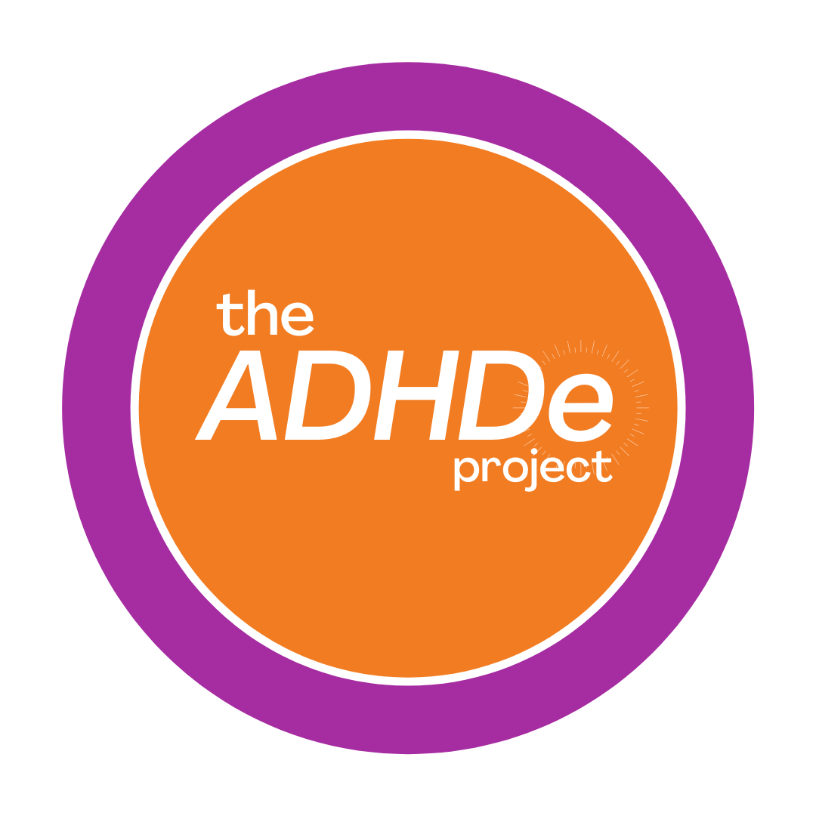
The ADHDe Project
PD workshop

Slide 2
Rules of engagement
We acknowledge the subject may be difficult for participants to discuss
Confidentiality; share learnings, not personal stories/identities/experiences of others.
Centre the importance of lived experience
Work together to create space for folks to engage authentically and honestly
Share the air; be mindful of how you take up space today
Guilt and shame
Discriminatory comments will not be tolerated
Notes:
Before we begin our workshop today, we would likely to briefly discuss the rules of engagement for this session. Fostering a supportive learning environment is a shared responsibility. Please note the following:
We acknowledge the subject may be difficult for participants to discuss
Confidentiality; share learnings, not personal stories/identities/experiences of others.
Centre the importance of lived experience
Work together to create space for folks to engage authentically and honestly
Share the air; be mindful of how you take up space today
Guilt and shame: we know folks are in different places/spaces with learning and that some may be managing these emotions as they reflect, consider next steps, and move forward in concrete ways
Discriminatory comments will not be tolerated

Slide 3
What We Will Cover Today
Who We Are
The AODA
An Introduction to ADHD
ADHD and Intersectionality
Diagnosis
Accessibility Barriers
How to be Supportive
Notes:
Before we jump in, here is a brief overview of what we will be covering today!
Who We Are
The AODA
An Introduction to ADHD
ADHD and Intersectionality
Diagnosis
Accessibility Barriers
How to be Supportive

Slide 4
Who We Are
The ADHDe Project is a student-led initiative that promotes inclusion and respect for students who have been diagnosed with ADHD or identify as neurodiverse.
This project was created to:
Destigmatize ADHD and neurodiversity on campus
Provide students with resources and support,
Promote a welcoming environment at the University of Windsor.
Notes:
The ADHDe Project is a student-led initiative that promotes inclusion and respect for students (especially those at the post-secondary level) who have been diagnosed with ADHD or identify as neurodiverse. This project was created to destigmatize ADHD and neurodiversity on campus, provide students with resources and support, and promote a welcoming environment at the University of Windsor. We recognize how difficult navigating university life can be for anyone, and sometimes more so for students who identify as neurodiverse or have ADHD. The ADHDe Project was produced by The University of Windsor and The Learning Disabilities Association of Windsor Essex with support from the Government of Ontario.

Slide 5
What’s with the “e”?
Education
Equity
Empowerment
Notes:
The name The ADHDe Project represents the three “e’s” of our mission; education, equity and empowerment. We believe that by amplifying the voices of people with ADHD we will be able to create a more inclusive and accessible campus.

Slide 6
The EnAbling Change Program
It is a grant program run by the Ministry for Seniors and Accessibility.
Encourage education about accessibility and encourage awareness about its benefits.
Thanks to the support from the EnAbling Change Program, The ADHDe Project was able to become a University wide accessibility initiative.
Notes:
The ADHDe Project was made possible by a grant from The EnAbling Change Program, which is a grant program run by the Ministry for Seniors and Accessibility.
The goals of the EnAbling Change Program are to encourage education about accessibility and encourage awareness about its benefits.
Thanks to the support from the EnAbling Change Program, The ADHDe Project was able to become a University wide accessibility initiative.

Slide 7
Accessibility Regulations
Notes:
When discussing accessibility and inclusion in Ontario, it is important to mention the AODA and the OHRC.

Slide 8
Accessibility Regulations
Educational institutions in Ontario have an obligation to adhere to two sets of regulations
The Ontario Human Rights Code:
Maintaining accessible, inclusive, discrimination and harassment-free education environments that respect human rights.
The Accessibility for Ontarians with Disabilities Act:
The AODA established the Integrated Accessibility Standard Regulations (IASR), a grouping of legal requirements that institutions must follow to help identify, remove, and prevent barriers faced by persons with disabilities. These requirements are divided in two categories: General Requirements and Accessibility Standards.
Sourced From: Universal Design for Learning (UDL) for Inclusion, Diversity, Equity, and Accessibility (IDEA) by Darla Benton Kearney
Notes:
Educational institutions in Ontario have an obligation to adhere to two sets of regulations, the Ontario Human Rights code (OHR) and the Accessibility for Ontarians with Disabilities Act (AODA).
The OHRC: Maintaining accessible, inclusive, discrimination and harassment-free education environments that respect human rights.
The AODA: The AODA established the Integrated Accessibility Standard Regulations (IASR), a grouping of legal requirements that institutions must follow to help identify, remove, and prevent barriers faced by persons with disabilities. These requirements are divided in two categories: General Requirements and Accessibility Standards. The Act was put into place in 2005, with the intention of creating a fully accessible Ontario by 2025.

Slide 9
Understanding ADHD
Notes:
To help everyone feel comfortable and informed about the topics we’ll be covering today we will start by discussing some of the concepts and terms that are key to this project. We hope that these carefully defined concepts and terms will give you a better understanding of the barriers, circumstances, and realities that students with ADHD experience.

Slide 10
Key Concepts and Terms
ADHD: Stands for Attention Deficit/ Hyperactivity Disorder. ADHD is a neurodevelopmental disorder. The three core symptoms of ADHD are: inattention, impulsivity, and hyperactivity.
Neurodiverse: Refers to a group of people who are neurologically diverse. This can include people with ADHD and people without ADHD.
Disability: Personal experience of barriers to participation in all aspects of society.
Invisible Disability: A disability that you might not be able to perceive when you first meet someone.
Notes:
ADHD: Stands for Attention Deficit/ Hyperactivity Disorder. ADHD as a neurodevelopmental disorder. The three core symptoms of ADHD are: inattention, impulsivity, and hyperactivity. There are three types of ADHD: inattentive type, hyperactive type, and combined type, which we will be covering later in the presentation.
Neurodiverse: Refers to a group of people who are neurologically diverse. This can include people with ADHD and people without ADHD. For example: “They are a neurodiverse family. There are two children and a parent who have ADHD, and one child and one parent who do not have ADHD”.
Disability: Personal experience of barriers to participation in all aspects of society.
Invisible Disability: A disability that you might not be able to perceive when you first meet someone.

Slide 11
Key Concepts and Terms
Executive function: set of skills that we use to navigate everyday life. Includes time management, self-control, flexible thinking, emotional regulation, etc.
Overstimulation: feeling extremely overwhelmed by a surplus of stimulating sensations such as loud music, certain textures, certain tastes, bright lights, etc. This can cause an emotional response.
Accessibility Barrier: An accessibility barrier is an obstacle or hurdle that prevents a person with a disability from participating in all aspects of society.
Notes:
Executive function: set of skills that we use to navigate everyday life. Includes time management, self-control, flexible thinking, emotional regulation, etc.
Overstimulation: feeling extremely overwhelmed by a surplus of stimulating sensations such as loud music, certain textures, certain tastes, bright lights, etc. This can cause an emotional response.
Accessibility Barrier: An accessibility barrier is an obstacle or hurdle that prevents a person with a disability from participating in all aspects of society. There are five types of accessibility barriers: physical/architectural, informational/communicational, technological, attitudinal, and organizational.

Slide 12
What is ADHD?
ADHD is often defined as a neurodevelopmental disorder. Common symptoms include:
Hyperactivity
Inattentiveness
Impulsivity
Many people with ADHD excel at creative problem solving, are exceptionally empathetic and often have a strong sense of fairness.
Many children and adults with ADHD have other co-associated conditions, like Learning Disabilities, ODD, Anxiety, or Depression.
There are effective psychological, educational, and medical supports available for people with ADHD.
Notes:
There has been a shift in ADHD terminology and labelling. Sometimes controversial. As a team we worked together to present an equitable and inclusive understanding of ADHD. Attention Deficit/Hyperactivity Disorder, ADHD, is often defined as a neurodevelopmental disorder. Common symptoms include hyperactivity, inattentiveness, and impulsivity. Many people with ADHD excel at creative problem solving, are exceptionally empathetic and often have a strong sense of fairness. Many children and adults with ADHD have other co-associated conditions, like Learning Disabilities, ODD, Anxiety, or Depression. There are effective psychological, educational, and medical supports available for people with ADHD. Some of the supports available are therapies, medication, support groups, educational programs, accommodations.

Slide 13
Hyperactive, Inattentive, Combined
There are three ways ADHD can present:
Hyperactive type
Inattentive type (Inattentive type was traditionally referred to as ADD, attention deficit disorder)
Combined type
Cisgender men are more likely to be diagnosed with Hyperactive type ADHD
Cis women are less likely to receive a diagnosis as a child and are more likely to be diagnosed with Inattentive type ADHD.
ADHD is NOT a gender-specific disorder.
Notes:
ADHD presents in different ways, depending on the individual. There are three main classifications of how ADHD can present. Hyperactive type, inattentive type, and combined type. Inattentive type was traditionally referred to as ADD (attention deficit disorder). Cisgender men are more likely to be diagnosed with Hyperactive type ADHD when compared to cisgendered women. Cis women are less likely to receive a diagnosis as a child and are more likely to be diagnosed with Inattentive type ADHD. ADHD is NOT a gender-specific disorder.

Slide 14
Common Symptoms
Common Inattentive Type Symptoms
Day dreaming
Hyper focusing
Easily distracted by small stimuli
Struggles with paying attention
Struggles with organization and time management
Excels at creative problem solving
Emotionally sensitive and struggles with rejection
Common Hyperactive Type Symptoms
Fidgeting, constant movement
Impatient
Struggles to control their volume
Very creative
Lots of physical and mental energy
Experiences intense crashes after exerting energy
May interrupt others
Notes:
Here are some examples of the most common Inattentive Type and Hyperactive Type symptoms.
Common Inattentive Type Symptoms:
Day dreaming
Hyper focusing
Easily distracted by small stimuli
Struggles with paying attention
Struggles with organization and time management
Excels at creative problem solving
Emotionally sensitive and struggles with rejection
Common Hyperactive Type Symptoms:
Fidgeting, constant movement
Impatient
Struggles to control their volume
Very creative
Lots of physical and mental energy
Experiences intense crashes after exerting energy
May interrupt others

Slide 15
Intersectionality
Notes:
When discussing ADHD, it is important that we think about intersectionality.

Slide 16
Intersectionality
Intersectionality is a concept made known by Kimberlé Crenshaw.
Intersectionality acknowledges that everyone has their own unique experiences, and their identities play a role in how they experience the world.
It’s important to take into consideration how a person’s identities such as race, gender, sexuality, ability, etc. may intersect with one another.
Notes:
Intersectionality is a concept made known by Kimberlé Crenshaw. It acknowledges that everyone has their own unique experiences, and their identities play a role in how they experience the world. Because of that, it’s important to take into consideration how a person’s identities such as race, gender, sexuality, ability, etc. may intersect with one another.

Slide 17
Intersectionality
Some examples of intersecting identities may include:
Race
Gender
Sexuality
Ability
Notes:
Some examples of intersecting identities may include:
Race
Gender
Sexuality
Ability
For example, women with ADHD are less likely to be diagnosed with ADHD than their male peers. Women are often diagnosed later in life and often struggle to receive accessibility accommodations and support.

Slide 18
Diagnosis
Notes:
Before we look at the benefits and challenges of an ADHD diagnosis, are there any questions?

Slide 19
Why is a diagnosis important?
Obtaining a diagnosis can help individuals with ADHD better understand their circumstances. The absence of diagnosis may leave people wondering why they:
Have difficulty creating and maintaining healthy relationships.
Difficulty with executive functioning leading to issues at home, work, social life, and wealth management.
An increase in stress and anxiety
Struggle with addiction and substance abuse.
A diagnosis also helps to obtain qualification for resources and supports. This includes access to supports such as mental health supports, academic accommodations, medications, and familial support.
Notes:
A big part of understanding ADHD and how to support people with ADHD is learning about the diagnosis process. Obtaining a diagnosis can help individuals with ADHD better understand their circumstances. The absence of diagnosis may leave people wondering why they:
Have difficulty creating and maintaining healthy relationships.
Struggles with addiction and substance abuse.
Difficulty with executive functioning leading to issues at home, work, social life, and wealth management.
An increase in stress and anxiety
After receiving a diagnosis, the individual is then able to reap the benefits. Diagnosis also helps to obtain qualification for resources and supports. This includes access to supports such as mental health supports, academic accommodations, medications, and familial support.

Slide 20
What are the potential barriers to a diagnosis?
There are barriers in place that make it difficult to receive a diagnosis:
A lack of funding for diagnostic tools (testing may be up to $2500)
Many professionals also don’t truly understand ADHD or the affect it has on day-to-day life.
ADHD can be difficult to diagnose
Notes:
It is important to understand that there are many potential barriers to getting an ADHD diagnosis. These barriers can make it difficult to receive a diagnosis and may discourage people from pursuing support.
A lack of funding for diagnostic tools (testing may be up to $2500)
Due to the stigma surrounding ADHD, many professionals also don’t truly understand ADHD or the affect it has on day-to-day life. As a result, ADHD is often undiagnosed or misdiagnosed.
ADHD can be difficult to diagnose because it is considered an “invisible disability”. Because it can’t be seen at first glance it is more challenging to diagnose then an obvious physical issue, such as broken arm.

Slide 21
Barriers
Notes:
Unfortunately, the barriers experienced during the diagnosis process is only the tip of the iceberg. After being diagnosed with ADHD there are many potential challenges that a person may face as a result of their diagnosis.

Slide 22
Stigma and Barriers
The stigmatization of ADHD is relevant in every aspect of society.
Education
Work
Social settings
Social stigma can lead to self-stigma which limits individuals by promoting negative self-views and associations with their diagnosis.
The severity of stigma can be placed on a continuum depending on the individual’s intersecting identifying factors (gender, race, ethnicity, religion, age, etc.).
Notes:
One of these barriers is stigma, which is a negative stereotype about a person or group of people. The stigmatization of ADHD is relevant in every aspect of society. ADHD stigma can create challenges in education, work, and social settings. It’s also important to note that social stigma can lead to self-stigma which can be limiting as it promotes negative self-views and associations with their diagnosis. The severity of stigma can be placed on a continuum depending on the individual’s intersecting identifying factors (gender, race, ethnicity, religion, age, etc.).

Slide 23
Stigma and Barriers
People may assume you are going to be unreliable, lazy, less intelligent, a distraction or uncommitted.
A lack of understanding leads to a lack of support for people with ADHD
Medication, therapy and receiving a diagnosis can all be expensive and difficult to access.
Notes:
Additionally, once potential employers, colleagues or friends discover you have ADHD they may make assumptions based on what they’ve seen in the media. They may assume you are going to be unreliable, lazy, less intelligent, a distraction or uncommitted.
Lack of Support and Misunderstanding of ADHD and Neurodiversity: a lack of understanding lends itself to a lack of support for people who have ADHD and/or identify as neurodiverse.
These misunderstandings and lack of support creates additional barriers to achieving academic, professional, and social goals.
Medication, therapy and receiving a diagnosis can all be expensive and difficult to access.

Slide 24
Being Supportive
Notes:
So, what comes next? Now that we know the barriers that individuals with ADHD may face, how do we support them?

Slide 25
The importance of inclusivity & accessibility
By age 10, it’s estimated that children with ADHD have received 20,000 more negative messages than positive ones. (Source: attitude magazine)
Creating an inclusive space is key for helping people with ADHD thrive. This also encourages everyone to be more aware of how their actions may impact others and creates an environment that models’ inclusivity.
Notes:
Considering the external and internal struggles that people with ADHD can face, it’s no surprise that many experience depression, anxiety, and self doubt. By age 10, it’s estimated that children with ADHD have received 20,000 more negative messages than positive ones. (Source: attitude magazine). That is why inclusive and accessible spaces are so important. People with ADHD deserve to feel as supported and valued as everyone else, and it’s up to all of us to help foster those spaces. Creating an inclusive space is key for helping people with ADHD thrive. This also encourages everyone to be more aware of how their actions may impact others and creates an environment that models’ inclusivity.

Slide 26
Accessibility
ADHD is commonly referred to as an “invisible disability”. This means that when you first meet someone you may not be able to tell that they have ADHD.
When possible, provide meeting notes, lecture notes, or other content ahead of time.
Encourage alternative working or learning styles.
Use inclusive and respectful language.
When in doubt, ask! Always refer to the person with ADHD when implementing accommodations or supports.
Notes:
ADHD is commonly referred to as an “invisible disability”. This means that when you first meet someone you may not be able to tell that they have ADHD. Because of that, people with ADHD may have a difficult time working, learning, and socializing in places designed for people without ADHD. Here are some suggestions to help create a more accessible and respectful place for all people.
When possible, provide meeting notes, lecture notes, or other content ahead of time.
Encourage alternative working or learning styles.
Use inclusive and respectful language.
When in doubt, ask! Always refer to the person with ADHD when implementing accommodations or supports.

Slide 27
Inclusivity
Offer constructive criticism. Be aware of your tone and body language.
Overstimulation can cause a lot of emotional, mental, and physical stress.
ADHD is not inherently bad or good, is simply one neurotype.
Notes:
Promoting and creating an inclusive space helps to ease potential anxieties and worries that individuals may students may have. Inclusivity should be approached with a wide lens, with the goal of encouraging all identities to thrive and feel comfortable doing so. Here are some tips on how you can create a more inclusive environment for people with ADHD:
Offer constructive criticism. Be aware of your tone and body language. Many people with ADHD interpret neutral body language as being negative and so positive reinforcement is key.
In some cases, a person may struggle with overstimulation. This can cause a lot of emotional, mental, and physical stress. Allowing everyone a few minutes to refresh and reset after an intense conversation or situation can be helpful.
Remember that ADHD is not inherently bad or good, is simply one neurotype.

Slide 28
Looking Back & Going Forward
Notes:
We would like to thank everyone for their attendance and participation in this workshop thus far! Before we finish up for today, we’d like to take a moment to review some of the information we discussed today, as well as look ahead at some of the ADHD friendly practices that can be implemented right away.

Slide 29
What we covered today
ADHD is a neurodevelopmental disorder
Common symptoms may include hyperactivity, inattention, and impulsivity
Intersecting identities may impact a person’s experience with ADHD
Receiving a diagnosis can be challenging. There are upsides and downsides to a diagnosis.
People with ADHD may need additional supports or accommodations, and that’s ok!
When in doubt, try to refer to the person with lived experience.
Notes:
In a nutshell, here is what we covered today.
ADHD is a neurodevelopmental disorder. There are three presentations, inattentive, hyperactive and combined type.
Common ADHD symptoms may include hyperactivity, inattention, and impulsivity
Intersecting identities may impact a person’s experience with ADHD. These identities can affect a person’s ability to receive a diagnosis, access accommodations, navigate their social life and be accepted as who they are.
Receiving a diagnosis can be challenging. There are upsides and downsides to a diagnosis.
People with ADHD may need additional supports or accommodations, and that’s ok! Having accessibility accommodations does not diminish a person’s achievement.
When in doubt, try to refer to the person with lived experience. Often, the person who is needing the accommodation will have a good idea of what will work best for them.

Slide 30
Going Forward
Approach ADHD with curiosity.
Try not to make assumptions.
The language you use matters!
Notes:
Going forward, here are some of the things you can do to help make your office, department and social environment more accessible and respectful for people with ADHD. Firstly, approach ADHD with curiosity. If ADHD is a new topic for you, that’s ok! Creating inclusive spaces is not about knowing every little detail, it’s about being open to learning new things, and treating people with respect. Secondly, try not to make assumptions. The people in your lives with ADHD will rarely look like the stereotypes you see in the media. Thirdly, even if they haven’t disclosed it, you likely know people with ADHD. When discussing ADHD and neurodiversity, be conscious that the words you use matter. You never know what the person you’re speaking to may be experiencing, so always keep it respectful.

Slide 31
Post Session Survey
Thank you!
Notes:
Before we finish up, I’d like to invite everyone to participate in a brief survey about this mini presentation. Your feedback will allow myself and my team the opportunity to improve the presentation for future attendees. It shouldn’t take too long to complete! We will have posted the link in the chat, and can also send links via email upon request.

Slide 32
Thank you!
adhdeproject@uwindsor.ca
https://www.uwindsor.ca/ohrea/212/adhde-project
Notes:
We would like the thank The Office of Human Rights Equity and Accessibility for their support with this workshop and initiative, as well as The Learning Disabilities Association of Windsor-Essex, The University of Windsor, and the Government of Ontario. Most importantly, we would like to thank all of our attendees for being here today. Please feel free to contact us via email at any time or visit our website for more project updates and announcements.

