Slide 1

ACC PEER VISITOR TRAINING
Notes:
Servant’s heart
Go around and make introductions
Icebreaker - how about two truths, and a lie

Slide 2


Section 1: Peer Support
Notes:
In this section of the guide, you will be introduced to peer support in general with a further discussion about individual peer support also known as peer visiting. We will talk about why peer support is important when it can be done and what the benefits of peer support are for persons with amputation
Peer Support
Peer support is based on the relationship between people who have had a shared lived experience.
The philosophy of peer support is that each person has within themselves the knowledge of what is best for them as well as a strong desire to find a way towards improved wellness.
Peer support is based on a relationship in which each person is considered equal to the other. There is a focus on health and recovery as opposed to illness and disability.
Peer support can be provided in many ways including individual sessions, self-help groups, and online groups. Peer visitors provide one on-to-one support.
Peer Visitors
• A peer visitor is someone who has experienced a life-changing event (limb loss, or congenital limb deficiency), is living a full and productive life, and has completed a training program preparing him/her to visit another individual and his/her family facing a similar experience
Peer supporters listen, provide emotional support, and most importantly inspire hope.
A peer visitor volunteers to serve as a role model, offer emotional support and provide information about the resources available locally and nationally

Slide 3
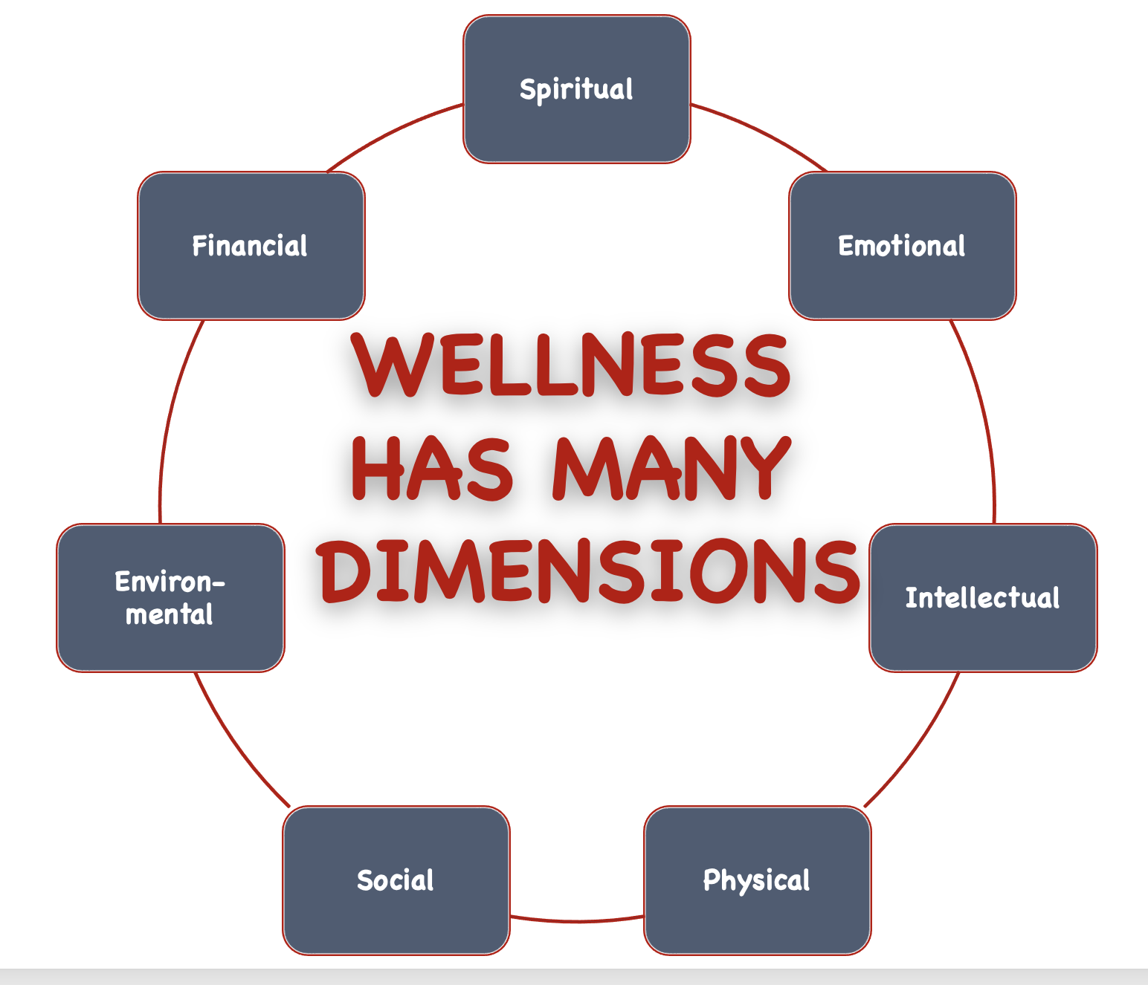
Health and Wellness
Notes:
● Peer support is focused on health [and wellbeing]. Wellness isn’t just physical, it is multi-dimensional and includes physical, emotional, and spiritual wellness. The following figure shows an 8-dimensional model of
wellness. Note that it even includes such things as financial wellness and environmental wellness.
• The World Health Organization (WHO) defines health as: “a state of complete physical, mental, and social well-being and not merely the absence of disease or infirmity (illness).”
• WHO defines wellness as: “the optimal state of health of individuals and groups,” and wellness is also described as “a positive approach to living.”
● A peer supporter is someone who has traveled a similar path to recovery and wellness and can relate to what the person they are visiting is going through. They can offer empathy (as opposed to sympathy) as well as validation. This conveys hope which is a key determinant of recovery and wellness.

Slide 4
Benefits of Peer Support
Group Discussion 1:
What do you think the short-term benefits of peer support are?
What do you think the long-term benefits are?
Notes:
● Peer support, during the rehabilitative process, can improve motivation and long-term health outcomes.
● It can help people stay in treatment, reduce hospital use, increase independence, and a sense of hope.
● Peer support can build a person’s self-confidence, sense of empowerment, and ability to function. It can also lead to improved physical, mental, emotional, and spiritual health

Slide 5
Benefits of Peer Support
Group Discussion 2:
What did you perceive to be the biggest benefit of peer support in your own amputation experience?
Notes:
Refer to Slides 3 and 4 for the group discussion as necessary
Discuss the following aspects as it relates to the question
Positive outcomes of peer support on well being: Direct, buffering and mediating
Direct benefits of peer support on well being
Lessens isolation and loneliness, promotes recovery etc…
Buffering effects of peer support on well being
Reduces harm caused by stressors, increasing coping strategy resources etc…
Mediating effects of peer support for well being
Positive reinforcement, role modelling etc…
Possible negative outcomes of peer supports
Conflict, criticism, emotional over-involvement etc…

Slide 6
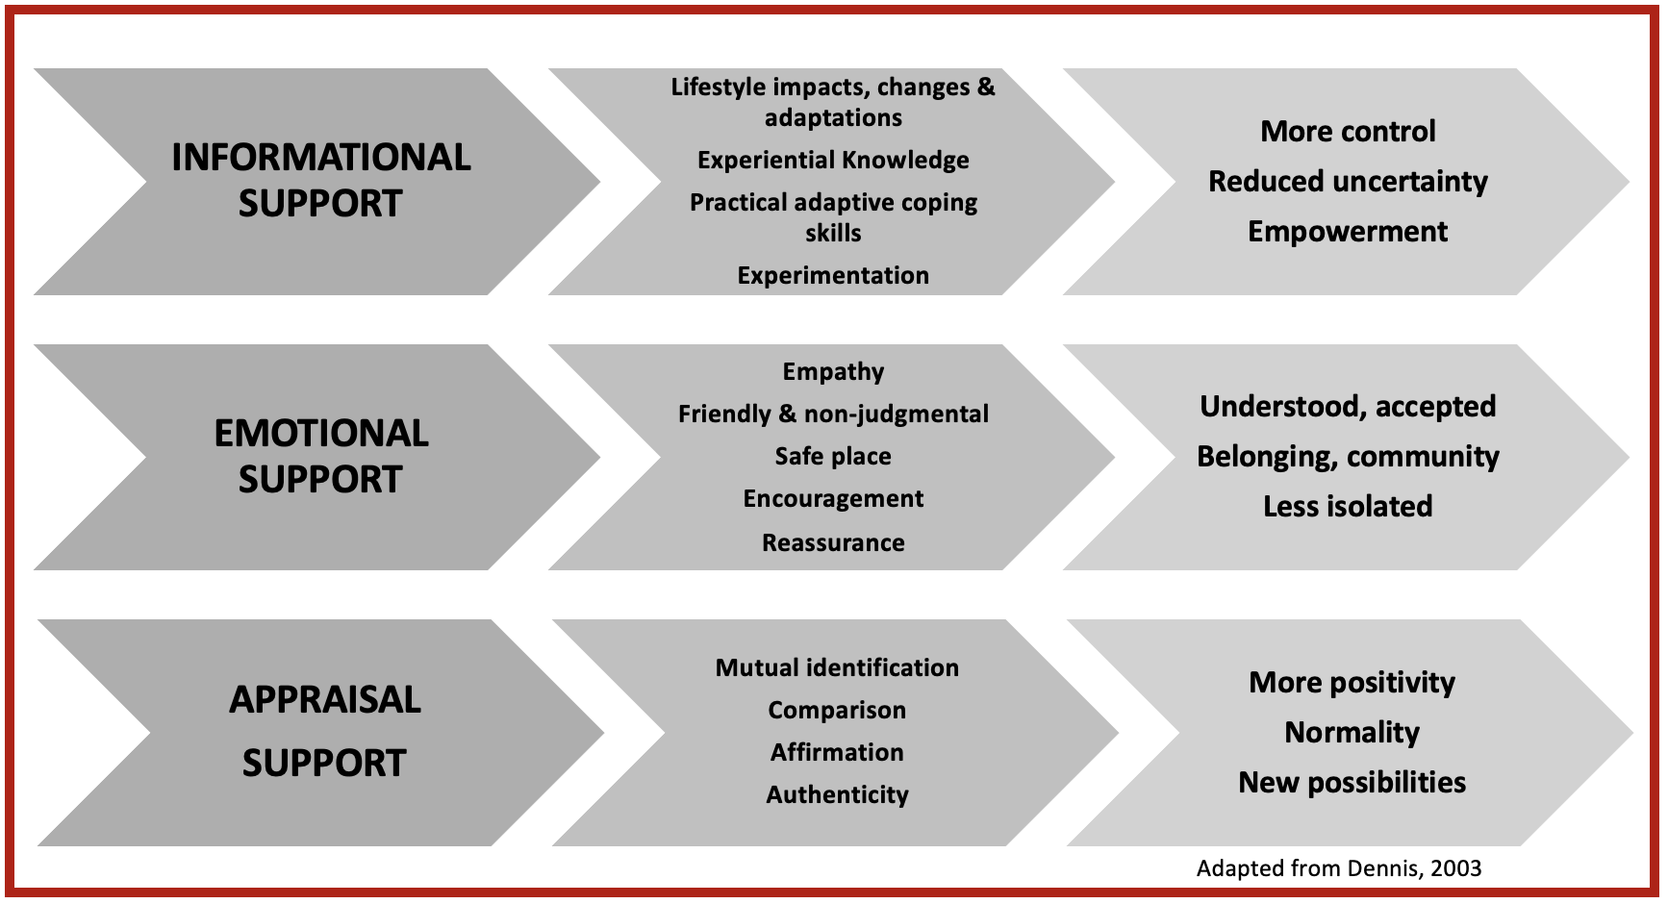
Attributes and Benefits of Peer Support

Slide 7
When could/can peer visiting be done?
Group Discussion 3:
If you had a peer support visitor, at what point in the amputation process did they play a role?
Notes:
Once Group discussion has been established – stop sharing screen for better discussion environment
The different ways peer support interactions can be facilitated
e.g individual sessions, online support groups, hospitals, walk in clinics etc
Peer support can be given at any point during or after the amputation process

Slide 8
When could/can peer visiting be done?
Group Discussion 4:
If you had a peer visitor, where did you meet with them?
  Did you find this place to be beneficial?
  If not, what could be improved?
Notes:
The different ways peer support interactions can be facilitated
e.g individual sessions, online support groups, hospitals, walk in clinics etc
Peer support can be given at any point during or after the amputation process

Slide 9

What is Peer Support & What is a Peer Visitor?
Notes:
Play video and discuss with key points to remember next slide

Slide 10
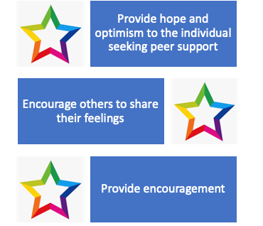
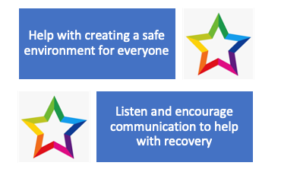
What is Peer Support & What is a Peer Visitor?
Notes:
Summarize and Discuss video in relation to these benefits
Describe key aspects of peer support
Different ways peer support can be provided: e.g self help groups, online groups
Aspects of a peer visitor
Requirements for becoming a peer visitor
What the role entails: e.g listen, emotional support, inspire hope
Why become a peer visitor
Why their unique experience can allow them to empathize in a way others cannot
Discuss the emotional outcomes of the Richardson Study for peer mentors

Slide 11
What is Peer Support & What is a Peer Visitor?
Role Playing Activity: Groups of 2
One person - peer support
One person with an amputation.
Act out how you would approach the individual and how you would get to know them.
Your goal is to try and figure out what their main concerns are and what resources they need
Separate into groupsof 2 persons to facilitate this role play.
Notes:
Read role playing activity out loud:
Split participants into breakout rooms of 2.
One person can be the peer support and the other can be the person with an amputation.
Act out how you would approach the individual and how you would get to know them.
Your goal is to try and figure out what their main concerns are and what resources.
Ensure each person in the group has a partner. Answer any questions prior to beginning
Allot approximately 5-10 minutes for the role play

Slide 12
What is Peer Support & What is a Peer Visitor?
Role Play Discussion:
Identify the strengths and weaknesses of your role play scenario.
What worked well?
What could be improved?
Notes:
Once Group discussion has been established – stop sharing screen for better discussion environment
Facilitate a group discussion that has participants
1) identify the strengths and weaknesses of their role play scenarios.
2) What worked well?
3) What could be improved? (Slide 9)
Offer appropriate ways in which they could initiate a therapeutic relationship with the amputee and what questions could be asked to facilitate an open conversation about their specific needs and goals

Slide 13

Section 2: Roles and Responsibilities
Notes:
The diverse roles of a peer support
e.g provide hope, encouragement and a safe welcoming environment etc…
The responsibilities of a peer support
e.g keeping on top of essential knowledge and skills, maintaining confidentiality etc…

Slide 14
Characteristics of a Peer Visitor
Good own recovery progress
Good listening skills
Understand and guide the person seeking support
Handle crisis situations
Provide appropriate Resources
Works within established boundaries
Notes:
Review Characteristics of a Peer Visitor – reference below
Have made progress in their own recovery journey
Have good active and sensitive listening skills
Understand and guide the person seeking support
Can identify and appropriately handle crisis situations
Are proactive in providing the person seeking support with ACC and other community resources and information
Understand the boundaries of a peer support visitor
Ask questions and for help when assistance is needed
Are approachable and easy to communicate with
Provide judgment-free care
Show respect, empathy, and compassion
Can acknowledge that the peer visitation is not about them and about the person seeking support
Are aware not to direct own beliefs onto the person seeking support

Slide 15
Characteristics of a Peer Visitor (continued)
Asks questions and for help when needed
Approachable and easy to communicate with
Provide judgment-free care
Show respect, empathy, and compassion
Peer visitation is not about them
Peer visitation is about the person seeking support
Does not direct own beliefs onto the person
Notes:
Review Characteristics of a Peer Visitor – reference below
Have made progress in their own recovery journey
Have good active and sensitive listening skills
Understand and guide the person seeking support
Can identify and appropriately handle crisis situations
Are proactive in providing the person seeking support with ACC and other community resources and information
Understand the boundaries of a peer support visitor
Ask questions and for help when assistance is needed
Are approachable and easy to communicate with
Provide judgment-free care
Show respect, empathy, and compassion
Can acknowledge that the peer visitation is not about them and about the person seeking support
Are aware not to direct own beliefs onto the person seeking support

Slide 16

Peer Visitor Competencies
Hope
Flexibility and adaptability
Demeanour
Self-awareness and confidence
Interpersonal
Initiative and commitment
Communications
Critical thinking
Self-management and resiliency
Continuous learning and development
Notes:
Characteristics a peer support demonstrates
e.g have made progress in their recovery journey, provide judgement free care, is proficient in identifying and handling crisis situations etc…
Competencies essential for a peer visitor
List each competency and describe what actions and/or behaviors it implies
Competencies
Peer visitors should also have the following competencies (2016 PSACC National Certification Handbook):
Hope Peer visitors express confidence that others will be successful in their own personal journeys of recovery
Demeanour Peer visitors are sensitive to what others might be feeling, have a capacity for non-judgmental empathy, and respond from an equal, genuine, and sharing point of view
Interpersonal relations Peer visitors honour the dignity of others and strive to build positive, respectful relationships
Communications Peer visitors listen with empathy and without judgment holding the person they’re visiting within unconditional high regard
Self-management and resiliency Peer visitors understand the importance of self-care and stress management. They model practices that work best for them to remain healthy while they support others.
Flexibility and adaptability Peer visitors are open to new ideas, deal comfortably with ambiguity, and adjust plans and behaviours recording to the situation.
Self-awareness and confidence Peer visitors interact in a manner that demonstrates a balance of self-confidence with openness to the opinions of others. They are able to self-reflect and understand that their personal thoughts and attitudes can affect their behaviours and their actions
Initiative and commitment peer visitors are dependable and carry their commitments to completion
Critical thinking Peer visitors are able to engage in active listening to better understand the situation and to recognize that there is more than one way to view any shoe. They consider the possible implications or outcomes of their actions and when asked will help their peers to explore the outcome or possible consequences of various options.
Continuous learning and development Peer visitors approach their life and volunteer work in a curious manner, identifying areas where they were personal growth is needed; they also take advantage of any opportunities to learn and develop in the role.

Slide 17
Roles and Responsibilities of a Peer Visitor
Group Discussion Question:
Are there any other roles or responsibilities you think should also be included for a peer visitor?
Notes:
Once Group discussion has been established – stop sharing screen for better discussion environment
Refer to Previous 3 slides if necessary

Slide 18
Characteristics of a Peer Visitor
Fill in the Blanks:
When a peer visitor is open to new ideas, they are competent in ________________.
When they respond from an equal and sharing point of view, they are demonstrating a competent ________________.
A peer visitor who listens with empathy and without judgment is demonstrating competency in ________________.
Peer visitors who consider the outcomes of their actions are demonstrating ________________.
critical thinking
demeanor
communication
flexibility and adaptability
Notes:
Read the paragraph below omitting the fill in the blank words and have everyone write down what they think the blank space word should be filled with
When everyone has written down their answers ask volunteers to share what their answers are
Go over the correct answers
When a peer visitor is open to new ideas they are competent in communication.
When they respond from and equal and sharing point of view they are demonstrating a competent demeanor.
A peer visitor who listens with empathy and without judgment is demonstrated competency in critical thinking.
Peer visitors who consider the outcomes of their actions are demonstrating flexibility and adaptability.

Slide 19
What is and What is not Allowed
Scenario #1:
Peer visitor: Hello, how are you doing today?
Person with amputation: I’m doing okay, I think, I’m still getting used to my new leg
Peer visitor: I can totally relate, don’t worry it only took me 2 months to get used to mine.
Notes:
Have 2 volunteers act out the scenarios in front of the class
What peer support visitors are NOT
e.g licensed counsellors, therapists etc…
What peer support visitors are NOT to do
Force/coerce participation, make false promises etc…

Slide 20
What is and What is not Allowed
Group Discussion Questions:
Did the peer visitor demonstrate any inappropriate behaviour?
Why why this behaviour inappropriate?
What could have been done differently?
Notes:
Once Group discussion has been established – stop sharing screen for better discussion environment
Ask: Did the peer support person demonstrate any inappropriate behavior?
Ask: Why was this behavior inappropriate? What could have been done differently?
ANSWER: Yes, the peer support visitor demonstrated inappropriate behavior
REASONING: You cannot ever fully understand another’s experience no matter how similar, and talking about how fast the adaptation to your prosthetic was is not helpful to someone who is still in the adjustment process

Slide 21
What is and What is not Allowed
Scenario #2:
Peer support: Good morning! How are you feeling today?
Person with amputation: um..I don’t know, I think I'm making progress with my arm, but it still feels really weird, it's taking me a long time to pick up objects, and it's all just so frustrating
Peer support: That must be rough, I had a similar experience when I first started, do you want to hear my story?
Notes:
Discussion
Ask: Do you think the peer support persons actions were appropriate?
ANSWER: Yes, the peer support visitor demonstrated appropriate behavior
REASONING: Peer support involves demonstrating empathy with a new amputee not sympathy. They are not pretending to understand their experience and they ask before they share their own experience
Ask the class for 2 volunteers to participate in the second role playing scenario

Slide 22
What is and What is not Allowed
Group Discussion Question:
Do you think the peer support person demonstrated appropriate behaviour?
Notes:
Once Group discussion has been established – stop sharing screen for better discussion environment
Discussion:
Ask: Do you think the peer support persons actions were appropriate?
ANSWER: Yes, the peer support visitor demonstrated appropriate behavior
REASONING: Peer support involves demonstrating empathy with a new amputee not sympathy. They are not pretending to understand their experience and they ask before they share their own experience

Slide 23
Ethics – Principles of Practice
Peer visitors are:
Peer support is:
  Volunteers
  Hopeful
  Open-minded
  Nonjudgmental
  Empathetic
  Respectful
  Change facilitators
  Honest and direct
  Mutual and reciprocal
  Equally shared power
  Strengths-focused recovery
  Transparent
  Personally driven
Notes:
Explain and have general discussion of the Principles of Practise as described in their manuals

Slide 24
Ethics
Discussion Activity:
Select 2 principles of practice
Write on a piece of paper how you would ensure these principles are met during a visit
Take about 5 minutes to prepare
Discuss
Notes:
Tell the class: to select 2 principles of practice
Ask them to write on a piece of paper how they would ensure these principles are met during a visit
Give 3-5 minutes for them to finish writing and then ask the group to raise their hands if they want to share

Slide 25
Ethics
Question #1:
True or false, peer visitors exercise power to direct the person they are visiting to do what they know is best for the person?
Question #2:
True or false, peer visitors are able to respond emotionally and/or spiritually to what the other person is saying?
Question #3:
True or false, peer visitors may share their stories as they relate to the challenges of the person they are visiting?
Notes:
Present Questions as presented on the slide
Question #1 Answer: False
Question #2 Answer: True
Question #3 Answer: True

Slide 26

Section 3: Communication
Notes:
Supportive communication can be both verbal and nonverbal.
○ The main goal of supportive communication, in the context of peer support, is to achieve change in a situation while at the same time strengthening the relationship between the two people who are communicating.
Empathy
○ Empathy is listening with the intent to understand.
○ It is the ability to emotionally and intellectually understand another person’s reality, accurately perceive unspoken feelings, and communicate this understanding to the other person.
○ Empathy is defined as “the action of understanding, being aware of, being sensitive to, and vicariously experiencing the feelings, thoughts, and experience of another of either the past or present without having the feelings, thoughts, and experience fully communicated in an objectively explicit manner” or “the ability to share someone else’s feelings”.
Showing empathy is different than showing sympathy.
• Sympathy is “the feeling that you care about and are sorry about someone else’s trouble, grief, misfortune, etc.”
• Sympathy is a good gesture and may provide sufficient support however, empathy is seen as more effective when providing emotional support.
• Empathy fuels connection. Sympathy drives disconnection.

Slide 27

Body Language
Notes:
● Body language
○ Body language or nonverbal communication is important to compliment and regulate verbal communication.
• If these two forms of communication are incongruent the individual speaking usually follows the nonverbal cues of the listener.
• Posture and gait reflect feelings, emotions, self-judgment, and even health status. For example, sitting up straight may indicate confidence, whereas leaning forward may suggest the individual is listening and paying attention.
• Facial expressions convey emotions. It is possible to unintentionally convey a facial expression that is non-congruent with how one feels. If the other person analyzes this, however, it may lead them to think that a different emotion is being portrayed.
• For example, if the peer visitor is having a bad day and reflects this in their facial expressions while the person seeking support is having a conversation about their feelings, they may sense the peer visitor is upset with what they are saying.
○ Please be aware of your body language when communicating with your peer!
○ Watch the following short video on body language (2 minutes)
AFTER THE VIDEO
● Eye contact
○ During a conversation, maintaining eye contact is important. ■ It demonstrates that you are paying attention and are interested in what is being stated.
■ A lack of eye contact may display nervousness, anxiety, discomfort, or lack of confidence.
■ Optimally, eye contact is at the same eye level; standing over someone and looking down can be seen as being in authority. ■ It is also important to consider that interpretation of eye contact can be subjective based on culture. In Eastern cultures, it may come across as disrespectful.
● Touch
○ Touch is an important element of communication and has the ability to provide affection, emotional support, encouragement, tenderness and personal attention.
○ Offering a gentle or firm touch to the shoulder can provide feelings of comfort, reassurance, and empathy. However, be aware of inappropriate or uncomfortable touching and cultural differences!

Slide 28
Body Language
Raised eyebrows signal ________________.
Eye contact shows ________________.
Crossed legs are a sign of ________________.
Shaking leg signals ________________.
Voice rising or lowering suggests _____________.
Open arms signal ________________.
low receptivity
Interest
discomfort
Approachability
Anxiety
interest
Notes:
Read aloud to the class the below sentences without the fill in the blank word. Ask the class to write down the words that go in the blanks on their piece of paper. Once you have given them a few minutes, read aloud the correct answers so people can check their answers.
Raised eyebrows signal discomfort .
Eye contact shows interest.
Crossed legs are a sign of low receptivity.
Shaking leg signals anxiety.
Voice rising or lowering suggests interest.
Open arms signal approachability.

Slide 29

Active Listening
Notes:
1:28
● Communication is used to both share information and set the tone
● Successful communication helps the peer visitor and person being visited better understand each other. It creates the conditions for sharing feelings and ideas and solving problems.
LISTENING (SHOW VIDEO FIRST)
● Listening is part of communication but is often not done well
● Successful communication helps the peer visitor and person being visited better understand each other. It creates the conditions for sharing feelings and ideas and solving problems.
● We talk at a rate of about 150 words per minute, but we can listen at a rate of nearly 1000 words per minute; this leaves time for our minds to wander.
● overestimate our skill as listeners. We fail to identify the need to improve our listening skills. Listening skills are essential for a peer visitor.
● Active listening means being attentive to what an individual is saying both verbally and non-verbally. It enhances trust and facilitates communication. Non-verbal skills to facilitate active listening include: facing the individual, making eye contact, and having good posture.
● BARRIERS TO COMMUNICATION
○ Ask what people think might be barriers
● Interpersonal communications fail for many reasons. Often this is because the message is not received in exactly the way the sender intended it to be understood. It is important when you communicate receive feedback to check that your message has been understood. Barriers to communication include physical, emotional, language, and culture barriers. We’ll talk about language and culture in the next section.
● People communicate differently based on individual needs, strengths, and backgrounds. One individual may be very direct and concise in their language, while others need more time to get their message across and prefer to provide many details. Some people rely on visual stimuli and gestures, while others are keen on the use of tone and facial expressions. These variations can create communication obstacles when people with diverse communication styles are unaware of and don’t recognize the needs of the other party.
● Some people may find it difficult to express their emotions and some topics may be completely ‘off-limits’. These topics could include, but are not limited to, politics, religion, disabilities, sexuality and sex, racism, and any opinion that may be seen as unpopular.
● Physical barriers include hearing impairments, speech impediments, visual impairments, or other physical or mental differences. These can act as communication barriers, can cause difficulty in performing daily tasks, and can complicate interpersonal communication.

Slide 30

“Listening is a magnetic and strange thing, a creative force. The friends who listen to us are the ones we move toward. When we are listened to, it creates us, makes us on fold and expand”
KARL A. MENNINGER
“The word ‘listen’ contains the same letters as the word ‘silent’”
ALFRED BRENDEL

Slide 31
Communication Skills
Discussion Activity:
Create a list of open- and close-ended questions you can ask in different contexts.
Notes:
Ask the class to:
create a list of open and closed questions they can ask in different contexts.
You can start by noting the sorts of questions other people ask and whether those questions get productive or unproductive answers.

Slide 32

Cross-cultural Communication
Notes:
5:45
It is important to be aware that as a peer visitor you may be partnered with someone from a different cultural or ethnic background and to understand that the beliefs held by the individual may not align with yours and this needs to be respected.
○ For example, body language cues may differ across cultures and therefore, no assumptions should be made.
○ In addition to the challenge of bridging cultures in your communication, there may also be language barriers.
Cultural Barriers
● Cultures form the foundation of how we view the world and dictate much of our behaviour and mannerisms.
○ Because the guiding principles of cultures vary, they create cultural barriers that can impede people from understanding one another.
○ In some cultures, it is disrespectful to touch the hand of a stranger, while in others it is standard practice and polite to shake hands when meeting.
○ In one culture strong eye contact may be considered a sign of aggression and disrespect, while in others consistent eye contact is a sign of interest and engagement in a conversation.
● You can overcome cultural barriers to communication and embrace diversity by:
• Ensuring your conversation is clear and polite
• Learning about different cultures
• Sharing knowledge.
Language Barriers
● Think about the following:
■ Is there a common language? Is it English?
■ Is the person you are speaking with, able to understand the language/words?
■ Are you using jargon?
■ When someone’s primary language differs from your own, you may have trouble understanding one another.
● Idiomatic phrases or expressions, where the actual meaning differs from what is literally said, do not translate well among languages and cause misunderstandings.
○ Here are some strategies to improve communication when there are language barriers:
■ Speak slowly and clearly
■ Politely ask for clarification and avoid assuming that you’ve understood what has been said
■ Frequently check for understanding, both your own and the understanding of the person you’re visiting
■ Avoid idioms. An example of an idiom is be ‘out in left field’
■ Be careful of jargon including acronyms
■ Be specific
■ Be patient.

Slide 33

Silence: Silence is an Excellent Communication Tool
Notes:
2:11
Silence is not an absence of communication, it is an important communication tool.
● Silence is not just an absence of noise; it can be as important as speech as part of communication.
● Silence can be constructive but it can also be destructive.
○ Constructive silence moves a conversation forward.
○ Constructive silences can enhance communication and both promote and maintain an existing relationship.
○ Destructive silence shuts down communication and creates barriers that discourage speakers from expressing themselves.
● Excellent communicators know how to use silence when it’s effective or called for. They are attentive to the need and use of silence in a conversation.
● Here are three reasons to use silence in your communication:
• To communicate better. Silence forces you to be quiet and get your message across in fewer words. Fewer words can result in stronger messages.
• To hear what’s really being said. When you’re quiet you can focus on what the other person is saying as well as on their nonverbal, communication and really hear what is being “said”.
• To reach resolution faster. This primarily applies in work and professional situations but if you were in a problem-solving conversation with the person you’re visiting the use of silence may help you reach solutions more rapidly.

Slide 34

Practicing with Silence
Choose a partner.
Take a few seconds to silently look each other directly in the eyes.
Begin by saying a couple of sentences about something important to you.
You maintain direct eye contact the whole time, and before the other person is allowed to respond, 10 full seconds must elapse in total silence while you continue to hold eye contact.
Then the other person responds with a statement or a question, in one or two sentences.
Again, before you respond, you sit facing each other for another 10 seconds of eye contact and silence.
Go back and forth you go like this for about three to four minutes.
Notes:
Explain the exercise to the group
Sit facing another person who is willing to engage in a practice conversation with you. Start by taking a few seconds to silently look each other directly in the eyes. Then begin by saying a couple of sentences about something important to you. It doesn’t have to be your deepest thoughts or secrets (although it could be if you want), just something that you wouldn’t normally share in whatever context you are in. You maintain direct eye contact the whole time, and before the other person is allowed to respond, 10 full seconds must elapse in total silence while you continue to hold eye contact.
Then the other person responds with a statement or a question, in one or two sentences. And again, before you respond, you sit facing each other for another 10 seconds of eye contact and silence. Back and forth you go like this for about three to four minutes.

Slide 35
Silent Activity Discussion
What did you notice during this exercise?
How do you think silence like this can result in better therapeutic communication?
Notes:
Ask the groups what they noticed during this exercise? and how they think silence like this can result in better therapeutic communication?

Slide 36

Section 4: Recovery
Notes:
Your role as a peer visitor is to support the recovery of the person you are visiting.
· Recovery looks different for all of us and in this section, we will explore what recovery and coping mean.
· We will talk about the phases of recovery as well as the role of spirituality in the recovery process.
· The time it takes for one to recover from an experience like an amputation may be different from another individual.
· Recovery is a work in progress.

Slide 37
Signs of Recovery
A sense of balance in emotions and relationships
Awareness of abilities and limitations
Positive self-concept and a sense of accomplishment
Ability to get around in the environment
Participation in social, vocational and/or recreational activities
Setting Priorities
Notes:
● There are six signs of recovery (Livneh & Antonak, 1997):
• A sense of balance in emotions and relationships
• Awareness of abilities and limitations
• Positive self-concept and a sense of accomplishment
• Ability to get around in the environment
• Participation in social, vocational and/or recreational activities
• Setting priorities.

Slide 38
What impedes Recovery?
Issues related to the amputation
Individual characteristics
Personality traits
Characteristics of the physical and social environment
Notes:
● Many things affect recovery from any life change including amputation – remember, we are all different. Keep this in mind as you’re talking to the person with whom you’re visiting.
● These fall into four broad categories:
● 1) issues related to the amputation,
○ Whether the amputation is sudden or chronic
○ The level of the amputation
○ How day-to-day ability to function is affected
● 2) individual characteristics,
○ These include things like age, health, status, financial status, potentially even ethnic background
● 3) personality traits
○ Coping strategies before the amputation
○ Sense of control
○ Attitudes towards health and illness
○ Self concept and body image
○ Previous experience with coping with loss
● 4) characteristics of the physical and social environment.
○ Availability of such things as social support systems, appropriate medical care, access to services in the community, etc.

Slide 39
Discussion – Recovery Challenges
What did you feel was the greatest barrier to your recovery?

Slide 40
Phases of Recovery
Enduring | Surviving surgery and pain
Suffering | Questioning “Why me?”
Reckoning | Becoming aware of the new reality
Reconciling | Putting the loss in perspective
Normalizing | Reordering priorities
Thriving | Living life to the fullest
Notes:
● The amputation experience for many begins prior to surgery, with the decision to amputate, and ends when they have regained what the person perceives to be functional independence (Columbo et al, 2018). The definition of functional independence varies from person to person but is often based on their preoperative level of function. In the study by Colombo at al (2018), the post- amputation recovery period was described as having both early (up to six months) and late (six months or more) phases.
● The Amputee Coalition (of America) developed a model for recovery which includes phases from enduring to thriving. A modified version of this model is shown in the following table. The table includes the role of the peer visitor at each stage.
● A peer visitor’s role may be shaped by the stage a person is at:
○ ENDURING: Hanging on – may refuse a visit; your role - Silent companion, support family
○ Suffering: Feelings about the loss, denial, depression – your role: Listening, empathy, validating, supporting family
○ Reckoning: Coming to terms with the extent of the loss, accepting what is left with the loss; Your role - Referral for emotional support
○ Reconciling: Increased awareness of one's strengths and uniqueness, taking control of one's life, your role - Validation of feelings, referral to a support group
○ Normalizing: Allowing priorities other than the loss to dominate, your role Role model, validating information
○ Thriving: Being more confident, trusting in oneself. Your role – this is the stage that a peer visitor should be at your role Working side by side

Slide 41
Phases of Recovery
Group Discussion:
Did you experience all 6 phases of recovery?
If so, did you experience them in this order?
Notes:
· Recovery from amputation is an ongoing process and it's important to remember that everybody's journey is different.
· Recovery may not occur in a particular order either.
· Persons with amputation may move from one phase to the next and then back to an earlier phase.
· They might also skip one or more phases or one phase could overlap with another.
· Some people may not reach the highest level of recovery.
· Coping patterns also differ with each phase in the recovery process.

Slide 42
Phases of Recovery
Question #1:
True or false: Coming to terms with the extent of the loss is referred to as reconciling?
Question #2:
True or false: Everyone reaches the thriving stage of recovery?
Question #3:
True or false: Active listening with empathy is an appropriate action when your person is in the suffering phase of recovery?
Notes:
Question #1:
True or false, coming to terms with the extent of the loss is referred to as reconciling?
Answer: FALSE
Question #2:
True or false, everyone reaches the thriving stage of recovery?
Answer: FALSE
Question #3:
True or false, active listening with empathy is an appropriate action when your person is in the suffering phase of recovery?
Answer: TRUE

Slide 43
Coping – Scenario 1
You walk into the hospital room of a person who has just undergone an above knee amputation.
She was an avid biker prior to the accident, and you see her selling her collection of bikes and accessories online.
You ask her why she is doing this, and she shrugs and replies “I’m never going to be able to do what I love again so may as well get started on selling things”
Notes:
● Coping
○ Coping involves adjusting to or tolerating negative events or realities while maintaining a positive self-image and emotional equilibrium.
○ Coping occurs in the context of life changes that are perceived to be stressful.
● As much as an amputation affects the individual undergoing the amputation, it may also have an effect on the individual’s families and friends.
● Coping strategies
● Positive ways to cope with an amputation include:
• Acknowledging feelings
• Expressing negative emotions
• Connecting with others
• Finding a purpose
• Setting meaningful goals
• Creating a daily routine
• Embracing optimism
● As a peer visitor, you can support the person you are visiting in exploring together ways to improve their coping,
Then proceed to the exercise

Slide 44
Coping
Scenario #1 Discussion Questions:
What stage of recovery do you think she is undergoing?
How would you reply to someone if they expressed this to you?
Notes:
Discussion Question: Open Discussion
What stage of recovery do you think she is undergoing?
How would you reply to someone if they expressed this to you?

Slide 45
Coping – Scenario 2
You have been peer support for a person since the beginning of their amputation process.
It has been 4 months since you started seeing them. You've noticed that the person has started to withdraw from social situations and avoids leaving the house.
The person’s family does not seem to be worried about this behaviour.
They now have little interest in seeing their friends or family and are growing increasingly isolated in their bed.
Notes:
Key Points to Cover
What is coping and when is it utilized
What coping can look like in family and friends of amputee
Positive coping strategies
How a peer visitor can encourage amputee to utilize these strategies
Explain Scenario and go to next slide for Questions after key points are covered

Slide 46
Coping
Scenario #2 Discussion Questions:
Is this a healthy coping strategy?
How would you address this with the person?
How would you attempt to improve their situation?

Slide 47
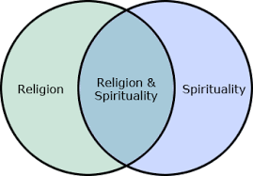
Spirituality in the recovery process
Subjective experience of each person as they search for meaning in their lives
Linked to:
  Improved physical health
  Improvements in mental health
  May act as a coping mechanism
Existential spirituality improves general health and social integration in persons with amputation (Peirano & Franz (2012)
During a peer visit questions about spirituality and faith may arise
As a peer visitor you are there to listen and encourage communication
Important not to impose your beliefs on the person you are visiting

Slide 48

Halfway Checkpoint Kahoot
Get your phones ready!
It’s Kahoot Time!
Go to https://kahoot.it/
Enter the pin on the screen
Notes:
Play Kahoot
Username: acckahoot2022@gmail.com
Password: peersupport2022
https://kahoot.com/

Slide 49
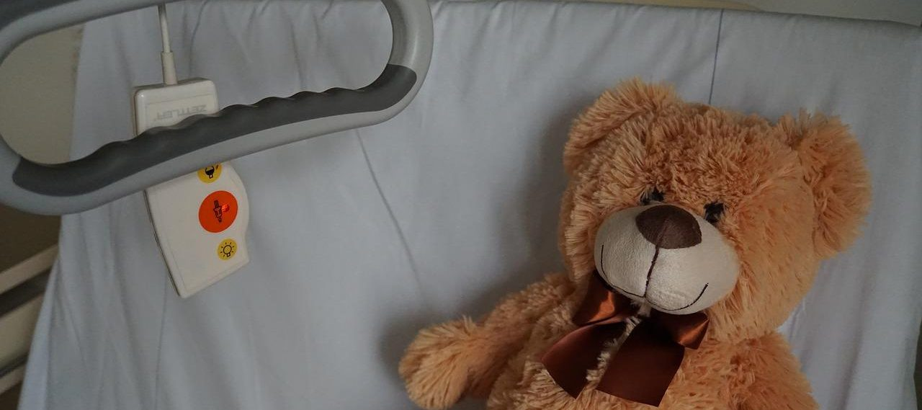
Section 5: The Visit
Notes:
How to find/receive referrals
Resources: e.g Hospitals, Clinics, ACC website
How to set up a visit
Explain the procedure for getting in contact with an amputee who is in need of peer support
How to prepare for a visit
Offer tips/tricks on researching for resources helpful to amputees
Give advice on how to better understand the needs of fellow amputees
Explain the procedure of acquiring accommodations for fellow amputees

Slide 50
Setting up the Visit
Role Playing Activity
Turn to a partner and pretend you are scheduling a visit with them.
Ask questions that will help you prepare for the visit.
  Age; date, level, and cause of amputation;
  Any other health conditions that might have an impact on the effectiveness of the visit;
  Emotional state;
  The types of information that have been requested by the person with amputation or by their family
Notes:
Read role playing activity out loud and split the participants into groups of two. Make sure to answer any pending questions.
Engage the group in discussion in reflection of how well the communication and interaction turned out
Offer advice on suitable actions during the role playing activity that will help peer supports in the visitation stage get a sense of how to approach fellow amputees and connect with them

Slide 51

The Visit – To Do’s
Be on time
Stop at the nurse’s station (if visit in hospital)
Confirm that this is a good time
Ensure amputee is comfortable for visit
Include family and friends
Reschedule if there is medical tests or if unsafe environment
Minimize distractions
Be aware of time zones (phone calls or video conferencing)
Be mindful of the amputee’s demeanor and energy level
Notes:
Hospital visits
Be on time
Stop at the nurse’s station and tell them who you are visiting, the group you represent (if applicable) and who requested the visit.
Ask whether this is a good time for a visit. If this is not a good time because of a change in status or other reasons, then let the person you were to visit or a family member know that you’ll call back to reschedule
Do not schedule visits during meal times
Knock before entering hospital rooms
If family or friends are present include them in the conversation
Step outside or offer to reschedule the visit of healthcare staff arrive to conduct an exam or a procedure
Home visits
Be on time
Ask the person you are visiting where they would be most comfortable during the visit
If there are distractions such as a television in the background politely ask whether they can be eliminated
End the visit if anything about the setting or the behaviour of anyone present makes you feel unsafe or uncomfortable
Phone visits
While in-person visits are preferable, phone or video conference may be the only option available
Prior to making the call, select a time and location where you are not going to be interrupted during the conversation
If the person isn’t local, be aware of the time zone that they are in when scheduling the call
Review the information you’ve been given about the person you will be calling
Introduce yourself, your affiliation if this is applicable, and why you are calling
Ask whether the time is convenient if the connection is good and whether the person can hear you adequately
Be mindful that it makes it more difficult to pick up on feelings over the phone; you will need to ask in order to verify what the person is saying

Slide 52

The Visit – What you should NOT do
Provide assistance to the bathroom
Administer any medications
Provide transportation
Handle any money or valuables
Provide medical advice or recommendations
Arrive unexpectedly
Sit on the bed of the person you are visiting

Slide 53
During the visit - Scenario
John, a peer visitor with the Amputee Coalition of Canada, is visiting Marie in the hospital.
She had her amputation four days ago and requested a peer visitor through the hospital’s peer visitor program.
John arrives at the visit rather harried and 10 minutes late.
He did not have time to check-in at the front desk and pulls up a chair beside Marie’s bed.
Notes:
The following were NOT “good” peer visitor practices
• Assisting Marie to the washroom
• Remaining after Marie shows signs of fatigue
• Not checking at the front desk
• Arriving late
• Arriving harried

Slide 54
During the visit - Scenario (continued)
After conversing for 15 minutes, Marie says she needs to go to the washroom and asks John to assist her.
There is no nurse in the room so he helps her get out of bed and walk to the washroom.
After she returns to the bed they continue to talk for another 15 minutes.
John does not notice that Marie is looking increasingly uncomfortable and less engaged in the conversation. He remains for another half hour.
Prior to leaving, he asks if she would like a further visit or further information.
Notes:
The following were NOT “good” peer visitor practices
• Assisting Marie to the washroom
• Remaining after Marie shows signs of fatigue
• Not checking at the front desk
• Arriving late
• Arriving harried

Slide 55
During the visit
Discussion questions :
What are some good peer visitor practices in this scenario?
Are there any bad peer visitor practices? Why or why not?
What should John do to improve the peer visiting experience for Marie?
Notes:
● YOU MIGHT WANT TO SHOW THESE QUESTIONS AND THEN POP BACK TO THE PREVIOUS SLIDE SO THEY CAN IDENTIFY GOOD AND BAD PRACTICES
● The following were NOT “good” peer visitor practices
• Assisting Marie to the washroom
• Remaining after Marie shows signs of fatigue • Not checking at the front desk
• Arriving late
• Arriving harried

Slide 56
After the visit
Scheduling a follow-up visit
Preferably schedule this before concluding the initial visit.
Let appropriate program contacts know if another visit is scheduled.
Notes:
Can make the “one and done” approach more clear
Scheduling a follow-up visit
If requested, schedule this before concluding the initial visit.
Let the program that gave you the request know that you are going to do a follow visit – the ACC per visitor standard practice is to have only one visit; this does not preclude follow up visits when they are needed.
Evaluate the visit
Ask the following questions after each visit:
Did I receive the information that I needed about the person I was visiting in advance of the visit?
Did I prepare appropriate materials for the visit?
Did it appear that the communication during the visit was effective or helpful? If not, why not?
What would I do differently the next time?
Are there any other resources that would’ve been helpful?

Slide 57
After the visit – Evaluate the visit
Did I have appropriate information in advance of the visit?
Did I prepare appropriately for the visit?
Was the communication during the visit effective or helpful?
If not, why not?
What would I do differently the next time?
Are there any other resources that would’ve been helpful?
Notes:
Evaluate the visit
Ask the following questions after each visit:
Did I receive the information that I needed about the person I was visiting in advance of the visit?
Did I prepare appropriate materials for the visit?
Did it appear that the communication during the visit was effective or helpful? If not, why not?
What would I do differently the next time?
Are there any other resources that would’ve been helpful?

Slide 58

After the visit – report the visit
To the organization or relevant individual
Provide a brief summary
Maintain confidentiality
You can complete a post-visit report at: https://trentu.qualtrics.com/jfe/form/SV_5mvtfDKyHj8rPPU
Notes:
Report the visit
If the visit was scheduled by an organization or an individual, contact them to make let them know that the visit was made, whether a follow-up visit will be made and whether other any other information is required.

Slide 59
After the visit – report the visit
To the organization or relevant individual
Provide a brief summary
Maintain confidentiality
Notes:
Report the visit
If the visit was scheduled by an organization or an individual, contact them to make let them know that the visit was made, whether a follow-up visit will be made and whether other any other information is required.

Slide 60
After the visit
Discussion questions:
How would you go about determining the effectiveness of your visit?
What would you do if there was a request by the amputee that was out of your scope of practice?
How would you handle the situation?
Notes:
Explain the proper procedure to schedule a follow up visit
Explain and emphasize the importance of self-reflection and evaluation of every visit
Talk about how to report a visit

Slide 61
The Visit
Group Exercise:
Place the following steps for a peer visit in the appropriate order by putting the correct number to the left of each activity, 1-7.
_____Make the initial contact to schedule the visit
_____Gather any information required for the visit
_____Schedule follow-up visit or activity as requested
_____Report the visit if required
_____Determine the type of visit required: home, hospital, phone or other
_____Conduct the visit
_____Evaluate the visit
Notes:
Correct order for the steps for a peer visit:
1. Determine the type of visit required: home, hospital, phone or other
2. Make the initial contact to schedule the visit
3. Gather any information required for the visit
4. Conduct the visit
5. Schedule follow-up visit or activity as requested
6. Evaluate the visit
7. Report the visit if required

Slide 62

Section 6: Mental Health
Notes:
Discussions about mental health will comprise a large part of most peer visits. What you are primarily doing is CREATING THE SPACE for the person you are visiting to share
● We will talk about a peer visitor’s role in supporting mental health including both what you can do and when and how you can provide support when issues arise that are beyond the scope of your role
● It is not the role of a peer visitor to diagnose or treat mental health challenges that the person they are visiting may be experiencing.
● Nor it is it their role to provide medical advice.
● Your role does include providing hope and optimism, encouraging the person you’re visiting to share their feelings, listening to them, engaging in communication to help them with their recovery, and generally providing support.

Slide 63
Peer Visitor Role in Mental Health
Discussion Questions:
What impact do you think that receiving an amputation had on your mental health?
What do you think is the most important aspect of helping someone who is struggling to cope in their recovery process?
What existing resources do you know that can be helpful to amputees struggling with their mental health?
Notes:
The primary responsibility of a peer visitor is to support an individual’s voice and choice to be heard.
● If you have had a similar experience to your peer’s, you can offer some insight as to what you did when you were in the situation and what worked for you.
● It is crucial that you are making it clear that you are not telling them to adopt the same methods and remedies as you did.
● Every individual is different and the same methods that worked for you may not apply to your peers.
● As a peer visitor, you have specifically agreed to use the wisdom you have gained through your personal experience in an intentional way.
● Much of the focus in your support of another person with amputation is on mutuality.
○ Mutuality means a focus on the relationship rather than either individual.
○ It also means an acceptance that both people involved can learn from and be impacted by the peer support relationship.
○ Mutuality also reduces power imbalances in peer support work; this is particularly important in the context of mental health challenges.

Slide 64
Grief, Depression, Anxiety?
Grief
  Painful feelings come and go and diminish over time
  Painful feelings are reduced in positive situations such as a birthday party
Depression
  Depressed mood is consistent over a long time period
  Symptoms remain constant in all situations
Anxiety
  Feeling of worry, nervousness, or unease
Notes:
● I cannot repeat often enough that, as a peer visitor, As a peer visitor, your role is not to diagnose any mental health challenges or disorders nor is it your role to treat them.
● Your role is to listen, support and refer the person for professional help as needed.
● Difference between grief and depression
○ Often, feelings of sadness and grief are mistaken for being depressed. Though grieving is natural and shares some similar features to depression, they differ in various ways.
○ We’ll talk about depression in more detail on the next slide
ANXIETY
○ Anxiety is a feeling of worry, nervousness, or unease, typically about an imminent event or something with an uncertain outcome.
○ can lead persons with amputation to avoid situations that lead to the worsening of their symptoms.
○ peer visitor’s role in supporting a person who is experiencing anxiety is similar to that of supporting persons with symptoms of depression.
QUALITY OF LIFE
● Quality of life (QoL) is about well-being, regarding both positive and negative elements within the entirety of their existence at a specific point in time
● Not surprisingly depression, anxiety, and PTSD that will talk about shortly are associated with lower quality of life
● Persons with amputation tend to report a lower quality of life than those without
● The aspects of quality of life, most affected for amputees are physical functioning, roll imitations to the physical problems, roll, imitations, due to emotional problems, vitality and mental health

Slide 65
Symptoms of Depression
Feeling sad or having a depressed mood
Lost interest in activities
Change in appetite – weight loss or gain
Trouble falling asleep or sleeping too much
Increased fatigue
Increased pace or slowed movement or speech (observable to others)
Feeling guilty
Difficulty making decisions
Thoughts of death or suicide
Notes:
DEPRESSION
● I will share some of the statistics that appear in your guide but you need to remember that everybody responds in a different way to amputation – these are generalizations
● In persons who have undergone amputation as a result of trauma, the incidence of depression ranges from 21 to 63%.
● Persons who have been amputated secondary to trauma have a greater risk for depressive symptoms (46%) as compared to those who have had an amputation as a result of vascular causes (38%) or cancer (16%) (Mckechnie & John, 2014).
● For persons with single-limb amputation, the rate of depression and anxiety increases with the level of amputation.
● Surprisingly, in at least one study, they found that persons with multiple amputations had lower levels of anxiety and depression.
● Persons with upper extremity amputations had higher levels of depression and less adjustment to their prosthesis when compared to persons with lower-limb amputations
● Most studies that have been done report depression for a period of up to two years post amputation
● 2 to 10 years post amputation depression rates are similar to those of the general population
● Although your role is not to treat depression, as a peer visitor there are many things you can do to help. These include:
• Starting a conversation; letting them know that you’re there for them (creating space)
• Help them reach out for support such as counseling
• If they are already receiving therapy, support them in continuing that therapy
• And very importantly, take care of yourself.

Slide 66
Grief, Depression, Anxiety and Quality of Life
Discussion Questions:
What are the differences and similarities between grief, depression and anxiety? What impact does it have on someone’s quality of life?
Have you ever experienced any of grief, depression, anxiety and other mental health problems during your recovery? Did you have a support system? Who/what helped you through this tough experience?
Are there any specific strategies you would recommend for improving your mental health or helping someone else with their mental health struggles?
Notes:
Take up discussion points

Slide 67
Grief, Depression, Anxiety and Quality of Life
Check your understanding:
Depression is associated with decreased use of _____________ and poorer _______________.
Depressive symptoms include ________________ .
As a peer visitor you can help them by _____________________.
Grief differs from depression in that it ________________ over time.
Persons with __________ extremity amputations have higher levels of anxiety than those with _________ extremity amputations.
Symptoms of anxiety include ________________ .
Depression and anxiety are correlated with ______________ quality of life.
self-rated health
increased fatigue
Prosthesis
Diminishes
Poorer
letting them know you are there
Upper
Lower
nervousness
Notes:
Depression is associated with decreased use of prostheses and poorer self-rated health.
Depressive symptoms include increased fatigue.
As a peer visitor you can help them by letting them know you are there.
Grief differs from depression in that it diminishes over time.
Persons with upper extremity amputations have higher levels of anxiety than those with lower extremity amputations.
Symptoms of anxiety include nervousness.
Depression and anxiety are correlated with poorer quality of life.

Slide 68
Grief, Depression, Anxiety and Quality of Life
Scenario:
The amputee you are supporting is an Indigenous man of the Anishinaabe Nation.
He tells you that he is currently going through rehabilitation at the local hospital, but he dreads going there every time due to the amount of discrimination he has experienced.
His physiotherapist is very impatient with him and often pushes him to do exercises he is not comfortable with.
Notes:
Take up scenario

Slide 69
Grief, Depression, Anxiety and Quality of Life
Scenario (continued):
When he tells his physiotherapist that he is very anxious about doing the exercises and he is afraid of further injuries since he is not ready, the response he received was: “You need to do these exercises, or you are never going to recover.”
What advice would you give him to help him through this tough situation?
Notes:
Take up scenario

Slide 70
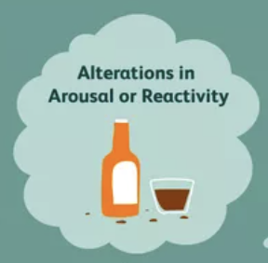
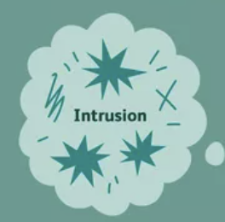
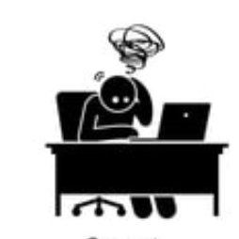
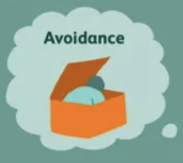
Post-Traumatic-Stress-Disorder - Symptoms
Alterations in arousal and reactivity
Intrusion
Alterations in Cognition
Avoidance
Notes:
Post-traumatic stress disorder (PTSD) is a psychological disorder that develops as a result of a traumatic event.
● more common in amputees who have lost limbs as a result of combat or traumatic injury.
● PTSD is relatively rare (< 5%) among amputees whose surgery follows a chronic illness such as diabetes or cancer but that does not mean that it doesn’t happen
Symptoms of PTSD fall into four categories:
Intrusion (memories, dreams, flashbacks)
Avoidance (staying away from places, events, objects that are reminders of the traumatic experience),
Alterations in cognition and mood (inability to remember key features in the event, negative thoughts about yourself, feelings of guilt or blame, and loss of interest in enjoyable activities)
Alterations in arousal and reactivity (being easily startled, feeling tense, difficulty sleeping, angry outbursts).
· Persons with PTSD require professional support.

Slide 71
Post Traumatic Stress Disorder
Get your phones ready!
It’s Kahoot Time!
Go to https://kahoot.it/
Enter the pin on the screen!
Notes:
Play Kahoot
Username: acckahoot2022@gmail.com
Password: peersupport2022
https://kahoot.com/

Slide 72
Body Image Disturbance
Perception of one’s body
Can be seen as a failure
Vitality, appearance, fitness expectations
Adapt physically, emotionally, socially and psychologically
Notes:
Amputees are challenged not only by how their body works and feels after amputation; they may also be concerned with how it looks.
Body image is a person’s perception of their body and is affected by both internal and external factors:
○ internal factors include things like age, sex, and physical condition
○ external factors can be social and environmental. Body image disturbance can result from social values that emphasize vitality, appearance and fitness.
■ Amputation could be seen as a sign of failure to meet these values

Slide 73

Body Image Disturbance
Provide support by:
Takes time to come to terms with their (potentially) new body
Listening when they are ready to talk about their concerns
Notes:
You can support the person you’re visiting with their body image concerns by:
• Letting them know that it takes time to come to terms with their (potentially) new body
• Listening when they are ready to talk about their concerns
• Just the opportunity to meet with another amputee can improve a persons, body positivity
• The Rams of Canada has a brochure on body image and positivity that you might share with someone who is experiencing this challenge.

Slide 74
Body Image Disturbance
Get your phones ready!
It’s Kahoot Time!
Go to https://kahoot.it/
Enter the pin on the screen!
Notes:
Play Kahoot
Username: acckahoot2022@gmail.com
Password: peersupport2022
https://kahoot.com/

Slide 75

Section 7: Difficult Issues

Slide 76
Suicide
Crisis Services Canada Questions:
How are you coping with what’s been happening in your life?
Do you ever feel like just giving up?
Are you thinking about dying?
Are you thinking about hurting yourself?
Are you thinking about suicide?
Have you ever thought about suicide before, or tried to harm yourself before?
Have you thought about how or when you’d do it?
Do you have access to weapons or things that can be used as weapons to harm yourself?
Notes:
● It can be quite distressing or uncomfortable, or both for peer visitor when the topic of suicide arises
● You may even want to avoid the conversation because you’re concerned that whatever you do, might make it worse. Remember, talking about suicide does not lead to more suicide and talking, and taking action of the best approaches.
● So, how do you proceed?
○ You can start by asking questions to find out whether they’re likely to act on their suicidal feelings
○ Having the opportunity to share their feelings, might actually reduce the chances of them acting on them
○ You can use the questions listed here and in your guide to help you with this conversation.

Slide 77
Suicide– Warning signs
Talking about suicide
Withdrawing from social contact and wanting to be left alone
Having wide mood swings
Being preoccupied with death, dying, or violence
Feeling trapped or hopeless about a situation
Increasing use of alcohol or drugs
Changing normal routine
Doing risky or self-destructive things
Giving away belongings or getting affairs in order
Saying goodbye to people as if they won’t be seen again
Developing personality changes or being severely anxious or agitated
Notes:
Some of the common warnings signs of suicide are listed on this slide and in your guide
· As a peer visitor who only sees this person once or twice, you may not see many of these common warning signs. Family members and friends may be more aware of them.

Slide 78
Suicide
If there is Immediate Danger:
  Don’t leave the person alone.
  Call 911 or your local emergency number right away.
  Try to find out if he or she is under the influence of alcohol or drugs or may have taken an overdose.
  Tell a family member or friend right away what’s going on.
It is very important that you do not try to handle the situation on your own.
Provide information if danger is not immediate:
  9-8-8: Suicide Crisis Helpline
Notes:
If someone has attempted suicide or you think that they are in immediate danger of doing so:
Don’t leave the person alone.
Call 911 or your local emergency number right away.
Try to find out if he or she is under the influence of alcohol or drugs or may have taken an overdose.
Tell a family member or friend right away what’s going on.
It is very important that you do not try to handle the situation on your own.
One of the resources that you can make the person aware of, if the danger is not as immediate is: the Canada Suicide Prevention Service (Hours: 24/7/365. Languages: English, French) at 833-456-4566.

Slide 79

Suicide
Notes:
Talk about how to have a conversation related to suicide and use the questions from Crisis Services Canada
Describe the warning signs of suicide
Explain the procedures for someone who is in immediate danger of suicide
Play video and discuss the highlights of the video

Slide 80
Suicide
Get your phones ready!
It’s Kahoot Time!
Go to https://kahoot.it/
Enter the pin on the screen!
Notes:
Play Kahoot
Username: acckahoot2022@gmail.com
Password: peersupport2022
https://kahoot.com/

Slide 81
Suicide
Group Discussion and Scenario:
The amputee you are supporting confides in you and tells you they have thought about taking their own life because they feel like no one cares about them and that they feel like their condition is a burden to everyone around them.
How would you respond?
Notes:
Take up the scenario

Slide 82

Sexuality
Fundamental part of a full and healthy life & a basic human right
Contributes to quality-of-life in everyone
Rarely addressed by health professionals
Defined as a combination of “sexual well-being” and “sexual functioning”.
  Sexual well-being- how someone experiences sexuality in the context of their life
  Sexual functioning - performance standards of the sexual response cycle
Illness, injury, and disability can have a negative impact on sexuality and particularly on sexual functioning.
Lack of satisfaction with their sexual life is reported by between 13 and 75% of persons with amputation (compared to 20% of persons without amputation)
Notes:
What is your role as a peer visitor?
● Prepare, in advance of your meeting, how you would respond if the person you are visiting expresses concerns about sexuality.
● During the visit, if you sense that it might be an issue for the person and they have not broached the topic, use a question about relationships to break the ice.
There is also a link to an article on texting him but intimacy after amputation that was published in amplitude magazine in 2019 that you could share with the person you’re visiting if it’s appropriate

Slide 83
Sexuality
Scenario:
The amputee you are supporting confides in you and tells you that they are a lesbian, but she pretended to be straight because she feels that her family might not support her through the recovery process if they found out the truth.
She doesn’t know what to do and asks you for advice.
How would you respond?
Notes:
Open Discussion of the Scenario

Slide 84
Sexuality
Get your phones ready!
It’s Kahoot Time!
Go to https://kahoot.it/
Enter the pin on the screen!
Notes:
Play Kahoot
Username: acckahoot2022@gmail.com
Password: peersupport2022
https://kahoot.com/

Slide 85
Gender Identity
Scenario:
The amputee you are supporting is a transgender woman in her 20s.
She tells you that she has lost a lot of friends due to her gender identity and even the ones remaining aren’t very supportive, but her family accepts her for who she is.
However, becoming an amputee has made her life harder in addition to the on-going discrimination from others and now she feels really self-conscious about her body.
She also feels that she could lose her only support system, her family, because she feels she might be a burden to them.
How would you respond?
Notes:
Open Discussion of the Scenario

Slide 86

Section 8: Self-Care
Notes:
Define and describe self-care
Self-care is self-preservation and self-love
Engage participants in self-reflection activity where they can share their own version of self-care
Discuss the practice of self-care with peer support participants

Slide 87
For those of you, who struggle with guilt regarding self-care, answer this question: what greater gift can you give to those you love than your own wholeness?
SHANNON TANNER

Slide 88
Self-Care
Discussion questions:
What are some of your favourite self-care routines?
Why is self-care important to amputees in the recovery process?
Notes:
Take up discussion/reflection questions

Slide 89
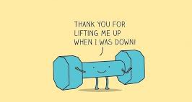
Exercise – Why Bother?
Helps maintain a healthy and stable weight.
Reduce the risk of developing diabetes and cardiovascular disease.
Preventative treatment against Type 2 diabetes and vascular disease.
Can reduce symptoms of PVD.
Improves blood circulation.
Positive effect on the skeletal system and help prevent osteoporosis.
Releases neurotransmitters and endorphins.
Notes:
The benefits of exercise for persons with amputation include:
Helps maintain a healthy and stable weight; gaining or losing weight has a major impact on prosthetic fitting
For non-vascular amputees exercise(s) is a preventative treatment to reduce the risk of developing diabetes and cardiovascular disease.
A healthy well-balanced diet is also important for the prevention of diabetes.
Exercises for amputees with vascular disease are a preventative treatment against the ongoing process of Type 2 diabetes and vascular disease.
For amputees with vascular disease, exercise can reduce symptoms of PVD such as breathlessness, angina and intermittent claudication pain often felt during walking. By improving blood circulation through exercises, type 2 diabetes can be better controlled.
Good nutrition and regular exercise have a positive effect on the skeletal system and help prevent osteoporosis.
Exercising releases neurotransmitters and endorphins, which create feelings of happiness and elation.

Slide 90
Exercise
Get your phones ready!
It’s Kahoot Time!
Go to https://kahoot.it/
Enter the pin on the screen!
Notes:
Play Kahoot
Username: acckahoot2022@gmail.com
Password: peersupport2022
https://kahoot.com/

Slide 91

Nature
Discussion questions:
What do you do to get out and experience nature?
How does it make you feel?
Are there things you could do to get out more? What are these?
Notes:
Describe the benefits of nature on one’s biopsychosocial wellbeing
Explain how to incorporate nature into one’s daily life
Engage participants in reflection activity and discuss the impact of nature on one’s life
Take up discussion questions on the slide questions themselves.

Slide 92
Mindfulness
Acceptance, letting go, and non-striving
Adopting a beginner’s mindset
Trust
Patience
Gratitude and generosity
Notes:
Acceptance, letting go, and non-striving – living in the moment and not trying to control everything
Adopting a beginner’s mindset – approach life with fresh eyes
Trust – trust yourself, understand that your knowledge and experience will help you. As if your visitor, they will also help you help others
Patience – patient with yourself and your progress
Gratitude and generosity – bring lightheartedness and generosity to everything you face.

Slide 93
Mindfulness
Discussion questions:
What does Mindfulness mean to you?
Do you currently engage in any mindfulness practices?
What are some of the benefits of Mindfulness?
Which of the 5 Mindfulness Tenets do you think is the most important and why?
Notes:
Take up discussion questions

Slide 94


Continuing Education
Notes:
Discuss the importance of continuing to learn as peer visitors

Slide 95
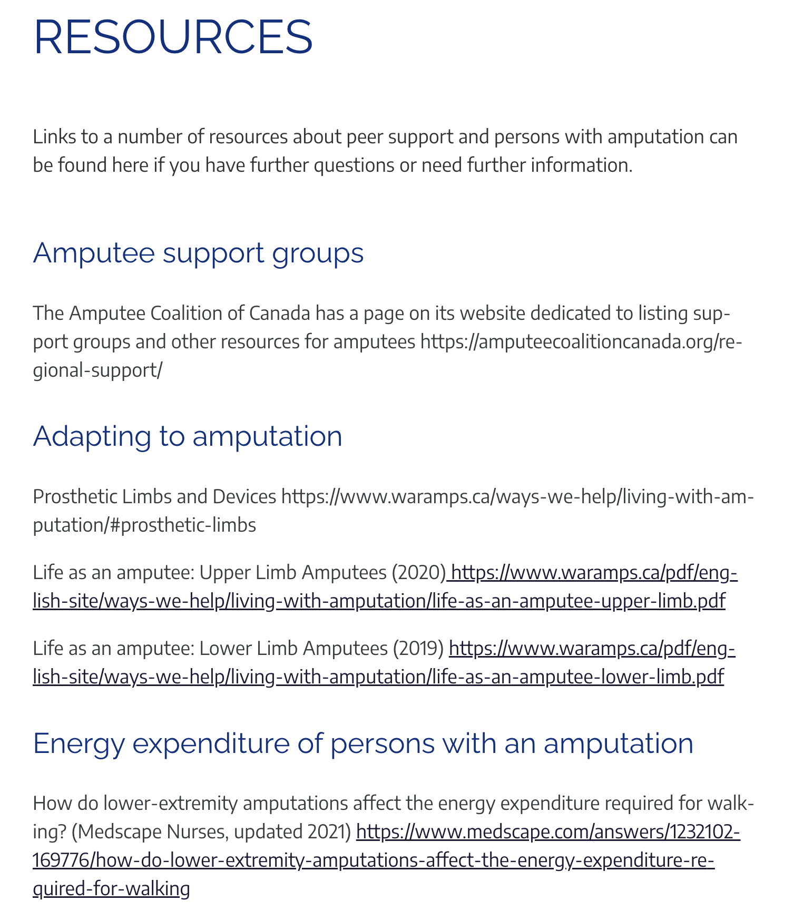
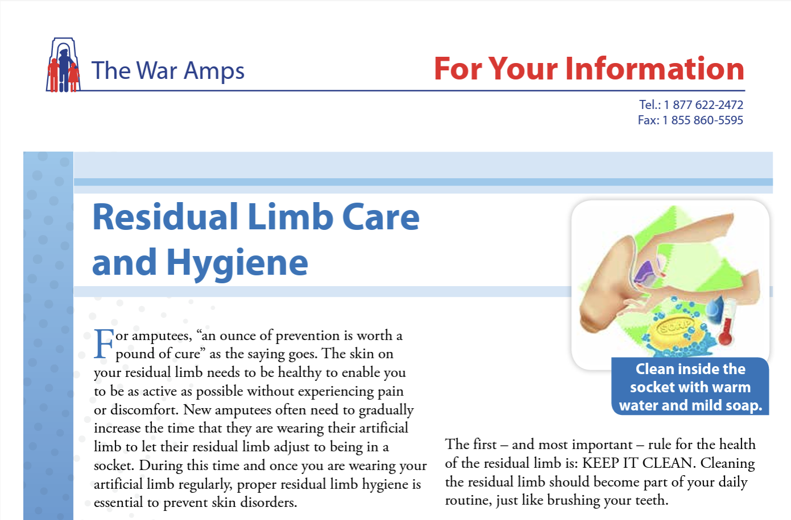
Resources
Links to resources that can be shared at the end of the Peer Visitor Guide
Notes:
At the back of the guide, you’ll find a list of resources with links that you can use to increase your own knowledge or to share with peer visitors as appropriate
● If you have other resources that you think are excellent for persons with amputation, please share them with us, and we can add them to the guide.

Slide 96
ACC Vulnerable Sector Check Policy
Vulnerable Sector Checks must be completed for all volunteers working with the Amputee Coalition of Canada including:
  Members of the Board of Directors
  Amputee Peer Visitors and Amputee Peer Visitor Trainers
  Any volunteer who has contact with members of the Amputee Coalition of Canada.
This policy applies to all volunteers who are involved in programs or activities that include contact with vulnerable persons including those with amputations.
VSCs will be completed by successful candidates prior to commencing their roles and renewed every three (3) years. Persons who are already in these roles will complete a VSC within 6 months of this policy being in place and will renew the VSC every three (3) years

Slide 97
Getting your VSC
Contact your local police service:
  This could be a municipal police service, the Royal Canadian Mounted Police (RCMP), or provincial police services like the Ontario Provincial Police
You may need to provide details such as:
  A description of the volunteer position.
  The name of the organization requesting the check.
  A letter from the organization stating that you will not be paid for your services 1
Submit your application (Depending on your location this may be online, in person, or by mail)
Wait for processing - processing time can vary
Submit an electronic copy of your VSC to the ACC coordinator

Slide 98

Questions

Slide 99
Don’t forget to complete the post-test and evaluation
THANK YOU!

