Slide 1
Human Resources for Operations Managers
CHAPTER 8: HRM-RELATED LEGISLATION
Unless otherwise noted, this work is licensed under a Creative Commons Attribution-NonCommercial-ShareAlike 4.0 International (CC BY-NC-SA 4.0) license. Feel free to use, modify, reuse or redistribute any portion of this presentation.

Slide 2
Learning Outcomes
Upon successful completion of this chapter, you will be able to:
List the employment legislation you need to be familiar with in Operations Management.
Recall the main concepts of Management-Employee labour relations in the workplace.

Slide 3
8.1 Introduction
When working in Operations Management, you may be responsible for work processes and/or people. Either way, you will be required to follow employment legislation that impacts the workers.
Some of the provincial legislation we will explore includes:
Employment Standards
Occupational Health and Safety
Labour Relations
Human Rights
Pay Equity
Accessibility
Leaves of Absence
Workers Compensation
Notes:
In this chapter, we will review some of the pertinent employment legislation that impacts a business, such as minimum standards, safety and human rights. This text will focus on employers that fall under provincial legislation. If you are working for a federally regulated employer, such as a bank or a broadcaster, your organization will follow federal employment legislation.

Slide 4
8.2 Overview Of Employment Legislation
Every area of your business will be impacted by employment legislation as every department is made up of people. Let’s look at a few areas directly impacted by employment legislation.
Talent Acquisition
Payroll
Safety
Supervisory/Management Roles
Terminations

Slide 5
8.3 HRM-Related Legislation: Part One I
Employment Standards
The purpose of Employment Standards Legislation is to provide employers with the minimum worker requirements in areas such as:
Hours of Work and Overtime
Wages
Notice of Termination of Employment and Severance Pay
Public Holidays
Vacation Time and Vacation Pay
Notes:
Remember that you should be in contact with your Human Resources representative when questions or concerns arise in any of these areas as they can provide immediate guidance and coaching. In the absence of HRM, you can contact an Employment Lawyer to answer your questions.

Slide 6
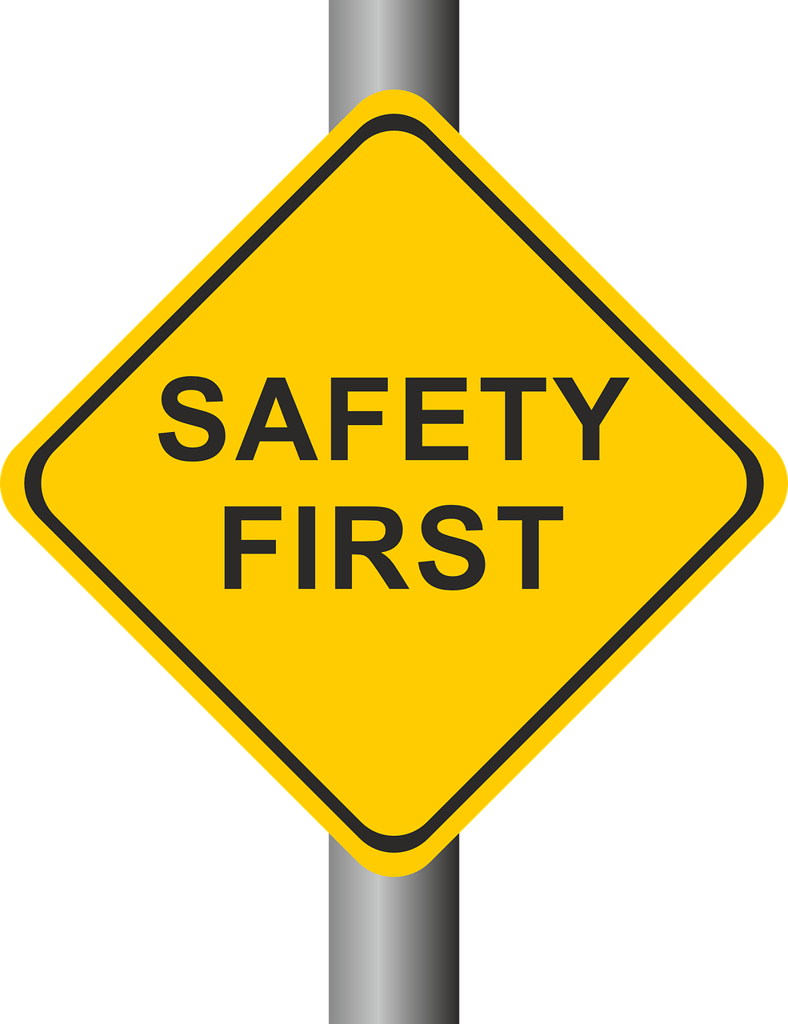
8.3 HRM-Related Legislation: Part One II
Occupational Health and Safety
Keeping workers, visitors, and contractors safe is a basic responsibility of every organization. In Operations Management, you may have workers that report directly to you. As such, you are directly responsible for their safety in the workplace
Photo by succo, Pixabay License
Notes:
As safety is such an important part of your role, we take a close look at the following safety topics later in this text
Health and Safety Legislation
WHMIS 2015
Hazard Recognition, Assessment and Controls
Incident Investigations
Disability Management and Return-to-Work

Slide 7
8.3 HRM-Related Legislation: Part One III
Labour Relations
If you work in a unionized workplace, you will be responsible for working within the parameters of the Collective Agreement that has been established between the management team and the union.
Photo by Peggy_Marco, Pixabay License

Slide 8
8.3 HRM-Related Legislation: Part One IV
Human Rights
It is important for employers to understand that the Ontario Human Rights Code is legislation that provides for an individual’s opportunities without discrimination and equal rights. In Ontario, there are five protected social areas including:
Employment
Housing
Goods, services and facilities
Contracts
Membership in trade and vocational associations
Notes:
Specifically, the Ontario Human Rights Code (OHRC) details protected grounds including:
Race
Ancestry
Place of origin
Colour
Ethnic origin
Citizenship
Creed
Sex
Sexual orientation
Gender identity
Gender expression
Age
Marital status
Family status
Disability

Slide 9
8.4 HRM-Related Legislation: Part Two I
Ontario’s Pay Equity Act is the legislative document that applies to employers in the private sector that employ ten or more employees. The goal of the Pay Equity Act is “to redress systemic gender discrimination in compensation for work performed by employees in female job classes.”
Notes:
A review and comparison of the value of work between male and female job classes and the compensation paid to each is the basis of this legislation.

Slide 10
8.4 HRM-Related Legislation: Part Two II
Accessibility
Employers must make their workplaces accessible to workers. According to the Accessibility for Ontarians with Disabilities Act, 2005 (AODA), Ontario employers are expected to follow all five of the standards in the AODA legislation including:
Employment
Customer Service
The Design of Public Spaces
Information and communications
Transportation
Notes:
The Accessibility for Ontarians with Disabilities Act, or AODA, aims to identify, remove, and prevent barriers for people with disabilities. The AODA became law on June 13, 2005 and applies to all levels of government, nonprofits, and private sector businesses in Ontario that have one or more employees (full-time, part-time, seasonal, or contract).

Slide 11
8.4 HRM-Related Legislation: Part Two III
Leaves of Absence
There are a number of “leaves” available to your employees, and it is important that you work closely with your Human Resources representative if an employee asks about any of the following leaves from work:
Pregnancy Leave
Parental Leave
Family Medical Leave
Personal Emergency Leave
Critical Illness Leave
Family Caregiver Leave
Reservist Leave
Notes:
From time-to-time, your employees may seek a leave of absence from work.

Slide 12
8.4 HRM-Related Legislation: Part Two IV
Workers Compensation
In Ontario, WSIB or the Workplace Safety and Insurance Board, provides coverage when an injury or illness occurs in any workplace that is covered by the Workplace Safety and Insurance Act.
Some of the benefits and services available from WSIB include:
Income Replacement
Health Care Equipment and Supplies
Return-to-Work Services
Health Care Benefits
Loss of Retirement Income
Non-Economic Loss
Survivor Benefits
Notes:
WSIB not only provides compensation if a workplace injury claim is approved, but it also assists injured workers with a safe return to work. WSIB is funded by employers and they play an important role in Ontario’s Health and Safety system.

Slide 13
8.5 Labour Relations I
Employees, as separate individuals, have very little power when it comes to their relationship with companies’ management. However, when organized as a group, employees gain some power and can start leveraging that power to negotiate with their employer.
Notes:
This section discusses the process that a group of employees must undertake to become an official union.

Slide 14
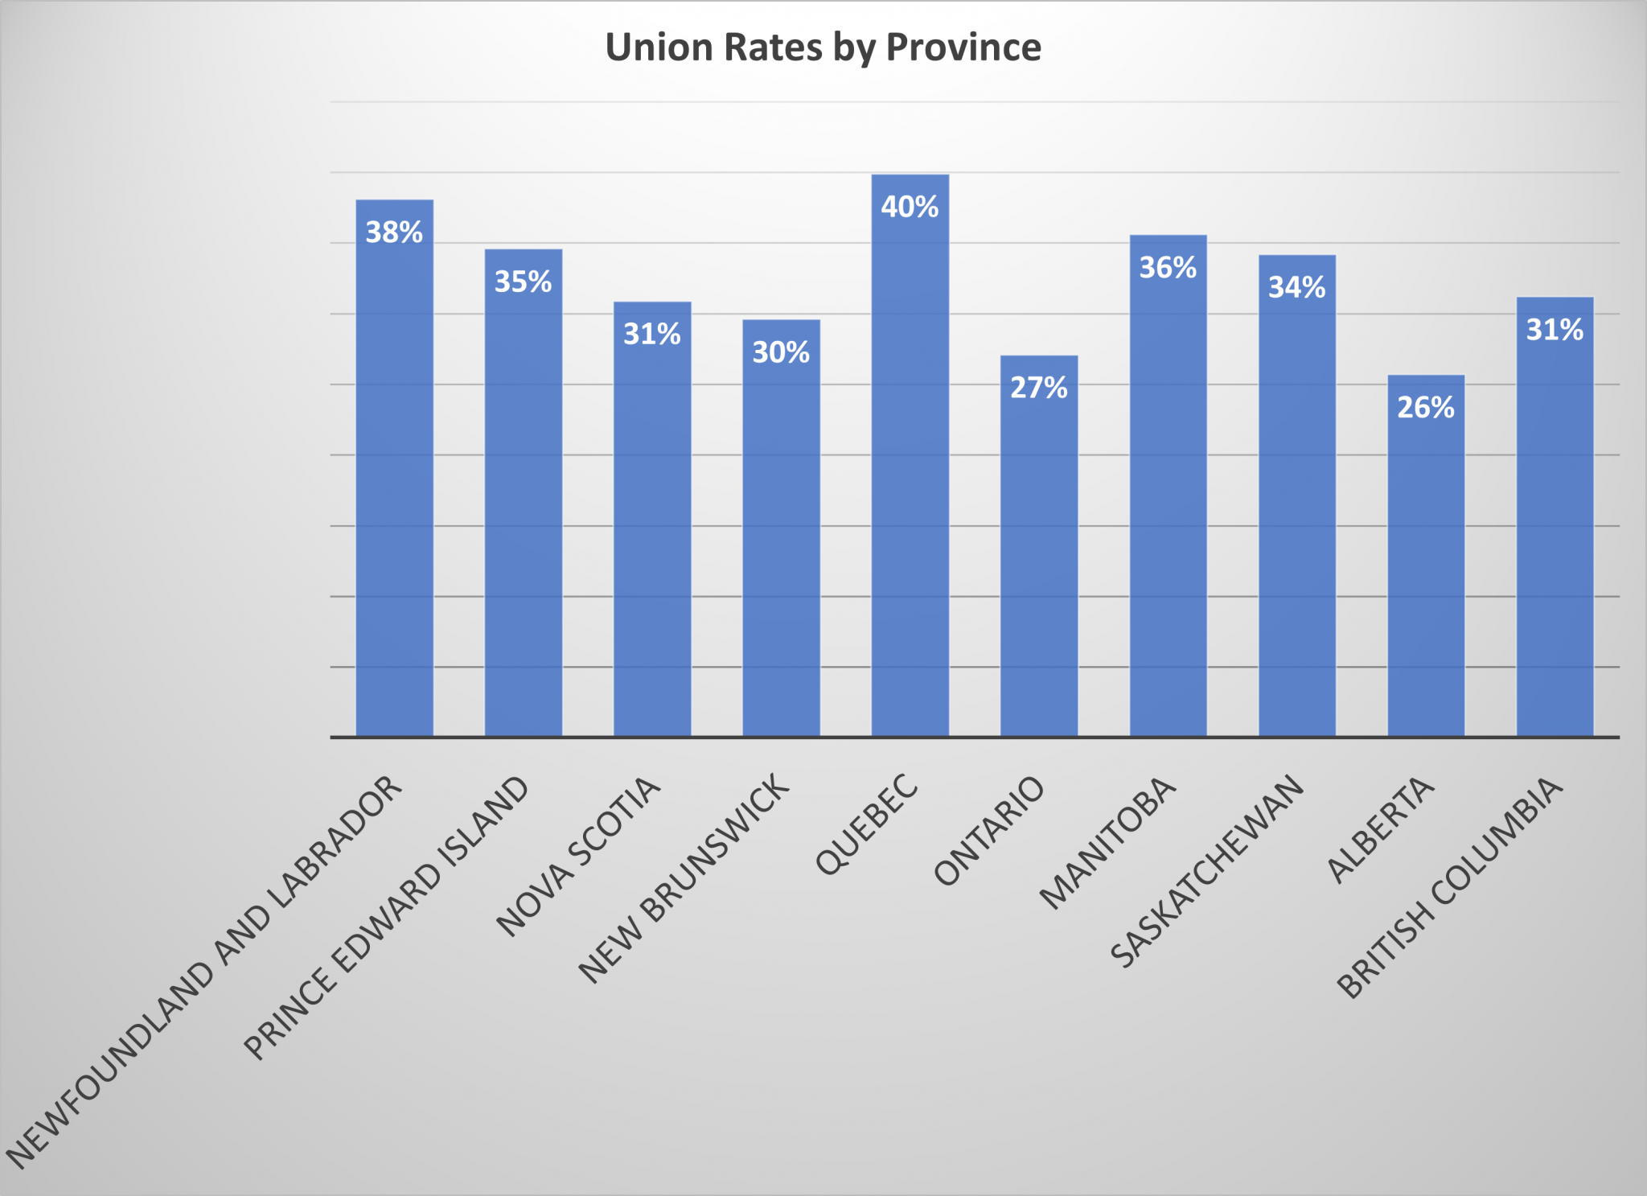
8.5 Labour Relations II
Union Membership Rates in Canada – by Province
Notes:
The path to unionization and the process of maintaining a union is heavily regulated. These regulations can vary from one legislation to another. In Canada, collective bargaining is embodied in federal and provincial labour relations acts and labour codes. Canadian workers have the right to join trade unions, which may be certiﬁed to collectively bargain conditions of employment with their employers on their behalf.

Slide 15
8.5 Labour Relations III
Union and employees make contact | As a result of employee dissatisfaction, union and employees make contact and discuss the possibility of joining forces.
Initial Organization Meeting | An initial meeting with the union is scheduled to gather employee support.
Formation of organizing committee | Local union leadership is identified. Its objectives are to organize a campaign to obtain the signature of a majority or workers willing to join the union.
Application to Labour Relations Board | Once a majority of these signatures are gathered, the workers can apply for official recognition to the Labour Relations Board.
Certificate is issued by the Board | After checking the process and the signatures, the Board certifies the union.
Election of the bargaining committee and contract negotiation | After having been certified, the first step for the newly formed union is to elect a bargaining team that will be tasked with negotiating a contract with the employer.
Notes:
The creation of a union follows a fairly strict process. First, an established union may contact employees and discuss the possibility of a union, or employees may contact a union on their own. The union will then help employees gather signatures to show that the employees want to be part of a union. To hold an election, the union must show signatures from over 35 percent of the organization’s employees.
Unions approach prospective members with promises like higher pay, better health insurance, and more vacation time. Not surprisingly, management may resist unions because they generally add to the cost of doing business.
As a result, the union organizing process can be a very delicate process because most employers feel the constraints of having a union organization are too great. Collective bargaining can put management at odds with its employees.

Slide 16
8.5 Labour Relations IV
Things That Shouldn’t Be Said to Employees during a Unionization Process
Notes:
There exists legal protection for employees considering unionization and it is advisable for HR and management to be educated on what can legally and illegally be said during this process. It is illegal to threaten or intimidate employees if they are discussing a union. Employers cannot threaten job, pay, or benefits loss as a result of forming a union
The figure above includes information on what should legally be avoided if employees are considering unionization.

Slide 17
8.6 Key Takeaways
Operations Managers must ensure compliance with the employment legislation in their jurisdiction.
The legislation covered in this chapter impacts safety, documentation, hiring, payroll and the termination of employees.
At every step, you will want to work closely with your Human Resources representative (or Employment Lawyer) to ensure you are meeting the legislative requirements to protect your people and your organization.

