Slide 1
Human Resources for Operations Managers
CHAPTER 6: DISABILITY MANAGEMENT AND
RETURN TO WORK
Unless otherwise noted, this work is licensed under a Creative Commons Attribution-NonCommercial-ShareAlike 4.0 International (CC BY-NC-SA 4.0) license. Feel free to use, modify, reuse or redistribute any portion of this presentation.

Slide 2
Learning Outcomes
Upon successful completion of this chapter, you will be able to:
Explain the business case for disability management.
List disability prevention strategies.
Identify the key components of a disability management program
Explain various return to work strategies.

Slide 3
6.1 Disability Management I
Disability management is a set of employer practices designed to prevent or reduce workplace disability and assist workers in recovering normal functioning as quickly as and to the maximum degree possible. In sections that follow, we’ll examine each of the three interrelated aspects of disability management:
Accommodation
Prevention
Support for recovery
Notes:
Prevention Employers may seek to prevent injuries and illnesses that give rise to disabilities through injury prevention efforts as well as employee assistance and wellness programs.
Accommodation Workers who have disabilities may require accommodation. This may include assistive technologies and modifications to work, work processes, and the workplace.
Recovery Some disabilities are temporary in nature. Sick leave, modified work, disability benefits (including workers’ compensation), and return to work programs can assist workers during the period of time required for them to recover.^{[1]}

Slide 4
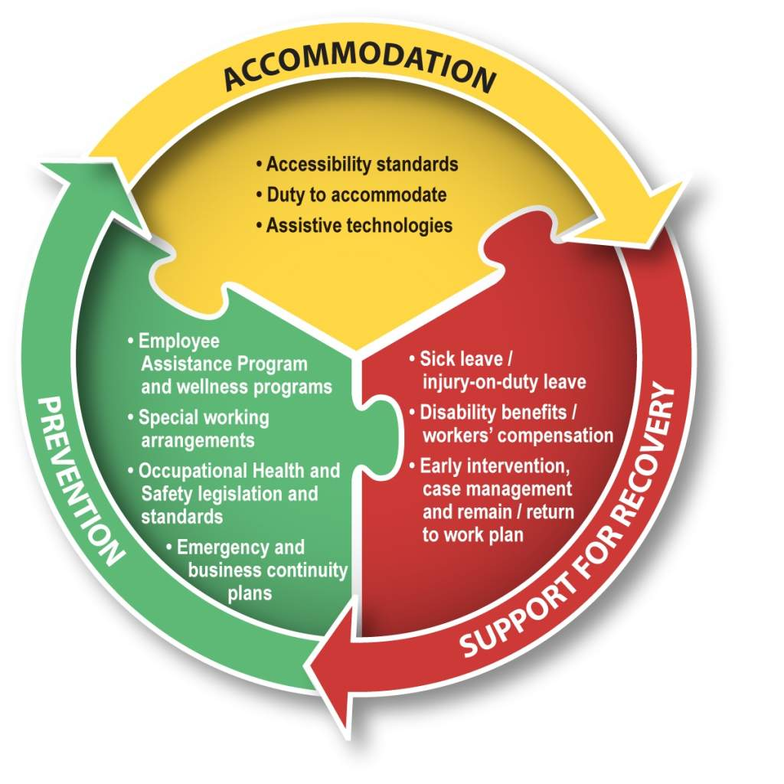
6.1 Disability Management II
Notes:
Before discussing disability management, it is useful to consider what the term disability means. Disability is often discussed as a characteristic of a worker (i.e., the worker is disabled). While a worker may indeed have an impairment, it is important to remember that it is the workplace context that turns the impairment into a disability.
Disability management is often said to minimize the cost of disability to employers.^{[3]} These practices also ensure that employers meet their duty to accommodate. Human rights legislation requires employers to avoid discriminatory workplace practices.

Slide 5
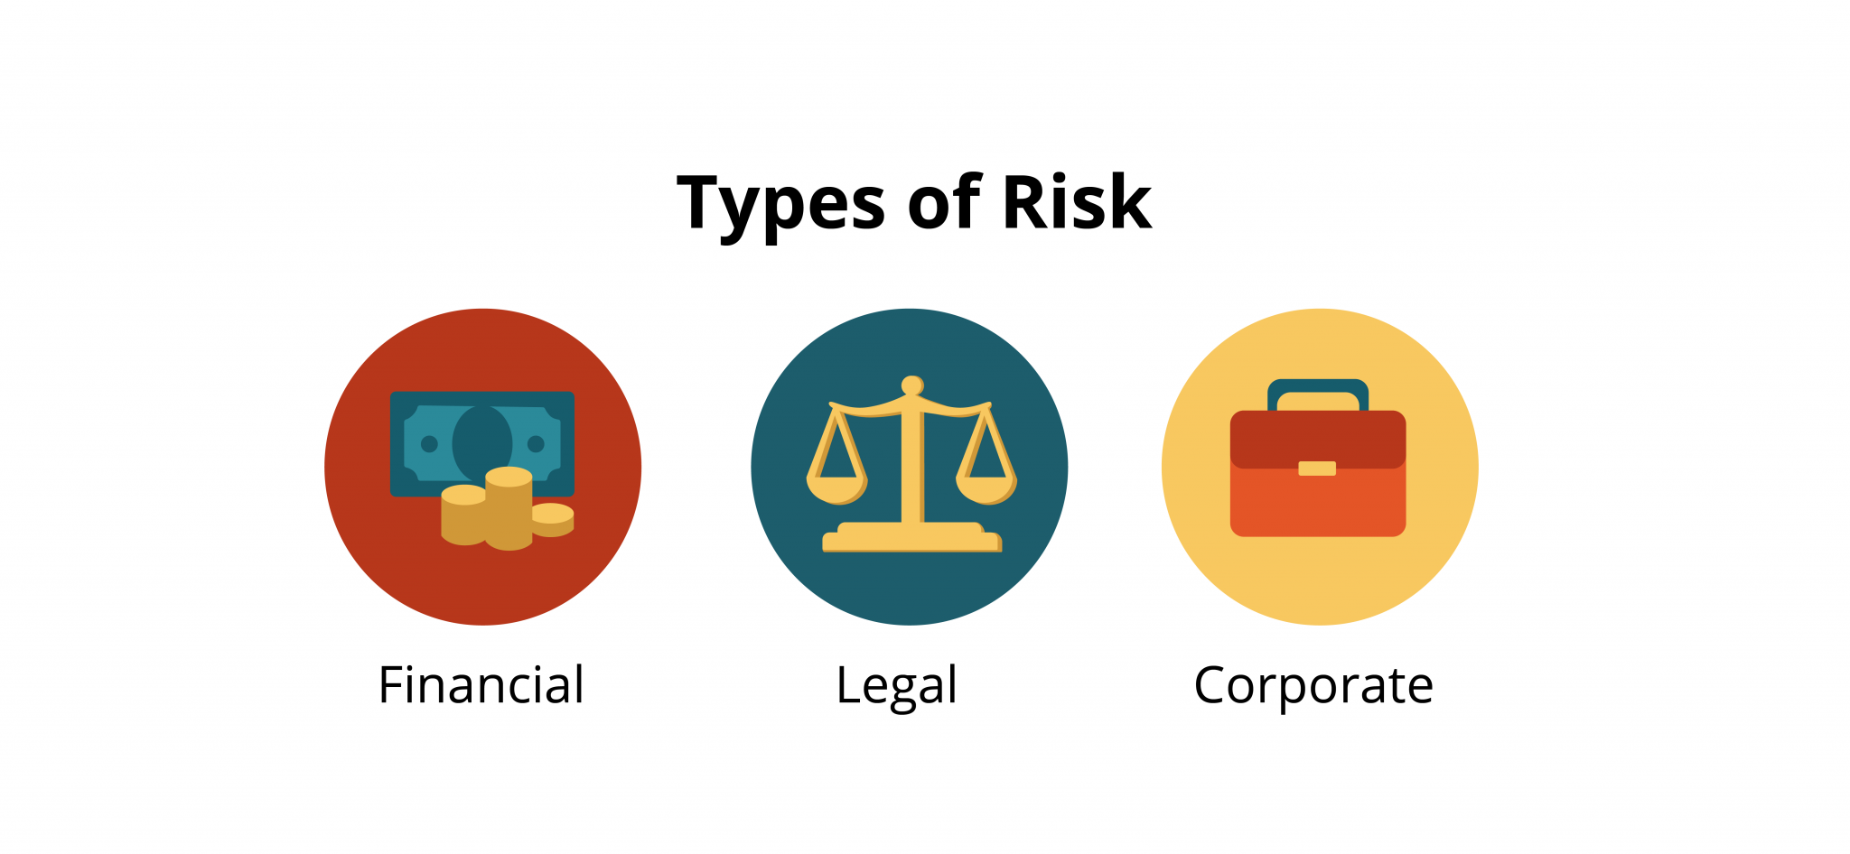
6.2 The Business Case For Disability Management
Notes:
Risk assessment is an important part of operations management. One risk to an organization includes the failure to develop and implement a disability management program. Three areas of risk associated with disability management include legal, corporate image and financial.
Legal Compliance - It is important that an employer recognize and follow legislation surrounding disability management. For example, in Ontario, an employer is expected to comply with AODA (Accessibility for Ontarians with Disabilities Act) legislation and the Ontario Human Rights Commission legislation
Organizational Reputation (Corporate)- Every organization wants to be known as a responsible corporate citizen. Should an employer develop a reputation for failing to support individuals that have suffered a workplace injury, illness or disability, the impact on the organization may be costly. With the ease of use and popularity of social media, it is easy for employees and former employees to share information about their employer, including disability management and return to work practices.
Financial Consideration- What is the cost to an organization if they fail to follow good disability management practices? There are direct costs such as the premium costs associated with Workers Compensation. In Ontario, an organization’s WSIB (Workplace Safety and Insurance Board) premiums are partially based on the number of lost time accident days an employer incurs. If an injury is deemed to be a lost time accident it typically means the employee is absent from work on the day(s) following their injury.

Slide 6
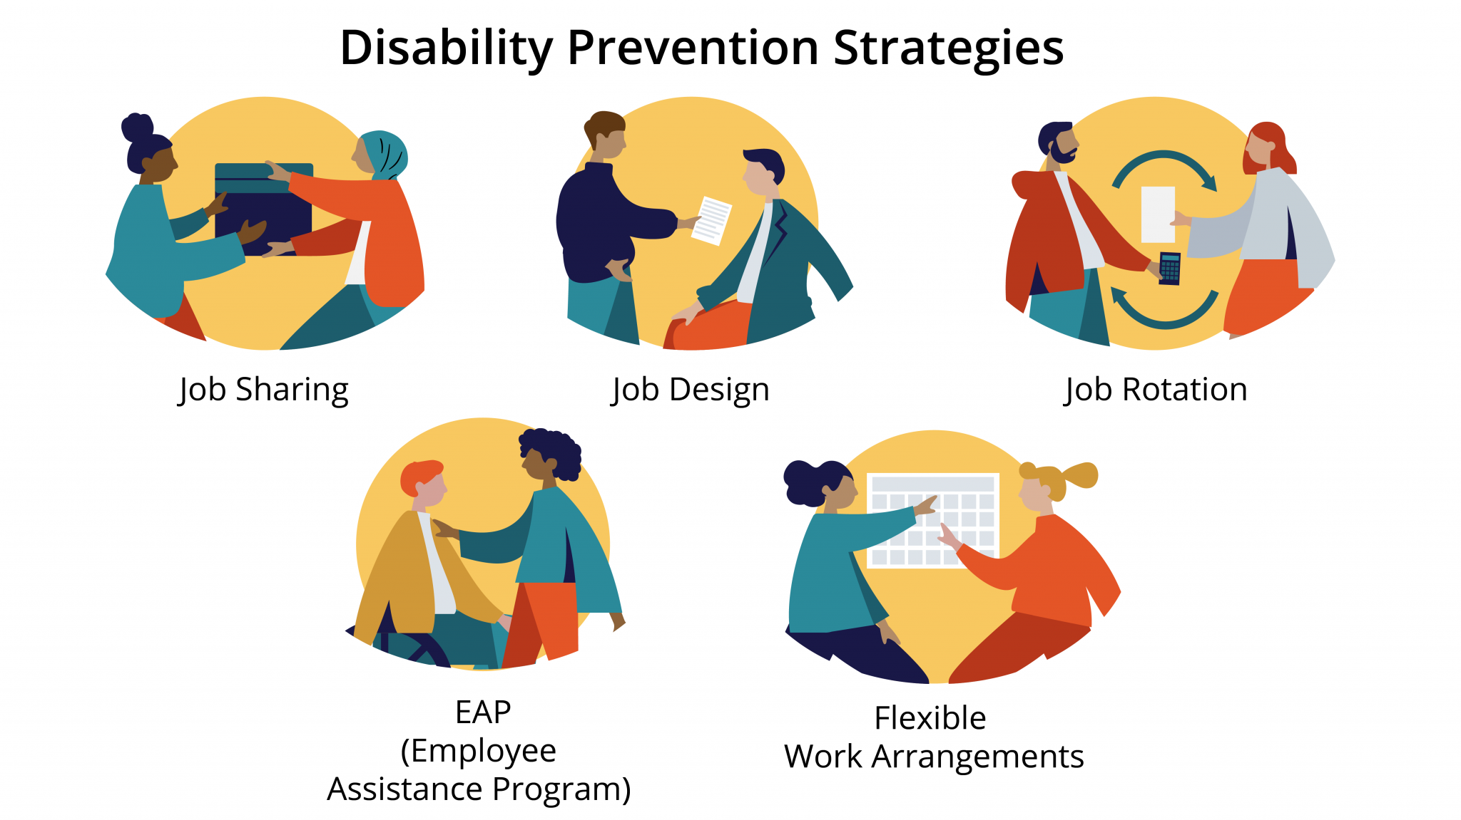
6.3 Disability Prevention
Notes:
While all employers have legislative obligations to prevent injury (as outlined in Chapter 2), some employees also provide an employee assistance program (EAP) as part of their disability management program. These programs normally provide access to short-term psychological counselling to help employees to cope with personal problems.
Some wellness initiatives that do actually modify the workplace are things like flexible work arrangements, such as compressed workweeks. In a compressed workweek, a worker puts in slightly longer hours but fewer days per week.
Some workplaces will also allow job sharing, wherein two workers share a single position with each worker working some portion of the full-time job.
Other wellness initiatives include job design and job rotation. In job design, department leaders work with the Human Resources department to review the makeup and expectations of a job to ensure the workload and physical requirements of the role are realistic and support good overall health. In job rotation, employers cross-train employees to rotate job coverage so no one person experiences an entire shift of heavy lifting, awkward positioning, or risk of repetitive strain injury.

Slide 7
6.4 Accommodation
There are a number of ways that employers commonly accommodate disabilities. The duties of worker may be modified so that the worker is able to perform them despite the disability. Once an accommodation is established, the worker is obligated to inform the employer if the need for or nature of the required accommodation changes and provide documentation to support such accommodation.
Notes:
For example, a warehouse worker with a torn rotator cuff in her shoulder may still perform those parts of their normal duties that do not require lifting, pushing, pulling, or overhead work. A machine operator who develops contact dermatitis on their hands from exposure to chemicals may be assigned to an entirely different job, such as quality checks.
Such modified work may be permanent or temporary, depending upon changes in the worker’s abilities. Accommodating permanent disabilities may also entail retraining workers to perform jobs they are presently unqualified to perform.
Employers may also make workplace modifications in order to accommodate disabilities. A common and obvious change is adjusting buildings, equipment (e.g., work stations), and tools to accommodate workers with mobility impairments.

Slide 8
6.5 Return To Work I
“Our research shows that if you don’t get a worker back within 90 days of their injury, the chances that they ever go back to work drop by 50 per cent,” said David Marshall, president and CEO of Ontario’s Workplace Safety and Insurance Board, in 2015.
Notes:
Marshall’s views are shared by many employers and OHS practitioners who see a return-to-work (RTW) program as a way to reintegrate injured workers into the workplace via practices such as modified work. As an added bonus, RTW programs save employers money on their workers’ compensation premiums.

Slide 9
6.5 Return To Work II
The final component of disability management consists of programs designed to assist workers in recovering from temporary impairment (such as injuries and illnesses) that cause disabilities. The most common disability recovery program is sick leave, which is paid leave designed to help workers recover from short-term illness or injury.
Notes:
Sick leave is so widely available because it is sometimes specifically required by employment standards legislation and generally seen as a reasonable accommodation required by human rights legislation.

Slide 10
6.5 Return To Work III
Notes:
There are numerous Stakeholders—primarily employers and workers, but also governments, unions, and medical practitioners—involved in disability management and return to work strategies. Each stakeholder brings a unique perspective to the table. It is the job of the employer to ensure the concerns of each stakeholder is taken into account as they seek to manage workplace disabilities and return to work programs, and stakeholders are included in the process.

Slide 11
6.6 Summary
The field of disability management encompasses disability prevention, accommodation, and recovery.
A complete disability management program serves to meet employers’ statutory obligations to prevent and accommodate disabilities created by occupational health and safety, human rights, and workers’ compensation legislation.
Such programs can also minimize the cost of injuries and disabilities borne by employers, primarily by returning workers to productive work as quickly as possible.

