Slide 1
Human Resources for Operations Managers
CHAPTER 5: INCIDENT INVESTIGATION
Unless otherwise noted, this work is licensed under a Creative Commons Attribution-NonCommercial-ShareAlike 4.0 International (CC BY-NC-SA 4.0) license. Feel free to use, modify, reuse or redistribute any portion of this presentation.

Slide 2
Learning Outcomes
Upon successful completion of this chapter, you will be able to:
List the steps in an incident investigation.
Articulate incident investigation reporting requirements.
Identify forms to complete during and after an incident investigation.
List the materials needed for an incident investigation toolkit.

Slide 3
5.1 Introduction To Incident Investigations
Incident investigations are intended to uncover all of the key facts about how and why an incident occurred so that action can be taken to prevent it happening again. Not conducting the investigation in a careful and thorough manner can undermine the results and create the risk of a repeat incident
Notes:
Employers are responsible for investigating workplace incidents. Before the formal incident investigation begins, the employer needs to take the necessary steps to meet both internal and external reporting requirements.

Slide 4
5.2 The Business Case For Incident Investigations
The Canadian Center for Occupational Health and Safety suggests the top reasons for conducting incident investigations include:
Most importantly, to find out the cause of incidents and to prevent similar incidents in the future
To fulfill any legal requirements
To determine the cost of an incident
To determine compliance with applicable regulations (e.g., occupational health and safety, criminal, etc.)
To process workers’ compensation claims
Notes:
Some employers may not realize the benefits of conducting a thorough incident investigation.

Slide 5
5.3 Who Investigates Workplace Incidents?
Who investigates an incident is a particularly important question.
The lead investigator should be someone with investigative experience, knowledge of the work and work processes, and an understanding of how incidents are caused. Many workplaces will task a senior health and safety official or senior manager with managing incident investigations.
Notes:
No one should investigate an incident alone, and other people should be selected to assist, to provide different perspectives, and to divide the workload.
Other possible participants should include joint health and safety committee members or some other worker representative, people linked to the work that had been performed, and, in most cases, the direct supervisor of the work (although there are cases when inclusion of the supervisor may not be appropriate).

Slide 6
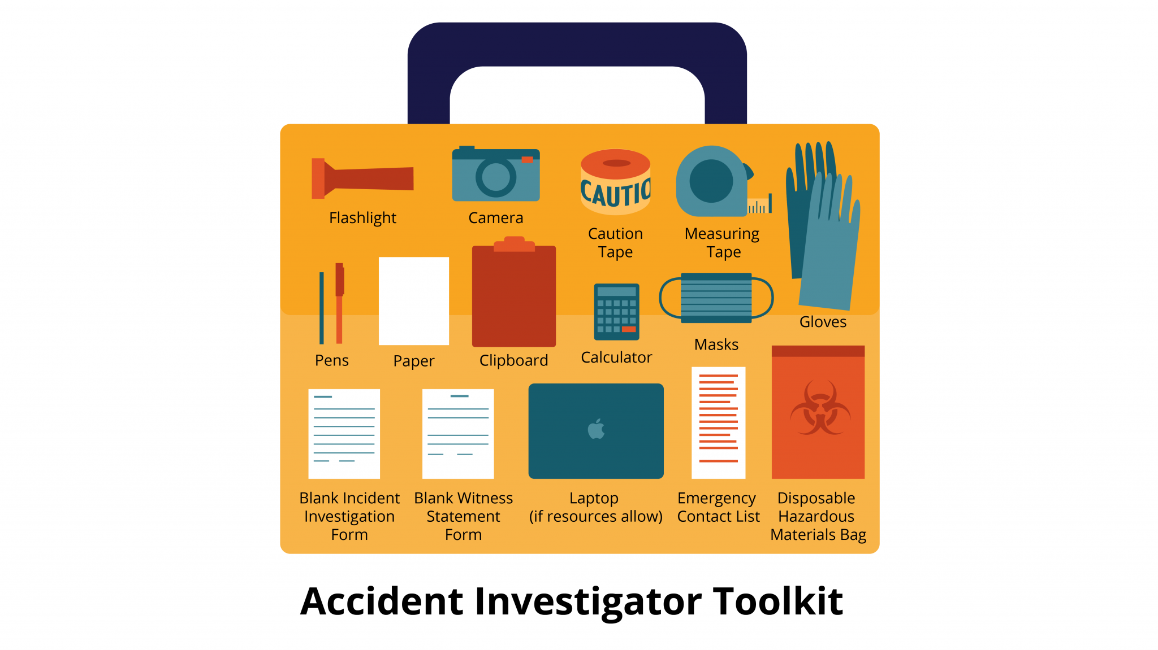
5.4 The Incident Investigation Toolkit
This graphic illustrates some of the materials that should be included in an employer’s investigation kit.
Notes:
Creation of an investigation kit is also an important pre-incident task. An incident investigation kit is a pre-assembled box or tote containing the tools, forms, and material needed in an investigation. It is recommended the employer place a piece of sealing or tamper proof tape around the investigation kit.
This sealing tape can easily be cut open and it allows the employer to quickly identify when the kit has been used in order to re-stock any missing items. Investigators can then act quickly by grabbing the kit and beginning their work.

Slide 7
5.5 Essential Incident Investigation Steps I
A successful incident investigation begins with a consistent process designed to uncover what happened so future incidents can be avoided.
Investigations need to be performed as soon after the incident as possible and be completed as quickly as possible
Photo by Scott Graham, Unsplash License
Notes:
Witnesses’ recall may deteriorate over time and important evidence may disappear if there is a delay. The sooner an investigation is completed, the sooner changes can be made to make the worksite safer. Employers may also be required to report incidents and investigation results within a specified time period.

Slide 8
5.5 Essential Incident Investigation Steps II
Step 1 - Scene Security
Step 2 - Identify and Interview Witnesses
Step 3 - Complete the Investigation
Step 4 - Root Cause Analysis
Step 5 - Reporting and Recommendations
Step 6 - Follow up
Notes:
Step 1. Scene Security - Securing the scene entails two actions. First, any uncontrolled hazard (e.g., leaking gas) needs to be eliminated to ensure the safety of the investigators and others. Second, the scene needs to be protected so that no evidence can be destroyed or altered (intentionally or unintentionally) until the completion of the investigation. Protection normally includes restricting access to the scene. In some circumstances, it may also require protecting the scene from inclement weather.
Step 2. Identify and Interview Witnesses - Investigators normally prioritize interviewing witnesses, including the injured worker(s). Witnesses should be interviewed as soon as possible after the incident while their memories are fresh and uncontaminated by discussing the event with others.
Step 3. Complete the Investigation - The next step in an investigation is to gather evidence. There are a number of techniques for collecting the relevant information. They will be used in various combinations depending on the nature of the incident and the workplace
Step 4. Root Cause Analysis - Once all the information has been gathered, the next step is to analyze the data to determine the causes. This is a crucial step, and is often where investigations go wrong. The immediate reasons for the incident will be the first to appear. These causes will usually be worker error or some factor that may appear to be uncontrollable
Step 5. Reporting and Recommendations - The next step in the investigation process is to write a formal report outlining the findings and making recommendations. In some respects this can be considered the most crucial phase, as a careful investigation is without value if the recommendations fail to improve the situation. The incident report will be the permanent record of the incident and its causes and thus should clearly outline what happened and why it happened.
Step 6. Follow up - The final step in the incident investigation process is follow up. During the reporting stage, specific recommendations were put forward which most often include corrective and preventative measures. The goal is to eliminate or minimize the risk of a similar incident happening in the future.

Slide 9
5.6 Summary
This chapter examined the key steps involved in an incident investigation.
All investigations have the task of preventing injury and ill health, meaning they should be conducted with care and precision.
Every employer must ensure they have trained incident investigators and an incident investigation toolkit on site.
There are action items that need to take place following a workplace incident, some to meet internal expectations and some to meet external expectations, such as government and legal requirements.
An employer needs to know who to contact under which circumstances, when to contact them and which forms to complete.
Every employer needs to be prepared to conduct a thorough and timely incident investigation in order to meet expectations and protect its people.

