Slide 1
Human Resources for Operations Managers
CHAPTER 4: HAZARD RECOGNITION, ASSESSMENT,
AND CONTROL
Unless otherwise noted, this work is licensed under a Creative Commons Attribution-NonCommercial-ShareAlike 4.0 International (CC BY-NC-SA 4.0) license. Feel free to use, modify, reuse or redistribute any portion of this presentation.

Slide 2
Learning Outcomes
Upon successful completion of this chapter, you will be able to:
Explain how to identify a workplace hazard.
List hazard assessment techniques.
Explain how to control hazards at the source-path-employee.

Slide 3
4.1 Hazard Recognition, Assessment & Control
Hazard recognition (which is sometimes called hazard identification) is the systematic task of identifying all hazards present, or potentially present, in a workplace. It is the first step of any HRAC process.
The second step is hazard assessment (which is sometimes called hazard analysis). In a hazard assessment, workers and employers determine which of the hazards needs to be addressed most urgently.
Finally, the hazard control process sees preventive and corrective measures implemented to eliminate or mitigate the effect of the hazard(s)
Notes:
The key to preventing workplace injuries and fatalities is to identify hazards and control them, otherwise known as Hazard Recognition, Assessment and Control (HRAC).
This chapter examines how workers and employers identify, prioritize, and control workplace hazards. A workplace hazard is anything that might harm, damage, or adversely affect any person or thing under certain conditions at work. It can be an object, process, context, person, or set of circumstances which has the potential to create injury or ill health. While this definition may seem vague, it is intentionally vague in order to ensure that anything that could potentially harm a worker is included.

Slide 4
4.2 Hazard Recognition, Assessment & Control I
Let’s review the business case for making hazard recognition a key activity at work.
Reduce Risk. The best way to reduce the number of workplace incidents is to avoid the incidents completely. Get ahead of the hazards, be proactive, identify hazards, assess risk, and implement the controls necessary to minimize or eliminate the risk.
Financial. The investment in hazard recognition is low compared to the cost of a workplace incident. Employees that will assist with hazard recognition are already on the payroll. The employer needs to task employees to complete a thorough review of the workplace.
Participation - In some jurisdictions, the legal system talks about the “rights of the worker” which includes the right to know and the right to participate.
Notes:
Hazard recognition or identification is perhaps that most important function of an employer, a safety program, a health and safety representative/committee
1. An example, if the employer identifies low-lighting in the parking lot, have the lighting fixed, updated, replaced to reduce the chance of a workplace incident in the parking lot such as a slip and fall or a theft. The goal of the hazard recognition activity is to eliminate or reduce the risk of future incidents.
2. Don’t forget meeting rooms, washrooms, eating areas, storage cabinets and parking lots. The employer may choose to hire a third-party company to assist or lead the hazard recognition activity. Either way, the cost of these pro-active activities is less than the cost of a workplace incident.
3. There is no easier way to provide workers with the right to participate than to involve them in the identification of workplace hazards. An example, strike a small committee consisting of members of the health and safety committee and employees that work in the maintenance area to perform a walk through of the maintenance area to identify hazards that others may not see.

Slide 5
4.2 Hazard Recognition, Assessment & Control II
4. Training. Once an employer identifies workplace hazards, it is easy to establish a safety training program.
5. Due Diligence. At the center of each safety program is due diligence, or the act of doing everything possible to ensure the safety of individuals in the workplace.
6. Internal Responsibility System. The IRS or Internal Responsibility System suggests everyone is responsible for safety
7. Compliance and Record Keeping. Should an employer need to provide evidence of their safety program and compliance with safety legislation, keeping hazard identification forms on file is a required practice.
Notes:
4. An example, a wheelchair manufacturer recognizes they cannot eliminate the use of sharp objects and metal in their work process. They implement a “sharps” training program that emphasizes the use of proper PPE (Personal Protective Equipment) such as gloves, to every employee and re-trains employees on the sharps safety program annually.
5. An example, employers should the appropriate safety signage is located throughout their workplace in languages that represent the diversity of their employees.
6. An example, at the monthly staff meeting, the leadership team encourages employees to report hazards in the workplace and reviews safety concerns identified in the past 30 days, as well as the actions taken to eliminate or minimize each hazard.
7. For example, should an organization receive unplanned visit from their government safety agency or ministry, the organization must be able to retrieve hazard identification records that demonstrate a pro-active approach to safety.

Slide 6
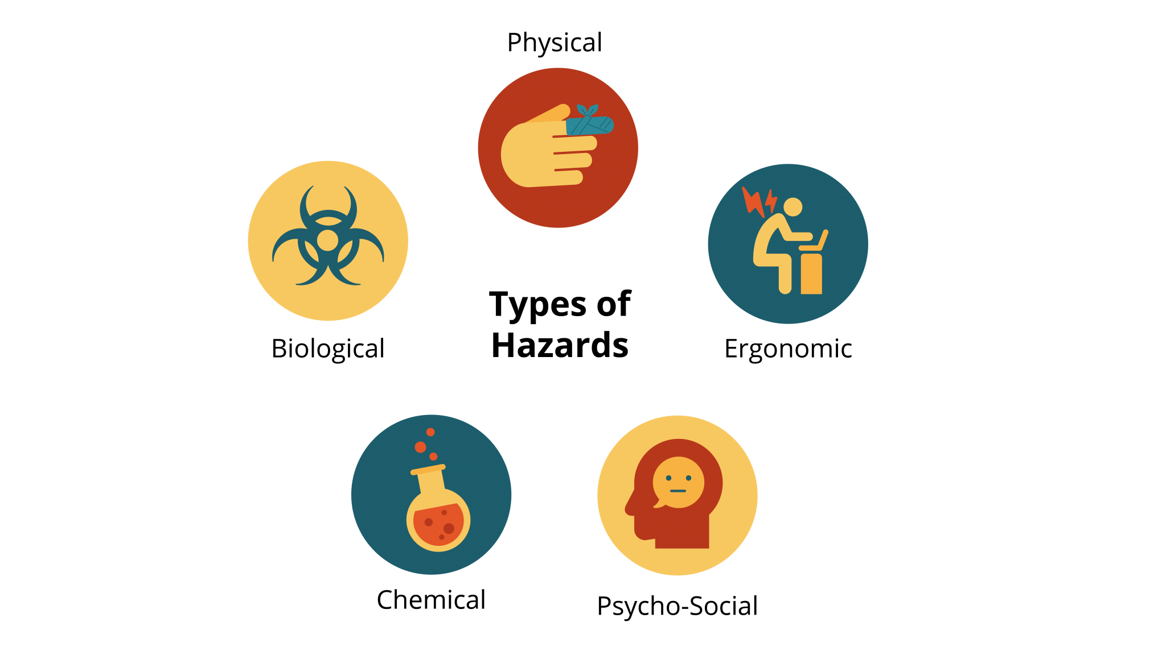
4.3 Types of Hazards
Notes:
The HRAC process starts with comprehensively identifying all the hazards in a workplace. The five categories of hazards include physical, ergonomic, chemical, biological and psycho-social. Let’s review each one in detail.
Physical hazards typically entail a transfer of energy from an object, such as a box falling off a shelf, which results in an injury. These are the most widely recognized hazards and include contact with equipment or other objects, working at heights, and slipping.
Ergonomic hazards occur as a result of the interaction of work design and the human body, such as work-station design, tool shape, repetitive work, requirements to sit/stand for long periods, and manual handling of materials.
Chemical hazards cause harm to human tissue or interfere with normal physiological functioning. The short-term effects of chemical hazards can include burns and disorientation. Longer-term effects of chemical hazards include cancer and lead poisoning.
Biological hazards are organisms—such as bacteria, molds, funguses—or the products of organisms (e.g., tissue, blood, feces) that harm human health.
Psycho-social hazards are social, environmental, and psychological factors that can affect human health and safety. These hazards include harassment and violence but also incorporate issues of stress, mental fatigue, and mental illness.

Slide 7
4.3 Hazard Identification
Hazard Identification Techniques
There are a variety of hazard-identification techniques, and these are often used in combination to create a fuller picture of a workplace’s hazards:
Inspecting the workplace:
Talking with workers
Job inventory
Records and data
Measuring and testing
Research
Notes:
Inspecting the workplace: Physically observing the workplace and how work is performed within it is a powerful step in identifying hazards.
Talking with workers: Passive observation can miss many important aspects of how work is performed. Getting the perspective of the people conducting the work will reveal other insights.
Job inventory: Acquiring job descriptions and specifications can also reveal hazards. Mapping out the flow of work to create a task analysis allows for a systematic examination of how a job is supposed to be conducted.
Records and data: Reviewing records of previous workplace incidents, safety reports, and other documentation can yield useful information about the hazards in a workplace.
Measuring and testing: Sometimes, to discover if something is a hazard, you will need to measure or test it. This is particularly true for noise, chemical hazards, and biological hazards.
Research: Knowing something is present in the workplace may be insufficient to determine if it is a hazard. You may need to conduct research on a substance, material, design, or environment to assess its potential for harm

Slide 8
4.4 Hazard Assessment I
Once hazards have been identified, it is necessary to prioritize which hazards will be controlled first. Much like hazard recognition, hazard assessment is not just a technical practice. Through prioritizing, certain hazards will be brought to the forefront, and will therefore be more likely to be controlled, while others will be downgraded and likely receive little or no attention.
Notes:
It is important to be mindful of who benefits and who is harmed by the prioritization decisions

Slide 9
4.4 Hazard Assessment II
A risk assessment quantifies the likelihood of injury or ill health by assessing the probability, consequences, and exposure posed by the hazards:
Probability is the likelihood that the hazard will result in an incident.
Consequences refers to the severity of injury or ill health that will result from an incident.
Exposure refers to how often or regularly workers come in contact with the hazard.
Notes:
Risk assessment is a common tool used by those determining the priorities in hazard assessment. Risk is the likelihood that a hazard will result in injury or ill health.

Slide 10
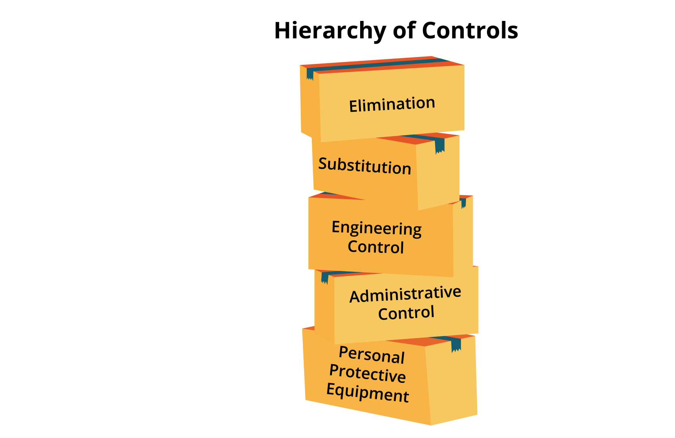
4.5 Hazard Control I
Hazard control is a regulatory requirement in every Canadian jurisdiction and entails implementing measures to eliminate or reduce the potential of a hazard causing an incident.
Notes:
Employers must exercise due diligence in the HRAC process in order to avoid prosecution for any workplace injuries under OHS law. Some forms of hazard control are more effective than others, and, consequently, a hierarchy of controls (with five levels) has been established:
Elimination removes the hazard from the worksite. For example, relocating work performed at a height to ground level eliminates the risk of falling. This control is most easily implemented at the design stage, thereby preventing the hazard from entering the workplace.
Substitution entails replacing something that produces a hazard with something that does not. For example, we might replace chemical-based cleaning solvents with plant oil–based solvents.
Engineering controls are modifications to the workplace, equipment, materials, or work processes that reduce workers’ exposure to hazards
Administrative controls are changes to work process, policies, training, or rules designed to reduce exposure to hazards
Personal protective equipment (PPE) is equipment worn by workers that is designed to protect them should they come into contact with a hazard.

Slide 11
4.5 Hazard Control II
Notes:
Multiple controls can be combined to provide a higher degree of control. Different levels of control may be appropriate at different times. For example, when first addressing a hazard it may be necessary to use PPE until a more permanent engineering control can be implemented. It is important to not unduly delay the implementation of the (likely more effective) engineering control.
Control at the source addresses the hazard where it first occurs. This type of control prevents the hazard from entering the workplace via elimination, substitution, or some types of engineering controls.
Control along the path addresses the hazard at some point between its source and when workers encounter the hazard (i.e., it prevents the hazard from reaching the worker).
Control at the worker implements controls over the hazard only after it reaches the worker. These controls are designed to prevent or reduce the consequences of the hazard, rather than control the hazard itself.

Slide 12
4.6 Key Takeaways
While the HRAC process doesn’t guarantee that workers will never be injured on the job, it can dramatically reduce the incidence of workplace injuries and fatalities.
HRAC is not immune from the conflicts inherent in the employment relationship.
Employers and workers each have vested interests in the outcomes of an HRAC process.
Collaboration is key to the hazard recognition, assessment, and control process. Stackholders from various areas of the business need to be included in the hazard identification, assessment and control process in order to eliminate or reduce workplace incidents.

