Slide 1
Human Resources for Operations Managers
CHAPTER 14: COMMUNICATION AND CONFLICT
RESOLUTION
Unless otherwise noted, this work is licensed under a Creative Commons Attribution-NonCommercial-ShareAlike 4.0 International (CC BY-NC-SA 4.0) license. Feel free to use, modify, reuse or redistribute any portion of this presentation.

Slide 2
Learning Outcomes
Upon successful completion of this chapter, you will be able to:
Explain how social media communication impacts the workplace.
List effective conflict resolution strategies.
Explain how to deliver difficult messages.

Slide 3
14.1 Communication In The Digital Age
Developing conversational skills is hugely important by the time they enter a workforce mostly populated by older generations that grew up without smartphones, developed those advanced conversational skills the hard way by making mistakes and learning from them, and expect well-developed conversational skills of younger generations entering the workforce.
Notes:
Though plenty of business is done online these days, there really is no good substitute for face-to-face interaction.
Customer service aside, face-to-face interactions are still vitally important to the functioning of any organization.
In a study on the effectiveness of in-person requests for donations versus requests by e-mail, for instance, the in-person approach was found to be 34 times more successful.
Our responsibility in handling that mix requires that we become competent in the use of a variety of devices that bring us a competitive advantage in our work.

Slide 4
14.2 Electronic Written Communication I
While working in Operations Management, you will be required to use electronic channels of communication. E-mail deserves a close look because it is the most widespread and established of the electronic forms. Since so much of our lives are wrapped up in electronic interaction, reviewing the netiquette principles established at the outset of the electronic communications revolution can actually help us move forward as we look at the newest and fastest communication channels, texting and instant messaging.

Slide 5
14.2 Electronic Written Communication II
The Writing Process
When creating an e-mail, it is important to consider your audience, the intended message and the desired outcome.
Photo by Stephen Phillips - Hostreviews.co.uk, Unsplash License
Notes:
Let’s begin with the audience. Is your e-mail intended for one person, a department or an entire organization? Next, consider the purpose of your e-mail. Perhaps you are providing information to others, such as the results of a recent survey. Finally, consider whether you are going to provide the reader with an action item, such as providing you with their feedback within 2 days.
It is best to create a draft of your e-mail and review it for accuracy. For extremely important e-mails, it may be helpful to draft the e-mail one day early and return to it the following day for a final proofread before hitting “send”. Should you write an e-mail while upset, it is best to create a draft of your proposed e-mail and then revisit the e-mail the following day before sending it to the intended audience.
Once 24 hours have passed, you will often read your draft e-mail and decide not to send it as time has passed and you can see the situation more clearly.
NB….. Although e-mail is certainly a convenient method of communication, it isn’t always the right method of communication.

Slide 6
14.3 Netiquette And Social Media I
We create and curate personal profiles, post content and comments, and interact via social media as a normal part of both our personal and professional lives. How we conduct ourselves on the open internet can leave a lasting impression, one not so easily undone if it’s regrettable.
Notes:
The hilarious but compromising selfie you posted on Instagram five years ago is still there for your potential employer to find, judge for what it says about your professionalism, and speculate about what customers might think if they saw it too. Some guidance about what can be done about those mistakes, as well as how to conduct ourselves properly moving forward, can help improve your employability.^{[1]}

Slide 7
14.3 Netiquette And Social Media II
Virginia Shea’s Rules of Netiquette offer helpful guidelines for online behaviour:
Remember the human on the other side of the electronic communication.
Adhere to the same standards of behaviour online that you follow in real life.
Know where you are in cyberspace.
Respect other people’s time and bandwidth.
Make yourself look good online.
Share expert knowledge.
Keep flame wars under control.
Respect other people’s privacy.
Don’t abuse your power.
Be forgiving of other people’s mistakes.
Notes:
Legal Responsibilities - Your writing in a business context means that you represent yourself and your company. What you write and how you write it can be part of your company’s success but can also expose it to unintended consequences and legal responsibility. When you write, keep in mind that your words will keep on existing long after you have moved on to other projects.
Using Social Media Professionally - Review sites, blogs, tweets, and online community forums are some of the continually developing means of social media being harnessed by business and industry to reach customers and other stakeholders. People’s comfort in the online environment forces businesses to market and interact there or risk a massive loss in sales and interest.

Slide 8
14.4 Traditional Written Communication I
Traditional document forms that are still vital to the functioning of modern businesses. Despite origins as handwritten and typed hard-copy documents, letters, memos, reports, and proposals continue to prove their worth both in the form of printed hard copies and electronic documents shared by e-mail. Every professional should familiarize themselves with the conventions associated with each type of document so that they can use them to achieve their particular purposes.

Slide 9
14.4 Traditional Written Communication II
Letters
As one of the most formal documents you can send, a letter conveys a high degree of respect to its recipient. Sending a letter is your way of saying that the recipient matters
Photo by Towfiqu barbhuiya, Unsplash License

Slide 10
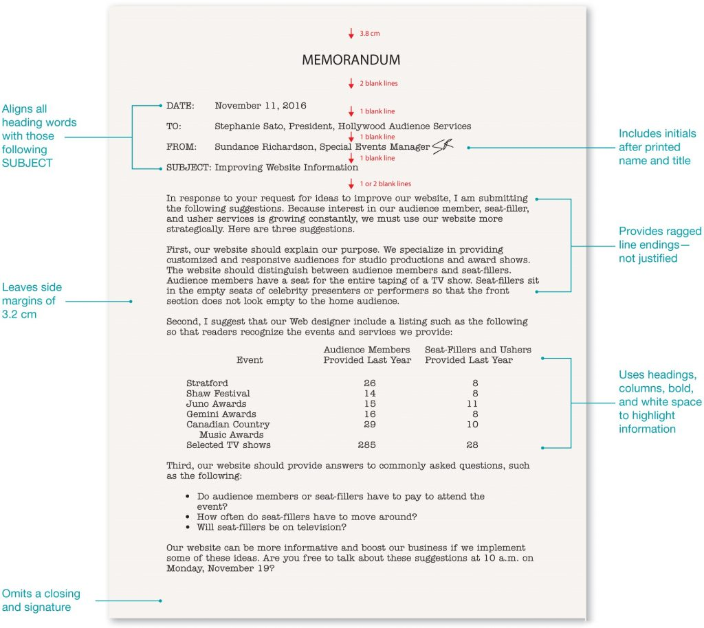
14.4 Traditional Written Communication III
Memos
A memo (or memorandum, meaning “reminder”) communicates policies, procedures, short reports, or related official business within an organization.
“Four Components of a Memo” by Jordan Smith, CC BY 4.0
Notes:
A memo assumes a one-to-all perspective, broadcasting a message to a group audience, rather than to an individual. Memos are objective in tone and avoid all personal bias or subjective preference, especially because they may have legal standing when reflecting policies or procedures. Accuracy is therefore paramount in memos lest ambiguities result in mistakes that then become legal matters.
Memo Purpose - A memo’s purpose is often to inform, but it occasionally includes an element of persuasion or call to action. Memos are most appropriately used for internal organizational messages that may be too detailed or too long to be communicated via an e-mail. Memos allow organizations to clearly spell-out for all employees what is going on with a particular issue.

Slide 11
14.4 Traditional Written Communication IV
Proposals
A proposal is a business document that makes a case for your product or service to a hiring company or funding organization. Knowing how to write a proposal is a vital skill in business because organizations seeking services from business-to-business contractors will often put out a request for proposals, or RFP, to select the right contractor to perform the work.
Photo by Alexander Grey, Unsplash License
Notes:
A proposal formally bids on that contract and is therefore essential to gaining work.
Purpose - Effective business proposals are built around a great idea or solution. While you may be able to present your normal product, service, or solution in an interesting way, you want your document and its solution to stand out against the background of competing proposals.

Slide 12
14.5 Delivering Difficult Messages I
Just as in life, the workplace isn’t always sunny. Sometimes things don’t go according to plan, and it’s your job to communicate about them in a way that doesn’t ruin your relationships with customers, coworkers, managers, the public, and other stakeholders. When doing damage control, bad-news messages require care and skillful language because your main point will meet resistance.
Notes:
Rarely are people okay being told that they’re laid off, their application has been rejected, their shipment got lost en route, prices or rates are increasing, their appointment has to be moved back several months, or they’re losing their benefits. Though some people prefer that the messenger be blunt about it, in most cases you can assume that the receiver will appreciate or even benefit from a more tactful, indirect approach.

Slide 13
14.5 Delivering Difficult Messages II
The Seven Goals of Bad-news Messages
Be clear and concise to avoid being asked for additional clarification.
Help the receiver understand and accept the news.
Reduce the anxiety associated with the bad news as much as possible by expressing sympathy or empathy.
Maintain trust and respect between you and your audience to ensure the possibility of good future relations.
Deliver the bad news in a timely fashion in the appropriate channel(s).
Avoid the legal liability that comes with admitting negligence or guilt.
Achieve the designated business outcome.
Notes:
Your ability to manage, clarify, and guide understanding is key to addressing challenging situations while maintaining trust and integrity with customers, coworkers, managers, the public, and other stakeholders.

Slide 14
14.5 Delivering Difficult Messages III
Organizing an Indirect Bad-news Message
Key to avoiding misunderstandings when delivering bad news, then, is the following four-part organization:
Buffer
Justification
Bad news + redirection
Positive action closing
Notes:
Key to achieving Goal #2 of delivering bad news—i.e., helping the receiver understand and accept information they don’t want to hear or read—is organizing the message using the indirect approach. If you tactlessly provide your audience with really bad news, you run the risk of them rejecting or misunderstanding it because they may be reeling from the blow and be too distracted with anger or sadness to rationally process the explanation or instructions for what to do about the bad news.
Bad-news Message Buffer - Begin with neutral or positive statements that set a goodwill tone and serve as a buffer for the information to come. A buffer softens the blow of bad news
Bad-news Justification - The justification explains the background or context for the bad news before delivering the bad news itself.
The Bad News Itself and Redirection - Burying the bad news itself in the message is a defining characteristic of the indirect approach. It’s akin to the “hamburger” organization of constructive criticism sandwiched between statements of praise
Positive Action Closing- As we’ve seen in previous explorations of message organization, the closing here involves action information. If your redirection involves some alternative, such as a recommendation to apply elsewhere, some follow-up details here would help the reader focus on the future elsewhere rather than getting hung up on you and your company’s decision.

Slide 15
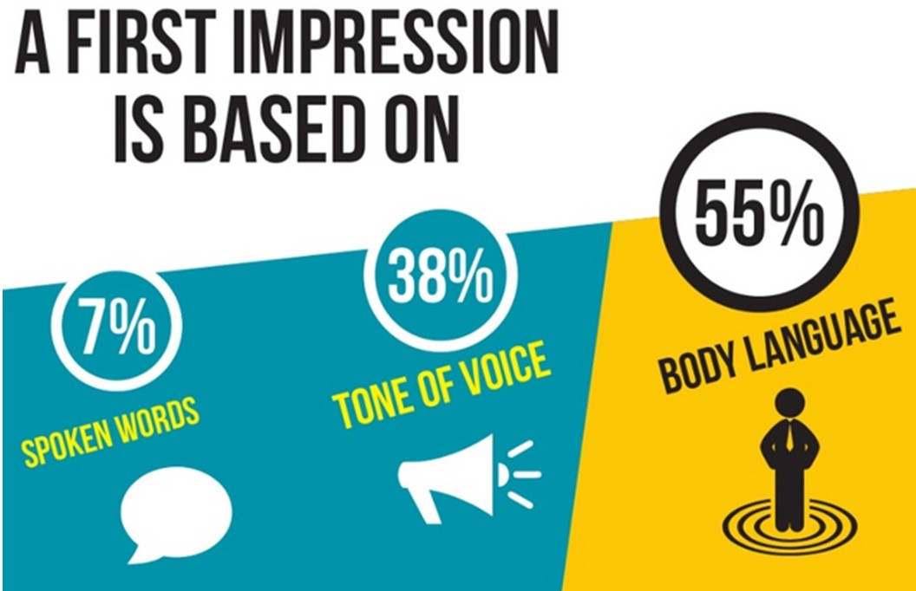
14.6 Non-verbal Communication I
Nonverbal communication is the process of conveying a message without the use of words. It can include gestures and facial expressions, tone of voice, timing, posture and where you stand as you communicate.
Nonverbal communication makes up 93% of our communication, (Steemit, 2017)
Notes:
Non-verbal communication can help or hinder the clear understanding of your message, but it doesn’t reveal (and can even mask) what you are really thinking.
It’s not always what you say, but how you say it that makes a difference. We sometimes call this “body language,” or “nonverbal communication,” and it is a key aspect of effective business communication.

Slide 16
14.6 Non-verbal Communication II
Types of Non-verbal Communication
Eight types of non-verbal communication are:
Body language
Space or Proxemics
Paralanguage
Time or Chronemics
Physical Characteristics
Touch
Artifacts
Environment

Slide 17
14.6 Non-verbal Communication III
Developing Your Non-verbal Communication Skills
Nonverbal communication is an important aspect of business communication, from the context of interpersonal interaction to a public presentation. It is a dynamic, complex, and challenging aspect of communication. You are never done learning and adapting to your environment and context, and improving your understanding of nonverbal communication comes with the territory.
Notes:
three ways to develop your nonverbal communication skills
1. Watch Reactions - Market research is fundamental to success in business and industry. So, too, you will need to do a bit of field research to observe how, when, and why people communicate the way they do.
2. Enroll an Observer - Most communication in business and industry involves groups and teams, even if the interpersonal context is a common element. Enroll a co-worker or colleague in your effort to learn more about your audience, or even yourself
3. Focus on a Specific Type of Nonverbal Communication - What is the norm for eye contact where you work? Does this change or differ based on gender, age, ethnicity, cultural background, context, environment? Observation will help you learn more about how people communicate; looking for trends across a specific type of nonverbal communication can be an effective strategy. Focus on one behaviour you exhibit, like pacing, hand gestures, or eye contact.

Slide 18
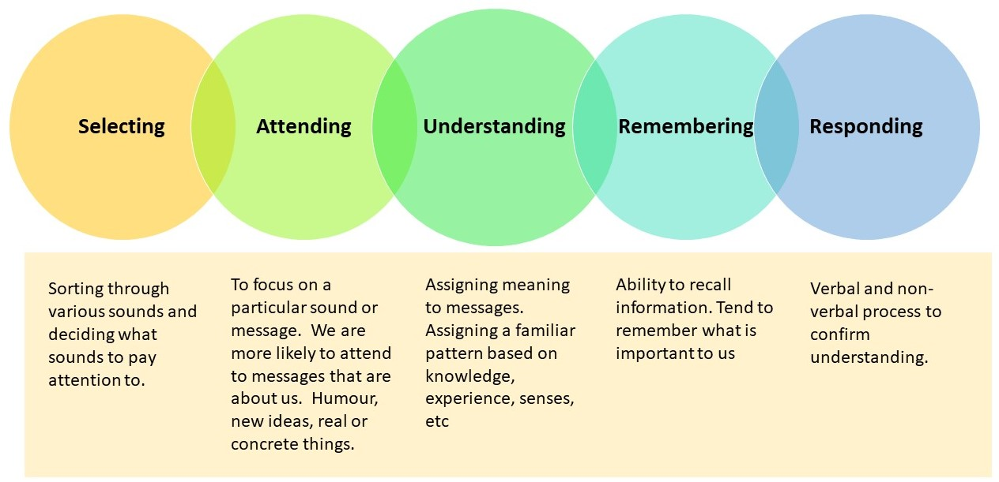
14.6 Non-verbal Communication IV
Active Listening
"The steps in the listening process' by Jordan Smith, CC BY 4.0
Notes:
There are five steps in the listening process: selecting, attending, understanding, remembering, and responding.
Here are some tips to facilitate active listening:
Maintain eye contact with the speaker
Don’t interrupt
Focus your attention on the message, not your internal monologue.
Restate the message in your own words and ask if you understood correctly.
Ask clarifying questions to communicate interest and gain insight.

Slide 19
14.7 Conflict Resolution Strategies I
Conflict Resolution
Conflict arises everywhere communication occurs and can be very costly. Effective communicators can predict, anticipate, and formulate strategies to address conflict in order to successfully resolve it. How you choose to approach conflict influences its resolution. Conflict can be cognitive or affective.
Notes:
Cognitive conflict is productive and constructive. As we discussed, during the storming stage of team formation, there is often conflict. However, the conflict is focused on the tasks, responsibilities, and roles and often serves to clarify these variables and create a clearer vision for the team when the conflict is resolved.
Affective conflict, however, is destructive. Here, disagreements are about personalities, personal choices, and feelings. This sort of conflict can lead to permanent group division and disharmony.

Slide 20
14.7 Conflict Resolution Strategies II
Conflict Management Skills
When conflict is serious enough that it causes a rift within the workplace culture, the kind that pollutes the work atmosphere and threatens irreparable damage, a methodical, collaborative approach to conflict resolution can help lead to an amicable solution.
Some conflict management options include:
Confront and Problem Solve
Reframing:
Appeal to Third Party
Negotiation
Notes:
NB - Conflicts are inevitable, but conflicts do not have to be dysfunctional. Understanding your conflict management style and possessing some conflict resolution skills will make you more effective in the work environment.
Confront and Problem Solve: The most effective manner of resolving a conflict is to address it directly. First, the true source of the conflict must be identified. The confrontation in this approach is gentle and tactful no combative and abusive. To ensure this strategy works, allow some time to pass between the conflict and problem-solving. An important advantage of this option is its focus on the issue that caused the conflict and not on the personalities involved in the conflict.
Reframing: Looking at a conflict from an alternative point of view helps to shed light on the causes of the conflict. Cognitive restructuring allows you to reframe the conflict and to gain insight into possible solutions. How you frame or choose your thoughts can determine the outcome of a conflict. Seeing the conflict from the other side allows you to also deal with the conflict in a positive way.
Appeal to Third Party: When there seems no path to a resolution, enlist the help of a third party with more power than you or the other parties in the conflict have. In many cases, simply suggesting that a third party will be contacted will encourage all parties to find their own resolution.
Negotiation: Conflicts often involve negotiations. Negotiations require that all parties are open to cooperating and to compromise. Negotiation takes place frequently in the workplace. The achieve the best negotiations: create a positive negotiating environment, practice active listening, be reasonable, focus on common ground, make a last and final offer, be tactful.

Slide 21
14.8 Key Takeaways
Advanced communication skills, whether written or verbal, will be part of your success in Operations Management.
You will be required to send e-mail on behalf of your organization, lead meetings and write policies for your department.
You will also need to navigate the world of social media as it can be both a friend and a foe of your company.
You will need to deliver difficult messages and resolve conflict in the workplace.
Taking professional development courses to build your communication and conflict resolution skills will help you navigate the day-to-day expectations of your role in Operations Management.

