Slide 1
Human Resources for Operations Managers
CHAPTER 13: EMPLOYEE DEVELOPMENT
Unless otherwise noted, this work is licensed under a Creative Commons Attribution-NonCommercial-ShareAlike 4.0 International (CC BY-NC-SA 4.0) license. Feel free to use, modify, reuse or redistribute any portion of this presentation.

Slide 2
Learning Outcomes
Upon successful completion of this chapter, you will be able to:
Describe the importance of succession planning at work.
List the various methods used to develop an employee.
Explain the use of a career development plan.

Slide 3
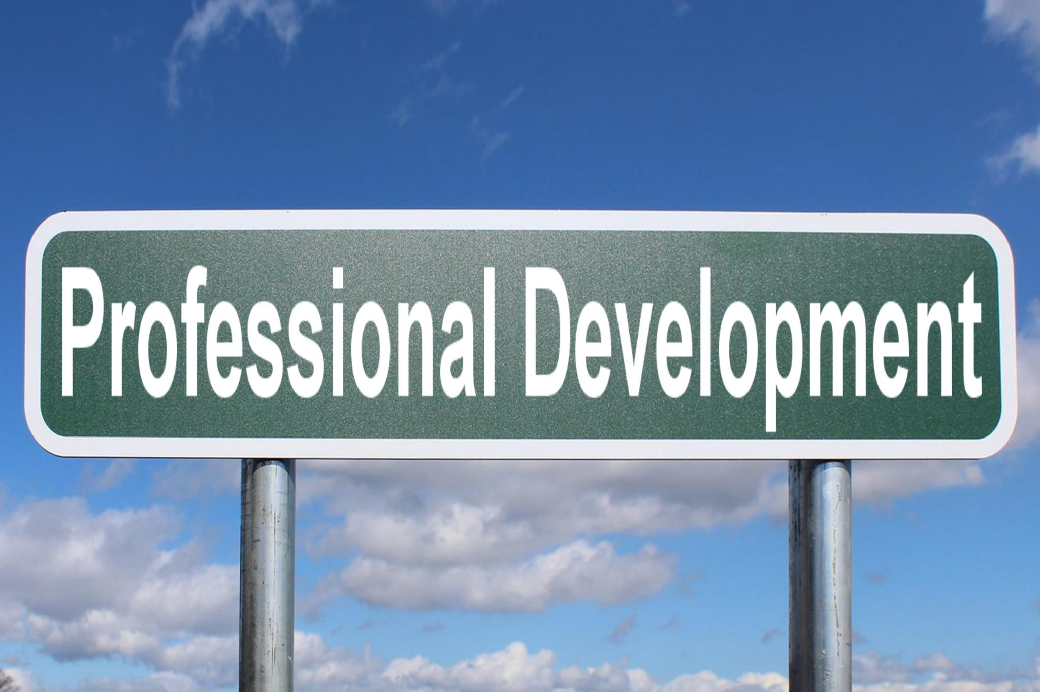
13.1 Employee Development
Employee development should be considered a natural extension of training. Like training, this process is concerned with the growth of employees.
“Professional Development” by Nick Youngson, CC BY-SA 3.0
Notes:
However, unlike training which occurs in a short period and is targeted at specific KSAs, employee development unfolds over a longer period of time and targets a more general set of competencies

Slide 4
13.2 Employee Development Business Case
As an Operations Manager, you will need to invest time, money and effort into developing existing employees in preparation for future roles and the growth of your organization.
Business case for employee development within your organization:
Staffing and Skills Shortage Employee Turnover The Competition Equity, Diversity and Inclusion Talent Acquisition Strategic Planning | Productivity Culture of Learning Institutional Knowledge Morale and Engagement Specialized Competencies
Notes:
While hiring managers typically turn to the Talent Acquisition team to hire such talent, competition for qualified job candidates is high and organizations must look within and develop their existing talent. Let’s review the business case for employee development within your organization.
Staffing and Skills Shortages- Those that work in Talent Acquisition will tell you, it is hard to find employees that possess the skills needed to fill existing job openings. Some employers are partnering with higher education facilities to develop courses for their employees
Employee Turnover - Why does an employee decide to leave an organization? Some individuals suggest their manager is the problem, their workload is too great, or the culture is lacking. Others point to a lack of flexibility or a lack of employee development
The Competition - Regardless of your industry, there is always “the competition”. They are happy to hire your employees and take from your business. The competition for skilled staff has never been so high.
Equity, Diversity, and Inclusion - If an organization wants to be known as an employer of choice, the business needs to hire individuals at every level of the organization that represent the community in which they work
Strategic Planning - Does your organization conduct regular needs analysis to determine the skills your employees need? Perhaps you have three Operations Managers that will be retiring in the next 5 years.
Productivity - Workers who recognize the time and effort an organization is investing into their career are motivated to work hard. You will seldom find individuals that are bored at work if they are valued and included in the future of the company .
Culture of Learning - The culture of an organization matters. Prospective employees are often attracted to company’s that are made up of good people, exhibit a concern for the environment, and are effective in what they do.
Institutional Knowledge - Think about the institutional knowledge your employees possess. After years of working for your organization, many of your employees are paid for their analytical and problem solving (what they know) as opposed to what they do for your company.
Morale and Engagement - How happy are your employees? An employee’s attitude, participation, engagement and morale tend to increase when offered meaningful employee development programs such as a career development plan.
Specialized Competencies - There is a good chance that your organization employs a number of individuals that will be difficult to replace. Perhaps your CEO is going to retire, or your subject matter expert in the quality department is going on a leave.

Slide 5
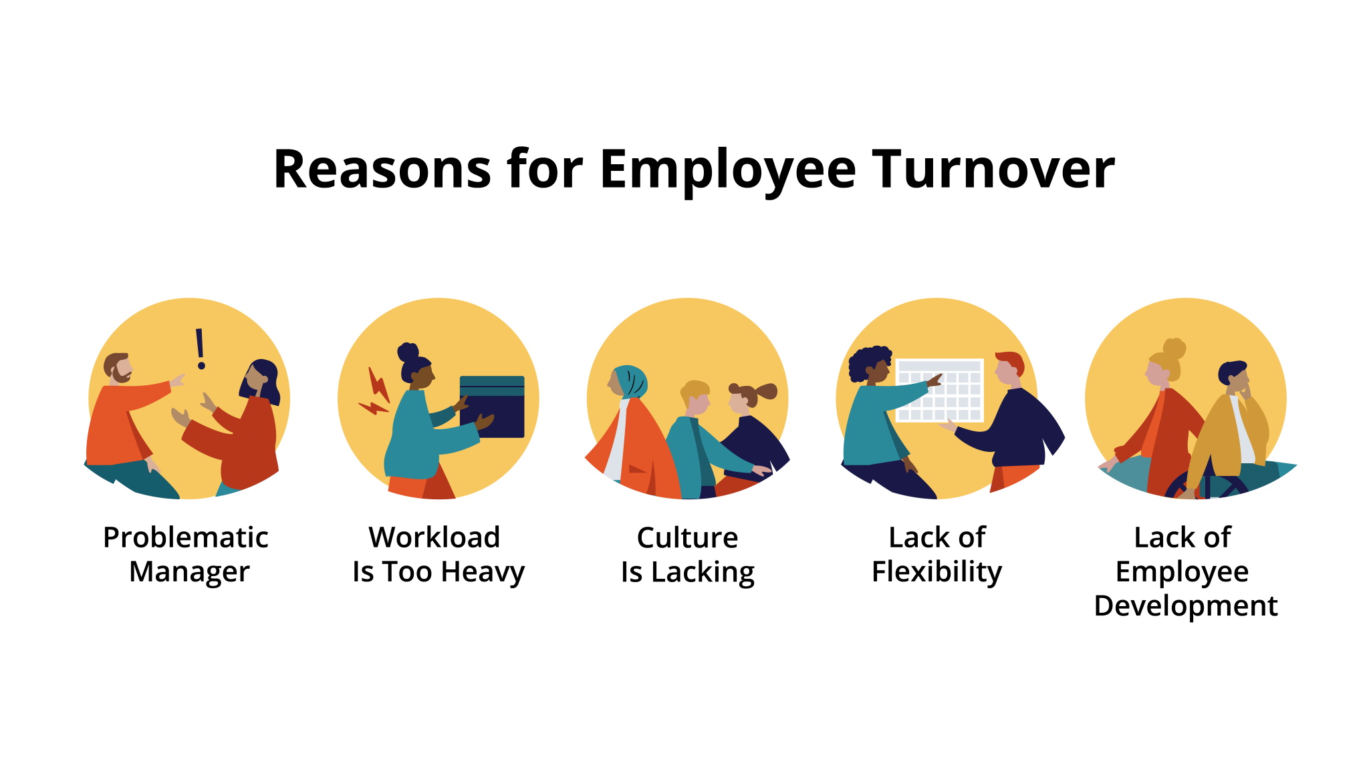
13.2 Reasons for Employee Turnover
Notes:
Why does an employee decide to leave an organization? Some individuals suggest their manager is the problem, their workload is too great, or the culture is lacking. Others point to a lack of flexibility or a lack of employee development .
Employee development takes time. Organizations that fail to offer an employee development program to their employees may signal they do not recognize the value of their existing employees. Employees expect their company will invest in their development to assist with their career path and promotability.

Slide 6
13.3 Succession Planning
Succession planning is key to the success of organizations. An organization should always be concerned with the growth and development of its next generation of leaders. This is sometimes referred to as an organization’s “bench strength”, meaning who is ready and up next to take on a role within your business.
Notes:
Because this development unfolds over many years, succession planning has to be a constant priority for HR managers and Senior Management. It usually takes 20 years to develop the CEO of a large organization, so one must start early and be very proactive to ensure that the pipeline of leadership talent for top positions is healthy.
Terminology - It is helpful to become familiar with some of the terminology surrounding succession planning, such as career planning and career management.
Career Planning - Career Planning focuses on the employee and their career interests. An organization would provide the individual with development options that align with their individual goals.
Career Management - Career Management focuses on the business objectives of the organization. The goal is to create positions and structures that support these business objectives.
Succession Planning- Succession Planning focuses on the future. It involves the identification of skills and abilities needed to perform jobs within the organization and developing a pipeline of people to fill these roles.
Replacement Planning- Replacement Planning involves the identification of employees that would be suitable replacements for open roles in key areas of the operation.
Training - Training focuses on an individual’s current role and provides them with the skills, ability and knowledge to perform their job.
Development - Development focuses on the long-term game with the goal of preparing employees for roles and responsibilities they will take on in the future.

Slide 7
13.3 Succession Planning II
Succession Planning Obstacles While we want to focus on the positives of succession planning, being aware of the possible challenges allows the implementation team to plan for and mitigate such obstacles.
Leadership Support is essential to the success of any internal program
Resistance to Change is yet another challenge to overcome. This resistance to change could come from your leaders and/or your employees.
Departmental Resistance can be expected. You are asking departmental managers to let some of their best talent join your succession planning program.
Notes:
Do your leaders understand the skills gaps, the staffing shortages, the competition to hire candidates and why your organization needs to build a talent pipeline? Ensuring you have leadership buy-in will help launch your succession planning program forward and draw the attention of prospective internal candidates.

Slide 8
13.4 Employee Development
Employee Development Guidelines
A successful employee development program involves buy-in and a connection to the overall goals of the organization. Let’s look at a few guidelines that help support this initiative:
Buy-In
Involvement
Connection
Values
Outcome
Notes:
Buy-In - Holding meetings ahead of time to get upper-management buy-in can speed up the process. Answering their questions, providing clarity and communicating how your succession planning program supports the business is critical to your success.
Involvement - Have the upper-management team involved in the program roll-out. Asking them to communicate the highlights of the program will emphasize the value they see in their employees.
Connection - Ensure your employee development program is related to your performance management program. Employees want to know what to expect and how these programs relate to one another.
Values - How do your employees see employee development and what value do they put on such programs? Employees are often very interested in their development and appreciate when an organization invests time and money in these initiatives.
Outcome - Has your organization communicated the skills, abilities and knowledge each employee will achieve as a result of the employee development program? It is important to focus on the skills your organization will need most going forward.

Slide 9
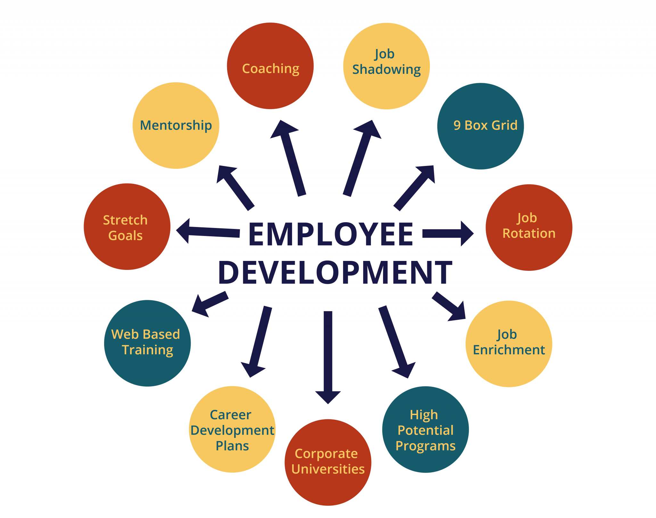
13.4 Employee Development Methods
Notes:
9-Box Grid - When assessing an employee’s current contribution to your organization as well as their potential contribution, the 9-box grid is an effective tool. This visual tool allows people leaders to see an employee’s likelihood of filling a leadership role in the future.
“Stretch” Goals - Providing employees with opportunities to work on projects or assignments that require skills typically associated with next-level positions will stretch an individual and allow them to attain new competencies they will need for future job postings.
Job Rotation - Allowing employees to move between jobs in the organization is known as job rotation. Regardless of the size of your company, you can identify roles that can be shared by many individuals.
Job Enrichment - Adding a higher level of responsibility and control to an existing employee’s job description can be motivating.
Corporate Universities - Some industry leading organizations put a lot of effort into employee development and even invest in what is classified as ‘corporate universities’.
High Potential Programs - High potential (hi-po) programs are concerned with the early identification and the development of employees who have the potential to assume leadership positions in the future.
Career Development Plans - A career development plan usually includes a list of short- and long-term goals that employees have pertaining to their current and future jobs, and a planned sequence of formal and informal training and experiences needed to help them reach their goals.

Slide 10
13.5 Key Takeaways
As employee development takes time and investment, managers must continually provide their team members with opportunities to further develop their skills.
When it comes to succession planning, or your “bench strength,” it can take years to develop the talent needed to fill management or specialized roles.
Succession planning is a strategic initiative that pays off in dividends if it is carried out correctly. It makes an organization competitive, and it prevents companies from facing the dreaded skills gap.
Employee personal development is meant to equip your employees with the skills needed to move within your organization.
Create a career development plan that highlights both short-term and long-term development goals and specific initiatives to achieve such goals.
Take the time to develop both succession planning and employee personal development programs to become an employer of choice.

