Slide 1
Human Resources for Operations Managers
CHAPTER 12: PERFORMANCE MANAGEMENT
Unless otherwise noted, this work is licensed under a Creative Commons Attribution-NonCommercial-ShareAlike 4.0 International (CC BY-NC-SA 4.0) license. Feel free to use, modify, reuse or redistribute any portion of this presentation.

Slide 2
Learning Outcomes
Upon successful completion of this chapter, you will be able to:
Deliver a performance appraisal to your employees.
Write an improvement plan for an employee.
Explain the types of performance issues in the workplace and the internal and external reasons for poor performance.
Develop a process for handling employee performance issues.
Outline current compensation and benefit administration procedures.

Slide 3
12.1 An Introduction To Performance Management
Performance Management often conjures up an image of discipline. Performance management, however, does not have to involve correction, it can simply involve an evaluation of an individual’s performance at work. Strong organizations have established a method and cadence to deliver performance feedback to their employees
Notes:
These organizations use the performance management process to develop their employees, strengthen their relationships, share expectations and coach employees on areas of improvement. In this chapter, we will look at performance appraisals, performance issues, investigations, discipline and ending the employment relationship.

Slide 4
12.2 Performance Appraisals I
As an Operations Manager, providing employees with continual feedback is an important part of the business. An argument can be made for annual performance appraisals versus semi-annual performance appraisals, but most agree they need to occur.
Notes:
Although most conversations will be positive, from time-to-time a leader must have a challenging talk with an employee. Let’s look at what it is like to have a difficult conversation with an employee.

Slide 5
12.2 Performance Appraisals II
Performance Management Systems
A performance management system is an integrated set of processes aimed at helping employees contribute to organizational effectiveness. At their core, these systems involve the assessment of individual performance. To ‘manage performance,’ the first thing you need to do is find out who does what and how well they do it.
Notes:
After this information is collected, managers can feed the data in various systems to help the employee and improve the organization in general. Some of these processes include compensation, employee development, and employee records. Performance management is an important HR process because it goes to the essence of employee performance and relates to every other organizational processes.

Slide 6
12.3 Components Of A Performance Management System I
Frequency of the Performance Appraisal
Every organization must determine how often performance appraisals should be given. Please keep in mind that managers should constantly be giving feedback to employees. The performance appraisal is a formal process for managing performance on a scheduled basis. Some organizations choose to give performance evaluations once per year, while others give them twice per year or more.
Notes:
The advantages to giving an evaluation twice per year, of course, are more feedback and more opportunity for employee development. The downside is the time it takes for the manager to write the evaluation and discuss it with the employee. If done well, it could take several hours for just one employee. Depending on your organization’s structure, you may choose one or the other.

Slide 7
12.3 Components Of A Performance Management System II
Advantages and Disadvantages of Each Source for Performance Evaluations
Source | Advantages | Disadvantages
Manager/Supervisor | Usually has extensive knowledge of the employee’s performance and abilities | Bias Favouritism
Self | Self-analysis can help with employee growth Works well when the supervisor does not always directly observe the employee | In the employee’s interest to inflate his or her own ratings Relationships can create bias in the review
Peer | Can bring different perspectives, since peers know the job well | If evaluations are tied to pay, this can put both the employee and the peer in an awkward situation If confidential, may create mistrust within the organization Personal relationships may introduce bias

Slide 8
12.3 Components Of A Performance Management System III
Advantages and Disadvantages of Each Source for Performance Evaluations
Source | Advantages | Disadvantages
Customer/Client | Customers often have the best view of employee behaviour Can enhance long-term relationships with the customer by asking for feedback | Can be expensive to obtain this feedback Possible bias
Subordinate | Data garnered can include how well the manager treats employees Can determine if employees feel there is favouritism within their department Can be used as self-development tool for managers | Possible retaliation if results are not favourable Subordinates may not understand the “big picture” and rate low as a result Rating inflation If confidential, may create mistrust within the organization If nothing changes despite the evaluation, could create motivational issues among employees

Slide 9
12.4 Appraisal Methods
Comparative methods compare one employee with other employees.
Results methods are focused on objective employee accomplishments. Note that many organizations will use these methods in combination.
Graphic Rating Scale - The graphic rating scale, a trait method, is perhaps the most popular choice for performance evaluations.
Essay Appraisal - In an essay appraisal, the evaluator answers a series of questions about the employee’s performance in essay form.
Checklist Scale. A checklist method for performance evaluations lessens the subjectivity, although subjectivity will still be present in this type of rating system.
Notes:
Critical Incident Appraisals. While Critical Incident Appraisals are more time-consuming to develop, they can be effective because they provide specific examples of behaviour to anchor the ratings. With a critical incident appraisal, the manager records examples of the employee’s effective and ineffective behaviour during the time period between evaluations, which is in the behavioural category.
Work Standards Approach. A work standards approach could be the more effective way of evaluating employees for certain specific jobs in which productivity is essential. With this results-focused approach, a minimum level is set and the employee’s performance evaluation is based on this level.
Work Standards Approach. A work standards approach could be the more effective way of evaluating employees for certain specific jobs in which productivity is essential. With this results-focused approach, a minimum level is set and the employee’s performance evaluation is based on this level.

Slide 10
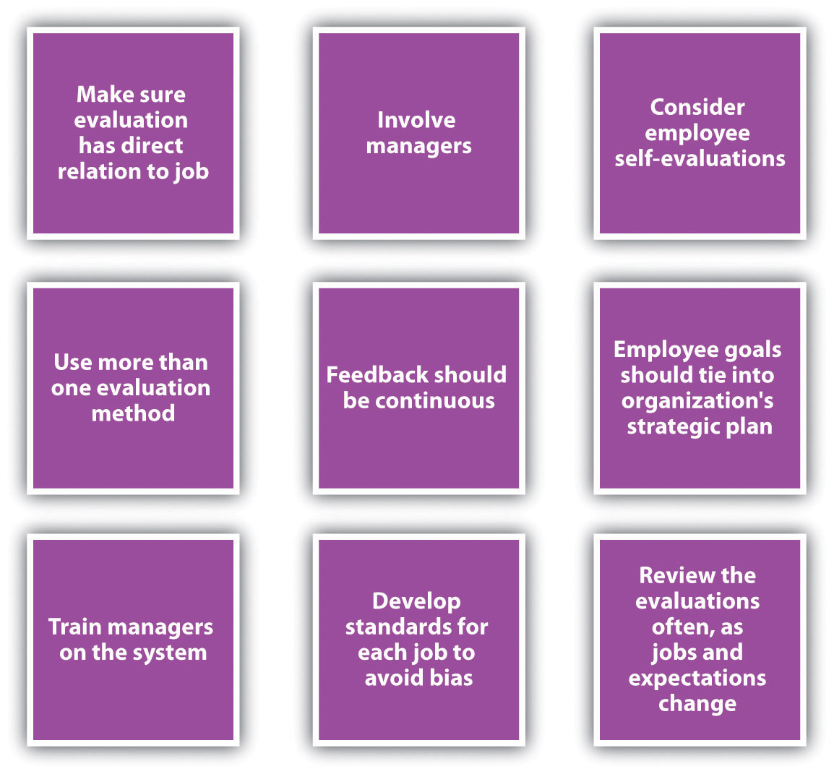
12.5 Completing And Conducting The Appraisal I
Best Practices in Performance Appraisals
Notes:
The performance appraisal aspect is just one part of the entire process. We can call this a performance review system. The first step of the process is goal setting with the employee. Building out the performance appraisal criteria with the employee in advance of the appraisal timeframe is a very effective way to communicate and set expectations – get on the same page.

Slide 11
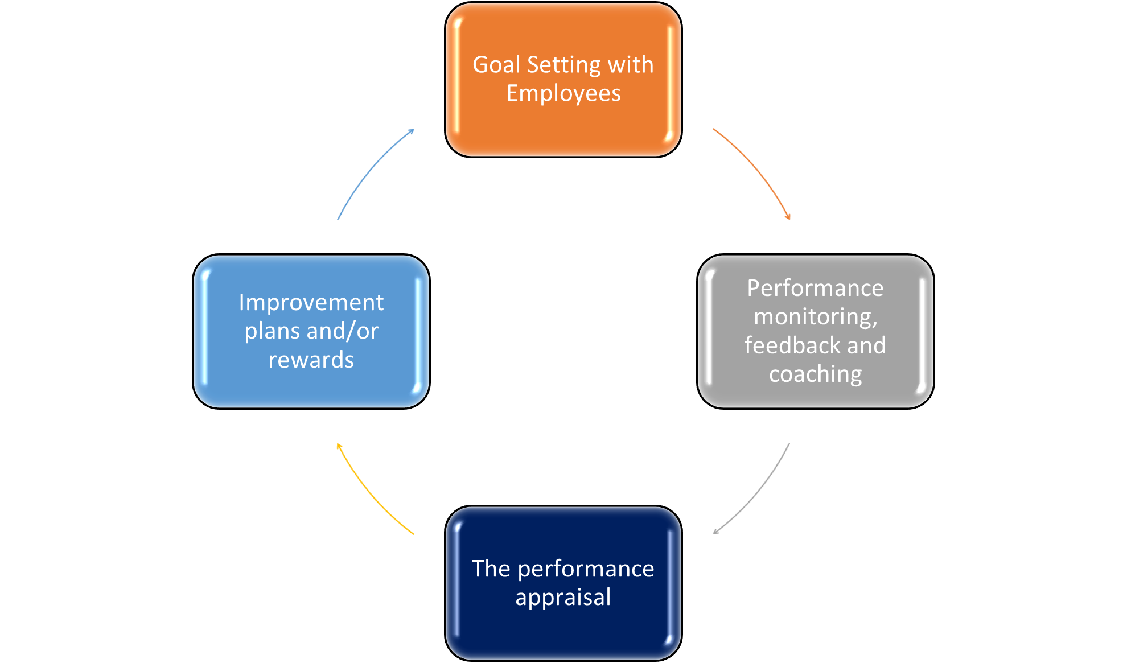
12.5 Completing And Conducting The Appraisal II
Performance Review System

Slide 12
12.6 Organizing The Performance Appraisal Process
While it will be up to the individual manager to give performance appraisals to employees, your HR team will develop the process and help to manage the process. Here are some aspects to consider to manage the process effectively:
Ensure you have a job description for each employee. The job description should highlight the expectations of each job title and provide a sound basis for review.
Ensure you have the necessary documents, such as the criteria and rating sheets for each job description.
Understand the instructions and ground rules for filling out the documents.
Notes:
Con’t –
If your organization has decided to tie performance evaluations with pay increases, determine the pay for each employee. If you are given a budget, clearly understand what the pay increase budget (total) and target percentage increase are for each range of performance ratings.
If necessary, ask for coaching assistance on the development of objectives and improvement plans.
Ensure you know the time lines for each performance review that you are responsible for writing.
It is helpful to keep a spreadsheet or other documents that lists all your employees and time-lines for completion of performance evaluations. This makes it easier to keep track of when performance evaluations should be given.

Slide 13
12.7 Types Of Performance Issues I
As you know, the time and money investment in a new employee is significant. The cost to select, hire, and train a new employee is staggering. But what if that new employee is not working out?
One of the most difficult parts of managing others is not when they are doing a great job—it is when they are not doing a good job. In this section, we will address some examples of performance issues and how to handle them.
Notes:
Constantly late or leaves early. While we know that flexible schedules can provide a work-life balance, managing this flexible schedule is key. Some employees may take advantage, and instead of working at home, perform non-work-related tasks instead.
Too much time spent doing personal things at work. Most companies have a policy about using a computer or phone for personal use. For most companies, some personal use is acceptable, but it can become a problem if someone does not know where to draw the line.
Inability to handle proprietary information. Many companies handle important client and patient information. The ability to keep this information private for the protection of others is important to the success of the company.
Absenteeism. This is defined as a habitual pattern of not being at work. There could be a number of personal or professional reasons for an employee being absent from work.
Drug and alcohol abuse. Substance abuse can cause obvious problems, such as tardiness, absenteeism, and nonperformance, but it can also result in accidents or other more serious issues.

Slide 14
12.7 Types Of Performance Issues II
What Influences Performance?
Internal factors may include the following:
Career goals are not being met with the job.
There is conflict with other employees or the manager.
The goals or expectations are not in line with the employee’s abilities.
The employee views unfairness in the workplace.
The employee manages time poorly.
The employee is dissatisfied with the job.
Notes:
When an employee is not performing as expected, it can be very disappointing. When you consider the amount of time it takes to recruit, hire, and train someone, it can be disappointing to find that a person has performance issues. Sometimes performance issues can be related to something personal, but often it is a combination of factors.
Some of these factors can be internal while others may be external.

Slide 15
12.7 Types Of Performance Issues III
Some of the external factors may include the following:
The employee does not have the correct equipment or tools to perform the job.
The job design is incorrect.
External motivation factors are absent.
There is a lack of management support.
The employee’s skills and job are mismatched.
Notes:
All the internal reasons speak to the importance once again of hiring the right person from the start. The external reasons may be something that can be easily addressed and fixed. Whether the reason is internal or external, performance issues must be handled promptly.

Slide 16
12.8 Investigations And Discipline I
Investigation of Performance Issues
Some performance issues require an investigation, such as an accusation of bullying at work. It is the responsibility of the people leaders and human resources to investigate the matter. Proper documentation is necessary should the employee need to be terminated later for that performance issue.
Photo by Stephen Phillips, Unsplash License
Notes:
The documentation should include the following information:
Date of incident
Time of incident
Location (if applicable) of incident
A description of the performance issue
Notes on the discussion with the employee on the performance issue
An improvement plan, if necessary
Next steps, should the employee commit the same infraction
Signatures from both the manager and employee

Slide 17
12.8 Investigations And Discipline II
Defining Discipline
Discipline is defined as the process that corrects undesirable behaviour. The goal of a discipline process shouldn’t necessarily be to punish but to help the employee meet performance expectations. Often supervisors choose not to apply discipline procedures because they have not documented past employee actions or did not want to take the time to handle the situation.
Notes:
If an employee is not meeting the expectations, discipline might need to occur.
To have an effective discipline process, rules and policies need to be in place and communicated so all employees know the expectations. Here are some guidelines on the creation of rules and organizational policies:
All rules or procedures should be in a written document.
Rules should be related to the safety and productivity of the organization.
Rules should be written clearly, so no ambiguity occurs between different managers.
Supervisors, managers, and human resources should communicate rules clearly in orientation, training, and via other methods.
Rules should be revised periodically as the organization’s needs change.

Slide 18
12.9 Performance Management And Compensation I
Developing A Compensation Package
There are a few basic aspects of compensation packages we should discuss before moving into the specific aspects of compensation. These foundations can assist in the development of a compensation strategy that meets the goals of your organization and is in line with your strategic plan.
Notes:
Before beginning to work on your compensation packages, some analysis should be done to determine your organization’s philosophy in regard to compensation. Before developing your compensation philosophies, there are some basic questions to address:
From the employee’s perspective, what is a fair wage?
Are wages too high to achieve financial health in your organization?
Do managers and employees know and buy into your compensation philosophy?
Does the pay scale reflect the importance of various job titles within the organization?
Is your compensation competitive enough to attract and retain employees?
Are you abiding by the laws with your compensation package?
Is your compensation philosophy keeping in line with labour market changes, industry changes, and organizational changes?

Slide 19
12.9 Performance Management And Compensation II
Compensation Policy
Some organizations choose a market compensation policy, market plus, or market minus philosophy. A market compensation policy is to pay the going rate for a particular job, within a particular market based on research and salary studies. The organization that uses a market plus philosophy will determine the going rate and add a percentage to that rate, such as 5 percent.
Notes:
So if a particular job category median pays $57,000, the organization with a market plus of 5 percent philosophy will pay $59,850. A market minus philosophy pays a particular percentage less than the market; so in our example, if a company pays 5 percent less, the same job would pay $54,150.

Slide 20
12.9 Performance Management And Compensation III
Goals of a Compensation Package
A compensation package can include pay, health-care benefits, and other benefits such as retirement plans.
A compensation package should be positive enough to attract the best people for the job. An organization that does not pay as well as others within the same industry will likely not be able to attract the best candidates, resulting in poorer overall company performance.
Notes:
Most of us, no matter how much we like our jobs, would not do them without a compensation package. When we think of compensation, often we think of only our paycheck, but compensation in terms of HRM is much broader
Once the best employees and talent come to work for your organization, you want the compensation to be competitive enough to motivate people to stay with your organization. Although we know that compensation packages are not the only thing that motivates people, compensation is a key component.
Compensation can be used to improve morale, motivation, and satisfaction among employees. If employees are not satisfied, this can result not only in higher turnover but also in poor quality of work for those employees who do stay. A proper compensation plan can also increase loyalty in the organization.

Slide 21
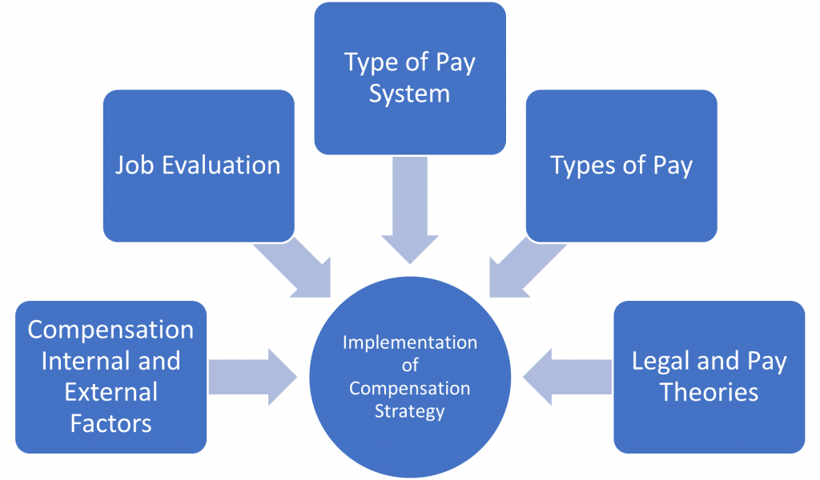
12.9 Performance Management And Compensation IV
Types of Pay Systems
Notes:
Once you have determined your compensation strategy based on internal and external factors, you will need to evaluate jobs, develop a pay system, and consider pay theories when making decisions.
Job Evaluation Systems - As mentioned when we discussed internal and external factors, the value of the job is a major factor when determining pay.

Slide 22
12.10 Key Takeaways
As an Operations Manager, you will not only be required to be familiar with these processes, you will often lead the process.
Delivering timely and effective feedback is essential in the employee-manager relationship.
Providing employees with a regularly scheduled performance review allows the manager to share expectations, highlight successes and coach if there are any areas for improvement.
Should there be performance concerns, investigations, performance improvement plans, and possible disciplinary action may be required to resolve such matters.
Overall, taking the time to share performance feedback with your team will strengthen the business by ensuring everyone is working towards the goals of the organization.

