Slide 1
Human Resources for Operations Managers
CHAPTER 11: TRAINING
Unless otherwise noted, this work is licensed under a Creative Commons Attribution-NonCommercial-ShareAlike 4.0 International (CC BY-NC-SA 4.0) license. Feel free to use, modify, reuse or redistribute any portion of this presentation.

Slide 2
Learning Outcomes
Upon successful completion of this chapter, you will be able to:
Explain basic legislation related to training in organizations.
Describe employee orientation.
Describe the steps in developing training programs.

Slide 3
11.1 The Business Case For Training I
Training is undoubtedly one of the ways in which an organization achieves these goals. Having an effective training program allows Operations Managers to feel confident about the abilities of the employee they work with.
Photo by geralt, Pixabay License
Notes:
Operations Managers know the importance of consistency, quality and compliance in all that they do.
Compliance - legislative compliance is one of the most important responsibilities of an organization. Ensuring we provide for the Health and Safety, Human Rights, and minimum work standards of our employees is not only mandated, it supports morale and engagement.
Setting Expectations - There is no better way to ensure every worker understands the goal(s) of the organization than by way of training. When every employee completes a set of standard training programs, the organization ensures that each employee understands the expectations set by each leader, department and the company as a whole.
Conveying Culture - If you want to ensure an employee knows what the organization stands for and what the organization believes in, train your employees. Training courses reinforce the values and beliefs of the business, and help employees understand the kind of company they work for.
Quality - In Operations Management, quality really does matter. Regardless of the product or service you provide, you want to have systems in place that regulate the materials, the specifications and the final product.
New Hire Orientation - Most would agree that the time and effort an organization puts into a thorough new hire orientation program pays off in dividends. From time-to-time you may hear of an organization that provides a new hire with payroll paperwork to complete and sends them off to begin their new job with no training
Investment in Your People - As a minimum, does your organization train your employees on the legislative requirements in your jurisdiction? Beyond that, does your organization train your employees on health and well-being, pension-benefit-financial planning, advanced computer skills, and project management? Employees that work for an organization that invests in their employees is seen as a successful organization that job candidates want to work for and employees want to advance with.

Slide 4
11.1 The Business Case For Training II
Training: Not Like It Used To Be
No longer do people sit in hot, stuffy rooms to get training on boring content. Training has become highly interactive, technical, and interesting owing to the number of multimedia we can use—just think of the possibilities offered by Virtual Reality!
Photo by Domenico Loia, Unsplash License
Notes:
Due to the high cost of training, managers must develop the right training programs to meet the needs; otherwise, these funds are virtually wasted.

Slide 5
11.1 The Business Case For Training III
Employee Training
Training is the act of increasing the knowledge, skills, and abilities of an employee for doing a particular job. Organizations invest in training to make sure employees can perform their jobs effectively.
Photo by Campaign Creators, Unsplash License
Notes:
A vast amount of research supports the fact that training is positively and directly related to organizational performance.^{[1]}
Even when the right person has been selected, they may need training in how your company does things.
NB - Lack of training can result in loss of productivity, loss of customers, and poor relationships between employees and managers. It can also result in dissatisfaction, which means retention problems and high turnover. All of these consequences can have an impact on direct costs to the organization.

Slide 6
11.1 The Business Case For Training IV
Training and Development
Training- Refers to formal and planned efforts to help employees acquire knowledge, skills, and abilities to improve performance in their current job.
Development- Refers to formal and planned efforts to help employees acquire the knowledge, skills, and abilities required to perform future job responsibilities and for the long-term achievement of individual goals and/or organizational objectives.
Notes:
Training can also be described as an endeavor aimed to improve or develop additional competency or skills in an employee on the job one currently holds in order to increase performance or productivity

Slide 7
11.1 The Business Case For Training V
Employee Orientation
Employee orientation is the process used for welcoming a new employee into the organization.
The objectives of employee orientation are as follows:
To reduce start-up costs.
To reduce anxiety
To reduce employee turnover
To save time for the supervisor and coworkers
To set expectations and attitudes
Notes:
To reduce start-up costs - If an orientation is done right, it can help get the employee up to speed on various policies and procedures, so the employee can start working right away.
To reduce anxiety. Starting a new job can be stressful. One goal of an orientation is to reduce the stress and anxiety people feel when going into an unknown situation.
To reduce employee turnover. Employee turnover tends to be higher when employees don’t feel valued or are not given the tools to perform. Employee orientation can show that the organization values the employee and provides the tools necessary for a successful entry.
To save time for the supervisor and coworkers. A well-done orientation makes for a better prepared employee, which means less time having to teach the employee.
To set expectations and attitudes. If employees know from the start what the expectations are, they tend to perform better. Likewise, if employees learn the values and attitudes of the organization from the beginning, there is a higher chance of a successful tenure at the company.

Slide 8
11.2 Training Delivery Methods I
Training Program Development Framework
The framework for developing a training program are as follows:
Needs assessment and learning objectives
Learning Strategies.
Delivery mode
Budget
Content.
Timelines
Notes:
A very important step in the training process is to create a training framework that will help guide the training program. Information on how to use the framework is included in this section.
When developing a training plan, there are a number of considerations to keep in mind. Training is a process that should be planned and developed in advance. Operations Managers will need to work closely with the Human Resources team to assess and define the needs of the organization.
Needs assessment and learning objectives - Articulating specific and measurable learning objectives will in turn guide you in determining the learnings required – and specific areas for training.
Learning Strategies - Determine the right learning strategies best suited to the learning styles of your employee audience to ensure the training is successful.
Delivery mode. What is the best way to get your message across? Is web-based training more appropriate, or should mentoring be used? Can simulation training be used for a portion of the training while job shadowing be used for another part of the training? Most training programs will include a variety of delivery methods.
Budget. How much money do you have to spend on this training?
Content. What needs to be taught? How will you organize and sequence the information and course materials
Timelines. How much time is required for the training – is it one-time only, are there multiple segments, is it repeated annually (e.g., safety training)? Is there a deadline for training to be completed?

Slide 9
11.2 Training Delivery Methods II
Step 1: Needs Assessment & Learning Objective
The first step in developing a training program is to determine exactly what the organization needs in terms of training. There are three levels of training needs assessment: organizational assessment, occupational (task) assessment, and individual assessment.
A learning objective is what you want the learner to be able to do, explain, or demonstrate at the end of the training period
Notes:
Organizational assessment. In this type of needs assessment, we can determine the skills, knowledge, and abilities a company needs to meet its strategic objectives. This type of assessment considers things such as changing demographics and technological trends, and is forward-looking.
Occupational (task) assessment. This type of assessment looks at the specific tasks, skills knowledge, and abilities required to do the different jobs within the organization. Data for this step can come from a review of performance evaluations that can uncover a pattern where employees in specific jobs are not meeting expectations.
Individual assessment. An individual assessment looks at the performance of an individual employee and determines what training should be provided for that individual. If an organization relies on technology, they must assess each employee’s level of comfort with the new technology.
Good learning objectives are performance-based and clear, and the result of the learning objective can be observable or measured in some way. Examples of learning objectives might include the following:
Be able to explain the company policy on sexual harassment and give examples of sexual harassment.
Be able to show the proper way to take a customer’s order.
Perform a variety of customer needs analyses using company software.
Understand and utilize the new expense-tracking software.

Slide 10
11.2 Training Delivery Methods III
Step 2: Learning Strategies or the Psychology of Learning
Learning strategies refer to techniques that have been proven to facilitate learning and increase the effectiveness of training programs. These strategies are based on known psychological processes to enhance the retention of learned material.
Notes:
Learning styles refer to individual preferences in how people learn new material. The concept of learning styles has gained much popularity in training circles and a whole industry has been built around this concept. Unfortunately, the research evidence supporting the concept is very weak.^{[1]} However, this is not to say that psychological principles do not play a role in the effectiveness of training
Retrieval Practice or practice testing, is a form of low-stakes or no-stakes quizzing that attempts to force retrieval of material from one’s memory.
Distributed Practice or spaced practice, refers to distributing the practice of material over time. This spacing of practice aids in the retention of material much better than cramming. The amount of spacing depends on the complexity of the task and can range from hours to months.
Interleaved Practice involves shifting the focus of one’s studies among differing topics. This is in contrast to studying and practicing all of one topic before moving on to the next topic of study. While this does make studying more difficult, studies have shown far greater retention of material on summative evaluations with the interleaving of material.

Slide 11
11.2 Training Delivery Methods IV
Step 3: Delivery Mode
Depending on the type of training that needs to be delivered, you will likely choose a different method to deliver the training.
Photo by Austin Distel, Unsplash License
Notes:
An orientation might lend itself best to vestibule training, while sexual harassment training may be better for web-based training. When choosing a delivery mode, it is important to consider learning objectives, the audience, and any budget constraints.
On-the-Job Coaching- On-the-job coaching is one way to facilitate employee skills training. On-the-job coaching refers to an approved person training another employee on the skills necessary to complete tasks
Mentoring - Mentoring is a type of training delivery that has gained popularity in organizations. A mentor is a trusted, experienced advisor who has direct interest or investment in the development of an employee. Mentoring is a process by which an employee is coached, supported, and developed by an experienced person.
Web-Based - Web-based training delivery has several labels: e-learning, Internet-based, computer-based, or technology-based learning. Regardless of the terminology used, any web-based training involves the use of technology to facilitate training. There are two types of web-based learning. First, synchronous learning uses instructor-led facilitation. Asynchronous learning is self-directed, and no instructor facilitating the course.
Job Shadowing - Job shadowing is a training delivery method that places an employee who already has the skills with another employee who wants to develop those skills

Slide 12
11.2 Training Delivery Methods V
Step 4: Budget
Training programs can be very expensive and HR managers are often required to have a detailed budget before implementing them.
According to the 2017 State of the Industry report from the Association for Talent Development, organizations spend an average of $1,273 per employee for direct learning expenditures.
Photo by Giorgio Trovato, Unsplash License
Notes:
If we extrapolate this figure for a large company like CAE, which is headquartered in Montreal (10,000 employees), you get an approximate training budget of $13 million!^{[4]} Thus, tight budgeting is important for organizations to obtain the maximum value from their investment in training.
Budgeting for training programs should include direct costs such as travel, trainers’/programmers’ fee, training material, and catering. It should also consider the time of employees. If employees are in training for two hours, the cost to the organization of them not performing their job is an indirect cost of training.

Slide 13
11.2 Training Delivery Methods VI
Step 5: Content Development
The content that HR managers want to deliver is perhaps one of the most important parts of training and one of the most time-consuming to develop. Development of learning objectives and content development go hand-in-hand.
Notes:
The things you want your learners to know after the training makes for more focused training. Think of learning objectives as goals—what should someone know after completing this training? Here are some samples of learning objectives:
Be able to define and explain the handling of hazardous materials in the workplace.
Be able to utilize the team decision process model.
Understand the definition of sexual harassment and be able to recognize sexual harassment in the workplace.
Understand and be able to explain the company policies and structure.

Slide 14
11.2 Training Delivery Methods VII
Step 6: Timelines
For some types of training, timelines may be required to ensure the training is completed within a specified period of time. This is often the case for safety training. In other words, in what time frame should an employee complete the training?
Photo by Eric Rothermel, Unsplash License
Notes:
Another consideration regarding timelines is how much time you think you need to complete the training. Perhaps one hour will be enough, but sometimes, training may take a day or even a week – it may also have to be repeated annually with refreshed content (e.g., safety regulations). After you have developed your training content, you will likely have a better idea as to how long it will take to deliver. The time demands of any training must be integrated with the employee(s) work schedule to ensure the least amount of disruption to production and job demands.

Slide 15
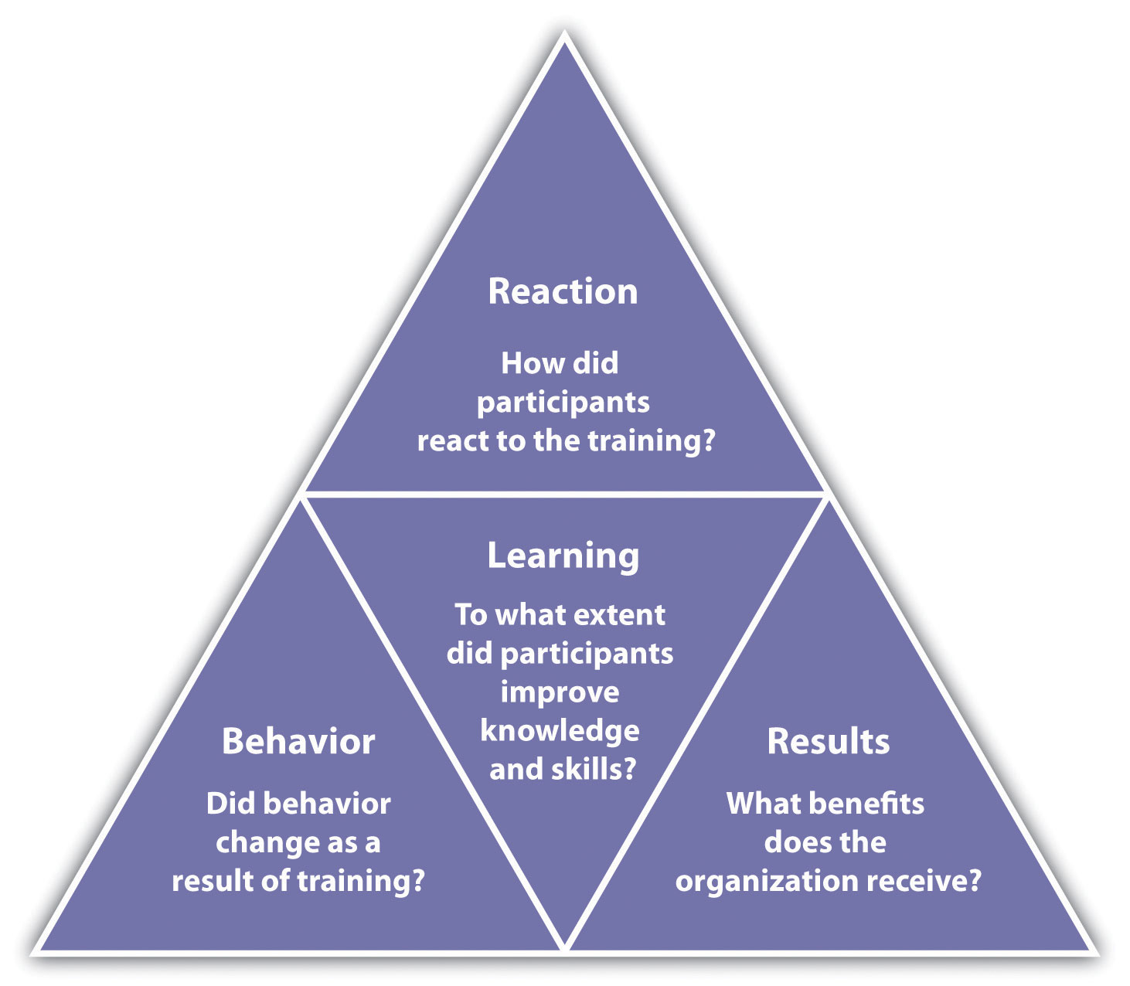
11.2 Training Delivery Methods VIII
Measuring Training Effectiveness
Notes:
After we have completed training, It is important to make sure the training objectives were met and that the training was effective. Given the resources required to train employees, managers are increasingly required to justify their budget and show the return on investment (ROI) of their activities. For training, this involves demonstrating that the investment in training has led to increased effectiveness of the employee and, ultimately, of the organization.
The classic model to measure the effectiveness of training is the Kirkpatrick model.^{[5]} His model has four levels:
Reaction: How did the participants react to the training program?
Learning: To what extent did participants improve knowledge and skills?
Behaviour: Did behaviour change as a result of the training?
Results: What benefits to the organization resulted from the training?

Slide 16
11.3 Key Takeaways
The importance of employee training in Operations Management cannot be overstated.
Training demonstrates your compliance with legislation, your investment in people, and the importance of quality in your organization.
The use of in-house or external trainers allows for flexibility.
Making use of programs such as mentorship, on-the-job coaching or job shadowing allows employees to learn those with more experience in a safe environment.
Don’t forget to take a look at your new hire orientation program, it is your organizations opportunity to set the stage for a new hire’s safety and success.
An investment in people is truly an investment in your organizational success.

