Slide 1
Human Resources for Operations Managers
CHAPTER 1: INTRODUCTION TO HUMAN RESOURCES
MANAGEMENT
Unless otherwise noted, this work is licensed under a Creative Commons Attribution-NonCommercial-ShareAlike 4.0 International (CC BY-NC-SA 4.0) license. Feel free to use, modify, reuse or redistribute any portion of this presentation.

Slide 2
Learning Outcomes
Upon successful completion of this chapter, you will be able to:
Explain the role of HRM in organizations.
Discuss the major HRM activities.
Outline how the business context influences HRM.

Slide 3
1.1 Human Resources Management I
Human Resource Management (HRM) or Employee Relations is an integrated set of processes, practices, programs, and systems in an organization that focuses on the effective deployment and development of its employees.
Notes:
These processes include employing people, training them, compensating them, developing policies relating to them, and developing strategies to retain them.
It is, by most accounts, one of the most critical functions of an organization, because for an organization to be efficient, it needs employees and systems that support them.

Slide 4
1.1 Human Resources Management II
The Role of HRM in Organizations
HRM is an ‘umbrella’ term for many different and interrelated functions. It is necessary to point out at the very beginning of this text, that every manager has a role relating to Human Resource Management. Just because we do not have the title of HR manager, it does not mean we won’t perform all or at least some of the HRM tasks.
Notes:
For example, most managers deal with the selection, compensation, and motivation of employees—making these aspects not only part of HRM but also part of management in general.

Slide 5
1.1 Human Resources Management III
Legislation and the Law
An HR Manager will work under the following legal frameworks:
Federal Government
Provincial Government
Health and Safety Requirements
Labour Laws
Employment Standards
Notes:
It is very important that Human Resource Managers are aware of all the laws that affect the workplace and they ensure that the processes in place abide by them.
The legal environment of HRM is always changing, therefore, HRM must always be aware of changes taking place and then communicate the changes to the entire management team of the organization.

Slide 6
1.1 Human Resources Management IV
Corporate Policies
In addition to having to comply with the requirements mandated by law, every organization may have their own set of unique policies. These policies can be set to ensure fairness, to enhance effectiveness, or simply to reinforce the culture.
Notes:
Some of the roles of HRM are to identify issues that can be addressed by implementing a policy; these can range from chronic tardiness of employees to a lack of decorum in meetings. HRM, management and executives are all involved in the process of developing policies.
For example, the HRM professional will likely recognize the need for a new policy or a change of policy, they will then seek opinions on the policy, write the policy, and then communicate that policy to employees.

Slide 7
1.2 HR Activities I
External Forces that Influence Business Activities
The Human Resources function in a business is responsible for:
Job analysis and design
Talent acquisition
Training and development
Performance management
Compensation
Labour relations
Health and safety.
Notes:
Job Analysis and Design - Organizations rely on the execution of numerous and varied tasks. These tasks, which are often carried out by employees, have to be structured in such a way to maximize efficiency. They should be clear and distinct from each other. They should also be performed by capable employees. HRM supports the definition, documentation and organization of these tasks through the processes of job analysis and job design.

Slide 8
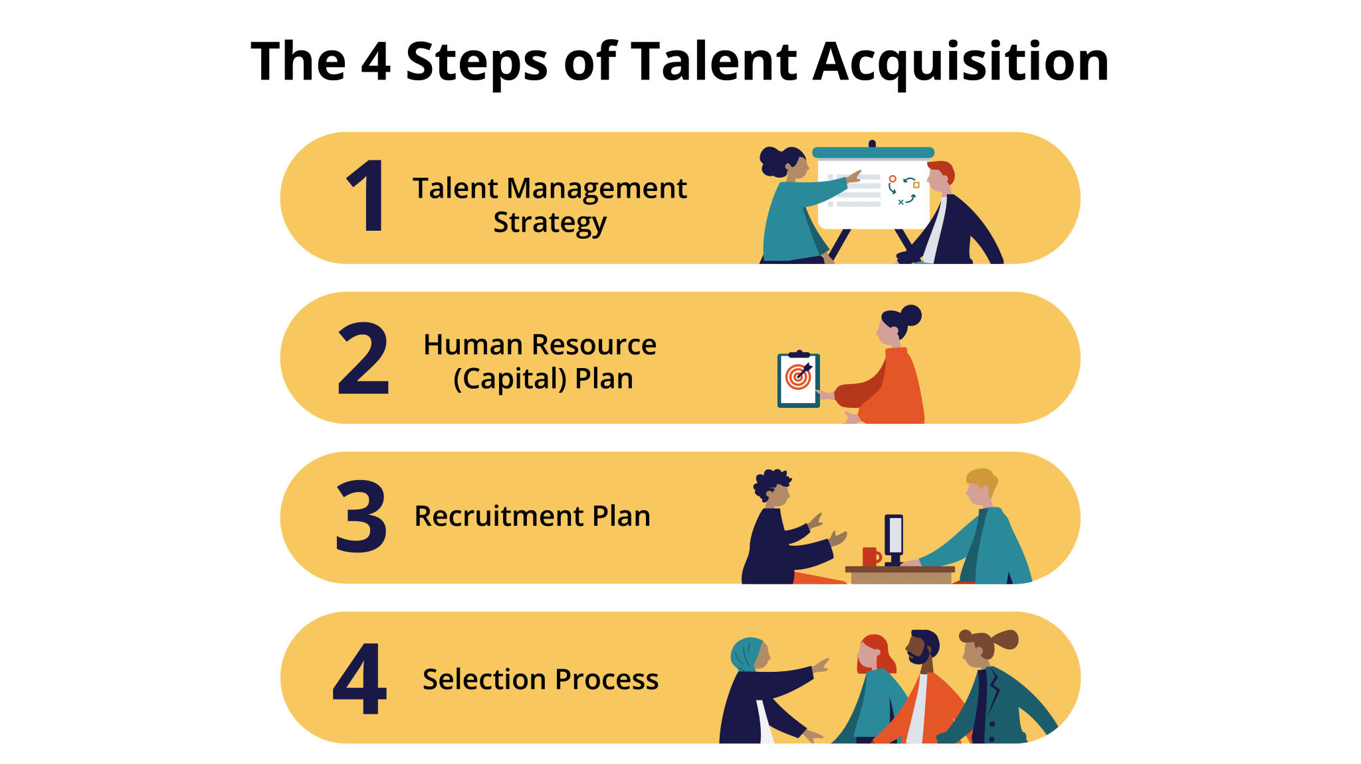
1.2 HR Activities II
Talent Acquisition
Notes:
You need the right people to perform tasks and get work done in the organization. Even with the most sophisticated machines, humans are still needed, therefore, one of the major tasks in HRM is talent acquisition.. Talent acquisition involves the entire hiring process from posting a job to negotiating a salary package.
Within the talent acquisition function, there are four main steps:
Talent Management Strategy
Human Resource (Capital) Plan
Recruitment Plan
Selection Process

Slide 9
1.2 HR Activities III
Training and Development
Once we have spent the time to hire new employees, we want to make sure they are trained to do the job and continue to grow and develop new skills. This results in higher productivity for the organization.
Notes:
Training is also a key component in employee motivation. Employees who feel they are developing their skills tend to be happier in their jobs, which results in an increase of employee performance, productivity and retention.
Examples of training courses and programs might include the following:
Job skills training, such as how to use a computer program
Training on communication
Team-building activities
Policy and legal training, such as sexual harassment training, safety training and ethics training
Time management skills

Slide 10
1.2 HR Activities IV
Performance Assessment and Management
Employee performance is a support role provided by HRM to the organization and management. HR has the responsibility of designing, maintaining and administering an organization’s performance management policies and systems. Basically, people have to be good at what they do. In a coffee shop, baristas have to produce a great cup of coffee, within a certain amount of time, and serve it to the customer in a pleasant manner.
Notes:
Every job is different and quite complex when you think of the different ways in which performance is defined. It is the role of the HRM professional to devise systems to measure this performance with precision and use this information to help the employee and the organization. Performance appraisal systems may include appraisal processes, annual employee performance appraisals, or performance improvement plans to name a few.
However, assessing performance is only the beginning. Once a measure of performance is obtained, the HRM professional uses it for multiple purposes, including:
Provide feedback for employees
Determine compensation (e.g., bonus, raise, etc.)
Take disciplinary measures
Support career development

Slide 11
1.2 HR Activities V
Compensation and Benefit Administration
Notes:
HRM professionals need to determine that compensation is fair, meets industry standards, and is high enough to entice people to work for the organization. Compensation includes anything the employee receives for his or her work. In addition, HRM professionals need to make sure the pay is comparable to what other people performing similar jobs are being paid
Total compensation (package) may include the following:
Pay
Group Life and Health Insurance
Retirement pension plans
Stock grants and purchase plans
Vacation time
Sick leave and benefits
Bonuses
Tuition reimbursement

Slide 12
1.2 HR Activities VI
Labour Relations
A labour union, also called a trade union or worker’s union, is an organization that represents the collective interests of employees. HRM professionals are involved in the negotiation (collective bargaining) and management of union contracts.
Notes:
These contracts typically cover compensation, work schedules, benefits, discipline, and other work-related processes. Unions are very prevalent throughout Canada. As such, an understanding of labour unions is very important to be effective.

Slide 13
1.2 HR Activities VII
Health and Safety
Safety is a major consideration in all organizations. Often times new laws are created with the goal of setting federal or provincial standards to ensure worker safety.
Worker protection issues might include the following:
Chemical hazards
Heating and ventilation requirements
Use of “no fragrance” zones
Protection of private employee information
Notes:
Unions and union contracts can also impact the requirements regarding worker safety in the workplace. It is up to the Human Resource Manager to be aware of worker protection requirements and ensure the workplace is meeting federal, provincial, industry specific and union standards.

Slide 14
1.3 HRM And Business Challenges I
HR processes are designed to improve the effectiveness of an organization through professional human resource management, for example, by ensuring that the right people are hired, trained, and fairly evaluated and compensated. While HR processes are internal to the organization, these same processes need to have an external focus and help organizations overcome the challenges that they face.
Notes:
The HR manager needs to consider the many external forces that may affect HR processes and the organization as a whole. In this section, we describe how HR management has to be in tune with changes in the environment.

Slide 15
1.3 HRM And Business Challenges II
Every organization must have the capacity to adjust to changes in its environment. It is important for organizations to be aware of outside factors, or external factors.
External factors might include the following:
Globalization
Offshoring
Changes to employment law
Health, safety, and employee protection
Employee expectations (e.g., compensation, standard hours)
Diversity of the workforce
Changing demographics of the workforce
Changes in education profile of workers
Layoffs and downsizing
Advanced technologies
Evolving industry
Notes:
It is important for organizations to be aware of outside factors, or external factors. These factors are beyond their control but could positively or negatively impact the organization and their human resources
Basically, HRM professionals have to be aware of external factors, so they can develop policies that meet not only the needs of the company but also the needs of the employees

Slide 16
1.3 HRM And Business Challenges III
Crisis Management
We now know that pandemics and the rapid spread of infectious diseases represents an external factor affecting organizations and HRM. It is an understatement to say that the
COVID-19 crisis had an impact on organizations in a major way.
Photo by Obi - @pixel7propix, Unsplash License
Notes:
The COVID-19 crisis made health and safety a priority for governments and organizations.
Of course, organizations have had to deal with crises in the past, such as in 2008, where the economy was hit with a massive financial crisis. The relaxing of credit lending standards by investment banks and a significant increase in subprime lending was the cause of this crisis. This resulted in the collapse of the financial system. In just a few weeks, the S&P 500 lost half of its value and housing prices lost 20% of their value in the US. Companies, banks, and even countries, went bankrupt.
The impact of this event on HRM was immediate: the economy slowed down considerably which led to massive layoffs (unemployment in the US shot up to 10%).^{[1]}

Slide 17
1.3 HRM And Business Challenges IV
Globalization
The implication of globalization is significant for HRM. For HRM professionals, globalization means dealing with people from different cultures and adjusting to different employment laws and business practices.
Photo by Anne Nygård, Unsplash License
Notes:
In 2020, it would be almost impossible to find an organization that does not have some part of its activities outside of its national border. You can look at any local success story and you will see how these organizations have deep international connections.

Slide 18
1.3 HRM And Business Challenges V
Cost Containment and Efficiency
Factors such as global competition and increasing costs puts an enormous pressure on organizations to maximize their efficiency and productivity and remain viable. All departments of the organization must be focused on operational efficiencies and costs. For HRM, this means that the processes it manages contribute to the ‘bottom line’ in an objective and measurable way.
Notes:
For example, an HR manager who asks for $20,000 for a training budget will have to make their business case, and show that this investment will lead to better employee performance and productivity and, ultimately, more profits (or less costs).

Slide 19
1.3 HRM And Business Challenges VI
Technology
Technology has greatly impacted human resources and will continue to do so as advanced technologies are developed. Technology can impact HRM in many ways. From an employee perspective it eliminates jobs, changes job requirements, and alters the demands on the employee and employee expectations.
Photo by Marvin Meyer, Unsplash License
Notes:
It influences skills and competencies that employees need to perform their job.
Technology also creates a workforce that expects to be mobile. Due to the ability to work from home or anywhere else, many employees may request and even demand a flexible schedule to meet their own family and personal needs. Productivity can be a concern for all managers in the area of flextime, and another challenge is the fairness to other workers when one person is offered a flexible schedule.

Slide 20
1.4 Key Takeaways
Human Resources Management is an umbrella term that covers numerous areas such as compensation, safety, performance management and training.
The focus of Human Resources Management is always on the people.
As an Operations Manager, you need to understand the scope of HRM and work closely with this group of business professionals to lead your team, your department, and your organization.
In organizations without HRM, you may need to take on many of these responsibilities yourself.

