Slide 1
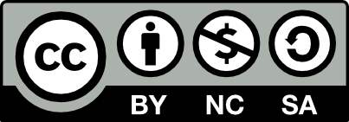
Global Marketing in a Digital World
CHAPTER 9: GLOBAL DISTRIBUTION
Unless otherwise noted, this work is licensed under a Creative Commons Attribution-NonCommercial-ShareAlike 4.0 International (CC BY-NC-SA 4.0) license. Feel free to use, modify, reuse or redistribute any portion of this presentation.

Slide 2
Learning Outcomes
Upon successful completion of this chapter, you should be able to:
List the characteristics and flows of a distribution channel
Describe the channel partners that support distribution channels
Explain the role of wholesale intermediaries
Describe the different types of retailers businesses use to distribute products
Differentiate between supply chains and distributions channels
Outline the advantages of global sourcing
List the pros and cons of sole-sourcing and multisourcing
Describe the distribution-management choices companies have when entering new international markets

Slide 3
9.1 CHANNELS OF DISTRIBUTION I
Distribution channels – which is “place” in the 4 Ps – cover all the activities needed to transfer the ownership of goods and move them from the point of production to the point of consumption.
Notes:
In this section you’ll learn more about distribution channels and some of the common strategies companies use to take advantage of them.

Slide 4
9.1 CHANNELS OF DISTRIBUTION II
Important Characteristics of the Channel
The channel consists of organizations, some under the control of the producer and some outside the producer’s control. Yet all must be recognized, selected, and integrated into an efficient channel arrangement.
The channel management process is continuous and requires continuous monitoring and reappraisal. The channel operates twenty-four hours a day and exists in an environment where change is the norm.
Channels should have certain distribution objectives guiding their activities. The structure and management of the marketing channel is thus, in part, a function of a firm’s distribution objective. It’s also a part of the marketing objectives, especially the need to make an acceptable profit. Channels usually represent the largest costs in marketing a product.
Notes:
we define a channel of distribution, also called a marketing channel, as sets of interdependent organizations involved in the process of making a product or service available for use or consumption, as well as providing a payment mechanism for the provider.

Slide 5
9.1 CHANNELS OF DISTRIBUTION III
Channel Flows
One traditional framework that has been used to express the channel mechanism is the concept of flow. These flows reflect the many linkages that tie channel members and other agencies together in the distribution of goods and services. From the perspective of the channel manager, there are 5 important flows.
Product flow
Negotiation flow
Ownership flow
Information flow
Promotion flow
Notes:
Product flow: the movement of the physical product from the manufacturer through all the parties who take physical possession of the product until it reaches the ultimate consumer
Negotiation flow: the institutions that are associated with the actual exchange processes
Ownership flow: the movement of title through the channel
Information flow: the individuals who participate in the flow of information either up or down the channel
Promotion flow: the flow of persuasive communication in the form of advertising, personal selling, sales promotion, and public relations

Slide 6
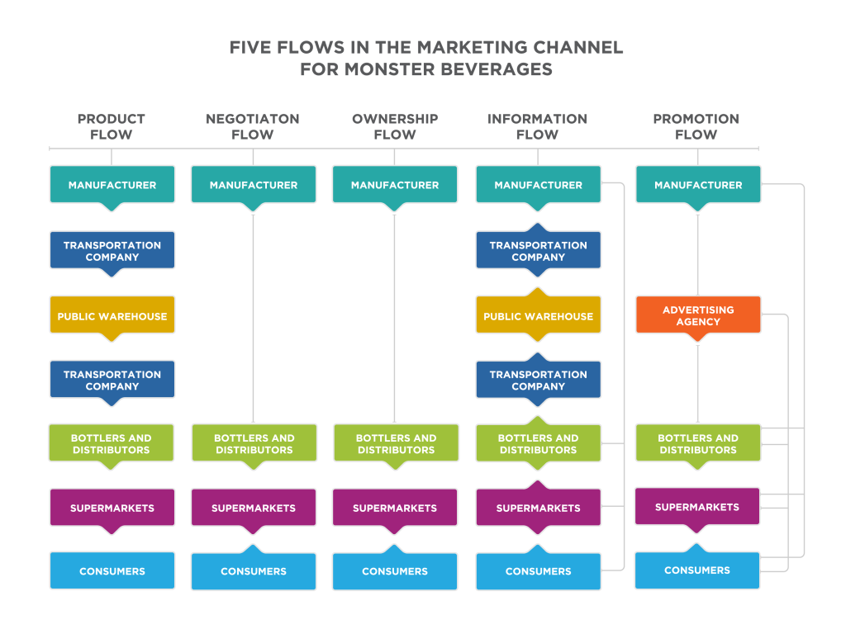
9.1 CHANNELS OF DISTRIBUTION IV
Notes:
This figure maps the channel flows for the Monster Energy drink (and many other energy drink brands). Why is Monster’s relationship with Coca-Cola so valuable? Every single flow passes through bottlers and distributors in order to arrive in supermarkets where the product will be available to consumers.

Slide 7
9.2 CHANNEL PARTNERS I
While channels can be very complex, there is a common set of channel structures that can be identified in most transactions. Each channel structure includes different organizations. Generally, the organizations that collectively support the distribution channel are referred to as channel partners.

Slide 8
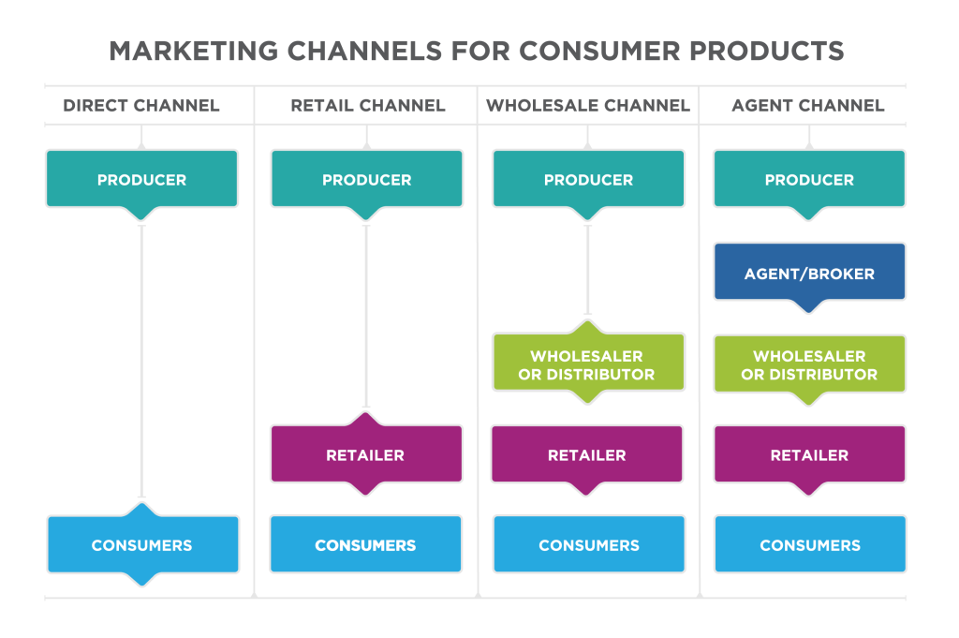
9.2 CHANNEL PARTNERS II
Notes:
The direct channel is the simplest channel. In this case, the producer sells directly to the consumer. The most straightforward examples are producers who sell in small quantities.
Retailers are companies in the channel that focuses on selling directly to consumers. You are likely to participate in the retail channel almost every day. The retail channel is different from the direct channel in that the retailer doesn’t produce the product.
From a consumer’s perspective, the wholesale channel looks very similar to the retail channel, but it also involves a wholesaler.
The broker or agent channel includes one additional intermediary. Agents and brokers are different from wholesalers in that they do not take title to the merchandise. In other words, they do not own the merchandise because they neither buy nor sell.

Slide 9
9.3 ROLE OF WHOLESALE INTERMEDIARIES
Wholesalers play an important role as intermediaries. Intermediaries act as a link in the distribution process, but the roles they fill are broader than simply connecting the different channel partners. Wholesalers, often called “merchant wholesalers,” help move goods between producers and retailers.

Slide 10
9.3 ROLE OF WHOLESALE INTERMEDIARIES I
Functions that a merchant wholesaler fulfills:
Purchasing
Warehousing and Transportation
Grading and Packaging
Risk Bearing
Marketing
Distribution
Notes:
1. Wholesalers purchase very large quantities of goods directly from producers or from other wholesalers. By purchasing large quantities or volumes, wholesalers are able to secure significantly lower prices.
2. Once the wholesaler has purchased a mass quantity of goods, it needs to get them to a place where they can be purchased by consumers. This is a complex and expensive process. McLane Company operates 22 modern distribution centers around the country. It relies on its own vast trucking fleet of over 1,600 tractors and 2,700 multi-temperature trailers to handle the transportation of product (McLane Company Inc., n.d.)
3. Wholesalers buy a very large quantity of goods that they then break down into smaller lots. The process of breaking large quantities into smaller lots to be resold is called “bulk breaking”. Often this includes physically sorting, grading, and assembling the goods.
4. Wholesalers either take title to the goods they purchase, or they own the goods they purchase. There are two primary consequences of this, both of which are both very important to the distribution channel. First, it means that the wholesaler finances the purchase of the goods and carries the cost of the goods in inventory until they are sold. Because this is a tremendous expense, it drives wholesalers to be accurate and efficient in their purchasing, warehousing, and transportation processes. Second, wholesalers also bear the risk for the products until they are delivered. If goods are damaged in transport and cannot be sold, then the wholesaler is left with the goods and the cost. If there is a significant change in the value of the products between the time of the purchase from the producer and the sale to the retailer, the wholesaler will absorb that profit or loss.
5. Often, the wholesaler will fill a role in the promotion of the products that it distributes. This might include creating displays for the wholesaler’s products and providing the display to retailers to increase sales. The wholesaler may advertise its products that are carried by many retailers
6. As distribution channels have evolved, some retailers, such as Walmart and Target, have grown so large that they have taken over aspects of the wholesale function. Still, it is unlikely that wholesalers will ever go away.

Slide 11
9.3 ROLE OF WHOLESALE INTERMEDIARIES II
Retailers that Distribute Products
Retailing involves all activities required to market consumer goods and services to ultimate consumers who are purchasing for individual or family needs.
Department Stores
Chain Stores
Supermarkets
Discount Retailers
Warehouse Retailers
Franchises
Malls and Shopping Centers
Online Retailing
Catalog Retailing
Non-store Retailing
Notes:
1. Department stores are characterized by their very wide product mixes. That is, they carry many different types of merchandise, which may include hardware, clothing, and appliances. Each type of merchandise is typically displayed in a different section or department within the store.
2. The 1920s saw the evolution of the chain store movement. Because chain store businesses were so large, they were able to buy a wide variety of merchandise at discounted prices. The discounts substantially lowered their cost compared to costs of single-unit retailers. As a result, they could set retail prices that were lower than those of their small competitors and thereby increase their share of the market.
3. Supermarkets are large, self-service stores with central checkout facilities. They carry an extensive line of food items and often nonfood products. Supermarkets’ entire approach to the distribution of food and household cleaning and maintenance products is to offer large assortments these goods at each store at a minimal price.
4. Discount retailers are characterized by a focus on price as their main sales appeal. Merchandise assortments are generally broad and include both hard and soft goods, but assortments are typically limited to the most popular items, colors, and sizes.
5. Warehouse retailers provide a bare-bones shopping experience at very low prices. Costco is the dominant warehouse retailer. Warehouse retailers streamline all operational aspects of their business and pass on the efficiency savings to customers.
6. The franchise approach brings together national chains and local ownership. An owner purchases a franchise which gives her the right to use the firm’s business model and brand for a set period of time.
7. Malls and shopping centers are successful because they provide customers with a wide assortment of products across many stores. If you want to buy a suit or a dress, a mall provides many alternatives in one location.
8. Online retailing is unquestionably a dominant force in the retail industry, but today it accounts for only a small percentage of total retail sales. Companies like Amazon and Overstock.com complete all or most of their sales online.
9. Catalogs have long been used as a marketing device to drive phone and in-store sales. As online retailing began to grow, it had a significant impact on catalog sales. Many retailers who depended on catalog sales—Sears, Land’s End, and J.C. Penney, to name a few—suffered as online retailers and online sales from traditional retailers pulled convenience shoppers away from catalog sales.
10. Beyond those mentioned in the categories above, there’s a wide range of traditional and innovative retailing approaches. Although the Avon lady largely disappeared at the end of the last century, there are still in-home sales from Arbonne facial products, cabi women’s clothing, WineShop at Home, and others.

Slide 12
9.4 SUPPLY CHAINS AND DISTRIBUTION CHANNELS I
A supply chain is the system through which an organization acquires raw material, produces products, and delivers the products and services to its customers.
Notes:
Supply chain management helps increase the efficiency of logistics service by minimizing inventory and moving goods efficiently from producers to the ultimate users.
On their way from producers to end users and consumers, products pass through a series of marketing entities known as a distribution channel.

Slide 13
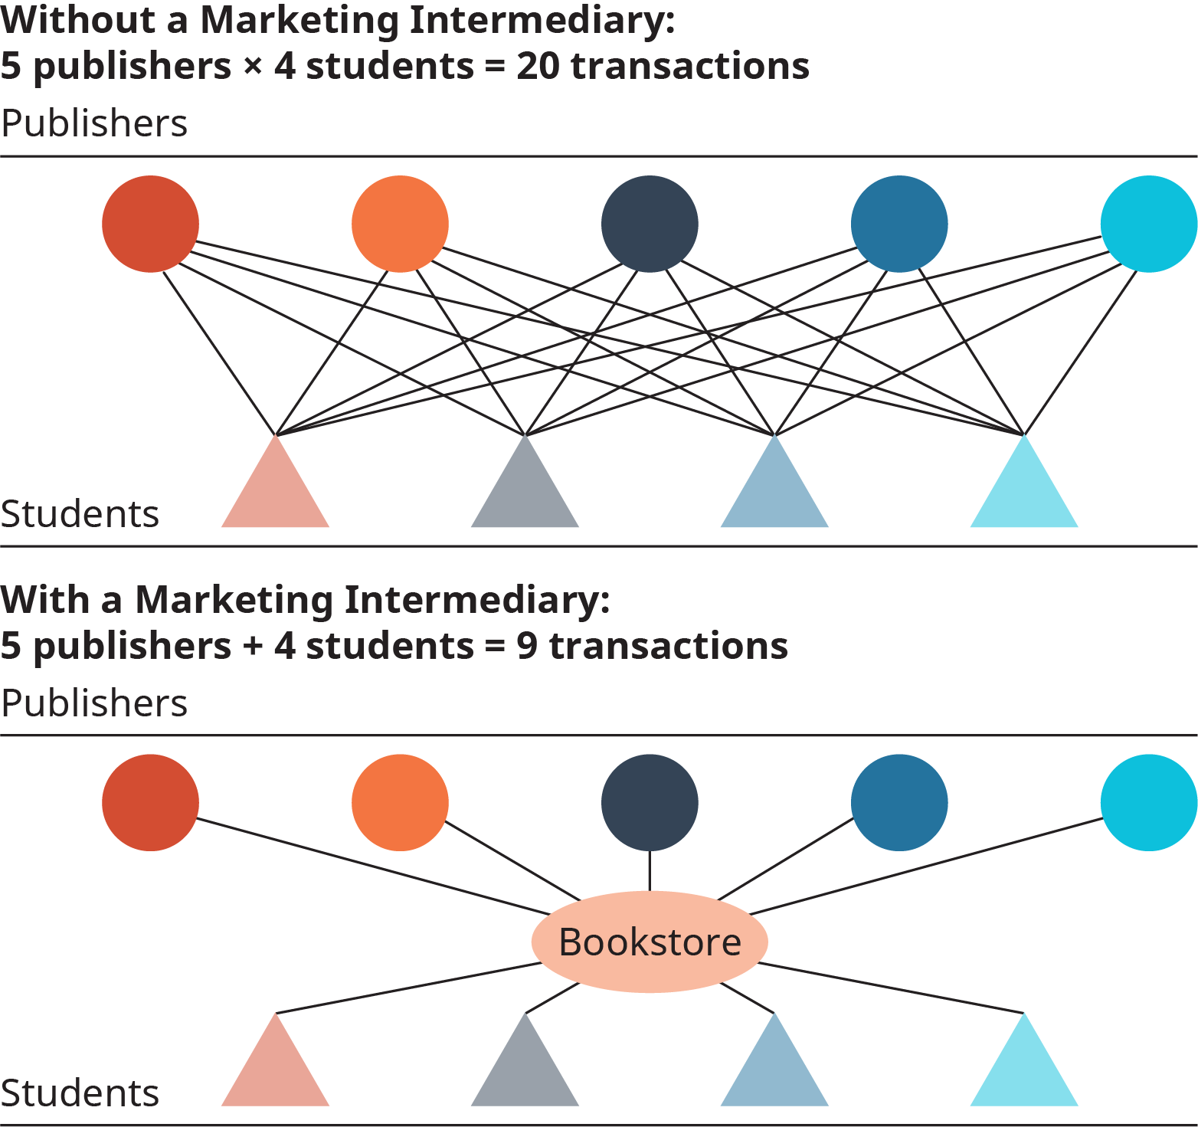
9.4 SUPPLY CHAINS AND DISTRIBUTION CHANNELS II
The Functions of Distribution Channels
Notes:
Channels serve a number of functions.
Channels Reduce the Number of Transactions
Channels make distribution simpler by reducing the number of transactions required to get a product from the manufacturer to the consumer.

Slide 14
9.4 SUPPLY CHAINS AND DISTRIBUTION CHANNELS III
Supply Chain vs. Marketing Channels
The supply chain is broader than marketing channels.
Marketing channels are purely customer facing.
Marketing channels are part of the marketing mix.
Notes:
1. It begins with raw materials and delves deeply into production processes and inventory management. Marketing channels are focused on bringing together the partners who can most efficiently deliver the right marketing mix to the customer in order to maximize value. Marketing channels provide a more narrow focus within the supply chain.
2. Supply chain management seeks to optimize how products are supplied, which adds a number of financial and efficiency objectives that are more internally focused. Marketing channels emphasize a stronger market view of the customer expectations and competitive dynamics in the marketplace.
3. Supply chain professionals are specialists in the delivery of goods. Marketers view distribution as one element of the marketing mix, in conjunction with product, price, and promotion. Supply chain management is more likely to identify the most efficient delivery partner. A marketer is more likely to balance the merits of a channel partner against the value offered to the customer.

Slide 15
9.5 GLOBAL SOURCING AND DISTRIBUTION I
Global sourcing refers to buying the raw materials or components that go into a company’s products from around the world, not just from the headquarters’ country. For example, Starbucks buys its coffee from locations like Colombia and Guatemala.
Notes:
The advantages of global sourcing are quality and lower cost. Global sourcing is possible to the extent that the world is flat—for example, buying the highest-quality cocoa beans for making chocolate or buying aluminum from Iceland, where it’s cheaper because it’s made using free geothermal energy.
When making global-sourcing decisions, firms face a choice of whether to sole-source (i.e., use one supplier exclusively) or to multisource (i.e., use multiple suppliers). The advantage of sole-sourcing is that the company will often get a lower price by giving all of its volume to one supplier.
On the other hand, using multiple suppliers gives a company more flexibility. For instance, if there’s a natural disaster or other disruption at one of their suppliers, the company can turn to its other suppliers to meet its needs.

Slide 16
9.5 GLOBAL SOURCING AND DISTRIBUTION II
Sole-Sourcing Advantages
Price discounts based on higher volume
Rewards for loyalty during tough times
Exclusivity brings differentiation
Greater influence with a supplier
Sole-Sourcing Disadvantages
Higher risk of disruption
Supplier has more negotiating power on price

Slide 17
9.5 GLOBAL SOURCING AND DISTRIBUTION III
Multisourcing Advantages
More flexibility in times of disruption
Negotiating lower rates by pitting one supplier against another
Multisourcing Disadvantages
Quality across suppliers may be less uniform
Less influence with each supplier
Higher coordination and management costs
Notes:
Whichever sourcing strategy a company chooses, it can reduce risk by visiting its suppliers regularly to ensure the quality of products and processes, the financial health of each supplier, and the supplier’s adherence to laws, safety regulations, and ethics.

Slide 18
9.5 GLOBAL SOURCING AND DISTRIBUTION IV
Distribution Management
Selling internationally means considering how your company will distribute its goods in the market. Developed countries have good infrastructure—passable roads that can accommodate trucks, retailers who display and sell products, and reliable communications infrastructure and media choices.
Notes:
Emerging markets, on the other hand, often have very fragmented distribution networks, limited logistics, and much smaller retailer outlets. Hole-in-the-wall shops, door-to-door peddlers, and street vendors play a much larger role in emerging-market countries. In the emerging countries of Africa, for example, books might be sold from the back of a moped.

Slide 19
9.5 GLOBAL SOURCING AND DISTRIBUTION V
Distribution-Management Choices: Partner, Acquire, or Build from Scratch
There are typically 3 distribution strategies for entering a new market.
Companies can do a joint-venture or partnership with a local company.
Acquire a local company to have immediate access to large-scale distribution.
A company can build its own distribution from scratch.
Notes:
1. This is the strategy Walmart used when entering Mexico.
2. The Home Depot pursued this strategy in China when it acquired a partner with whom it had been working for quite some time
3. Retailer Carrefour chose this route in China years ago, because it knew China would offer a big opportunity, and Carrefour wanted to develop its own local capabilities.
NB---Which strategy the company chooses depends on its timetable for volume in the market, local foreign-ownership laws, and the availability of suitable partners or acquisition targets.

Slide 20
9.6 KEY TERMS
Accumulating: Bringing similar stocks together into a larger quantity. Twelve large Grade A eggs could be placed in some cartons and 12 medium Grade B eggs in other cartons. Another example would be to merge several lines of women’s dresses from different designers together. 9.4
Allocating: Breaking similar products into smaller and smaller lots (allocating at the wholesale level is called breaking bulk.) For instance, a tank-car load of milk could be broken down into gallon jugs. The process of allocating generally is done when the goods are dispersed by region and as ownership of the goods changes. 9.4
Broker or Agent Channel: Includes one additional intermediary. Agents and brokers are different from wholesalers in that they do not take title to the merchandise. In other words, they do not own the merchandise because they neither buy nor sell. 9.2
Channel of Distribution: also called a marketing channel, a set of interdependent organizations involved in the process of making a product or service available for use or consumption, as well as providing a payment mechanism for the provider. 9.1
Direct Channel: Is the simplest channel. In this case, the producer sells directly to the consumer. 9.2
Distribution Chennel: On their way from producers to end users and consumers, products pass through a series of marketing entities 9.4
Grading and Packaging: Wholesalers buy a very large quantity of goods that they then break down into smaller lots. The process of breaking large quantities into smaller lots to be resold is called “bulk breaking”. Often this includes physically sorting, grading, and assembling the goods. 9.3
Information Flow: The individuals who participate in the flow of information either up or down the channel. 9.1
Negotiation Flow: The institutions that are associated with the actual exchange processes. 9.1
Ownership Flow: The movement of title through the channel. 9.1
Product Flow: The movement of the physical product from the manufacturer through all the parties who take physical possession of the product until it reaches the ultimate consume. 9.1
Promotion Flow: The flow of persuasive communication in the form of advertising, personal selling, sales promotion, and public relations. 9.1
Purchasing: Wholesalers purchase very large quantities of goods directly from producers or from other wholesalers. By purchasing large quantities or volumes, wholesalers are able to secure significantly lower prices. 9.3
Retail Channel: Is different from the direct channel in that the retailer doesn’t produce the product. The retailer markets and sells the goods on behalf of the producer 9.2
Risk Bearing: Wholesalers either take title to the goods they purchase, or they own the goods they purchase. 9.3
Sorting Out: Breaking many different items into separate stocks that are similar. Eggs, for instance, are sorted by grade and size. Another example would be different lines of women’s dresses—designer, moderate, and economy lines. 9.4
Wholesaler: Is primarily engaged in buying and usually storing and physically handling goods in large quantities, which are then resold (usually in smaller quantities) to retailers or to industrial or business users. 9.2
Wholesale Channel: Looks very similar to the retail channel, but it also involves a wholesaler. 9.2

