Slide 1
Global Marketing in a Digital World
CHAPTER 8: GLOBAL PRICING
Unless otherwise noted, this work is licensed under a Creative Commons Attribution-NonCommercial-ShareAlike 4.0 International (CC BY-NC-SA 4.0) license. Feel free to use, modify, reuse or redistribute any portion of this presentation.

Slide 2
Learning Outcomes
Upon successful completion of this chapter, you should be able to:
Explain pricing from the customer’s viewpoint.
Describe the objectives businesses hope to achieve with product pricing.
Explain the methods businesses use for discounts and allowances.
Apply the basics of pricing to global pricing decisions.
Discuss the global marketer’s view of price.
List the alternative approaches to determining global prices.
Discuss penetration and skimming in global pricing.
Explain the role of currency fluctuations and global pricing.

Slide 3
8.1 OVERVIEW OF PRICE I
Pricing decisions are a critical element of the marketing mix that must reflect costs, competitive factors, and customer perceptions regarding value of the product. In a true global market, the law of one price would prevail.
Notes:
Pricing strategies include market skimming, market penetration, and market holding. Novice exporters frequently use cost-plus pricing. International terms of a sale such as ex-works, F.A.S., F.O.B., and C.I.F. are known as Incoterms and specify which party to a transaction is responsible for covering various costs. These and other costs lead to export price escalation, the accumulation of costs that occurs when products are shipped from one country to another.

Slide 4
8.1 OVERVIEW OF PRICE II
Customer-Oriented Pricing
Notes:
Customer-oriented pricing is also referred to as value-oriented pricing. Given the centrality of the customer in a marketing orientation, it will come as no surprise that customer-oriented pricing is the recommended pricing approach because its focus is on providing value to the customer.
Customer-oriented pricing looks at the full price-value equation (above) and establishes the price that balances the value. The company seeks to charge the highest price that supports the value received by the customer.
Whether a customer is the ultimate user of the finished product or a business that purchases components of the finished product, the customer seeks to satisfy a need through the purchase of a particular product. The customer uses several criteria to decide how much she is willing to spend in order to satisfy that need. Her preference is to pay as little as possible.
In an attempt to bring the customer voice into pricing decisions, many companies conduct primary market research with target customers. Crafting questions to get at the value perceptions of the customer is difficult, though, so marketers often turn to something called the Van Westerndorp price-sensitivity meter. This method uses the following four questions to understand customer perceptions of pricing:
1. At what price would you consider the product to be so expensive that you would not consider buying it? (Too expensive)
2. At what price would you consider the product to be priced so low that you would feel the quality couldn’t be very good? (Too cheap)
3. At what price would you consider the product starting to get expensive, such that it’s not out of the question, but you would have to give some thought to buying it? (Expensive/High Side)
4. At what price would you consider the product to be a bargain—a great buy for the money? (Cheap/Good Value)
Each of these questions asks about the customer’s perspective on the product value, with price as one component of the value equation.

Slide 5
8.1 OVERVIEW OF PRICE III
Pricing Objectives
Companies set the prices of their products in order to achieve specific objectives.
Common Pricing Objectives include:
Profit Objective
Competitive Objective
Customer Objective
Notes:
Profit-oriented pricing (Profit objective) places an emphasis on the finances of the product and business. A business’s profit is the money left after all costs are covered. In other words, profit = revenue – costs. In profit-oriented pricing, the price per product is set higher than the total cost of producing and selling each product to ensure that the company makes a profit on each sale.
Competitor Objective- Sometimes prices are set almost completely according to competitor prices. A company simply copies the competitor’s pricing strategy or seeks to use price as one of the features that differentiates the product. That could mean either pricing the product higher than competitive products, to indicate that the firm believes it to provide greater value, or lower than competitive products in order to be a low-price solution.
Customer Objective-For example, “Increase customer retention”

Slide 6
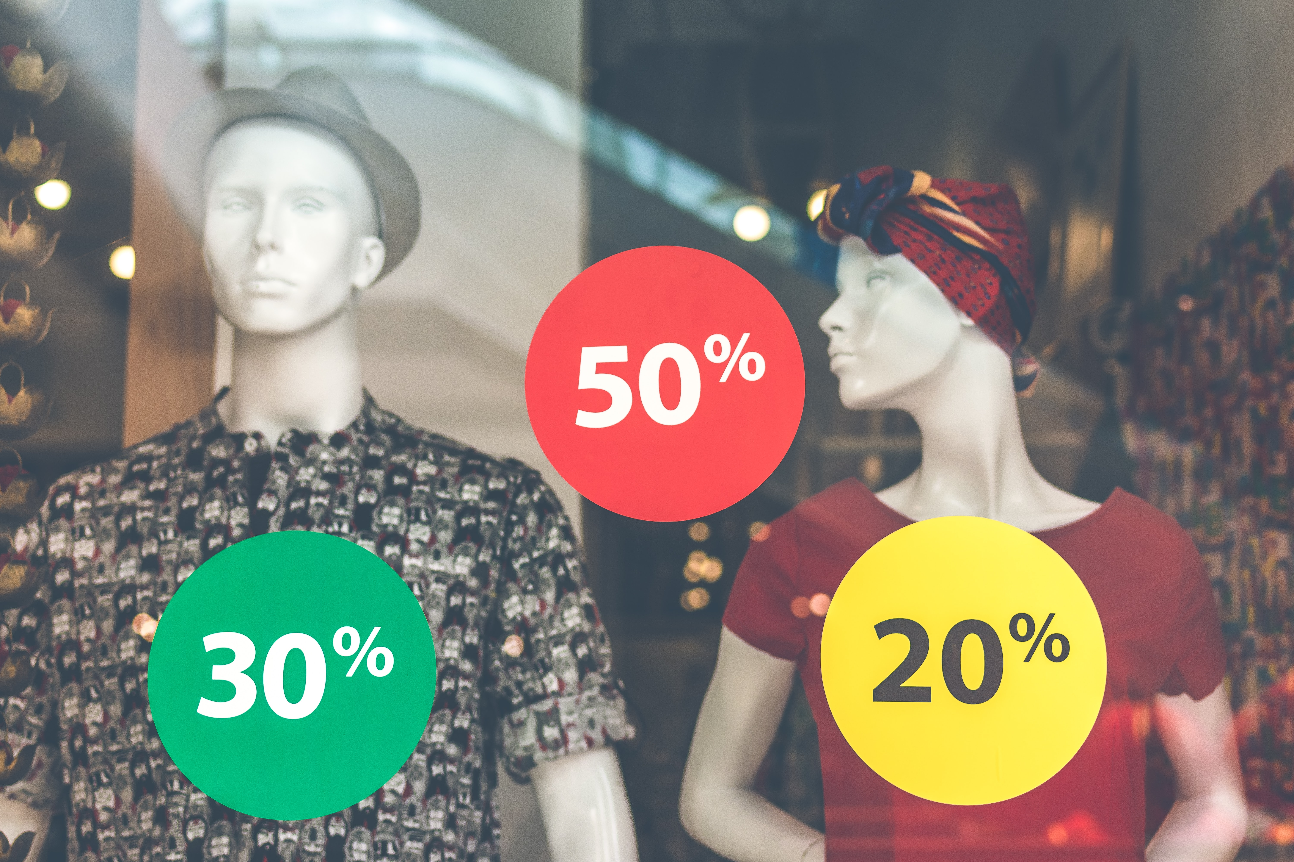
8.1 OVERVIEW OF PRICE IV
Discounting Strategies
In addition to deciding about the base price of products and services, marketing managers must also set policies regarding the use of discounts and allowances. There are many different types of price reductions–each designed to accomplish a specific purpose.
Photo by Artem Beliaikin on Unsplash

Slide 7
8.1 OVERVIEW OF PRICE V
Quantity discounts
Quantity discounts are reductions in base price given as the result of a buyer purchasing some predetermined quantity of merchandise. In a B2B environment, a noncumulative quantity discount applies to each purchase and is intended to encourage buyers to make larger purchases.
Notes:
This means that the buyer holds the excess merchandise until it is used, possibly cutting the inventory cost of the seller and preventing the buyer from switching to a competitor at least until the stock is used. A cumulative quantity discount applies to the total bought over a period of time. The buyer adds to the potential discount with each additional purchase. Such a policy helps to build repeat purchases.

Slide 8
8.1 OVERVIEW OF PRICE VI
Quantity discounts
There are as many quantity discount deals as there are products to price.
Seasonal discounts
Cash discounts
Trade discounts
Personal allowances
Trade-in allowances
Price bundling
Notes:
Seasonal discounts are price reductions given for out-of-season merchandise—snowmobiles discounted during the summer, for example. The intention of such discounts is to spread demand over the year, which can allow fuller use of production facilities and improved cash flow during the year.
Cash discounts are reductions on base price given to customers for paying cash or within some short time period. For example, a 2 percent discount on bills paid within 10 days is a cash discount. The purpose is generally to accelerate the cash flow of the organization and to reduce transaction costs.
Trade discounts are price reductions given to middlemen (e.g., wholesalers, industrial distributors, retailers) to encourage them to stock and give preferred treatment to an organization’s products. For example, a consumer goods company might give a retailer a 20 percent discount to place a larger order for soap.
Personal allowances are similar strategies aimed at middlemen. Their purpose is to encourage middlemen to aggressively promote the organization’s products. For example, a furniture manufacturer may offer to pay some specified amount toward a retailer’s advertising expenses if the retailer agrees to include the manufacturer’s brand name in the ads.
Trade-in allowances also reduce the base price of a product or service. These are often used to help the seller negotiate the best price with a buyer. The trade-in may, of course, be of value if it can be resold.
Price bundling is a very popular pricing strategy. The marketer groups similar or complementary products and charges a total price that is lower than if they were sold separately.

Slide 9
8.2 GLOBAL PRICING I
Several factors affect the global pricing of a product, e.g., manufacturing cost, market place, competition, market condition, and quality of product, distribution channels, country factors and company factors (Alon & Jaffe 2013).
Notes:
At its basic level, pricing is the process of determining what a company will receive in exchange for its products. As one of the four “Ps” in the marketing mix, pricing is the only revenue generating element.

Slide 10
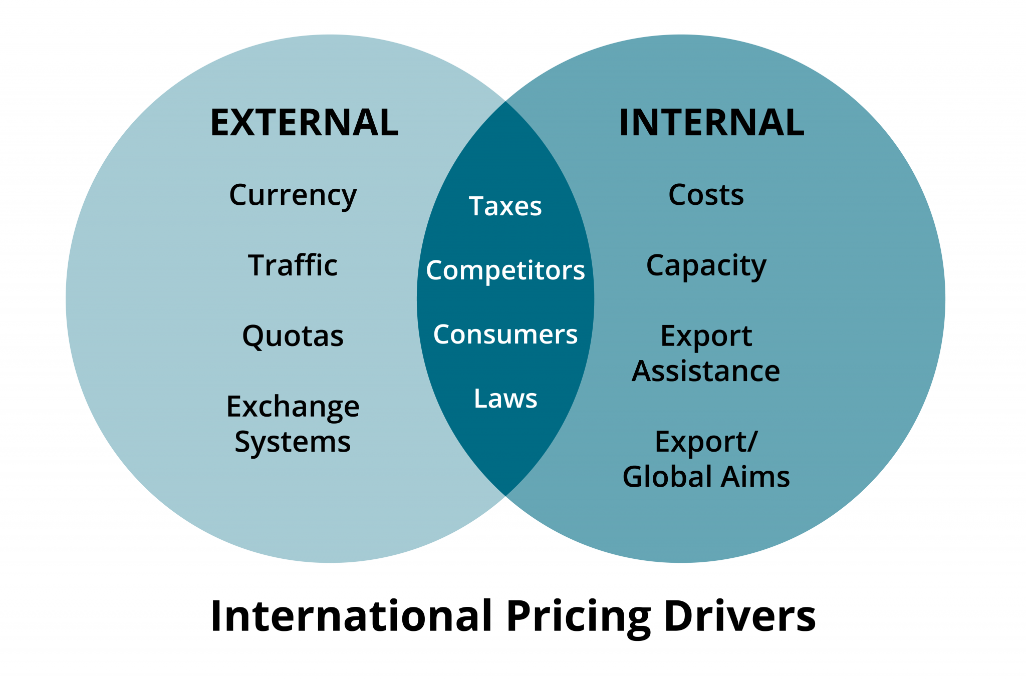
8.2 GLOBAL PRICING II
Notes:
According to Clarke and Wilson (2009), international pricing decisions also need to take account of tariffs, quotas, local taxes, subsidies, grants, currency exchange, rates, local purchasing power, local business and consumer characteristics. The figure here shows the drivers of international pricing.
Prices can be used both to set values and provide signals in international markets (Eden & Rodriguez 2004). From a customer’s point of view, value is the sole justification for price. Many times customers lack an understanding of the cost of materials and other costs that go into the making of a product. But those customers can understand what that product does for them in the way of providing value. It is on this basis that customers make decisions about the purchase of a product.

Slide 11
8.2 GLOBAL PRICING III
Price From a Global Marketer’s Perspective
Price is important to global marketing, because it represents marketers’ assessment of the value customers see in the product or service and are willing to pay for a product or service. A number of factors have changed the way marketers undertake the pricing of their products and services.
Notes:
Local competition puts pressure on the global firms’ pricing strategies. Many local-made products are high in quality and compete in global markets on the basis of lower price for good value.
Local competitors often try to gain market share by reducing their prices. The price reduction is intended to increase demand from customers who are judged to be sensitive to changes in price.
New products are far more prevalent today than in the past. Pricing a new product can represent a challenge, as there is often no historical basis for pricing new products. If a new product is priced incorrectly, the marketplace will react unfavorably and the “wrong” price can do long-term damage to a product’s chances for marketplace success.
Technology has led to existing products having shorter marketplace lives. New products are introduced to the market more frequently, reducing the “shelf life” of existing products. As a result, marketers face pressures to price products to recover costs more quickly. Prices must be set for early successes including fast sales growth, quick market penetration, and fast recovery of research and development costs.

Slide 12
8.3 GLOBAL PRICING APPROACHES I
Global pricing decisions can be based on a number of factors, including cost, demand, competition, value, or some combination of factors. However, while many marketers are aware that they should consider these factors, pricing remains somewhat of an art.

Slide 13
8.3 GLOBAL PRICING APPROACHES II
For purposes of discussion, we categorize the alternative approaches to determining price as follows:
cost-oriented pricing
demand-oriented pricing
value-based approaches
Notes:
1. The cost-plus method, sometimes called gross margin pricing, is perhaps most widely used by marketers to set price. The manager selects as a goal a particular gross margin that will produce a desirable profit level.
2. Demand-oriented pricing focuses on the nature of the demand curve for the product or service being priced. The nature of the demand curve is influenced largely by the structure of the industry in which a firm competes.
3. If we consider the three approaches to setting price, cost-based is focused entirely on the perspective of the company with very little concern for the customer; demand-based is focused on the customer, but only as a predictor of sales; and value-based pricing focuses entirely on the customer as a determinant of the total price/value package.

Slide 14
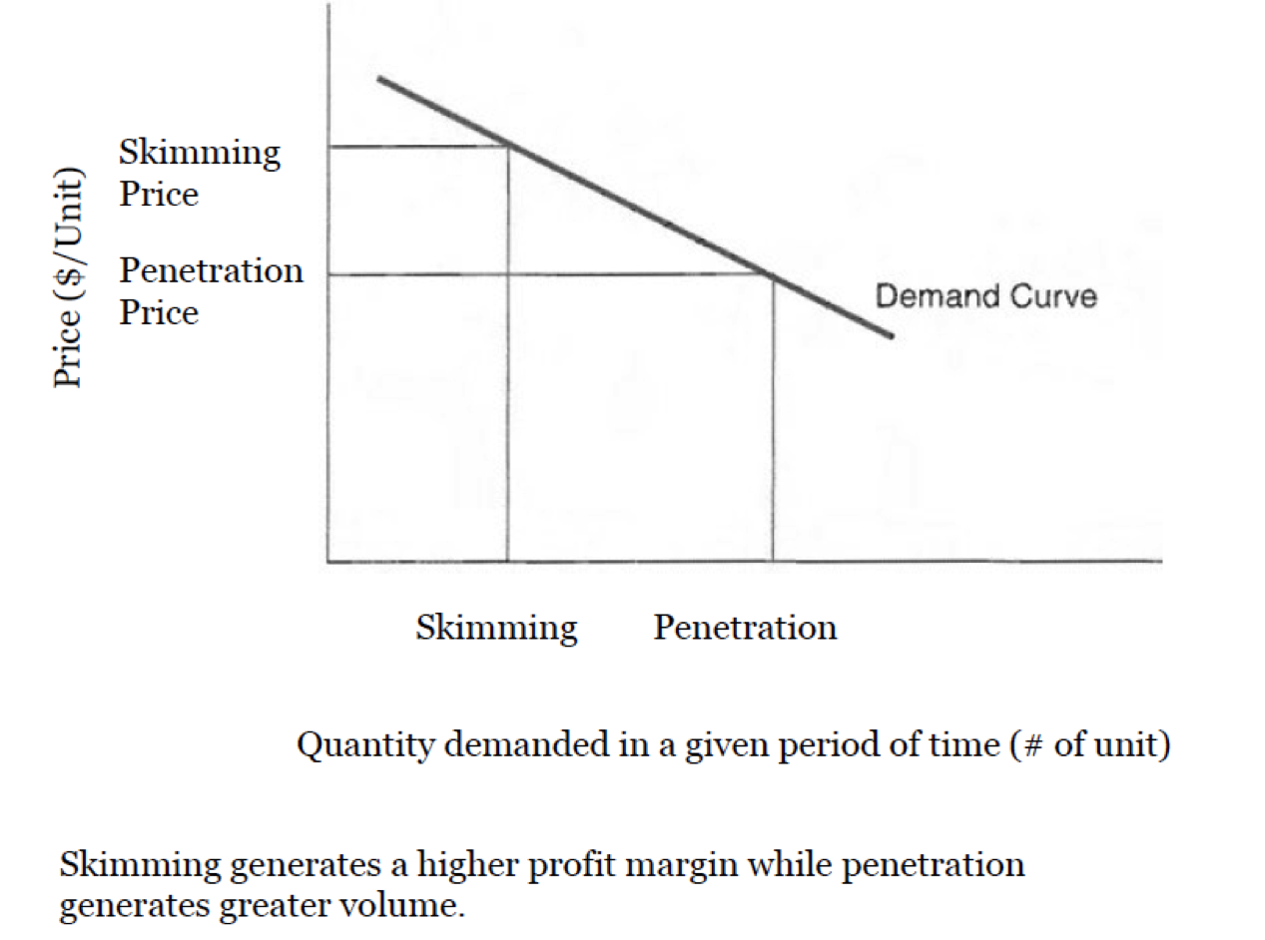
8.3 GLOBAL PRICING APPROACHES III
Penetration and Skimming Pricing
Notes:
Penetration pricing is usually used in the introductory stage of a new product’s life cycle, and involves accepting a lower profit margin and to price relatively low. Such a strategy should generate greater sales and establish the new product in the market more quickly.
Price skimming involves the top part of the demand curve. Price is set relatively high to generate a high profit margin and sales are limited to those buyers willing to pay a premium to get the new product
Penetration pricing can be used to achieve market share as a competitive strategy to achieve market leadership. Other times, it can also be used to increase market and sales growth.
Which strategy is best depends on a number of factors. A penetration strategy would generally be supported by the following conditions: price-sensitive consumers, opportunity to keep costs low, the anticipation of quick market entry by competitors, a high likelihood for rapid acceptance by potential buyers, and an adequate resource base for the firm to meet the new demand and sales.

Slide 15
8.4 CURRENCY FLUCTUATIONS AND GLOBAL PRICING I
Currency is any form of money in general circulation in a country. What exactly is a foreign exchange? In essence, foreign exchange is money denominated in the currency of another country or—now with the euro—a group of countries. Simply put, an exchange rate is defined as the rate at which the market converts one currency into another.

Slide 16
8.4 CURRENCY FLUCTUATIONS AND GLOBAL PRICING II
Exchange fluctuations and global prices
The strengthening or weakening of a home (exporting) country’s currency in relation to that of the host (foreign) country, can have far-reaching effects on the price setting in the foreign country, as well as other elements of the global marketer’s marketing strategy.
Image by PublicDomainPictures from Pixabay
Notes:
For example, if the value of the U.S. dollar relative to the euro was U.S.$1 to 1.8315 euros in 2001, and U.S.$1 to 0.8499 euros in 2003, then the exchange rate U.S.$1 to 1.8315 euros is said to be stronger for the US dollar, and the exchange rate U.S.$1 to 0.8499 euros is said to be weaker for the US dollar.
When the home currency of the global marketer weakens, the exchange rates are supposed be favorable to the global marketer, because the home currency will fetch lesser in terms of the foreign currency, and hence the prices of the exported product in the foreign country’s currency will come down. Therefore, the global marketer can cut prices in the foreign country, and hence, increase market share.

Slide 17
8.5 KEY TERMS
Cash Discounts: These are reductions on the base price given to customers for paying cash or within some short time period. 8.1
Currency: Is any form of money in general circulation in a country. 8.4
Customer-Oriented Pricing: Is also referred to as value-oriented pricing. Given the centrality of the customer in a marketing orientation (and this marketing course!), it will come as no surprise that customer-oriented pricing is the recommended pricing approach because its focus is on providing value to the customer. Customer-oriented pricing looks at the full price-value equation (above) and establishes the price that balances the value. 8.1
Foreign Exchange: Is money denominated in the currency of another country or—now with the euro—a group of countries. Simply put, an exchange rate is defined as the rate at which the market converts one currency into another. 8.4
Personal Allowances: Are similar strategies aimed at middlemen. Their purpose is to encourage middlemen to aggressively promote the organization’s products. 8.1
Profit-Oriented: Pricing places an emphasis on the finances of the product and business. A business’s profit is the money left after all costs are covered. In other words, profit = revenue – costs. In profit-oriented pricing, the price per product is set higher than the total cost of producing and selling each product to ensure that the company makes a profit on each sale 8.1
Quantity Discounts: Are reductions in base price given as the result of a buyer purchasing some predetermined quantity of merchandise. 8.1
Seasonal Discounts: are price reductions given for out-of-season merchandise—snowmobiles discounted during the summer 8.1
Trade Discounts: Are price reductions given to middlemen (e.g., wholesalers, industrial distributors, retailers) to encourage them to stock and give preferred treatment to an organization’s products. 8.1

