Slide 1
Global Marketing in a Digital World
CHAPTER 7: GLOBAL PRODUCTS
Unless otherwise noted, this work is licensed under a Creative Commons Attribution-NonCommercial-ShareAlike 4.0 International (CC BY-NC-SA 4.0) license. Feel free to use, modify, reuse or redistribute any portion of this presentation.

Slide 2
Learning Outcomes
Upon successful completion of this chapter, you should be able to:
Describe common consumer product categories
Describe the product life cycle
Explain marketing considerations through the product life cycle
Explain the stages of the new-product development process
Outline the trade-offs between standardized versus customized products
List the dimensions of value proposition adaptation
List the major drivers behind value proposition adaptation
Outline the significant advantages of a global innovation strategy
List the steps in the global innovation strategy of a firm
Outline the nature and size of BOP markets
Provide examples of firms pursuing BOP strategies

Slide 3
7.1 OVERVIEW OF PRODUCTS I
Product defines what will be priced, promoted, and distributed. If you are able to create and deliver a product that provides exceptional value to your target customer, the rest of the marketing mix is easier to manage. A successful product makes every aspect of a marketer’s job easier—and more fun.
Notes:
Often when we hear the word marketing, we think about promotion or perhaps only advertising, but product is the core of the marketing mix.
A product is a bundle of attributes (features, functions, benefits, and uses) that a person receives in an exchange. In essence, the term “product” refers to anything offered by a firm to provide customer satisfaction, tangible or intangible. Thus, a product may be an idea (recycling), a physical good (a pair of sneakers), a service (banking), or any combination of the three (Marketing Accountability Standards Board, 2020).

Slide 4
7.1 OVERVIEW OF PRODUCTS II
Consumer Product Categories
Consumer products are often classified into 4 groups related to different kinds of buying decisions:
Convenience
Shopping
Specialty
Unsought products
Notes:
Consumer products are purchased by the final consumer.

Slide 5
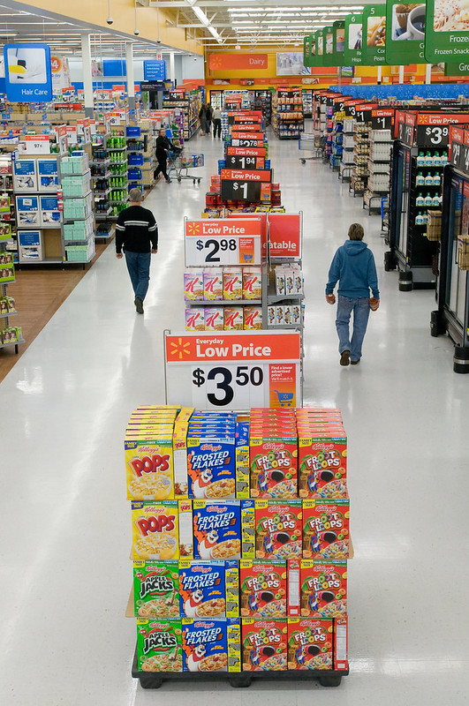
7.1 OVERVIEW OF PRODUCTS III
A convenience product is an inexpensive product that requires a minimum amount of effort on the part of the consumer in order to select and purchase it.
Action Alley by Walmart Corporate via Flickr under a CC-BY 2.0 license
Notes:
Examples of convenience products are bread, soft drinks, pain reliever, and coffee. They also include headphones, power cords, and other items that are easily misplaced.
From the consumer’s perspective, little time, planning, or effort go into buying convenience products. Often product purchases are made on impulse, so availability is important. Consumers have come to expect a wide variety of products to be conveniently located at their local supermarkets.
They also expect easy online purchase options and low-cost, quick shipping for those purchases. Convenience items are also found in vending machines and kiosks.

Slide 6
7.1 OVERVIEW OF PRODUCTS IV
Shopping Products
Shopping products are usually more expensive and are purchased occasionally. The consumer is more likely to compare a number of options to assess quality, cost, and features.
Photo by Arturo Rey, Unsplash
Notes:
Although many shopping goods are nationally advertised, in the marketing strategy it is often the ability of the retailer to differentiate itself that generates the sale.

Slide 7
7.1 OVERVIEW OF PRODUCTS V
Specialty Products
Specialty goods represent the third product classification. From the consumer’s perspective, these products are so unique that it’s worth it to go to great lengths to find and purchase them.
Photo by Laura Chouette, Unsplash
Notes:
Almost without exception, price is not the principle factor affecting the sales of specialty goods. Although these products may be custom-made or one-of-a-kind, it is also possible that the marketer has been very successful in differentiating the product in the mind of the consumer.
For example, some consumers feel a strong attachment to their hair stylist or barber. They are more likely to wait for an appointment than schedule time with a different stylist.

Slide 8
7.1 OVERVIEW OF PRODUCTS VI
Unsought Products
Unsought products are those the consumer never plans or hopes to buy. These are either products that the customer is unaware of or products the consumer hopes not to need.
Photo by CDC, Unsplash
Notes:
For example, most consumers hope never to purchase pest control services and try to avoid purchasing funeral plots. Unsought products have a tendency to draw aggressive sales techniques, as it is difficult to get the attention of a buyer who is not seeking the product.

Slide 9
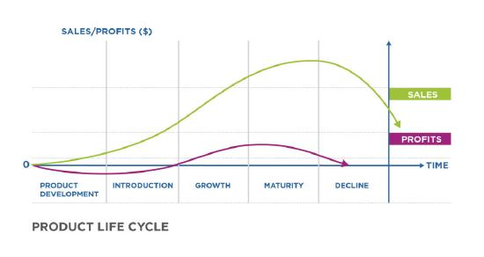
7.2 PRODUCT LIFE CYCLE I
The product life cycle (PLC) starts with the product’s development and introduction, then moves toward maturity, withdrawal and eventual decline.
Notes:
A company has to be good at both developing new products and managing them in the face of changing tastes, technologies, and competition. Products generally go through a life cycle with predictable sales and profits. Marketers use the product life cycle to follow this progression and identify strategies to influence it.
Product development- investment is made, sales have not begun, new product ideas are generated, operationalized, and tested
Market introduction- costs are very high, slow sales volumes to start, little or no competition, demand has to be created, customers have to be prompted to try the product, makes little money at this stage
Growth- costs reduced due to economies of scale, sales volume increases significantly, profitability begins to rise, public awareness increases, competition begins to increase with a few new players in, establishing market, increased competition leads to price decreases
Maturity- costs are lowered as a result of increasing production volumes and experience curve effects, sales volume peaks and market saturation is reached, new competitors enter the market, prices tend to drop due to the proliferation of competing products, brand differentiation and feature diversification is emphasized to maintain or increase market share, profits decline
Decline- costs increase due to some loss of economies of scale, sales volume declines, prices and profitability diminish, profit becomes more a challenge of production/distribution efficiency than increased sales

Slide 10
7.2 PRODUCT LIFE CYCLE II
Marketing through the Product Cycle
There are some common marketing considerations associated with each stage of the PLC. How marketers think about the marketing mix and the blend of promotional activities–also known as the promotion mix–should reflect a product’s life-cycle stage and progress toward market adoption.
Notes:
These considerations cannot be used as a formula to guarantee success, but they can function as guidelines for thinking about budget, objectives, strategies, tactics, and potential opportunities and threats.

Slide 11
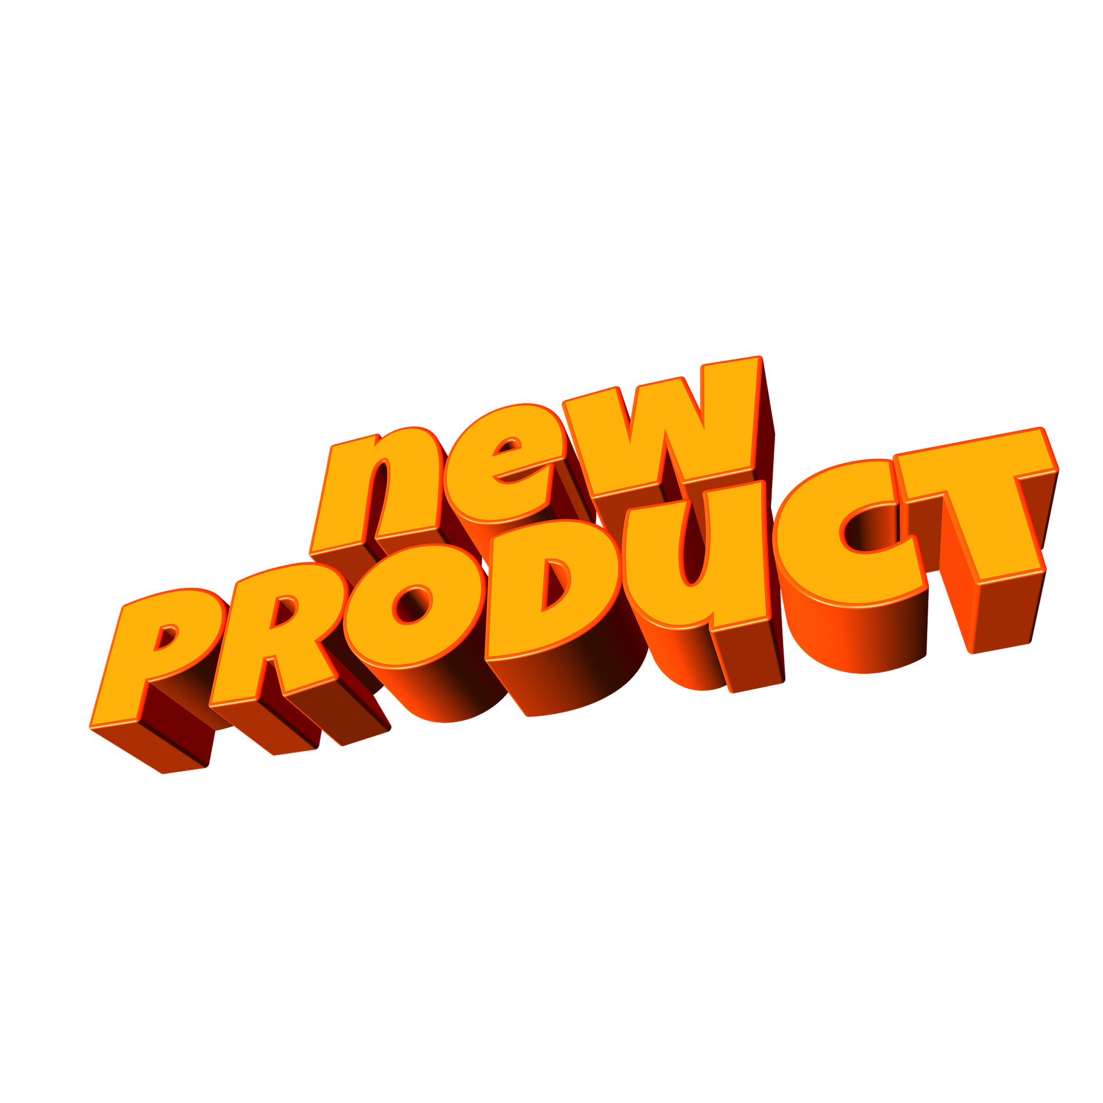
7.2 PRODUCT LIFE CYCLE III
Market Introduction Stage
Think of the market introduction stage as the product launch. This phase of the PLC requires a significant marketing budget. The market is not yet aware of the product or its benefits. Introducing a product involves convincing consumers that they have a problem or need which the new offering can uniquely address.
Image by Gerd Altmann, Pixabay
Notes:
At its core, messaging should convey, “This product is a great idea! You want this!” Usually a promotional budget is needed to create broad awareness and educate the market about the new product. To achieve these goals, often a product launch includes promotional elements such as a new Web site (or significant update to the existing site), a social media campaign, print or broadcast advertising, a press release and press campaign.

Slide 12
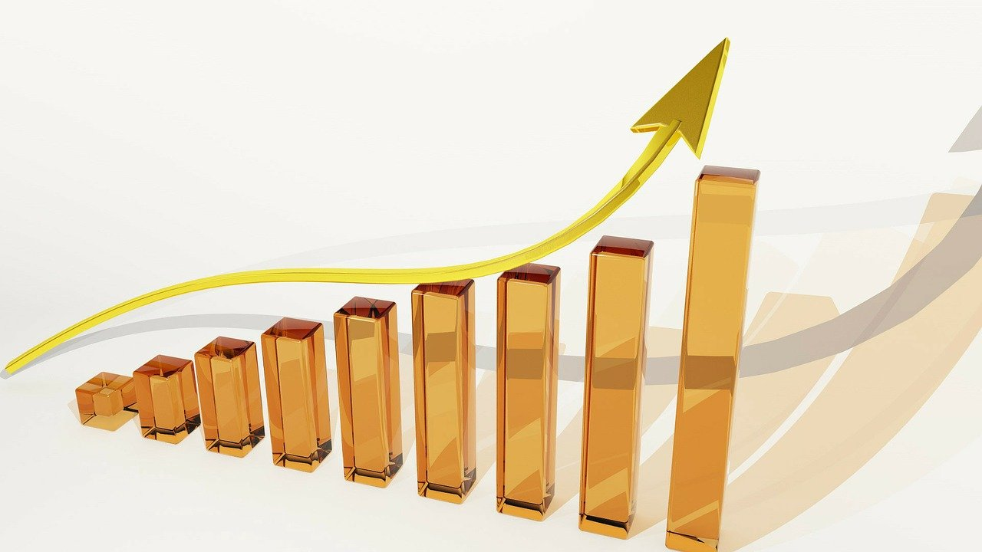
7.2 PRODUCT LIFE CYCLE IV
Growth Stage
Once rapid growth begins, the product or industry has entered the growth stage. When a product category begins to demonstrate significant growth, the market usually responds: new competitors enter the market, and larger companies acquire high-growth companies and products.
Image by PublicDomainPictures, Pixabay
Notes:
These emerging competitive threats drive new marketing tactics. Marketers who have been seeking to build broad market awareness through the introduction phase must now differentiate their products from competitors, emphasizing unique features that appeal to target customers. The central thrust of market messaging and promotion during this stage is “This brand is the best!” Pricing also becomes more competitive and must be adjusted to align with the differentiation strategy.

Slide 13
7.2 PRODUCT LIFE CYCLE V
Maturity Stage
When growth begins to plateau, the product has reached the maturity phase. In order to achieve strong business results through the maturity stage, the company must take advantage of economies of scale. This is usually a period in which marketers manage budget carefully, often redirecting resources toward products that are earlier in their life cycle and have higher revenue potential.
Notes:
At this stage, organizations are trying to extract as much value from an established product as they can, typically in a very competitive field. Marketing messages and promotions seek to remind customers about a great product, differentiate from competitors, and reinforce brand loyalty: “Remember why this brand is the best.”

Slide 14
7.2 PRODUCT LIFE CYCLE VI
Decline Stage
Once a product or industry has entered decline, the focus shifts almost entirely to minimizing costs. Marketing spend is reduced for products in this life stage, because the marketing investment is better spent on other priorities.
Image by Clker-Free-Vector-Images, Pixabay
Notes:
For goods, distributors will seek to eliminate inventory by cutting prices. For services, companies will reallocate staff to ensure that delivery costs are in check. Where possible, companies may initiate a planned obsolescence process. Commonly technology companies will announce to customers that they will not continue to support a product after a set obsolescence date.
Often a primary focus for marketers during this stage is to transition customers to newer products that are earlier in the product life cycle and have more favorable economics.

Slide 15
7.2 PRODUCT LIFE CYCLE VII
The New-Product Development Process
There are probably as many varieties of new-product development systems as there are types of companies, but most of them share the same basic steps or stages—they are just executed in different ways.
Stage 1: Generating New Product Ideas
Stage 2: Screening Product Ideas
Stage 3: Concept Development and Testing
Stage 4: Business Case Analysis
Stage 5: Technical and Marketing Development
Stage 6: Test Marketing
Stage 7: Launch
Notes:
Stage 1: Generating New Product Ideas- Generating new product ideas is a creative task that requires a particular way of thinking. Coming up with ideas is easy, but generating good ideas is another story. Companies use a range of internal and external sources to identify new product ideas. A SWOT analysis might suggest strengths in existing products that could be the basis for new products or market opportunities.
Stage 2: Screening Product Ideas- The second stage of the product development process is idea screening. This is the first of many screening points. At this early stage much is not known about the product and its market opportunity.
Stage 3: Concept Development and Testing- Today, it is increasingly common for companies to run some small concept test in a real marketing setting. The product concept is a synthesis or a description of a product idea that reflects the core element of the proposed product.
Stage 4: Business Case Analysis- Before companies make a significant investment in a product’s development, they need to be sure that it will bring a sufficient return.
Stage 5: Technical and Marketing Development- A product that has passed the screening and business analysis stages is ready for technical and marketing development. Technical development processes vary greatly according to the type of product.
Stage 6: Test Marketing and Validation- Test marketing is the final stage before commercialization; the objective is to test all the variables in the marketing plan including elements of the product. Test marketing represents an actual launching of the total marketing program, done on a limited basis.
Stage 7: Launch- Finally, the product arrives at the commercial launch stage. The marketing mix comes together to introduce the product to the market. This stage marks the beginning of the product life cycle.

Slide 16
7.3 GLOBAL PRODUCTS AND SERVICES
Companies deciding to market their products in different countries typically have a choice of three common strategies to pursue.
Product extension
Product adaptation
Product invention
Notes:
This means taking the company’s current products and selling them in other countries without making changes to the product. The advantages of this strategy are that the company doesn’t need to invest in new research, development, or manufacturing. Changes may be made in packaging and labeling, but these are driven by local regulatory requirements. The disadvantages, however, are that its products may not be well suited to local needs and that the products may be more costly due to higher manufacturing and labour costs in the United States.
This refers to modifying the company’s existing product in a way that makes it fit better with local needs. For example, when Procter & Gamble (P&G) introduced Tide laundry detergent in emerging markets like India, it changed the formulation to remove softeners.
is creating an entirely new product for the target market. In this strategy, companies go back to the drawing board and rethink how best to design a product for that country.

Slide 17
7.4 PRODUCT ADAPTATION DECISIONS I
Value proposition adaptation deals with a whole range of issues, ranging from the quality and appearance of products to materials, processing, production equipment, packaging, and style.
Notes:
A product may have to be adapted to meet the physical, social, or mandatory requirements of a new market. It may have to be modified to conform to government regulations or to operate effectively in country-specific geographic and climatic conditions. Or it may be redesigned or repackaged to meet the diverse buyer preferences or standard-of-living conditions.
A product’s size and packaging may also have to be modified to facilitate shipment or to conform to possible differences in engineering or design standards in a country or in regional markets.

Slide 18
7.4 PRODUCT ADAPTATION DECISIONS II
Drivers behind value proposition adaptation
Many products must be adapted to local geographic and climatic conditions. Factors such as topography, humidity, and energy costs can affect the performance of a product or even define its use in a foreign market.
Notes:
EG-- The cost of petroleum products, along with a country’s infrastructure, for example, may mandate the need to develop products with a greater level of energy efficiency
The availability, performance, and level of sophistication of a commercial infrastructure will also warrant a need for adaptation or localization of products
Differences in buyer preferences are also major drivers behind value proposition adaptation. Local customs, such as religion or the use of leisure time, may affect market acceptance. The sensory impact of a product, such as taste or its visual impression, may also be a critical factor.
The availability, performance, and level of sophistication of a commercial infrastructure will also warrant a need for adaptation or localization of products. For example, a company may decide not to market its line of frozen food items in countries where retailers do not have adequate freezer space.
A country’s standard of living and the target market’s purchasing power can also determine whether a company needs to modify its value proposition. The level of income, the level of education, and the availability of energy are all factors that help predict the acceptance of a product in a foreign market.

Slide 19
7.5 GLOBAL INNOVATION I
A core competency in global innovation—the ability to leverage new ideas all around the world—has become a major source of global competitive advantage, as companies such as Nokia, Airbus, SAP, and Starbucks demonstrate. They realize that the principal constraint on innovation “performance” is knowledge.
Notes:
Many companies now have global supply chains and product development processes, but few have developed effective global innovation capabilities (Santos et al., 2004). Increasingly, however, technology access and innovation are becoming key global strategic drivers. This move from cost to growth and innovation is likely to continue as the centre of gravity of economic activity shifts further to the East.
Accessing a diverse set of sources of knowledge is, therefore, a key challenge and is critical to successful differentiation. Companies whose knowledge pool is the same as that of its competitors will likely develop uninspired “me, too” products; access to a diversity of knowledge allows a company to move beyond incremental innovation to attention-grabbing designs and breakthrough solutions.

Slide 20
7.5 GLOBAL INNOVATION II
Steps in the Global Innovation Strategy.
To reap the benefits of global innovation, companies must do 3 things:
Prospect
Assess
Mobilize
Notes:
1. Find the relevant pockets of knowledge from around the world. Finding valuable new pockets of knowledge to spur innovation—may well be the most challenging task. The process involves knowing what to look for, where to look for it, and how to tap into a promising source
2. Decide on the optimal “footprint” for a particular innovation. Assessing new sources of innovation, that is, incorporating new knowledge into and optimizing an existing innovation network, is the second important challenge companies face.
3. Use cost-effective mechanisms to move distant knowledge without degrading (Santos et al., 2004). ---Mobilizing the footprint, that is, integrating knowledge from different sources into a virtual melting pot from which new products or technologies can emerge, is the third challenge. To accomplish this, companies must bring the various pieces of (technical) knowledge that are scattered around the world together and provide a suitable organizational form for innovation efforts to flourish.

Slide 21
7.6 GLOBAL INNOVATION AT THE BOP I
In 1998, Professors C. K. Prahalad and Stuart L. Hart defined the Bottom of the Pyramid (BOP) as the billions of people living on less than $2 per day. Both men expanded this definition of BOP in their subsequent writing (Prahalad, 2004; Hart, 2005). The BOP is estimated to comprise between 4 billion and 5 billion people.
Notes:
In Prahalad and Hart’s view, companies that understand the potential for commercial consumption at the BOP can open a new, potentially lucrative market that benefits the business as well as BOP consumers. By innovating to meet the needs of BOP customers, a company treats them with dignity and respect that previously was afforded only to the wealthy, Prahalad and Hart say.

Slide 22
7.6 GLOBAL INNOVATION AT THE BOP II
Prahalad’s 12 Principles of BOP Innovation
Focus on value and on delivering performance for the price
Innovate
Make the solution scalable
Aim to conserve resources
Identify functionality
Think in terms of process innovations
Reduce the skills required to do the job
Educate consumers in the use of products
Design products and services to operate in very tough infrastructure environments
Make the interface simple and the learning curve short
Innovate in distribution
Challenge assumptions
Notes:
Addressing the bottom of the pyramid requires a fresh managerial mind-set, summarized below in Prahalad’s “12 Principles of BOP Innovation”—which are innovations themselves (Prahalad, 2004).
In developed markets, Prahalad suggests that one may take the availability of electricity, telephones, credit, refrigeration, and other such amenities for granted. At the BOP, the infrastructure is much spottier and more hostile. Consumers may have to cope with frequent electric-power blackouts and brownouts. Credit may be extremely costly. Refrigeration may be unavailable. Products marketed to the bottom of the pyramid must be able to withstand such an environment.
1. The BOP consumer isn’t interested merely in cheap prices but in getting the greatest possible performance for the price paid. It’s extraordinary how low a price can be and still be highly profitable, if the seller is organized to deliver value.
2. Old technologies can’t solve the problems of BOP consumers, and products aimed at the BOP market can’t simply be watered-down versions of developed-world products. Instead, products must be rethought to bring radically lower cost while at the same time having features that meet the BOP’s highest needs.
3. When delivering high performance at affordable prices, profits must be generated through volume sales. The product itself must be low cost, but with four billion to five billion BOP customers across the world, scaling the operation is what will make the venture sustainable. Solutions should be scalable across borders.
4. BOP consumers cannot afford to waste resources. Per capita water consumption in the United States is almost 2,000 cubic meters per year, compared to less than 500 in China and less than 700 in India. The developed world’s high standard of living is a water- and waste-intensive lifestyle. Innovations should emphasize conserving resources, recycling materials, and eliminating waste.
5. BOP customers likely require different functionality than high-end consumers. For example, prosthetic legs developed for India’s BOP consumers needed to meet some special requirements: consumers needed to be able to squat, sit cross-legged, and walk on rough ground. Dr. Pramod Karan Sethi and Ram Chandra developed the Jaipur Foot prosthetic for this purpose. The charity Bhagwan Mahaveer Viklang Sahayata Samiti, which is based in Jaipur, India, made them available for less than $30 (Mcgirk, 1997).
6. This is one way to bring costs down dramatically is to standardize processes. That’s how Aravind is able to bring down the costs of cataract surgery so dramatically. Aravind made the process highly standardized and trained young village women to prepare patients and handle postoperative care. Thus doctors focus exclusively on surgery and perform only cataract surgery—nothing else. This focused process lets one doctor and two technicians perform fifty surgeries per day.
7. Design products and services suitable to people without skills. Voxiva, a Peruvian start-up, developed a system enabling health-care workers to diagnose illnesses such as smallpox by comparing a patient’s lesions to a picture of a similar lesion. With this simplified diagnostic process, health-care workers don’t require great skills to know when to call a doctor.
8. This may require collaborating with nongovernmental organizations (NGOs), governments, and others. HUL launched a program in some of India’s village schools to promote the washing of hands with soap as a way to prevent the childhood diarrhea that kills two million children per year. HUL educated the children, who in turn educated their parents.
9. When Indian conglomerate ITC built a network connecting Indian villages, it had to provide personal computers that could handle wide voltage fluctuations. ITC included surge suppressors and solar panels to give the system adequate, reliable electricity.
10. In Mexico, the chain retailer Elektra uses automated teller machines (ATMs) with a fingerprint identification system so BOP consumers don’t have to remember lengthy identification codes.
11. Avon has built a Brazilian direct-sales business that delivers revenues of $1.7 billion annually.
12. The Jaipur Foot and Aravind Eye Care System hospitals defy conventional wisdom about how (and at what price) it’s possible to deliver health care to the poor.

Slide 23
7.7 KEY TERMS
Brand is a bundle of images and experiences in the mind of the customer. 7.0
Business products are purchased by other companies. Some products, like computers, for instance, may be both consumer products and business products, depending on who purchases and uses them. 7.1
Consumer products are purchased by the final consumer. 7.1
Convenience products: The product is an inexpensive product that requires a minimum amount of effort on the part of the consumer in order to select and purchase it. 7.1
Product: can be viewed as a collection of tangible and intangible attributes (features, functions, benefits, and uses) that collectively provide benefits to a buyer. 7.0/7.1
Product adaptation refers to modifying the company’s existing product in a way that makes it fit better with local needs. 7.3
Product extension means taking the company’s current products and selling them in other countries without making changes to the product. 7.3
Product invention is creating an entirely new product for the target market. 7.3
Product life cycle (PLC) is a model marketers use to identify the phases of a product’s development to help identify strategies to influence it. 7.2
Prospecting—that is, finding valuable new pockets of knowledge to spur innovation. 7.5
Reverse innovation means designing a product for a developing country and bringing that innovation back to the home country. 7.3
Shopping products are usually more expensive and are purchased occasionally. 7.1
Specialty products are so unique that it’s worth it for buyers to go to great lengths to find and purchase them.
Unsought products are those the consumer never plans or hopes to buy. 7.1

