Slide 1
Global Marketing in a Digital World
CHAPTER 6: GLOBAL MARKET ENTRY MODES
Unless otherwise noted, this work is licensed under a Creative Commons Attribution-NonCommercial-ShareAlike 4.0 International (CC BY-NC-SA 4.0) license. Feel free to use, modify, reuse or redistribute any portion of this presentation.

Slide 2
Learning Outcomes
Upon successful completion of this chapter, you should be able to:
Define and describe the 5 common international-expansion entry modes
Discuss the advantages and disadvantages of each entry mode
Explain why companies would select each mode of entry

Slide 3
6.1 INTERNATIONAL ENTRY MODES I
The 5 Common International-Expansion Entry Modes
Exporting
Licensing and Franchising
Partnering and Strategic Alliance
Acquisition
Greenfield Venture (Launch of a new, wholly owned subsidiary)
Notes:
Many companies move from exporting to licensing to a higher investment strategy, in effect treating these choices as a learning curve. Each has distinct advantages and disadvantages. In this section, we will explore the traditional international-expansion entry modes.

Slide 4
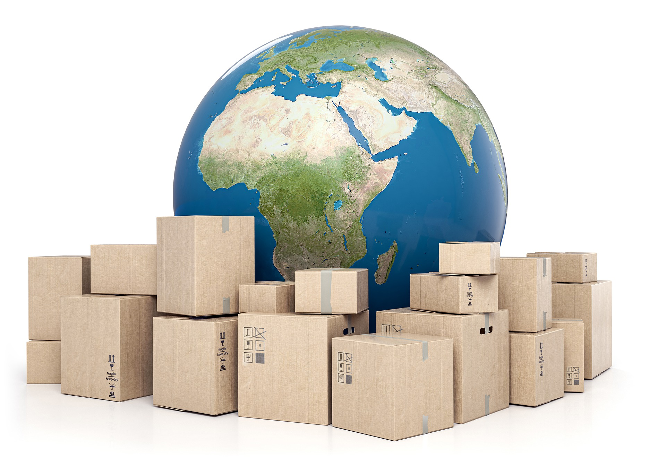
6.1 INTERNATIONAL ENTRY MODES II
Exporting
Exporting is the marketing and direct sale of domestically produced goods in another country. Exporting is a traditional and well-established method of reaching foreign markets.
Image by Gino Crescoli, Pixabay
Notes:
Advantages- Fast entry, low risk
Disadvantages- Low control, low local knowledge, potential negative environmental impact of transportation
Since it does not require that the goods be produced in the target country, no investment in foreign production facilities is required. Most of the costs associated with exporting take the form of marketing expenses.

Slide 5
6.1 INTERNATIONAL ENTRY MODES III
Licensing and Franchising
A company that wants to get into an international market quickly while taking only limited financial and legal risks might consider licensing agreements with foreign companies.
An international licensing agreement allows a foreign company (the licensee) to sell the products of a producer (the licensor) or to use its intellectual property (such as patents, trademarks, copyrights) in exchange for royalty fees.
Notes:
Here’s how it works: You own a company in the United States that sells coffee-flavored popcorn. You’re sure that your product would be a big hit in Japan, but you don’t have the resources to set up a factory or sales office in that country. You can’t make the popcorn here and ship it to Japan because it would get stale. So you enter into a licensing agreement with a Japanese company that allows your licensee to manufacture coffee-flavored popcorn using your special process and to sell it in Japan under your brand name. In exchange, the Japanese licensee would pay you a royalty fee.
Advantages- Fast entry, low cost, low risk
Disadvantages- Less control, licensee may become a competitor, legal and regulatory environment (IP and contract law) must be sound

Slide 6
6.1 INTERNATIONAL ENTRY MODES IV
Partnerships and Strategic Alliances
Another way to enter a new market is through a strategic alliance with a local partner. A strategic alliance involves a contractual agreement between two or more enterprises stipulating that the involved parties will cooperate in a certain way for a certain time to achieve a common purpose.
Image by mohamed Hassan, Pixabay
Notes:
To determine if the alliance approach is suitable for the firm, the firm must decide what value the partner could bring to the venture in terms of both tangible and intangible aspects.
Advantages- Shared costs reduce investment needed, reduced risk, seen as local entity
Disadvantages- Higher cost than exporting, licensing, or franchising; integration problems between two corporate cultures

Slide 7
6.1 INTERNATIONAL ENTRY MODES V
Acquisitions
An acquisition is a transaction in which a firm gains control of another firm by purchasing its stock, exchanging the stock for its own, or, in the case of a private firm, paying the owners a purchase price. In our increasingly flat world, cross-border acquisitions have risen dramatically.
Image by diema, Pixabay
Notes:
In recent years, cross-border acquisitions have made up over 60 percent of all acquisitions completed worldwide. Acquisitions are appealing because they give the company quick, established access to a new market.
Advantages- Fast entry; known, established operations
Disadvantages- High cost, integration issues with home office

Slide 8
6.1 INTERNATIONAL ENTRY MODES VI
Wholly Owned Subsidiaries
Firms may want to have a direct operating presence in the foreign country, completely under their control. To achieve this, the company can establish a new, wholly owned subsidiary (i.e., a greenfield venture) from scratch, or it can purchase an existing company in that country.
Notes:
Some companies purchase their resellers or early partners (as Vitrac Egypt did when it bought out the shares that its partner, Vitrac, owned in the equity joint venture). Other companies may purchase a local supplier for direct control of the supply. This is known as vertical integration.
Advantages- Gain local market knowledge; can be seen as insider who employs locals; maximum control
Disadvantages- High cost, high risk due to unknowns, slow entry due to setup time

Slide 9
6.2 EXPORTING
Exporting is defined as the sale of products and services in foreign countries that are sourced or made in the home country. Importing is the flipside of exporting. Importing refers to buying goods and services from foreign sources and bringing them back into the home country.
Notes:
Exporting is an effective entry strategy for companies that are just beginning to enter a new foreign market. It’s a low-cost, low-risk option compared to the other strategies. These same reasons make exporting a good strategy for small and midsize companies that can’t or won’t make significant financial investment in the international market.

Slide 10
6.3 LICENSING I
Licensing gives a licensee certain rights or resources to manufacture and/or market a certain product in a host country.
Licensing is a business arrangement in which one company gives another company permission to manufacture its product for a specified payment
Notes:
Licensing is defined as the granting of permission by the licenser to the licensee to use intellectual property rights, such as trademarks, patents, brand names, or technology, under defined conditions. The possibility of licensing makes for a flatter world, because it creates a legal vehicle for taking a product or service delivered in one country and providing a nearly identical version of that product or service in another country.

Slide 11
6.3 LICENSING II
Advantages
Obtain extra income for technical know-how and services.
Reach new markets not accessible by export from existing facilities.
Quickly expand without much risk and large capital investment.
Pave the way for future investments in the market.
Retain established markets closed by trade restrictions.
Political risk is minimized as the licensee is usually 100% locally owned.
Notes:
Licensing is a relatively flexible work agreement that can be customized to fit the needs and interests of both licensor and licensee. The following are the main advantages and reasons to use international licensing for expanding internationally:

Slide 12
6.3 LICENSING III
Disadvantages
Lower income than in other entry modes.
Loss of control of the licensee manufacture and marketing operations and practices leading to loss of quality.
Risk of having the trademark and reputation ruined by an incompetent partner.
The foreign partner also can become a competitor by selling its products in places where the parental company has a presence.
Notes:
This is highly attractive for companies that are new in international business. On the other hand, international licensing is a foreign market entry mode that presents some disadvantages and reasons why companies should not use it because there is:

Slide 13
6.4 FRANCHISING
Franchising is the practice of licensing another firm’s business model as an operator.
It is the practice of using another firm’s successful business model. For the franchiser, the franchise is an alternative to building “chain stores” to distribute goods that avoids the investments and liability of a chain.
Notes:
The franchiser’s success depends on the success of the franchisees. The franchisee is said to have a greater incentive than a direct employee because he or she has a direct stake in the business. Essentially, and in terms of distribution, the franchiser is a supplier who allows an operator, or a franchisee, to use the supplier’s trademark and distribute the supplier’s goods. In return, the operator pays the supplier a fee.

Slide 14
6.5 CONTRACT MANUFACTURING I
In contract manufacturing, a hiring firm makes an agreement with the contract manufacturer to produce and ship the hiring firm’s goods.
A contract manufacturer (“CM”) is a manufacturer that enters into a contract with a firm to produce components or products for that firm. It is a form of outsourcing. In a contract manufacturing business model, the hiring firm approaches the contract manufacturer with a design or formula

Slide 15
6.5 CONTRACT MANUFACTURING II
Contract manufacturing offers a number of benefits:
Cost Savings
Mutual Benefit to Contract Site
Advanced Skills
Quality
Focus
Economies of Scale
Notes:
Cost Savings: Companies save on their capital costs because they do not have to pay for a facility and the equipment needed for production. They can also save on labor costs such as wages, training, and benefits. Some companies may look to contract manufacture in low-cost countries, such as China, to benefit from the low cost of labor.
Mutual Benefit to Contract Site: A contract between the manufacturer and the company it is producing for may last several years. The manufacturer will know that it will have a steady flow of business at least until that contract expires.
Advanced Skills: Companies can take advantage of skills that they may not possess, but the contract manufacturer does. The contract manufacturer is likely to have relationships formed with raw material suppliers or methods of efficiency within their production.
Quality: Contract Manufacturers are likely to have their own methods of quality control in place that help them to detect counterfeit or damaged materials early.
Focus: Companies can focus on their core competencies better if they can hand off base production to an outside company.
Economies of Scale: Contract Manufacturers have multiple customers that they produce for. Because they are servicing multiple customers, they can offer reduced costs in acquiring raw materials by benefiting from economies of scale. The more units there are in one shipment, the less expensive the price per unit will be.

Slide 16
6.5 CONTRACT MANUFACTURING III
Balanced against the above benefits of contract manufacturing are a number of risks:
Lack of Control
Relationships
Quality
Intellectual Property Loss
Outsourcing Risks
Capacity Constraints
Loss of Flexibility and Responsiveness:
Notes:
Lack of Control: When a company signs the contract allowing another company to produce their product, they lose a significant amount of control over that product. They can only suggest strategies to the contract manufacturer; they cannot force them to implement those strategies.
Relationships: It is imperative that the company forms a good relationship with its contract manufacturer. The company must keep in mind that the manufacturer has other customers. They cannot force them to produce their product before a competitor’s. Most companies mitigate this risk by working cohesively with the manufacturer and awarding good performance with additional business.
Quality: When entering into a contract, companies must make sure that the manufacturer’s standards are congruent with their own. They should evaluate the methods in which they test products to make sure they are of good quality. The company has to ensure the contract manufacturer has suppliers that also meet these standards.
Intellectual Property Loss: When entering into a contract, a company is divulging their formulas or technologies. This is why it is important that a company not give out any of its core competencies to contract manufacturers. It is very easy for an employee to download such information from a computer and steal it. The recent increase in intellectual property loss has corporate and government officials struggling to improve security. Usually, it comes down to the integrity of the employees.
Outsourcing Risks: Although outsourcing to low-cost countries has become very popular, it does bring along risks such as language barriers, cultural differences, and long lead times. This could make the management of contract manufacturers more difficult, expensive, and time-consuming.
Capacity Constraints: If a company does not make up a large portion of the contract manufacturer’s business, they may find that they are de-prioritized over other companies during high production periods. Thus, they may not obtain the product they need when they need it.
Loss of Flexibility and Responsiveness: Without direct control over the manufacturing facility, the company will lose some of its ability to respond to disruptions in the supply chain. It may also hurt their ability to respond to demand fluctuations, risking their customer service levels

Slide 17
6.6 JOINT VENTURES I
A joint venture is a business agreement in which parties agree to develop a new entity and new assets by contributing equity. They exercise control over the enterprise and consequently share revenues, expenses and assets.
Image by Mariana Anatoneag, Pixabay
Notes:
In a joint venture business model, two or more parties agree to invest time, equity, and effort for the development of a new shared project.
When two or more persons come together to form a partnership for the purpose of carrying out a project, this is called a joint venture. In this scenario, both parties are equally invested in the project in terms of money, time and effort to build on the original concept. While joint ventures are generally small projects, major corporations use this method to diversify.
A joint venture can ensure the success of smaller projects for those that are just starting in the business world or for established corporations.

Slide 18
6.6 JOINT VENTURES II
Risks of Joint Ventures
Equity joint ventures pose both opportunities and challenges for the companies involved.
First and foremost is the challenge of finding the right partner—not just in terms of business focus but also in terms of compatible cultural perspectives and management practices.
Second, the local partner may gain the know-how to produce its own competitive product or service to rival the multinational firm.
Notes:
2. This is what’s currently happening in China. To manufacture cars in China, non-Chinese companies must set up joint ventures with Chinese automakers and share technology with them. Once the contract ends, however, the local company may take the knowledge it gained from the joint venture to compete with its former partner. For example, Shanghai Automotive Industry (Group) Corporation, which worked with General Motors (GM) to build Chevrolets, has pursued plans to increase sales of its own vehicles tenfold to 300,000 in five years and to compete directly with its former partner(Rowley, 2009).

Slide 19
6.7 KEY TERMS I
Acquisition: Is a transaction in which a firm gains control of another firm by purchasing its stock, exchanging the stock for its own, or, in the case of a private firm, paying the owners a purchase price. 6.1
Contract Manufacturing: A hiring firm makes an agreement with the contract manufacturer to produce and ship the hiring firm’s goods. 6.5
Cultural And Linguistic Differences: These affect all relationships and interactions inside the company, with customers, and with the government. Understanding the local business culture is critical to success. 6.1
Experience of The Partner Company: Assessing the experience of the partner company in the market – with the product and in dealing with foreign companies – is essential in selecting the right local partner. 6.1
Exporting: Is defined as the sale of products and services in foreign countries that are sourced or made in the home country. Importing is the flipside of exporting. Importing refers to buying goods and services from foreign sources and bringing them back into the home country. 6.2
Franchising: Is the practice of licensing another firm’s business model as an operator. 6.4
Importing: Is also known as global sourcing. 6.2
Joint Venture: Business model, 2 or more parties agree to invest time, equity, and effort for the development of a new shared project. 6.6

Slide 20
6.7 KEY TERMS Ii
Licensing: Gives a licensee certain rights or resources to manufacture and/or market a certain product in a host country. 6.3
Manufacturing: The cost to manufacture a given unit decreased because Vitrac has been able to manufacture at higher volumes and buy source materials in higher volumes, thus benefitting from volume discounts. 6.2
Market: The company has access to a new market, which has brought added revenues. 6.2
Money: Not only has Vitrac earned more revenue, but it has also gained access to foreign currency, which benefits companies located in certain regions of the world, such as in Vitrac’s home country of Egypt. 6.2
Political and Economic Issues: Policy can change frequently, and companies need to determine what level of investment they’re willing to make, what’s required to make this investment, and how much of their earnings they can repatriate. 6.1
Quality and Training of Local Contacts and/or Employees: Evaluating skill sets and then determining if the local staff is qualified is a key factor for success. 6.1

