Slide 1
Global Marketing in a Digital World
CHAPTER 5: COMPETING IN GLOBAL MARKETING
Unless otherwise noted, this work is licensed under a Creative Commons Attribution-NonCommercial-ShareAlike 4.0 International (CC BY-NC-SA 4.0) license. Feel free to use, modify, reuse or redistribute any portion of this presentation.

Slide 2
LEARNING OUTCOMES
Upon successful completion of this chapter, you should be able to:
Describe the strategic analysis process and why firms need to analyze their competitive environment
Discuss the importance of SWOT analysis when looking at global competitors
Outline a PESTEL analysis
Identify what makes up a firm’s external macro environment
Identify what makes up a firm’s external micro environment
Explain Porter’s 5 Forces
Discuss the strategy in building a firm’s competitive advantage
Explain the elements that go into determining a firm’s strategic position

Slide 3
5.1 GAINING ADVANTAGES BY UNDERSTANDING THE COMPETITIVE ENVIRONMENT I
Strategic analysis is the process that firms use to study and understand the many different layers and aspects of their competitive environment.
Notes:
Why do firms spend time and money trying to understand what is going on around them?
Firms do not operate in a vacuum. They are impacted by forces and factors from inside their organizations and outside in the world at large. Understanding these forces and factors is crucial to achieving success as a business.

Slide 4
5.1 GAINING ADVANTAGES BY UNDERSTANDING THE COMPETITIVE ENVIRONMENT II
A firm’s competitive environment includes components inside the firm and outside the firm. External factors are things in the global environment that may impact a firm’s operations or success, examples are a rise in interest rates, or a natural disaster
Notes:
External factors cannot be controlled, but they must be managed effectively and to understand them so that the firm can be as successful. For example, the unemployment rate will affect a firm’s ability to hire qualified employees at a reasonable rate of pay. If unemployment is high, meaning that a lot of people are looking for jobs, then a firm will probably have a lot of applicants for any positions it needs to fill.
Internal factors are characteristics of the firm itself. To plan to compete against other firms, a firm needs to understand what physical, financial, and human resources it has, what it is good at, and how it is organized.

Slide 5
5.2 USING SWOT FOR STRATEGIC ANALYSIS I
One very common tool firms use to analyze their strategic and competitive situations is SWOT, which is an acronym for:
Strengths
Weaknesses
Opportunities
Threats
Notes:
Firms use SWOT analysis to get a general understanding of what they are good or bad at and what factors outside their doors might present chances for success or difficulty.

Slide 6
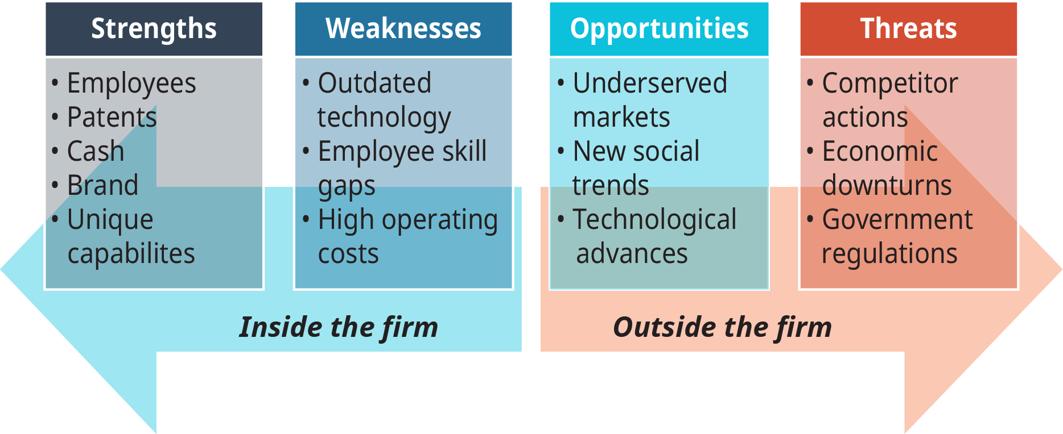
5.2 USING SWOT FOR STRATEGIC ANALYSIS II
Components of SWOT
Notes:
Strengths- A firm’s strengths are, to put it simply, what it is good at. Nike is good at marketing sports products, McDonald’s is good at making food quickly and inexpensively, and Ferrari is good at making beautiful fast cars.
Weaknesses- A firm’s weaknesses are what it is not good at—things that it does not have the capabilities to perform well. Weaknesses are not necessarily faults—remember that not all firms can be great at all things. When a firm understands its weaknesses, it will avoid trying to do things it does not have the skills or assets to succeed in, or it will find ways to improve its weaknesses before undertaking something new.
Opportunities- While strengths and weaknesses are internal to an organization, but opportunities and threats are always external. An opportunity is a potential situation that a firm is equipped to take advantage of. Think of opportunities in terms of things that happen in the market. Opportunities offer positive potential, however sometimes a firm is not equipped to take advantage of an opportunity which is why considering the entire SWOT is important before deciding what to do.
Threats- When a manager assesses the external competitive environment, she labels anything that would make it harder for her firm to be successful as a threat. A wide variety of situations and scenarios can threaten a firm’s chances of success, from a downturn in the economy to a competitor launching a better version of a product the firm also offers.

Slide 7
5.2 USING SWOT FOR STRATEGIC ANALYSIS III
Limitations of SWOT Analysis
Although a SWOT analysis can identify important factors and situations that affect a firm, it only works as well as the person doing the analysis. SWOT can generate a good evaluation of the firm’s internal and external environments, but it is more likely to overlook key issues because it is difficult to identify or imagine everything that could, for example, be a threat to the firm.
Notes:
That’s why the remainder of this chapter will present tools for developing a strategic analysis that is more thorough and systematic in examining both the internal and external environments that firms operate in.

Slide 8
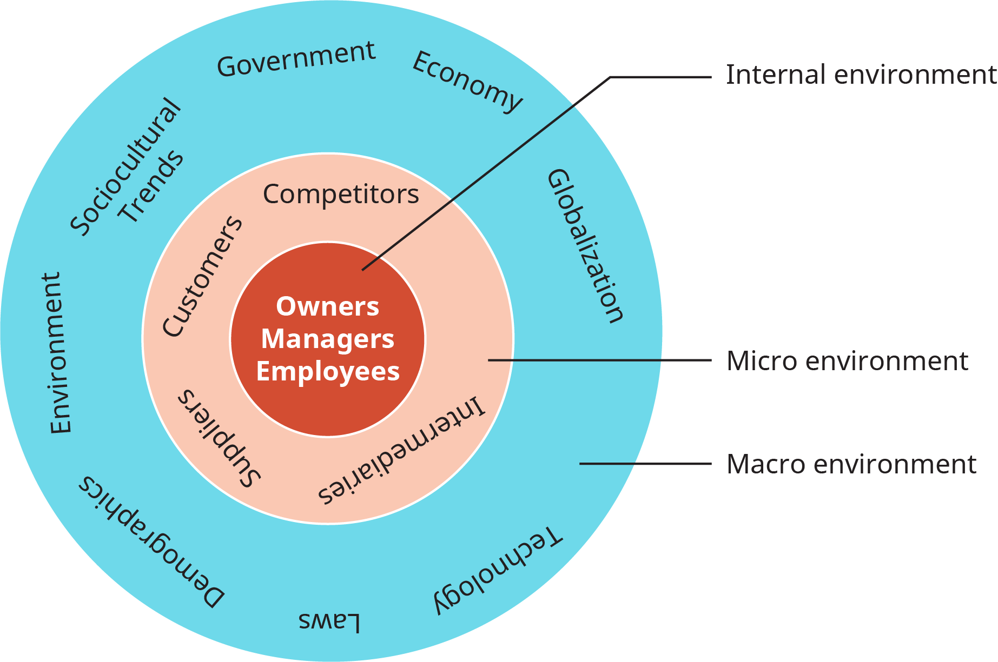
5.3 A FIRM'S EXTERNAL MACRO ENVIRONMENT PESTEL I
Components of a Firm’s Environment
Notes:
The world at large forms the external environment for businesses. A firm must confront, adapt to, take advantage of, and defend itself against what is happening in the world around it to succeed. To make gathering and interpreting information about the external environment easier, strategic analysts have defined several general categories of activities and groups that managers should examine and understand.
This figure illustrates layers and categories found in a firm’s environment.
A firm’s macro environment contains elements that can impact the firm but are generally beyond its direct control. These elements are characteristics of the world at large and are factors that all businesses must contend with, regardless of the industry they are in or type of business they are

Slide 9
5.3 A FIRM'S EXTERNAL MACRO ENVIRONMENT PESTEL II
PESTEL Analysis
PESTEL analysis is an important and widely used tool that helps show the big picture of a firm’s external environment, particularly as related to foreign markets. PESTEL is an acronym for the Political, Economic, Sociocultural, Technological, Environmental, and Legal contexts in which a firm operates.
Notes:
A PESTEL analysis helps managers gain a better understanding of the opportunities and threats they face; consequently, the analysis aids in building a better vision of the future business landscape and how the firm might compete profitably. This useful tool analyzes for market growth or decline and, therefore, the position, potential, and direction for a business.

Slide 10
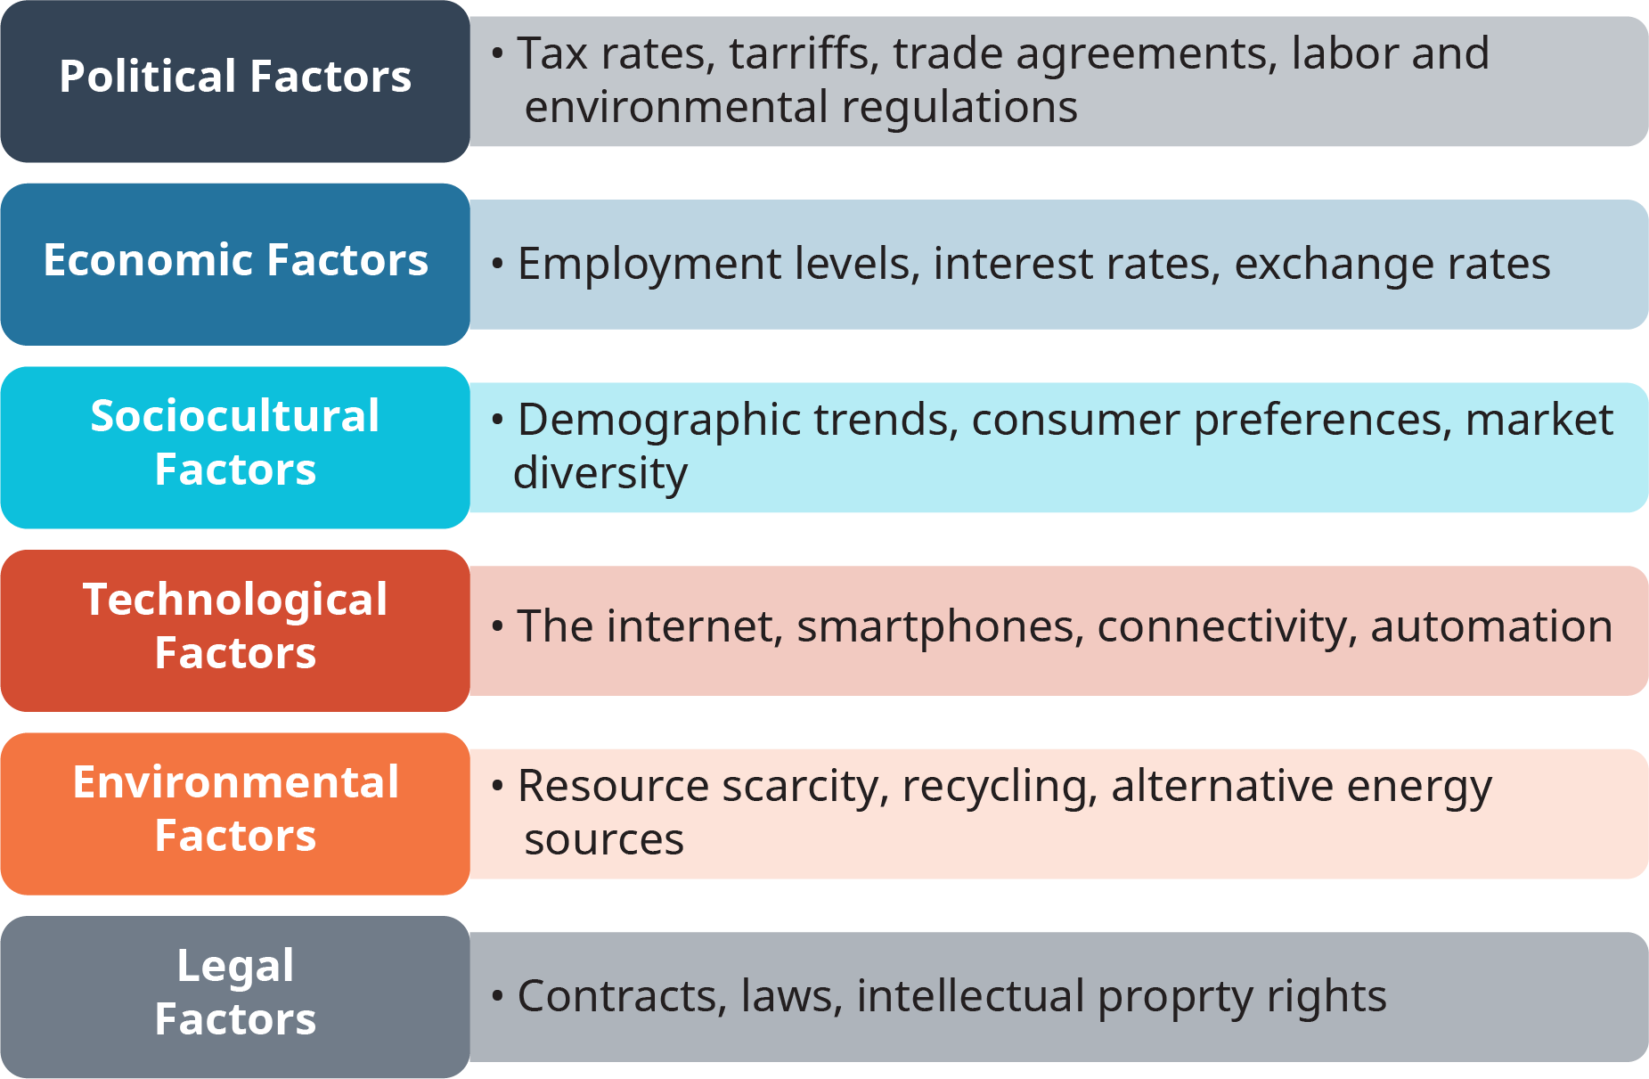
5.3 A FIRM'S EXTERNAL MACRO ENVIRONMENT PESTEL III
Notes:
Political Factors- Political factors in the macro environment include taxation, tariffs, trade agreements, labour regulations, and environmental regulations. Note that in PESTEL, factors are not characterized as opportunities or threats.
Economic Factors- All firms are impacted by the state of the national and global economies. The increased interdependence of individual country economies has made evaluating the economic factors in a firm’s macro environment more complex.
Sociocultural Factors- Quite possibly the largest category of macro environmental factors an analyst might examine are sociocultural factors. This broad category encompasses everything from changing national demographics to fashion trends and many things in between.
Technological Factors- The rise of the Internet may be the most disruptive technological change of the last century. The globe has become more interconnected and interdependent because of the fast, low-cost communications the Internet provides.
Environmental Factors- The physical environment, which provides natural resources for manufacturing and energy production, has always been a key part of human business activity. As resources become scarcer and more expensive, environmental factors impact businesses more every day.
Legal Factors- Legal factors in the external environment often coincide with political factors because laws are enacted by government entities. This does not mean that the categories identify the same issues, however. Although labour laws and environmental regulations have deep political connections, other legal factors can impact business success.

Slide 11
5.3 A FIRM'S EXTERNAL MACRO ENVIRONMENT PESTEL IV
PESTEL and Globalization
Over the past decade, new markets have been opened to foreign competitors, whole industries have been deregulated, and state-run enterprises have been privatized. Globalization involves much more than companies simply exporting products to another country. Some industries that aren’t normally considered global do, in fact, have strictly domestic players.
Notes:
But these companies often compete alongside firms with operations in multiple countries; in many cases, both sets of firms are doing equally well. In contrast, in a truly global industry, the core product is standardized, the marketing approach is relatively uniform, and competitive strategies are integrated in different international markets (Porter, 1986). In these industries, competitive advantage clearly belongs to the firms that can compete globally.

Slide 12
5.3 A FIRM'S EXTERNAL MACRO ENVIRONMENT PESTEL V
PESTEL and Globalization
A number of factors reveal whether an industry has globalized or is in the process of globalizing. The sidebar below groups globalization factors into four categories:
markets
costs
governments
competition
Notes:
These dimensions correspond well to Thomas Friedman’s flatteners (as described in his book The World Is Flat), though they are not exhaustive (Friedman, 2005).
Markets- The more similar markets in different regions are, the greater the pressure for an industry to globalize. Coca-Cola and PepsiCo, for example, are fairly uniform around the world because the demand for soft drinks is largely the same in every country.
Costs- In both of these industries, costs favor globalization. Coca-Cola and PepsiCo realize economies of scope and scale because they make such huge investments in marketing and promotion.
Governments and Competition
Obviously, favorable trade policies encourage the globalization of markets and industries. Governments, however, can also play a critical role in globalization by determining and regulating technological standards. Railroad gauge—the distance between the two steel tracks—would seem to favor a simple technological standard

Slide 13
5.4 A FIRM'S MICRO ENVIRONMENT:PORTER'S 5 FORCES I
All firms are part of an industry – a group of firms all making similar products or offering similar services and they all face similar situations in terms of customer interests, supplier relations, and industry growth or decline. Harvard Strategy professor, Michael Porter, developed Porter’s 5 Forces, an analysis tool used to examine and evaluate different micro-environmental groups.
Notes:
This tool is different than Porter’s generic strategy typology.

Slide 14
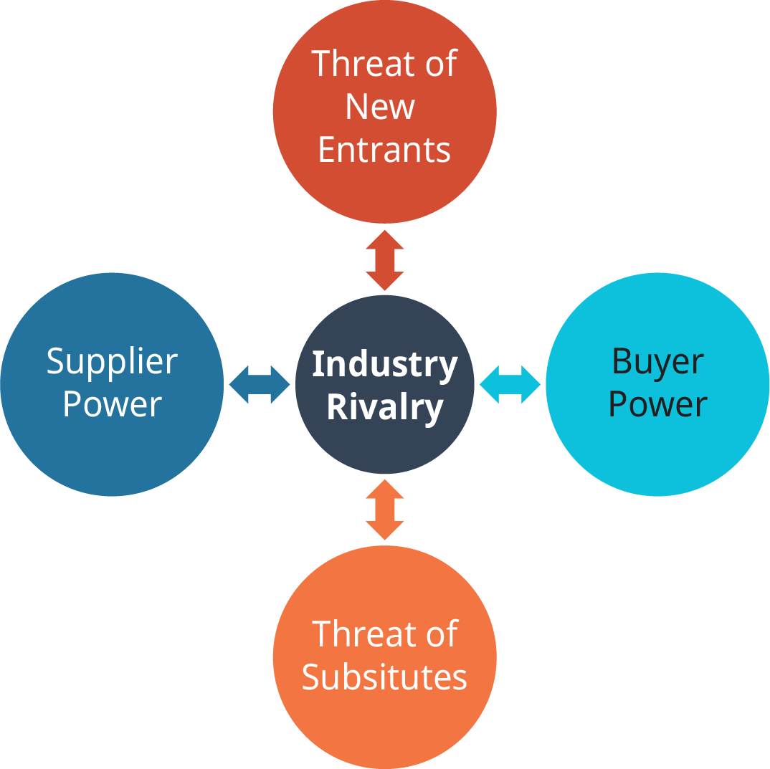
5.4 A FIRM'S MICRO ENVIRONMENT:PORTER'S 5 FORCES II
Porter’s Five Forces is a tool used to examine different micro-environmental groups in order to understand the impact each group has on a firm in an industry
Notes:
Harvard strategy professor Michael Porter developed an analysis tool to evaluate a firm’s micro environment.
Each of the forces represents an aspect of competition that affects a firm’s potential to be successful in its industry. It is important to note that this tool is different than Porter’s generic strategy typology that we will discuss later.
Industry rivalry, the first of Porter’s forces, is in the center of the diagram. Note that the arrows in the diagram show two-way relationships between rivalry and all of the other forces.
The Threat of New Entrants- In an industry, there are incumbent (existing) firms that compete against each other as rivals. If an industry has a growing market or is very profitable, however, it may attract new entrants.
Threat of Substitutes- In the context of Porter’s model, a substitute is any other product or service that can satisfy the same need of a customer as an industry’s offerings. Be careful not to confuse substitutes with rivals.
Supplier Power- Virtually all firms have suppliers who sell parts, materials, labour, or products. Supplier power refers to the balance of power in the relationship between firms and their suppliers in an industry.
Buyer Power- The last of Porter’s forces is buyer power, which refers to the balance of power in the relationship between a firm and its customers. If a firm provides a unique good or service, it will have the power to charge its customers premium prices, because those customers have no choice but to buy from the firm if they need that product.

Slide 15
5.5 THE INTERNAL ENVIRONMENT I
The internal environment consists of members of the firm itself, investors in the firm, and the assets a firm has.
"Internal Environment" by Alyssa Giles, CC BY-NC-SA 4.0
Notes:
Employees and managers are good examples; they are firm members who have skills and knowledge that are valuable assets to their firms.
Evaluating a firm’s internal environment is not just a matter of counting heads, however. Successful firms have a wide range of resources and capabilities that they can use to maintain their success and grow into new ventures. A thorough analysis of a firm’s internal situation provides a manager with an understanding of the resources available to pursue new initiatives, innovate, and plan for future success.

Slide 16
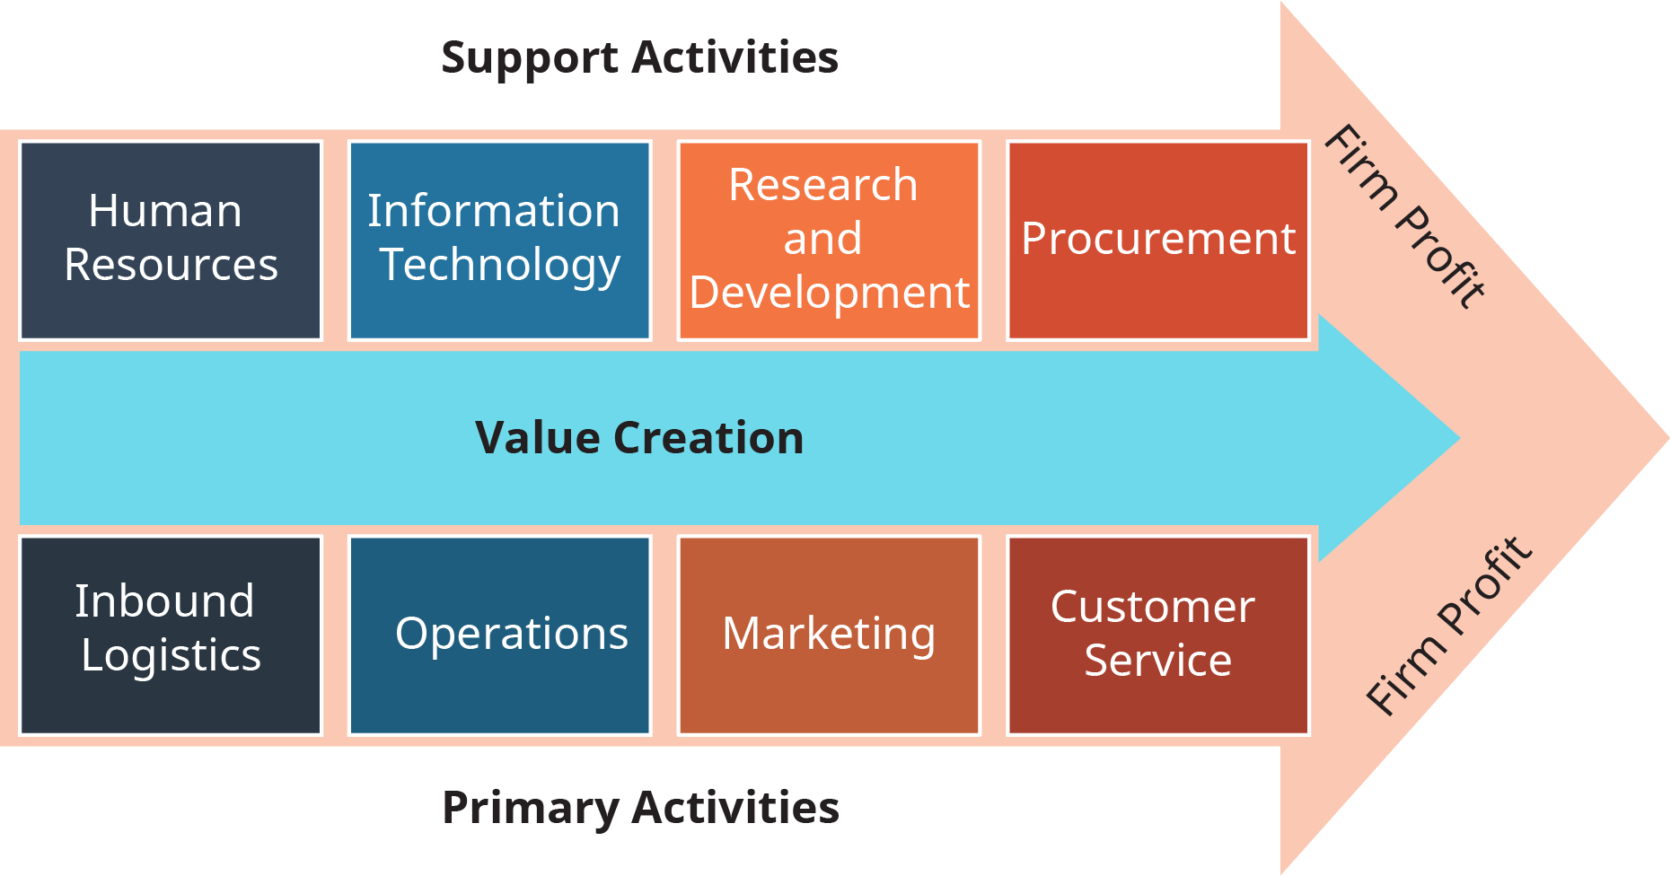
5.5 THE INTERNAL ENVIRONMENT II
A Value Chain Example
Notes:
Before examining the role of resources and capabilities in firm success, let’s take a look at the importance of how a firm uses those factors in its operations.
A firm’s value chain is the progression of activities it undertakes to create a product or service that consumers will pay for. A firm should be adding value at each of the chain of steps it follows to create its product. The goal is for the firm to add enough value so that its customers will believe that the product is worth buying for a price that is higher than the costs the firm incurs in making it.’
As an example, the figure above illustrates a hypothetical value chain for some of Walmart’s activities.

Slide 17
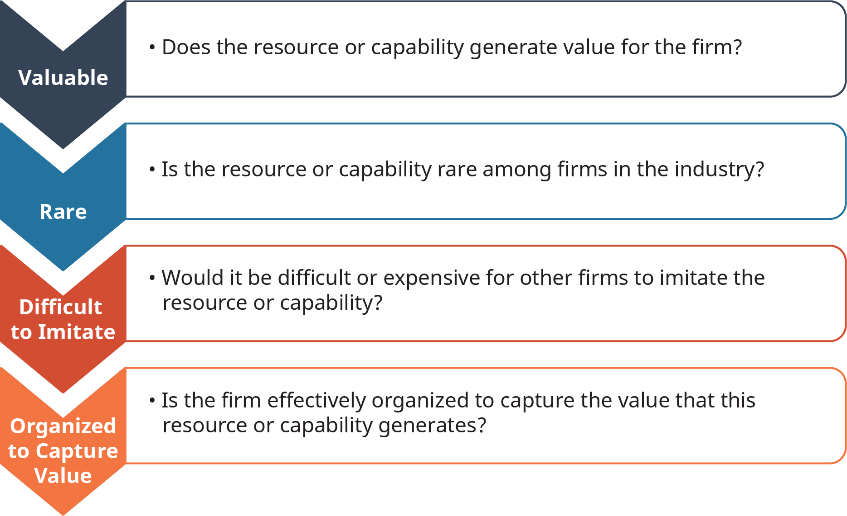
5.5 THE INTERNAL ENVIRONMENT III
Using VRIO
Notes:
The analytical tool used to assess resources and capabilities is called VRIO. As usual, this is an acronym developed to remind managers of the questions to ask when evaluating their firms’ resources and capabilities.
The four questions of VRIO, which focus on value, rarity, imitation, and organization, are illustrated in this figure.

Slide 18
5.6 COMPETITION, STRATEGY AND COMPETITIVE ADVANTAGE I
Businesses exist to make profits by offering goods and services in the marketplace at prices that are higher than the costs they incurred creating those goods and services. Businesses rarely exist alone in an industry; competition is a usually a key part of any marketplace. This means that businesses must find ways to attract customers to their products and away from competitors’ products. Strategy is the process of planning and implementing actions that will lead to success in competition.

Slide 19
5.6 COMPETITION, STRATEGY AND COMPETITIVE ADVANTAGE II
Competition
Porter’s Five Forces model is centered around rivalry, a synonym for competition. In any industry, multiple firms compete against each other for customers by offering better or cheaper products than their rivals
Notes:
Firms use PESTEL to understand what consumers are interested in and use VRIO to evaluate their own resources and capabilities so that they can figure out how to offer products and services that match those consumer interests and that are better in quality and price than the products offered by their competitors.
A firm is described as having a competitive advantage when it successfully attracts more customers, earns more profit, or returns more value to its shareholders than rival firms do. A firm achieves a competitive advantage by adding value to its products and services or reducing its own costs more effectively than its rivals in the industry.

Slide 20
5.6 COMPETITION, STRATEGY AND COMPETITIVE ADVANTAGE III
Generic Business-Level Competitive Strategies
Michael Porter defined three generic business-level strategies that outline the basic methods of organizing to compete in a product market. He called the strategies “generic” because these ways of organizing can be used by any firm in any industry.
Cost Leadership
Differentiation
Focus
Notes:
When pursuing a cost-leadership strategy, a firm offers customers its product or service at a lower price than its rivals can. To achieve a competitive advantage over rivals in the industry, the successful cost leader tightly controls costs throughout its value chain activities.
Not all products or services in the marketplace are offered at low prices, of course. A differentiation strategy is exactly the opposite of a cost-leadership strategy. While firms do not look to spend as much as possible to produce their output, firms that differentiate try to add value to their products and services so they can attract customers who are willing to pay a higher price.
Porter’s third generic competitive strategy, focus, is a little different from the other two. A firm that focuses still must choose one of the other strategies to organize its activities. It will still strive to lower costs or add value.

Slide 21
5.6 COMPETITION, STRATEGY AND COMPETITIVE ADVANTAGE IV
Strategic Groups
When managers analyze their competitive environment and examine rivalry within their industry, they are not confronted by an infinite variety of competitors. Although there are millions of businesses of all sizes around the globe, a single business usually competes mainly against other businesses offering similar products or services and following the same generic competitive strategy
Notes:
Groups of businesses that follow similar strategies in the same industry are called strategic groups, and it is important that a manager know the other firms in their strategic group. Rivalry is fiercest within a strategic group, and the actions of one firm in a group will elicit responses from other group members, who don’t want to lose market share in the industry.

Slide 22
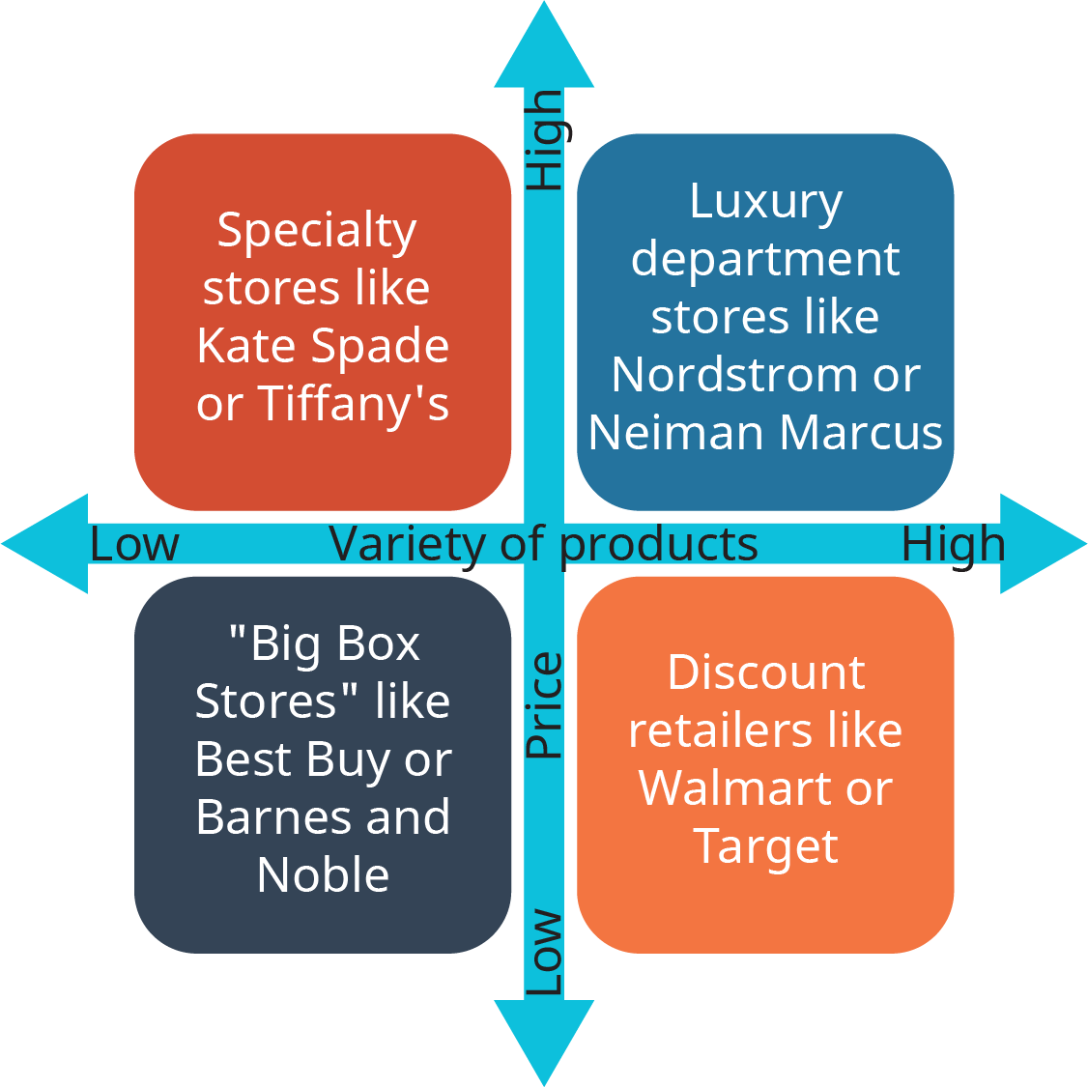
5.6 COMPETITION, STRATEGY AND COMPETITIVE ADVANTAGE V
Notes:
Although some cross competition can occur (for example, you could buy a Kate Spade wallet at Nordstrom), firms in different strategic groups tend to compete more with each other than against firms outside their group. Although Walmart and Neiman Marcus both offer a wide variety of products, the two firms do not cater to the same customers, and their managers do not lose sleep at night wondering what each might do next.

Slide 23
5.7 STRATEGIC POSITIONING
A manager who has done all of the analysis described so far in this chapter has some decisions to make based on all of the information the analysis has revealed. A firm’s decisions on how to serve customers and compete against rivals is called strategic positioning.
Notes:
In order to develop its position, a firm combines its understanding of the competitive environment, including the firm’s own resources and capabilities, its industry situation, and facts about the macro environment. A strategic position includes a choice of generic competitive strategy, which a firm selects based on its own capabilities and in response to the positions already staked out by its industry rivals. The firm also determines which customers to serve and what those customers are willing to pay for. A strategic position also includes decisions about what geographic markets to participate in.

Slide 24
5.8 KEY TERMS I
Barriers To Entry: Factors that prevent new firms from successfully competing in the industry. 5.4
Buyer Power: Which refers to the balance of power in the relationship between a firm and its customers. 5.4
Capabilities Are things a firm can do, such as deliver good customer service or develop innovative products to create value. 5.5
Competition Business: Actions a firm undertakes to attract customers to its products and away from competitors’ products. 5.6
Competitive Advantage: When it successfully attracts more customers, earns more profit, or returns more value to its shareholders than rival firms do. 5.6
Competitive Environment: Factors and situations both inside the firm and outside the firm that has the potential to impact its operations and success. 5.1
Cost-Leadership Strategy: A generic business-level strategy in which a firm tightly controls costs throughout its value chain activities in order to offer customers low-priced goods and services at a profit. 5.6
Demographics: A subset of this category, includes facts about income, education levels, age groups, and the ethnic and racial composition of a population. All of these facts present market challenges and possibilities. 5.3
Differentiation Strategy: A generic business-level strategy in which firms add value to their products and services in order to attract customers who are willing to pay a higher price. 5.6
Economic Factors: PESTEL category that includes facts (such as unemployment rates, interest rates, and commodity prices) about the state of the local, national, or global economy. 5.3

Slide 25
5.8 KEY TERMS II
External Factors: PESTEL category examines a firm’s external situation with respect to the natural environment, including pollution, natural resource availability and preservation, and alternative energy. 5.1
Environmental Scanning: the systematic and intentional analysis of both a firm’s internal state and its external, competitive environment. From a local coffee shop to an international corporation, firms of all sizes benefit from strategic analysis 5.1
External Environment for Businesses: A firm must confront, adapt to, take advantage of, and defend itself against what is happening in the world around it to succeed. To make gathering and interpreting information about the external environment easier, strategic analysts have defined several general categories of activities and groups that managers should examine and understand. 5.3
External Factors: Things in the world or industry environments that may impact a firm’s operations or success, such as the economy, government actions, or supplier power. Strategic decisions can be made in response to these things but normally cannot directly influence or change them. 5.3
Focus: A firm that focuses still must choose one of the other strategies to organize its activities. It will still strive to lower costs or add value. The difference here is that a firm choosing to implement a focused strategy will concentrate its marketing and selling efforts on a smaller market than a broad cost leader or differentiator. 5.6
Focus Strategy: A generic business-level competitive strategy that firms use in combination with either a cost-leadership or differentiation strategy in order to target a smaller demographic or geographic market with specialized products or services. 5.6

Slide 26
5.8 KEY TERMS III
Generic Business-Level Strategies: Basic methods of organizing firm value chain activities to compete in a product market that can be used by any sized firm in any industry. 5.6
Industry: a group of firms all making similar products or offering similar services, for example, automobile manufacturers or airlines. 5.4
Internal Environment: Consists of members of the firm itself, investors in the firm, and the assets a firm has. Employees and managers are good examples; they are firm members who have skills and knowledge that are valuable assets to their firms. 5.5
Internal Factors: Are characteristics of the firm itself. To plan to compete against other firms, a firm needs to understand what physical, financial, and human resources it has, what it is good at, and how it is organized. 5.1
Legal Factors: In PESTEL, the laws impacting business, such as those governing contracts and intellectual property rights and illegal activities, such as online piracy. 5.3
Macro Environment: The outermost layer of elements in a firm’s external environment that can impact a business but are generally beyond the firm’s direct control, such as the economy and political activity. 5.3
Micro Environment: The middle layer of elements in a firm’s external environment, primarily concerned with a firm’s industry situation. 5.3
New Entrants: One of Porter’s Five Forces, the threat of new entrants assesses the potential that a new firm will start operations in an industry. 5.4
Opportunity: This is a potential situation that a firm is equipped to take advantage of. 5.2

Slide 27
5.8 KEY TERMS IV
PESTEL: A strategic analysis tool that examines several distinct categories in the macro-environment: political, economic, sociocultural, technological, environmental, and legal. 5.3
Political Factors: PESTEL factor that identifies political activities in the macro-environment that may be relevant to a firm’s operations. 5.3
Porter’s Five Forces: Evaluate the interconnected relationships between various actors in the industry, including competing firms, their suppliers, and their customers, by examining five forces: industry rivalry, the threat of new entrants, the threat of substitutes, supplier power, and buyer power. 5.4
Primary Activities: Firm activities on the value chain that are directly responsible for creating, selling, or servicing a product or service, such as manufacturing and marketing. 5.5
Resources: These are things a firm has to work with, such as equipment, facilities, raw materials, employees, and cash. 5.5
Sociocultural Factors: PESTEL category that identifies trends, facts, and changes in society’s composition, tastes, and behaviours, including demographics. 5.3
Strategic Analysis: This is the process that firms use to study and understand the many different layers and aspects of their competitive environment. 5.1
Strategic Groups: Businesses offering similar products or services and following the same generic competitive strategy. 5.6
Strategic Positioning: A firm’s decisions on how to serve customers and compete against rivals 5.6

Slide 28
5.8 KEY TERMS V
Strategy: This is the process of planning and implementing actions that will lead to success in competition. 5.6
Strengths: Are, to put it simply, what it is good at. 5.2
Substitute: One of Porter’s Five Forces; is products or services outside a firm’s industry that can satisfy the same customer needs as industry products or services can. 5.4
Supplier Power: One of Porter’s Five Forces; describes the balance of power in the relationship between firms in an industry and their suppliers. 5.4
Support Activities: Value chain activities that a firm performs to sustain itself; do not directly create a product or service but are necessary to support the firm’s existence, such as accounting and human resources. 5.5
Switching Costs: Penalty, financial or otherwise, that a consumer bears when giving up the use of a product currently being used to select a competing product or service. 5.4
SWOT: is an acronym for strengths, weaknesses, opportunities, and threats. Firms use SWOT analysis to get a general understanding of what they are good or bad at and what factors outside their doors might present chances for success or difficulty. 5.2
Technological Factors: PESTEL category includes factors such as the Internet, social media, automation, and other innovations that impact how businesses compete or how they manufacture, market, or sell their goods or services. 5.3
Threat: Anything in the competitive environment that would make it harder for a firm to be successful. 5.2
Value Chain: Sequence of activities that firms perform to turn inputs (parts or supplies) into outputs (goods or services). 5.5
VRIO: An analytical tool that evaluates a firm’s resources and capabilities to determine whether or not it can support an advantage for the firm in the competitive environment: value, rarity, imitation, and organization. 5.5
Weaknesses: Things that a firm does not have good capabilities to perform or gaps in firm resources. 5.2

