Slide 1
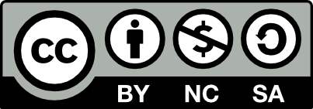
Global Marketing in a Digital World
CHAPTER 2: THE ECONOMIC AND POLITICAL ENVIRONMENT
Unless otherwise noted, this work is licensed under a Creative Commons Attribution-NonCommercial-ShareAlike 4.0 International (CC BY-NC-SA 4.0) license. Feel free to use, modify, reuse or redistribute any portion of this presentation.

Slide 2
Learning Objectives
Upon successful completion of this chapter, you should be able to:
Outline the importance of the economic environment
Discuss the implication of inflation, deflation and balance of payments
Discuss the importance of the political environment
Define political risk
Explain the effect of government policy changes on international marketing
Define legal risk
Outline the importance of the legal environment

Slide 3
2.1 ECONOMIC ENVIRONMENT I
Economic growth is the increase in the amount of the goods and services produced by an economy over time. It is measured as a % change in either:
Gross Domestic Product (GDP) Gross National Product (GNP)
Notes:
The economic environment is important because of the rapid integration of international economic markets. Increasingly, businesses, consumers, and governments realize that their lives are affected not only by what goes on in their own town, state, or country but also by what is happening around the world.
Inflation (rising prices) or deflation (falling prices) can make it difficult to measure. Therefore, statistics on economic growth are often adjusted for inflation or deflation.

Slide 4
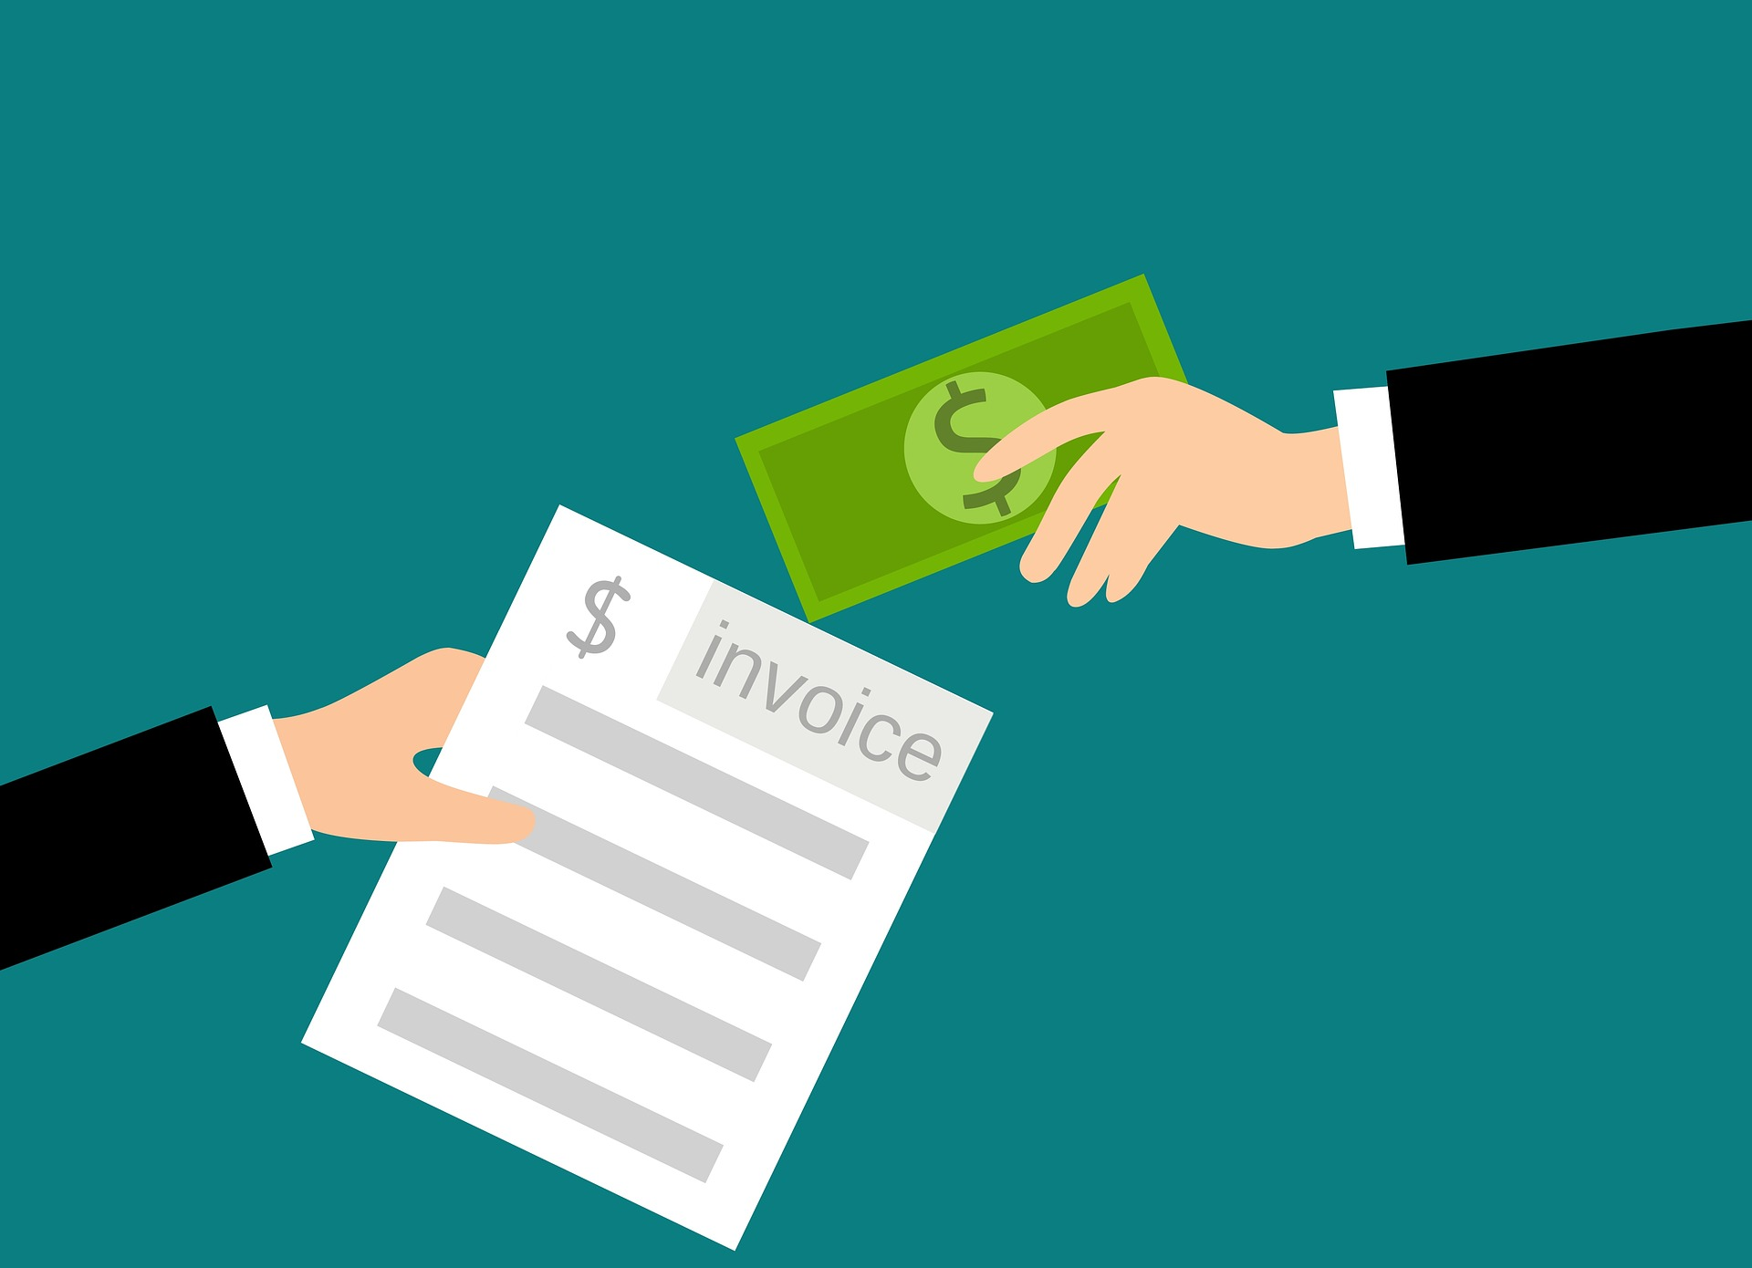
2.1 ECONOMIC ENVIRONMENT II
A country’s balance of payments is a record of its economic transactions with the rest of the world.
Image by mohamed Hassan, Pixabay
Notes:
This record shows whether a country has a:
trade surplus (value of exports exceeds the value of imports) or a
trade deficit (value of imports exceeds the value of exports)
Trade figures can be further divided into merchandise trade and services trade accounts

Slide 5
2.1 ECONOMIC ENVIRONMENT III
Trade
The growth of international trade and investment has been stimulated partly by the steady decline of trade barriers since the Great Depression of the 1930s. In the post–World War II era, the General Agreement on Tariffs and Trade or GATT, prompted regular negotiations among a growing body of members to reciprocally reduce tariffs (import taxes) on imported goods.
Notes:
During each of these regular negotiations (eight of these rounds was completed between 1948 and 1994), countries promised to reduce their tariffs on imports in exchange for concessions—that means tariffs reductions—by other GATT members.
NB….. The World Trade Organization (WTO) was created to manage this system of new agreements, to provide a forum for regular discussion of trade matters, and to implement a well-defined process for settling trade disputes that might arise among countries.

Slide 6
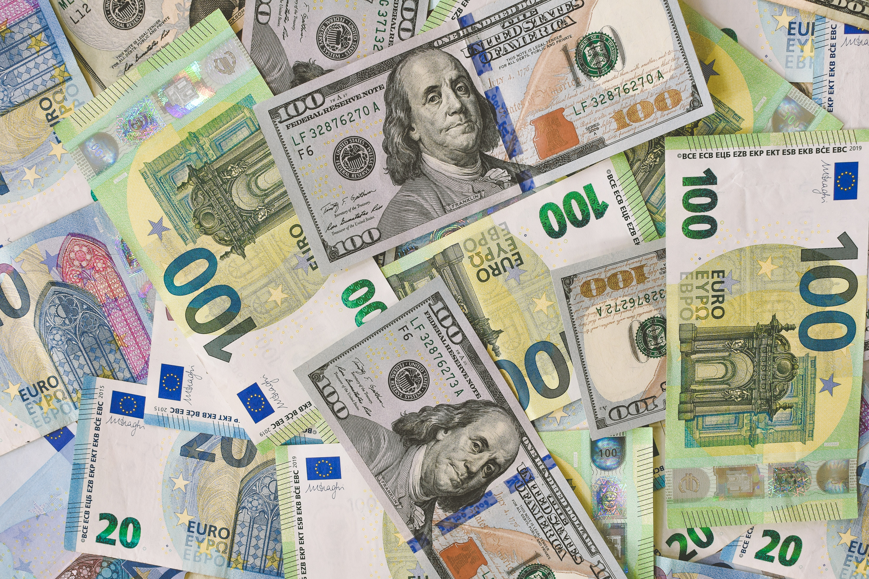
2.1 ECONOMIC ENVIRONMENT
Foreign exchange provides a means for settling accounts across borders. The dynamics of international finance can have a significant impact on a nation’s economy as well as the fortunes of individual companies.
Photo by Ibrahim Boran, Unsplash
Notes:
Currencies can be subject to devaluation or revaluation as a result of actions taken by a country’s central banker. Currency trading by international speculators can also lead to devaluation. When a country’s economy is strong or when demand for its goods is high, its currency tends to appreciate in value. When currency values fluctuate, global firms face various types of economic exposure. Firms can manage exchange rate exposure by hedging.

Slide 7
2.2 POLITICAL ENVIRONMENT I
The political environment abroad is quite different from that of North America. Most nations desire to become self-reliant and to raise their status in the eyes of the rest of the world. This is the essence of nationalism.
Notes:
The nationalistic spirit that exists in many nations has led them to engage in practices that have been very damaging to other countries’ marketing organizations. For example, foreign governments can intervene in marketing programs in the following ways:
contracts for the supply and delivery of goods and services
the registration and enforcement of trademarks, brand names, and labeling
patents
marketing communications
pricing
product safety, acceptability, and environmental issues

Slide 8
2.2 POLITICAL ENVIRONMENT II
Political Stability
Business activity tends to grow and thrive when a nation is politically stable. When a nation is politically unstable, firms can still be profitable, but strategies will be impacted.
Notes:
Most firms probably prefer to engage in the export business rather than invest considerable sums of money in investments in foreign subsidiaries.
Inventories will be low and currency will be converted rapidly. The result is that consumers in the foreign nation pay high prices, get less satisfactory products, and have fewer jobs.

Slide 9
2.3 POLITICAL RISK I
Political risk is the risk to business interests as a result of political decisions or events. Political risks can be macro, meaning they impact everyone in a country, or micro, meaning that a particular industry or company is impacted. Political risk may be caused by actions of legitimate governments such as controls on prices, outputs, activities, and currency and remittance restrictions.
Notes:
Political risk may also result from events outside of government controls such as war, revolution, terrorism, labor strikes, and extortion.
Political risk can adversely affect all aspects of the international business from the right to export or import goods to the right to own or operate a business. AON for example, categorizes risk based on: economic; exchange transfer; strike, riot, or civil commotion; war; terrorism; sovereign non-payment; legal and regulatory; political interference; and supply chain vulnerability (AON Group, Inc., 2020).
For a firm considering a new foreign market, there are three broad categories of international business: trade, international licensing of technology and intellectual property, and foreign direct investment. A company developing a business plan may have different elements of all three categories depending on the type of product or service.
The risk between these three categories of market entry varies significantly with trade ranked the least risky if the company does not have offices overseas and does not keep inventories there. On the other side of the spectrum is direct foreign investment, which generally brings the greatest economic exposure and thus the greatest risk to the company.

Slide 10
2.3 POLITICAL RISK II
Protection from political risk
Companies can reduce their exposure to political risk by careful planning and monitoring political developments. The company should have a deep understanding of domestic and international affairs for the country they are considering entering. The company should know how politically stable the country is, the strength of its institutions, the existence of any political or religious conflicts, ethnic composition, and minority rights.
Notes:
The country’s standing in the international arena should also be part of the consideration; this includes its relations with neighbors, border disputes, membership in international organizations, and recognition of international law.

Slide 11
2.4 LEGAL RISK
Legal risk is the risk arising from failure to comply with statutory or regulatory obligations. Generally, all laws in the host country will apply to an entrepreneur’s local business operations.
Photo by eskay lim, Unsplash License (Cropped)
Notes:
Examples include:
filing procedures
employment law
environmental law
tax law
ownership requirements
Many countries limit foreign ownership of assets and legally force foreign companies into a joint venture with a local partner in order to do business there.

Slide 12
2.5 KEY TERMS I
Economic growth is the increase in the amount of the goods and services produced by an economy over time. 2.1
Foreign Exchange provides a means for settling accounts across borders. 2.1
General Agreement on Tariffs and Trade, or GATT: Prompted regular negotiations among a growing body of members to reciprocally reduce tariffs (import taxes) on imported goods. 2.1
Gross Domestic Product (GDP) is the value of all final goods and services produced within a country in a given year. 2.1
Gross National Product (GNP) includes what is produced domestically and what is produced by domestic labor and business abroad in a year. 2.1
Inflation is a general and ongoing rise in the level of prices in an entire economy. 2.1
Legal Environment Consists of Laws: Courts, attorneys, legal customs, and practices. International law is comprised of the rules and principles that nation-states consider binding upon themselves. 2.0
Legal Risk: Is the risk arising from failure to comply with statutory or regulatory obligations 2.4
Nationalism: Most nations desire to become self-reliant and to raise their status in the eyes of the rest of the world. The nationalistic spirit that exists in many nations has led them to engage in practices that have been very damaging to other countries’ marketing organizations. 2.2

Slide 13
2.6 Key Terms II
Political Environment of Global Marketing: This is the set of governmental institutions, political parties, and organizations that are the expression of the people in the nations of the world. 2.0
Political Risk: Is generally defined as the risk to business interests resulting from political instability or political change. Political risk exists in every country around the globe and varies in magnitude and type from country to country. 2.3
Trade Deficit is when a country’s value of imports exceeds the value of exports.2.1
Trade Surplus is when a country’s value of exports exceeds the value of imports.2.1
Uruguay Round: Round pf multilateral trade negotiations under the GATT that was finalized in 1994. Member countries succeeded in extending the agreement to include liberalization promises in a much larger sphere of influence. 2.1
World Trade Organization (WTO):was created to manage international trade agreements, to provide a forum for regular discussion of trade matters, and to implement a well-defined process for settling trade disputes that might arise among countries. 2.1

