Slide 1
Global Marketing in a Digital World
CHAPTER 13: E-BUSINESS
Unless otherwise noted, this work is licensed under a Creative Commons Attribution-NonCommercial-ShareAlike 4.0 International (CC BY-NC-SA 4.0) license. Feel free to use, modify, reuse or redistribute any portion of this presentation.

Slide 2
13.0 Learning Outcomes
Upon successful completion of this chapter, you will be able to:
Define e-business and e-commerce and explain the difference between them.
List the major categories of e-business.
Describe advantages and disadvantages of e-commerce.
Outline the business-to-consumer e-commerce cycle.
Summarize the major models of e-commerce.
Discuss the different technologies used for e-commerce.
Explain social commerce, and New Retail, and the reasons for its increasing popularity.

Slide 3
13.1 Definitions
E-Business
Electronic business or e-business, in a broad sense, is the use of computer networks to improve organizational performance. Increasing profitability, gaining market share, improving customer service, and delivering products faster are some of the organizational performance gains possible by doing business electronically.
Notes:
E-business is more than ordering goods online, it involves all aspects of an organization’s electronic interactions with its stakeholders. E-business includes activities such as establishing a webpage to support investor relations or communicating electronically with employees.

Slide 4
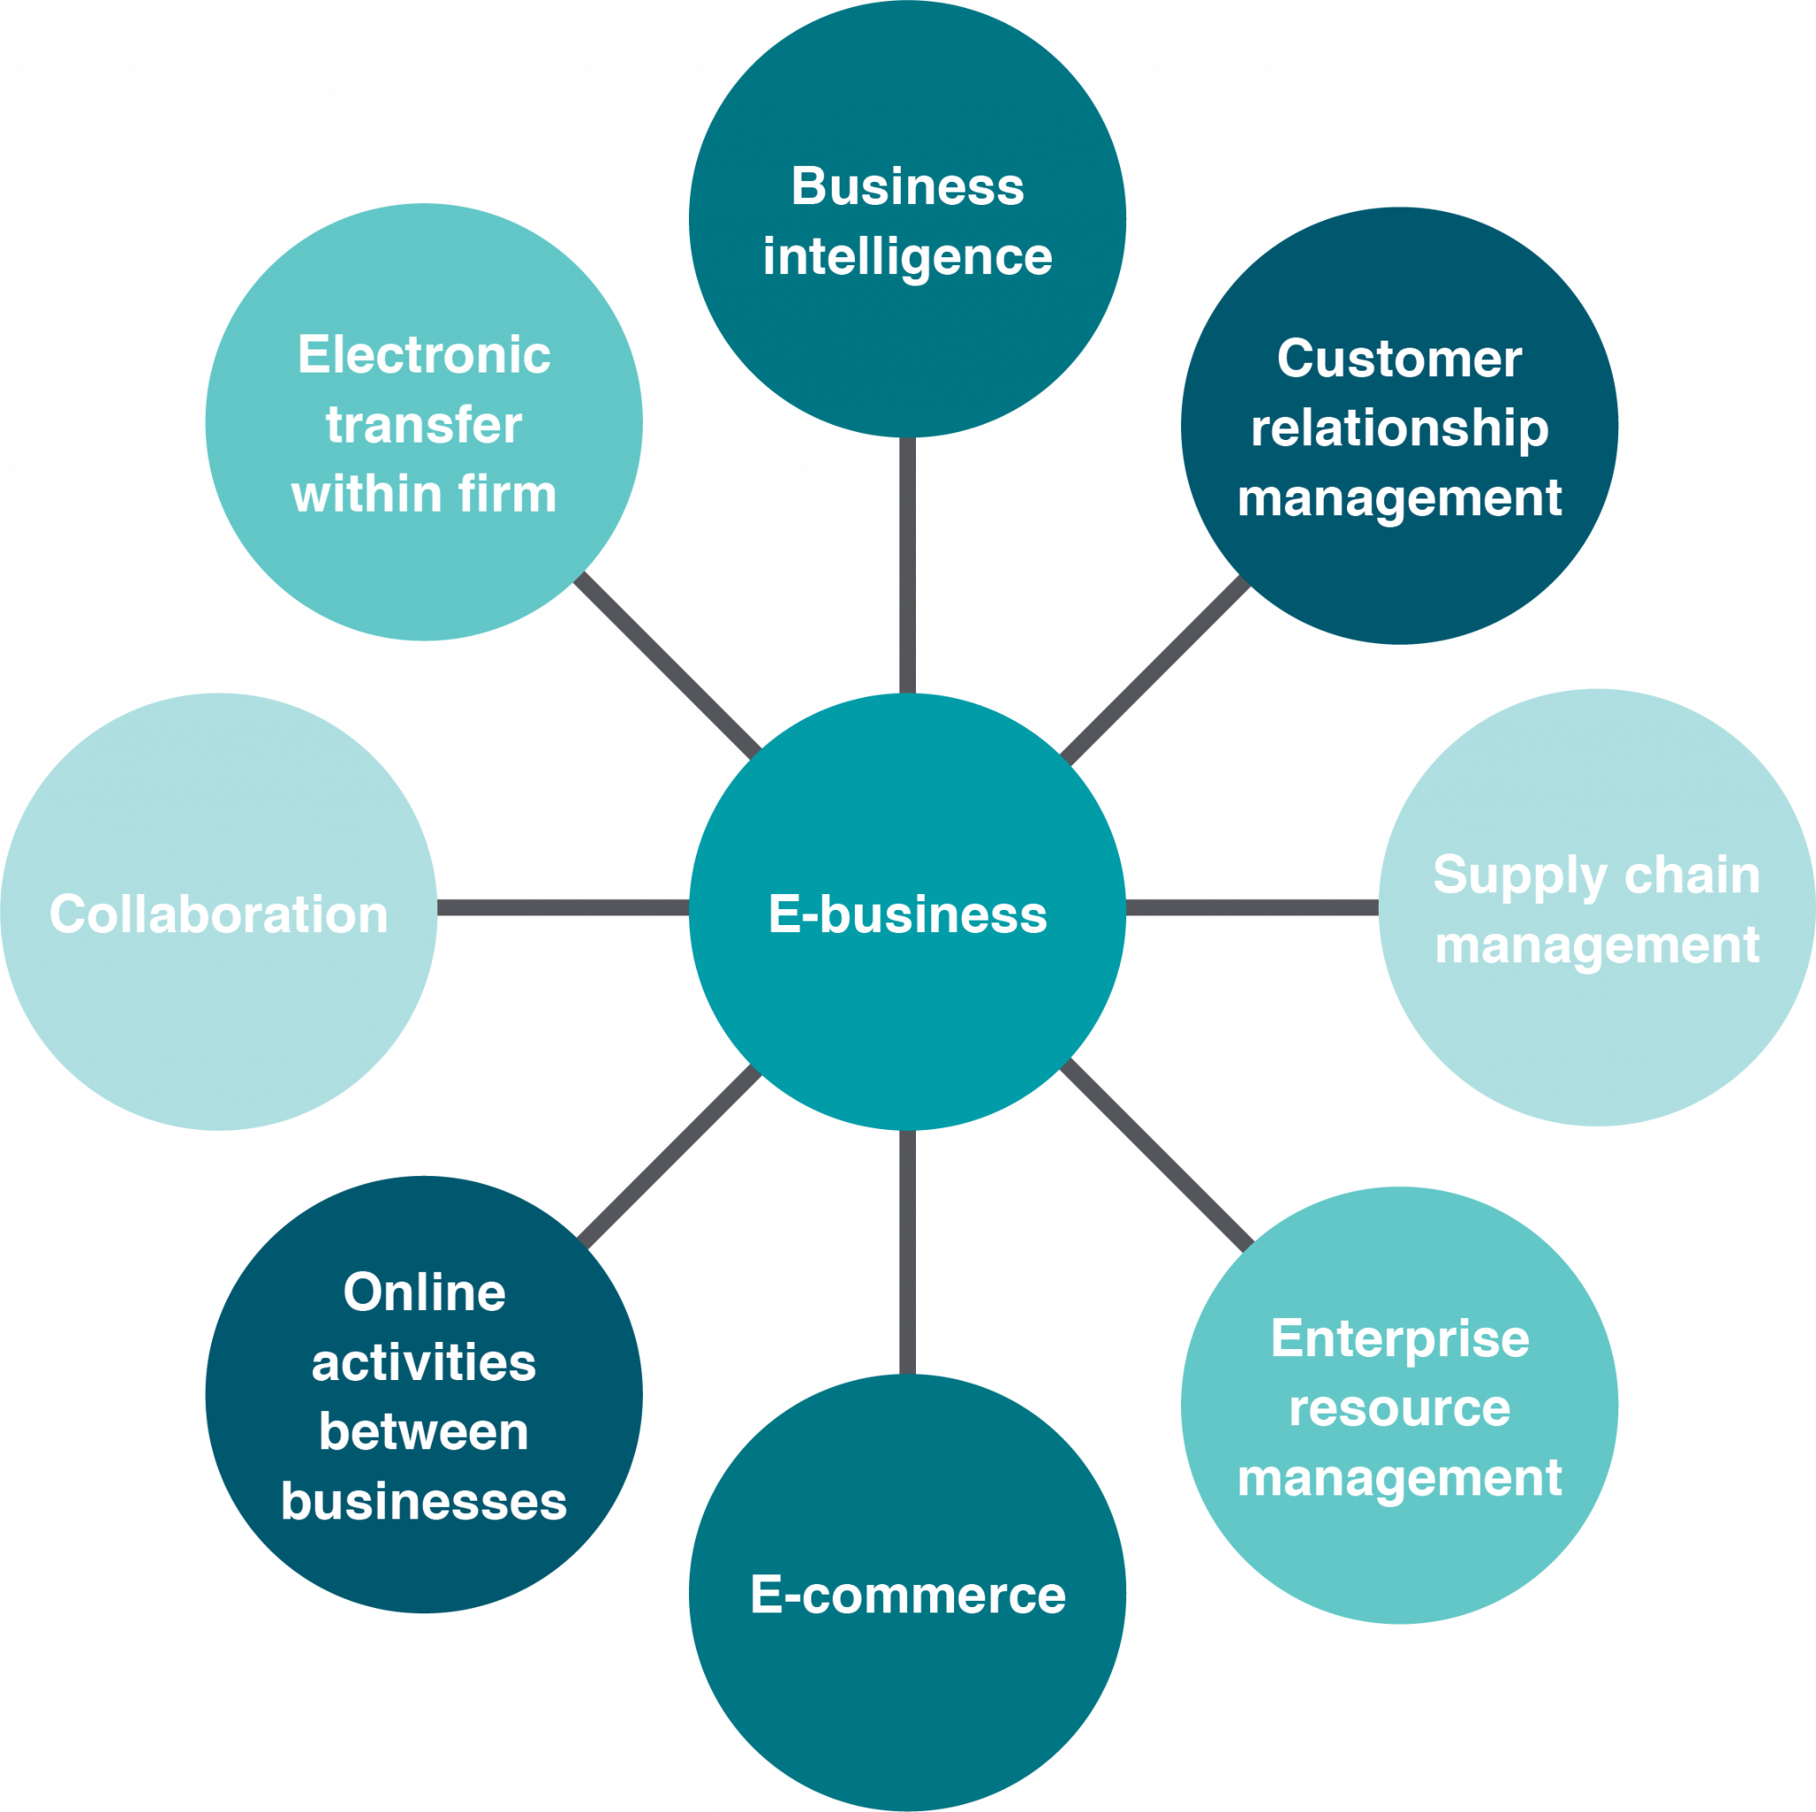
13.1 Definitions cont.
E-Business
E-business involves several major components:
Notes:
Business intelligence (BI), customer relationship management (CRM), supply chain management (SCM), enterprise resource planning (ERP), e-commerce, conducting electronic transactions within the firm, collaboration, and online activities among businesses.

Slide 5
13.1 Definitions Cont.
E-Commerce
E-business and e-commerce are often used interchangeably, but they are not the same thing.
E-commerce is the marketing, selling, and buying of goods and services online. It generates revenue, while e-business does not.

Slide 6
13.2 E-Commerce Advantages And Disadvantages
Advantages
Expanded Markets
Increased Availability
Reduce Cost
Improve Efficiency
Improved Customer Service
Disadvantages
Technical & Accessibility Issues
Security & Privacy Issues
Establishing Customer Trust & Satisfaction

Slide 7
13.3 Online Strategy
Every business needs to consider the extent of their online presence. There are two key factors to be considered when considering an online strategy:
How many existing or potential customers are likely to do business online?
What is the information intensity of the product?

Slide 8
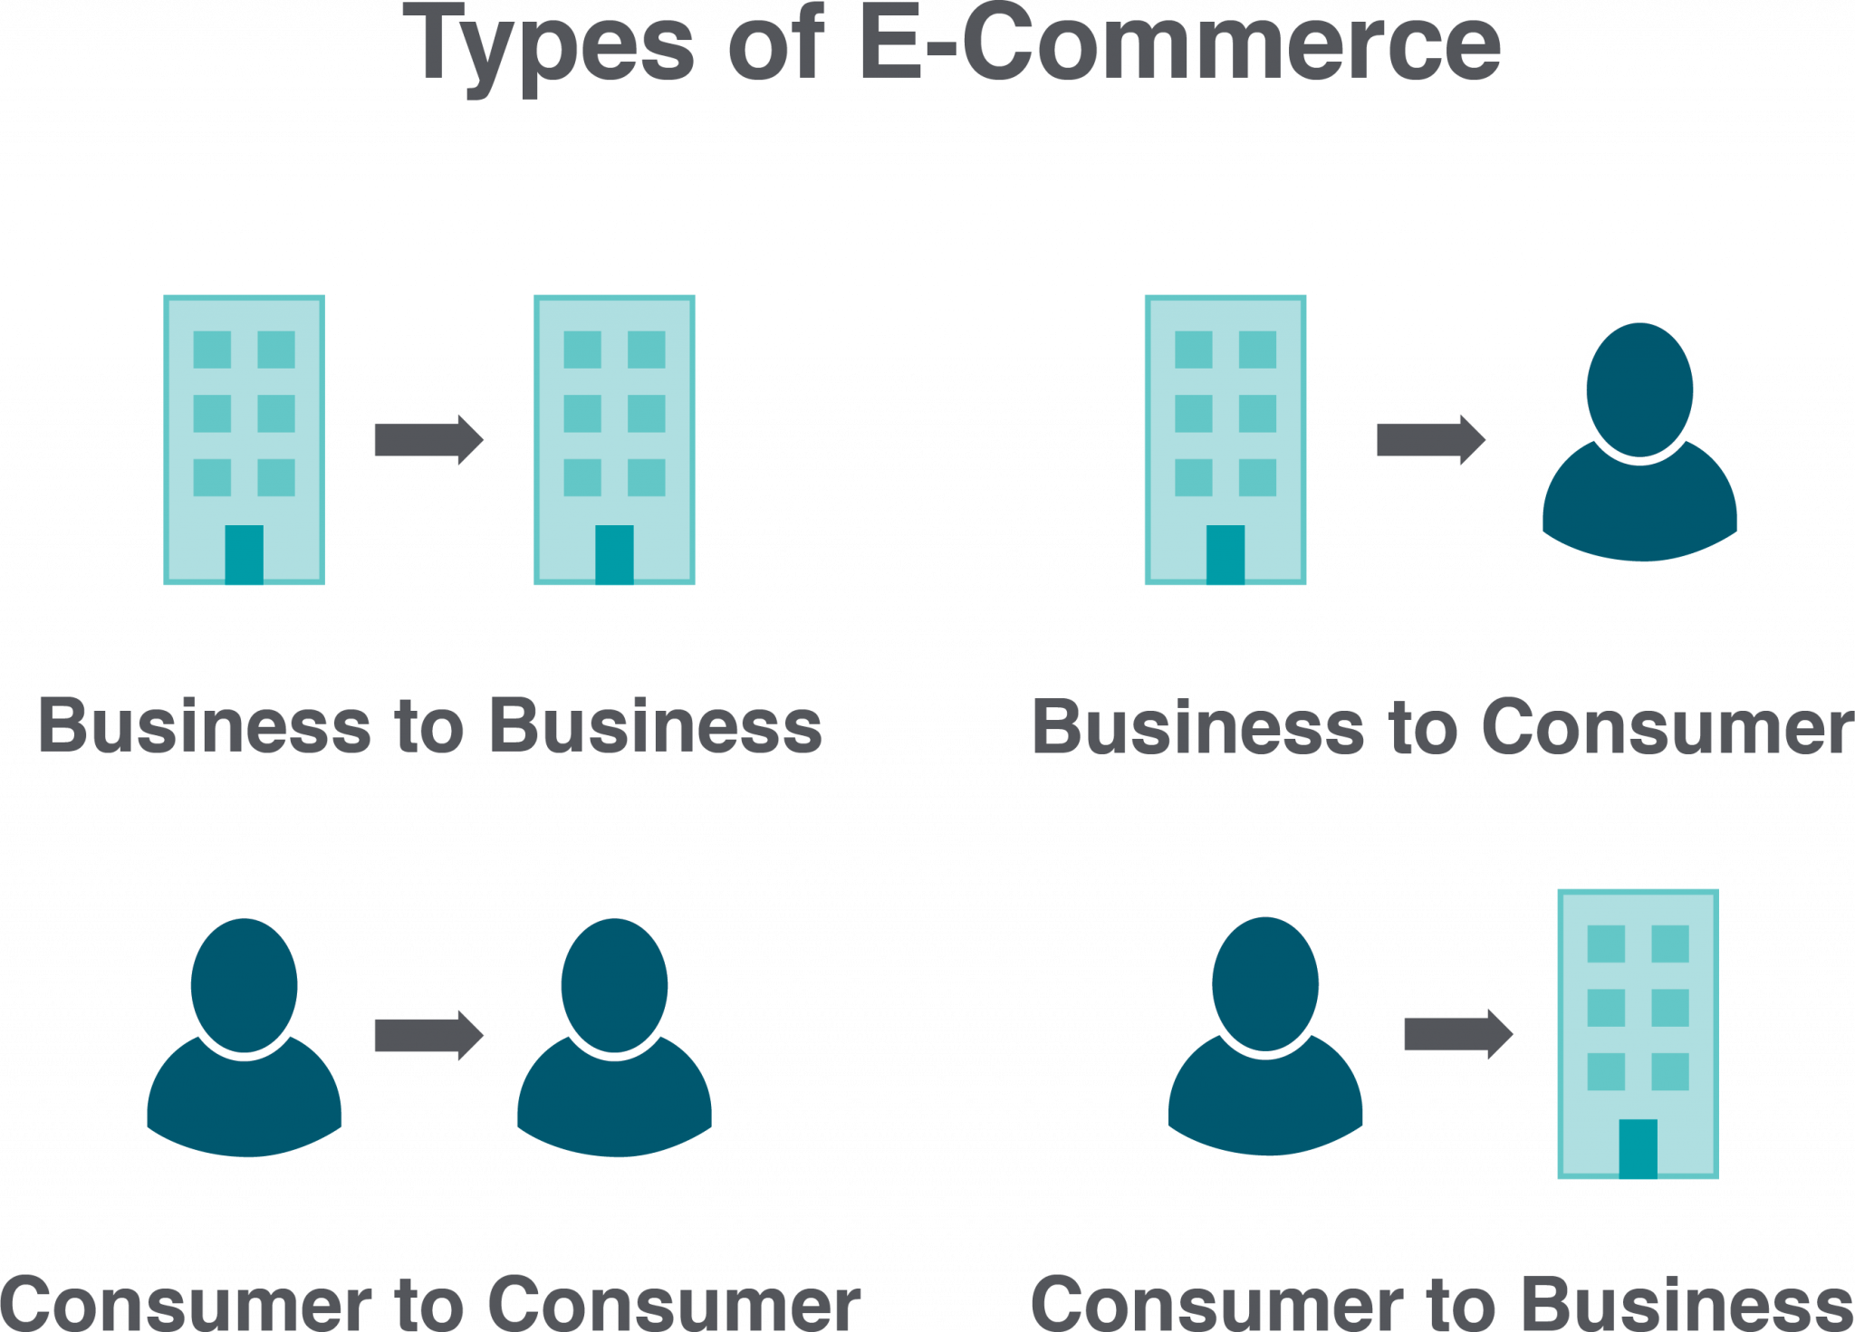
13.4 Types Of E-Commerce
Notes:
There are several different types of e-commerce that can describe almost every transaction that takes place between consumers and businesses.

Slide 9
13.4 Mobile Commerce
Mobile e-commerce (m-commerce) refers to the purchase of goods and services through wireless technology, such as cell phones and handheld devices.
M-commerce transactions continue to grow as a result of the following:
The rapid adoption of e-commerce
Improved technology
Broadband technology and lowering data costs
Need for instant gratification

Slide 10
13.5 E-Commerce Models
An e-commerce business model is the method that a business uses to generate revenue online. Models include:
Retail
Wholesale
Dropshipping
Crowdfunding
Subscription
Transaction Brokers

Slide 11
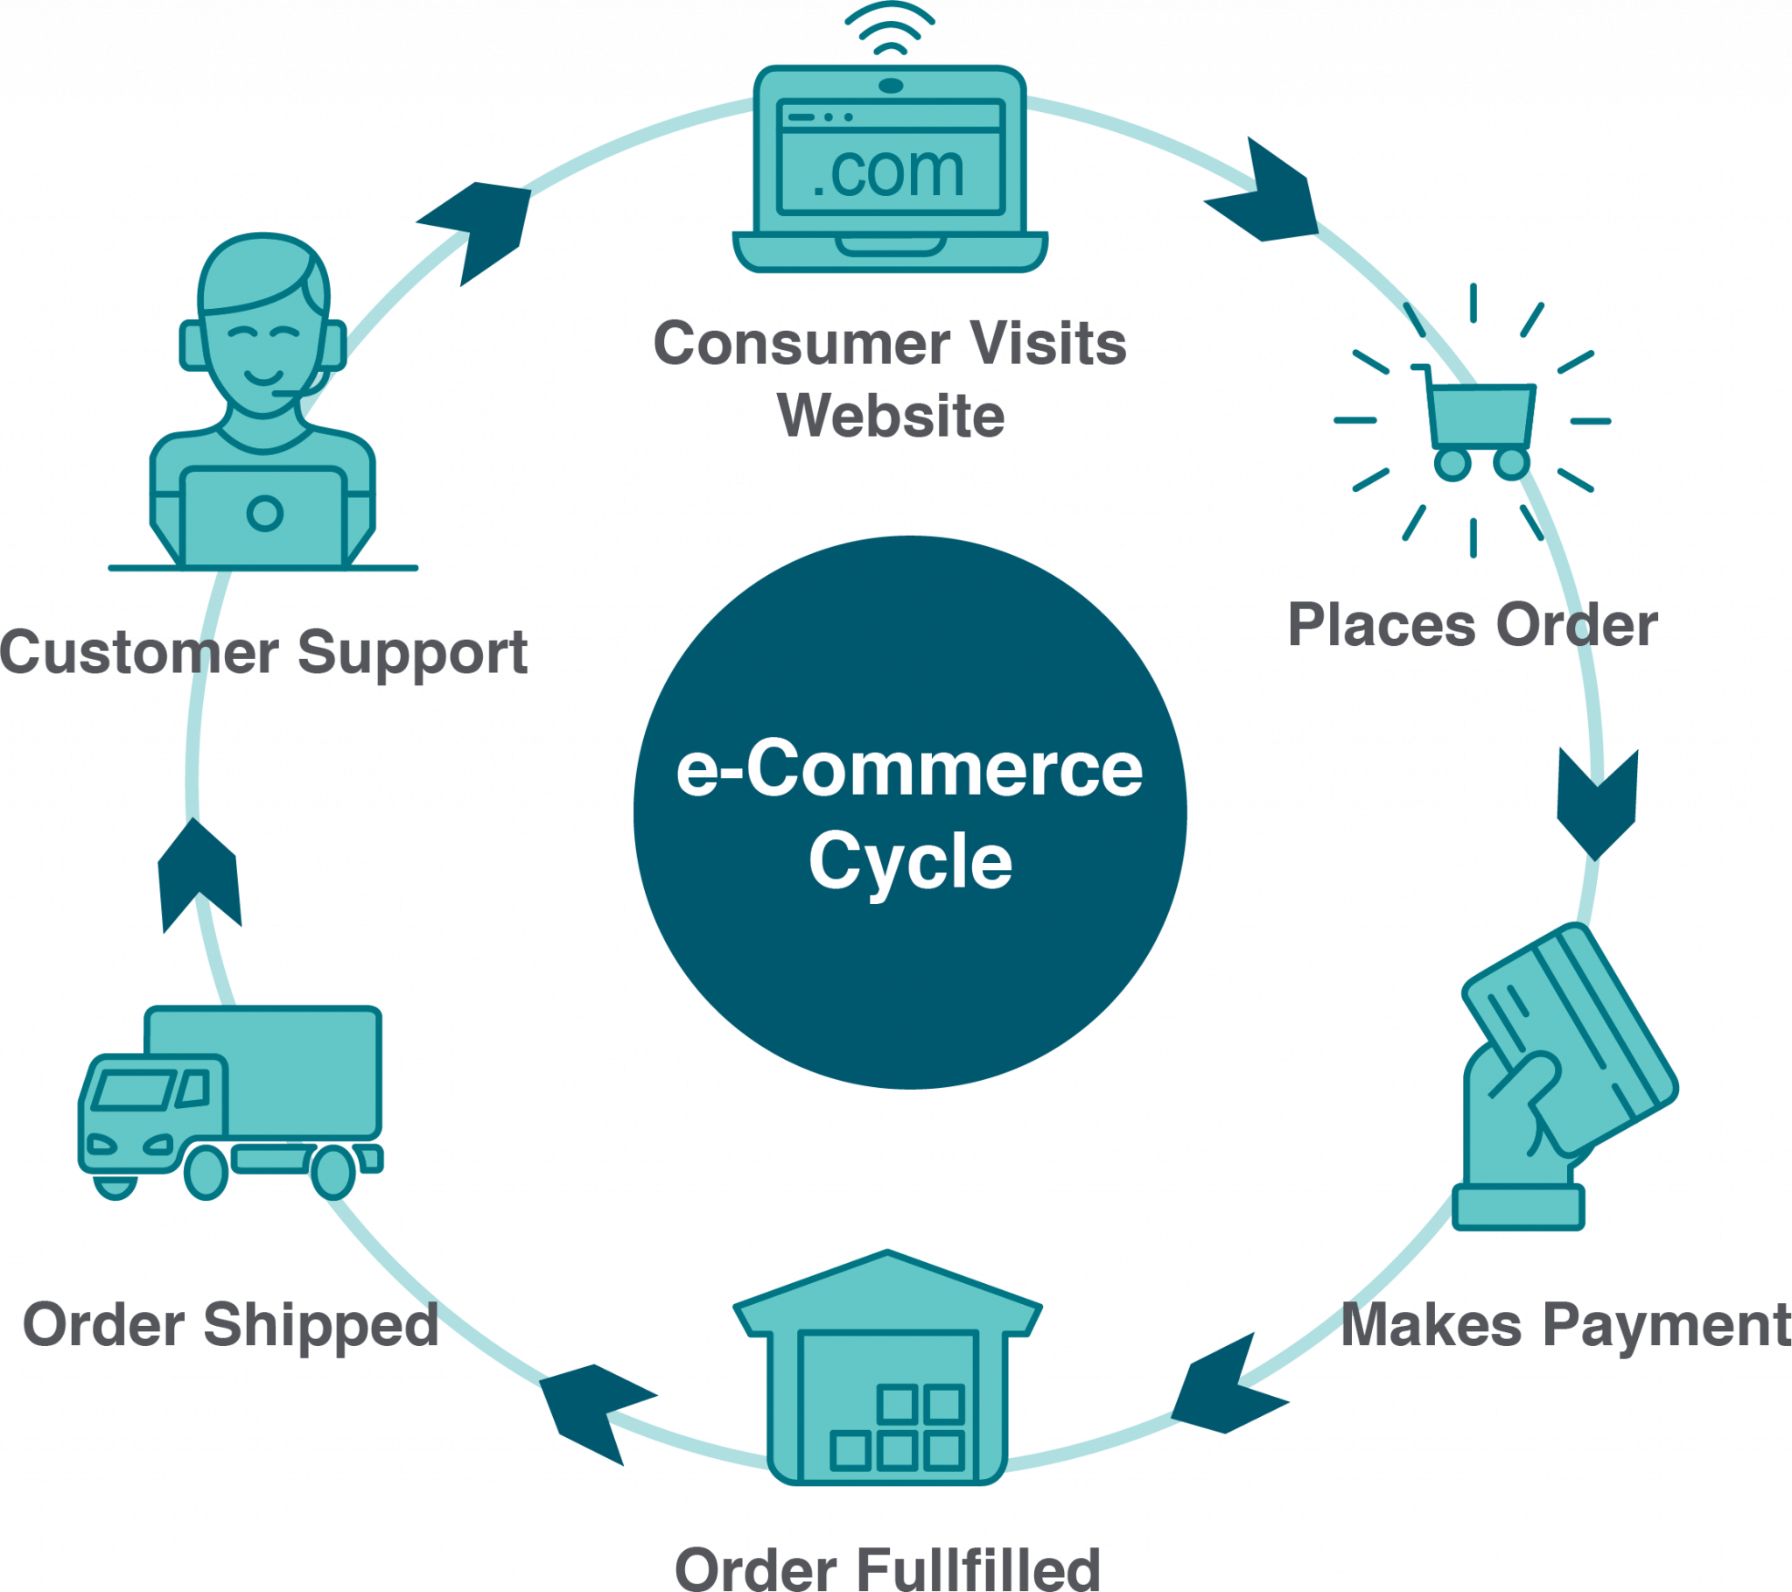
13.5 E-Commerce Models cont.
The Business to Consumer Cycle
Notes:
In the B2C e-commerce cycle a customer visits a website and peruses the products offered. They choose a product and place an order which gets added to their online shopping cart.

Slide 12
13.6 E-Commerce Technology
An e-commerce platform is a way to build and create an online experience that allows a company to make sales and fulfill orders. It includes: custom styling, search engine optimization, credit card processing, promotions, catalog management, analytics, product browsing, checkout, and order management.
Some examples of e-commerce platforms are Shopify, Wix and BigCommerce.

Slide 13
13.6 E-Commerce Technology
Search Engine Optimization (SEO) refers to the techniques that help a website rank high in organic search results (such as on Google and other search engines).
There are the two types of listings that appear when using a search engine: organic search and paid search.

Slide 14
13.6 E-Commerce Technology – Payment Methods
E-payment is any payment done electronically. This form of payment includes:
Debit cards, credit cards, gift cards
E-Transfers
E-Mail (Paypal)
Mobile Wallets
Cryptocurrency

Slide 15
13.8 Blockchain And Bitcoin
Blockchain is a peer-to-peer network which provides an open, distributed record of transactions between two parties
Bitcoin is a form of digital currency sometimes referred to as a cryptocurrency which is a new form of money that is tradable throughout the world. It operates without the involvement of central banks or a clearinghouse and runs as a P2P network

Slide 16
13.9 Trends
Social Commerce
Social factors—our attitudes, values, ethics, and lifestyles—influence what, how, where, and when people purchase products or services. However, they can be difficult to predict, define, and measure making the job of marketing more challenging.
Photo by Mohamed Hassan, CCO 1.0
Notes:
Social networks are changing that as customers are providing larges amounts of information about themselves and their preferences online for digital advertisers to mine and collect.

Slide 17
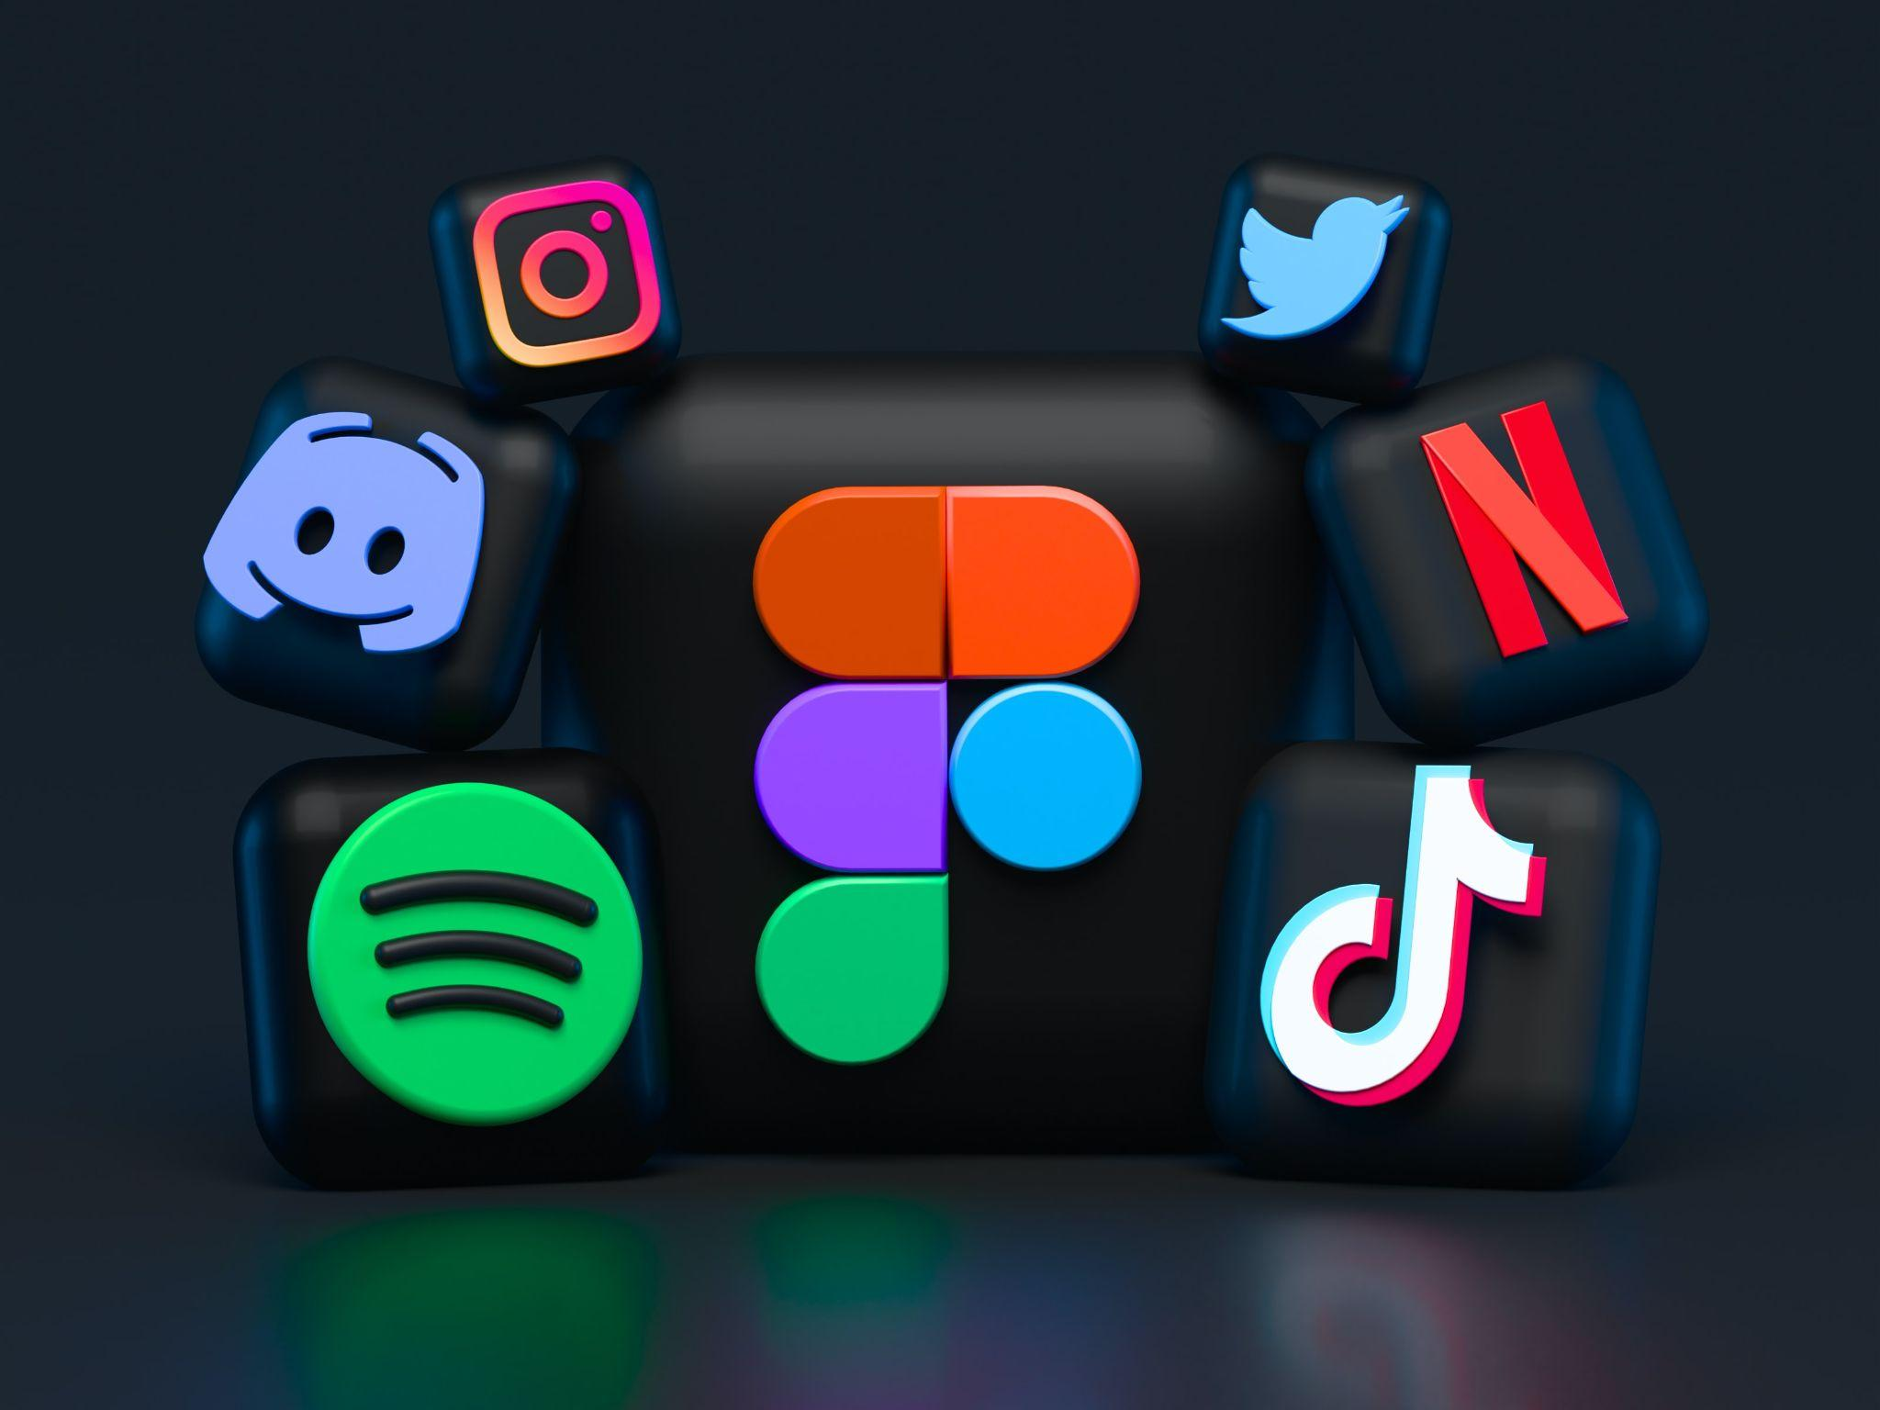
13.9 Trends cont.
Social Media Marketing
As more and more people around the planet become connected through social media, the influence of these channels continues to grow.
Image by Alexander Shatov Unsplash License
Notes:
In response, organizations are allocating more of their promotion budgets to social media.
When used effectively, social media marketing can generate a lot of buzz without a lot of expense. There are still costs associated with content creation, but the proliferation of online content creators and hungry media outlets means that on social media, content tends to be cheap.

Slide 18
Key Takeaways
E-business and e-commerce are not synonymous terms. E-business consists of several major components, one of which is e-commerce.
Every Internet business is either pure-play (an Internet presence only) or brick-and-click (having both a physical and an online presence).
The seven major types of e-commerce are B2B, B2C, C2C, B2G, C2B, m-commerce, and P2P.
An e-commerce business model is the method that a business uses to generate revenue online. Some models are very simple; others are more complicated. New business models are being introduced all the time.
Different technologies can be used for e-commerce including all-in-one e-commerce platforms, and digital payments systems.
Blockchain which is a digital distributed record of transactions is being leveraged for bitcoin which is a cryptocurrency that can be used for digital payment.
Social media platforms are popular tools for marketers to promote products and services and glean valuable customer data.
New Retail blurs the line between off-line and on-line commerce to improve the customer experience.

