Slide 1
Global Marketing in a Digital World
CHAPTER 12: CREATING A GLOBAL BRAND
Unless otherwise noted, this work is licensed under a Creative Commons Attribution-NonCommercial-ShareAlike 4.0 International (CC BY-NC-SA 4.0) license. Feel free to use, modify, reuse or redistribute any portion of this presentation.

Slide 2
Learning Outcomes
Upon successful completion of this chapter, you should be able to:
Outline the elements of brand architecture
Explain the value of a corporate brand endorsement
Outline the advantages and disadvantages of global branding.
Identify the trade-offs of centralized versus decentralized marketing decision making.
Identify the special challenges of branding decisions in emerging markets.
Outline the brand structures in multinational companies
Outline the principles guiding brands in the global market
Outline the factors shaping a company’s international brand structure
Explain the role of firm-based, product-market, and market dynamic characteristics in global branding
List the approaches to globally manage and monitor strategic brands
State the benefits of corporate branding

Slide 3
12.1 ELEMENTS AND BENEFITS OF BRANDING I
A brand consists of all the features that distinguish the goods and services of one seller from another: name, term, design, style, symbols, customer touch points, etc. Together, all elements of the brand work as a psychological trigger or stimulus that causes an association to all other thoughts one has had about this brand.

Slide 4
12.1 ELEMENTS AND BENEFITS OF BRANDING II
Brands are interesting, powerful concoctions of the marketplace that create tremendous value for organizations and for individuals.
Image by Peggy und Marco Lachmann-Anke from Pixabay
Notes:
Because brands serve several functions, we can define the term “brand” in the following ways:
A brand is an identifier: a name, sign, symbol, design, term, or some combination of these things that identifies an offering and helps simplify choice for the consumer.
A brand is a promise: the promise of what a company or offering will provide to the people who interact with it.
A brand is an asset: a reputation in the marketplace that can drive price premiums and customer preference for goods from a particular provider.
A brand is a set of perceptions: the sum total of everything individuals believe, think, see, know, feel, hear, and experience about a product, service, or organization.
A brand is “mind share“: the unique position a company or offering holds in the customer’s mind, based on their past experiences and what they expect in the future.
Brands are a combination of tangible and intangible elements, such as the following:
-Visual design elements (i.e., logo, color, typography, images, tagline, packaging, etc.)
-Distinctive product features (i.e. quality, design sensibility, personality, etc.)
-Intangible aspects of customers’ experience with a product or company (i.e. reputation, customer experience, etc.)

Slide 5
12.1 ELEMENTS AND BENEFITS OF BRANDING III
Brands Create Market Perceptions
A brand can convey multiple levels of meaning, including the following:
Attributes
Benefits
Values:
Culture
Personality
User
Notes:
A successful brand is much more than just a name or logo. As suggested in one of the definitions above, a brand is the sum of perceptions about a company or product in the minds of consumers. Effective brand building can create and sustain a strong, positive, and lasting impression that is difficult to displace.
Attributes: specific product features. The Mercedes-Benz brand, for example, suggests expensive, well-built, well-engineered, durable vehicles.
Benefits: attributes translate into functional and emotional benefits. Mercedes automobiles suggest prestige, luxury, wealth, reliability, self-esteem.
Values: company values and operational principles. The Mercedes brand evokes company values around excellence, high performance, power.
Culture: cultural elements of the company and brand. Mercedes represents German precision, discipline, efficiency, quality.
Personality: strong brands often project a distinctive personality. The Mercedes brand personality combines luxury and efficiency, precision and prestige.
User: brands may suggest the types of consumers who buy and use the product. Mercedes drivers might be perceived and classified differently than, for example, the drivers of Cadillacs, Corvettes, or BMWs.

Slide 6
12.2 FORMULATING A GLOBAL BRAND STRATEGY
To create an effective global brand structure capable of spanning operations in different countries and product lines, companies must clearly define the importance and role of each level of branding (corporate, product division, or product brand level), as well as the interrelation or overlap of branding at each level.
Image by Gerd Altmann from Pixabay
Notes:
They should also determine the appropriate geographic scope for each level relative to the firm’s current organizational structure. To be effective, such “architecture” should satisfy three key principles: parsimony, consistency, and connectivity.
Parsimony requires that the brand architecture should incorporate all existing brands, whether developed internally or acquired, and provide a framework for consolidation to reduce the number of brands and strengthen the role of individual brands.
A second important element of brand architecture is its consistency relative to the number and diversity of products and product lines within the company. A balance needs to be struck between the extent to which brand names differentiate product lines or establish a common identity across different products.

Slide 7
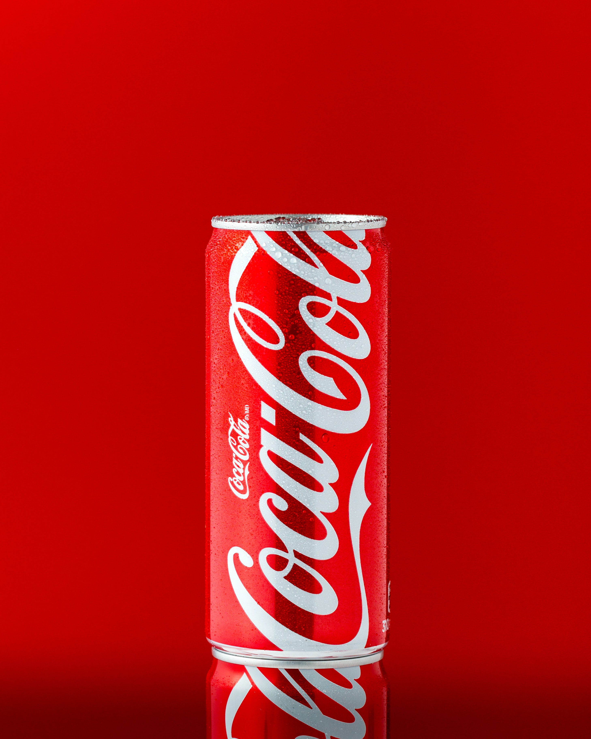
12.3 GLOBAL BRANDING I
A global brand is the brand name of a product that has worldwide recognition. Some of the most-recognized brands in the world include Coca-Cola, IBM, Microsoft, GE, Nokia, McDonald’s, Google, Toyota, Intel, and Disney (Interbrand, 2010).
Photo by Mae Mu on Unsplash
Notes:
The advantages of creating a global brand are economies of scale in production and packaging, which lower marketing costs while leveraging power and scope.
The disadvantages, however, are that consumer needs differ across countries, as do legal and competitive environments.
So while global branding, and consumer acceptance of such, is a flattener, significant country differences remain even when a firm has a strong global brand. Companies may decide to follow a global-brand strategy but also make adjustments to their communications strategy and marketing mix locally based on local needs.

Slide 8
12.3 GLOBAL BRANDING II
Centralized versus Decentralized Marketing Decisions
Who has the authority to make marketing decisions?
In a centralized-marketing organizational structure, the home-country headquarters retains decision-making power. In a decentralized-marketing organizational structure, the regions are able to make decisions without headquarters’ approval.
Notes:
The advantage of the centralized structure is speed, consistency, and economies of scale that can save costs (such as through global-marketing campaigns).
The disadvantages are that the marketing isn’t tied to local knowledge and doesn’t reflect local tastes, so sales aren’t optimized to appeal to regional differences.

Slide 9
12.3 GLOBAL BRANDING III
Planning a Brand Strategy for Emerging Markets
Entering an emerging market with a developed-country brand poses an extra challenge. Income levels in emerging markets are lower, so companies tend to price their products as inexpensively as possible. This low-cost strategy may have consequences for the company’s brand, however.
Notes:
For example, if a company introduces its brand as a “premium” product despite having a lower price, how will it introduce and differentiate its true “premium” brand later as consumers’ incomes rise?

Slide 10
12.4 GLOBAL BRAND STRUCTURES
Multinational companies typically operate with one of three brand structures:
a corporate-dominant
a product-dominant,
a hybrid structure.
Notes:
A corporate-dominant brand structure is most common among firms with relatively limited product or market diversity, such as Shell, Toyota, or Nike.
Product-dominant structures, in contrast, are often used by (mostly industrial) companies, such as Akzo Nobel, that have multiple national or local brands or by firms such as Procter & Gamble (P&G) that have expanded internationally by leveraging their “power” brands.
The most commonly used structure is a hybrid (think of Toyota Corolla cars or Cadbury Dairy Milk chocolate) consisting of a mix of global (corporate), regional, and national product-level brands or different structures for different product divisions.
In many companies, “global” branding evolves as the company enters new countries or expands product offerings within an existing country. Typically, expansion decisions are made incrementally, and often on a country-by-country, product-division, or product-line basis, without considering their implications on the overall balance or coherence of the global brand portfolio.

Slide 11
12.5 DETERMINANTS OF GLOBAL BRAND STRUCTURE I
A company’s international brand structure is shaped by three sets of factors:
1. Firm-based characteristics,
2. Product-market characteristics
3. Underlying market dynamics
(Douglas et al., 2001).
Notes:
The kinds of issues a company must resolve as it tries to shape a coherent global branding strategy reflect its globalization history—how it has expanded internationally and how it has organized its international operations. At any given point, the structure of a brand portfolio reflects a company’s past management decisions as well as the competitive realities the brand faces in the marketplace.

Slide 12
12.5 DETERMINANTS OF GLOBAL BRAND STRUCTURE II
Firm-Based Characteristics
Firm-based characteristics reflect the full array of past management decisions. First, a company’s administrative heritage—in particular, its organizational structure—defines the template for its brand structure. Second, a firm’s international expansion strategy—acquisition or organic growth—affects how its brand structure evolves over time.
Notes:
What is more, the use of strategic alliances to broaden the geographic scope of the firm’s operations often results in a “melding” of the brand strategies of the partners. Third and fourth, the importance of corporate identity and the diversity of the firm’s product lines and product divisions also determine the range and number of brands.

Slide 13
12.5 DETERMINANTS OF GLOBAL BRAND STRUCTURE III
Product-Market Factors
Three product-market factors play an important role in brand architecture: the nature and scope of the target market, the product’s cultural associations, and the competitive market structure (Douglas et al., 2001).
Notes:
When companies target a global market segment with relatively homogeneous needs and preferences worldwide, global brands provide an effective means of establishing a distinctive global identity. Luxury brands such as Godiva, Moet and Chandon, and Louis Vuitton, as well as brands such as deBeers, Benetton, and L’Oreal are all targeted to the same market segment worldwide and benefit from the cachet provided by their appeal to a global consumer group.

Slide 14
12.5 DETERMINANTS OF GLOBAL BRAND STRUCTURE IV
Market Dynamics
While the firm’s history and the product markets in which it operates shape its brand structure, market dynamics—including ongoing political and economic integration, the emergence of a global market infrastructure, and consumer mobility—shape and continually change the context in which this evolves (Douglas et al., 2001).
Notes:
Increasing political and economic integration in many parts of the world has been a key factor behind the growth of international branding. As governments remove tariff and nontariff barriers to business transactions and trade with other countries, and as people and information move easily across borders, the business climate has become more favourable to the marketing of international brands.

Slide 15
12.6 MANAGING KEY STRATEGIC BRANDS I
Companies must also think about how to globally manage and monitor key strategic brands to ensure that they build and retain their integrity, visibility, and value. This entails assigning brand custody or appointing a brand champion responsible for approving brand extensions and monitoring brand positioning.
Notes:
One option is to negotiate the harmonization of specific brand positions between corporate headquarters and country managers. This is appropriate for firms with strong country management that operate in product markets where brands were historically tailored to local market characteristics.
A more proactive and increasingly popular solution is to appoint a brand champion responsible for building and managing a brand worldwide. This includes monitoring the consistency of the brand positioning in international markets as well as authorizing the use of the brand (brand extensions) on other products or other product businesses.

Slide 16
12.6 MANAGING KEY STRATEGIC BRANDS II
Benefits of Corporate Branding
Corporations around the world are increasingly becoming aware of the enhanced value that corporate branding strategies can provide. A strong corporate branding strategy can add significant value in terms of helping the entire corporation and the management team with implementing its long-term vision, creating unique positions in the marketplace for the company and its brands, and signalling a commitment to a broader set of stakeholder issues.
Notes:
An effective corporate branding strategy, therefore, enables the company to leverage its tangible and nontangible assets and promote excellence throughout the corporation. To be effective and meet such objectives, corporate branding requires a high level of personal attention and commitment from the CEO and the senior management.

Slide 17
12.7 COMMON BRANDING STRATEGIES
A branding strategy helps establish a product within the market and to build a brand that will grow and mature. Making smart branding decisions up front is crucial since a company may have to live with their decisions for a long time. The following are commonly used branding strategies:
‘Branded House’ Strategy
‘House of Brands’ Strategy
Private-Label or Store Branding
‘No-Brand’ Branding
Personal and Organizational Brands
Place Branding
Co-Branding
Notes:
1. A “branded house” strategy (sometimes called a “house brand”) uses a strong brand—typically the company name—as the identifying brand name for a range of products (for example, Mercedes Benz or Black & Decker) or a range of subsidiary brands (such as Cadbury Dairy Milk or Cadbury Fingers).
2. With the “house of brands” strategy, a company invests in building out a variety of individual, product-level brands. Each of these brands has a separate name and may not be associated with the parent company name at all.
3. Also called store branding, private-label branding has become increasingly popular. In cases where the retailer has a particularly strong identity, the private label may be able to compete against even the strongest brand leaders and may outperform those products that are not otherwise strongly branded.
4. A number of companies successfully pursue “no-brand” strategies by creating packaging that imitates generic-brand simplicity. “No brand” branding can be considered a type of branding since the product is made conspicuous by the absence of a brand name.
5. Personal and organizational branding are strategies for developing a brand image and marketing engine around individual people or groups. Personal branding treats persons and their careers as products to be branded and sold to target audiences. Organizational branding promotes the mission, goals, and/or work of the group being branded.
6. The developing fields of place branding and nation branding work on the assumption that places compete with other places to win over people, investment, tourism, economic development, and other resources.
7. Co-branding is an arrangement in which two established brands collaborate to offer a single product or service that carries both brand names. In these relationships, generally both parties contribute something of value to the new offering that neither would have been able to achieve independently.

Slide 18
12.8 KEY TERMS
“Branded House” Strategy: Sometimes called a “house brand” uses a strong brand—typically the company name—as the identifying brand name for a range of products. 12.7
“House of Brands” Strategy: A company invests in building out a variety of individual, product-level brands. 12.7
“No-Brand” Branding: A number of companies successfully pursue “no-brand” strategies by creating packaging that imitates generic-brand simplicity. “No brand” branding can be considered a type of branding since the product is made conspicuous by the absence of a brand name. 12.7
Attributes are specific product features. 12.1
Benefits are attributes translate into functional and emotional benefits. 12.1
Brand consists of all the features that distinguish the goods and services of one seller from another: name, term, design, style, symbols, customer touch points, etc. Together, all elements of the brand work as a psychological trigger or stimulus that causes an association to all other thoughts one has had about this brand. 12.1
Brand analysis involves a measurement of how a brand influences customer demand at the point of purchase. 12.6
Brand extension moves an existing brand name into a new product category, with a new or somehow modified product. 12.7
Brand ownership should be the responsibility of an organization’s management and employees. Brand ownership is about building and maintaining a brand that reflects your principles and values. 12.7
Branding strategy helps establish a product within the market and to build a brand that will grow and mature. Making smart branding decisions up front is crucial since a company may have to live with their decisions for a long time. 12.7
Brand Strength Score: As brands are assets, valuing them requires an assessment of their ability to secure future earnings on behalf of the businesses that own them. Brand strength is a measure of the brand’s ability to secure demand, and therefore earnings, over time. 12.6
Brand’s value is a financial representation of a business’s earnings due to the superior demand created for its products and services through the strength of its brand. 12.6
Line extension – when it introduces a new variety of offering within the same product category. 12.7
Managing Brands As Strategic Assets: As organizations establish and build strong brands, they can pursue a number of strategies to continue developing them and extending their value to stakeholders (customers, retailers, supply chain and distribution partners, and of course the organization itself). 12.7
Personality: strong brands often project a distinctive personality. 12.1
Private-Label or Store Branding: Also called store branding, private-label branding has become increasingly popular. In cases where the retailer has a particularly strong identity, the private label may be able to compete against even the strongest brand leaders and may outperform those products that are not otherwise strongly branded. 12.7
User: brands may suggest the types of consumers who buy and use the product. 12.1
Values: company values and operational principles. 12.1

