Slide 1
Global Marketing in a Digital World
CHAPTER 11: THE GLOBAL MARKETING PLAN
Unless otherwise noted, this work is licensed under a Creative Commons Attribution-NonCommercial-ShareAlike 4.0 International (CC BY-NC-SA 4.0) license. Feel free to use, modify, reuse or redistribute any portion of this presentation.

Slide 2
Learning Outcomes
Upon successful completion of this chapter, you should be able to:
Explain how the marketing plan is used to track progress, evaluate impact, and adjust course where needed
Explain why and how to update the marketing plan
Outline the decision sequence in international marketing
Explain how the marketing mix elements are integrated in the international marketing plan
Explain how the basic principles of marketing apply to global marketing

Slide 3
11.1 THE MARKETING PLAN I
The marketing plan captures the outputs from the marketing planning process in one cohesive document. If the plan is done well, it puts a plan in place that aligns the marketing strategy, objectives, and tactics with the corporate mission. It also supports the corporate objectives and strategy, which creates alignment with other functions across the company.

Slide 4
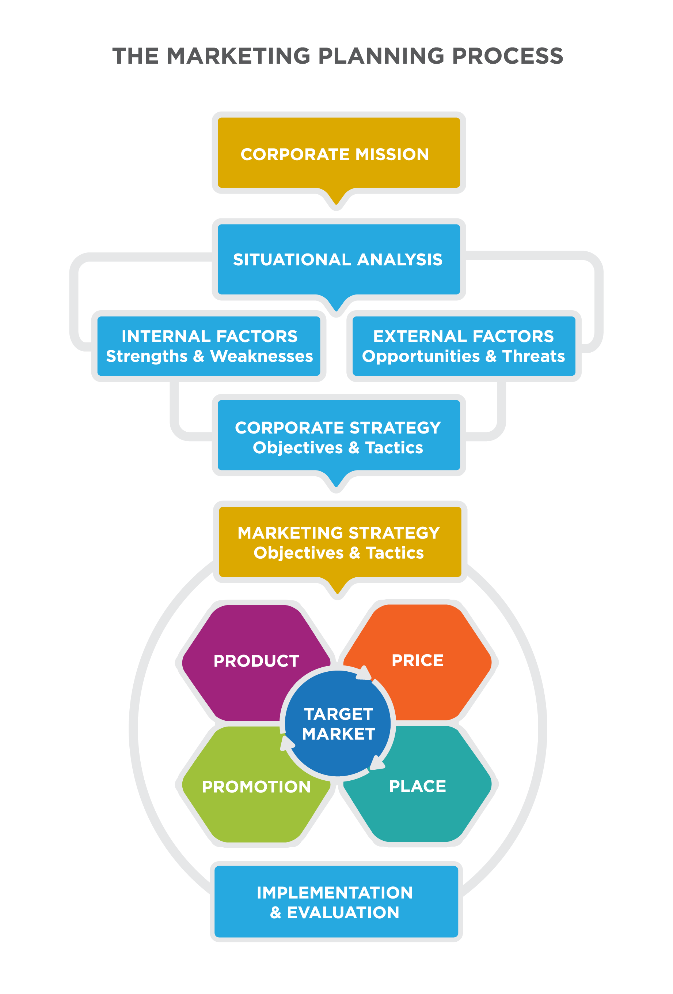
11.1 THE MARKETING PLAN II
The marketing plan acts as a mechanism to communicate with other functions and to check for alignment.
Notes:
While this alignment is assumed, the presentation and formalization of the marketing plan often surfaces misalignment. Perhaps the finance team had assumed that the promotion strategy was not central to the plan and had reduced the budget. Perhaps the supply chain team had not recognized how aggressive the new product plans were and is not staffed to support them. While it it frustrating to identify points of confusion and misalignment, it is always best to do that in the planning process before it has impact on customers and on the market.

Slide 5
11.1 THE MARKETING PLAN III
Clarifying the Action Plan
There are many reasons why organizations fail to execute effectively, but many can be traced back to communication. When a large marketing organization begins to execute a plan, it’s important that everyone understands what the goals are, but it’s equally important to know which analysis supports (or possibly undermines) the plan.
Image by Gerd Altmann from Pixabay
Notes:
If a marketer is not fully aware of competitive threats that have been identified, then he may unknowingly make trade-offs that fail to address the competitive risk. If a product marketer is deeply focus on defining a new product and bringing it to market, she might not be aware of significant dependencies on the supply chain and distribution channels.
The marketing plan is an important tool to communicate detailed plans within the marketing function.

Slide 6
11.1 THE MARKETING PLAN IV
Informing Adjustments and New Strategies
As soon as the first activity identified in the plan is executed, the marketing plan begins to be outdated. The more successful the plan is, the more quickly it will require a significant revision. If you are able to identify and implement a strategy that results in tremendous success, that will change the competitive dynamics and cause other companies to adjust their strategy and tactics.
Notes:
Sometimes an organization can get away with small quarterly updates to the marketing plan and major annual revisions. Other times, the market has shifted enough by the end of one quarter that a completely new approach is warranted—or a more aggressive implementation of the current approach.

Slide 7
11.2 WRITING THE GLOBAL MARKETING PLAN
The decision sequence in international marketing is much larger than that of domestic markets.
Notes:
It should be apparent by now that companies and organizations planning to compete effectively in world markets need a clear and well-focused international marketing plan that is based on a thorough understanding of the markets in which the company is introducing its products.
the challenge of international marketing is to ensure that any international strategy has the discipline of thorough research, and an understanding and accurate evaluation of what is required to achieve the competitive advantage.
The Corporate Level---We begin at the corporate level, where firms decide whether to become involved in international markets and determine the resources they are willing to commit. Thus, this stage is primarily concerned with the analysis of international markets. Decisions here will be dependent on matching the results of that analysis with the company’s objectives.
The Business Level--Business-level considerations begin with the assessment of the stakeholders involved in the business. It is important to clearly identify the different stakeholder groups, understand their expectations, and evaluate their power, because the stakeholders provide the broad guidelines within which the firm operates.
The Functional Level--Having set the objectives for the company, both at the corporate level and the business level, the company can now develop a detailed program of functional activities to achieve the objectives. Following the integrated approach employed throughout this text, each of the functional elements (e.g. finance, human resources, research) must be considered jointly.

Slide 8
11.3 THE MARKETING MIX IN GLOBAL MARKETING I
The same marketing principles that lead to marketing success in domestic marketing can also apply to global marketing. With the rapidly growing force of globalization, the distinction between marketing within an organization’s home country and marketing within external markets is disappearing very quickly.
Notes:
With this in mind, organizations are modifying their marketing strategies to meet the challenges of the global marketplace while trying to sustain their competitiveness within home markets. These changes have also prompted brands to customize their global marketing mix for different markets, based on local languages, needs, wants, and values.

Slide 9
11.3 THE MARKETING MIX IN GLOBAL MARKETING II
Global Marketing Mix: Product Plus Promotion
For multinational corporations (MNCs), the interplay between product and promotion is important because it can enable a company to make minor adjustments to a single product and its promotion strategy rather than totally revamping the product and promotion for different markets.
Notes:
Coca-Cola is a strong example of this principle. The beverage brand uses two formulas (one with sugar and one with corn syrup) for all markets. The product packaging in every country incorporates Coca-Cola’s contour bottle design and signature ribbon in some shape or form. However, the bottle can also include the country’s native language and appear in identical sizes as other beverage bottles or cans in that country’s market.
Before launching promotional programs, global companies must first define their target markets and determine the products that will resonate most with those consumers and businesses. This research can help inform marketing leaders about what course to take—localization versus standardization strategy—as they learn more about the target market’s receptivity to their goods and services.

Slide 10
11.3 THE MARKETING MIX IN GLOBAL MARKETING III
Global Marketing Mix: Promotion
Global marketers must balance four potentially competing business objectives when developing worldwide advertising:
building a brand while speaking with one voice
developing economies of scale in the creative process
maximizing local effectiveness of advertisements
increasing the company’s speed of implementation
Notes:
Before a company decides to become global, it must consider social, cultural, economic, political, competitive, and other factors relative to the global expansion it is considering. Creating a worldwide marketing plan is no simple task.
It is virtually impossible for a company to communicate one identical message in a unified voice to global markets unless a company holds the same position against its competition in all markets (e.g., market leader, low cost, etc.). This is rarely the case, so most global companies must be open to some level of localization and be nimble enough to adapt to changing local market trends, tastes, and needs.

Slide 11
11.3 THE MARKETING MIX IN GLOBAL MARKETING IV
Global Marketing Mix: Price
Pricing is the process of determining what a company will receive in exchange for its products. Many pricing considerations in global marketing are similar to domestic marketing. As marketers develop pricing strategy, they should keep the following goals in mind:
Achieving the financial goals of the company and generating profits
Matching the realities of the marketplace and consumer buying trends
Supporting the designated positioning for a product, making it consistent with other elements of the marketing mix, product, promotion and placement
Notes:
Similar to domestic marketing, in the global marketing mix, factors that affect pricing include manufacturing cost, distribution channels, marketplace, competition, market conditions, and quality of product. For instance, if distribution is exclusive to one channel partner, then prices are likely to be higher.

Slide 12
11.4 LULULEMON MARKETING STRATEGY AND PLAN I
Lululemon’s mission statement is “to elevate the world from mediocrity to greatness.” The mission statement comprises of these components: improving lives, improving health, and exceeding expectations. Lululemon is passionate when it comes to initiating long-lasting changes in everyone that uses their products.
Photo by Raysonho CCO 1.0
Notes:
Lululemon’s vision statement is “to be the experimental brand that ignites a community of people living the sweat life through sweat, grow and connect.” The statement consists of the following components: exceptional brand, ignite communities through sweat, and create connections. Lululemon prioritizes quality over quantity to provide value to their customers (Mission Statement Academy, 2019).

Slide 13
11.4 LULULEMON MARKETING STRATEGY AND PLAN II
Lululemon Goals, Strategies and Budget
Lululemon has many goals they hope to achieve. These include:
Identify retail locations to open new stores and attract new customers.
Provide customers with new products.
Sustain their brand image.
Achieve growth and maintain cash flow.
Increase sales of current stores.
Operate efficiently in all departments.
Keep their dedicated and experienced staff (Ghani, 2015)
Notes:
Lululemon’s strategy allows them to become one of the major players in athletic apparel. To achieve its goals, Lululemon uses three main strategies.
1. Innovation forever- they have a very active Research and Development department and are always looking to get new and improved products to their customers.
2. Interactive digital marketing- they portray their brand as essential for athletic teams, fitness facilities and yoga studios.
3. Expanding the market by launching new product lines in different regions – while Lululemon has been very successful in North America, they hope to expand their marketing to China (Business Strategy Hub, 2019).

Slide 14
11.5 KEY TERMS
E-Commerce Partnerships: B2B partnerships will be responsible for finding another e-commerce platform to get out product on by the end of the year. They will also continue working with their current partner, Tmall to find more distribution partners to get our products to our consumers quickly and efficiently. 11.4
Four Ps of Marketing: Product, price, placement, and promotion—are all affected as a company moves through the different phases to become and maintain dominance as a global company. 11.3
Marketing Plan: Captures the outputs from the marketing planning process in one cohesive document. If the plan is done well, it puts a plan in place that aligns the marketing strategy, objectives, and tactics with the corporate mission. 11.1
Product Adaptation Team: The team will consist of representatives from market analysis, finance, sales and design departments. They will meet at the end of each product season to evaluate the strengths and weaknesses of a seasonal product with a focus on logos, colours and sizing. Based on their evaluation they will come up with a plan to improve next year’s product and tailor it to our target market. 11.4
Service Adaptations Team: The team will consist of representatives from market analysis, digital marketing, customer service, retail operations, e-commerce and distribution departments. They will evaluate the strengths and weaknesses in our services offered instore and online. They will meet quarterly and submit evaluations and suggestions to improve servicing our market. 11.4
Showroom Expansion: A New Store Opening team, which will operate under retail ops will consist of real estate, facilities, visual, and IT will be created for each major city Shanghai, Hangzhou, Guangzhou, Chengdu, Shenzhen and Beijing. 11.5

