Slide 1
Global Marketing in a Digital World
CHAPTER 10: GLOBAL PROMOTION
Unless otherwise noted, this work is licensed under a Creative Commons Attribution-NonCommercial-ShareAlike 4.0 International (CC BY-NC-SA 4.0) license. Feel free to use, modify, reuse or redistribute any portion of this presentation.

Slide 2
Learning Outcomes
Upon successful completion of this chapter, you should be able to:
Explain integrated marketing communication (IMC)
Explain the promotion mix
Describe common marketing communication methods, including their advantages and disadvantages
Explain how organizations use IMC to support their marketing strategies
List driving factors in global promotion decisions
Outline the steps in changing the global promotional mix

Slide 3
10.1 INTEGRATED MARKETING COMMUNICATION I
Integrated marketing communication is the the process of coordinating all this activity across different communication methods. Note that a central theme of this definition is persuasion: persuading people to believe something, to desire something, and/or to do something.
Notes:
Having a great product available to your customers at a great price does absolutely nothing for you if your customers don’t know about it. That’s where promotion enters the picture: it does the job of connecting with your target audiences and communicating what you can offer them.
In today’s marketing environment, promotion involves integrated marketing communication (IMC). In a nutshell, IMC involves bringing together a variety of different communication tools to deliver a common message and make a desired impact on customers’ perceptions and behavior.
Effective marketing communication is goal directed, and it is aligned with an organization’s marketing strategy. It aims to deliver a particular message to a specific audience with a targeted purpose of altering perceptions and/or behavior. Integrated marketing communication (IMC) makes marketing activity more efficient and effective because it relies on multiple communication methods and customer touch points to deliver a consistent message in multiple means and in more compelling ways.
Marketing communication includes all the messages, media, and activities used by an organization to communicate with the market and help persuade target audiences to accept its messages and take action accordingly.

Slide 4
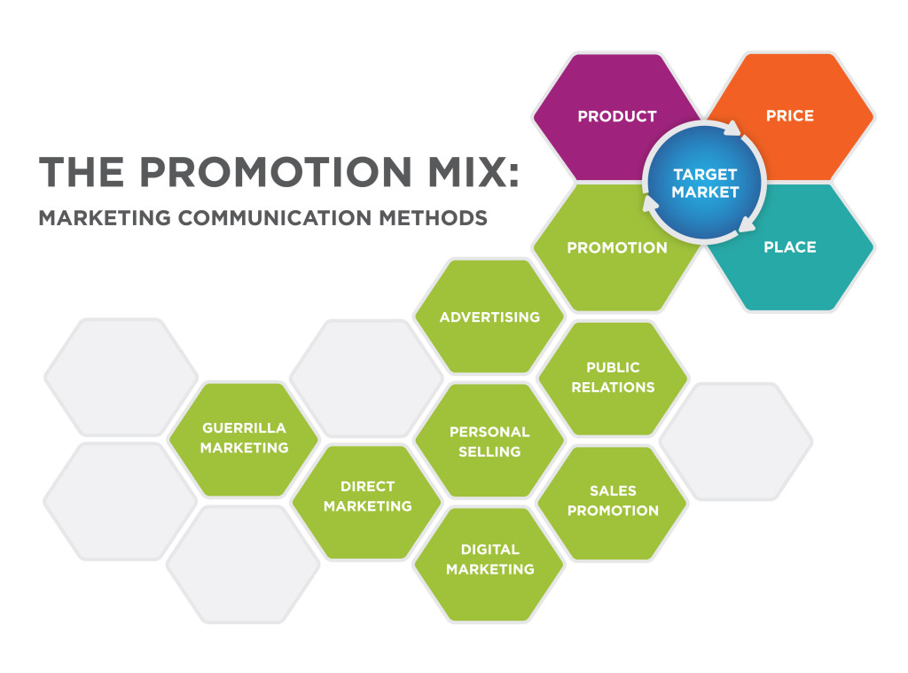
10.1 INTEGRATED MARKETING COMMUNICATION II
The Promotion Mix: Marketing Communication Methods
Notes:
The promotion mix refers to how marketers combine a range of marketing communication methods to execute their marketing activities. Different methods of marketing communication have distinct advantages and complexities, and it requires skill and experience to deploy them effectively.
Not surprisingly, marketing communication methods evolve over time as new communication tools and capabilities become available to marketers and the people they target.

Slide 5
10.1 INTEGRATED MARKETING COMMUNICATION III
Seven common methods of marketing communication are:
Advertising
Public relations (PR)
Personal selling
Sales promotion
Direct marketing
Digital marketing
Guerrilla marketing
Notes:
***Guerrilla marketing: This newer category of marketing communication involves unconventional, innovative, and usually low-cost marketing tactics to engage consumers in the marketing activity, generate attention and achieve maximum exposure for an organization, its products, and/or services. Generally guerrilla marketing is experiential: it creates a novel situation or memorable experience consumers connect to a product or brand.

Slide 6
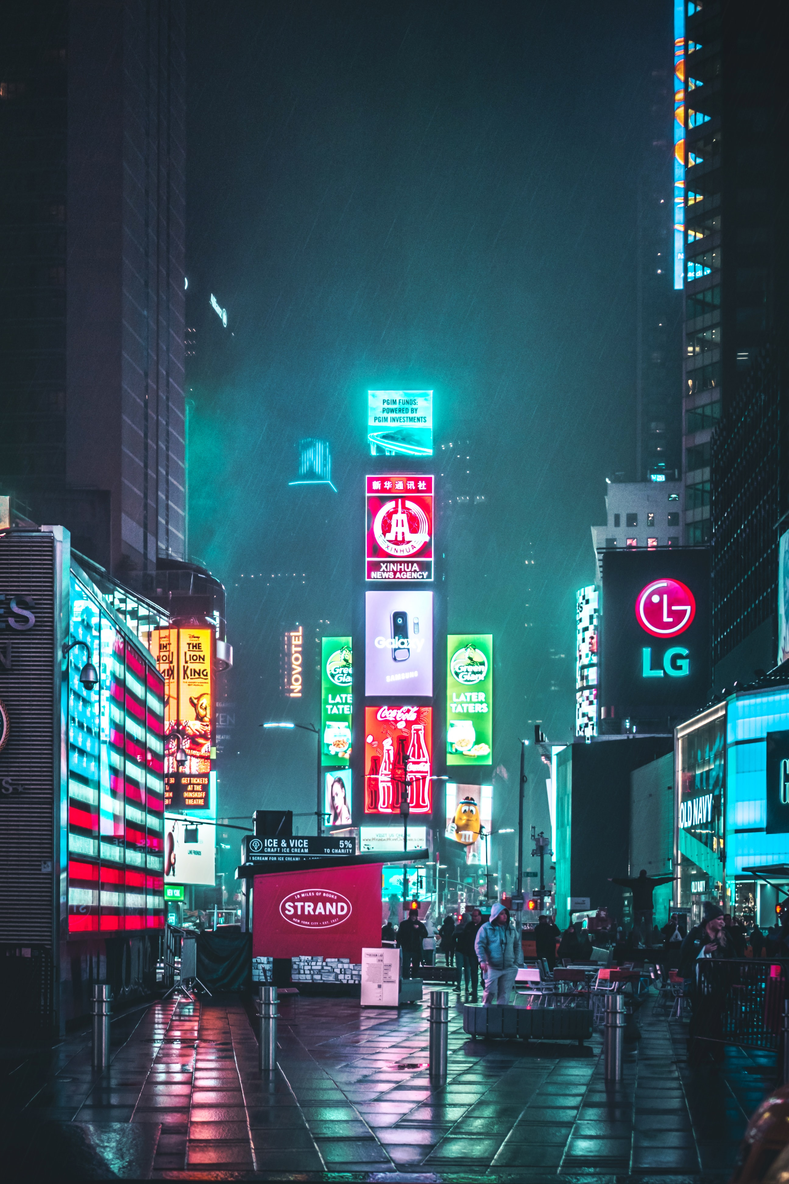
10.2 COMMON MARKETING COMMUNICATION METHODS I
Advertising
Advertising is probably the first thing you think of when you think of marketing. Advertising is any paid form of communication from an identified sponsor or source that draws attention to ideas, goods, services or the sponsor itself- essentially commercials and ads (whether digital or print).
Photo by Andre Benz on Unsplash
Notes:
Most advertising is directed toward groups rather than individuals, and advertising is usually delivered through media such as television, radio, newspapers and, increasingly, the internet. Ads are often measured in impressions (the number of times a consumer is exposed to an advertisement).
Advantages-----advertising creates a sense of credibility or legitimacy when an organization invests in presenting itself and its products in a public forum. Ads can convey a sense of quality and permanence, the idea that a company isn’t some fly-by-night venture. Advertising allows marketers to repeat a message at intervals selected strategically.
Disadvantages- The primary disadvantage of advertising is cost. Marketers question whether this communication method is really cost-effective at reaching large groups. Of course, costs vary depending on the medium, with television ads being very expensive to produce and place. In contrast, print and digital ads tend to be much less expensive.

Slide 7
10.2 COMMON MARKETING COMMUNICATION METHODS II
Public Relations
Public Relations (PR) is the process of maintaining a favorable image and building beneficial relationships between an organization and the public communities, groups, and people it serves. Unlike advertising, which tries to create favorable impressions through paid messages, public relations does not pay for attention and publicity.
Photo by LinkedIn Sales Solutions, Unsplash
Notes:
Instead, PR strives to earn a favorable image by drawing attention to newsworthy and attention-worthy activities of the organization and its customers. For this reason, PR is often referred to as “free advertising.”
Advantages- Because PR activity is earned rather than paid, it tends to carry more credibility and weight.

Slide 8
10.2 COMMON MARKETING COMMUNICATION METHODS III
Personal Selling
Personal selling uses in-person interaction to sell products and services. This type of communication is carried out by sales representatives, who are the personal connection between a buyer and a company or a company’s products or services.
Photo by Christiann Koepke, Unsplash
Notes:
In addition to enhancing customer relationships, this type of marketing communications tool can be a powerful source of customer feedback, as well.
Advantages-- The most significant strength of personal selling is its flexibility. Salespeople can tailor their presentations to fit the needs, motives, and behavior of individual customers. A salesperson can gauge the customer’s reaction to a sales approach and immediately adjust the message to facilitate better understanding.
Disadvantages-- High cost is the primary disadvantage of personal selling. With increased competition, higher travel and lodging costs, and higher salaries, the cost per sales contract continues to rise.

Slide 9
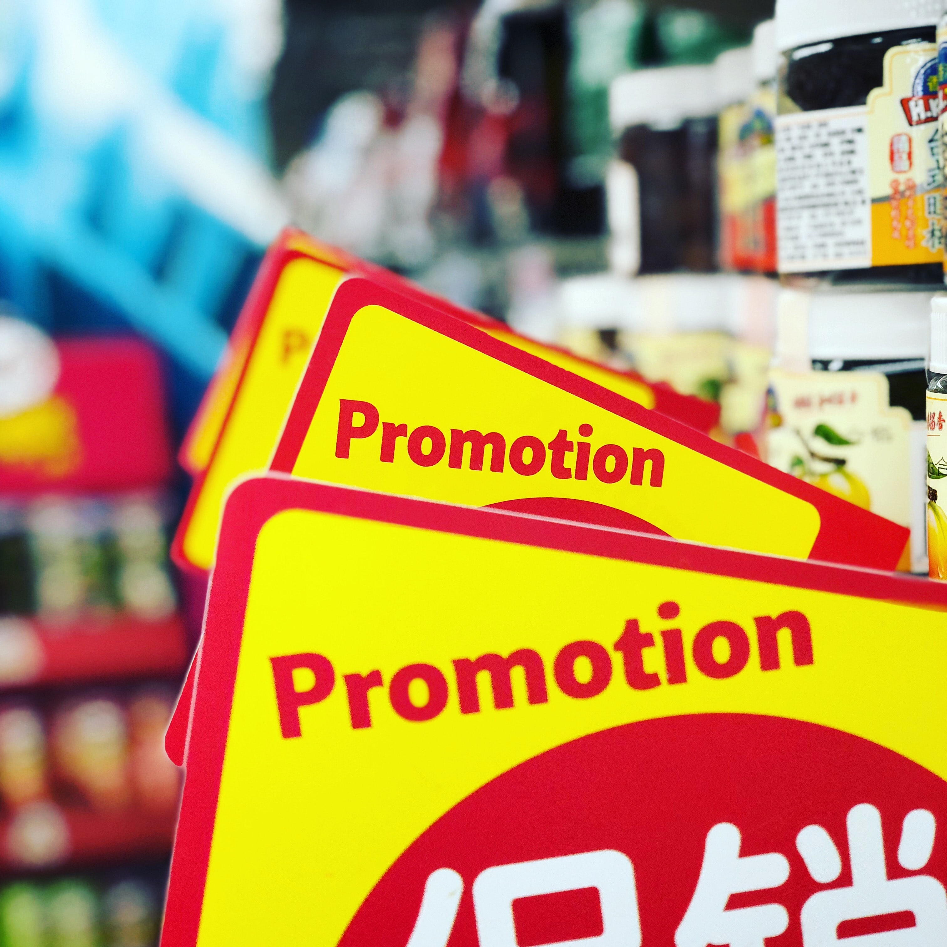
10.2 COMMON MARKETING COMMUNICATION METHODS IV
Sales promotions
Sales Promotions are a marketing communication tool for stimulating revenue or providing incentives or extra value to distributers, sales staff, or customers over a short time period. Sales promotion activities include special offers, displays, demonstrations, and other nonrecurring selling efforts that aren’t part of the ordinary routine.
Photo by JJ Ying, Unsplash
Notes:
As an additional incentive to buy, these tools can be directed at consumers, retailers and other distribution partners, or the manufacturer’s own sales force.
Companies use many different forms of media to communicate sales promotions, such as printed materials like posters, coupons, direct mail pieces and billboards, radio and television ads, digital media (like text messages), email, websites, social media, and so forth
Advantages-- In addition to their primary purpose of boosting sales in the near term, companies can use consumer sales promotions to help them understand price sensitivity. Coupons and rebates provide useful information about how pricing influences consumers’ buying behavior. Sales promotions can also be a valuable–and sometimes sneaky–way to acquire contact information for current and prospective customers
Disadvantages-- Sales promotions can be a two-edged sword: if a company is continually handing out product samples and coupons, it can risk tarnishing the company’s brand. Offering too many freebies can signal to customers that they are not purchasing a prestigious or “limited” product. Another risk with too-frequent promotions is that savvy customers will hold off purchasing until the next promotion, thus depressing sales.

Slide 10
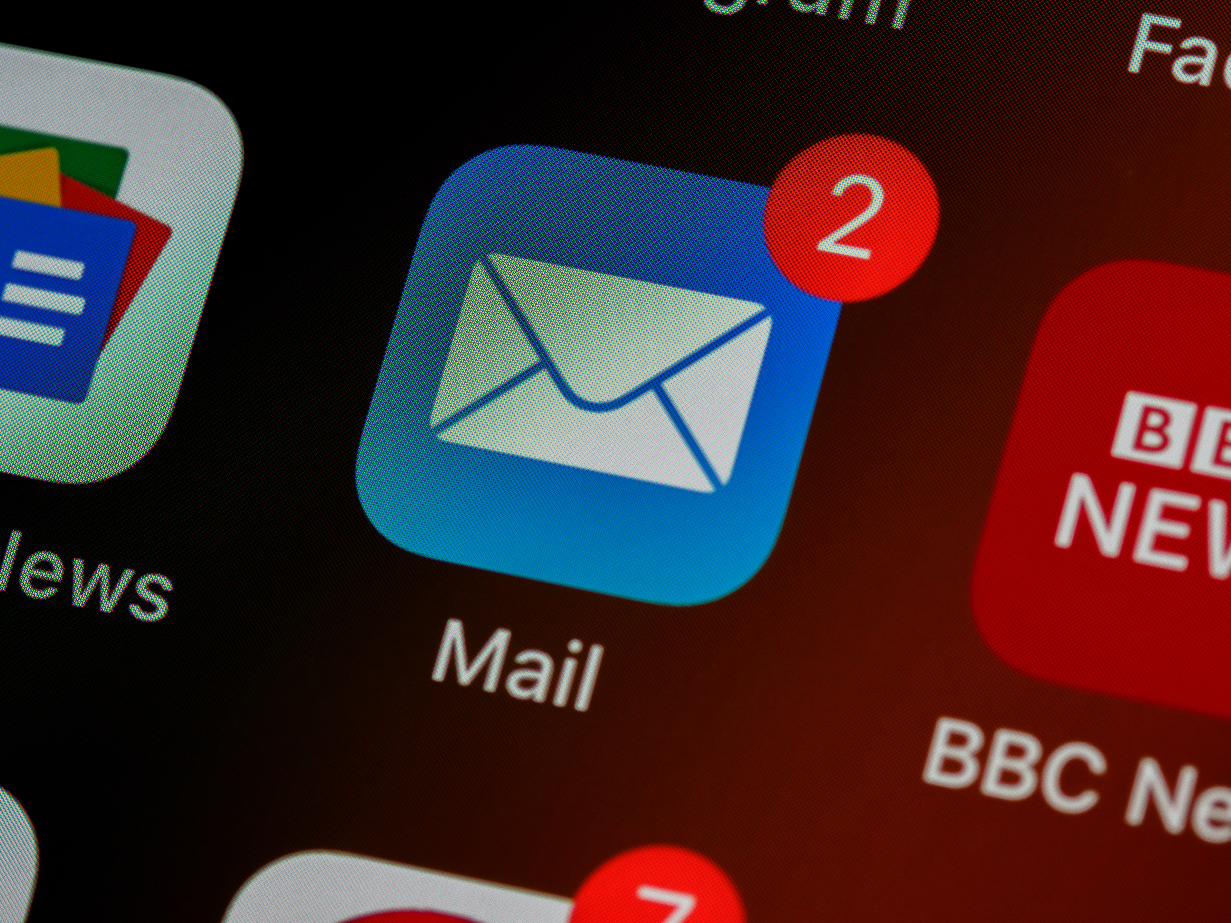
10.2 COMMON MARKETING COMMUNICATION METHODS V
Direct Marketing
Direct marketing activities bypass any intermediaries and communicate directly with the individual consumer. Direct mail is personalized to the individual consumer, based on whatever a company knows about that person’s needs, interests, behaviors, and preferences.
Photo by Brett Jordan, Unsplash
Notes:
Traditional direct marketing activities include mail, catalogs, and telemarketing. The thousands of “junk mail” offers from credit card companies, bankers, and charitable organizations that flood mailboxes every year are artifacts of direct marketing.
Advantages-- Direct marketing can offer significant value to consumers by tailoring their experience in the market to things that most align with their needs and interests.
Disadvantages- Among the leading disadvantages of direct marketing are, not surprisingly, customer concerns about privacy and information security. Data-driven direct marketing might seem a little creepy or even nefarious, and certainly it can be when marketers are insensitive or unethical in their use of consumer data

Slide 11
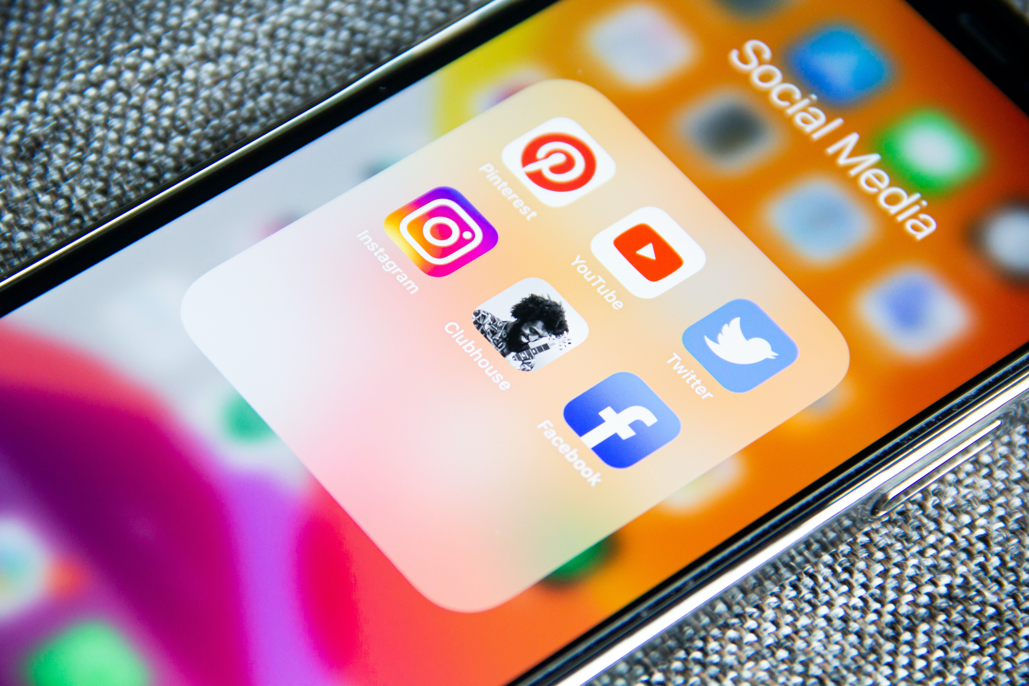
10.2 COMMON MARKETING COMMUNICATION METHODS VI
Digital Marketing
Digital marketing is an umbrella term for using digital tools to promote and market products, services, organizations and brands. As consumers and businesses become more reliant on digital communications, the power and importance of digital marketing have increased.
Photo by Adem AY on Unsplash
Notes:
There are several essential tools in the digital marketing tool kit: email, mobile marketing, websites, content marketing and search-engine optimization (SEO), and social media marketing. For now, we’ll focus on websites and social media.
The advantages and benefits of social media marketing focus heavily on the two-way and even multidirectional communication between customers, prospects, and advocates for your company or brand. By listening and engaging in social media, organizations are better equipped to understand and respond to market sentiment. Social media helps organizations identify and cultivate advocates for its products, services, and brand, including the emergence of customers who can become highly credible, trusted voices to help promote the brand.
Disadvantages- At the same time, digital marketing strategies carry costs and risks. Websites require some investment of time and money to set up and maintain. Organizations should make wise, well-researched decisions about information infrastructure and website hosting, to ensure their sites remain operational with good performance and uptime.

Slide 12
10.3 CHANGES IN PROMOTION I
Global Promotion
Language is usually one element that is customized in a global promotional mix.
For global advertisers, there are four potentially competing business objectives that must be balanced when developing worldwide advertising: building a brand while speaking with one voice, developing economies of scale in the creative process, maximizing local effectiveness of advertisements, and increasing the company’s speed of implementation.
Notes:
Global marketers can use the following approaches when executing global promotional programs: exporting executions, producing local executions, and importing ideas that travel.

Slide 13
10.3 CHANGES IN PROMOTION II
Factors in Global Promotion
Language
Colours
Values
Business norms
Religious beliefs
Notes:
To successfully implement these approaches, brands must ensure their promotional campaigns take into how consumer behavior is shaped by internal conditions (e.g., demographics, knowledge, attitude, beliefs) and external influences (e.g., culture, ethnicity, family, lifestyle) in local markets.
Language– The importance of language differences is extremely crucial in global marketing, as there are almost 3,000 languages in the world. Language differences have caused many problems for marketers in designing advertising campaigns and product labels.
Colours– Colours also have different meanings in different cultures. For example, in Egypt, the country’s national colour of green is considered unacceptable for packaging because religious leaders once wore it.
Values– An individual’s values arise from his or her moral or religious beliefs and are learned through experiences.
Business norms– The norms of conducting business also vary from one country to the next. For example, in France, wholesalers do not like to promote products.
Religious beliefs– A person’s religious beliefs can affect shopping patterns and products purchased in addition to his or her values.
There are many other factors, including a country’s political or legal environment, monetary circumstances, and technological environment that can impact a brand’s promotional mix. Companies have to be ready to quickly respond and adapt to these challenges as they evolve and fluctuate in the market of each country.

Slide 14
10.3 CHANGES IN PROMOTION III
Changing the Global Promotional Mix
When launching global advertising, public relations or sales campaigns, global companies test promotional ideas using marketing research systems that provide results comparable across countries. The ability to identify the elements or moments of an advertisement that contribute to the success of a product launch or expansion is how economies of scale are maximized in marketing communications.
Notes:
Market research measures such as flow of attention, flow of emotion, and branding moments provide insight into what is working in an advertisement in one or many countries. These measures can be particularly helpful for marketers since they are based on visual, not verbal, elements of the promotion.

Slide 15
10.4 Key Terms I
Advertising: Any paid form of presenting ideas, goods, or services by an identified sponsor. Historically, advertising messages have been tailored to a group and employ mass media such as radio, television, newspaper, and magazines. 10.1
Business Norms: The norms of conducting business also vary from one country to the next. For example, in France, wholesalers do not like to promote products. They are mainly interested in supplying retailers with the products they need. 10.3
Colors: Colors also have different meanings in different cultures. For example, in Egypt, the country’s national color of green is considered unacceptable for packaging because religious leaders once wore it. In Japan, black and white are colors of mourning and should not be used on a product’s package. Similarly, purple is unacceptable in Hispanic nations because it is associated with death. 10.3
Digital Marketing: Digital marketing covers a lot of ground, from Web sites to search-engine, content, and social media marketing. Digital marketing tools and techniques evolve rapidly with technological advances, but this umbrella term covers all of the ways in which digital technologies are used to market and sell organizations, products, services, ideas, and experiences. 10.1
Direct Marketing: This method aims to sell products or services directly to consumers rather than going through retailers. Catalogs, telemarketing, mailed brochures, or promotional materials and television home shopping channels are all common traditional direct marketing tools. 10.1
Guerrilla Marketing: This newer category of marketing communication involves unconventional, innovative, and usually low-cost marketing tactics to engage consumers in the marketing activity, generate attention and achieve maximum exposure for an organization, its products, and/or services. Generally guerrilla marketing is experiential. 10.1
Integrated Marketing Communication (IMC): In a nutshell, IMC involves bringing together a variety of different communication tools to deliver a common message and make a desired impact on customers’ perceptions and behavior. 10.1

Slide 16
10.4 Key Terms II
Language: The importance of language differences is extremely crucial in global marketing, as there are almost 3,000 languages in the world. Language differences have caused many problems for marketers in designing advertising campaigns and product labels. Language becomes even more significant if a country’s population speaks several languages. 10.3
Marketing Communication: Includes all the messages, media, and activities used by an organization to communicate with the market and help persuade target audiences to accept its messages and take action accordingly. 10.1
Personal Selling: Personal selling uses people to develop relationships with target audiences for the purpose of selling products and services. Personal selling puts an emphasis on face-to-face interaction, understanding the customer’s needs, and demonstrating how the product or service provides value. 10.1
Promotion Mix: Refers to how marketers combine a range of marketing communication methods to execute their marketing activities. 10.1
Public Relations (PR): The purpose of public relations is to create goodwill between an organization (or the things it promotes) and the “public” or target segments it is trying to reach. 10.1
Religious Beliefs: A person’s religious beliefs can affect shopping patterns and products purchased in addition to his or her values. In the United States and other Christian nations, Christmas time tends to be a major sales period. In other religions, significant religious holidays may or may not serve as popular times for purchasing products. 10.3
Sales Promotion: Sales promotions are marketing activities that aim to temporarily boost sales of a product or service by adding to the basic value offered, such as “buy one get one free” offers to consumers or “buy twelve cases and get a 10 percent discount” to wholesalers, retailers, or distributors. 10.1
Values: An individual’s values arise from his or her moral or religious beliefs and are learned through experiences. For example, Americans place a very high value on material well-being and are much more likely to purchase status symbols than people in India. In India, the Hindu religion forbids the consumption of beef. 10.3

