Slide 1
Global Marketing in a Digital World
CHAPTER 1: INTRODUCTION TO GLOBAL MARKETING
Unless otherwise noted, this work is licensed under a Creative Commons Attribution-NonCommercial-ShareAlike 4.0 International (CC BY-NC-SA 4.0) license. Feel free to use, modify, reuse or redistribute any portion of this presentation.

Slide 2
Learning Outcomes
Upon successful completion of this chapter, you will be able to:
Define global marketing
Define value chain, global value chain and outline components
Explain why firms enter and/or avoid international markets
Explain the difference between domestic marketing, international marketing, export marketing, multinational marketing, and global marketing
Outline the benefits of global marketing to firms and marketing managers
List the challenges and opportunities presented by global markets
Discuss the positive and negative effects of globalization
Describe the flattening world perspective in the globalization debate
Explain the multidomestic perspective in the globalization debate
Compare standardized marketing to localized marketing

Slide 3
1.1 DEFINING GLOBAL MARKETING I
Marketing is an organizational function and a set of processes for creating, communicating, and delivering value to customers and for managing customer relationships in ways that benefit the organization and its stakeholders.
Notes:
A company that engages in global marketing focuses resources on global market opportunities and threats.
Global companies also maintain strategic focus while pursuing competitive advantage.

Slide 4
1.1 DEFINING GLOBAL MARKETING II
At its simplest level, global marketing involves the firm making one or more marketing decisions across national boundaries. At its most complex, it involves the firm establishing manufacturing and marketing facilities overseas and coordinating marketing strategies across markets
Notes:
A firm’s global marketing strategy (GMS) can enhance its worldwide performance. The GMS addresses several issues:
nature of the marketing program in terms of the balance between a standardization (extension) approach to the marketing mix and a localization (adaptation) approach that is responsive to country or regional differences.
concentration of marketing activities in a few countries or the dispersal of such activities across many countries.
a firm’s GMS will address the issue of global market participation.

Slide 5
1.1 DEFINING GLOBAL MARKETING III
Global vs Domestic Marketing
Historically, there has been much discussion over commonalities and differences between global and domestic marketing, but the three most common points of view upon which scholars agree are the following:
All marketing is about the formulation and implementation of the basic policies known as the 4 P’s: Product, Price, Place, and Promotion.
Global marketing, unlike domestic marketing, is understood to be carried out “across borders”.
Global marketing is not synonymous with international trade (Perry, 1990).
Notes:
One of the inevitable questions that surfaces concerning global marketing is, how does global marketing truly differ from domestic marketing, if at all?
3. Perhaps the best way to distinguish between the two is simply to focus on the textbook definition of international marketing. One comprehensive definition states that “international marketing means identifying needs and wants of customers in different markets and cultures, providing products, services, technologies, and ideas to give the firm a competitive marketing advantage, communicating information about these products and services and distributing and exchanging them internationally through one or a

Slide 6
1.2 THE GLOBAL VALUE CHAIN I
Global Value Chain is when an organization does the full range of activities including supply, production, marketing, sales, distribution, and support to the end consumer, across geographical locations to gain competitive advantage
"GVC" by Alyssa Giles, CC BY-NC-SA 4.0
Notes:
When a company evolves into international trade and divide it’s operations across countries, they participate in global value chain.
In simple words, when a company evolves into international trade and divide it’s operations across countries, they participate in global value chain.
Global value chains (GVCs) have brought about revolutionary changes in international trade, industrialization, and economic development. The GVC story is still rapidly unfolding, as vividly demonstrated by the supply chain crisis, particularly for semiconductors and other components, that broke out during the COVID-19 pandemic, causing further anxiety (Alvarez et al, 2021).
Global value chains (GVCs) have brought about revolutionary changes in international trade, industrialization, and economic development. The GVC story is still rapidly unfolding, as vividly demonstrated by the supply chain crisis, particularly for semiconductors and other components, that broke out during the COVID-19 pandemic, causing further anxiety (Alvarez et al, 2021).
Global value chains (GVCs) have brought about revolutionary changes in international trade, industrialization, and economic development. The GVC story is still rapidly unfolding, as vividly demonstrated by the supply chain crisis, particularly for semiconductors and other components, that broke out during the COVID-19 pandemic, causing further anxiety (Alvarez et al, 2021).
Global value chains (GVCs) have brought about revolutionary changes in international trade, industrialization, and economic development. The GVC story is still rapidly unfolding, as vividly demonstrated by the supply chain crisis, particularly for semiconductors and other components, that broke out during the COVID-19 pandemic, causing further anxiety (Alvarez et al, 2021).

Slide 7
1.2 THE GLOBAL VALUE CHAIN II
Global Trade allows countries to expand their markets and access the products which are not available domestically.
Photo by Peter Bond, Unsplash License
Notes:
We live in a global marketplace. Have you ever wondered how is it possible that the products manufactured around the world are available in your nearby supermarket? The answer to such questions is International Trade.

Slide 8
1.2 THE GLOBAL VALUE CHAIN III
Positioning Economies in Global Value Chains
Notes:
With the rise of global value chains (GVCs), patterns of specialization have expanded to cover not only products but also tasks. Indeed, gross trade statistics may lead to the conclusion that an economy has a product specialization when in fact it has a functional specialization.
A case in point is developing countries with major electronics exports, such as the Philippines. These economies do not specialize in electronics, but in a particular segment in the electronics value chain (Timmer, Miroudot, and de Vries 2019).
This figure shows that since the forward GVC length is noticeably longer than the backward GVC length, this economy is positioned relatively upstream in GVCs.

Slide 9
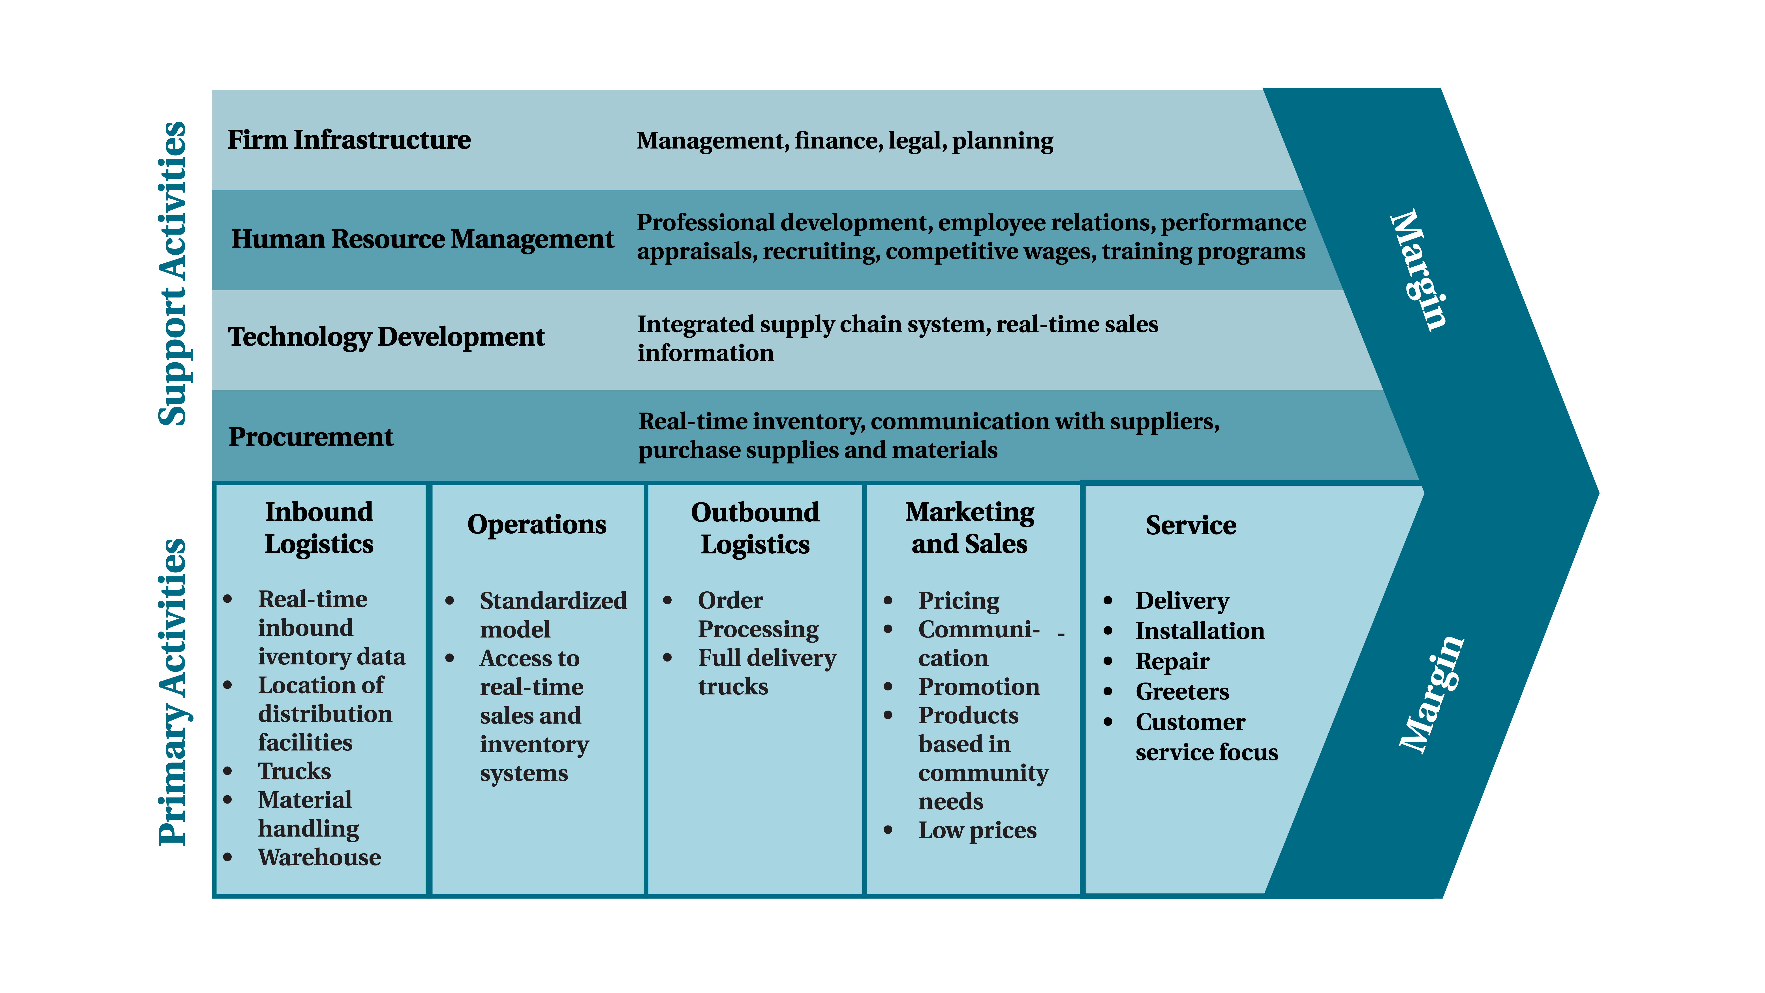
1.2 THE GLOBAL VALUE CHAIN IV
Components of Value Chain
Notes:
The concept of Value Chain is used as an internal assessment tool to help a firm determine where it might be able to achieve a competitive advantage and answering questions as:
In which areas of the primary and secondary activities is the firm particularly strong?
Can that activity be leveraged to provide a competitive advantage over its rivals?
Primary activities are essential for creating value and competitive advantage.
There are 5 components of primary activities:
Inbound Logistics: Inbound logistics refers to the arrival of raw materials.
Operations: Operations refers to the actual production process.
Outbound Logistics: Outbound logistics tracks the movement of finished products to customers.
Marketing and Sales: Attracting potential customers and convincing them to make purchases is the domain of marketing and sales.
Services: Service refers to the extent to which a firm provides assistance to their customers.
Secondary/Support activities help primary activities work efficiently.
There are 4 components of secondary activities.
Firm Infrastructure: Firm infrastructure refers to how the firm is organized and led by executives. The effects of this organizing and leadership can be profound
Human Resource Management: Human resource management is also important. Human resource management involves the recruitment, training, and compensation of employees.
Technology: Technology refers to the use of computerization and telecommunications to support primary activities
Procurement: Procurement is the process of negotiating for and purchasing raw materials.

Slide 10
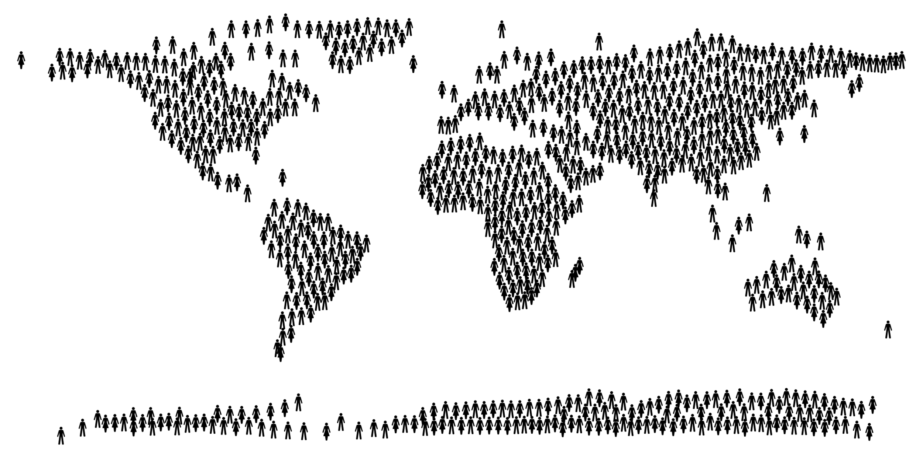
1.3 THE MOTIVATION FOR GLOBAL MARKETING I
Reasons for Entering Global Markets
large market size
stability through diversification
profit potential
unsolicited orders
proximity of market
excess capacity
offer by foreign distributor
increasing growth rate
smoothing out business cycles
"People world Map" by OpenSVG Public Domain License
Notes:
Many marketers have found the international marketplace to be extremely hostile. A study by Barker and Kaynak (1992) for example, found that less than 20 percent of firms in Texas with export potential actually carried out business in international markets. But although many firms view in markets with trepidation, others still make the decision to go international. Why?
In the Barker and Kaynak (1992) study, these are the motivating factors that were given for initiating overseas marketing involvement (in order of importance):

Slide 11
1.3 THE MOTIVATION FOR GLOBAL MARKETING II
Reasons to Avoid International Markets
too much red tape
trade barriers
transportation difficulties
lack of trained personnel
lack of incentives
lack of coordinated assistance
unfavourable conditions overseas
slow payments by buyers
lack of competitive products
payment defaults
language barriers
Notes:
Despite attractive opportunities, most businesses do not enter foreign markets. The reasons given for not going international are numerous. The biggest barrier to entering foreign markets is seen to be a fear by these companies that their products are not marketable overseas and a consequent preoccupation with the domestic market.
The above mentioned points were highlighted by the findings in the previously mentioned study by Barker and Kaynak, who listed the most important barriers:
It is the combination of these factors that determines not only whether companies become involved in international markets, but also the degree of any involvement.

Slide 12
1.4 STAGES IN GLOBAL MARKETING I
Firms typically approach involvement in international marketing rather cautiously, and there appears to exist an underlying lifecycle that has a series of critical success factors that change as a firm moves through each stage. Those stages are:
Domestic Marketing
International Marketing
Export Marketing
Notes:
Two points should be noted: ---The process tends to be ranked in order of “least risk and investment” to “greatest involvement”.
---These are not necessarily sequential steps, even though exporting is apparently most common as an initial entry.
Domestic Marketing- This involves the company manipulating a series of controllable variables, such as price, advertising, distribution, and the product, in a largely uncontrollable external environment that is made up of different economic structures, competitors, cultural values, and legal infrastructure within specific political or geographic country boundaries.
International Marketing- This involves the company operating across several markets in which not only do the uncontrollable variables differ significantly between one market and another, but the controllable factor in the form of cost and price structures, opportunities for advertising, and distributive infrastructure are also likely to differ significantly.
Export Marketing- In this case, the firm markets its goods and/or services across national/political boundaries. In general, exporting is a simple and low risk-approach to entering foreign markets. Firms may choose to export products for several reasons. First, products in the maturity stage of their domestic life cycle may find new growth opportunities overseas, as Perrier chose to do in the US. Second, some firms find it less risky and more profitable to expand by exporting current products instead of developing new products. Third, firms who face seasonal domestic demand may choose to sell their products to foreign markets when those products are “in season” there. Finally, some firms may elect to export products because there is less competition overseas.

Slide 13
1.4 STAGES IN GLOBAL MARKETING II
A firm can export its products in one of three ways: indirect exporting, semi-direct exporting, and direct exporting.
Indirect exporting is a common practice among firms that are just beginning their exporting.
In semi-direct exporting, an American exporter usually initiates the contact through agents, merchant middlemen, or other manufacturers in the US.
When direct exporting is the means of entry into a foreign market, the manufacturer establishes an export department to sell directly to a foreign film.
Notes:
Indirect exporting--Sales, whether foreign or domestic, are treated as domestic sales. All sales are made through the firm’s domestic sales department, as there is no export department. Indirect exporting involves very little investment, as no overseas sales force or other types of contacts need to be developed. Indirect exporting also involves little risk, as international marketing intermediaries have knowledge of markets and will make fewer mistakes than sellers.
Semi-direct exporting- Such semi-direct exporting can be handled in a variety of ways: (a) a combination export manager, a domestic agent intermediary that acts as an exporting department for several non-competing firms; (b) the manufacturer’s export agent (MEA) operates very much like a manufacturer’s agent in domestic marketing settings; (c) a Webb-Pomerene Export Association may choose to limit cooperation to advertising, or it may handle the exporting of the products of the association’s members and;
Direct exporting- The exporting manufacturer conducts market research, establishes physical distribution, and obtains all necessary export documentation. Direct exporting requires greater investment and also carries a greater risk. However, it also provides greater potential return and greater control of its marketing program.

Slide 14
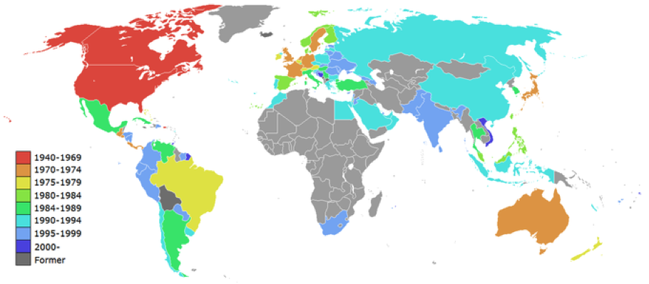
1.5 CHALLENGES OF GLOBAL MARKETING I
McDonald’s locations: Over the last 70 years, McDonald’s has become a global corporation.
Notes:
A global company is generally referred to as a multinational corporation (MNC). An MNC is a company that operates in two or more countries, leveraging the global environment to approach varying markets in attaining revenue generation. These international operations are pursued as a result of the strategic potential provided by technological developments, making new markets a more convenient and profitable pursuit both in sourcing production and pursuing growth.
International operations are therefore a direct result of either achieving higher levels of revenue or a lower cost structure within the operations or value-chain.

Slide 15
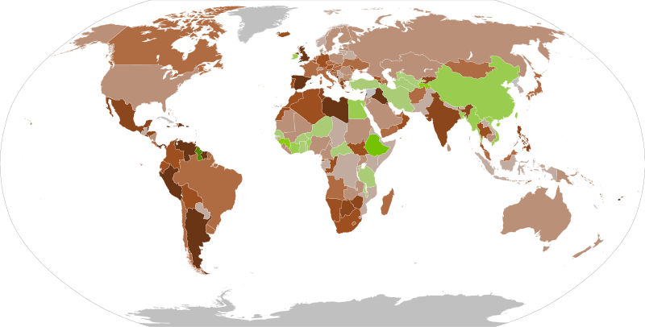
1.5 CHALLENGES OF GLOBAL MARKETING II
Opportunities
Notes:
As gross domestic product (GDP) growth migrates from mature economies, such as the US and EU member states, to developing economies, such as China and India, it becomes highly relevant to capture growth in higher-growth markets.
It is a particularly strong visual representation of the advantages a global corporation stands to capture, where the darker green areas represent where the highest GDP growth potential resides. High growth in the external environment is a strong opportunity for most incumbents in the market.

Slide 16
1.5 CHALLENGES OF GLOBAL MARKETING III
Despite the general opportunities a global market provides, there are significant challenges MNCs face in penetrating these markets. These challenges can loosely be defined through four factors:
Public Relations
Ethics
Organizational Structure
Leadership
Notes:
Public Relations: Public image and branding are critical components of most businesses. Building this public relations potential in a new geographic region is an enormous challenge, both in effectively localizing the message and in the capital expenditures necessary to create momentum.
Ethics: Arguably the most substantial of the challenges faced by MNCs, ethics have historically played a dramatic role in the success or failure of global players. For example, Nike had its brand image hugely damaged through utilizing ‘sweat shops’ and low-wage workers in developing countries. Maintaining the highest ethical standards while operating in developing countries is an important consideration for all MNCs.
Organizational Structure: Another significant hurdle is the ability to efficiently and effectively incorporate new regions within the value chain and corporate structure. International expansion requires enormous capital investments in many cases, along with the development of a specific strategic business unit (SBU) in order to manage these accounts and operations. Finding a way to capture value despite this fixed organizational investment is an important initiative for global corporations.
Leadership: The final factor worth noting is attaining effective leaders with the appropriate knowledge base to approach a given geographic market. There are differences in strategies and approaches in every geographic location worldwide, and attracting talented managers with high intercultural competence is a critical step in developing an efficient global strategy.
Combining these four challenges for global corporations with the inherent opportunities presented by a global economy, companies are encouraged to chase the opportunities while carefully controlling the risks to capture the optimal amount of value. By effectively maintaining ethics and a strong public image, companies should create strategic business units with strong international leadership in order to capture value in a constantly expanding global market.

Slide 17
1.5 CHALLENGES OF GLOBAL MARKETING IV
Globalization
Opportunities
Those in favor of globalization theorize that a wider array of products, services, technologies, medicines, and knowledge will become available and that these developments will have the potential to reach significantly larger customer bases.
Notes:
This means larger volumes of sales and exchange, larger growth rates in GDP, and more empowerment of individuals and political systems through acquiring additional resources and capital. These benefits of globalization are viewed as utilitarian, providing the best possible benefits for the largest number of people.

Slide 18
1.5 CHALLENGES OF GLOBAL MARKETING V
Globalization
Challenges
Along with arguments supporting the benefits of a more globally-connected economy, there are criticisms that question the profits that are captured. Opponents argue that the expansion of global trade creates unfair exchanges between larger and smaller economies, arguing that developed economies capture significantly more value because of financial leverage.
Notes:
Other commonly raised concerns include damage to the environment, decreased food safety, unethical labor practices in sweatshops, increased consumerism, and the weakening of traditional cultural values.

Slide 19
1.6 THE GLOBALIZATION DEBATE I
What is the globalization debate?
Well, it’s not so much a debate as it is a stark difference of opinion on how the internationalization of businesses is affecting countries’ cultural, consumer, and national identities—and whether these changes are desirable.
Notes:
For instance, the ubiquity of such food purveyors as Coca-Cola and McDonald’s in practically every country reflects the fact that some consumer tastes are converging, though at the likely expense of local beverages and foods. Remember, globalization refers to the shift toward a more interdependent and integrated global economy. This shift is fueled largely by:
declining trade and investment barriers
new technologies, such as the Internet. The globalization debate surrounds whether and how fast markets are actually merging together.

Slide 20
1.6 THE GLOBALIZATION DEBATE II
Many people consider globalization a modern phenomenon, but according to Friedman, this is its third stage.
The first stage of global development, what Friedman calls “Globalization 1.0,” started with Columbus’s discovery of the New World and ran from 1492 to about 1800.
“Globalization 2.0,” from about 1800 to 2000, was disrupted by the Great Depression and both World Wars and was largely shaped by the emerging power of huge, multinational corporations.
“Globalization 3.0” began around 2000, with advances in global electronic interconnectivity that allowed individuals to communicate as never before.
Notes:
First stage- Driven by nationalism and religion, this lengthy stage was characterized by how much industrial power countries could produce and apply.
Globalization 2.0 grew with the European mercantile stock companies as they expanded in search of new markets, cheap labor, and raw materials. It continued with subsequent advances in sea and rail transportation. This period saw the introduction of modern communications and cheaper shipping costs.

Slide 21
1.6 THE GLOBALIZATION DEBATE III
We Live in a Multidomestic World, Not a Flat One!
International business professor Pankaj Ghemawat takes strong issue with the view that the world is flat and instead espouses a world he characterizes as “semiglobalized” and “multidomestic.”
Notes:
If the world were flat, international business and global strategy would be easy. According to Ghemawat (2005), it would be domestic strategy applied to a bigger market. In the semiglobalized world, however, global strategy begins with noticing national differences.

Slide 22
1.6 THE GLOBALIZATION DEBATE IV
Ghemawat’s 2005 research suggests that to study “barriers to cross-border economic activity” you will use a “CAGE” analysis. The CAGE framework covers these four factors:
Culture
Administration
Geography
Economics
Notes:
1. Culture. Generally, cultural differences between two countries reduce their economic exchange. Culture refers to a people’s norms, common beliefs, and practices. Cultural distance refers to differences based in language, norms, national or ethnic identity, levels of trust, tolerance, respect for entrepreneurship and social networks, or other country-specific qualities.
2. Administration. Bilateral trade flows show that administratively similar countries trade much more with each other. Administrative distance refers to historical governmental ties, such as those between India and the United Kingdom.
3. Geography. This is perhaps the most obvious difference between countries. You can see that the market for a product in Los Angeles is separated from the market for that same product in Singapore by thousands of miles. Generally, as distance goes up, trade goes down, since distance usually increases the cost of transportation. Geographic differences also include time zones, access to ocean ports, shared borders, topography, and climate.
4. Economics. Economic distance refers to differences in demographic and socioeconomic conditions. The most obvious economic difference between countries is size (as compared by gross domestic product, or GDP). Another is per capita income. This distance is likely to have the greatest effect when (1) the nature of demand varies with income level, (2) economies of scale are limited, (3) cost differences are significant, (4) the distribution or business systems are different, or (5) organizations have to be highly responsive to their customers’ concerns.

Slide 23
1.7 STANDARDIZATION AND CUSTOMIZATION I
Most of the basic principles for effective marketing apply equally well to domestic and global marketing activity. However, globalization introduces a number of challenges that are unique to operating simultaneously in different countries and global markets.
Notes:
In 1983, Harvard marketing professor Theodore Levitt wrote an article entitled, “The Globalization of Markets”, and nothing about marketing has been the same since. According to Levitt, a new economic reality-the emergence of global consumer markets for single standard products-has been triggered in part by technological developments. Worldwide communications ensure the instant diffusion of new lifestyles and pave the way for a wholesale transfer of goods and services.

Slide 24
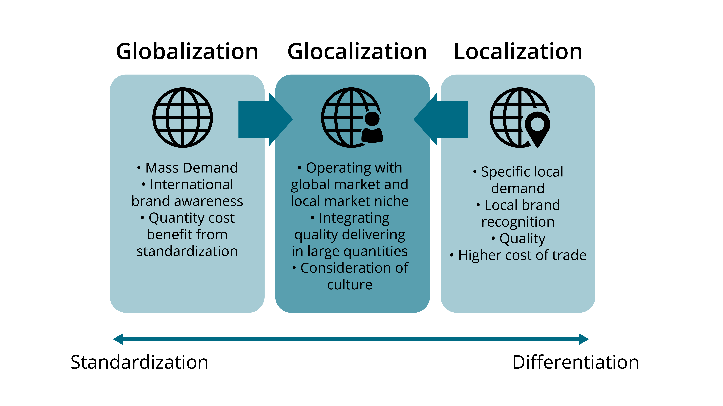
1.7 STANDARDIZATION AND CUSTOMIZATION II
Global Marketing Strategies
Notes:
U.S. firms choose to engage in global marketing for many reasons, the most attractive of which are market expansion and new profit opportunities. When a firm chooses to market internationally, it must decide whether to adjust its domestic marketing program—depending on how much centralized control a firm wishes to maintain over its marketing.
If an organization wants to maintain strong centralized control and uniformity in its products and marketing activities, it is choosing a strategy called standardization.
If an organization wants to adjust products, messaging, and marketing activities to fit the needs and preferences of local markets around the world, it is choosing a localization strategy.

Slide 25
1.7 STANDARDIZATION AND CUSTOMIZATION III
Global Standardization: The Argument for Standardized Marketing
To the extent that global consumers desire standardized products, companies can pursue a global standardization strategy. Using this approach, a product and the way in which it is marketed are largely uniform across the world, with little variation in the marketing mix from country to country.
Notes:
Advocates of standardization strategy argue that companies can achieve competitive advantage by offering the optimal combination of price, quality, and reliability with products that are identical in design and function throughout the world; they also claim that consumers will prefer this standardized product to a highly localized product that is also more expensive.
Standardization can translate into lower operating costs because there aren’t extra costs associated with developing and marketing unique products tailored to local market needs. It also expands the customer base receptive to a common global product.
Marketers can use the same approach for developing, promoting, and delivering products and services worldwide, creating lower operating costs and economies of scale in product development and marketing
The ability to develop and invest in a unified brand and/or company identity throughout the world, along with the opportunity to develop brand awareness and brand equity that give a competitive advantage
Product lines that consist of a small number of global brands rather than a plethora of localized product brands and extensions, along with cost savings and improved efficiencies associated with managing a smaller total number of brands
Companies that pursue this approach assume that consumer needs are relatively homogenousaround the world and that the same basic marketing mix will work across global markets. These organizations typically have a centralized approach to the marketing function and try to minimize the need for developing localized marketing strategies.

Slide 26
1.7 STANDARDIZATION AND CUSTOMIZATION IV
Localization: The Argument to Localize Marketing
On the other end of the spectrum is localization strategy, in which firms adjust their products and marketing mix for each target market. Advocates of localization argue that, in reality, global standardization doesn’t work, and in fact nearly all exported products require one or more adaptations to be successful.
Notes:
In work by Kotler (1986), one study found that 80 percent of U.S. exports require one or more adaptations, and the average product requires at least four to five adaptations out of eleven different elements: labelling, packaging, materials, colors, name, product features, advertising themes, media, execution, price, and sales promotion.
Localization strategy recognizes that diversity exists in global markets and that marketers need to understand and respond to this diversity in the goods they offer and the way they market to consumers in these markets. Language, culture, customs, the physical environment, the degree of economic development, societal institutions, and other factors all contribute to how well a product fits a local market’s needs. Localization may involve:
1) altering existing products to fit the needs of the local target market or
2) creating completely new products to fit the needs of the local target market.
Although localization does increase the cost and complexity associated with developing and marketing tailored products, its supporters argue that it results in products and marketing strategy that are a better fit for local market needs and ultimately a greater sales success. A localized approach can protect companies from high-profile, disastrous consequences when a standardized product fails.
Standardization is often responsible for marketing misfires like offensive marketing images, catastrophic naming, and product-design glitches. Its critics argue that standardization strategy overestimates how well any single, uniform product and marketing approach will succeed in markets all over the world.

Slide 27
1.8 KEY TERMS I
“Globalization 1.0”: The first stage of global development, what Friedman calls “Globalization 1.0,” started with Columbus’s discovery of the New World and ran from 1492 to about 1800. Driven by nationalism and religion, this lengthy stage was characterized by how much industrial power countries could produce and apply. 1.6
“Globalization 2.0”: From about 1800 to 2000, was disrupted by the Great Depression and both World Wars and was largely shaped by the emerging power of huge, multinational corporations. Globalization 2.0 grew with the European mercantile stock companies as they expanded in search of new markets, cheap labour, and raw materials. It continued with subsequent advances in sea and rail transportation. This period saw the introduction of modern communications and cheaper shipping costs. 1.6
“Globalization 3.0”: Began around 2000, with advances in global electronic interconnectivity that allowed individuals to communicate as never before 1.6
Administration: Bilateral trade flows show that administratively similar countries trade much more with each other. Administrative distance refers to historical governmental ties, such as those between India and the United Kingdom. 1.6
Culture: Generally, cultural differences between two countries reduce their economic exchange. Culture refers to a people’s norms, common beliefs, and practices. 1.6
Direct Exporting: Is the means of entry into a foreign market, the manufacturer establishes an export department to sell directly to a foreign film. 1.4
Diversity: Exists in global markets and marketers need to understand and respond to this diversity in the goods they offer and the way they market to consumers in these markets. 1.7

Slide 28
1.8 KEY TERMS II
Domestic Marketing: This involves the company manipulating a series of controllable variables, such as price, advertising, distribution, and the product, in a largely uncontrollable external environment that is made up of different economic structures, competitors, cultural values, and legal infrastructure within specific political or geographic country boundaries. 1.4
Economics: Economic distance refers to differences in demographic and socioeconomic conditions. The most obvious economic difference between countries is size (as compared by gross domestic product, or GDP). 1.6
Economies of Scale: This refers to the situation where, as the quantity of output goes up, the cost per unit goes down. This is the idea behind “warehouse stores” like Costco or Walmart. In everyday language: a larger factory can produce at a lower average cost than a smaller factory. 1.5
Export marketing: A firm can export its products in one of three ways: indirect exporting, semi-direct exporting, and direct exporting 1.4
Firm Infrastructure: Firm infrastructure refers to how the firm is organized and led by executives. The effects of this organizing and leadership can be profound. For example, Ron Joyce’s leadership of the Canadian doughnut shop chain Tim Hortons was so successful that Canadians consume more doughnuts per person than all other countries. 1.2
Global Marketing: Involves the firm making one or more marketing decisions across national boundaries. At its most complex, it involves the firm establishing manufacturing and marketing facilities overseas and coordinating marketing strategies across markets. 1.1
Global Value Chain: This is when an organization does the full range of activities including supply, production, marketing, sales, distribution, and support to the end consumer, across geographical locations to gain a competitive advantage. 1.2

Slide 29
1.8 KEY TERMS III
Gross Domestic Product (GDP): Growth migrates from mature economies, such as the US and EU member states, to developing economies, such as China and India, it becomes highly relevant to capture growth in higher-growth markets. 1.5
Human Resource Management: Human resource management is also important. Human resource management involves the recruitment, training, and compensation of employees. Recent research used data from more than twelve thousand organizations to demonstrate that the knowledge, skills, and abilities of a firm’s employees can act as a strategic resource and strongly influence the firm’s performance (Crook et al., 2011). 1.2
Inbound Logistics: Inbound logistics refers to the arrival of raw materials. 1.2
Increase The Cost and Complexity: Associated with developing and marketing tailored products, its supporters argue that it results in products and marketing strategies that are a better fit for local market needs and ultimately a greater sales success. 1.6
Indirect Exporting: Is a common practice among firms that are just beginning their exporting. Sales, whether foreign or domestic, are treated as domestic sales. All sales are made through the firm’s domestic sales department, as there is no export department. 1.4
International Marketing: This involves the company operating across several markets in which not only do the uncontrollable variables differ significantly between one market and another, but the controllable factor in the form of cost and price structures, opportunities for advertising, and distributive infrastructure are also likely to differ significantly. 1.4
Marketing and Sales: Attracting potential customers and convincing them to make purchases is the domain of marketing and sales. 1.2

Slide 30
1.8 KEY TERMS IV
Operations: Operations refers to the actual production process. 1.2
Outbound Logistics: Outbound logistics tracks the movement of finished products to customers. 1.2
Primary Activities: Are actions that are directly involved in the creation and distribution of goods and services. There are five primary activities in Porter’s Value Chain namely Inbound Logistics, Operations, Outbound Logistics, Marketing & Sales and Services. 1.2
Procurement: Procurement is the process of negotiating for and purchasing raw materials. 1.2
Public Relations: Public image and branding are critical components of most businesses. Building this public relations potential in a new geographic region is an enormous challenge, both in effectively localizing the message and in the capital expenditures necessary to create momentum. 1.5
Secondary Activities: Are not directly involved in the evolution of a product, but instead provide important underlying support for primary activities. Four activities are attributed as Secondary in Porter’s Value Chain namely Infrastructure, Human Resource Management, Technological Development and Procurement. 1.2
Semi-Direct Exporting: An American exporter usually initiates the contact through agents, merchant middlemen, or other manufacturers in the US. Such semi-direct exporting can be handled in a variety of ways. 1.4
Services: Service refers to the extent to which a firm provides assistance to its customers. Voodoo Donuts in Portland, Oregon, has developed a clever website (voodoodoughnut.com) that helps customers understand their uniquely named products, such as the Voodoo Doll, the Texas Challenge, and the Memphis Mafia, and the Dirty Snowball. 1.2
Technology: Technology refers to the use of computerization and telecommunications to support primary activities. 1.2

