Slide 1
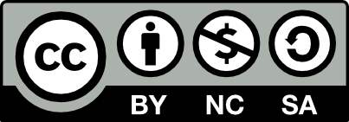
Principles of Marketing
Chapter 9 – Using Supply Chains to Create Value for Customers
Unless otherwise noted, this work is licensed under a Creative Commons Attribution-NonCommercial-ShareAlike 4.0 International (CC BY-NC-SA 4.0) license. Feel free to use, modify, reuse or redistribute any portion of this presentation.

Slide 2
9.1 Sourcing and Procurement
Learning Objectives:
Explain why sourcing and procurement activities are an important part of supply chain management.
Describe the reasons why the use of outsourcing and offshoring has grown.
Explain some of the drawbacks companies face when they outsource their activities.

Slide 3
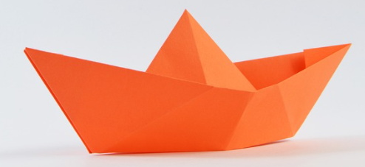
Sourcing and Procurement
Sourcing is the process of evaluating and hiring individual businesses to supply goods and services to your business.
Procurement is the process of actually purchasing those goods and services.
Rather than their own fleets of trucks, ships, and airplanes, most companies outsource at least some of their transportation tasks to shippers such as Roadway and FedEx.
Boat by padrinan is licensed under the Pixabay License

Slide 4
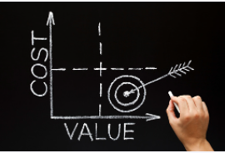
The Growth of Outsourcing and Offshoring
Beginning in the 1990s, companies began to outsource a lot of other activities besides transportation
Their goal was twofold: (1) to lower their costs and
(2) to focus on the activities they do best.
Many “producers” of products no longer produce them at all but outsource their production instead.
Low Cost by IvelinRadkov is licensed under the Pixabay License.

Slide 5
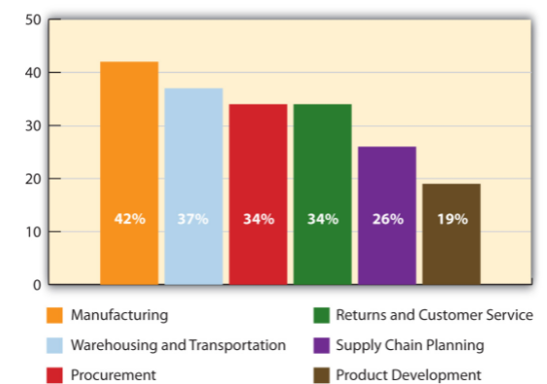
Percentage of Supply Chain Functions Offshored in 2008
Notes:
Outsourcing work to companies abroad is called offshoring. Figure 9.2 “Percentage of Supply Chain Functions Offshored in 2008” shows the percentage of supply chain functions three hundred global manufacturers and service organizations say they now offshore and the percentages these organizations expect to offshore by 2010.

Slide 6
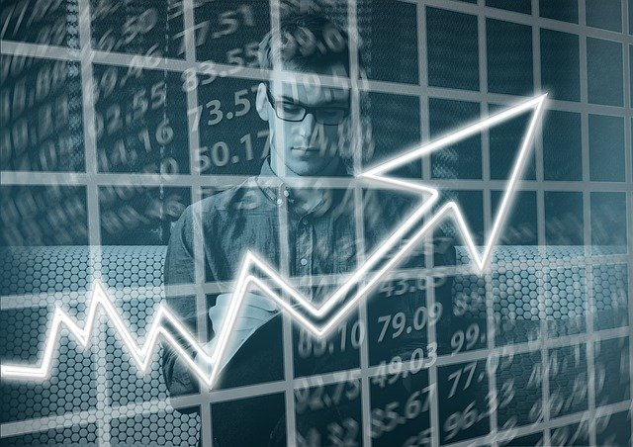
Some of the Ins and Outs of Outsourcing
A company faces a number of trade-offs when it outsources an activity.
The loss of control—particularly when it comes to product quality and safety—is one of them.
The loss of control of their technology is another outsourcing risk that companies face
Trade by geralt is licensed under the Pixabay License.

Slide 7
9.1 Key Takeaway
Sourcing is the process of evaluating and hiring individual businesses to supply goods and services to your business.
Companies outsource activities to lower their costs to focus on the activities they do best.
Companies face numerous trade offs when they outsource activities, which can include a loss of control and product-quality and safety problems.
Customer should be the focus of any insourcing and outsourcing decisions companies make.

Slide 8
9.2 Demand Planning and Inventory Control
Learning Objectives:
Explain why demand planning adds value to products.
Describe the role inventory control plays when it comes marketing products.
List the reasons why firms collaborate with another for the purposes of inventory control and demand planning.

Slide 9
Demand and Planning
Demand planning is the process of estimating how much of a good or service customers will buy from you.
Sourcing decisions—deciding which suppliers to use—are generally made periodically.
Forecasting decisions must be made more frequently—sometimes daily.
Supply chain managers also consult with marketing managers and sales executives when they are generating demand forecasts.
Planning by StartupStockPhotos is licensed under the Pixabay License.

Slide 10
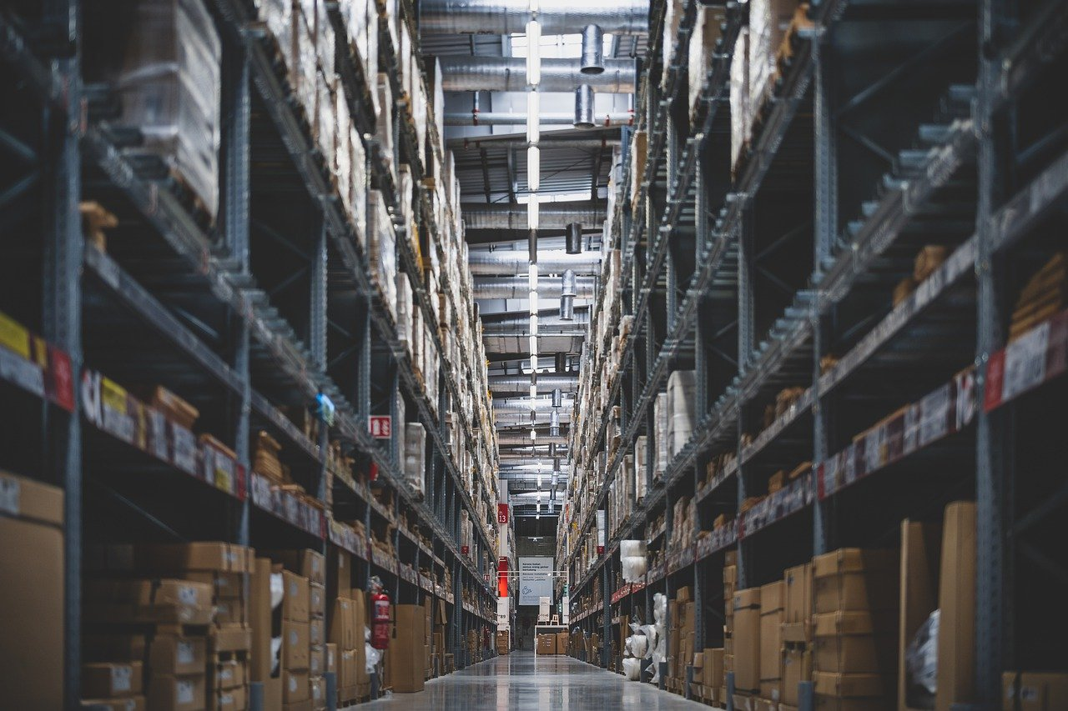
Inventory Control
Demand forecasting is part of a company’s overall inventory control activities.
Inventory control is the process of ensuring your firm has an adequate supply of products and a wide enough assortment of them meet your customers’ needs.
Shelves by tianya1223 is licensed under the Pixabay License.

Slide 11
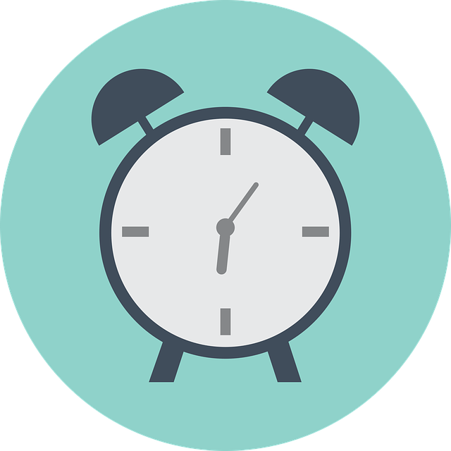
Just-in-Time Inventory Systems
To lower the amount of inventory and still maintain they stock some organizations use just-in-time inventory systems.
Firms with just-in-time inventory systems keep very little inventory on hand.
Instead, they contract with their suppliers to ship them inventory as they need it—and even sometimes manage their inventory for them—a practice called vendor-managed inventory (VMI).
Clock by Memed_Nurrohmad is licensed under the Pixabay License.

Slide 12
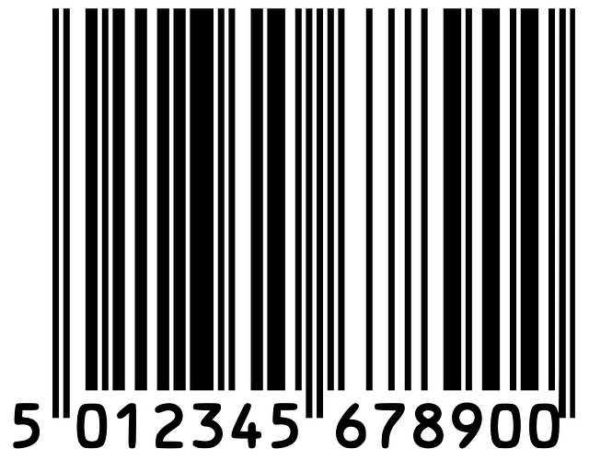
Product Tracking
An electronic product code (EPC) is similar to a barcode, only better, because the number on it is truly unique.
The codes contain information about when the product was manufactured, where they shipped from, and where they were going.
EPC technology can also be used to combat “fake” products, or knockoffs, in the marketplace.
Barcode by OpenClipart-Vectors is licensed under the Pixabay License.

Slide 13
Radio-Frequency Identification (RFID)
Electronic product codes are stored on radio-frequency identification (RFID) tags.
A radio-frequency identification (RFID) tag emits radio signals that can record and track a shipment as it comes in and out of a facility.
If you have unlocked your car door remotely, microchipped your dog, or waved a tollway tag at a checkpoint, you have used RFID technology.

Slide 14
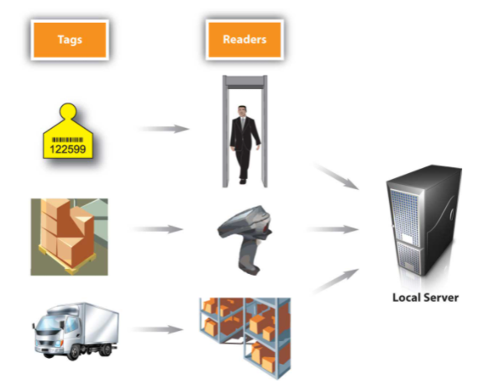
How RFID Tagging Works

Slide 15
9.2 Key Takeaways
Demand forecasting is the process of estimating how much of a good or service a customer will buy from you.
Demand forecasting is part of a company’s overall inventory control activities.
Inventory control is the process of ensuring your firm has an adequate amount of products and a wide enough assortment of them meet your customers’ needs.
One of the goals of inventory control is to avoid stockouts without keeping too much of a product on hand.

Slide 16
9.3 Warehousing and Transportation
Learning Objectives:
Understand the role warehouses and distribution centers play in the supply chain.
Outline the transportation modes firms have to choose from and the advantages and disadvantages of each.

Slide 17
Warehousing
Companies generally maintain a certain amount of safety stock, oftentimes in warehouses.
Some firms store products until their prices increase, oil is an example.
A distribution center is a warehouse or storage facility where the emphasis is on processing and moving goods on to wholesalers, retailers, or consumers

Slide 18
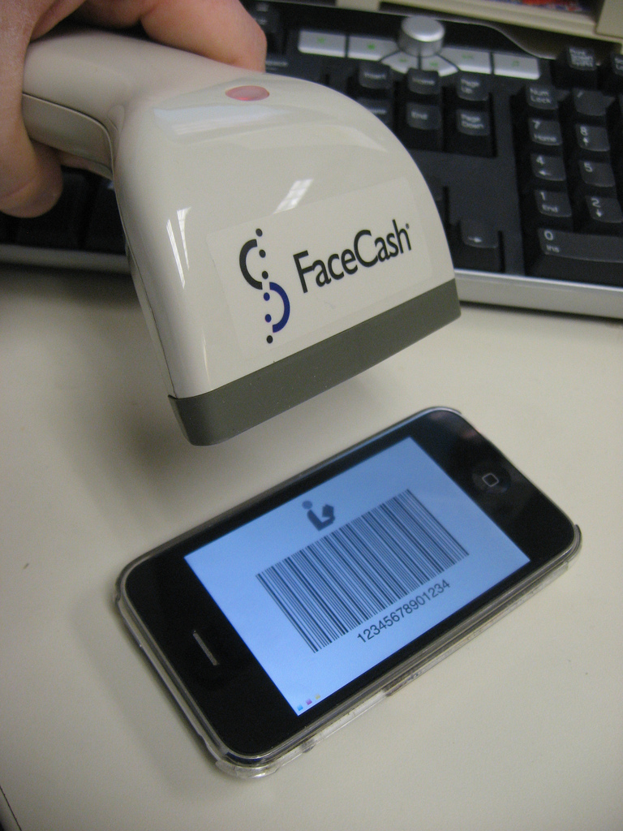
How Warehouses and Distribution Centers Function
Each type of product that is unique because of some characteristic—say, because of its manufacturer, size, color, or model—must be stored and accounted for separate from other items.
To help distinguish it, its manufacturer gives it its own identification number, called a SKU (stock-keeping unit).
Brian Herzog – Scanning – CC BY-NC-SA 2.0.
Notes:
- Figure 9.10 “An Example of an SKU” shows an example of a SKU that appears on a box of products. When the product enters the warehouse, it is scanned and given an “address,” or location, in the warehouse where it is stored until it is plucked from its shelf and shipped.

Slide 19
Modes of Transportation
Trucks
Water
Railroads
Air
Pipeline

Slide 20
Trucks
More products are shipped by truck than by another means.
Trucks can go anywhere there are roads, including straight to customer’s homes.
By contrast, planes, trains, and ships are limited as to where they can go.
Shipping by truck is also fast relative to other modes (except for air transportation).
However, it’s also fairly expensive. Some goods—especially those that are heavy or bulky—would require so many trucks and drivers it would be economically unfeasible to use them over long distances.
Notes:
More products are shipped by truck than by another means. Trucks can go anywhere there are roads, including straight to customer’s homes. By contrast, planes, trains, and ships are limited as to where they can go. Shipping by truck is also fast relative to other modes (except for air transportation). However, it’s also fairly expensive. Some goods—especially those that are heavy or bulky—would require so many trucks and drivers it would be economically unfeasible to use them over long distances. Coal is a good example of such a product. It would take four to five hundred trucks and drivers to haul the amount of freight that one coal train can. The amount of CO₂ emitted by trucks is also high relative to some of the other transportation modes, so it’s not the greenest solution.

Slide 21
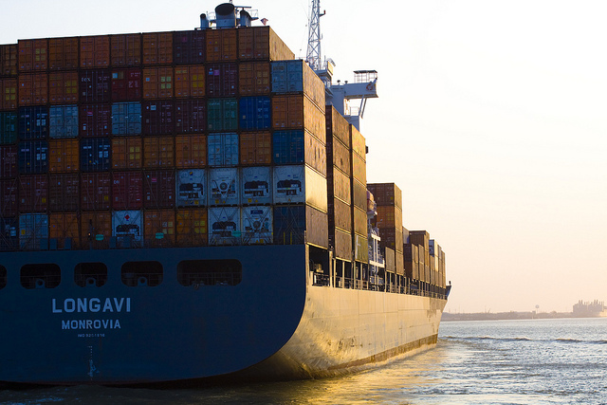
Water
International trade could scarcely be conducted without cargo shipping. Cargo ships transport “loose” cargo such as grain, coal, ore, petroleum, and other mined products. But they also transport consumer products—everything from televisions to toys.
Consumer goods are often shipped in intermodal containers.
Intermodal containers are metal boxes.
Bridget Coila – Cargo into Sunlight – CC BY-SA 2.0.
Pipeline
Notes:
The largest containers are fifty-three feet long and one hundred inches tall. The biggest cargo ships are huge and carry as many 15,000 containers. By contrast, the maximum a train can carry is around 250 containers stacked on top of each other. Figure 9.12 shows a picture of a cargo ship carrying intermodal containers. The good news about shipping via waterway is that inexpensive. The bad news is that it’s very slow. In addition, many markets aren’t accessible by water, so another method of transportation has to be utilized.

Slide 22
Air
Air freight is the fastest way to ship goods.
However, it can easily cost ten times as much to ship a product by air as by sea (Thompson, et. al.).
High-dollar goods and a small fraction of perishable goods are shipped via air. Freshly cut flowers and fresh seafood bound for sushi markets are examples of the latter.
Keeping perishable products at the right temperature and humidity levels as they sit on runways and planes can be a challenge.
Notes:
They often have to be shipped in special types of containers with coolants. Freight forwarders are often hired to arrange the packing for perishables traveling by air and to ensure they don’t deteriorate while they are in transit. Despite the fact that it is expensive, air transportation is growing faster than any other transportation mode, thanks to companies like FedEx.

Slide 23
Railroads
Railroads carry many of the same products as cargo ships—only over land. A significant percentage of intermodal containers offloaded from ships end up on railcars bound for inland destinations. The containers are then are trucked shorter distances to distribution centers, warehouses, and stores. Businesses that need to ship heavy, bulky goods often try to locate their facilities next to railroads. Lumber mills are an example.
In terms of speed and cost, shipping by rail falls somewhere between truck and water transportation. It’s not as slow and inexpensive as moving goods by water. However, it’s not as fast as shipping them by truck. Nor is it as expensive. So, when the price of gasoline rose in to record highs in 2008, shippers that traditionally used trucks began to look at other transportation alternatives such as rail.

Slide 24
Pipelines
Pipelines are generally used to transport oil, natural gas, and chemicals. Two-thirds of petroleum products are transported by pipeline, including heating oil, diesel, jet fuel, and kerosene.
Pipelines are costly to build, but once they are constructed, they can transport products cheaply.
For example, for about one dollar you can transport a barrel of petroleum products via pipeline from Houston to New York.
Pipeline

Slide 25
9.3 Key Takeaways
Some firms store products until their prices increase.
A distribution center is a warehouse or storage facility where the emphasis is on processing and moving goods on to other parts of the supply chain.
Logistics refers to the physical flow of materials in the supply chain.
Products that need to be transported physically to get to customers are moved via, air, rail, truck, water, and pipelines.
The transportation modes a firm uses should be based on what its customers want and are willing to pay for.

Slide 26
9.4 Track and Trace Systems and Reverse Logistics
Learning Objectives:
Understand why being able to trace products is important to organizations and their customers.
Explain what reverse logistics is and why firms utilize it.

Slide 27
9.4 Key Takeaways
Most shippers have track and trace systems that can track product loads.
Tracking individual products, especially after they are combined to make other products, is more difficult.
Reverse logistics is the process of running damaged and defective products and scrap materials backward through the supply chain to extract value from them.
Companies are increasingly employing reverse logistics not only to save money but for environmental reasons.

