Slide 1
Principles of Marketing
Chapter 8 – Using Marketing Channels to Create Value for Customers
Unless otherwise noted, this work is licensed under a Creative Commons Attribution-NonCommercial-ShareAlike 4.0 International (CC BY-NC-SA 4.0) license. Feel free to use, modify, reuse or redistribute any portion of this presentation.

Slide 2
8.1 Marketing Channels and Channel Partners
Learning Objectives:
Explain why marketing channel decisions can result in the success or failure of products.
Understand how supply chains differ from marketing channels.
Describe the different types of organizations that work together as channel partners and what each does.

Slide 3
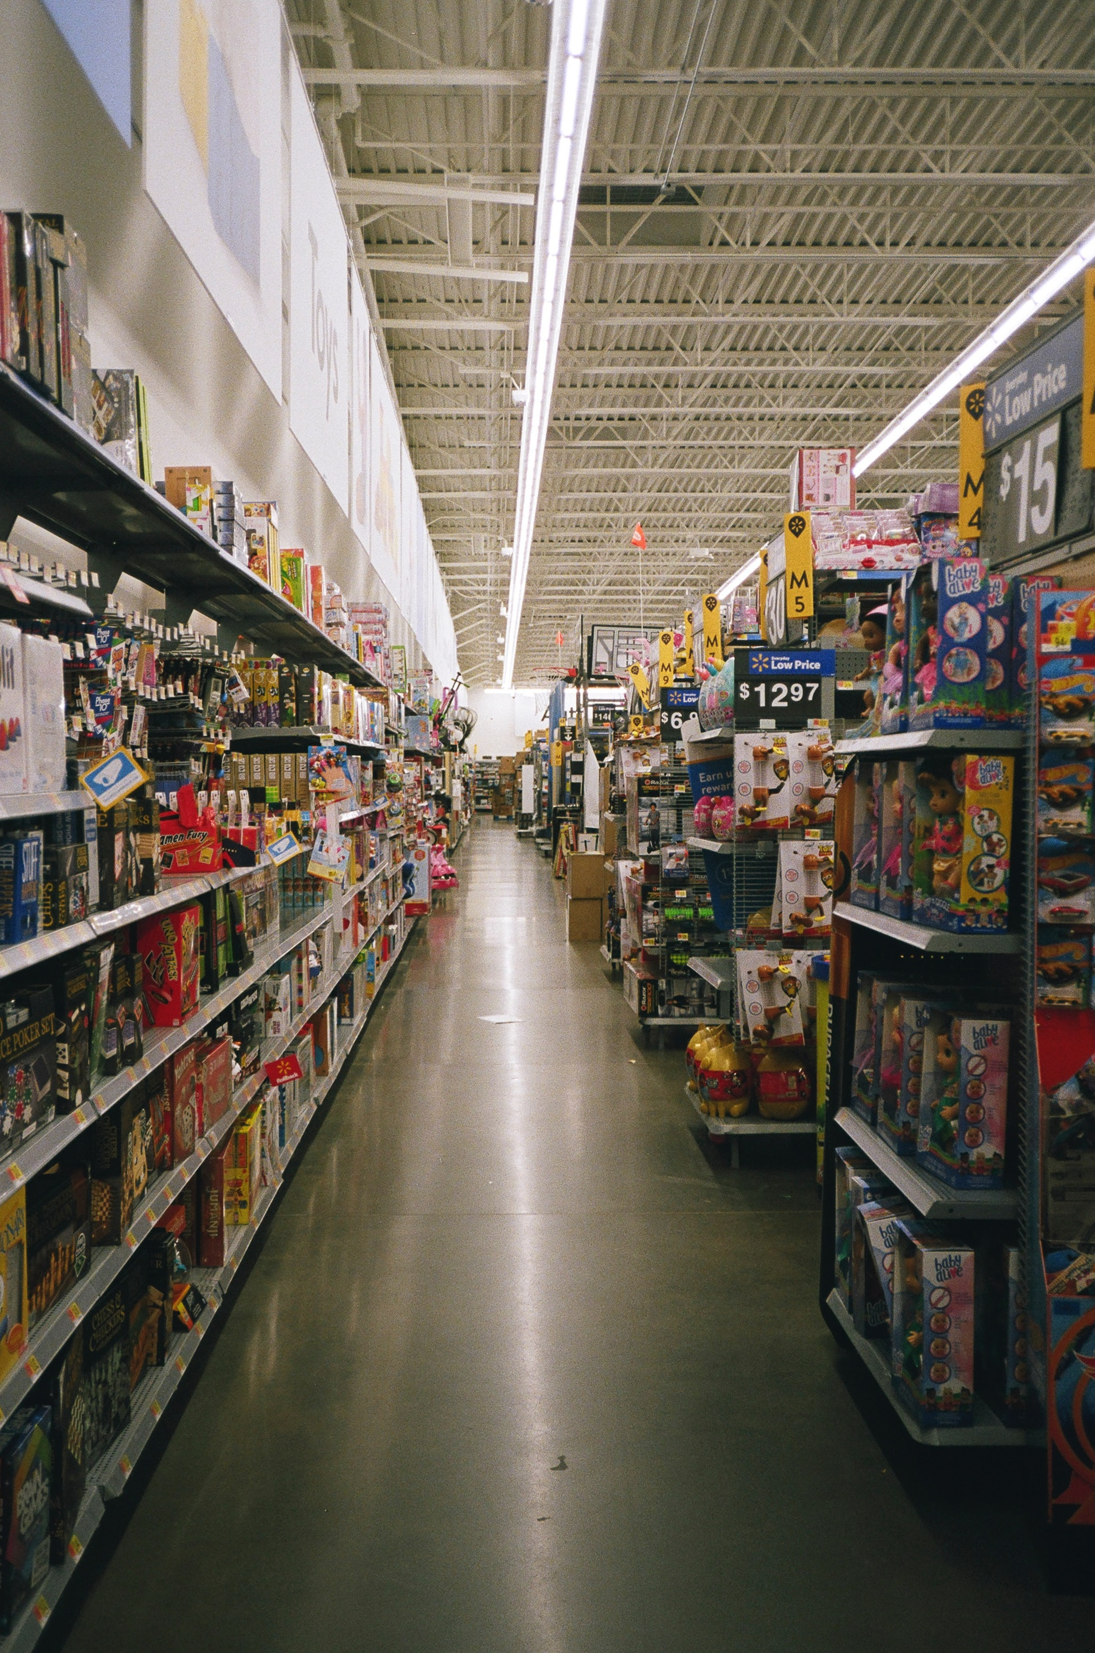
Channel Members, Partners and, Intermediaries
Channel members (or partners). Companies strive to choose not only the best marketing channels but also the best channel partners.
Many other products and services pass through multiple organizations before they get to you. These organizations are called intermediaries (or middlemen or resellers).
Photo by Caique Morais is licensed under the Unsplash License
Notes:
A strong channel partner like Walmart can promote and sell the heck out of a product that might not otherwise turn a profit for its producer. In turn, Walmart wants to work with strong channel partners it can depend on to continuously provide it with great products that fly off the shelves. By contrast, a weak channel partner can be a liability.
Companies partner with intermediaries not because they necessarily want to (ideally they could sell their products straight to users) but because the intermediaries can help them sell the products better than they could working alone. In other words, they have some sort of capabilities the producer needs.

Slide 4
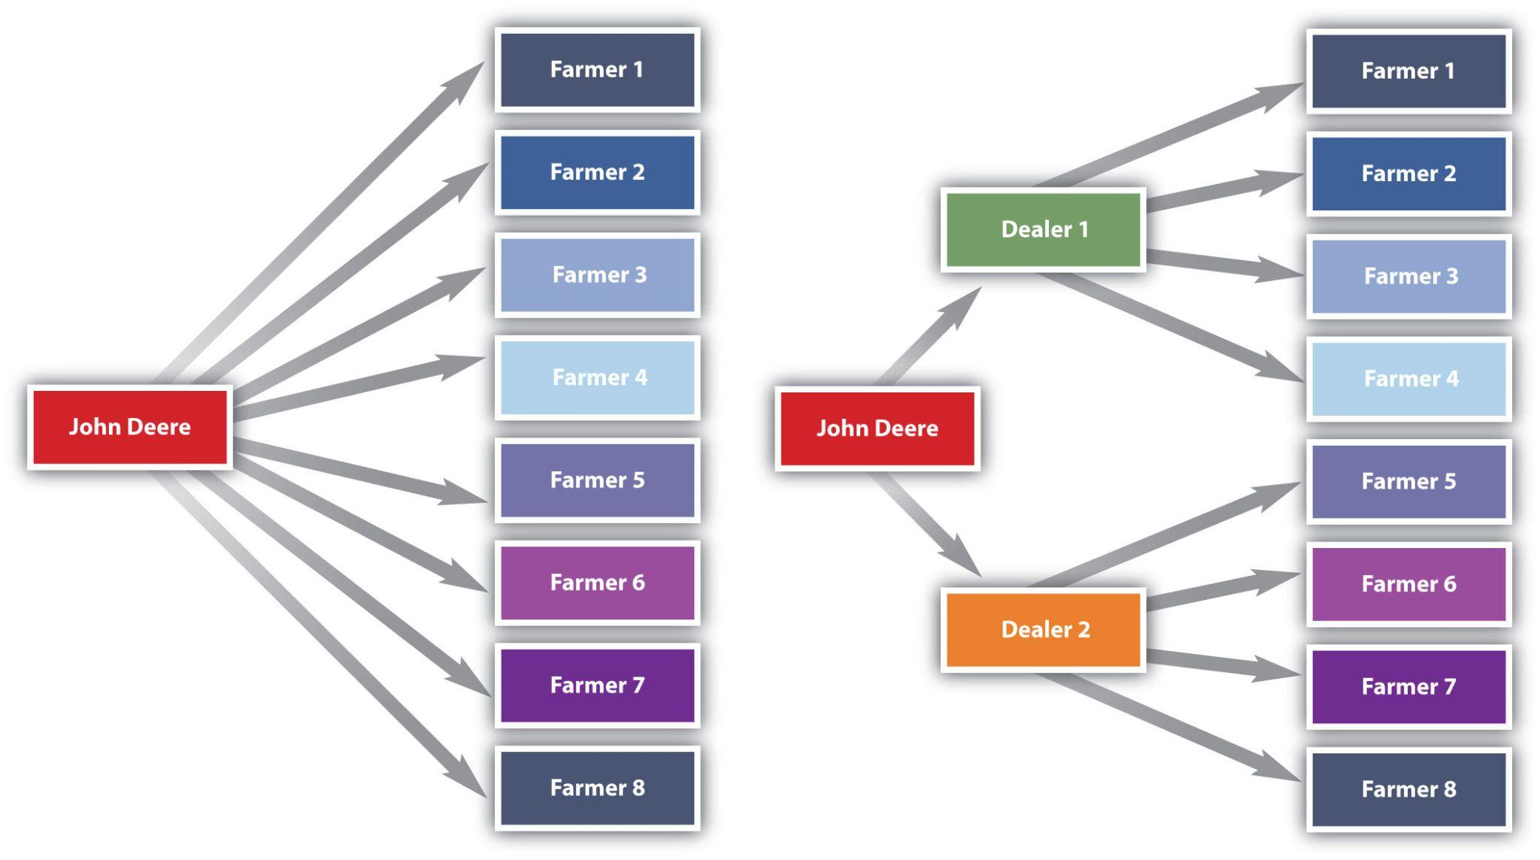
Streamlining Transactions
Notes:
Intermediaries also create efficiencies by streamlining the number of transactions an organization must make, each of which takes time and costs money to conduct. As Figure 8.1 “Using Intermediaries to Streamline the Number of Transactions” shows, by selling the tractors it makes through local farm machinery dealers, the farm machinery manufacturer John Deere can streamline the number of transactions it makes from eight to just two.

Slide 5
Marketing Channels versus Supply Chains
Supply Chain - all of the organizations that figure into any part of the process of producing, promoting, and delivering an offering to its user.
The supply chain includes producers of the raw materials that go into a product.
A product’s supply chain also includes transportation companies such as railroads that help physically move the product
And companies that build websites for other companies.
Supply Chain Management - Firms are constantly monitoring their supply chains and tinkering with them so they’re as efficient as possible.

Slide 6
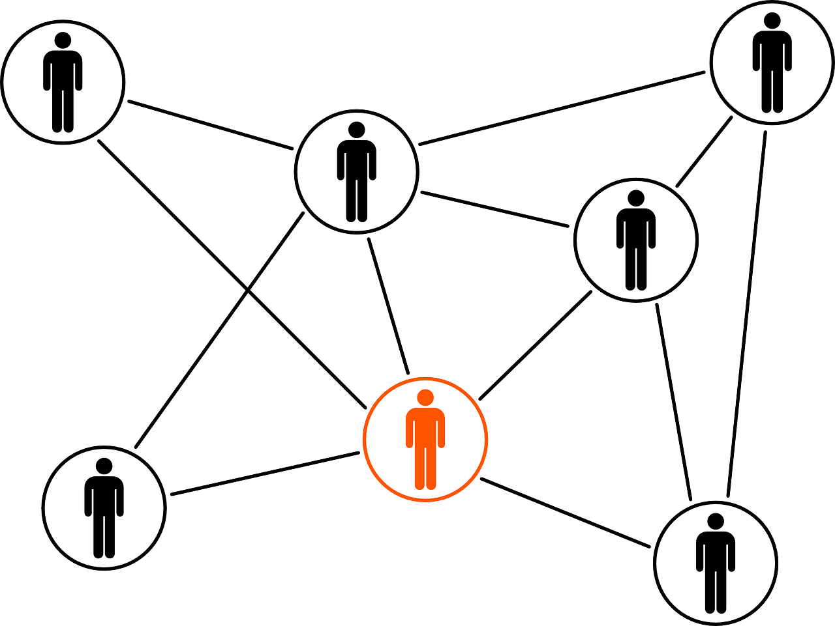
Types of Channel Partners
The two types you hear about most frequently are wholesalers and retailers.
The lines between wholesalers, retailers, and producers have begun to blur considerably.
Many producers have outsourced their manufacturing, and although they still call themselves manufacturers, they act more like wholesalers.
Partners - Free on Pixabay.

Slide 7
Channel Partners
Wholesalers
Agents / Brokers
Retailers

Slide 8
Wholesalers
Wholesalers obtain large quantities of products from producers, store them, and break them down into cases and other smaller units more convenient for retailers to buy, a process called “breaking bulk.”
Wholesalers get their name from the fact that they resell goods “whole” to other companies without transforming the goods.
Some wholesalers carry a wide range of different products.
Others carry narrow ranges of products.
Three types of wholesalers: merchant wholesalers, brokers and manufactures’ agents.

Slide 9
Merchant Wholesalers
Merchant wholesalers are wholesalers that take title to the goods.
They are also sometimes referred to as distributors, dealers, and jobbers.
Includes both full-service wholesalers and limited-service wholesalers.
Full-service wholesalers perform a broad range of services for their customers, such as stocking inventories, operating warehouses, supplying credit to buyers, employing salespeople to assist customers, and delivering goods to customers.
Merchant - Free from Pixabay.

Slide 10
Wholesaler Categories I
Full-service wholesalers perform a broad range of services for their customers, such as stocking inventories, operating warehouses, supplying credit to buyers, employing salespeople to assist customers, and delivering goods to customers.
Limited-service wholesalers offer fewer services to their customers but lower prices. Might not offer delivery services, extend their customers’ credit, or have sales forces that actively call sellers. Cash-and-carry wholesalers are an example.
Drop shippers are another type of limited-service wholesaler. They earn a commission by finding sellers and passing their orders along to producers, who then ship them directly to the sellers.
Mail-order wholesalers sell their products using catalogs instead of sales forces and then ship the products to buyers.
Notes:
Small retailers often buy from cash-and-carry wholesalers to keep their prices as low as big retailers that get large discounts because of the huge volumes of goods they buy.

Slide 11
Wholesaler Categories II
Truck jobbers (or truck wholesalers) actually store products, which are often highly perishable (e.g., fresh fish), on their truck
The trucks make the rounds to customers, who inspect and select the products they want straight off the trucks.
Rack jobbers sell specialty products, such as books, hosiery, and magazines that they display on their own racks in stores.
Retain the title to the goods while the merchandise is in the stores for sale.
Periodically, they take count of what’s been sold off their racks and then bill the stores for those items.
Notes:
Small retailers often buy from cash-and-carry wholesalers to keep their prices as low as big retailers that get large discounts because of the huge volumes of goods they buy.

Slide 12
Brokers
Brokers, or agents, don’t purchase or take title to the products they sell. Their role is limited to negotiating sales contracts for producers. Clothing, furniture, food, and commodities such as lumber and steel are often sold by brokers. Generally paid a commission for what they sell and are assigned to different geographical territories by the producers with whom they work. Because they have excellent industry contacts, brokers and agents are “go-to” resources for both consumers and companies trying to buy and sell products. The most common form of agent and broker consumers encounter are in real estate.
Businessman - Free on Pixabay.
Notes:
Figure 7.5 “New Offering Ideas” shows some product ideas that came from each of the sources we have discussed—employees, customers, suppliers, and one’s competitors. Innovations like the iPhone are rare. However, many new ideas (and consequently new products) aren’t actually new but rather are versions of products and services already available.

Slide 13
Manufacturers’ Sales Offices or Branches
Manufacturers’ sales offices or branches are selling units that work directly for manufacturers.
These are found in business-to-business settings.
For example, Konica-Minolta Business Systems (KMBS) has a system of sales branches that sell KMBS printers and copiers directly to companies that need them.
Sale - Free on Pixabay.
Notes:
In the idea screening stage, the company tries to evaluate the new offering by answering these questions:

Slide 14
Retailers I
Retailers buy products from wholesalers, agents, or distributors and then sell them to consumers. Retailers vary by the types of products they sell, their sizes, the prices they charge, the level of service they provide consumers, and the convenience or speed they offer.
Supermarkets, or grocery stores, are self-service retailers that provide a full range of food products to consumers, as well as some household products.
Convenience stores are miniature supermarkets.

Slide 15
Retailers II
Drugstores specialize in selling over-the-counter medications, prescriptions, and health and beauty products.
Off-price retailers are stores that sell a variety of discount merchandise that consists of seconds, overruns, and the previous season’s stock other stores have liquidated.
A Category killer sells a high volume of a particular type of product and, in doing so, dominates the competition, or “category.” PetSmart and Best Buy are examples.

Slide 16
Retailers III
Specialty stores sell a certain type of product, but they usually carry a deep line of it.
Department stores, by contrast, carry a wide variety of household and personal types of merchandise such as clothing and jewelry.
Superstores are oversized department stores that carry a broad array of general merchandise as well as groceries.
Warehouse clubs are supercenters that sell products at a discount.
Online retailing; party selling; selling to consumers via television, catalogs, and vending machines; and telemarketing are examples of nonstore retailing

Slide 17
Retailers IV
Outlet stores were a new phenomenon at the end of the last century. These were discount retailers that operated under the brand name of a single manufacturer, selling products that couldn’t be sold through normal retail channels due to mistakes made in manufacturing.
Online retailers can fit into any of the previous categories; indeed, most traditional stores also have an online version.
Used retailers are retailers that sell used products.
Pop-up stores are small temporary stores. They can be kiosks or temporarily occupy unused retail space.

Slide 18
8.1 Key Takeaway
How a product moves from raw material to finished good to the consumer is a marketing channel, also called a supply chain.
Marketing channel decisions are as important as the decisions companies make about the features and prices of products.
Channel partners are firms that actively promote and sell a product as it travels through its channel to its user.
Companies try to choose the best channels and channel partners to help them sell products because doing so can give them a competitive advantage

Slide 19
8.2 Typical Marketing Channels
Learning Objectives
Describe the basic types of channels in business-to-consumer (B2C) and business-to-business (B2B) markets.
Explain the advantages and challenges companies face when using multiple channels and alternate channels.
Explain the pros and cons of disintermediation.
List the channels firms can use to enter foreign markets.

Slide 20
Direct Channel and Indirect Channel
Direct Channel: A channel that includes one or more intermediaries—say, a wholesaler, distributor, or broker or agent—is an indirect channel.
Indirect Channel: The product passes through one or more intermediaries. That doesn’t mean the producer will do no marketing directly to consumers. Levi’s runs ads on TV designed to appeal directly to consumers. The makers of food products run coupon ads. However, the seller also has to focus its selling efforts on these intermediaries because the intermediary can help with the selling effort. Not everyone wants to buy Levi’s online.

Slide 21
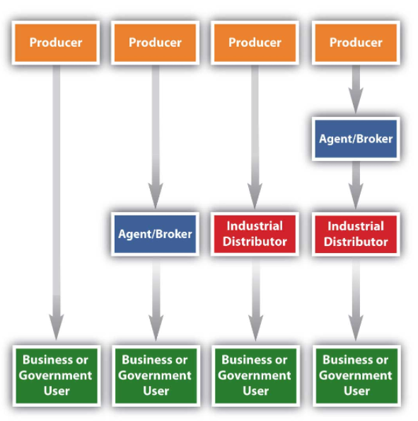
Channels in Business I
Figure 8.4 “Typical Channels in Business-to-Consumer (B2C) Markets” shows the typical channels in business-to-consumer (B2C) markets. As we explained, the shortest marketing channel consists of just two parties—a producer and a consumer. A channel such as this is a direct channel.

Slide 22
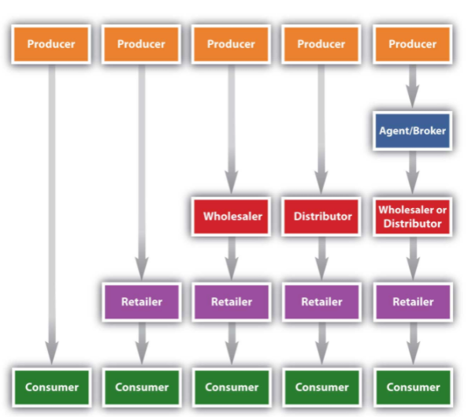
Channels in Business II
Figure 8.5 “Typical Channels in Business-to-Business (B2B) Markets” shows the marketing channels common in business-to-business (B2B) markets. Notice how the channels resemble those in B2C markets, except that the products are sold to businesses and governments instead of consumers like you

Slide 23
Cutting out the Middleman
Scissors - Free on Pixabay.
Large retailers, including Target and Walmart, sometimes bypass middlemen. Instead, they buy their products directly from manufacturers and then store and distribute them to their own retail outlets. However, sometimes cutting out the middleman is desirable but not always. A wholesaler with buying power and excellent warehousing capabilities might be able to purchase, store, and deliver a product to a seller more cheaply than its producer could acting alone.
Likewise, hiring a distributor will cost a producer money. But if the distributor can help the producer sell greater quantities of a product, it can increase the producer’s profits. When you cut out the middlemen you work with, you have to perform the functions they once did.

Slide 24
Disintermediation
Disintermediation – the process of cutting out middlemen/intermediaries, often so products can be sold more cheaply
The Internet has facilitated a certain amount of disintermediation by making it easier for consumers and businesses to contact one another without going through any middlemen.
To remain in business, resellers need to find new ways to add value to products.
For some products, disintermediation via the Internet doesn’t work so well.
Insurance is an example.
You can buy it online directly from companies, but many people want to buy through an agent they can talk to for advice.
Sometimes it’s simply impossible to cut out middlemen.

Slide 25
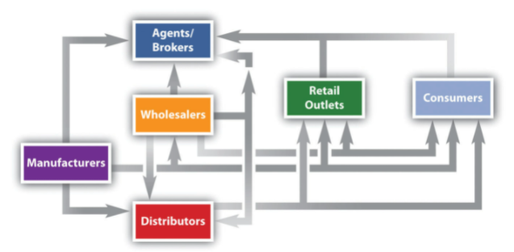
Multiple Channels and Alternate Channels
Notes:
Marketing channels can get a lot more complex than the channels
Notice how in some situations, a wholesaler will sell to brokers, who then sell to retailers and consumers. In other situations, a wholesaler will sell straight to retailers or straight to consumers. Manufacturers also sell straight to consumers, and, as we explained, sell straight to large retailers like Target.

Slide 26
International Marketing Channels
Consumer and business markets in North America are well developed and growing slowly
The opportunities for growth abound in other countries.
Some third-world countries lack good intermediary systems. In these countries, firms are on their own in terms of selling and distributing products downstream to users.
Other countries have elaborate marketing channels that must be navigated.
Corruption and unstable governments also make it difficult to do business in some countries.

Slide 27
8.2 Key Takeaway
A direct marketing channel consists of just two parties—a producer and a consumer.
A channel that includes one or more intermediaries (wholesaler, distributor, or broker or agent) is an indirect channel.
Firms often utilize multiple channels to reach more customers and increase their effectiveness.
Other companies look for ways to cut out the middlemen from the channel, a process known as disintermediation.
Notes:
Direct foreign investment, joint ventures, exporting, franchising, and licensing are some of the channels by which firms attempt to enter foreign markets.

Slide 28
8.3 Functions Performed by Channel Partners
Learning Objectives:
Describe the activities performed in channels.
Explain which organizations perform which functions

Slide 29
Disseminate Marketing Communications and Promote Brands
Somehow wholesalers, distributors, retailers, and consumers need to be informed—via marketing communications—that an offering exists and that there’s a good reason to buy it.
Sometimes, a push strategy is used to help marketing channels accomplish this.
A Push strategy is one in which a manufacturer convinces wholesalers, distributors, or retailers to sell its products.
Consumers are informed via advertising and other promotions that the product is available for sale, but the main focus is to sell to intermediaries.
The problem with a push strategy is that it doesn’t focus on the needs of the actual users of the products

Slide 30
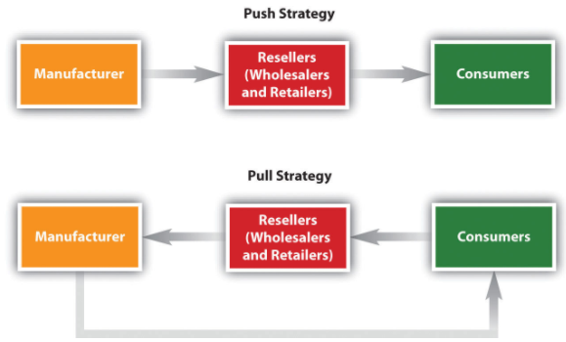
Push/Pull Strategy
A push strategy is one in which a manufacturer convinces wholesalers, distributors, or retailers to sell its products.
A pull strategy focuses on creating demand for a product among consumers so that businesses agree to sell the product
Notes:
Figure 8.12: A Push versus a Pull Strategy

Slide 31
Sorting and Regrouping Products
Many businesses don’t want to receive huge quantities of a product.
One of the functions of wholesalers and distributors is to break down large quantities of products into smaller units and provide an assortment of different products to businesses.
Sorting - Free on Pixabay.

Slide 32
Storing and Managing Inventory
If a channel member has run out of a product when a customer wants to buy it, the result is often a lost sale.
That’s why most channel members stock, or “carry,” reserve inventory
Storing products is not free.
Warehouses cost money to build or rent and heat and cool; employees have to be paid to stock shelves, pick products, ship them, and so forth.
Some companies, including Walmart, put their suppliers in charge of their inventory.
Storage also involves storing commodities like grain prior to processing

Slide 33
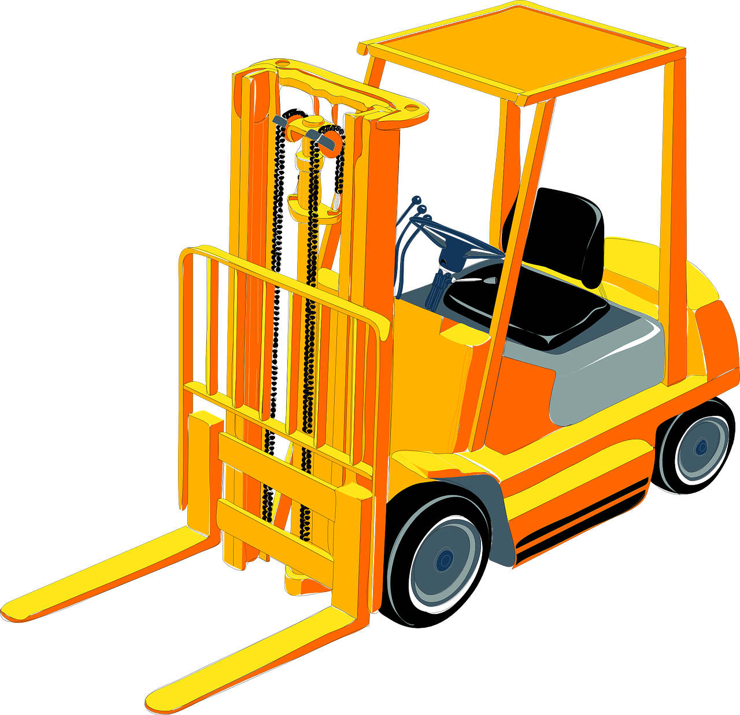
Distributing Products
Physical goods that travel within a channel need to be moved from one member to another and sometimes back again.
Some large wholesalers, distributors, and retailers own their own fleets of trucks for this purpose.
In other cases, they hire third-party transportation providers—trucking companies, railroads, and so forth—to move their products.
They want to know where their products are at all times and what shape they are in.
Losing inventory or having it damaged or spoiled can wreak havoc on a company’s profits
Distribution - Free on Pixabay.
Notes:
Being able to track merchandise like you can track a FedEx package is extremely important to channel partners.

Slide 34
Assume Ownership Risk and Extend Credit
If products are damaged during transit, one of the first questions asked is who owned the product at the time.
It is distributed among channel members depending on the contracts they have with one another and their free on board provisions.
A free on board (FOB) provision designates who is responsible for what shipping costs and who owns the title to the goods and when.
The type of product, the demand for it, marketing conditions, and the clout of the various organizations in its marketing channel can affect the contract terms channel members are willing to agree to.
Some companies try to wait as long as possible to take ownership of products so they don’t have to store them.

Slide 35
Share Marketing and Other Information
Each of the channel members has information about the demand for products, trends, inventory levels, and what the competition is doing.
The information is valuable and can be doubly valuable if channel partners trust one another and share it.
That said, confidentiality is a huge issue among supply chain partners because they share so much information with one another, such as sales and inventory data.
Many business buyers require their channel partners to sign nondisclosure agreements or make the agreements part of purchasing contracts.
A nondisclosure agreement (NDA) is a contract that specifies what information is proprietary, or owned by the partner, and how, if at all, the partner can use that information.

Slide 36
8.3 Key Takeaway
Different organizations in a marketing channel are responsible for different value-adding activities.
These activities include disseminating marketing communications and promoting brands, sorting and regrouping products, storing and managing inventory, distributing products, assuming the risk of products, and sharing information.

Slide 37
8.4 Marketing Channel Strategies
Learning Objectives:
Describe the factors that affect a firm’s channel decisions.
Explain how intensive, exclusive, and selective distribution differ from one another.
Explain why some products are better suited to some distribution strategies than others.

Slide 38
Intensity of Distribution
Intensive Distribution
Selective Distribution
Exclusive Distribution

Slide 39
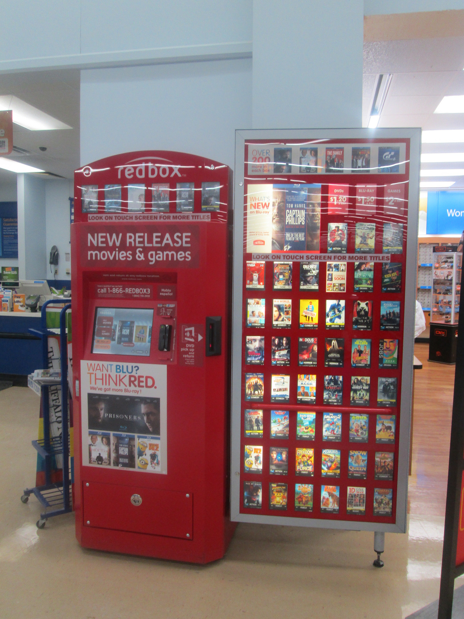
Intensive Distribution
Intensive Distribution strategy try to sell their products in as many outlets as possible. Intensive distribution strategies are often used for convenience offerings—products customers purchase on the spot without much shopping around. Soft drinks and newspapers are an example.
Random Retail – I Knew I Saw a Red Redbox – CC BY 2.0.

Slide 40
Selective Distribution
Selective Distribution involves selling products at select outlets in specific locations. For instance, Sony TVs can be purchased at a number of outlets such as Circuit City, Best Buy, or Walmart, but the same models are generally not sold at all the outlets.
Photo by Dario is licensed under the Unsplash License

Slide 41
Exclusive Distribution
Exclusive distribution involves selling products through one or very few outlets. Most students often think exclusive means high priced, but that’s not always the case. Exclusive simply means limiting distribution to only one outlet in any area, and can be a strategic decision based on applying the scarcity principle to creating demand.
Photo by Melanie Pongratz is licensed under the Unsplash License

Slide 42
Channel Selection Factors
Selecting the best marketing channel is critical because it can mean the success or failure of your product.
One of the reasons the Internet has been so successful as a marketing channel is because customers get to make some of the channel decisions themselves.
They can shop virtually for any product in the world when and where they want to, as long as they can connect to the Web.
They can also choose how the product is shipped.

Slide 43
Type of Customer
How your customers want to buy products will have an impact on the channel you select.
It should be your prime consideration.
When businesses buy expensive products such as machinery and computers or products that have to be customized, they generally expect to be sold to personally via salespeople.
And often they expect special payment term.
Customer - Free on Pixabay.

Slide 44
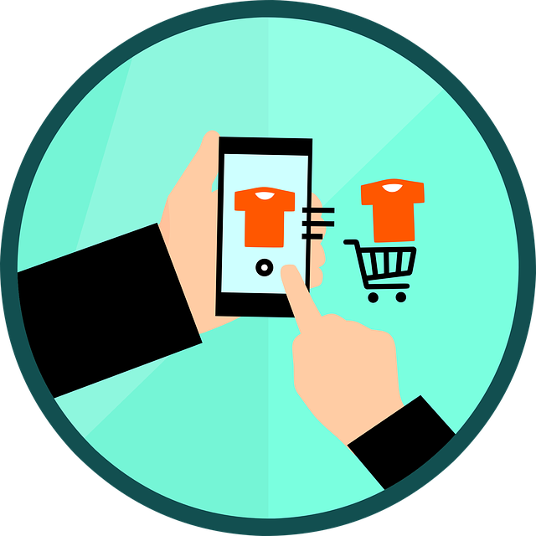
Type of Product
The type of product you’re selling will also affect your marketing channel choices.
Perishable products often have to be sold through shorter marketing channels than products with longer shelf lives.
canned tuna can be shipped by “slow boat” and handled by more intermediaries.
Valuable and fragile products also tend to have shorter marketing channels.
Automakers generally sell their cars straight to car dealers (retailers) rather than through wholesalers.
Customer - Free on Pixabay.

Slide 45
Channel Partner Capabilities
Your ability versus the ability of other types of organizations that operate in marketing channels can affect your channel choices.
If you produce downloadable products like digital books or recordings, you can sell your products straight to customers on the Internet.
Now you want to get the product into retail stores like Target, Walgreens, and Bed Bath & Beyond.
If you can get the product into these stores, you can increase your sales exponentially.
Customer - Free on Pixabay.
Notes:
In this case, you might want to contract with an intermediary—perhaps an agent or a distributor who will convince the corporate buyers of those stores to carry your product.

Slide 46
The Business Environment and Technology
The general business environment, such as the economy, can also affect the marketing channels chosen for products.
When the dollar falls, products imported from other countries cost more to buy relative to products produced and sold in the United States.
Products “made in China” become less attractive because they have gotten more expensive.
As a result, some companies then look closer to home for their products and channel partners.
Technological changes affect marketing channels
a company selling on the Internet has a digital footprint, or record, of what shoppers look at, or click on, at its site
As a result, it can recommend products they appear to be interested in and target them with special offers and even prices.

Slide 47
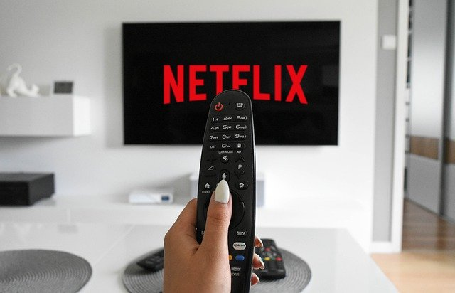
Competing Products’ Marketing Channels
How your competitors sell their products can also affect your marketing channels.
You don’t always have to choose the channels your competitors rely on, though.
Netflix is an example.
Netflix turned the video rental business on its head by coming up with a new marketing channel that better meets the needs of many consumers.
Beginning with direct mail and then moving to Internet delivery, Netflix (along with competitor Hulu) may end up revolutionizing the way television is watched
Netflix - Free on Pixabay.

Slide 48
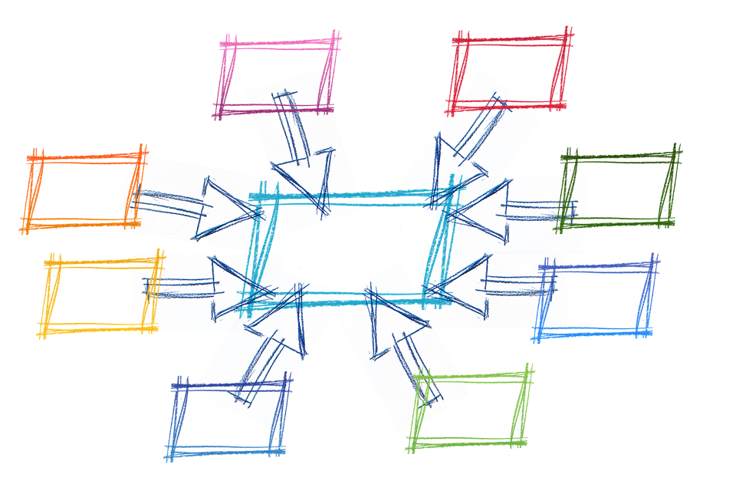
Factors That Affect a Product’s Intensity of Distribution
Firms that choose an intensive distribution strategy try to sell their products in as many outlets as possible.
Intensive distribution strategies are often used for convenience offerings—products customers purchase on the spot without much shopping around.
Soft drinks and newspapers are an example.
You see them sold in all kinds of different places.
Distribution - Free on Pixabay.

Slide 49
8.4 Key Takeaway
Selecting the best marketing channel is critical because it can mean the success or failure of your product.
The type of customer you’re selling to will have an impact on the channel you select. This should be your prime consideration.
The type of product, your organization’s capabilities versus those of other channel members, the way competing products are marketed, and changes in the business environment and technology can also affect your marketing channel decisions.
An intensive distribution strategy involves selling a product in as many outlets as possible.
Selective distribution involves selling a product at select outlets in specific locations.
Exclusive distribution involves selling a product through one or very few outlets.

Slide 50
8.5 Channel Dynamics
Learning Objectives:
Explain what channel power is and the types of firms that wield it.
Describe the types of conflicts that can occur in marketing channels.
Describe the ways in which channel members achieve cooperation with one another.

Slide 51
Channel Dynamics
Channel Power
Channel Conflict
Channel Cooperation
Channel Integration

Slide 52
Channel Power
Strong channel partners often wield what’s called channel power and are referred to as channel leaders, or channel captains.
More often today, big retailers like Walmart and Target are commanding more channel power.
They have millions of customers and are bombarded with products wholesalers and manufacturers want them to sell.
As a result, these retailers increasingly are able to call the shots.
Category killers are in a similar position.
Consumers like you are gaining marketing channel power, too.
Regardless of what one manufacturer produces or what a local retailer has available, you can use the Internet to find whatever product you want at the best price available and have it delivered when, where, and how you want.

Slide 53
Channel Conflict
A dispute among channel members is called a channel conflict.
Channel conflicts are common.
Part of the reason for this is that each channel member has its own goals, which are unlike those of any other channel member.
All channel members want to have low inventory levels but immediate access to more products.
Wholesalers and retailers frequently lament that the manufacturers they work with aren’t doing more to promote their products—for example, distributing coupons for them, running TV ads, and so forth—so they will move off store shelves more quickly.
Channel conflicts can also occur when manufacturers sell their products online.
When they do, wholesalers and retailers often feel like they are competing for the same customers when they shouldn’t have to.

Slide 54
Vertical versus Horizontal Conflict
The conflicts we’ve described so far are examples of vertical conflict.
A vertical conflict is conflict that occurs between two different types of members in a channel—say, a manufacturer, an agent, a wholesaler, or a retailer.
By contrast, a horizontal conflict is conflict that occurs between organizations of the same type—say, two manufacturers that each want a powerful wholesaler to carry only its products.
Horizontal conflict can be healthy because it’s competition driven. But it can create problems, too.
Channel leaders like Walmart usually have a great deal of say when it comes to how channel conflicts are handled.
A manufacturer with channel power still needs good retailers to sell its products; a retailer with channel power still needs good suppliers from which to buy products.

Slide 55
Achieving Channel Cooperation Ethically
Oftentimes companies produce informational materials and case studies showing their partners how they can help boost their sales volumes and profits.
Channel partners also want to feel assured that the products coming through the pipeline are genuine and not knockoffs and that there will be a steady supply of them.
Your goal is to show your channel partners that you understand issues such as these and help them generate business.
Producing marketing and promotional materials their channel partners can use for sales purposes can also facilitate cooperation among companies.
In-store displays, brochures, banners, photos for Websites, and advertisements the partners can customize with their own logos and company information are examples.

Slide 56
Channel Integration: Vertical and Horizontal Marketing Systems
Another way to foster cooperation in a channel is to establish a vertical marketing system.
In a vertical marketing system, channel members formally agree to closely cooperate with one another.
A vertical marketing system can also be created by one channel member taking over the functions of another member; this is a form of disintermediation known as vertical integration.
Backward integration occurs when a company moves upstream in the supply chain—that is, toward the beginning.
A horizontal marketing system is one in which two companies at the same channel level—say, two manufacturers, two wholesalers, or two retailers—agree to cooperate with another to sell their products or to make the most of their marketing opportunities, and is sometimes called horizontal integration.

Slide 57
8.5 Key Takeaway
Channel partners that wield channel power are referred to as channel leaders.
A dispute among channel members is called a channel conflict.
Vertical conflict is one that occurs between two different types of members in a channel.
By contrast, a horizontal conflict is one that occurs between organizations of the same type.
Channel leaders are often in the best position to resolve channel conflicts.
Vertical and horizontal marketing systems can help foster channel cooperation, as can creating marketing programs to help a channel’s members all generate greater revenues and profits.

