Slide 1
Principles of Marketing
Chapter 6 – Creating Offerings
Unless otherwise noted, this work is licensed under a Creative Commons Attribution-NonCommercial-ShareAlike 4.0 International (CC BY-NC-SA 4.0) license. Feel free to use, modify, reuse or redistribute any portion of this presentation.

Slide 2
6.1 What Composes an Offering?
Learning Objectives:
Distinguish between the three major components of an offering—product, price, and service.
Explain, from both a product-dominant and a service-dominant approach, the mix of components that compose different types of offerings.
Distinguish between technology platforms and product lines.

Slide 3
6.1 What Composes an Offering Continued
Product, Price and Service
Most offerings consist of a product, or a tangible good people can buy, sell, and own.
A service is an action that provides a buyer with an intangible benefit. A haircut is a service
Services usually also require the consumer to be physically present or involved.
Service Reception Official - Free image on Pixabay

Slide 4
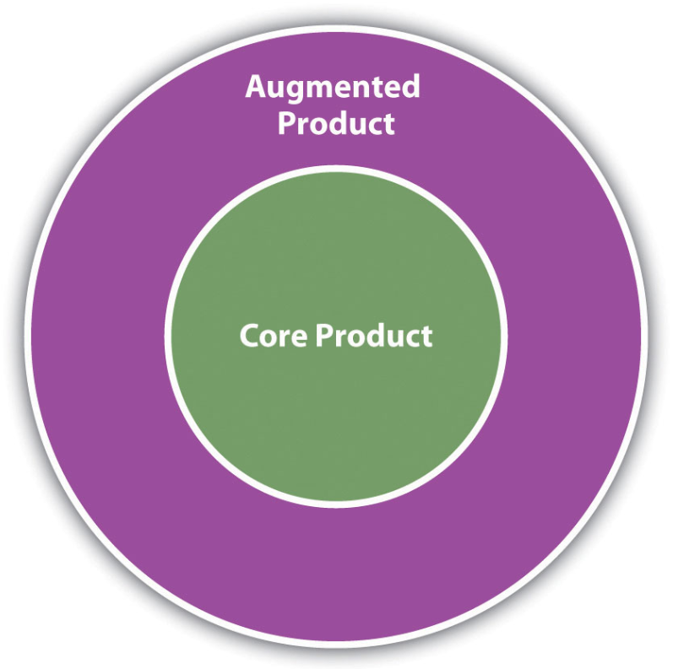
6.1 Augmented and Core Product
The physical product, in this case an iPod, is the core product. Surrounding it are services and accessories, called the augmented product, that support the core product.
Together, these make up the complete product. One limitation of this approach has already been mentioned; price is left out. But for many “pure” products, this conceptualization can be helpful in bundling different augmentations for different markets.

Slide 5
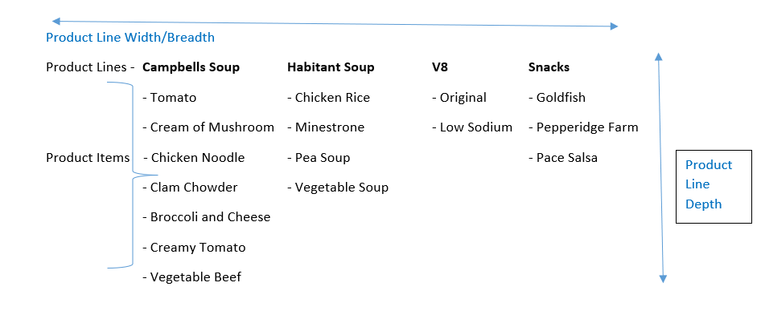
6.1 Campbell's Product Mix
Notes:
Alt Text
Diagram:
Campbells Soup product line width/ breadth includes: Campbells Soup, Habitant Soup, V8 and Snacks.
Campbells Soup Product items include: Tomato, cream of mushroom, chicken Noodle, Clam Chowder, Broccoli and cheese, Creamy Tomato, and Vegetable Beef
Habitant Soup Product items: Chicken and rice, Minestrone, Pea Soup, and Vegetable Soup
V8 Product items: Original and Low sodium
Snacks Product items : Goldfish, Pepperidge farm, peace salsa.
The product line depth is equal to the number of products that are in the product item list.

Slide 6
The Product Dominant Approach
From the traditional product-dominant perspective of business, marketers consider products, services, and prices as three separate and distinguishable characteristics.
Product Oriented firms

Slide 7
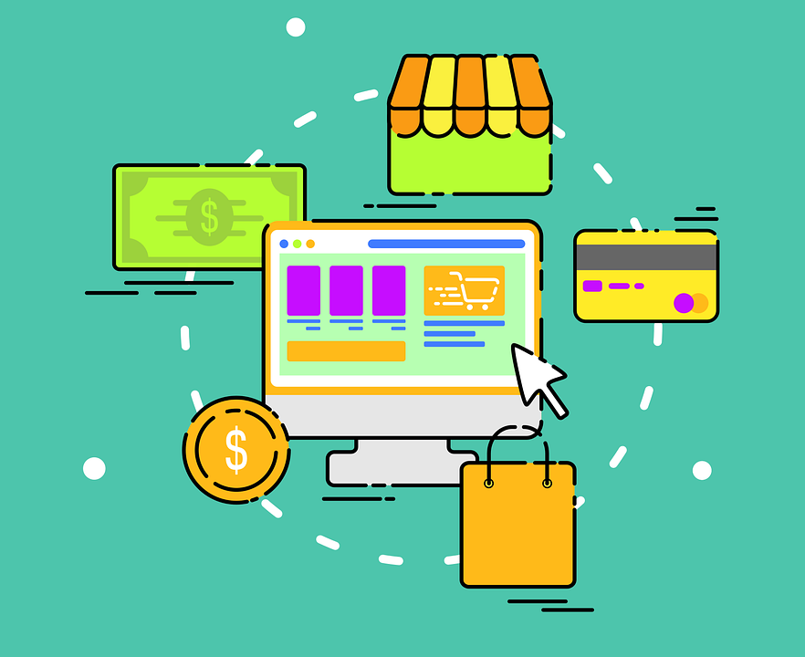
The Service Dominant Approach
The service-dominant approach is that it integrates the product, price, and service dimensions of an offering. This integration helps marketers think more like their customers, which can help them add value to their firm’s products.
This perspective helps marketers think more like their customers, which helps firms add value to their offerings.
Shopping Online Sale - Free vector graphic on Pixabay
Notes:
Critics of the service-dominant approach argue that the product-dominant approach also integrated services (though not price).

Slide 8
Product Levels & Product Lines
Most firms sell several offerings designed to work together to satisfy a broad range of customers’ needs and desires.
A product line is group of related offerings.
Product lines are created to make marketing strategies more efficient.
A product line can be broad. Or, a product line can be narrow.
Nick Youngson CC BY-SA 3.0 Pix4free

Slide 9
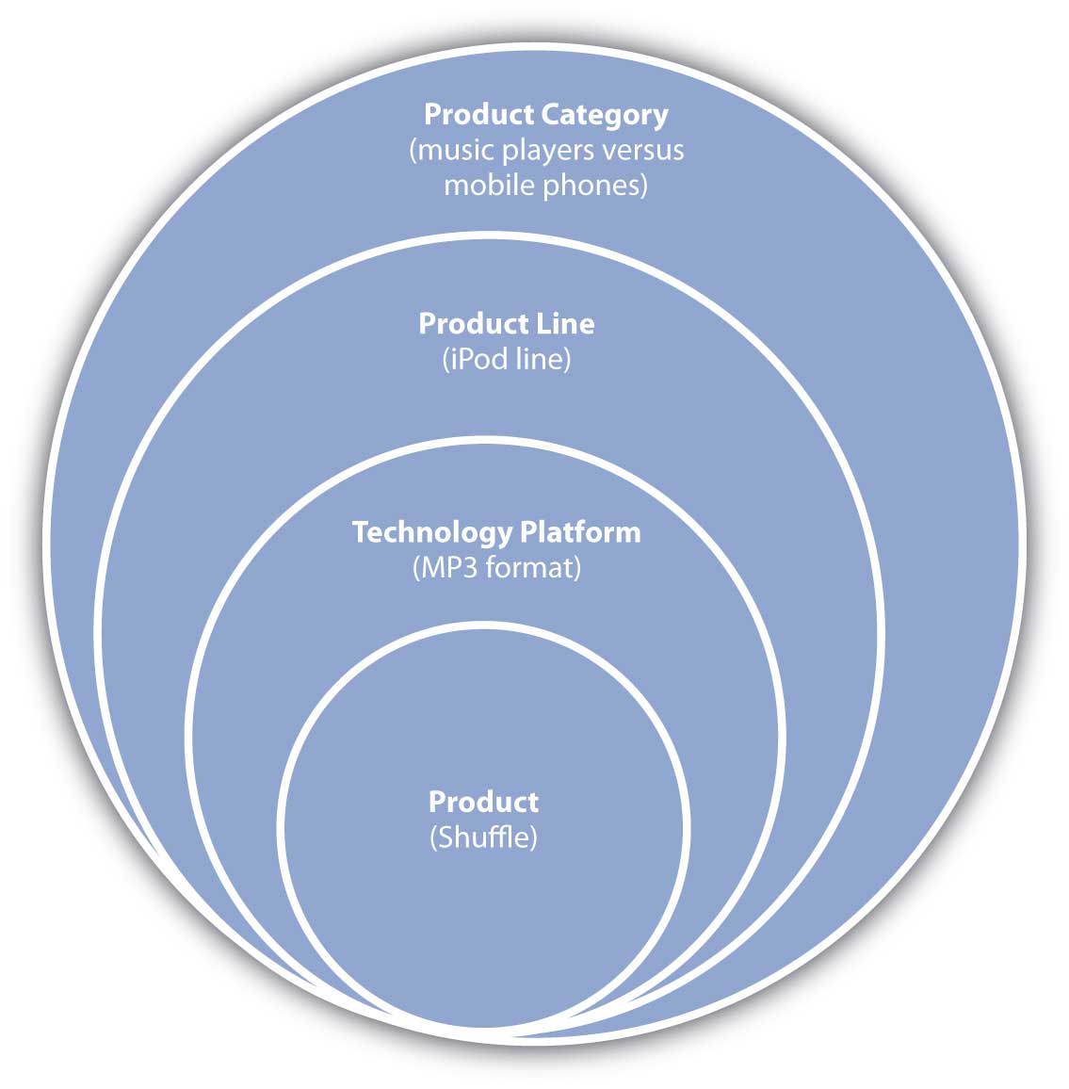
Product Levels
There are Four offering levels.
Consider the iPod Shuffle. (Fig 6.9)
the basic offering (the device itself)
the offering’s technology platform
the product line to which the Shuffle belongs (Apple’s iPod line of MP3 music players)
the product category to which the offering belongs.

Slide 10
6.2 Consumer Offerings
Convenience Offerings
Specialty Offering
Shopping Offering
Unsought Offering

Slide 11
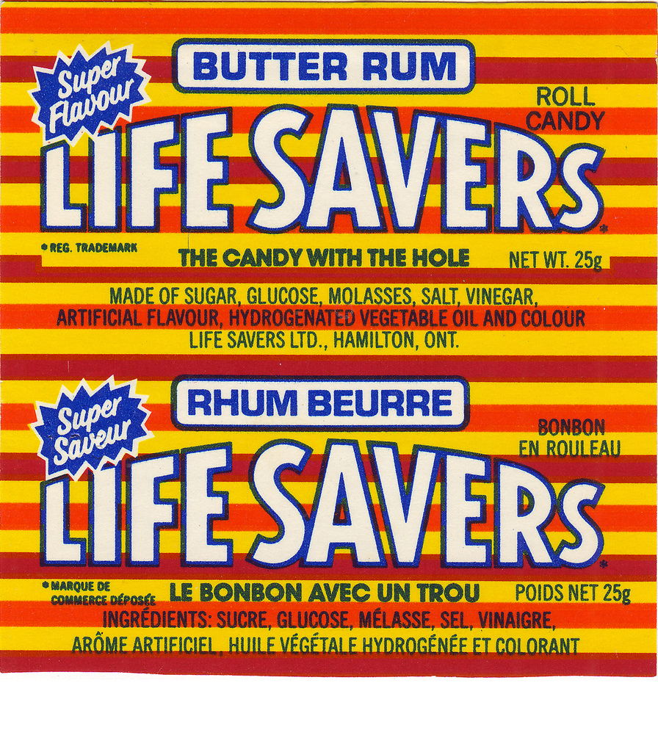
6.3 Convenience offerings
Convenience offerings are products and services consumers generally don’t want to put much effort into shopping for because they see little difference between competing brands. For many consumers, bread is a convenience offering.
Jason – Life Savers – CC BY-NC 2.0.
Notes:
A consumer might choose the store in which to buy the bread but be willing to buy whatever brand of bread the store has available. Marketing convenience items is often limited to simply trying to get the product in as many places as possible where a purchase could occur

Slide 12
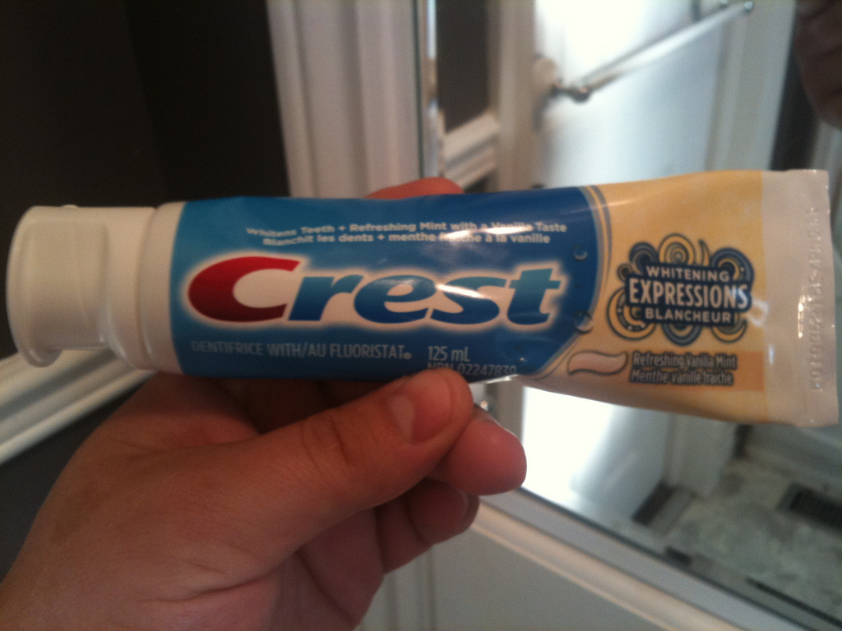
6.3 Shopping offerings
A shopping offering is one for which the consumer will make an effort to compare and select a brand. Consumers believe there are differences between similar shopping offerings and want to find the right one or the best price. Buyers might visit multiple retail locations or spend a considerable amount of time visiting Web sites and reading reviews about the product, such as the reviews found in Consumer Reports.
Ben Lucier – Crest Toothpaste – CC BY 2.0.

Slide 13
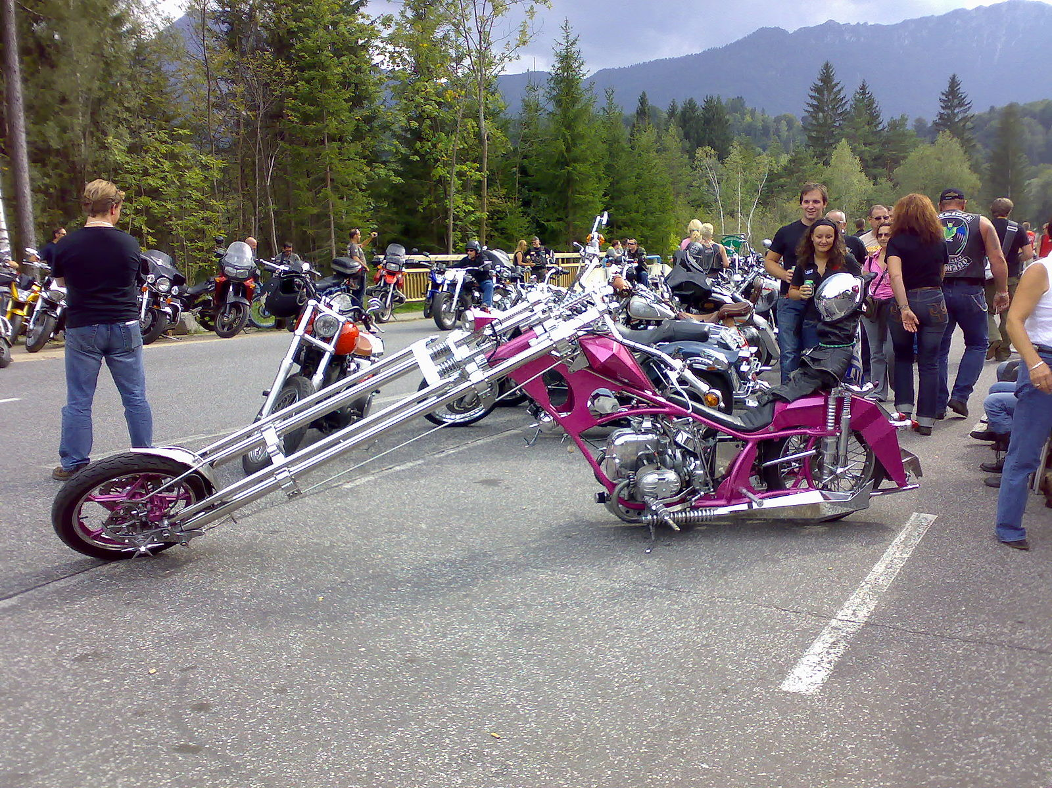
6.3 Specialty offerings
Specialty offerings are highly differentiated offerings, and the brands under which they are marketed are very different across companies, too. For example, an Orange County Chopper or Iron Horse motorcycle is likely to be far different feature-wise than a Kawasaki or Suzuki motorcycle.
Wikimedia Commons – CC BY 2.0.
Notes:
Typically, specialty items are available only through limited channels. For example, exotic perfumes available only in exclusive outlets are considered specialty offerings. Specialty offerings are purchased less frequently than convenience offerings. Therefore, the profit margin on them tends to be greater.

Slide 14
6.4 Branding, Labeling, and Packaging
Branding
Brand Name/ Brand Mark
Cannibalization
Packing
Function of Packaging
Primary/ Secondary/ Tertiary Packaging

Slide 15
6.4 Branding
A brand is a name, picture, design, or symbol, or combination of those items, used by a seller to identify its offerings and to differentiate them from competitors’ offerings.
Branding is the set of activities designed to create a brand and position it in the minds of consumers.
Photo by David Hurley licensed under the Unsplash License

Slide 16
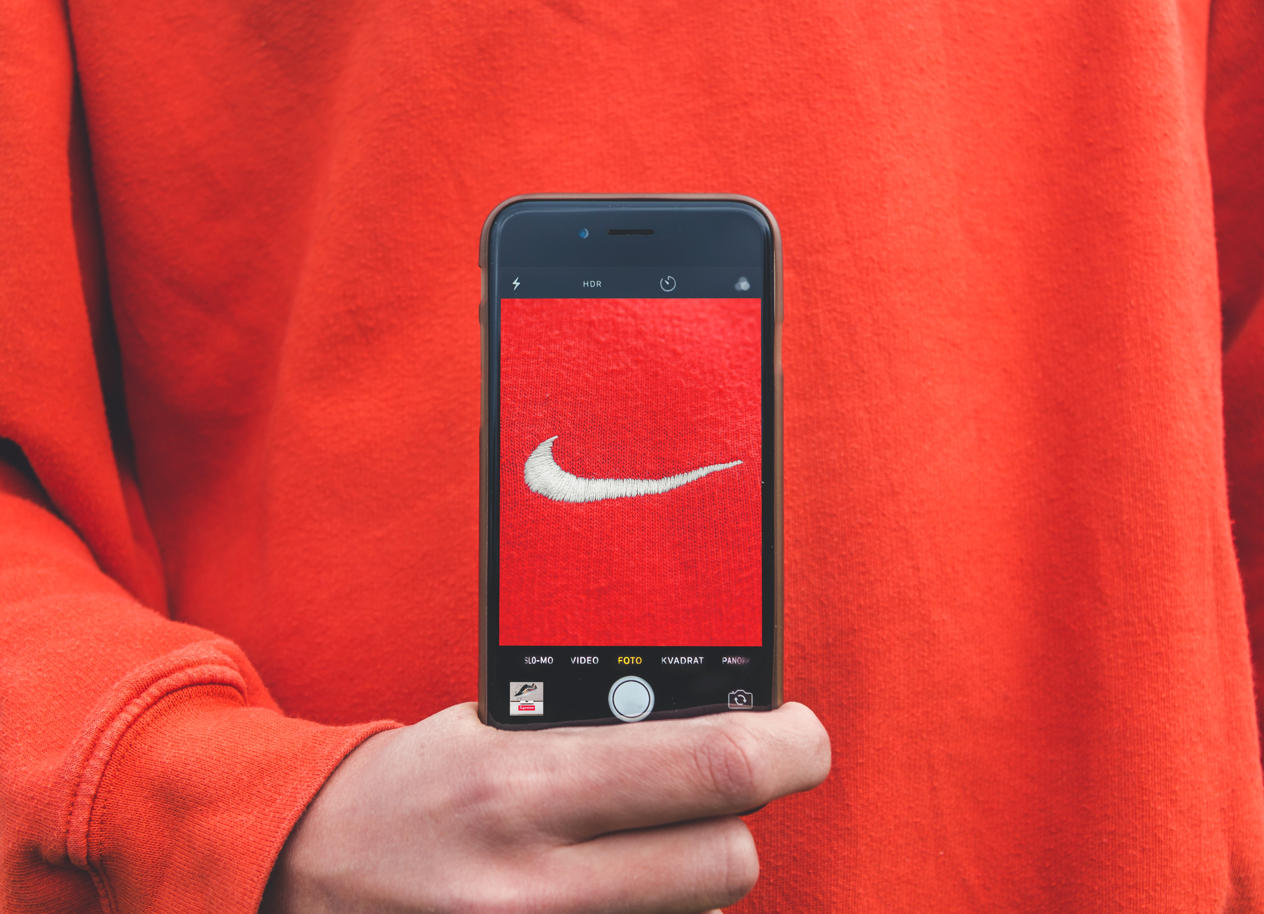
6.4 Labelling
A brand name, like Apple, is the spoken part of a brand’s identity.
A brand mark is the symbol, such as Coke’s wave or Apple Computer’s multicolor apple
Photo by Kristian Egelund is licensed under the Unsplash License

Slide 17
6.4 Cannibalization
Cannibalization occurs when a firm’s new offering eats into the sales of one of its older offerings. (Ideally, when you sell a new product, you hope that all of its sales come from your competitors’ buyers or buyers that are new to the market.) A completely new offering will not result in cannibalization, whereas a line extension likely will.
Photo by Nimble Made is licensed under the Unsplash License

Slide 18
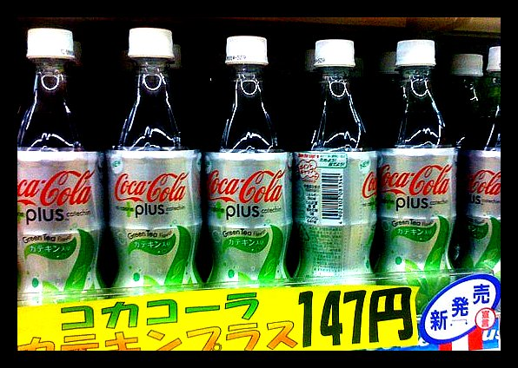
6.4 Packing
Another set of questions to consider involves the packaging on which a brand’s marks and name will be prominently displayed. Sometimes the package itself is part of the brand. For example, the curvaceous shape of Coca-Cola’s Coke bottle is a registered trademark. If you decide to market your beverage in a similar-shaped bottle, Coca-Cola’s attorneys will have grounds to sue you.
laxysupper – Coke – CC BY NC-ND 2.0.

Slide 19
6.4 Primary/ Secondary/ Tertiary Packaging
Primary Packaging: holds a single retail unit of a product. For example, a bottle of Coke, a bag of M&Ms, or a ream of printer paper (five hundred sheets) are all examples of primary packages.
Secondary Packaging: holds a single wholesale unit of a product. A case of M&M bags is an example, as are cartons of reams of paper.
Tertiary Packaging: is packaging designed specifically for shipping and efficiently handling large quantities.
Notes:
Primary packaging can be used to protect and promote products and get the attention of consumers. Primary packaging can also be used to demonstrate the proper use of an offering, provide instructions on how to assemble the product, or any other needed information. If warning or nutrition labels are required, they must be on the primary packaging. Primary packaging can be bundled together as well. Consumers can buy bottles of Coke sold in six-packs or cans of Coke in twelve-packs, for example.
Secondary packaging is designed more for retailers than consumers. It does not have to carry warning or nutrition labels but is still likely to have brand marks and labels. Secondary packaging further protects the individual products during shipping.
Tertiary packing is when a Coca-Cola bottler ships cases of Cokes to a grocery store, they are stacked on pallets (wooden platforms) and then wrapped in plastic. Pallets can be easily moved by a forklift truck and can even be moved within the grocery store by a small forklift.

Slide 20
6.5 Managing the Offering
Learning Objectives:
Understand the people involved in creating and managing offerings.
Recognize the differences in organizing product marketing for consumer versus B2B companies.

Slide 21
6.5 Product Manager
A product manager, someone with business responsibility for a particular product or product line.
Like the brand manager, the product manager must make many business decisions, such as which offerings to include, advertising selection, and so on.
Companies with brand managers include Microsoft, Procter & Gamble, SC Johnson, Kraft, Target, General Mills, and ConAgra Foods. Product managers are found at Xerox, IBM, Konica-Minolta Business Solutions, Rockwell International, and many others.

Slide 22
Brand Managers
Brand managers decide what products are to be marketed and how.
Other important positions include category managers, market managers, and vertical market managers. Category managers are found in consumer markets, usually in retail.
Market managers can be found in both consumer markets and B2B markets.
Vertical market managers are found only in B2B markets
Notes:
The brand manager is the person responsible for all business decisions regarding offerings within one brand. By business decisions, we mean making decisions that affect profit and loss, which include such decisions as which offerings to include in the brand, how to position the brand in the market, pricing options, and so forth.
Typically, B2B companies do not have multiple brands so the position is not common in the B2B environment. What you often find in a B2B company is a product manager, someone with business responsibility for a particular product or product line

Slide 23
Key Takeaway
A product line is a group of similar offerings. A product line can be deep (many offerings of a similar type) and/or broad (offerings that are very different from one another and cover a wide range of customers’ needs). The entire assortment of products that a company offers is called the product mix.

