Slide 1
Principles of Marketing
Chapter 5 – Market Segmenting, Targeting, and Positioning
Unless otherwise noted, this work is licensed under a Creative Commons Attribution-NonCommercial-ShareAlike 4.0 International (CC BY-NC-SA 4.0) license. Feel free to use, modify, reuse or redistribute any portion of this presentation.

Slide 2
5.1 Targeted Marketing versus Mass Marketing
Learning Objectives:
Distinguish between targeted marketing and mass marketing and explain what led to the rise of each.
Describe how targeted marketing can benefit firms.
Explain why companies differentiate among their customers.

Slide 3
5.1Types of Target Marketing Strategies
Differentiated Marketing:
Concentrated or Niche Marketing (one or two segments, select group)
Multisegmented Marketing (Many segments with different marketing mixes)
One-to-one or Microtargeting (Marketing at the individual level

Slide 4
Targeted Marketing
The segment(s) or group(s) of people and organizations you decide to sell to is called a target market.
Targeted marketing, or differentiated marketing, means that you may differentiate some aspect of marketing (offering, promotion, price) for different groups of customers selected.
It is a relatively new phenomenon.
Photo by Melanie Deziel on is licensed under the Unsplash License

Slide 5
Mass Marketing
Mass marketing, or undifferentiated marketing, came first. It evolved along with mass production and involves selling the same product to everybody.
Photo by Merakist on is licensed under the Unsplash License

Slide 6
Benefits of Segmenting and Targeting Markets
Avoid head-on competition with other firms trying to capture the same customers.
Develop new offerings and expand profitable brands and products lines.
Remarket older, less-profitable products and brands.
Identify early adopters.
Redistribute money and sales efforts to focus on your most profitable customers.
Retain “at-risk” customers in danger of defecting to your competitors.
Notes:
The trend today is toward more precise, targeted marketing. Figuring out “who’s who” in terms of your customers involves some detective work, though—often market research. A variety of tools and research techniques can be used to segment markets.

Slide 7
Steps in One-to-One Marketing
Establish short-term measures to evaluate your efforts.
Identify your customers.
Differentiate among your customers.
Interact with your customers, targeting your best ones
Customize your products and marketing messages to meet their needs.
Photo by Christiann Koepke on is licensed under the Unsplash License
Notes:
Steps companies take to target their best customers, form close, personal relationships with them, and give them what they want—a process called one-to-one marketing—are outlined in “Steps in One-to-One Marketing.”

Slide 8
Key Takeaway I
The trend today is toward more precise, targeted marketing.
Finding and attracting new customers is generally far more difficult than retaining current customers
The goal of firms is to do as much business with their best customers as possible.
Forming close, personal relationships with customers and giving them exactly what they want is a process called one-to-one marketing. It is the opposite of mass marketing.

Slide 9
5.2 How Markets Are Segmented
Learning Objectives:
Understand and outline the ways in which markets are segmented.
Explain why marketers use some segmentation bases versus others.

Slide 10
Types of Segmentation
Behaviour/ Benefits Sought
Demographic
Geographic
Physiographic
Usage Rate

Slide 11
Types of Segmentation Bases
Behavioural segmentation. What benefits do customers want, and how do they use our product?
Demographic segmentation. How do the ages, races, and ethnic backgrounds of our customers affect what they buy?
Geographic segmentation. Where are our customers located, and how can we reach them? What products do they buy based on their locations?
Psychographic segmentation. What do our customers think about and value? How do they live their lives?
Usage Rate. How often do users use the product?

Slide 12
Segmenting by Behaviour/Benefits Sought
Behavioral segmentation divides people and organization into groups according to how they behave with or act toward products. Benefits segmentation—segmenting buyers by the benefits they want from products—is very common. Take toothpaste, for example. Which benefit is most important to you when you buy a toothpaste
Photo by William Warby on is licensed under the Unsplash License
Notes:
The toothpaste’s price, ability to whiten your teeth, fight tooth decay, freshen your breath, or something else? Perhaps it’s a combination of two or more benefits. If marketing professionals know what those benefits are, they can then tailor different toothpaste offerings to you (and other people like you). For example, Colgate 2-in-1 Toothpaste & Mouthwash, Whitening Icy Blast is aimed at people who want the benefits of both fresher breath and whiter teeth.

Slide 13
Segmenting by Demographics
Demographics are commonly utilized to segment markets because demographic information is publicly available in databases around the world. You can obtain a great deal of demographic information on the U.S. Census Bureau’s Web site (http://www.census.gov).
Photo by Christina @ wocintechchat.com on is licensed under the Unsplash License
Notes:
Other government Web sites you can tap include FedStats (http://www.fedstats.gov) and The World Factbook (http://www.cia.gov/cia/publications/factbook), which contains statistics about countries around the world. In addition to current statistics, the sites contain forecasts of demographic trends, such as whether some segments of the population are expected to grow or decline.

Slide 14
Segmenting by Geography
Divides the market into areas based on location and explains why the checkout clerks at stores sometimes ask for your zip code. It’s also why businesses print codes on coupons that correspond to zip codes. When the coupons are redeemed, the store can find out where its customers are located—or not located.
Photo by GeoJango Maps on is licensed under the Unsplash License
Notes:
Geocoding is a process that takes data such as this and plots it on a map. Geocoding can help businesses see where prospective customers might be clustered and target them with various ad campaigns, including direct mail.

Slide 15
Segmenting by Psychographics
Can help fill in some of the blanks. Psychographic information is frequently gathered via extensive surveys that ask people about their activities, interests, opinion, attitudes, values, and lifestyles. One of the most well-known psychographic surveys is VALS (which originally stood for “Values, Attitudes, and Lifestyles”)
Photo by Gabin Vallet on is licensed under the Unsplash License
Notes:
was developed by a company called SRI International in the late 1980s. SRI asked thousands of Americans the extent to which they agreed or disagreed with questions similar to the following: “My idea of fun at a national park would be to stay at an expensive lodge and dress up for dinner” and “I could stand to skin a dead animal” (Donnelly, 2002). Based on their responses to different questions, consumers were divided up into the following categories, each characterized by certain buying behaviors.

Slide 16
Segmenting by Usage Rate
Segmenting users by how often they use a product or service.
Photo by Ghen Mar Cuaño on is licensed under the Unsplash License

Slide 17
Segmentation Bases Chart
By Behavior | By Demographic | By Geographic | By Psychographic
Benefits sough from the product How often the product is used (usage rate) Usage situation (daily use, holiday use, etc. Buyer status and loyalty to product (nonuser, potential user, first- time users, regular use) | Age/ gender Income Gender Family life cycle Religion Social class Ethnicity Family size Occupation Education Nationally | Region (continent country, state, neighborhood) Size of city of town Population density Climate | Activity Interests Opinions Values Attitudes Lifestyles
Notes:
By Behavior
Benefits sough from the product
How often the product is used (usage rate)
Usage situation (daily use, holiday use, etc.
Buyer status and loyalty to product (nonuser, potential user, first- time users, regular use)
By Demographic
Age/ gender
Income
Gender
Family life cycle
Religion
Social class
Ethnicity
Family size
Occupation
Education
Nationally
By Geographic
Region (continent country, state, neighborhood)
Size of city of town
Population density
Climate
By Psychographic
Activity
Interests
Opinions
Values
Attitudes
Lifestyles

Slide 18
Key Takeaway II
Behavioral segmentation divides people and organization into groups according to how they behave with or toward products.
Marketing professionals develop consumer insight when they gather both quantitative and qualitative information about their customers.
Many of the same bases used to segment consumer markets are used to segment business-to-business (B2B) markets

Slide 19
5.3 Selecting Target Markets and Target-Market Strategies
Learning Objectives:
Describe the factors that make some markets more attractive targets than others.
Describe the different market-segmenting strategies companies pursue and why.
Outline the market-segmentation strategies used in global markets.

Slide 20
Selecting Target Markets
A market worth targeting has the following characteristics:
It’s sizeable enough to be profitable, given your operating costs;
it’s growing;
it’s not already swamped by competitors, or you have found a way to standout in the crowd;
it’s accessible, or you can find a way to reach it;
you have the resources to compete in it; and
it “fits in” with your firm’s mission and objectives.

Slide 21
Target-Market Strategies
Most firms tailor their offerings in one way or another to meet the needs of different segments of customers:
A Multisegment marketing strategy can allow a company to respond to demographic and other changes in markets, including economic downturns.
Concentrated/Niche marketing involves targeting a very select group of customers. Niche marketing involves targeting an even more select group of consumers.
Microtargeting/One-to-one, is a new, effort to “super target” consumers by gathering all kinds of data available on people—everything from their tax and phone records to the catalogs they receive.

Slide 22
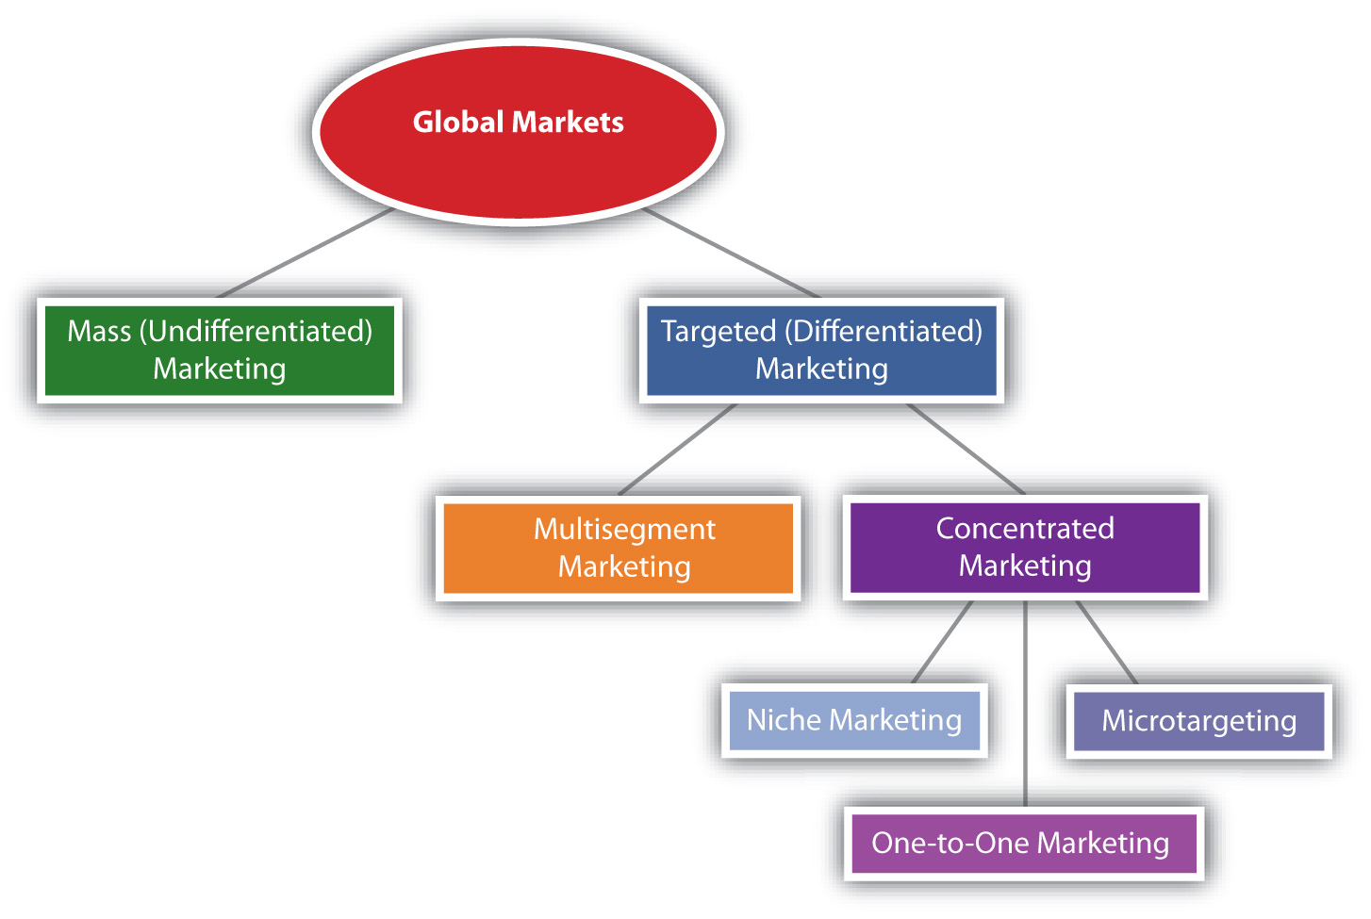
Targeting Global Markets
Firms that compete in the global marketplace can use any combination of the segmenting strategies.(Fig.5.9)
Notes:
Alt text
Diagram Tier
A the top of the Tier we have Global Markets
The next row we have Mass (Undifferentiated Marketing and Targeted (Deafferented marketing) that is connected to Global Marketing;
the following row is connected to Targeted (Deafferented marketing) and is Multisegmented Marketing and Concentrated Marketing.
We move down the tier to the next row that is connected to Concentrated Marketing, this row has Niche Marketing, Microtargeting and One- to-One Marketing.

Slide 23
5.4 Positioning and Repositioning
Learning Objectives:
Explain why positioning is an important element when it comes to targeting consumers.
Describe how a product can be positioned and mapped.
Explain what repositioning is designed is to do.

Slide 24
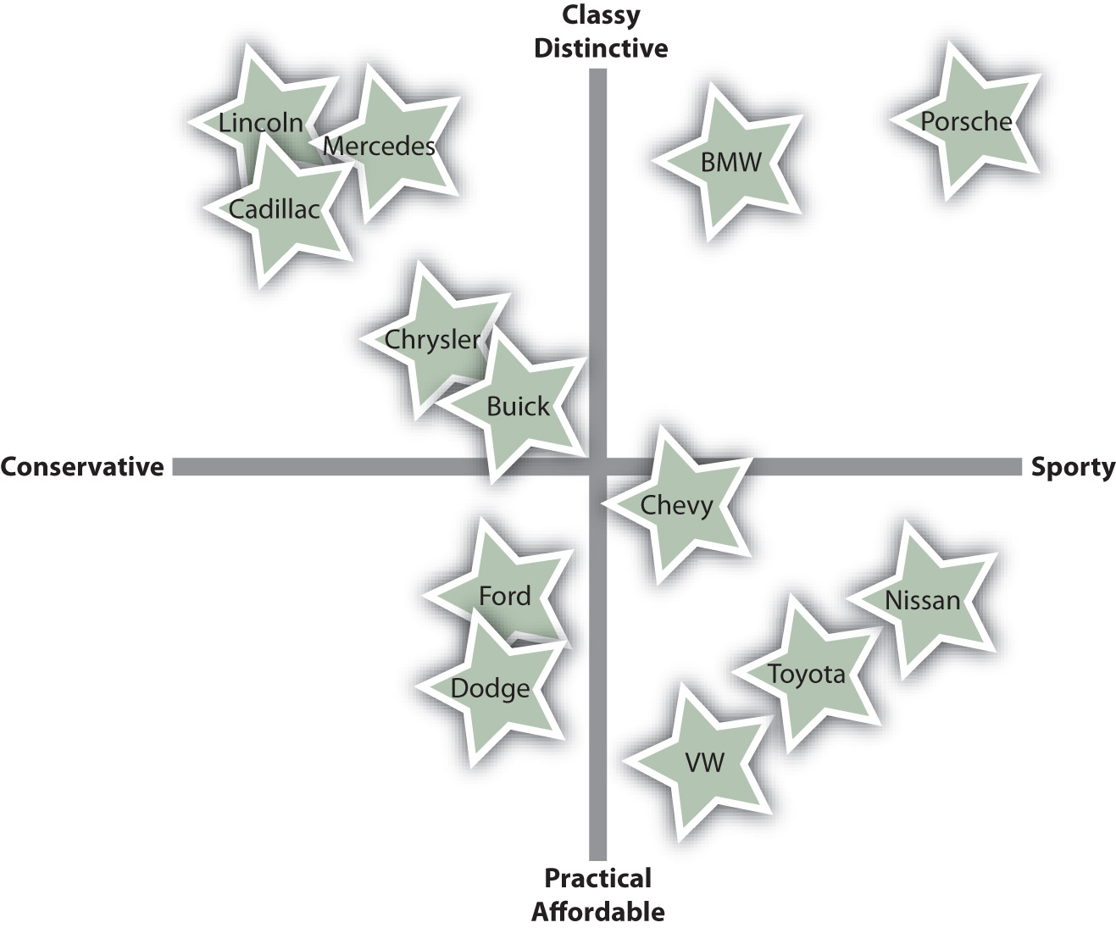
5.4 Positioning and Repositioning Offerings
Positioning is how consumers perceive a product relative to the competition
A Perceptual map is a two-dimensional graph that visually shows where a product stands, or should stand, relative to its competitors, based on criteria important to buyers. (Fig. 5.10)
Repositioning is an effort to “move” a product to a different place in the minds of consumers.

