Slide 1
Principles of Marketing
Chapter 3 – Consumer Behaviour: How People Make Buying Decisions
Unless otherwise noted, this work is licensed under a Creative Commons Attribution-NonCommercial-ShareAlike 4.0 International (CC BY-NC-SA 4.0) license. Feel free to use, modify, reuse or redistribute any portion of this presentation.

Slide 2
3.1 Factors That Influence Consumers’ Buying Behaviour
Learning Objectives
Describe the personal and psychological factors that may influence what consumers buy and when they buy it.
Explain what marketing professionals can do to influence consumers’ behavior.
Explain how looking at lifestyle information helps firms understand what consumers want to purchase.
Explain how Maslow’s hierarchy of needs works.
Explain how culture, subcultures, social classes, families, and reference groups affect consumers’ buying behavior.

Slide 3
3.1 Factors That Influence Consumers’ Buying Behaviour
Situational
Social situation, time, reason for purchase, and mood
Personal
Personality self-concept, demographic variables and lifestyle
Psychological
Motivation, perception, learning, attitude.
Societal
Culture, subculture, social class, reference groups, family
Photo by Eduardo Soares on Unsplash

Slide 4
3.1 Situational Factors
The social situation you’re in can significantly affect your purchase behavior.
Where do you take someone for your first date? Some people might take a first date to Subway, but other people would perhaps choose a restaurant that’s more upscale.
Social Situation
The time of day, time of year, and how much time consumers feel like they have to shop affect what they buy. Researchers have even discovered whether someone is a “morning person” or “evening person” affects shopping patterns.
Time
The reason you are shopping also affects the amount of time you will spend shopping. Are you making an emergency purchase? What if you need something for an important dinner or a project and only have an hour to get everything?
Purchase
Have you ever felt like going on a shopping spree? At other times wild horses couldn’t drag you to a mall. People’s moods temporarily affect their spending patterns.
Mood

Slide 5
3.1 Personal Factors
Personal factors influencing buying behaviour:
Personality and self-concept
Demographic variables
Lifestyle
Photo by Shane Rounce on Unsplash

Slide 6
3.1 Personal Factors
O
Openness to Experience
C
Conscientiousness
E
Extraversion
A
Agreeableness
N
Neuroticism
The “Big Five” Personality Traits: Psychologists discuss frequently include openness or how open you are to new experiences, conscientiousness or how diligent you are, extraversion or how outgoing or shy you are, agreeableness or how easy you are to have a good relationship with, and neuroticism or how prone you are to negative mental states.

Slide 7
3.1 Personal Factors Self-Concepts
Ideal Self: How you would like to see yourself—whether it’s prettier, more popular, more eco-conscious, or more “goth,” and others.’
Self-Concept: How you think others see you, also influences your purchase behavior.
Photo by Kenzie Kraft on Unsplash
Notes:
Marketers have had better luck linking people’s self-concepts to their buying behavior. Your self-concept is how you see yourself—be it positive or negative.
Marketing researchers believe people buy products to enhance how they feel about themselves—to get themselves closer to their ideal selves.

Slide 8
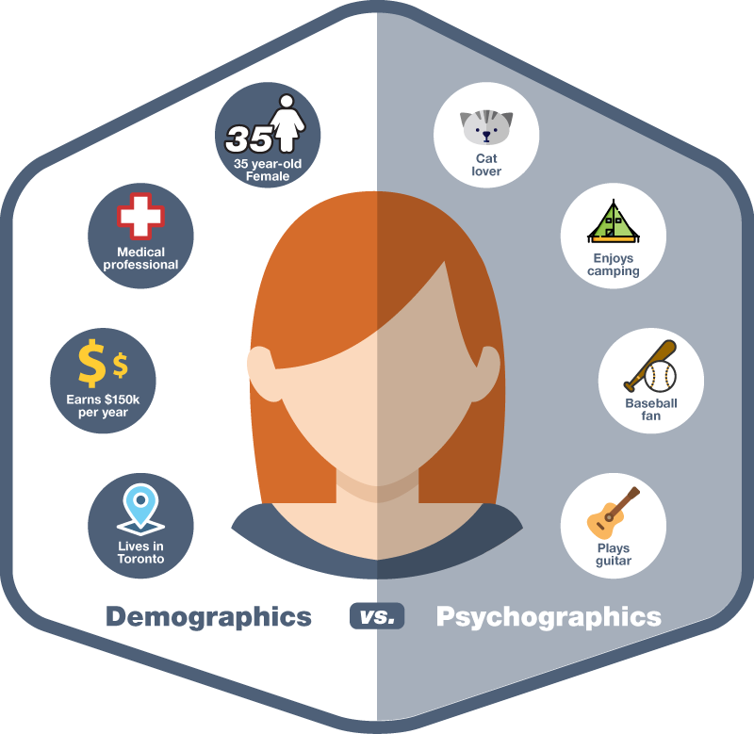
3.1 Personal Factors
Psychographics combines the lifestyle traits of consumers and their personality styles with an analysis of their attitudes, activities, and values to determine groups of consumers with similar characteristics.
Notes:
Psychographics combines the lifestyle traits of consumers and their personality styles with an analysis of their attitudes, activities, and values to determine groups of consumers with similar characteristics.
One of the most widely used systems to classify people based on psychographics is the VALS (Values, Attitudes, and Lifestyles) framework

Slide 9
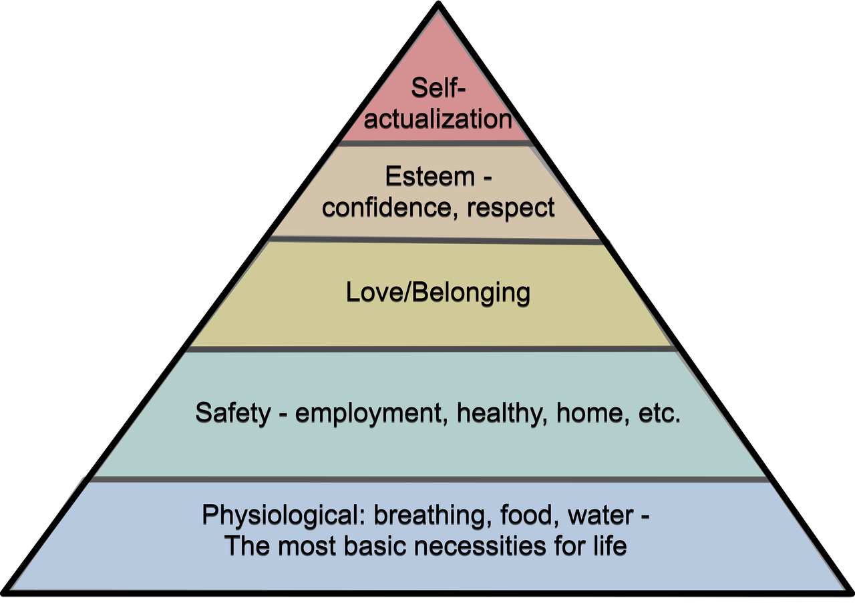
3.1 Psychological Factors: Maslow's Hierarchy of Needs
Maslow theorized that people must fulfill their basic needs—food, water, and sleep—before they can begin fulfilling higher-level needs.
Maslow Hierarchy by teegers via Pixabay Pixabay License
Notes:
Have you ever gone shopping when you were tired or hungry? Even if you were shopping for something that would make you the envy of your friends (maybe a new car) you probably wanted to sleep or eat even more. (Forget the car. Just give me a nap and a candy bar.

Slide 10
3.1 Psychological Factors
Other Psychological Factors included:
Perception: How you interpret the world around you and make sense of it in your brain.
Learning: Refers to the process by which consumers change their behavior after they gain information or experience.
Attitudes: Are “mental positions” or emotional feelings, favorable or unfavorable evaluations, and action tendencies people have about products, services, companies, ideas, issues, or institutions.
Notes:
Perception: You do so via stimuli that affect your different senses—sight, hearing, touch, smell, and taste. How you combine these senses also makes a difference.
Learning: It’s the reason you don’t buy a bad product twice. Learning doesn’t just affect what you buy; it affects how you shop.
Attitudes: Attitudes tend to be enduring, and because they are based on people’s values and beliefs, they are hard to change.

Slide 11
3.1 Societal Factors
Social factors are more outward and have broad influences on your beliefs and the way you do things. They depend on the world around you and how it works.
They include:
Culture
Subcultures
Social Class
Reference Groups and Opinion Leaders
Family

Slide 12
3.1 Societal Factors
Culture: The shared beliefs, customs, behaviors, and attitudes that characterize a society. Culture is a handed down way of life and is often considered the broadest influence on a consumer’s behavior.
Subcultures: A group of people within a culture who are different from the dominant culture but have something in common with one another such as common interests, vocations or jobs, religions, ethnic backgrounds, and geographic locations.

Slide 13
3.1 Societal Factors
Social Class: A group of people who have the same social, economic, or educational status in society5.
Reference Groups and Opinion Leaders: A groups (social groups, work groups, family, or close friends) a consumer identifies with and may want to join.
Family: Most market researchers consider a person’s family to be one of the most important influences on their buying behavior.

Slide 14
3.1 Key Takeaway:
Situational influences are temporary conditions that affect how buyers behave. They include physical factors such as a store’s buying locations, layout, music, lighting, and even scent.
Your personality describes your disposition as other people see it. Market researchers believe people buy products to enhance how they feel about themselves.
Psychologist Abraham Maslow theorized that people must fulfill their basic needs—like the need for food, water, and sleep—before they can begin fulfilling higher-level needs.
Image Source: Golden Key Cliparts #2843651(License: Personal Use)

Slide 15
3.2 Low-Involvement Versus High-Involvement Buying Decisions and the Consumer’s Decision-Making Process
Learning Objectives:
Distinguish between low-involvement and high-involvement buying decisions.
Understand what the stages of the buying process are and what happens in each stage.

Slide 16
3.2. Low-Involvement Versus High-Involvement
The level of involvement reflects how personally important or interested you are in consuming a product and how much information you need to make a decision.
Low-involvement purchases are made with no planning or previous thought. These buying decisions are called impulse buying.
High-involvement decisions carry a higher risk to buyers if they fail, are complex, and/or have high price tags. A car, a house, and an insurance policy are examples.
Notes:
The level of involvement in buying decisions may be considered a continuum from decisions that are fairly routine (consumers are not very involved) to decisions that require extensive thought and a high level of involvement. Consumers often engage in routine response behaviour when they make low-involvement decisions—that is, they make automatic purchase decisions based on limited information or information they have gathered in the past

Slide 17
3.2. The Three Hierarchy Stages
Routine Response Behaviour
When they make low-involvement decisions—that is, they make automatic purchase decisions based on limited information or information they have gathered in the past.
Limited problem solving
When they already have some information about a good or service but continue to search for a little more information.
Extended Problem solving
Where they spend a lot of time comparing different aspects such as the features of the products, prices, and warranties.

Slide 18
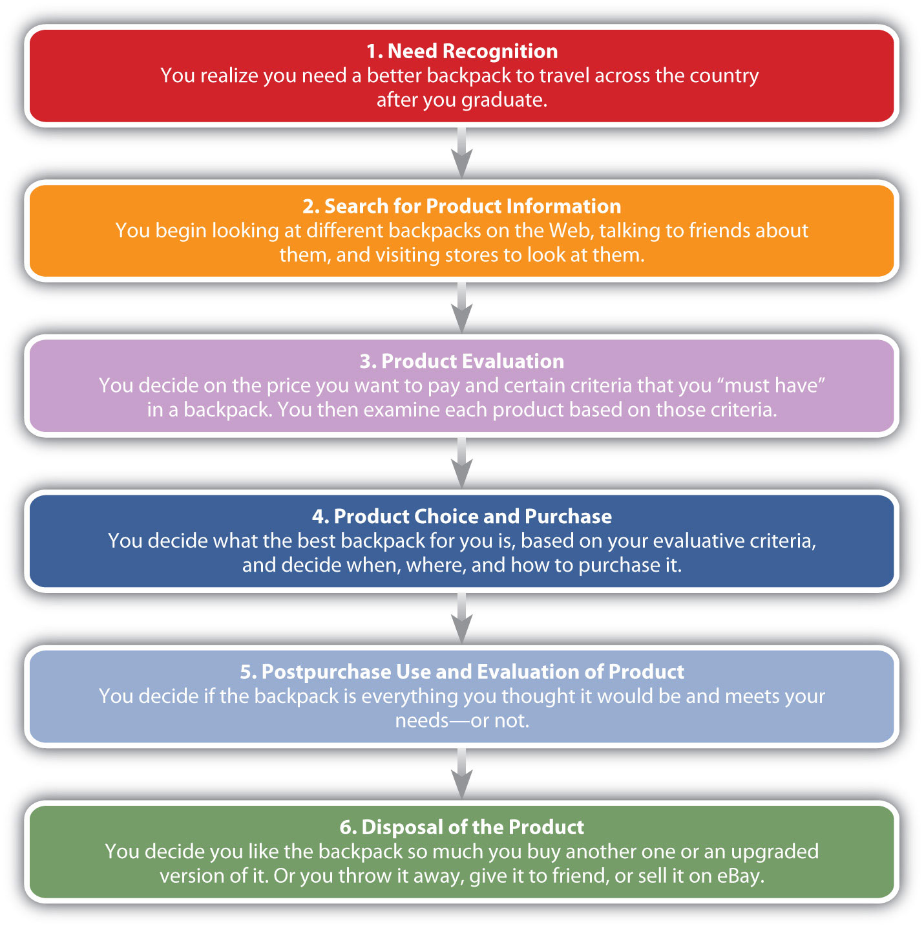
Stages in the Buying Process
Stage 1. Need Recognition
Stage 2. Search for Information
Stage 3. Product Evaluation
Stage 4. Product Choice and Purchase
Stage 5. Post purchase Use and Evaluation
Stage 6. Disposal of the Product

Slide 19
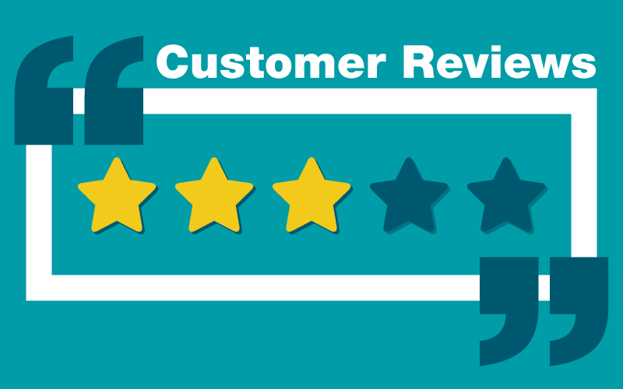
Stage 2: Search for Information
Where can you search for information on products and services?
Family and friends
Magazine reviews or suggestions
Online Reviews

Slide 20
Stage 3: Product Evaluation
Evaluative criteria are certain characteristics that are important to you such as the price of the backpack, the size, the number of compartments, and color. Some of these characteristics are more important than others
Companies want to convince you that the evaluative criteria you are considering reflect the strengths of their products.

Slide 21
Stage 4: Product Choice and Purchase
Low-involvement purchases - consumers may go from recognizing a need to purchasing the product.
High-involvement purchases may involve a number of factors, such as:
cost
Reviews
Where and how to purchase
Financing options

Slide 22
Stage 5: Post-Purchase Dissonance
Post-Purchase Dissonance: You might call it buyer’s remorse. Typically, dissonance occurs when a product or service does not meet your expectations. Consumers are more likely to experience dissonance with products that are relatively expensive and that are purchased infrequently.
Photo by 🇸🇮 Janko Ferlič on Unsplash

Slide 23
Stage 6: Product Disposal
There was a time when neither manufacturers nor consumers thought much about how products got disposed of, so long as people bought them. But that’s changed.
How products are being disposed of is becoming extremely important to consumers and society in general.
Computers and batteries, which leech chemicals into landfills, are a huge problem.
Consumers don’t want to degrade the environment if they don’t have to, and companies are becoming more aware of this fact.
jqpubliq – Recycling Center Pile – CC BY-SA 2.0.

Slide 24
3.2 Key Takeaways:
Consumer behavior looks at the many reasons why people buy things and later dispose of them.
Consumers go through distinct buying phases when they purchase products.
A consumer’s level of involvement is how interested he or she is in buying and consuming a product.
Image Source: Golden Key Cliparts #2843651(License: Personal Use)

