Slide 1
Principles of Marketing
Chapter 2 – Strategic Planning
Unless otherwise noted, this work is licensed under a Creative Commons Attribution-NonCommercial-ShareAlike 4.0 International (CC BY-NC-SA 4.0) license. Feel free to use, modify, reuse or redistribute any portion of this presentation.

Slide 2
2.1 The Value Proposition
Learning Objectives:
Explain what a value proposition is.
Understand why a company may develop different value propositions for different target markets.

Slide 3
What is a Value Proposition?
A value proposition is a thirty-second “elevator speech” stating the specific value a product or service provides to a target market.
Firms may develop different value propositions for different groups of customers.
The value proposition shows why the product or service is superior to competing offers and why the customer should buy it or why a firm should hire you.

Slide 4
2.2 Components of the Strategic Planning Process
Learning Objectives:
Explain how a mission statement helps a company with its strategic planning.
Describe how a firm analyzes its internal environment.
Describe the external environment a firm may face and how it is analyzed.

Slide 5
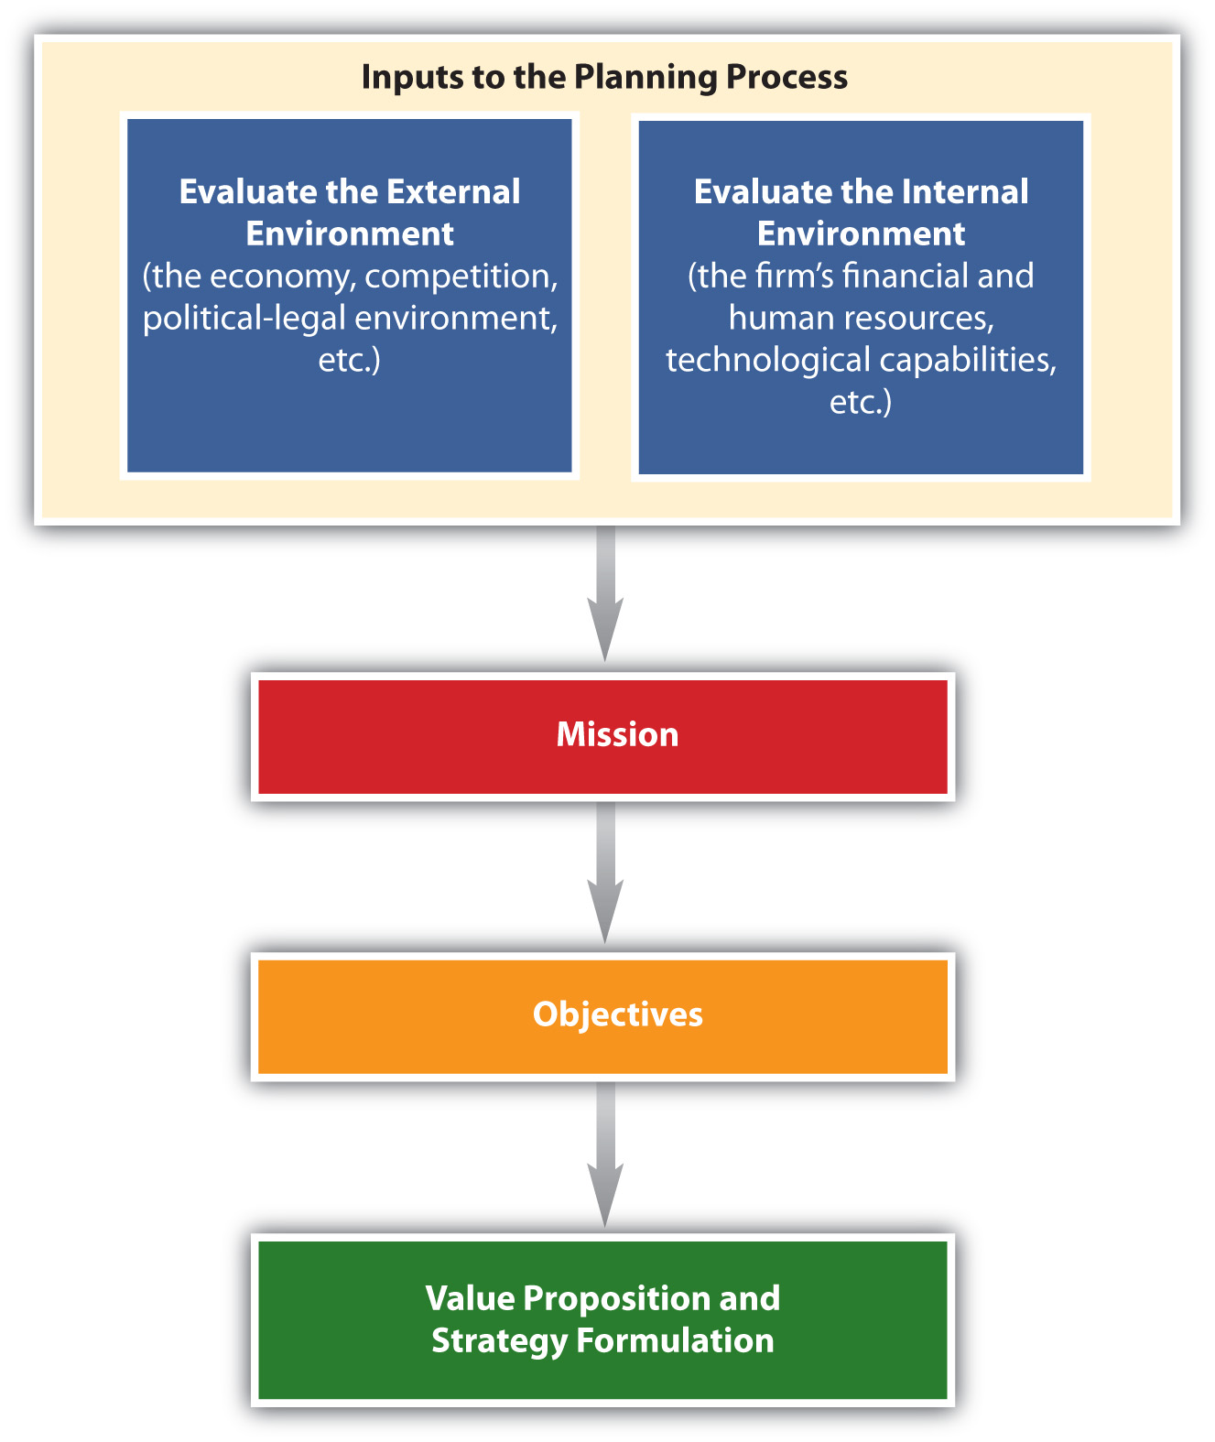
The Strategic Planning Process
Strategic planning is a process that helps an organization allocate its resources to capitalize on opportunities in the marketplace.
Typically, it is a long-term process.
The strategic planning process includes conducting a situation analysis and developing the organization’s mission statement, objectives, value proposition, and strategies
Figure 2.2: The Strategic Planning Process
Notes:
As part of the strategic planning process, a situation analysis must be conducted before a company can decide on specific actions. A situation analysis involves analyzing both the external (macro and micro factors outside the organization) and the internal (company) environments.

Slide 6
Conducting a Situation Analysis
A situation analysis involves analyzing both the external (macro and micro factors outside the organization) and the internal (company) environments.
The firm’s internal environment—such as its financial resources, technological resources, and the capabilities of its personnel and their performance—has to be examined.
It is also critical to examine the external macro and micro environments the firm faces, such as the economy and its competitors.

Slide 7
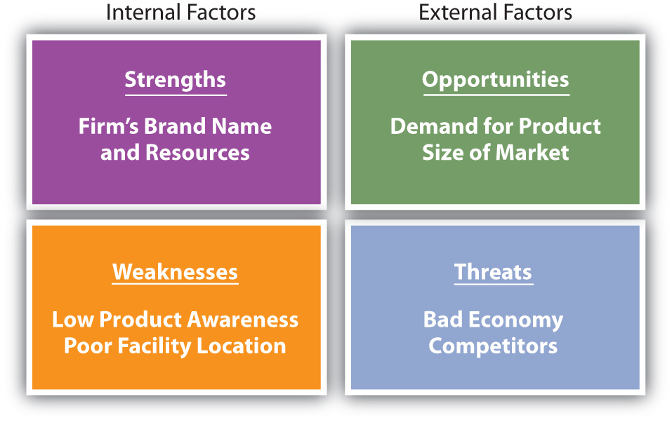
SWOT Analysis
Examining strengths, weaknesses, opportunities, and threats is called a SWOT analysis.
Strengths and weaknesses are internal
Opportunities and threats are factors that are external.
Figure 2.3: Elements of a SWOT Analysis
Notes:
An organization’s strengths might include its brand name, efficient distribution network, reputation for great service, and strong financial position.
A firm’s weaknesses might include a lack of awareness of its products in the marketplace, a lack of human resources talent, and a poor location. Opportunities might entail the international demand for the type of products the firm makes, few competitors, and favourable social trends such as people living longer.
Threats might include a bad economy, high interest rates that increase a firm’s borrowing costs, and an ageing population that makes it hard for the business to find workers.

Slide 8
Assessing the External Environment
Analyzing the external environment involves tracking conditions in the macro and micro marketplace.
The macro-environment includes economic factors, demographic trends, cultural and social trends, political and legal regulations, technological changes, and the price and availability of natural resources.
The micro-environment includes competition, suppliers, marketing intermediaries (retailers, wholesalers), the public, the company, and customers.

Slide 9
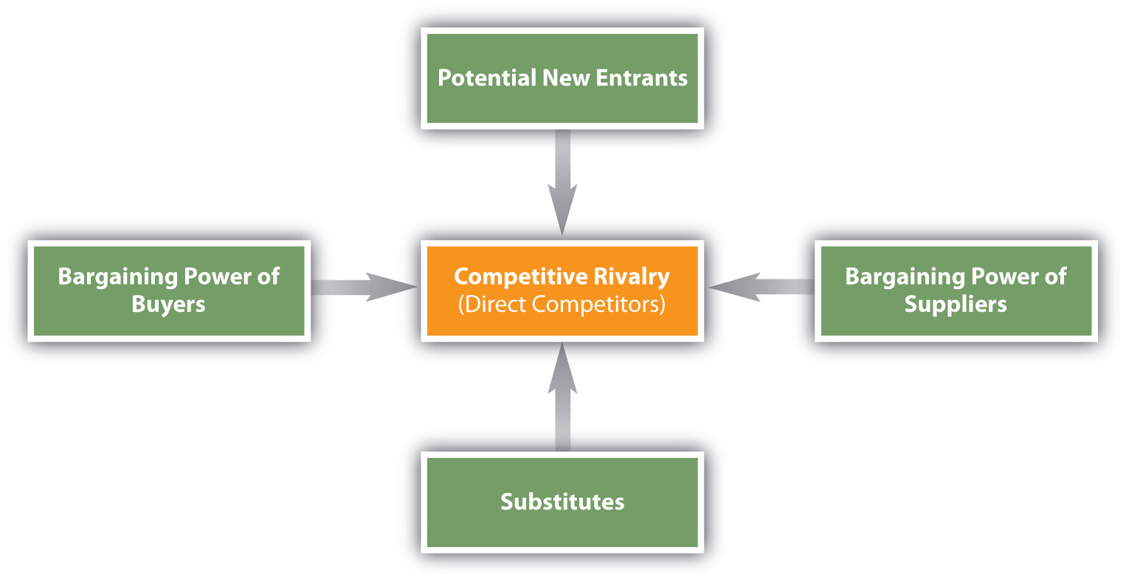
The Competitive Environment
The five forces model (Porter, 1980) is an approach for analyzing industries.
The framework helps organizations understand their current competitors as well as organizations that could become competitors in the future.
Figure 2.5: Five Forces Model (Porter, 1980
Notes:
All organizations must consider their competition, whether it is direct or indirect competition vying for the consumer’s dollar. Both non-profit and for-profit organizations compete for customers’ resources.
The framework can help firms find the best way to defend their position in the industry.

Slide 10
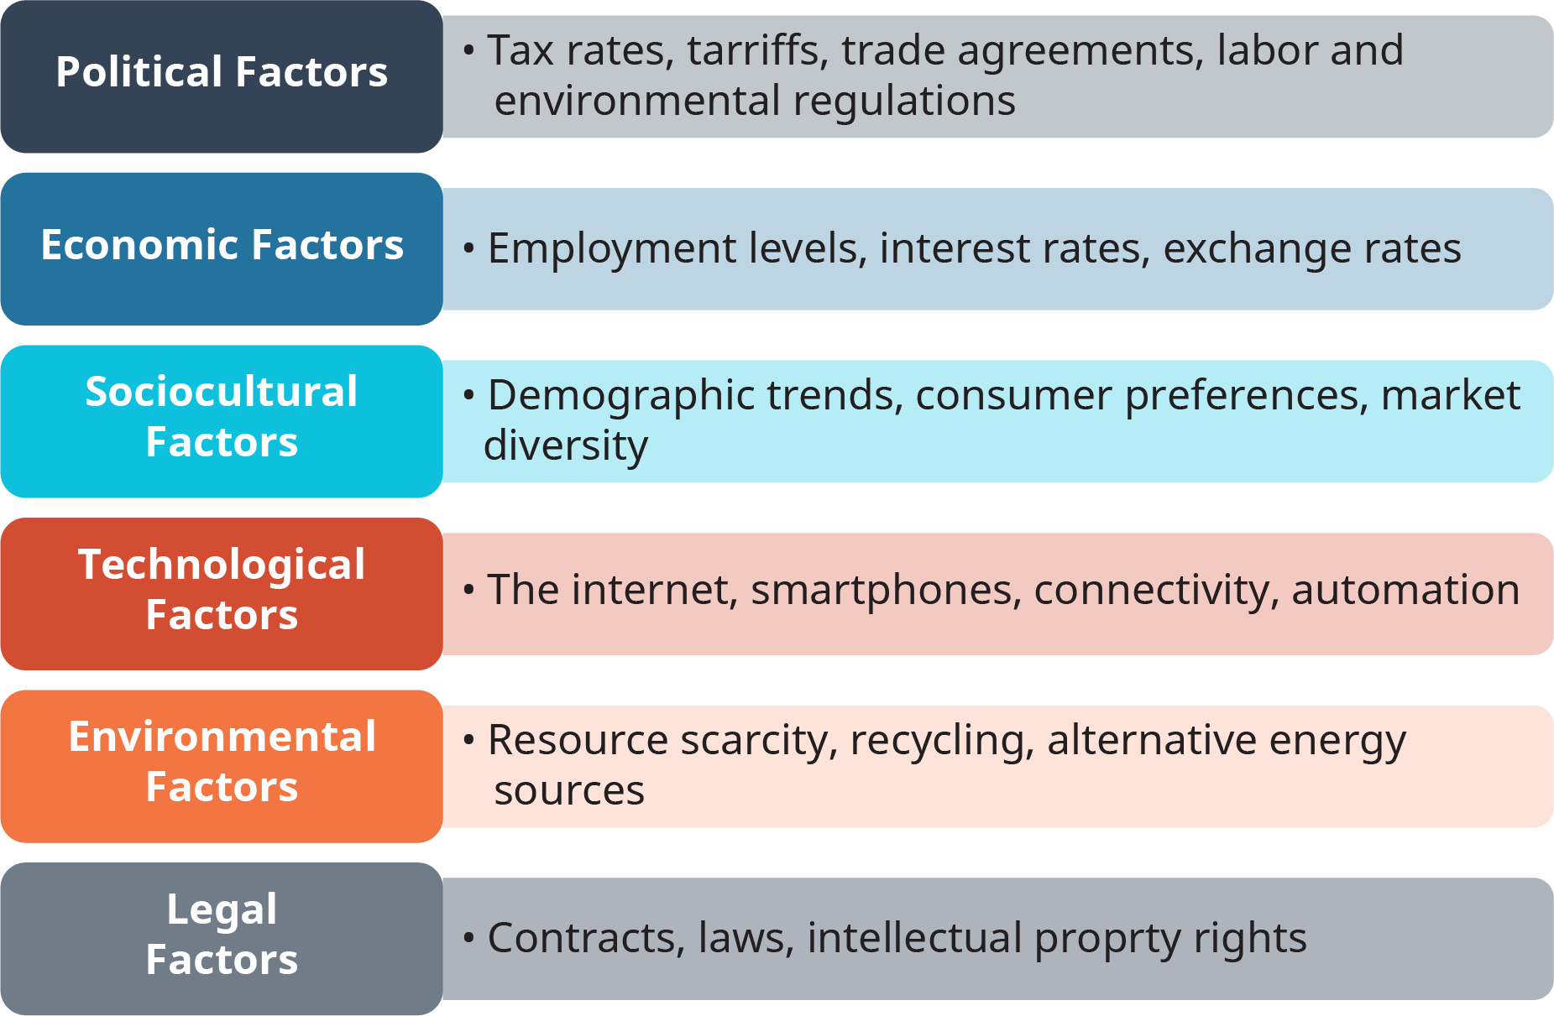
PESTLE Model
PESTEL is a tool to help analyze a firm’s macro environment.
The letters represent the categories to examine: political factors, economic factors, sociocultural factors, technological factors, environmental factors, and legal factors
PESTEL Model for External Environmental Analysis by Open Stax, Rice University CC-BY 4.0 license
Notes:
PESTEL is a tool that reminds managers to look at several distinct categories in the macro environment. Like SWOT, PESTEL is an acronym. In this case, the letters represent the categories to examine: political factors, economic factors, sociocultural factors, technological factors, environmental factors, and legal factors. When using PESTEL to analyze a specific firm’s situation, overlap between different categories of PESTEL factors can sometimes happen just as it can with SWOT.

Slide 11
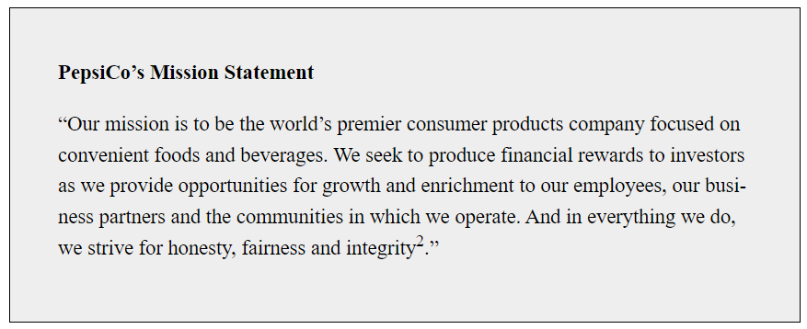
Mission Statement
The firm’s mission statement states the purpose of the organization and why it exists. Both profit and nonprofit organizations have mission statements, which they often publicize. The following are examples of mission statements

Slide 12
2.3 Developing Organizational Objectives and Formulating Strategies
Learning Objectives:
Explain how companies develop the objectives driving their strategies.
Describe the different types of product strategies and market entry strategies that companies pursue.

Slide 13
2.3 Developing Organizational Objectives and Formulating Strategies
Objectives are what organizations want to accomplish—the end results they want to achieve—in a given time frame.
Strategies are the means to the ends, the game plan, or what a firm is going to do to achieve its objectives.
A marketing plan is a strategic plan at the functional level that provides a firm’s marketing group with direction.
Notes:
In addition to being accomplished within a certain time frame, objectives should be realistic (achievable) and be measurable, if possible.
Successful strategies help organizations establish and maintain a competitive advantage that competitors cannot imitate easily.
A marketing plan is a road map that improves the firm’s understanding of its competitive situation.

Slide 14
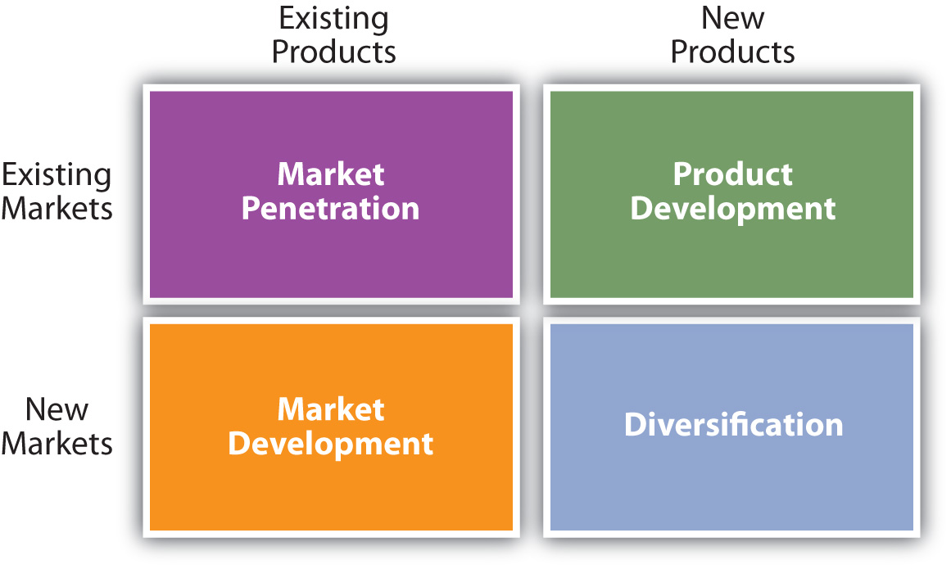
Market Strategies
Market penetration strategies focus on increasing a firm’s sales of its existing products to its existing customers.
Product development strategies involve creating new products for existing customers.
Market development strategies focus on entering new markets with existing products.
Diversification strategies involve entering new markets with new products or doing something outside a firm’s current businesses.
Figure 2.10: Product and Market Entry Strategies. The different types of product and market entry strategies a firm can pursue in order to meet their objectives.
Notes:
Key Takeaways:
The strategic planning process includes a company’s mission (purpose), objectives (end results desired), and strategies (means). Sometimes the different SBUs of a firm have different mission statements. A firm’s objectives should be realistic (achievable) and measurable. The different product market strategies firms pursue include market penetration, product development, market development, and diversification.

Slide 15
2.4 Where Strategic Planning Occurs within Firms
Learning Objectives:
Identify the different levels at which strategic planning may occur within firms.
Understand how strategic planning that occurs at multiple levels in an organization helps a company achieve its overall corporate objectives.

Slide 16
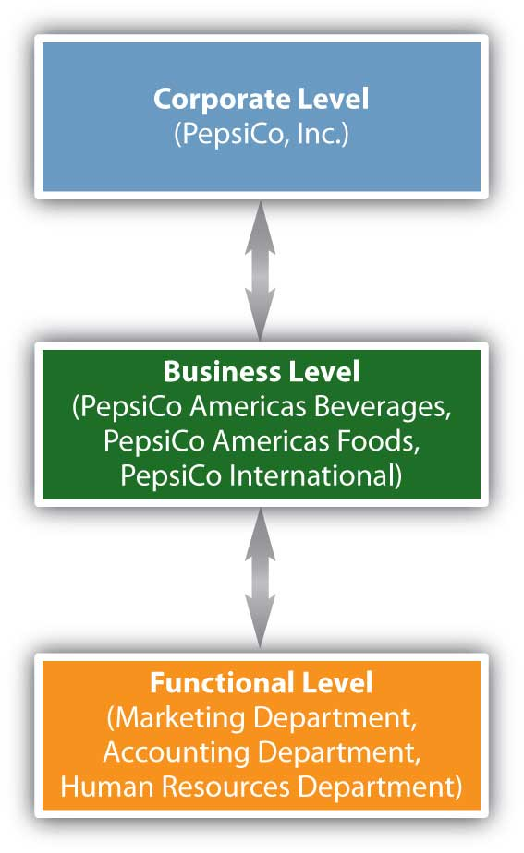
Strategic Business Unit (SBU)
A strategic business unit (SBU) is a business or product line within an organization that has its own competitors, customers, and profit center for accounting purposes. A firm’s SBUs may also have their own mission statement (purpose) and will generally develop strategic plans for themselves. The different departments, or functions within a company or SBU, might also develop strategic plans.
Figure 2.13: Strategic Planning Levels in an Organization
Notes:
Strategic planning is a long-term process that helps an organization allocate its resources to take advantage of different opportunities. In addition to marketing plans, strategic planning may occur at different levels within an organization. For example, in large organizations, top executives will develop strategic plans for the corporation as a whole. These are corporate-level plans. In addition, many large firms have different divisions, or businesses, called strategic business units.
The strategies and actions implemented at the functional (department) level must be consistent with and help an organization achieve its objectives at both the business and corporate levels and vice versa.

Slide 17
Key Takeaway:
Strategic planning can occur at different levels (corporate, business, and functional) in an organization. The number of levels may vary. However, if a company has multiple planning levels, the plans must be consistent, and all must help achieve the overall goals of the corporation.
Image Source: Golden Key Cliparts #2843651(License: Personal Use)

Slide 18
2.5 Strategic Portfolio Planning Approaches
Learning Objectives:
Explain how SBUs are evaluated using the Boston Consulting Group matrix.
Explain how businesses and the attractiveness of industries are evaluated using the General Electric approach.

Slide 19
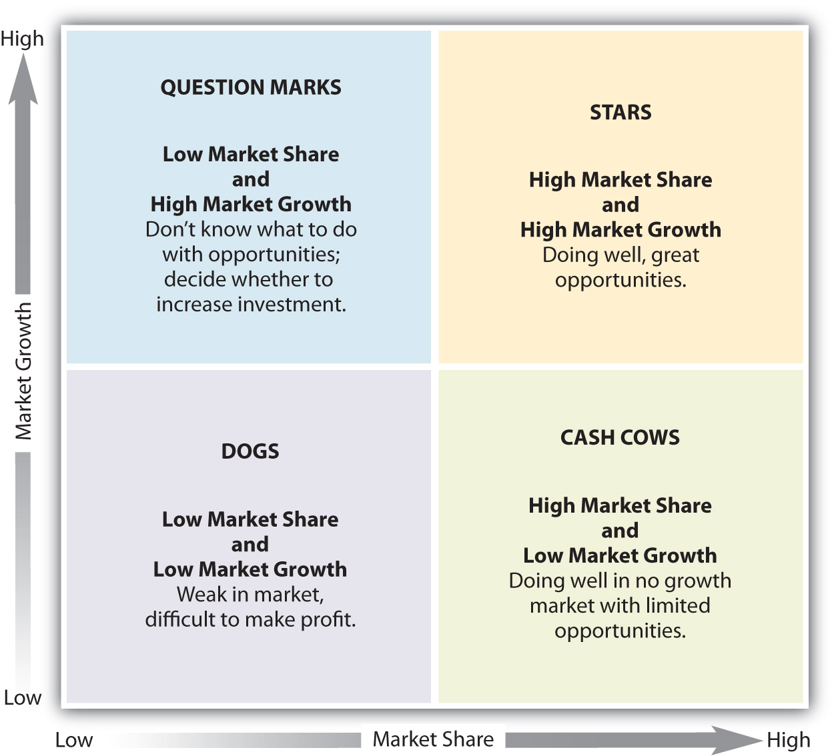
2.5 Strategic Portfolio Planning Approaches
The Boston Consulting Group (BCG) matrix helps companies evaluate each of its strategic business units based on two factors: (1) the SBU’s market growth rate (i.e., how fast the unit is growing compared to the industry in which it competes) and (2) the SBU’s relative market share (i.e., how the unit’s share of the market compares to the market share of its competitors).
Figure 2.16: The Boston Consulting Group (BCG) Matrix
Notes:
Key Takeaway:
A group of businesses is called a portfolio. Organizations that have multiple business units must decide how to allocate resources to them and decide what objectives and strategies are feasible for them. Portfolio planning approaches help firms analyze the businesses relative to each other. The BCG and GE approaches are two or the most common portfolio planning methods.

