Slide 1
Principles of Marketing
Chapter 15 – Price, the Only Revenue Generator
Unless otherwise noted, this work is licensed under a Creative Commons Attribution-NonCommercial-ShareAlike 4.0 International (CC BY-NC-SA 4.0) license. Feel free to use, modify, reuse or redistribute any portion of this presentation.

Slide 2
15.1 The Pricing Framework and a Firm’s Pricing Objectives
Learning Objective:
Understand the factors in the pricing framework.
Explain the different pricing objectives organizations have to choose from.

Slide 3
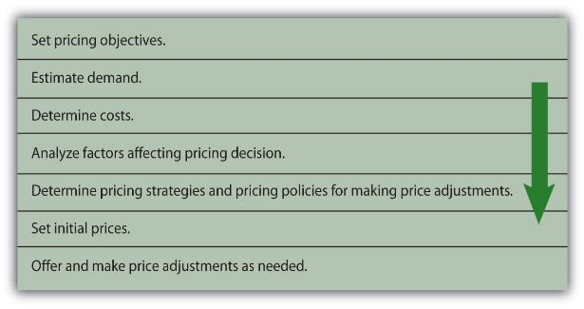
The Pricing Framework
Before pricing a product, an organization must determine its pricing objectives. In other words, what does the company want to accomplish with its pricing?
Companies must also estimate demand for the product or service, determine the costs, and analyze all factors (e.g., competition, regulations, and economy) affecting price decisions.
Then the organization should choose the most appropriate pricing strategy and determine policies and conditions regarding price adjustments.

Slide 4
Pricing Objectives
Earning a Targeted Return on Investment (RO
Maximizing Profits
Maximizing Sales
Maximizing Market Share
Maintaining Status Quo

Slide 5
Earning a Targeted Return on Investment (ROI)
ROI, or return on investment, is the amount of profit an organization hopes to make given the amount of assets, or money, it has tied up in a product. ROI is a common pricing objective for many firms. Companies typically set a certain percentage, such as 10 percent, for ROI in a product’s first year following its launch. So, for example, if a company has $100,000 invested in a product and is expecting a 10 percent ROI, it will want the product’s profit to be $10,000.
Photo by Mathieu Stern on is licensed under the Unsplit License

Slide 6
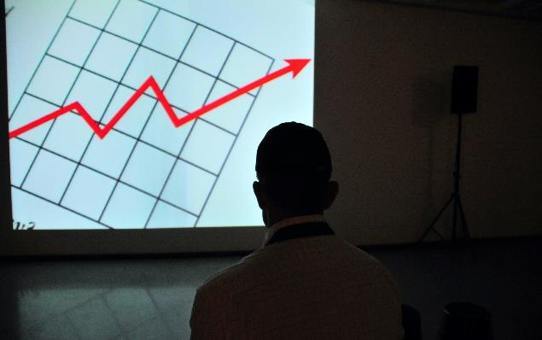
Maximizing Profits
Many companies set their prices to increase their revenues as much as possible relative to their costs. However, large revenues do not necessarily translate into higher profits. To maximize its profits, a company must also focus on cutting costs or implementing programs to encourage customer loyalty.
Photo by Frank Busch on is licensed under the Unsplit License
Notes:
In weak economic markets, many companies manage to cut costs and increase their profits, even though their sales are lower. How do they do this? The Gap cut costs by doing a better job of controlling its inventory. The retailer also reduced its real estate holdings to increase its profits when its sales were down during the latest economic recession. Other firms such as Dell, Inc., cut jobs to increase their profits. Meanwhile, Walmart tried to lower its prices so as to undercut its competitors’ prices to attract more customers. After it discovered that wealthier consumers who didn’t usually shop at Walmart before the recession were frequenting its stores, Walmart decided to upgrade some of its offerings, improve the checkout process, and improve the appearance of some of its stores to keep these high-end customers happy and enlarge its customer base. Other firms increased their prices or cut back on their marketing and advertising expenses. A firm has to remember, however, that prices signal value. If consumers do not perceive that a product has a high degree of value, they probably will not pay a high price for it. Furthermore, cutting costs cannot be a long-term strategy if a company wants to maintain its image and position in the marketplace.

Slide 7
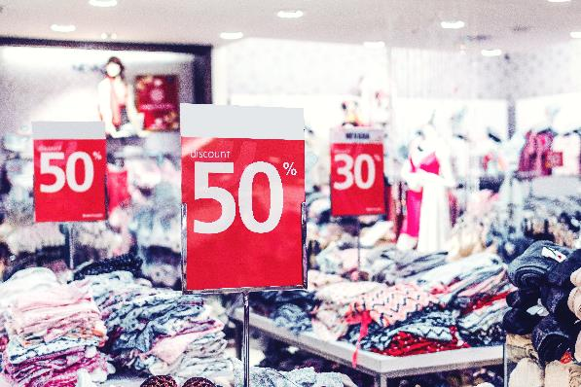
Maximizing Sales
Maximizing sales involves pricing products to generate as much revenue as possible, regardless of what it does to a firm’s profits. When companies are struggling financially, they sometimes try to generate cash quickly to pay their debts. They do so by selling off inventory or cutting prices temporarily. Such cash may be necessary to pay short-term bills, such as payroll. Maximizing sales is typically a short-term objective since profitability is not considered.
Photo by Artem Beliaikin on is licensed under the Unsplit License

Slide 8
Maintaining the Status Quo
Sometimes a firm’s objective may be to maintain the status quo or simply meet, or equal, its competitors’ prices or keep its current prices. Airline companies are a good example. Have you ever noticed that when one airline raises or lowers its prices, the others all do the same? If consumers don’t accept an airline’s increased prices (and extra fees) such as the charge for checking in with a representative at the airport rather than checking in online, other airlines may decide not to implement the extra charge and the airline charging the fee may drop it. Companies, of course, monitor their competitors’ prices closely when they adopt a status quo pricing objective.

Slide 9
Maximizing Market Share
Some organizations try to set their prices in a way that allows them to capture a larger share of the sales in their industries. Capturing more market share doesn’t necessarily mean a firm will earn higher profits, though. Nonetheless, many companies believe capturing a maximum amount of market share is downright necessary for their survival. In other words, they believe if they remain a small competitor they will fail. Firms in the cellular phone industry are an example. The race to be the biggest cell phone provider has hurt companies like Motorola. Motorola holds only 10 percent of the cell phone market, and its profits on their product lines are negative

Slide 10
5.1 Key Takeaway
Price is the only marketing variable that generates money for a company. All the other variables (product, communication, distribution) cost organizations money.
A product’s price is the easiest marketing variable to change and also the easiest to copy.
Before pricing a product, an organization must determine its pricing objective(s).
A company can choose from pricing objectives such as maximizing profits, maximizing sales, capturing market share, achieving a target return on investment (ROI) from a product, and maintaining the status quo in terms of the price of a product relative to competing products.

Slide 11
15.2 Factors That Affect Pricing Decisions
Learning Objective:
Understand the factors that affect a firm’s pricing decisions.
Understand why companies must conduct research before setting prices in international markets.
Learn how to calculate the breakeven point.

Slide 12
Factors That Affect Pricing Decisions
Product Costs
Demand
Customers
The External Environment

Slide 13
Customers
How will buyers respond? Three important factors are whether the buyers perceive the product offers value, how many buyers there are, and how sensitive they are to changes in price. In addition to gathering data on the size of markets, companies must try to determine how price sensitive customers are. Will customers buy the product, given its price? Or will they believe the value is not equal to the cost and choose an alternative or decide they can do without the product or service?
Photo by Joshua Rodriguez on is licensed under the Unsplit License
Notes:
Equally important is how much buyers are willing to pay for the offering. Figuring out how consumers will respond to prices involves judgment as well as research.

Slide 14
Price Elasticity (including definition along with definitions for price elastic and price inelastic)
Price elasticity, or people’s sensitivity to price changes, affects the demand for products. Think about a pair of sweatpants with an elastic waist. You can stretch an elastic waistband like the one in sweatpants, but it’s much more difficult to stretch the waistband of a pair of dress slacks. Elasticity refers to the amount of stretch or change.
Price elasticity = percentage change in quantity demanded ÷ percentage change in price
Notes:
For example, the waistband of sweatpants may stretch if you pull on it. Similarly, the demand for a product may change if the price changes. Imagine the price of a twelve-pack of sodas changing to $1.50 a pack. People are likely to buy a lot more soda at $1.50 per twelve-pack than they are at $4.50 per twelve-pack. Conversely, the waistband on a pair of dress slacks remains the same (doesn’t change) whether you pull on it or not. Likewise, demand for some products won’t change even if the price changes. The formula for calculating the price elasticity of demand is as follows.

Slide 15
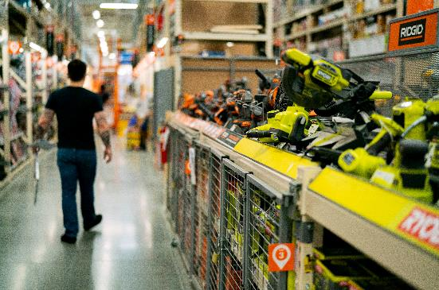
Competitors
How competitors' price and sell their products will have a tremendous effect on a firm’s pricing decisions. If you wanted to buy a certain pair of shoes, but the price was 30 percent less at one store than another, what would you do? Because companies want to establish and maintain loyal customers, they will often match their competitors’ prices. Some retailers, such as Home Depot, will give you an extra discount if you find the same product for less somewhere else.
Photo by Oxana Melis on is licensed under the Unsplit License
Notes:
Similarly, if one company offers you free shipping, you might discover other companies will, too. With so many products sold online, consumers can compare the prices of many merchants before making a purchase decision.
The availability of substitute products affects a company’s pricing decisions as well. If you can find a similar pair of shoes selling for 50 percent less at a third store, would you buy them? There’s a good chance you might. Recall from the five forces model discussed in Chapter 2 “Strategic Planning” that merchants must look at substitutes and potential entrants as well as direct competitors.

Slide 16
The External Environment (Content from The Economy and Government Laws and Regulations section)
The economy also has a tremendous effect on pricing decisions. In Chapter 2 “Strategic Planning” we noted that factors in the economic environment include interest rates and unemployment levels. When the economy is weak and many people are unemployed, companies often lower their prices. In international markets, currency exchange rates also affect pricing decisions.
Pricing decisions are affected by federal and state regulations. Regulations are designed to protect consumers, promote competition, and encourage ethical and fair behavior by businesses. For example, the Robinson-Patman Act limits a seller’s ability to charge different customers different prices for the same products

Slide 17
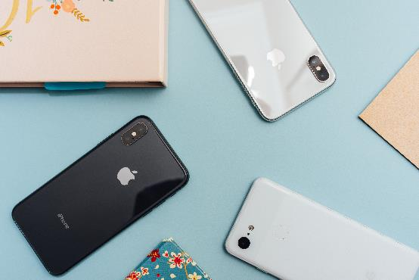
Product Costs
The costs of the product its inputs including the amount spent on product development, testing, and packaging required have to be taken into account when a pricing decision is made. So do the costs related to promotion and distribution. For example, when a new offering is launched, its promotion costs can be very high because people need to be made aware that it exists. Thus, the offering’s stage in the product life cycle can affect its price
Photo by Arnel Hasanovic on is licensed under the Unsplit License
Notes:
Keep in mind that a product may be in a different stage of its life cycle in other markets. For example, while sales of the iPhone remain fairly constant in the United States, the Koreans felt the phone was not as good as their current phones and was somewhat obsolete. Similarly, if a company has to open brick-and-mortar storefronts to distribute and sell the offering, this too will have to be built into the price the firm must charge for it.

Slide 18
Breakeven Point
The point at which total costs equal total revenue is known as the breakeven point (BEP). For a company to be profitable, a company’s revenue must be greater than its total costs. If total costs exceed total revenue, the company suffers a loss.
The formula for BEP is as follows:
BEP = total fixed costs (FC) ÷ contribution per unit (CU)
contribution per unit = MSP – variable costs (VC)
BEP = $200,000 ÷ ($15 – $7) = $200,000 ÷ $8 = 25,000 units to break even
To determine the breakeven point in dollars, you simply multiply the number of units to break even by the MSP. In this case, the BEP in dollars would be 25,000 units times $15, or $375,000.

Slide 19
Pricing Laws, Regulations, and Ethic
Price Fixing
Unfair Trade Laws
Predatory Pricing
Bait and Switch (Deceptive Pricing)
Price Decimation (Robinson-Patman Act)

Slide 20
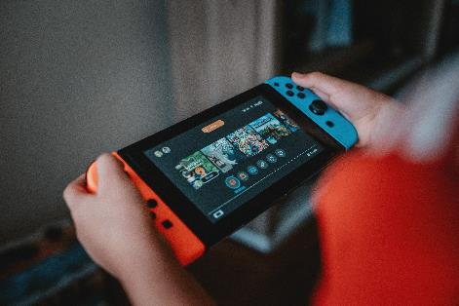
Price fixing
Price fixing, which occurs when firms get together and agree to charge the same prices, is illegal. Usually, price fixing involves setting high prices so consumers must pay a high price regardless of where they purchase a good or service. Video systems, LCD (liquid crystal display) manufacturers, auction houses, and airlines are examples of offerings in which price fixing existed. When a company is charged with price fixing, it is usually ordered to take some type of action to reach a settlement with buyers.
Photo by Alvaro Reyes on is licensed under the Unsplit License
Notes:
Price fixing isn’t uncommon. Nintendo and its distributors in the European Union were charged with price fixing and increasing the prices of hardware and software. Sharp, LG, and Chungwa collaborated and fixed the prices of the LCDs used in computers, cell phones, and other electronics. Virgin Atlantic Airways and British Airways were also involved in price fixing for their flights. Sotheby’s and Christie’s, two large auction houses, used price fixing to set their commissions.

Slide 21
Unfair Trade Laws and Predatory Pricing
Unfair Trade Laws: By requiring sellers to keep a minimum price level for similar products, unfair trade laws protect smaller businesses. Unfair trade laws are state laws preventing large businesses from selling products below cost (as loss leaders) to attract customers to the store.
Predatory Pricing: When companies act in a predatory manner by setting low prices to drive competitors out of business, it is a predatory pricing strategy.

Slide 22
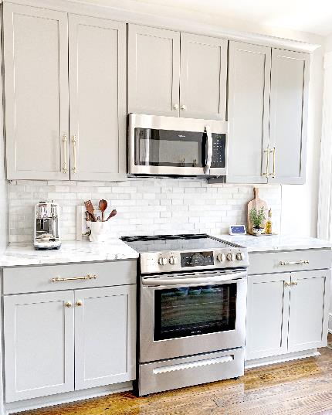
Bait and Switch (Deceptive Pricing)
Bait and switch, or bait advertising, occurs when a business tries to “bait,” or lure in, customers with an incredibly low-priced product. Once customers take the bait, sales personnel attempt to sell them more expensive products. Sometimes the customers are told the cheaper product is no longer available.
Photo by JOSBRA design on is licensed under the Unsplit License
Notes:
You perhaps have seen bait-and-switch pricing tactics used to sell different electronic products or small household appliances. While bait-and-switch pricing is illegal in many states, stores can add disclaimers to their ads stating that there are no rain checks or that limited quantities are available to justify trying to get you to buy a different product. However, the advertiser must offer at least a limited quantity of the advertised product, even if it sells out quickly.

Slide 23
Price Discrimination (Robinson-Patman Act)
Price discrimination or charging different customers different prices for the same product; In some situations, price discrimination is legal.
Certain customer groups (students, children, and senior citizens, for example) are sometimes offered discounts at restaurants and events. However, the discounts must be offered to all senior citizens or all children within a certain age range, not just a few.
Photo by Joe Hepburn on is licensed under the Unsplit License
Notes:
Price discrimination is used to get more people to use a product or service. Similarly, a company might lower its prices in order to get more customers to buy an offering when business is slow. Matinees are often cheaper than movies at night; bowling might be less expensive during nonleague times, and so forth.

Slide 24
5.2 Key Takeaway
In addition to setting a pricing objective, a firm has to look at a number of factors before setting its prices. Factors include the offering’s costs, the customers, the external environment and other aspects of the marketing mix.
In international markets, firms must look at environmental factors and customers’ buying behavior in each market. For a company to be profitable, revenues must exceed total costs.

Slide 25
15.3 Pricing Strategies
Learning Objectives:
Understand introductory pricing strategies.
Understand the different pricing approaches that businesses use.

Slide 26
Pricing Approaches
Cost- Plus (Markup
Odd-Even Pricing
Prestige Pricing
Price Lining
Demand Backward Pricing
Leader Pricing/ Loss Leaders
Sealed Bid Pricing
Going Rate Pricing
Price Bundling
Captive Pricing
Product Mix Pricing
Payment Pricing
Promotional Pricing

Slide 27
Pricing Approaches Part One
Skimming Price: Strategy is when a company sets a high initial price for a product.
Penetration Pricing: Strategy is one in which a low initial price is set.
Cost-Plus Pricing: Is very common. The strategy helps ensure that a company’s products’ costs are covered, and the firm earns a certain amount of profit.
Prestige Pricing: Occurs when a higher price is utilized to give an offering a high-quality image.
Leader Pricing: Involves pricing one or more items low to get people into a store.
Sealed bid Pricing: Is the process of offering to buy or sell products at prices designated in sealed bids.

Slide 28
Pricing Approaches Part Two
Going-Rate Pricing: Occurs when buyers pay the same price regardless of where they buy the product or from whom.
Price Bundling: Occurs when different offerings are sold together at a price that’s typically lower than the total price a customer would pay by buying each offering separately.
Captive Pricing: Is a strategy firms use when consumers must buy a given product because they are at a certain event or location or they need a particular product because no substitutes will work.
Promotional Pricing: Is a short-term tactic designed to get people into a store or to purchase more of a product.

Slide 29
Pricing Approaches Part Three
Cost-plus (Markup): In which they take the cost of the product and then add a profit to determine a price.
Odd-Even Pricing: occurs when a company prices a product a few cents or a few dollars below the next dollar amount.
Price Lining: Price lining is the practice of releasing multiple versions of the same product or service at different price points simultaneously.
Demand Backward Pricing: Knowing that people have certain maximum levels that they are willing to pay for gifts, some companies use

Slide 30
Pricing Approaches Part Four
Product Mix Pricing: Includes all the products a company offers. If you want to buy an automobile, the base price might seem reasonable, but the options such as floor mats might earn the seller a much higher profit margin.
Two Part Pricing: means there are two different charges customers pay. In the case of a cell phone, a customer might pay a charge for one service such as a thousand minutes, and then pay a separate charge for each minute over one thousand.
Payment Pricing: or allowing customers to pay for products in installments, is a strategy that helps customers break up their payments into smaller amounts, which can make them more inclined to buy higher-priced products.

Slide 31
Pricing Approaches Part Five
Product Mix Pricing: Pricing products consumers use together (such as blades and razors) with different profit margins
Two Part Pricing: Means there are two different charges customers pay. In the case of a cell phone, a customer might pay a charge for one service such as a thousand minutes, and then pay a separate charge for each minute over one thousand.
Payment Pricing: Allowing customers to pay for products in installments, is a strategy that helps customers break up their payments into smaller amounts, which can make them more inclined to buy higher-priced products.

Slide 32
Pricing Adjustments Table
Quantity Discounts | Giving customers discounts for larger purchases.
FOB (Free on Board) Origin | The title changes at the origin that is, when the product is purchased, and the buyer pays the shipping charges.
FOB (Free on Board) Destinations | Means the title changes at the destination—that is, after the product is transported—and the seller pays the shipping charges.
Uniform-Delivered Pricing | Also called postage-stamp pricing, means buyers pay the same shipping charges regardless of where they are located. If you mail a letter across town, the postage is the same as when you mail a letter to a different state.
Trade Allowance | Training, and special incentives given to retailers to market particular products and services, such as extra money, in-store displays, and prizes.

Slide 33
Introductory Pricing Strategies
Price Skimming
Penetration Pricing
Everyday Low Pricing
Status Quo Pricing

Slide 34
Price Skimming
Skimming price strategy is when a company sets a high initial price for a product. The idea is to go after consumers who are willing to pay a high price (top of the market) and buy products early. This way, a company recoups its investment in the product faster. The easy way to remember a skimming approach is to think of the turkey gravy at Thanksgiving.
Photo by Claudio Schwarz on is licensed under the Unsplit License
Notes:
When the gravy is chilled, the fat rises to the top and is often “skimmed” off before serving. Price skimming is a pricing approach designed to skim that top part of the gravy, or the top of the market. Over time, the price of the product goes down as competitors enter the market and more consumers are willing to purchase the offering.

Slide 35
Penetration Pricing
Penetration pricing strategy is one in which a low initial price is set. Often, many competitive products are already in the market. The goal is to get as much of the market as possible to try the product.
Penetration pricing is used on many new food products, health and beauty supplies, and paper products sold in grocery stores and mass merchandise stores such as Walmart, Target, and Kmart.
Photo by Eco Warrior Princess Schwarz on is licensed under the Unsplit License

Slide 36
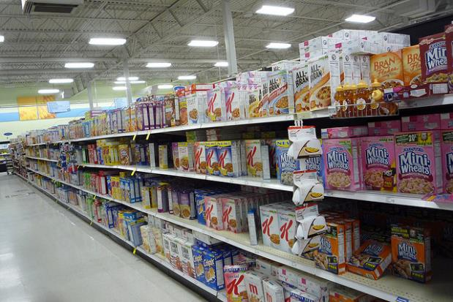
Everyday Low Pricing
Everyday low prices. That is, the price initially set is the price the seller expects to charge throughout the product’s life cycle. Companies like Walmart and Lowe’s use everyday low pricing. Lowe’s emphasizes their everyday low pricing strategy with the letters in their name plus the letter “t” (Lowest).
Rex Roof – Cereal Aisle – CC BY 2.0.

Slide 37
Status Quo Pricing
Sometimes a firm’s objective may be to maintain the status quo or simply meet, or equal, its competitors’ prices or keep its current prices. Airline companies are a good example. Have you ever noticed that when one airline raises or lowers its prices, the others all do the same? If consumers don’t accept an airline’s increased prices (and extra fees) such as the charge for checking in with a representative at the airport rather than checking in online, other airlines may decide not to implement the extra charge and the airline charging the fee may drop it. Companies, of course, monitor their competitors’ prices closely when they adopt a status quo pricing objective.

Slide 38
5.3 Key Takeaway
Both external and internal factors affect pricing decisions. Companies use many different pricing strategies and price adjustments.
The price must generate enough revenues to cover costs in order for the product to be profitable.
Organizations must also decide what their policies are when it comes to making price adjustments, or changing the listed prices of their products.
Some companies use price adjustments as a short-term tactic to increase sales.

