Slide 1
Principles of Marketing
Chapter 12 – Public Relations, Social Media, and Sponsorships
Unless otherwise noted, this work is licensed under a Creative Commons Attribution-NonCommercial-ShareAlike 4.0 International (CC BY-NC-SA 4.0) license. Feel free to use, modify, reuse or redistribute any portion of this presentation.

Slide 2
12.1 Public Relations Activities and Tools
Learning Objectives
Understand the concept of public relations and why organizations allocate part of their promotional budgets to it.
Understand what the different types of public relations tools are.
Explain how companies use different public relations tools to their advantage.

Slide 3
12.1 Continued
Good public relations (PR) efforts can help a firm create rapport with its customers, promote what it has to offer, and supplement its sales efforts.
Public relations materials include press releases, publicity, and news conferences.
Companies also use PR to promote products and to supplement their sales efforts.
Photo by Austin Distel is licensed under the Unsplit License

Slide 4
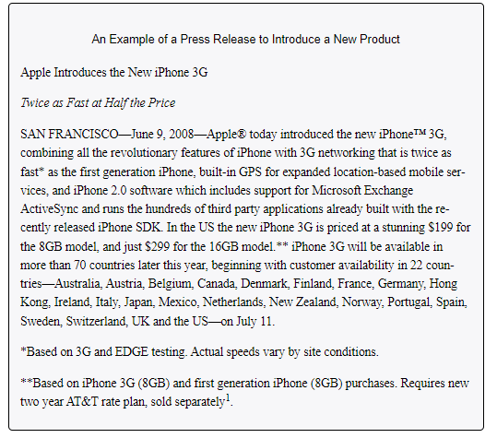
Press Releases
Part of a company’s public relations efforts includes putting a positive spin on news stories. A press release is a news story written by an organization to promote a product, organization, or person.
The PR opportunities that companies may seek to highlight in their press releases include charity events, awards, new products, company reports, and things they are doing to improve the environment or local community.

Slide 5
Cause-Related Marketing
Is one of the fastest-growing types of sponsorships. It occurs when a company supports a nonprofit organization in some way. For example, M&M’s sponsors the Special Olympics and American Airlines raises money for breast cancer research with an annual celebrity golf and tennis tournament. The airline also donates frequent flier miles to the cause. Yoplait Yogurt donates money for breast cancer research for every pink lid that is submitted. Cause-related marketing can have a positive PR impact by strengthening the affinity people have for a company that does it.

Slide 6
Product Placements
Getting a company’s product included as part of a television show, movie, video game, special event, or book is called a product placement. When you watch reruns of Seinfeld, you often see different Coca-Cola products being consumed. Likewise, you might see a Nissan Maxima on Desperate Housewives. Over four hundred product placements typically appear in each episode of The Biggest Loser. Apple placed products in twenty-four movies that reached number one between August 1, 2008, and August 1, 2009, while Ford products appeared twenty times and Budweiser products appeared twelve times5.

Slide 7
12.1 Sponsorships
A sponsorship involves paying a fee to have your name associated with different things, such as the following:
A particular venue (Wrigley Field; the Staples Center)
A superstar’s apparel (Tiger Woods wearing Nike hats and shirts)
An event (the AT&T National Golf Tournament; the Chick-fil-A Peach Bowl)
A cause (M&M’s support of the Special Olympics)
An educational workshop or information session

Slide 8
Key Takeaway
Public relations (PR) are the activities organizations engage in to create a positive image for a company, product, service, or a person. Press releases, a commonly used PR tool, are designed to generate publicity, but there is no guarantee the media will use them in the stories they write. Sponsorships are designed to increase brand awareness, improve corporate image, and reach target markets. Product placements are designed to generate exposure, brand awareness, and interest.

Slide 9
12.2 Social Media
Learning Objectives
Understand the different social media zones.
Understand how social media can generate publicity.
Explain how social media keeps changing.

Slide 10
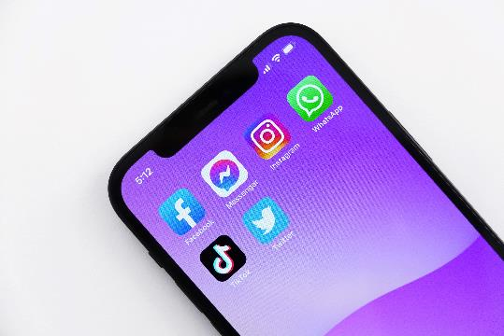
Social Media
Social media uses technology and mobility to provide an interactive means of communication among people, organizations, and communities who are interconnected and interdependent. Social media zones include social communities, social publishing, social entertainment, and social commerce. More companies are using social media to promote their products as well as for recruiting.
Photo by Jeremy Bezanger is licensed under the Unsplit License

