Slide 1
Principles of Marketing
Chapter 11 – Integrated Marketing Communications and the Changing Media Landscape
Unless otherwise noted, this work is licensed under a Creative Commons Attribution-NonCommercial-ShareAlike 4.0 International (CC BY-NC-SA 4.0) license. Feel free to use, modify, reuse or redistribute any portion of this presentation.

Slide 2
11.1 Integrated Marketing Communications (IMC)
Learning Objective:
Understand what integrated marketing communications (IMC) are.
Understand why organizations may change their promotional strategies to reach different audiences.

Slide 3
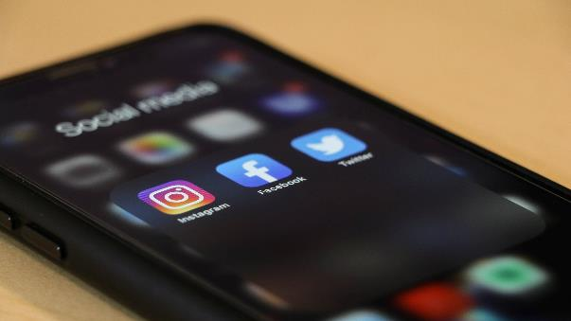
Social Media
Social media (online communication among interdependent and interconnected networks of organizations, people, and communities) explain one of the reasons why integrated marketing communications have become so important. Consumers are also changing. With access to many sources of information and often an interest in interactive media, consumers may collect more product information on their own.
Photo by dole777 on is licensed under the Unsplash License

Slide 4
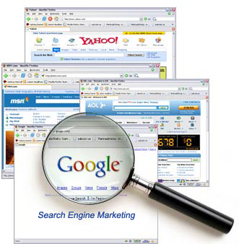
Mobile Marketing
You might opt to get promotions via mobile marketing—say, from stores on your cell phone as you walk by them or via a mobile gaming device that allows you to connect to the Web. Likewise, advertisements on Facebook are popular as businesses continue to utilize more social media.
Danard Vincente – Search-Engine-Marketing – CC BY 2.0.
Notes:
For example, when Honda let people on Facebook use the Honda logo to give heart-shaped virtual gifts on Valentine’s Day, over one and a half million people participated in the event and viewed the Honda Fit online in the process. Imagine the brand awareness generated for the Honda Fit.

Slide 5
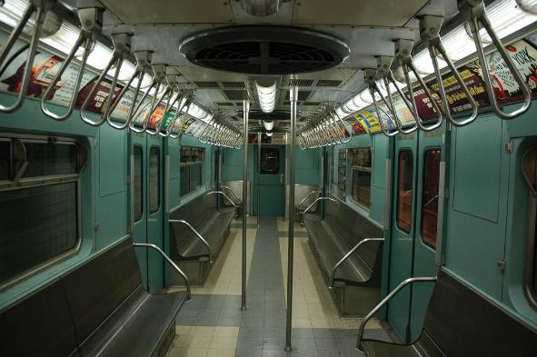
Out-of-Home Advertising
Out-of-home advertising such as billboards and movable promotions. You might have noticed that the tray tables on airplanes sometimes have ads on them. You have probably also seen ads on the inside of subway cars, in trains and buses, and even in bathroom stalls. These, too, are examples of out-of-home advertising.
emilydickinsonridesabmx – Vintage NYC Subway Trains – CC BY 2.0.

Slide 6
11.1 IMC
Integrated marketing communications (IMC) provide an approach designed to deliver one consistent message to buyers through an organization’s promotions that may span all different types of media such as TV, radio, magazines, the Internet, mobile phones, professional selling, and social media.

Slide 7
11.1 IMC Continued
Changes in communication technology and instant access to information through tools such as the Internet and social media (online communication among interdependent and interconnected networks of organizations, people, and communities) explains one of the reasons why integrated marketing communications have become so important.

Slide 8
11.1 Key Takeaway
As the media landscape changes, marketers may change the type of promotions they use in order to reach their target markets. With changing technology and social media (e.g., Facebook), less money is being budgeted for traditional media such as magazines and more money is budgeted for “non-traditional media.” Regardless of the type of media used, marketers use integrated marketing communications (IMC) to deliver one consistent message to buyers.

Slide 9
11.2 The Promotion (Communication) Mix
Learning Objective:
Understand the different components of the promotion (communication) mix and why organizations may consider all components when designing the IMC program.
Understand the difference between types of communication that target many people at one time versus types of communication that target individuals.

Slide 10
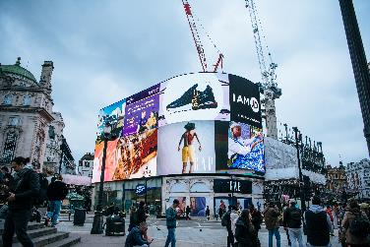
Advertising
Advertising involves paying to disseminate a message that identifies a brand (product or service), or an organization being promoted to many people at one time. The typical media that organizations utilize for advertising of course include television, magazines, newspapers, the Internet, direct mail, and radio. Businesses also advertise on mobile devices and social media such as Facebook, blogs, and Twitter.
Photo by Tânia Mousinho on is licensed under the Unsplash License

Slide 11
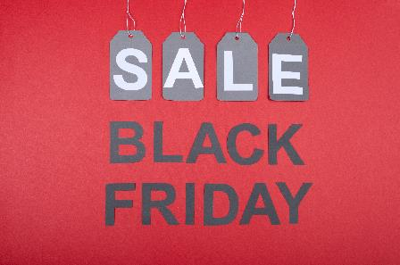
Consumer sales promotions
Consumer sales promotions consist of short-term incentives such as coupons, contests, games, rebates, and mail-in offers that supplement the advertising and sales efforts.
Photo by Tamanna Rumee on is licensed under the Unsplash License
Notes:
Sales promotions include promotions that are not part of another component of the communication mix and are often developed to get customers and potential customers to take action quickly, make larger purchases, and/or make repeat purchases.

Slide 12
Direct Marketing
Direct marketing involves the delivery of personalized and often interactive promotional materials to individual consumers via channels such as mail, catalogs, Internet, e-mail, telephone, and direct-response advertising. By targeting consumers individually, organizations hope to get consumers to act.
Photo by micheile dot com on is licensed under the Unsplash License

Slide 13
Professional Selling
Professional selling is an interactive, paid approach to marketing that involves a buyer and a seller. The interaction between the two parties can occur in person, by telephone, or via another technology. Whatever medium is used, developing a relationship with the buyer is usually something the seller desires.
Photo by Chase Chappell on is licensed under the Unsplash License

Slide 14
Public Relations
Public relations (PR) involves communication designed to help improve and promote an organization’s image and products. PR is often perceived as more neutral and objective than other forms of promotion because much of the information is tailored to sound as if it has been created by an organization independent of the seller.
Notes:
Public relations materials include press releases, publicity, and news conferences. While other techniques such as product placement and sponsorships, especially of events and experiences, tend to generate a lot of PR, the growth of expenditures and importance of sponsorships are so critical for so many companies that it is often considered a separate component in the communication mix. Many companies have internal PR departments or hire PR firms to find and create public relations opportunities for them. As such, PR is part of a company’s promotion budget and their integrated marketing communications.

Slide 15
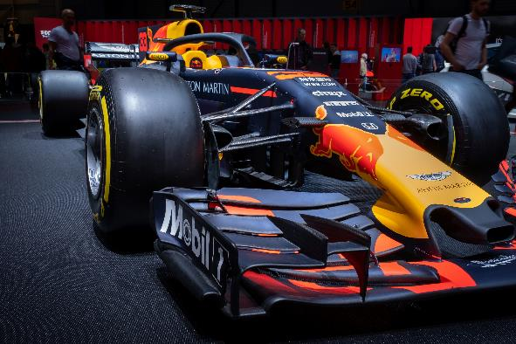
Sponsorships
Sponsorships typically refer to financial support for events, venues, or experiences and provide the opportunity to target specific groups. Sponsorships enhance a company’s image and usually generate public relations. With an increasing amount of money being spent on sponsorships, they have become an important component of the promotion mix.
Photo by Patrick Robert Doyle on is licensed under the Unsplash License

Slide 16
IMC 7 Factors
Advertising
Sales Promotions
Direct Marketing
Professional Selling
Public Relations
Sponsorships
Online Midea

Slide 17
11.2 The Promotion Mix
The different types of marketing communications an organization uses compose its promotion or communication mix, which consists of advertising, sales promotions, direct marketing, public relations and publicity, sponsorships (events and experiences), social media and interactive marketing, and professional selling.
Typical media that organizations utilize for advertising include television, magazines, newspapers, the Internet, direct mail, and radio.
Photo by charlesdeluvio on is licensed under the Unsplash License
Notes:
11.2 The Promotion Mix

Slide 18
11.2 Key Takeaway
Technology is changing the way businesses and individuals communicate. Organizations use Integrated Marketing Communications (IMC) to deliver a consistent message across all components of the promotion mix.
The promotion (communication) mix is composed of advertising, professional selling, public relations, sponsorships (events and experiences), sales promotion, direct marketing, and online media, including social media.

Slide 19
Factors that Influence the Promotion Mix Part One
Budget Available: For many companies, the budget available to market a product determines what elements of the promotion mix are utilized.
Stage in the Product Life Cycle: The stage in the product life cycle also affects the type and amount of promotion used.
Type of Product and Type of Purchase Decision: Different products also require different types of promotion. Very technical products and very expensive products (high involvement) often need professional selling, so the customer understands how the product operates and its different features.

Slide 20
Factors that Influence the Promotion Mix Part Two
Target market characteristics and consumers’ readiness to purchase: In order to select the best methods to reach different target markets, organizations need to know what types of media different targets use, how often they make purchases, where they make purchases, and what their readiness to purchase is as well as characteristics such as age, gender, and lifestyle.
Consumers’ preferences for various media: We’ve already explained that different types of consumers prefer different types of media. In terms of target markets, college-aged students may prefer online, cell phone, mobile marketing, and social media more than older consumers do

Slide 21
Factors that Influence the Promotion Part Three
Regulations, competitors, and environmental factors: Regulations can affect the type of promotion used. For example, laws in the United States prohibit tobacco products from being advertised on television.
Availability of media: Organizations must also plan their promotions based on availability of media. The top-rated television shows and Super Bowl ad slots, for example, often sell out quickly.

Slide 22
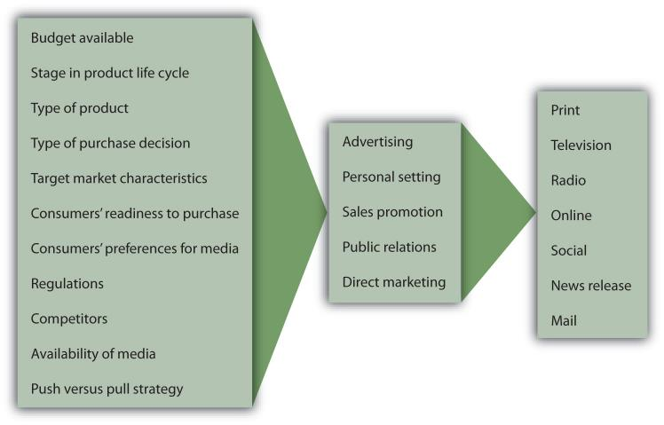
11.3 Factors Influencing the Promotion Mix, Communication Process, and Message Problems
Factors affect the choice of promotion mix elements. (Figure 11.5)

Slide 23
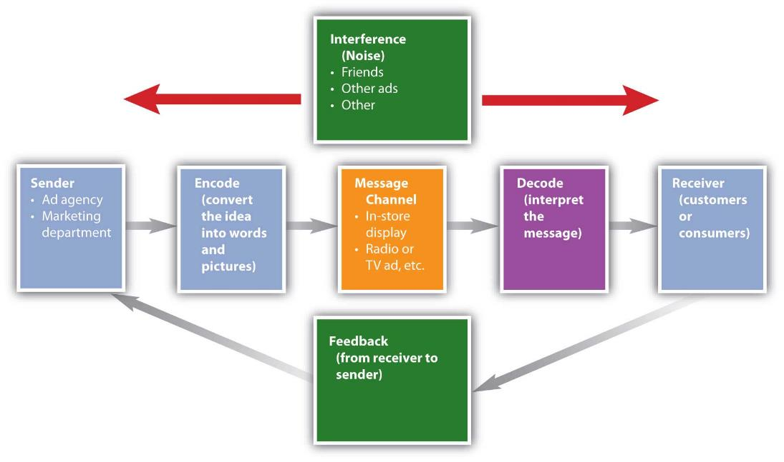
The Communications Process
Figure 11.6 “The Communication Process.
Notes:
The Communications Process

Slide 24
The Communications Process Continued
The communication process illustrates how messages are sent and received. The source (or sender) encodes, or translates, a message so that it’s appropriate for the message and shows the benefits and value of the offering.
The receiver (customer or consumer) then decodes, or interprets, the message.
For effective communication to occur, the receiver must interpret the message as the sender intended
Notes:
The Communications Process

Slide 25
11.4 Advertising and Direct Marketing
Learning Objective:
Understand the difference between media and vehicles.
Explain the similarities and differences between advertising and direct marketing.
Understand the benefits of direct marketing and what types of direct marketing organizations often utilize.

Slide 26
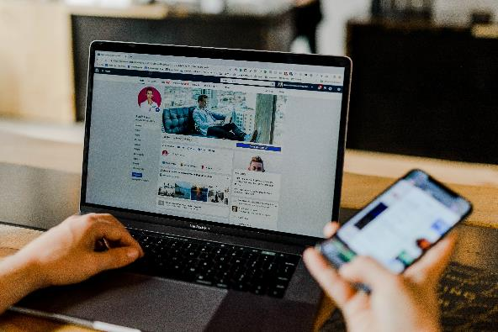
11.4 Advertising
Advertising is paid for communication that has an identified sponsor and reaches many people at one time. Once companies decide on different media (e.g., magazines or television), they must also select specific vehicles (e.g., Sports Illustrated or the Super Bowl),
Photo by Austin Distel on is licensed under the Unsplash License
Notes:
11.4 Advertising

Slide 27
11.4 Direct marketing
Direct marketing allows organizations to target specific individuals and use direct response advertising. Telemarketing, the Internet, direct mail, and catalogs are popular direct marketing methods.
Photo by Chris Murray on is licensed under the Unsplash License

Slide 28
11.5 Message Strategies
Learning Strategies:
Understand what a unique selling proposition is and how it is used.
Understand different types of promotion objectives.
Identify different message strategies.

Slide 29
AIDA model
Interest
Desire
Action
Attention
Notes:
AIDA model (attention, interest, desire, and action). AIDA objectives typically are achieved in steps. First, companies focus on attention and awareness of a product or service, which is especially important for new offerings. If a consumer or business is not aware of a product or service, they won’t buy it. Once consumers or businesses are aware of products or services, organizations try to get consumers interested and persuade them that their brands are best. Ultimately, companies want consumers to take action or purchase their products or services.

Slide 30
Message Characteristics and Advertising Appeals
Organizations must also determine what type of appeal to use and how to structure their messages. Some of the common advertising appeals are
Humorous
Emotional
Frightening (fear),
Rational (informative)
Environmentally conscious
Notes:
Many people like commercials that use humor because they are typically entertaining and memorable. Humor sells, but firms must be careful that the brand is remembered. Some commercials are very entertaining, but consumers cannot remember the brand or product.
Message Characteristics and Advertising Appeals

Slide 31
11.5 Unique Selling Proposition
When organizations want to communicate value, they must determine what message strategies work best for them. Smart organizations determine a product’s unique selling proposition (USP), or specific benefit consumers will remember.
When deciding on a message strategy, organizations must consider the audience, the objectives of the promotion, the media, and the budget, as well as the USP and the product.
Advertisers promotion objectives follow the AIDA model (attention, interest, desire, and action).
Notes:
11.5 Unique Selling Proposition

Slide 32
11.6 The Promotion Budget
Learning Objectives:
Understand different ways in which promotion budgets can be set.
Understand how the budget can be allocated among different media

Slide 33
Methods to Determine Promotion Budget
An offering’s budget is a critical factor when it comes to deciding which message strategies to pursue. Several methods can be used to determine the promotion budget.
Percentage of Last Year’s Sales
Affordable Method
Competitive Parity
Objective and Task Method

Slide 34
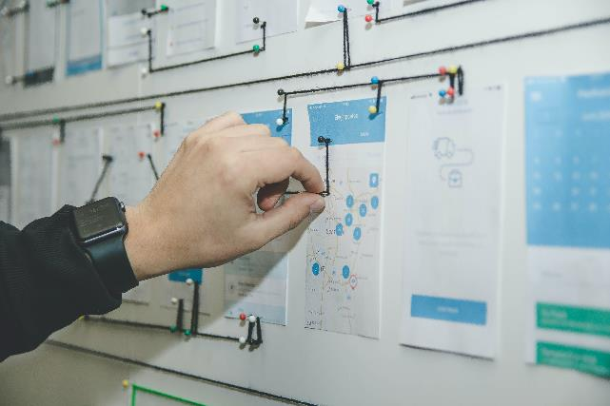
Percentage of Last Year’s Sales
The simplest method for determining the promotion budget is often merely using a percentage of last year’s sales or the projected sales for the next year. This method does not consider any changes in the market or unexpected circumstances. However, many firms use this method because it is simple and straightforward.
Photo by Alvaro Reyes on is licensed under the Unsplash License

Slide 35
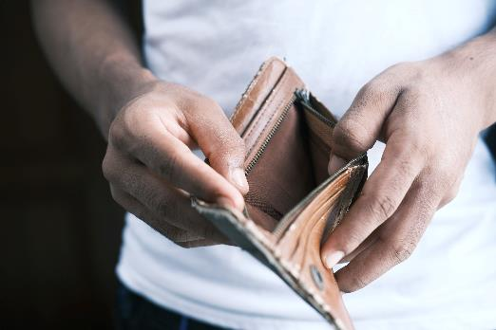
Affordable Method
Affordable method, or what you think you can afford, is a method used often by small businesses. Unfortunately, things often cost more than anticipated, and you may not have enough money. Many small businesses think they’re going to have money for promotion, but they run out and cannot spend as much on promotion as they had hoped.
Photo by Towfiqu barbhuiya on is licensed under the Unsplash License
Notes:
Such a situation may have happened to you when you planned a weekend trip based on what you thought you could afford, and you did not have enough money. As a result, you had to modify your plans and not do everything you planned.

Slide 36
Competitive Parity
Other companies may decide to use competitive parity—that is, they try to keep their promotional spending comparable to the competitors’ spending level. This method is designed to keep a brand in the minds of consumers. During a recession, some firms feel like they must spend as much—if not more—than their competitors to get customers to buy from them.
Photo by Sasun Bughdaryan barbhuiya on is licensed under the Unsplash License
Notes:
Other companies are forced to cut back on their spending or pursue more targeted promotions. When Kmart faced bankruptcy, they cut back on expenditures, yet they kept their advertising inserts (free-standing inserts, or FSI) in Sunday newspapers to remain competitive with other businesses that had an FSI.

Slide 37
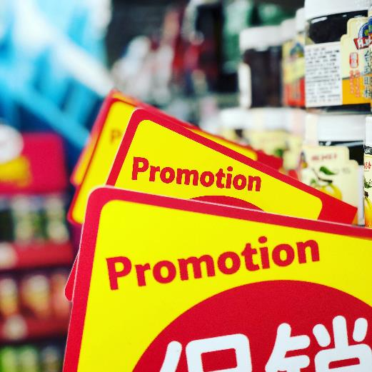
Objective and Task Method
A more rational and ideal approach is the objective and task method, whereby marketing managers first determine what they want to accomplish (objectives) with their communication. Then they determine what activities—commercials, sales promotions, and so on—are necessary to accomplish the objectives. Finally, they conduct research to figure out how much the activities, or tasks, cost in order to develop a budget.
Photo by JJ Ying on is licensed under the Unsplash License

Slide 38
11.6 Key Takeaway
Companies use sales promotions to get customers to take action (make purchases) quickly. Sales promotions increase the awareness of products, help introduce new products, and often create interest in the organizations that run the promotions. Coupons, contests, samples, and premiums are among the types of sales promotions aimed at consumers. Trade promotions, or promotions aimed at businesses, include trade shows, sales contests, trade allowances, and push money.
Notes:
11.6 Key Takeaway

Slide 39
11.7 Sales Promotions
Learning Objectives:
Learn about different types of sales promotions companies use to get customers to buy their products.
Understand the different types of sales promotions companies use with their business customers.
Understand why sales promotions have become such an integral part of an organization’s promotion mix.
Differentiate between push and pull strategies.

Slide 40
Consumer Sales Promotions
A Free Sample: allows consumers to try a small amount of a product so that hopefully they will purchase it. The strategy encourages trial and builds awareness.
Coupons: provide an immediate price reduction off an item. The amount of the coupon is later reimbursed to the retailer by the manufacturer. The retailer gets a handling fee for accepting coupons.
Point-of-Purchase Displays: including coupon machines placed next to products in stores, encourage consumers to buy a brand or product immediately.
Notes:
Consumer Sales Promotions

Slide 41
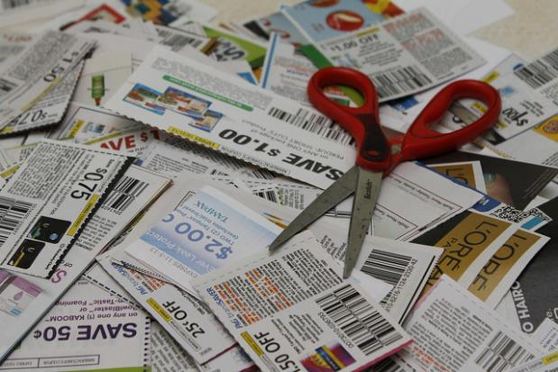
Consumer Sales Promotions Continued
Premium: is something you get either for free or for a small shipping and handling charge with your proof of purchase (sales receipt or part of package).
Contests are sales promotions people enter or participate in to have a chance to win a prize.
Carol Pyles – Coupon Pile Stock Pile – CC BY 2.0.

Slide 42
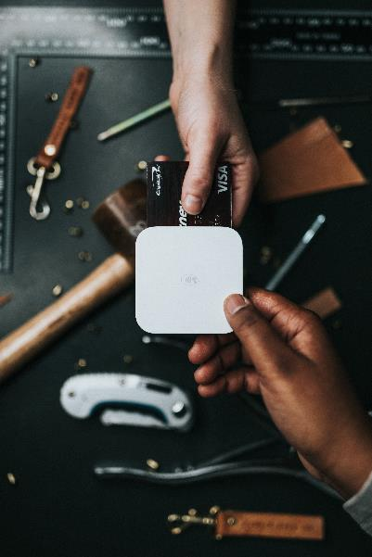
Loyalty programs
Loyalty programs are sales promotions designed to get repeat business. Loyalty programs include things such as frequent flier programs, hotel programs, and shopping cards for grocery stores, drugstores, and restaurants. Sometimes point systems are used in conjunction with loyalty programs.
Photo by Nathan Dumlao on is licensed under the Unsplit License
Notes:
After you accumulate so many miles or points, an organization might provide you with a special incentive such as a free flight, free hotel room, or free sandwich. Many loyalty programs, especially hotels and airlines, have partners to give consumers more ways to accumulate and use miles and points.

Slide 43
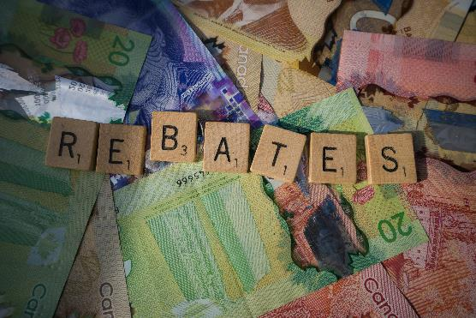
Rebates
Rebates are popular with both consumers and the manufacturers that provide them. When you get a rebate, you are refunded part (or all) of the purchase price of a product back after completing a form and sending it to the manufacturer with your proof of purchase.
Photo by Frugal Flyer on is licensed under the Unsplit License
Notes:
The trick is completing the paperwork on time. Although different types of sales promotions work best for different organizations, rebates are very profitable for companies because many consumers forget or wait too long to send in their rebate forms. Consequently, they do not get any money back. Rebates sound great to consumers until they forget to send it back

Slide 44
Trade Promotions and Trade Shows
Trade promotions include trade shows, conventions, event marketing, trade allowances, training, and special incentives given to retailers to market particular products and services, such as extra money, in-store displays, and prizes.
Trade shows are one of the most common types of sales promotions in B2B markets. A trade show is an event in which firms in a particular industry display and demonstrate their offerings to other organizations they hope will buy them

Slide 45
Trade Allowances and Advertising Allowance
Trade allowances give channel partners—for example, a manufacturer’s wholesalers, distributors, retailers, and so forth—different incentives to push a product. One type of trade allowance is an advertising allowance (money) to advertise a seller’s products in local newspapers.
An advertising allowance benefits both the manufacturer and the retailer. Typically, the retailer can get a lower rate than manufacturers on advertising in local outlets, saving the manufacturer money. The retailer benefits by getting an allowance from the manufacturer.
Notes:
Trade Allowances and Advertising Allowance

Slide 46
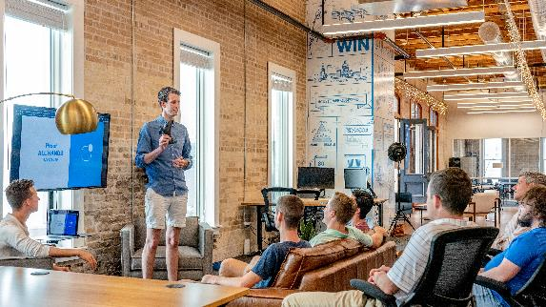
Training and Product Demonstration
Training to help their salespeople understand how the manufacturers’ products work and how consumers can be enticed to buy them.
Many manufacturers also provide in-store product demonstrations to show a channel partner’s customers how products work and answer any questions they might have.
Photo by Austin Distel on is licensed under the Unsplit License

Slide 47
Free Merchandise and Push Money
Free Merchandise: such as a tool, television, or other product produced by the manufacturer, can also be used to get retailers to sell products to consumers. In other words, a manufacturer of televisions might offer the manager of a retail electronics store a television to push its products.
Push Money: or a cash incentive from the manufacturer to push a particular item. The push to sell the item might be because there is a large amount of inventory of it, it is being replaced by a new model, or the product is not selling well.

Slide 48
Examples of Sales Promotions
Consumer Sales Promotions | Business-To-Business Sales Promotions
Coupons | Trade Show and Conventions
Sweepstakes or Contests | Sale Contests
Premiums | Trade and Advertising Allowance
Rebates | Product Demonstrations
Samples | Training
Loyalty Programs | Free Merchandise
Point-of-Purchase Displays | Push Money
Figure 11.15 “Examples of Sales Promotions”
Notes:
Figure 11.15 “Examples of Sales Promotions” recaps the different types of sales promotions designed for both consumers and businesses.

Slide 49
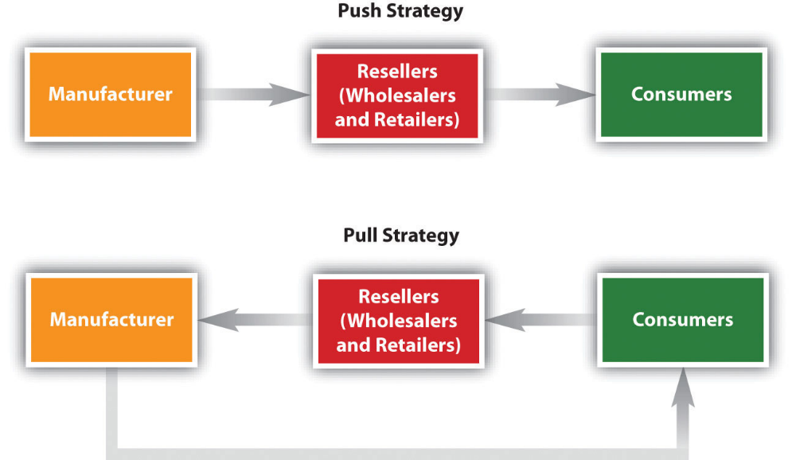
Push versus Pull Strategy
Figure 11.16 A Push versus a Pull Strategy

Slide 50
Push versus Pull Strategy Part One
Push strategy involves promoting a product to businesses (middlemen), such as wholesalers and retailers, who then push the product through the channel promoting it to final consumers. Manufacturers may set up displays in retail outlets for new products or provide incentives such as price discounts to the retailer so the retailer can promote or push the product to consumers.
Notes:
Push versus Pull Strategy

Slide 51
Push versus Pull Strategy Part Two
Pull strategy when they target final consumers with promotions. In other words, a company promotes it products and services to final consumers to pull consumers into the stores or get the consumers asking for the product. If a company sends coupons to the consumers, hopefully the consumers will take the coupons (sales promotion) to the store and buy the product. A manufacturer promotes its new product on television to consumers and places coupons in the newspaper inserts, hoping consumers will demand the product. Their pull causes wholesalers and retailers to buy the product to try to meet the demand.
Notes:
Push versus Pull Strategy

Slide 52
11.7 Key Takeaway
Companies use sales promotions to get customers to act (make purchases) quickly. Sales promotions increase the awareness of products, help introduce new products, and often create interest in the organizations that run the promotions. Coupons, contests, samples, and premiums are among the types of sales promotions aimed at consumers. Trade promotions, or promotions aimed at businesses, include trade shows, sales contests, trade allowances, and push money.
Notes:
Key Takeaway

