Slide 1
Chapter 9 Stoichiometry using Chemical Equations
Slides to accompany Enhanced Introductory College Chemistry by Gregory Anderson, Caryn Fahey, J.R. van Haarlem, Jackie MacDonald, Adrienne Richards, Samantha Sullivan Sauer, and David Wegman
Slide design and template by Revathi Mahadevan
Except where otherwise noted, images, tables & diagrams are reused from Enhanced Introductory College Chemistry, a derivative of Chemistry (Open Stax) by Paul Flowers, Klaus Theopold, Richard Langley & William R. Robinson and is licensed under CC BY 4.0. ​Access for free at Chemistry (OpenStax)​
Slides are licensed under CC-BY 4.0, Except while otherwise noted

Slide 2
Figure 9a
Figure 9a Example of a chemistry building that required stoichiometric quantifications to be constructed. (credit: Photo by Bree Evans, Unsplash license)

Slide 3
Figure 9.1a
Figure 9.1a Aluminum and iodine react to produce aluminum iodide. The heat of the reaction vaporizes some of the solid iodine as a purple vapour. (credit: modification of work by Mark Ott in Chemistry (OpenStax), CC BY 4.0.)

Slide 4
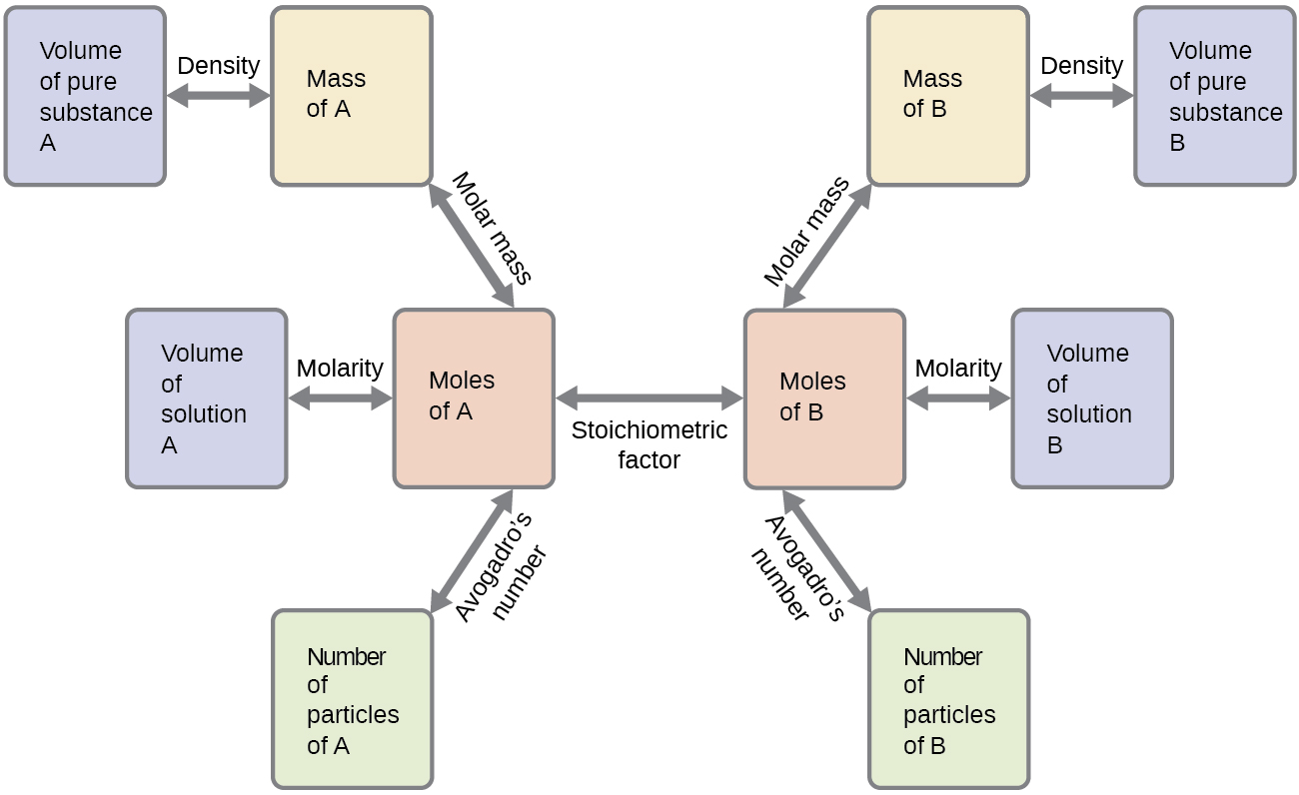
Figure 9.2a
Figure 9.2a The flowchart depicts the various computational steps involved in most reaction stoichiometry calculations. (credit: Chemistry (OpenStax), CC BY 4.0.)

Slide 5
Figure 9.2b
Figure 9.2b Airbags deploy upon impact to minimize serious injuries to passengers. (credit: work by Jon Seidman, CC BY 2.0)

Slide 6
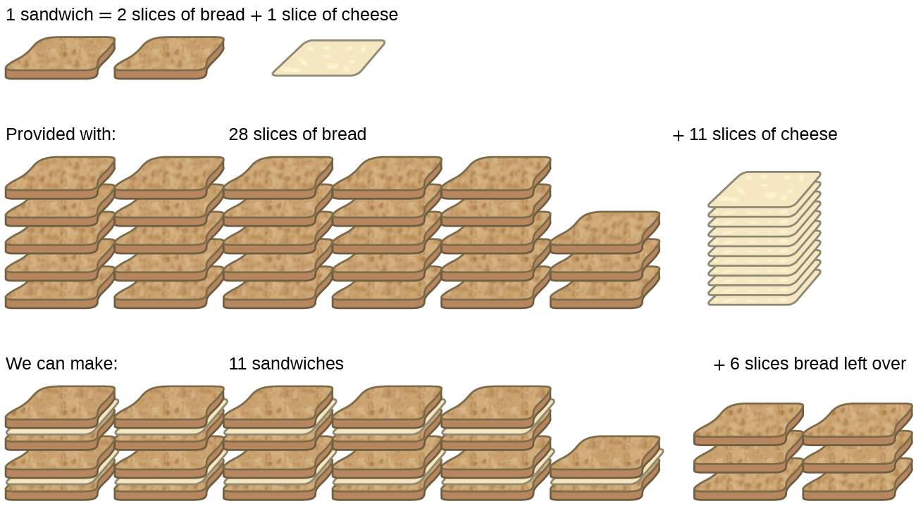
Figure 9.3a
Figure 9.3a Sandwich making can illustrate the concepts of limiting and excess reactants. (credit: Chemistry (OpenStax), CC BY 4.0.)

Slide 7
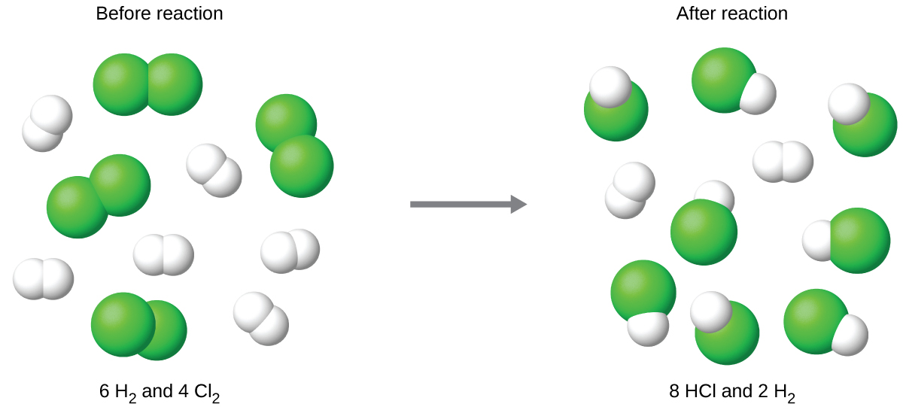
Figure 9.3b
Figure 9.3b When H₂ and Cl₂ are combined in nonstoichiometric amounts, one of these reactants will limit the amount of HCl that can be produced. This illustration shows a reaction in which hydrogen is present in excess and chlorine is the limiting reactant. (credit: Chemistry (OpenStax), CC BY 4.0.)

Slide 8
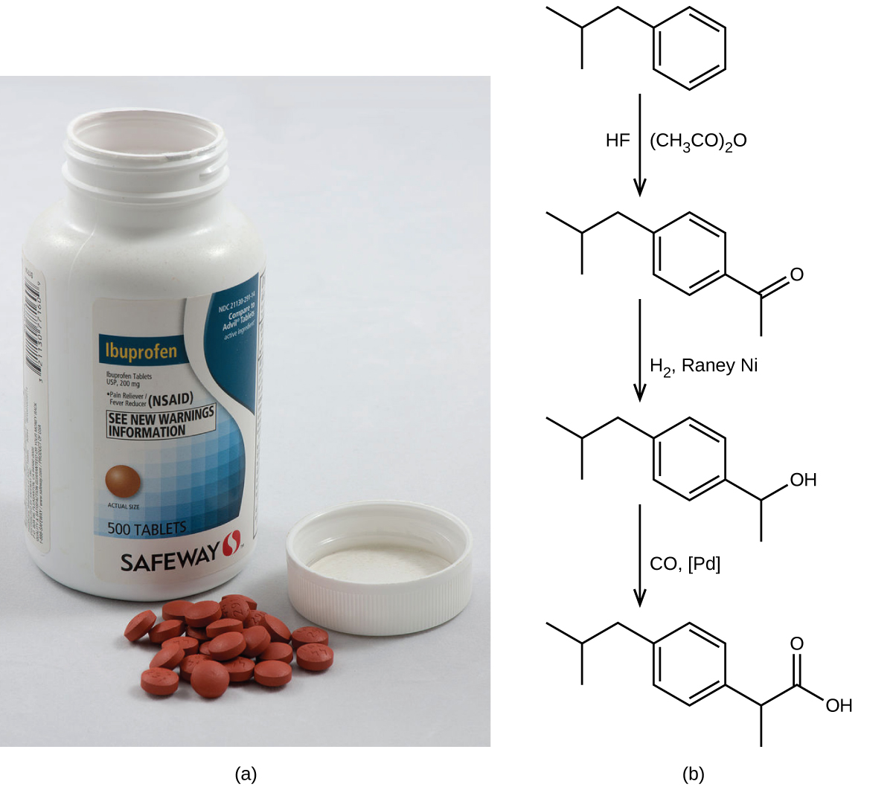
Figure 9.4a
Figure 9.4a (a) Ibuprofen is a popular nonprescription pain medication commonly sold as 200 mg tablets. (b) The BHC process for synthesizing ibuprofen requires only three steps and exhibits an impressive atom economy. (credit a: modification of work by Chiara Coetzee, CC0; credit b: Chemistry (OpenStax), CC BY 4.0.)

