Slide 1
Chapter 8 Chemical Equations
Slides to accompany Enhanced Introductory College Chemistry by Gregory Anderson, Caryn Fahey, J.R. van Haarlem, Jackie MacDonald, Adrienne Richards, Samantha Sullivan Sauer, and David Wegman
Slide design and template by Revathi Mahadevan
Except where otherwise noted, images, tables & diagrams are reused from Enhanced Introductory College Chemistry, a derivative of Chemistry (Open Stax) by Paul Flowers, Klaus Theopold, Richard Langley & William R. Robinson and is licensed under CC BY 4.0. ​Access for free at Chemistry (OpenStax)​
Slides are licensed under CC-BY 4.0, Except while otherwise noted

Slide 2
Figure 8a
Figure 8a Many modern rocket fuels are solid mixtures of substances combined in carefully measured amounts and ignited to yield a thrust-generating chemical reaction. (credit: work courtesy of NASA/JPL-Caltech, JPL Image Policy.)

Slide 3
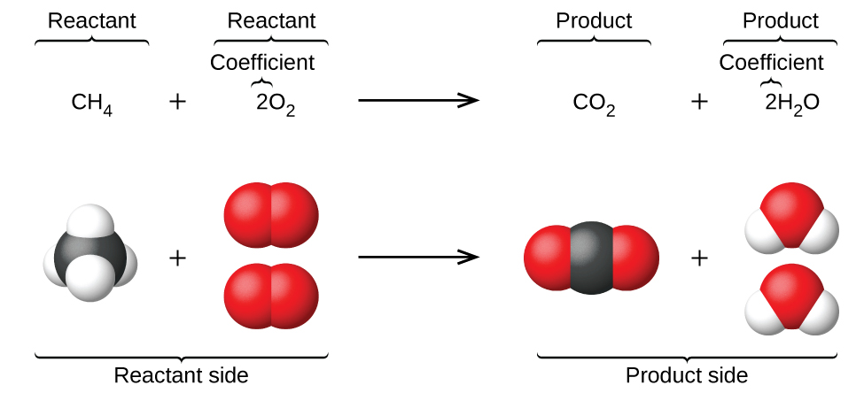
Figure 8.1a
Figure 8.1a The reaction between methane and oxygen to yield carbon dioxide and water (shown at bottom) may be represented by a chemical equation using formulas (top). (credit: Chemistry (OpenStax), CC BY 4.0.)

Slide 4
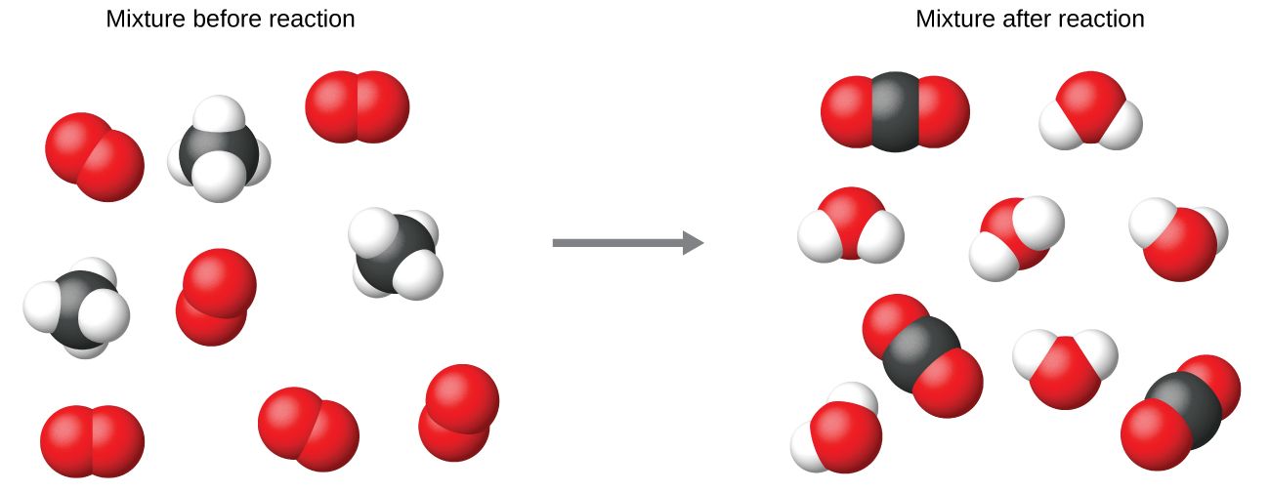
Figure 8.1b
Figure 8.1b Regardless of the absolute numbers of molecules involved, the ratios between numbers of molecules of each species that react (the reactants) and molecules of each species that form (the products) are the same and are given by the chemical reaction equation. (credit: Chemistry (OpenStax), CC BY 4.0.)

Slide 5
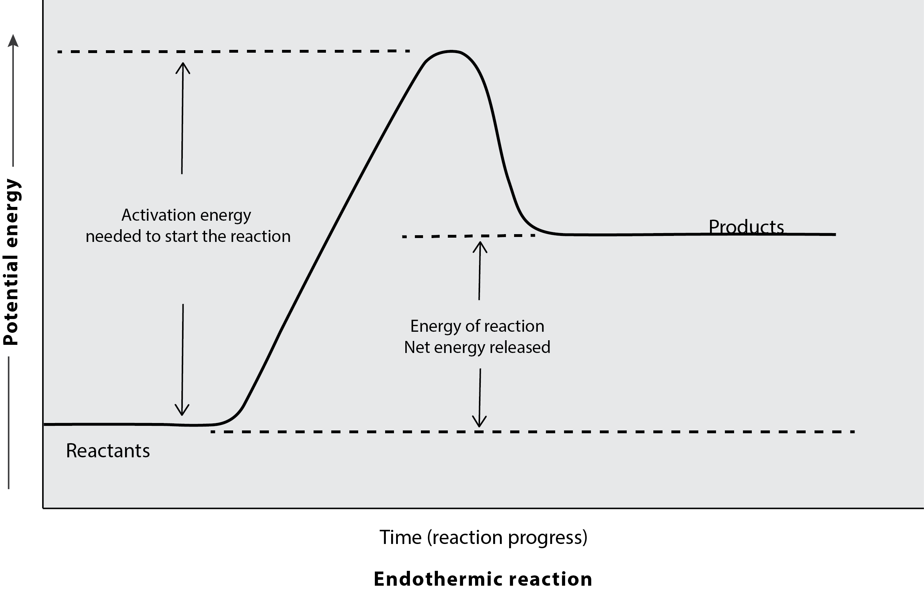
Figure 8.1c
Figure 8.1c The diagram depicts the change in potential energies as the reaction progresses over time for endothermic reactions. (credit: graphics by Revathi Mahadevan, CC BY 4.0)

Slide 6
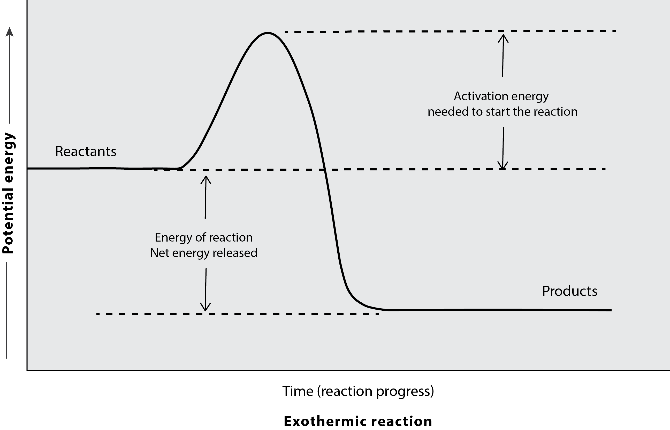
Figure 8.1d
Figure 8.1d The diagram depicts the change in potential energies as the reaction progresses over time for exothermic reactions. (credit: graphics by Revathi Mahadevan, CC BY 4.0)

Slide 7
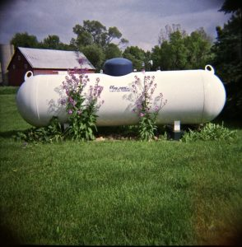
Figure 8.2a
Figure 8.2a Propane is a fuel used to provide heat for some homes. Propane is stored in large tanks like that shown here. (credit: work by vistavision, CC BY-NC-ND 2.0

Slide 8
Figure 8.3a
Figure 8.3a Birch tree (credit: work by Dallas Reedy, Unsplash license)

Slide 9
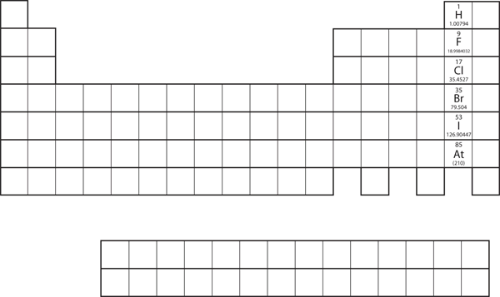
Figure 8.3b
Figure 8.3b "Halogens on the Periodic Table." The halogens are the elements in the next-to-last column on the periodic table. Review the Periodic Table of the Elements in other formats in Appendix A. (credit: Introductory Chemistry: 1st Canadian Edition, CC BY-NC-SA 4.0.)

Slide 10
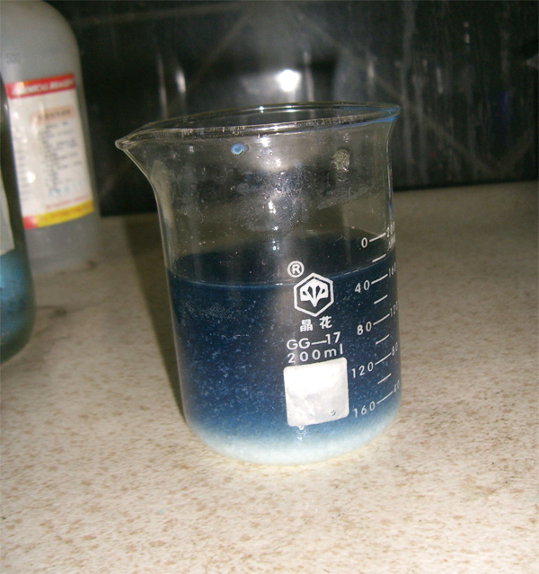
Figure 8.3c
Figure 8.3c "Double-Replacement Reactions." Some double-replacement reactions are obvious because you can see a solid precipitate coming out of the solution. (credit: work by Choij, PD)

