Slide 1
Chapter 7 A Mole of Compounds
Slides to accompany Enhanced Introductory College Chemistry by Gregory Anderson, Caryn Fahey, J.R. van Haarlem, Jackie MacDonald, Adrienne Richards, Samantha Sullivan Sauer, and David Wegman
Slide design and template by Revathi Mahadevan
Except where otherwise noted, images, tables & diagrams are reused from Enhanced Introductory College Chemistry, a derivative of Chemistry (Open Stax) by Paul Flowers, Klaus Theopold, Richard Langley & William R. Robinson and is licensed under CC BY 4.0. ​Access for free at Chemistry (OpenStax)​
Slides are licensed under CC-BY 4.0, Except while otherwise noted

Slide 2
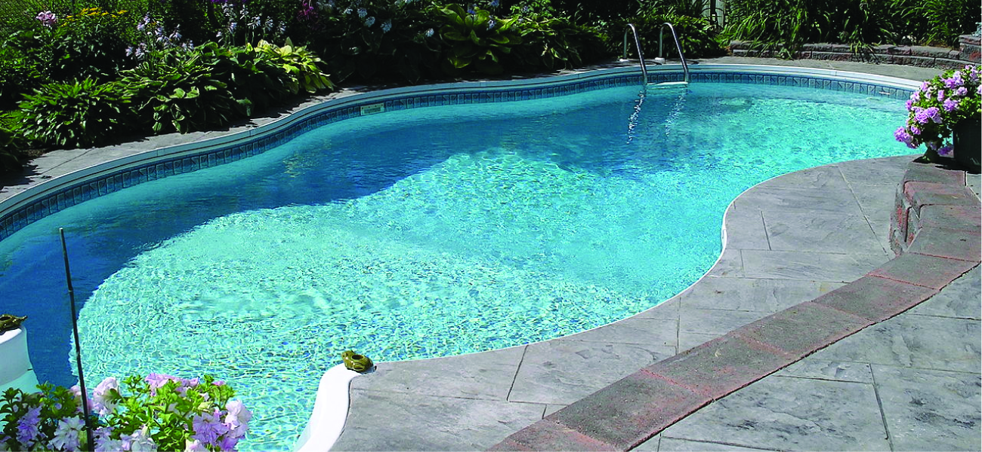
Figure 7a
Figure 7a The water in a swimming pool is a complex mixture of substances whose relative amounts must be carefully maintained to ensure the health and comfort of people using the pool. (credit: modification of work by Vic Brincat, CC BY 2.0)

Slide 3
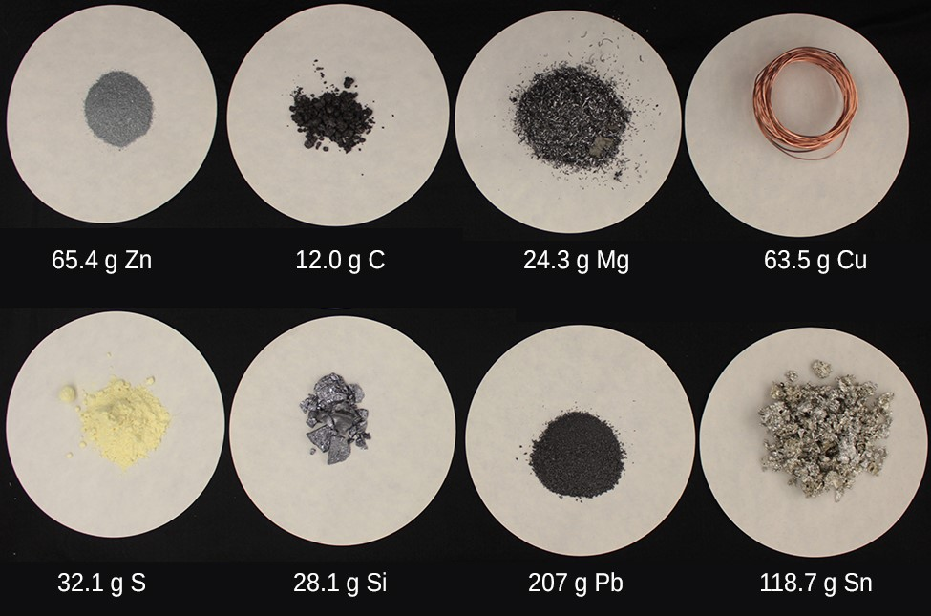
Figure 7.1a
Figure 7.1a Each sample contains 6.022 × 10²³ atoms —1.00 mol of atoms. From left to right (top row): 65.4 g zinc, 12.0 g carbon, 24.3 g magnesium, and 63.5 g copper. From left to right (bottom row): 32.1 g sulfur, 28.1 g silicon, 207 g lead, and 118.7 g tin. (credit: modification of work by Mark Ott in Chemistry (OpenStax), CC BY 4.0.)

Slide 4
Table 7.1a
Table 7.1a Examples of elements and their mass in amu/atom and molar mass in g/mol.
Element | Mass of a single atom | Mass of 6.022 x 10²³ atoms
argon (Ar) | 39.95 amu/atom | 39.95 g/mol
iron (Fe) | 55.85 amu/atom | 55.85 g/mol
selenium (Se) | 78.96 amu/atom | 78.96 g/mol
(credit: Chemistry (OpenStax), CC BY 4.0.)

Slide 5
Figure 7.2a
Figure 7.2a The average mass of a chloroform molecule, CHCl₃, is 119.37 amu, which is the sum of the average atomic masses of each of its constituent atoms. The model shows the molecular structure of chloroform. (credit: Chemistry (OpenStax), CC BY 4.0.)

Slide 6
Figure 7.2b
Figure 7.2b The average mass of an aspirin molecule is 180.15 amu. The model shows the molecular structure of aspirin, C₉H₈O₄. (credit: Chemistry (OpenStax), CC BY 4.0.)

Slide 7
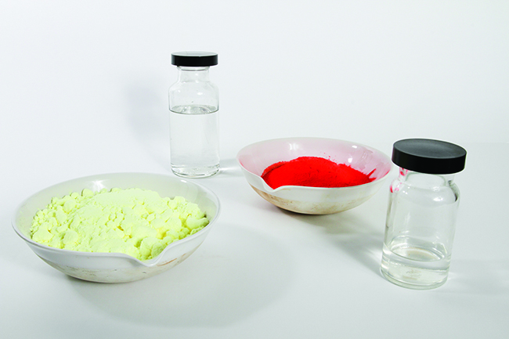
Figure 7.2c
Figure 7.2c Each sample contains 6.02 × 10²³ molecules or formula units—1.00 mol of the compound or element. Clock-wise from the upper left: 130.2 g of C₈H₁₇OH (1-octanol, formula mass 130.2 amu), 454.4 g of HgI₂ (mercury(II) iodide, formula mass 454.4 amu), 32.0 g of CH₃OH (methanol, formula mass 32.0 amu) and 256.5 g of S₈ (sulfur, formula mass 256.5 amu). (credit: Sahar Atwa in Chemistry (OpenStax), CC BY 4.0.)

Slide 8
Table 7.2a
Table 7.2a Examples of elements average atomic mass, molar mass and atoms/mole.
Element | Average Atomic Mass (amu) | Molar Mass (g/mol) | Atoms/Mole
C | 12.01 | 12.01 | 6.022 × 10²³
H | 1.008 | 1.008 | 6.022 × 10²³
O | 16.00 | 16.00 | 6.022 × 10²³
Na | 22.99 | 22.99 | 6.022 × 10²³
Cl | 35.45 | 33.45 | 6.022 × 10²³
(credit: Chemistry (OpenStax), CC BY 4.0.)

Slide 9
Figure 7.2d
Figure 7.2d The number of molecules in a single droplet of water is roughly 100 billion times greater than the number of people on earth. (credit: work by Tahlia Doyle, Unsplash license).

Slide 10
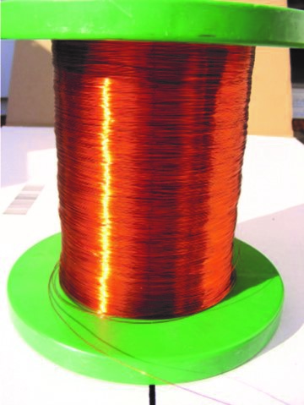
Figure 7.2e
Figure 7.2e Copper wire is composed of many, many atoms of Cu. (credit: work by Emilian Robert Vicol, CC BY 2.0).

Slide 11
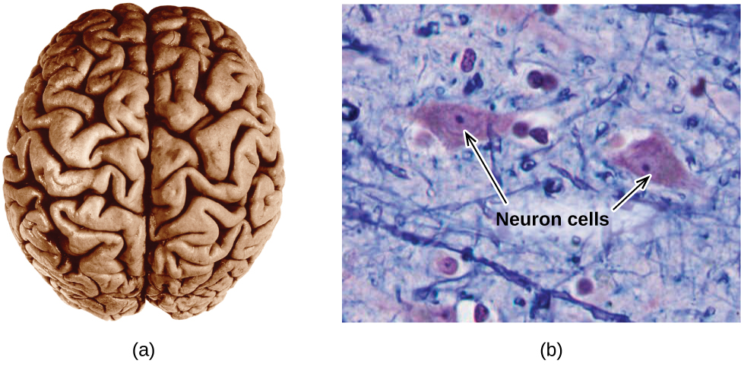
Figure 7.2f
Figure 7.2f (a) A typical human brain weighs about 1.5 kg and occupies a volume of roughly 1.1 L. (b) Information is transmitted in brain tissue and throughout the central nervous system by specialized cells called neurons (micrograph shows cells at 1600× magnification). (credit: Chemistry (OpenStax), CC BY 4.0.)

Slide 12
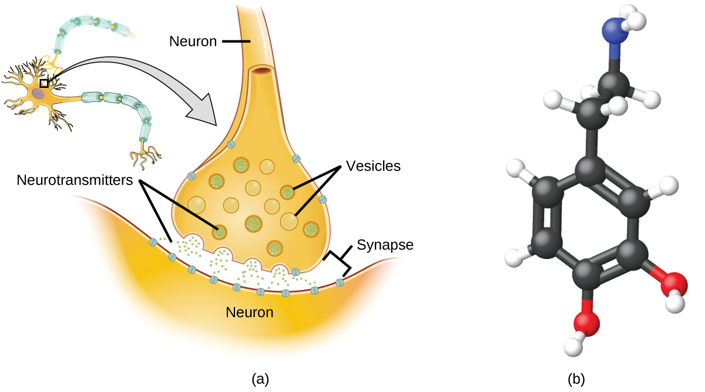
Figure 7.2g
Figure 7.2g (a) Chemical signals are transmitted from neurons to other cells by the release of neurotransmitter molecules into the small gaps (synapses) between the cells. (b) Dopamine, C₈H₁₁NO₂, is a neurotransmitter involved in a number of neurological processes. (credit: Chemistry (OpenStax), CC BY 4.0.)

Slide 13
Figure 7.4a
Figure 7.4a The empirical formula of a compound can be derived from the masses of all elements in the sample. (credit: Chemistry (OpenStax), CC BY 4.0.)

Slide 14
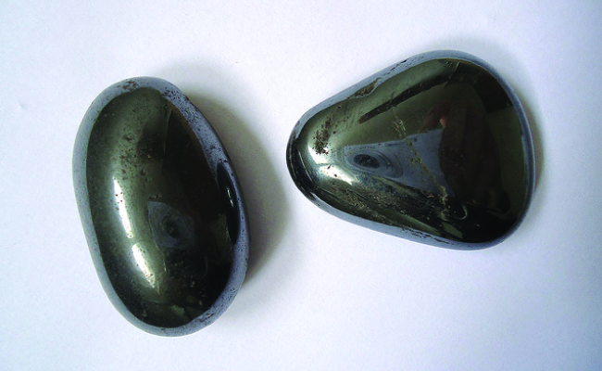
Figure 7.4b
Figure 7.4b Hematite is an iron oxide that is used in jewelry. (credit: work by Mauro Cateb, CC BY-SA 3.0)

Slide 15
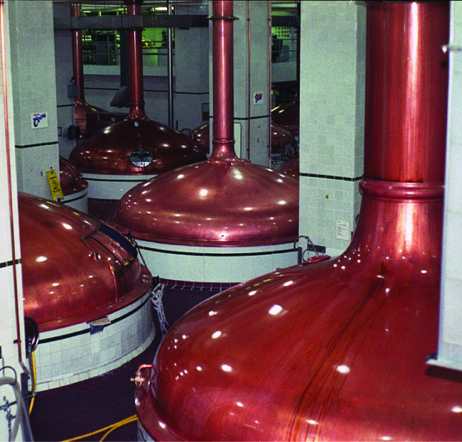
Figure 7.4c
Figure 7.4c An oxide of carbon is removed from these fermentation tanks through the large copper pipes at the top. (credit: work by Dual Freq, CC BY-SA 3.0)

Slide 16
Figure 7.4d
Figure 7.4d Structural Formulas and Ball-and-Stick Models of (a) Formaldehyde and (b) Glucose (credit: Chemistry 101A (Libretexts), CC BY-NC-SA 4.0.)

Slide 17
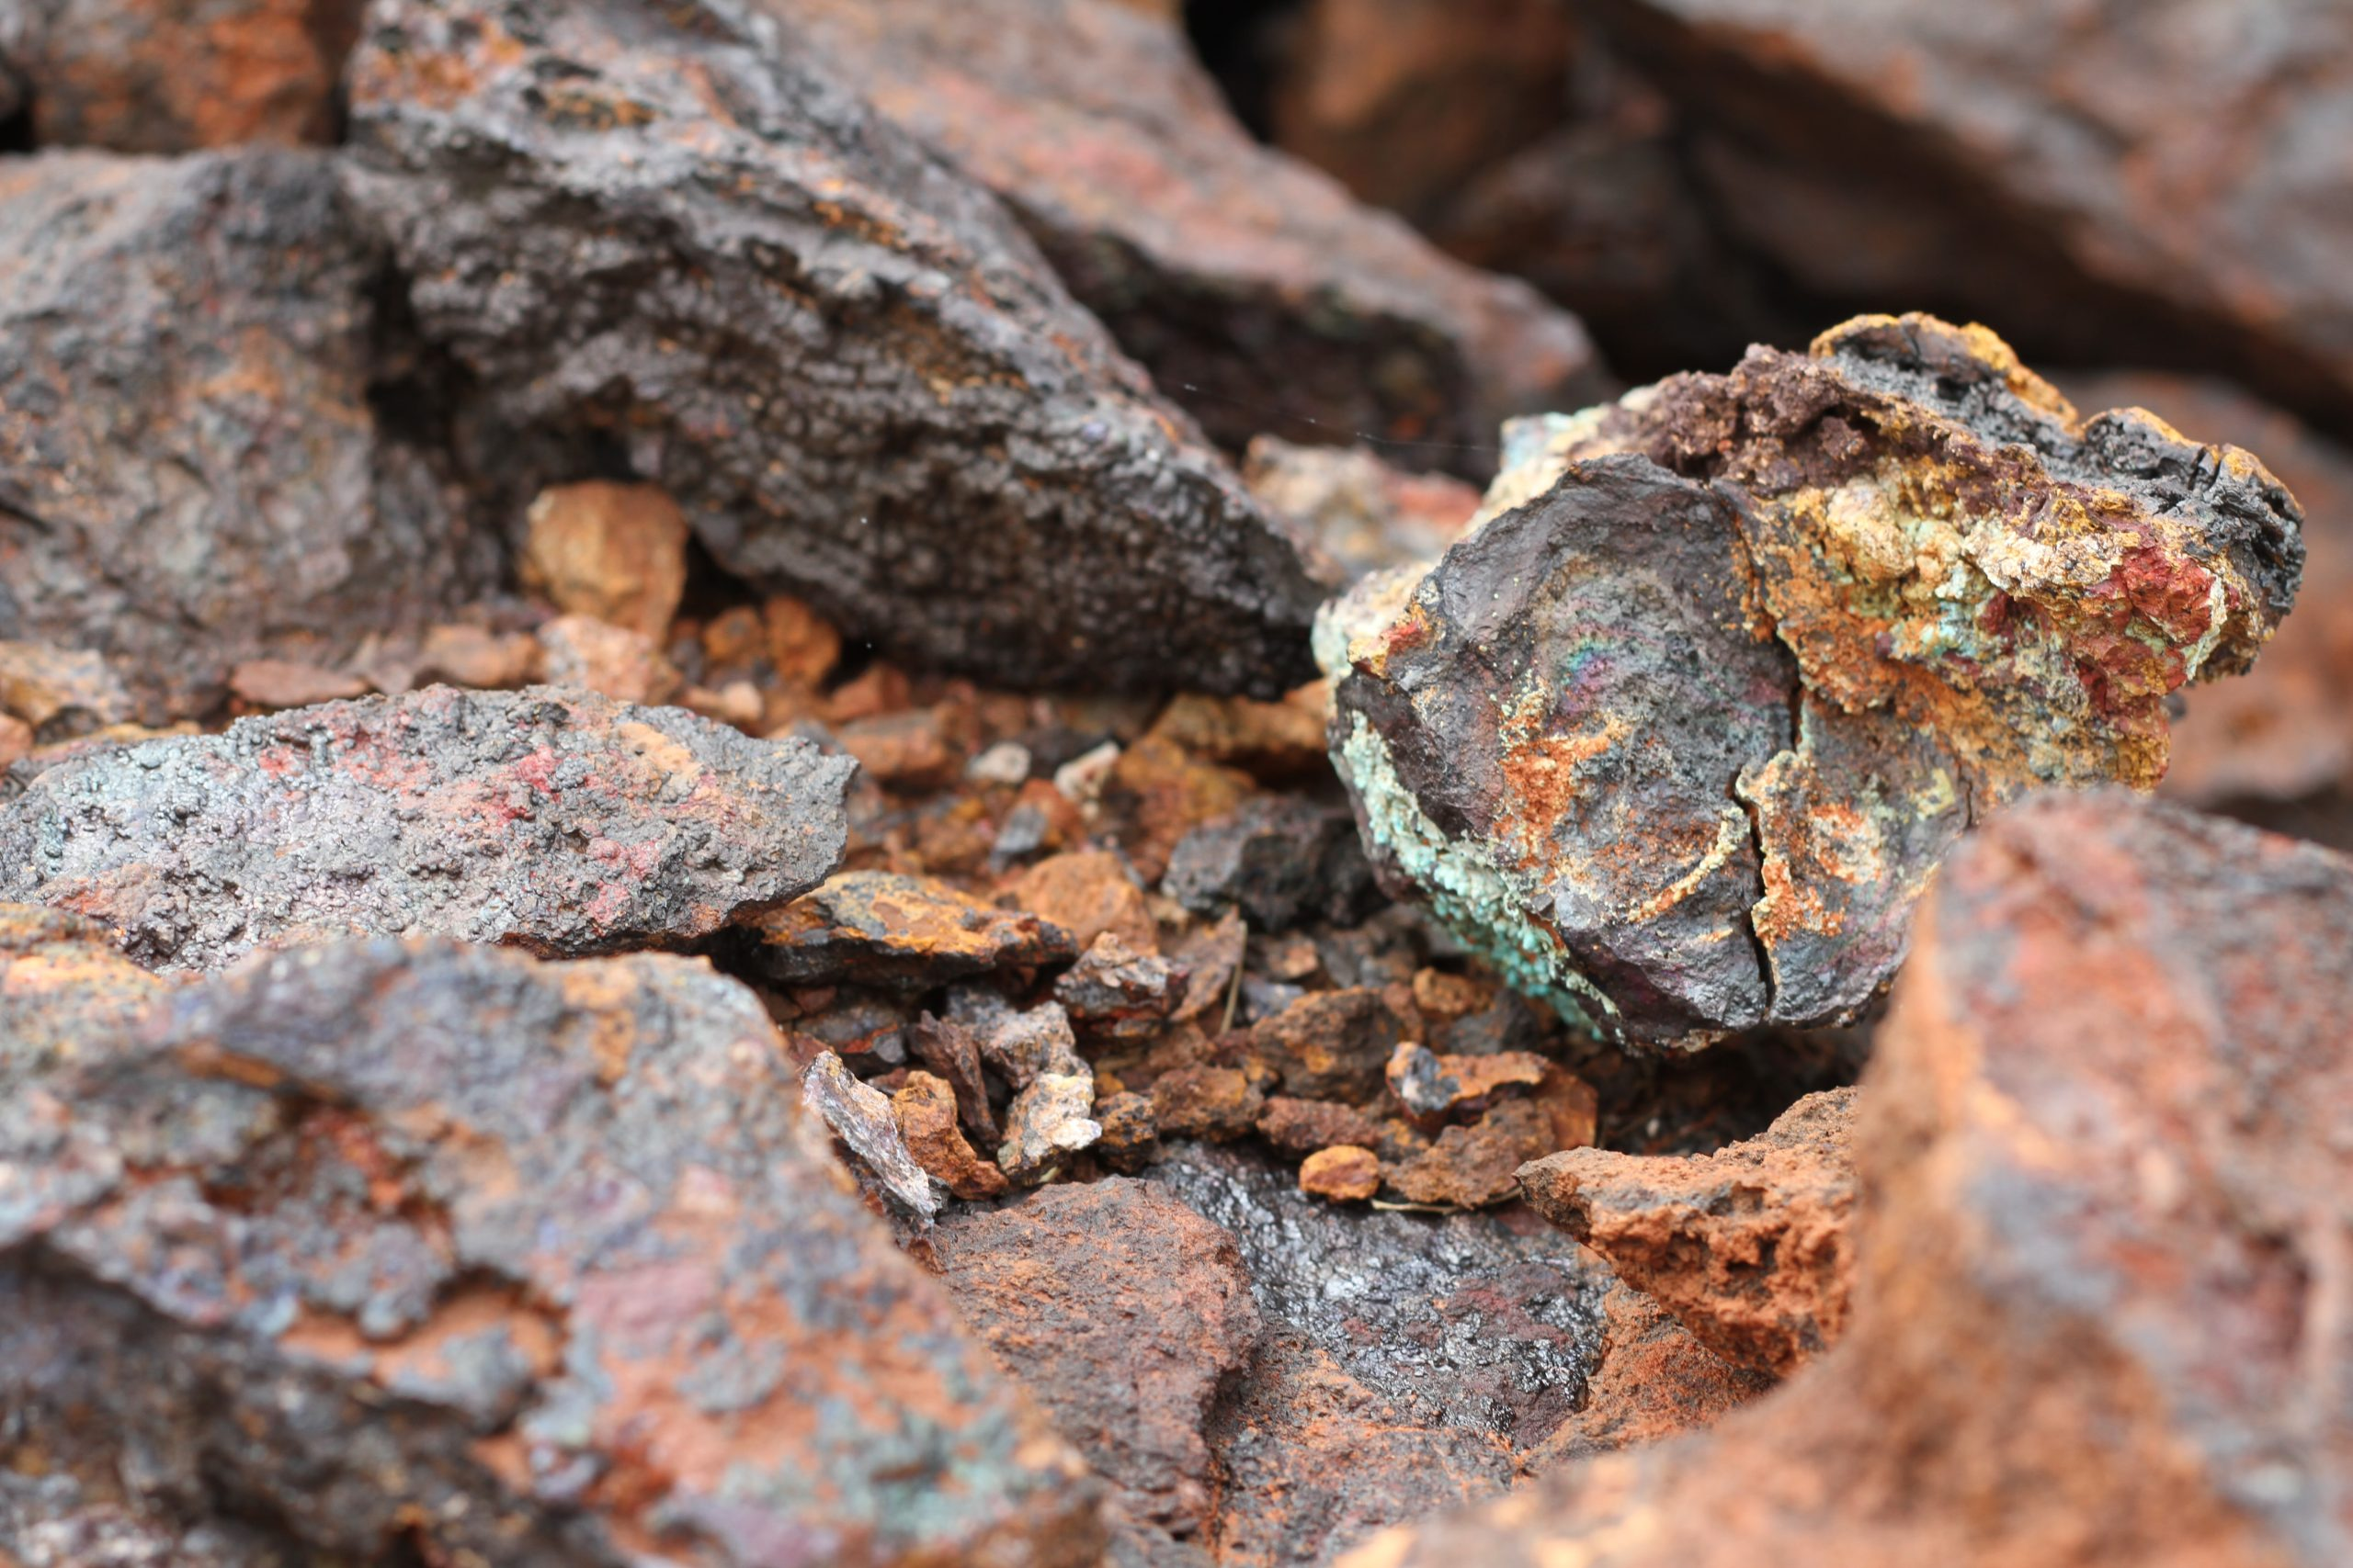
Figure 7.4e
Figure 7.4e Ore containing copper, cobalt, and nickel (credit: work by Paul-Alain Hunt, Unsplash license)

