Slide 1
Chapter 6 Inorganic Compound Nomenclature
Slides to accompany Enhanced Introductory College Chemistry by Gregory Anderson, Caryn Fahey, J.R. van Haarlem, Jackie MacDonald, Adrienne Richards, Samantha Sullivan Sauer, and David Wegman
Slide design and template by Revathi Mahadevan
Except where otherwise noted, images, tables & diagrams are reused from Enhanced Introductory College Chemistry, a derivative of Chemistry (Open Stax) by Paul Flowers, Klaus Theopold, Richard Langley & William R. Robinson and is licensed under CC BY 4.0. ​Access for free at Chemistry (OpenStax)​
Slides are licensed under CC-BY 4.0, Except while otherwise noted

Slide 2
Table 6a
Table 6a A list of popular names, their associated chemical name and formula.
Popular name | Chemical name | Formula
borax | sodium tetraborate decahydrate | B₄O₇·10H₂O
calomel | mercury(I) chloride | Hg₂Cl₂
milk of magnesia | magnesium hydroxide | Mg(OH)₂
muriatic acid | hydrochloric acid | HCl(aq)
oil of vitriol | sulfuric acid | H₂SO₄
saltpeter | sodium nitrate | NaNO₃
slaked lime | calcium hydroxide | Ca(OH)₂
(credit: Book: Chem1 (Lower) (LibreTexts Chemistry), CC BY 3.0.)

Slide 3
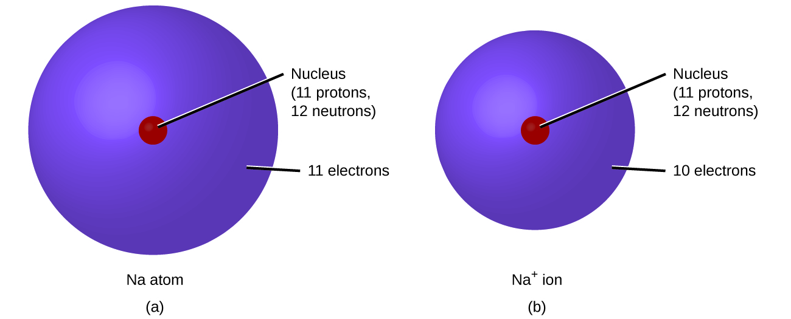
Figure 6.1a
Figure 6.1a (a) A sodium atom (Na) has equal numbers of protons and electrons (11) and is uncharged. (b) A sodium cation (Na⁺) has lost an electron, so it has one more proton (11) than electrons (10), giving it an overall positive charge, signified by a superscripted plus sign. (credit: Chemistry (OpenStax), CC BY 4.0.)

Slide 4
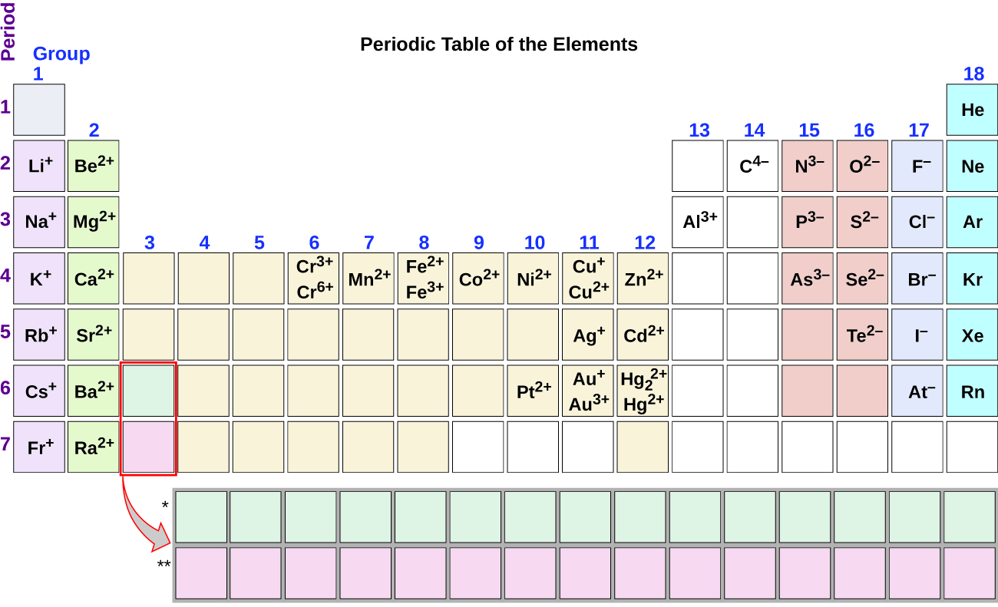
Figure 6.1b
Figure 6.1b Some elements exhibit a regular pattern of ionic charge when they form ions. Review the Periodic Table of the Elements in other formats in Appendix A. (credit: Chemistry (OpenStax), CC BY 4.0.)

Slide 5
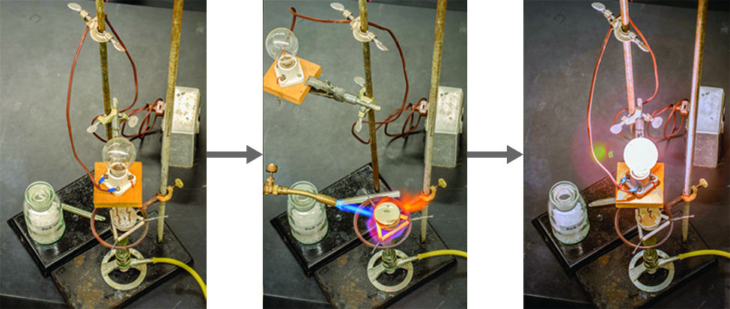
Figure 6.2a
Figure 6.2a Sodium chloride melts at 801 °C and conducts electricity when molten. (credit: modification of work by Mark Blaser and Matt Evans in Chemistry (OpenStax), CC BY 4.0.)

Slide 6
Table 6.2a
Table 6.2a Common Polyatomic Ions
Name | Formula | Related Acid | Formula
ammonium | NH₄⁺
hydronium | H₃O⁺
oxide | O₂⁻
peroxide | O₂²⁻
hydroxide | OH⁻
acetate | CH₃COO⁻ | acetic acid | CH₃COOH
cyanide | CN⁻ | hydrocyanic acid | HCN
azide | N₃⁻ | hydrazoic acid | HN₃
(credit: Chemistry (OpenStax), CC BY 4.0.)

Slide 7
Table 6.2a (Continued 1)
Table 6.2a (Continued) Common Polyatomic Ions
Name | Formula | Related Acid | Formula
carbonate | CO₃²⁻ | carbonic acid | H₂CO₃
bicarbonate | HCO₃⁻
nitrate | NO₃⁻ | nitric acid | HNO₃
nitrite | NO₂⁻ | nitrous acid | HNO₂
sulfate | SO₄²⁻ | sulfuric acid | H₂SO₄
hydrogen sulfate | HSO₄⁻
sulfite | SO₃²⁻ | sulfurous acid | H₂SO₃
hydrogen sulfite | HSO₃⁻
(credit: Chemistry (OpenStax), CC BY 4.0.)

Slide 8
Table 6.2a (Continued 2)
Table 6.2a (Continued) Common Polyatomic Ions
Name | Formula | Related Acid | Formula
phosphate | PO₄³⁻ | phosphoric acid | H₃PO₄
hydrogen phosphate | HPO₄²⁻
dihydrogen phosphate | H₂PO₄⁻
perchlorate | ClO₄⁻ | perchloric acid | HClO₄
chlorate | ClO₃⁻ | chloric acid | HClO₃
chlorite | ClO₂⁻ | chlorous acid | HClO₂
hypochlorite | ClO⁻ | hypochlorous acid | HClO
chromate | CrO₄²⁻ | chromic acid | H₂CrO₄
dichromate | Cr₂O₇²⁻ | dichromic acid | H₂Cr₂O₇
permanganate | MnO₄⁻ | permanganic acid | HMnO₄
(credit: Chemistry (OpenStax), CC BY 4.0.)

Slide 9
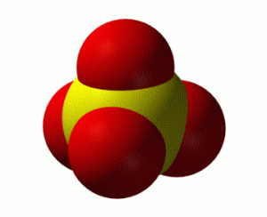
Figure 6.2b
Figure 6.2b A space-filling image of a sulfate ion, where the S is represented by a yellow sphere and the oxygens are represented by red spheres. (credit: work by Benjah-bmm27, PD)

Slide 10
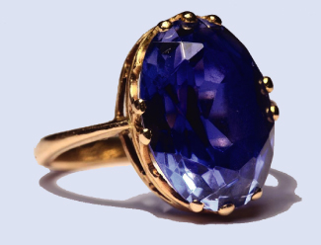
Figure 6.2c
Figure 6.2c Although pure aluminum oxide is colourless, trace amounts of iron and titanium give blue sapphire its characteristic colour. (credit: modification of work by Stanislav Doronenko, CC BY 3.0)

Slide 11
Table 6.3a
Table 6.3a The Modern and Common System of Cation Names
Element | Stem | Charge | Modern Name | Common Name
iron | ferr- | 2+ | iron(II) ion | ferrous ion
iron | ferr- | 3+ | iron(III) ion | ferric ion
copper | cupr- | 1+ | copper(I) ion | cuprous ion
copper | cupr- | 2+ | copper(II) ion | cupric ion
tin | stann- | 2+ | tin(II) ion | stannous ion
tin | stann- | 4+ | tin(IV) ion | stannic ion
lead | plumb- | 2+ | lead(II) ion | plumbous ion
lead | plumb- | 4+ | lead(IV) ion | plumbic ion
chromium | chrom- | 2+ | chromium(II) ion | chromous ion
chromium | chrom- | 3+ | chromium(III) ion | chromic ion
gold | aur- | 1+ | gold(I) ion | aurous ion
gold | aur- | 3+ | gold(III) ion | auric ion
(credit: The Basics of General, Organic and Biological Chemistry, CC BY-NC-SA 3.0.)

Slide 12
Table 6.3b
Table 6.3b Names of Some Transition Metal Ionic Compounds
Transition Metal Ionic Compound | Name
FeCl₃ | iron(III) chloride
Hg₂O | mercury(I) oxide
HgO | mercury(II) oxide
Cu₃(PO₄)₂ | copper(II) phosphate
(credit: Chemistry (OpenStax), CC BY 4.0.)

Slide 13
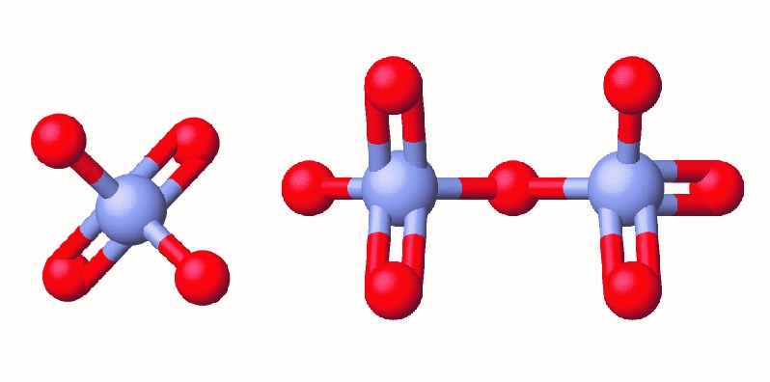
Figure 6.3a
Figure 6.3a The Cr(VI) ion is often present in water as the polyatomic ions chromate, CrO₄²⁻ (left), and dichromate, Cr₂O₇²⁻ (right). (credit: Chemistry (OpenStax), CC BY 4.0.)

Slide 14
Table 6.3c
Table 6.3c Elements that Exist as Diatomic Molecules
Name | Symbol
hydrogen | H₂
oxygen | O₂
nitrogen | N₂
fluorine | F₂
chlorine | Cl₂
bromine | Br₂
iodine | I₂
(credit: Introductory Chemistry: 1st Canadian Edition, CC BY-NC-SA 4.0.)

Slide 15
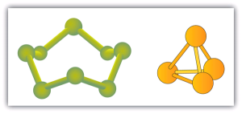
Figure 6.3b
Figure 6.3b "Molecular Art of S₈ and P₄ Molecules." If each green ball represents a sulfur atom, then the diagram on the left represents an S₈ molecule. The molecule on the right shows that one form of elemental phosphorus exists, as a four-atom molecule. (credit: Molecular Art of S₈ and P₄ Molecules by David W. Ball, CC BY-NC-SA 4.0 )

Slide 16
Table 6.3d
Table 6.3d Numerical Prefixes Used in Naming Molecular Compounds
Number of Atoms of Element | Prefix
1 | mono-
2 | di-
3 | tri-
4 | tetra-
5 | penta-
6 | hexa-
7 | hepta-
8 | octa-
9 | nona-
10 | deca-
(credit: Chemistry (OpenStax), CC BY 4.0.)

Slide 17
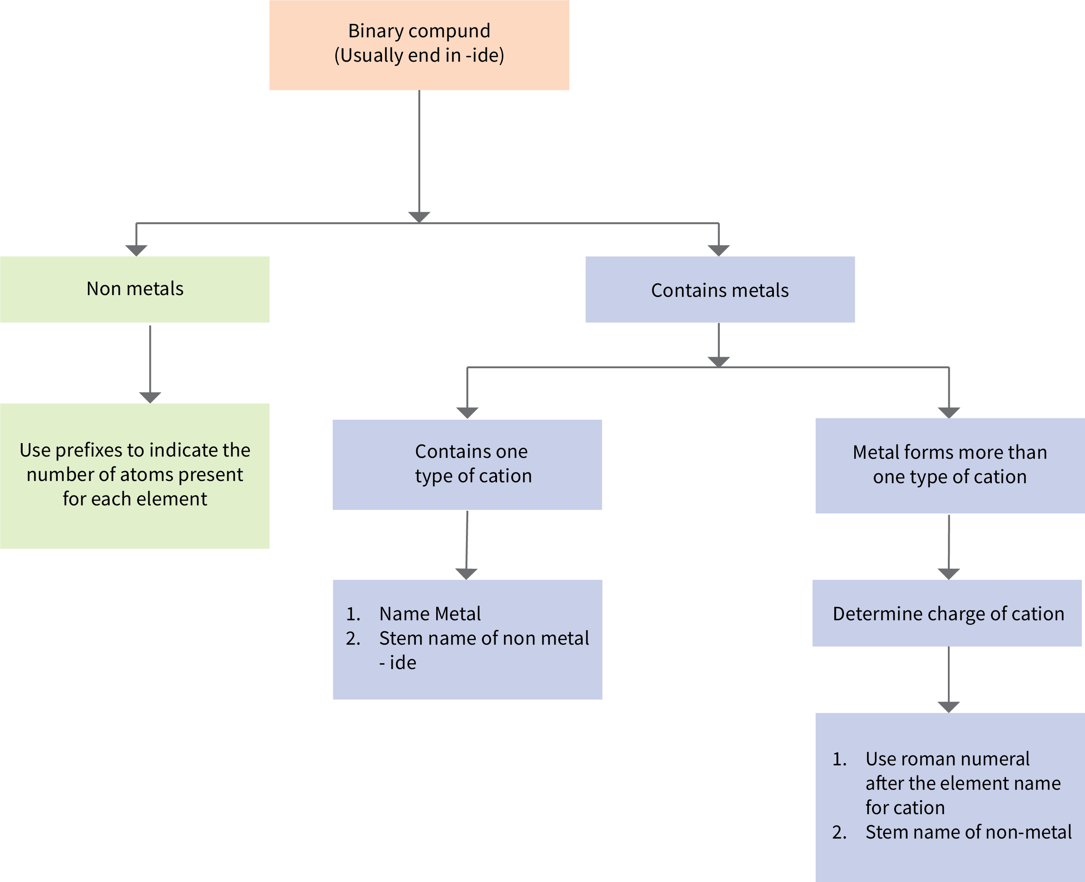
Figure 6.3c
Figure 6.3c Flowchart for naming binary compounds. (credit: Chemistry (Open Stax), CC BY 4.0. / Adapted into a flow chart by Revathi Mahadevan)

Slide 18
Table 6.4a
Table 6.4a Common Polyatomic Ions
Symbol | Name | Symbol | Name | Symbol | Name
CrO₄²⁻ | Chromate | BO₃³⁻ | Borate | SO₄²⁻ | Sulfate
CrO₇²⁻ | Dichromate | AsO₄³⁻ | Arsenate | SO₃²⁻ | Sulfite
CN⁻ | Cyanide | BrO⁻ | Hypobromite | HSO₄⁻ | Hydrogen sulfate (bisulfate)
SCN⁻ | Thiocyanide | BrO₃⁻ | Bromate | HSO₃⁻ | Hydrogen sulfite (bisulfate)
NO₃⁻ | Nitrate | CIO⁻ | Hypochlorite | PO₄³⁻ | Phosphate
NO₂⁻ | Nitrite | CIO₂⁻ | Chlorite | PO₃³⁻ | Phosphite
MnO₄⁻ | Permanganate | CIO₃⁻ | Chlorate | HPO₄²⁻ | Hydrogen phosphate
OH⁻ | Hydroxide | CIO₄⁻ | Perchlorate | H₂PO₄²⁻ | Dihydrogen phosphate
O₂²⁻ | Peroxide | IO₄⁻ | Periodate | CO₃²⁻ | Carbonate
NH₂⁻ | Amide | IO₃⁻ | Iodate | HCO₃⁻ | Hydrogen carbonate
C₂H₃O₂⁻ | Acetate | IO⁻ | Hypoiodite | HC₂O₄⁻ | Hydrogen oxalate
C₂O₄²⁻ | Oxalate | NH₄⁺ | Ammonium
(credit: Introductory Chemistry: 1st Canadian Edition, CC BY-NC-SA 4.0.)

Slide 19
Table 6.4b
Table 6.4b Some Sodium Compounds Added to Food
Sodium Compound | Use in Food
Sodium acetate | preservative, acidity regulator
Sodium adipate | food acid
Sodium alginate | thickener, vegetable gum, stabilizer, gelling agent, emulsifier
Sodium aluminum phosphate | acidity regulator, emulsifier
Sodium aluminosilicate | anticaking agent
Sodium ascorbate | antioxidant
Sodium benzoate | preservative
Sodium bicarbonate | mineral salt
Sodium bisulfite | preservative, antioxidant
Sodium carbonate | mineral salt
Sodium carboxymethylcellulose | emulsifier
Sodium citrates | food acid
(credit: Introductory Chemistry: 1st Canadian Edition, CC BY-NC-SA 4.0.)

Slide 20
Table 6.4b (Continued 1)
Table 6.4b (Continued) Some Sodium Compounds Added to Food
Sodium Compound | Use in Food
Sodium dehydroacetate | preservative
Sodium erythorbate | antioxidant
Sodium erythorbin | antioxidant
Sodium ethyl para-hydroxybenzoate | preservative
Sodium ferrocyanide | anticaking agent
Sodium formate | preservative
Sodium fumarate | food acid
Sodium gluconate | stabilizer
Sodium hydrogen acetate | preservative, acidity regulator
Sodium hydroxide | mineral salt
Sodium lactate | food acid
Sodium malate | food acid
Sodium metabisulfite | preservative, antioxidant, bleaching agent
Sodium methyl para-hydroxybenzoate | preservative
(credit: Introductory Chemistry: 1st Canadian Edition, CC BY-NC-SA 4.0.)

Slide 21
Table 6.4b (Continued 2)
Table 6.4b (Continued) Some Sodium Compounds Added to Food
Sodium Compound | Use in Food
Sodium nitrate | preservative, color fixative
Sodium nitrite | preservative, color fixative
Sodium orthophenyl phenol | preservative
Sodium propionate | preservative
Sodium propyl para-hydroxybenzoate | preservative
Sodium sorbate | preservative
Sodium stearoyl lactylate | emulsifier
Sodium succinates | acidity regulator, flavour enhancer
Sodium salts of fatty acids | emulsifier, stabilizer, anticaking agent
Sodium sulfite | mineral salt, preservative, antioxidant
Sodium sulfite | preservative, antioxidant
Sodium tartrate | food acid
Sodium tetraborate | preservative
(credit: Introductory Chemistry: 1st Canadian Edition, CC BY-NC-SA 4.0.)

Slide 22
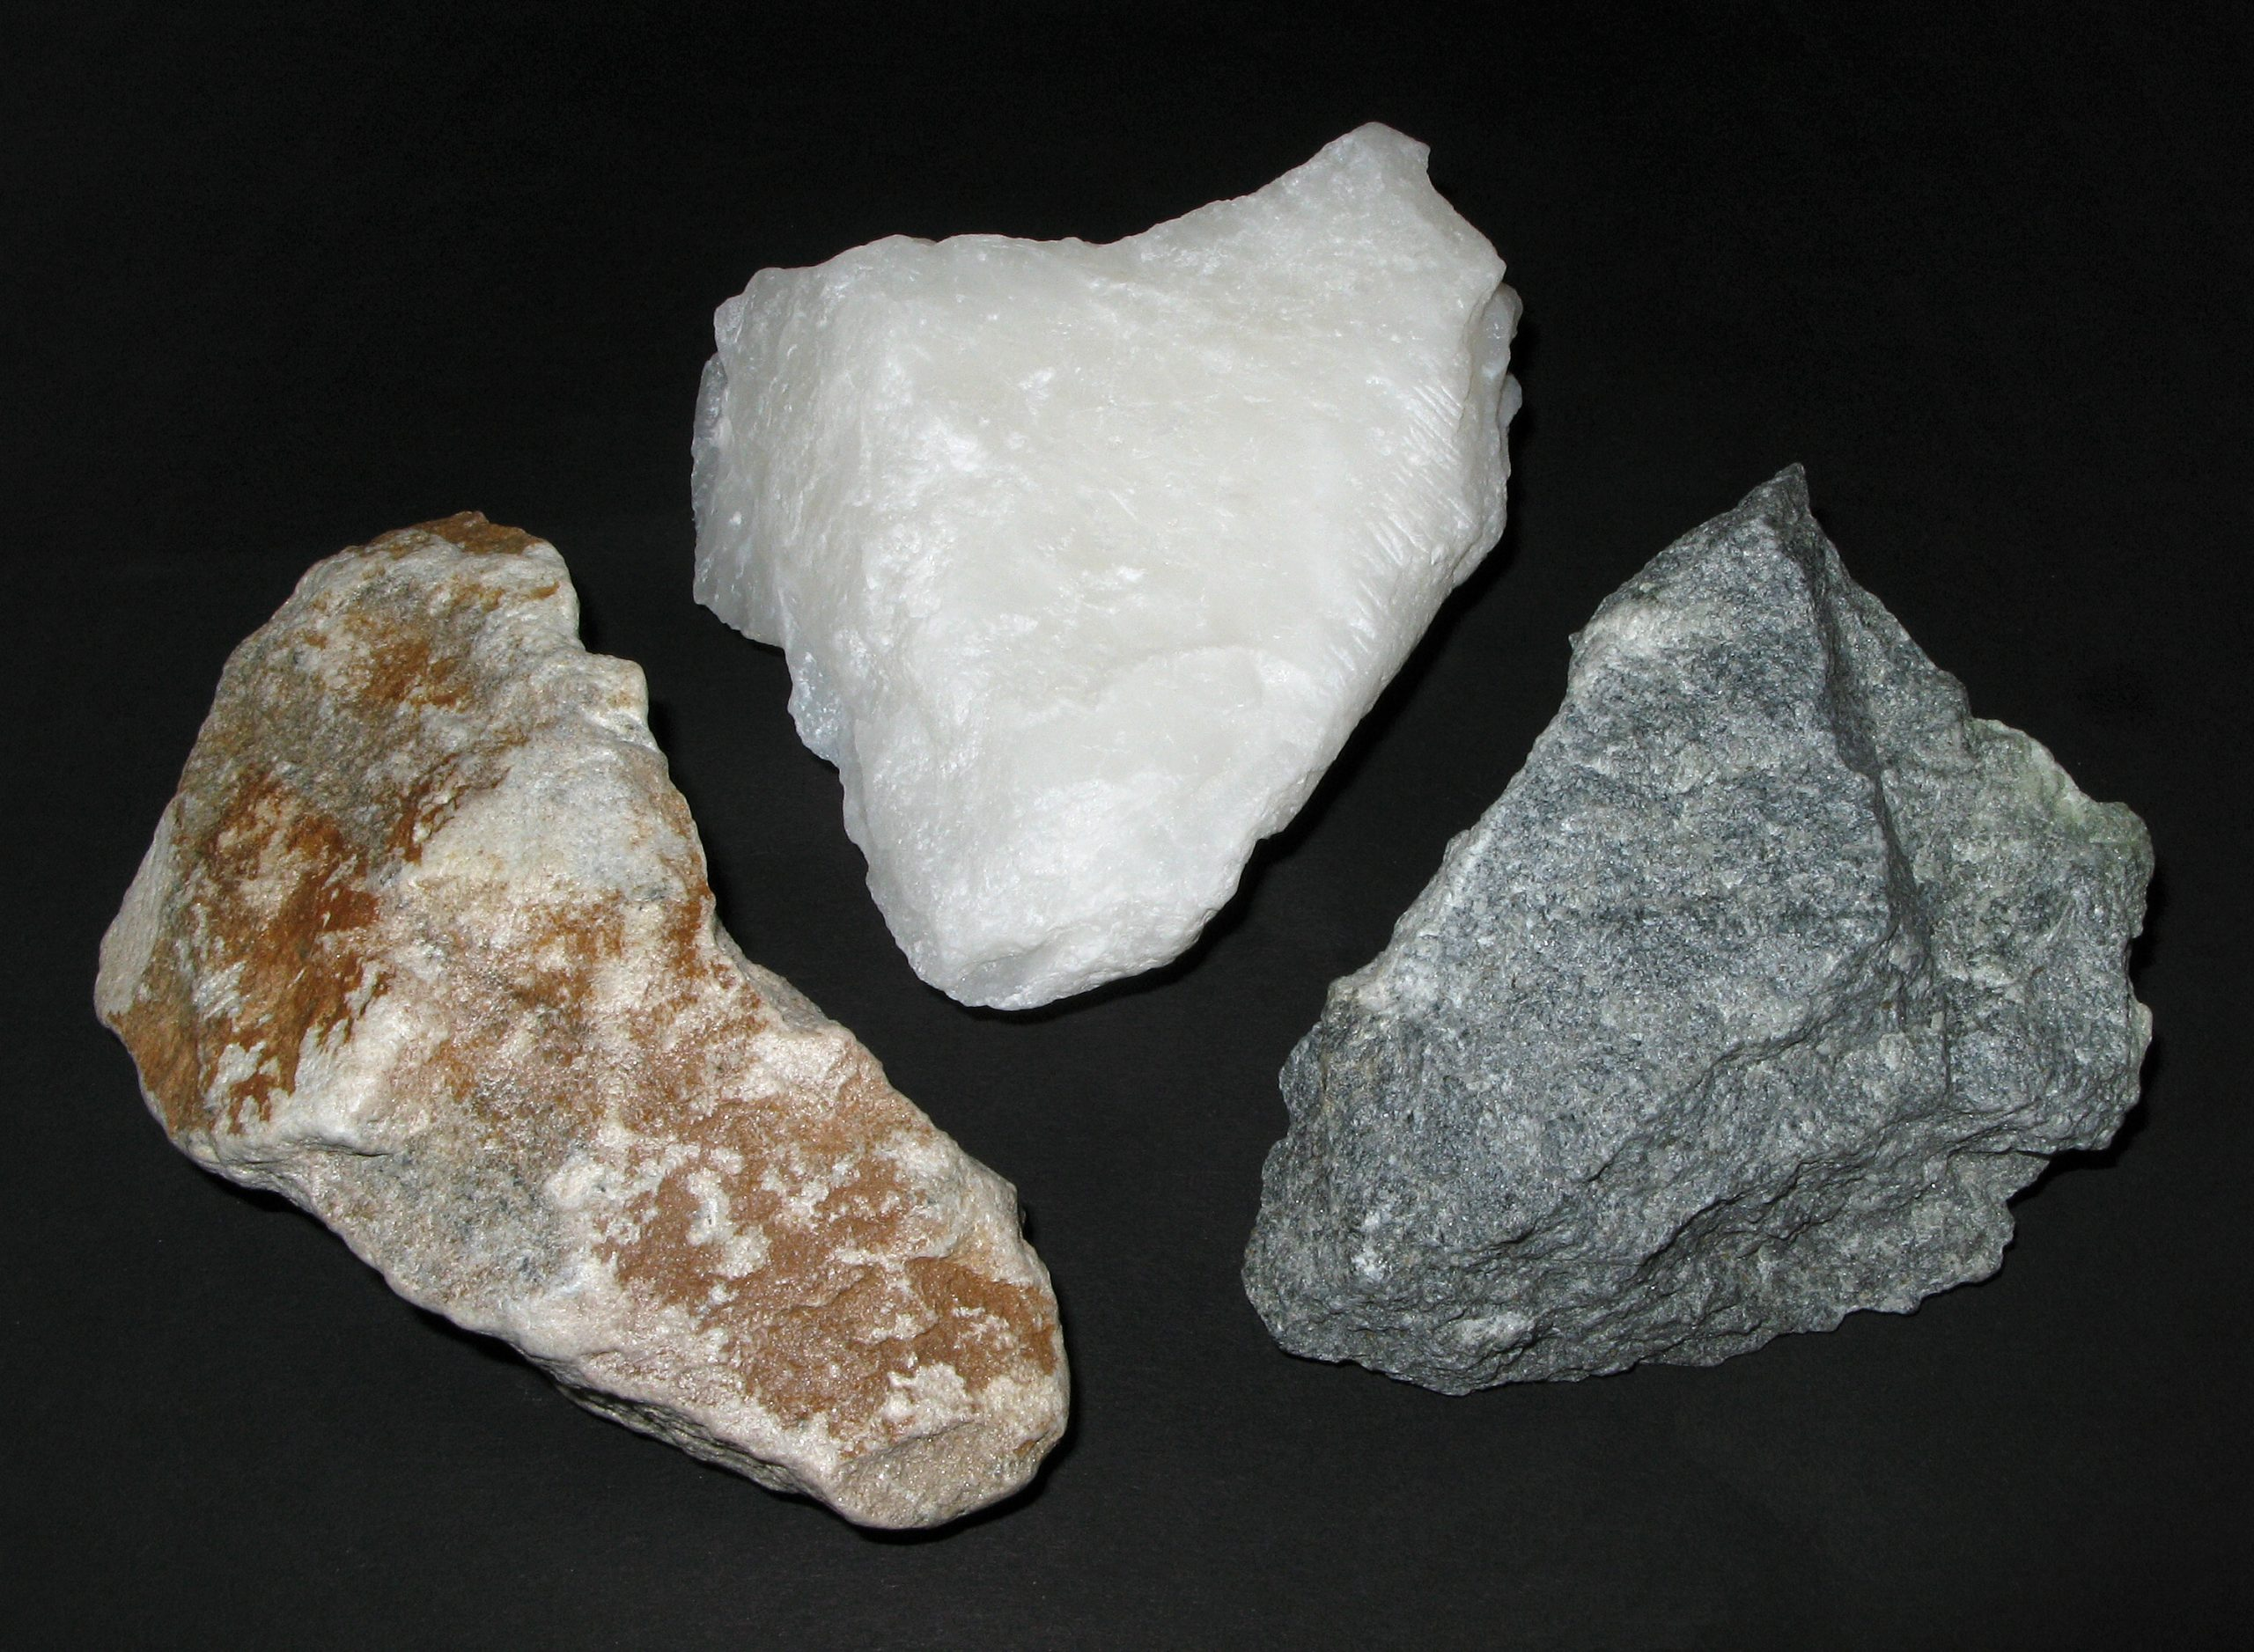
Figure 6.4a
Figure 6.4a Soapstone (Speckstein) (credit: work by Ra'ike, CC BY-SA 3.0)

Slide 23
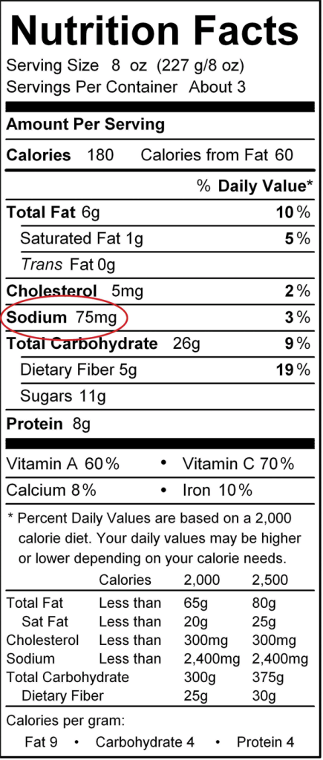
Figure 6.4b
Figure 6.4b "Nutrition Facts." Food labels include the amount of sodium per serving. This particular label shows that there are 75 mg of sodium in one serving of this particular food item. (credit: Introductory Chemistry: 1st Canadian Edition, CC BY-NC-SA 4.0.)

Slide 24
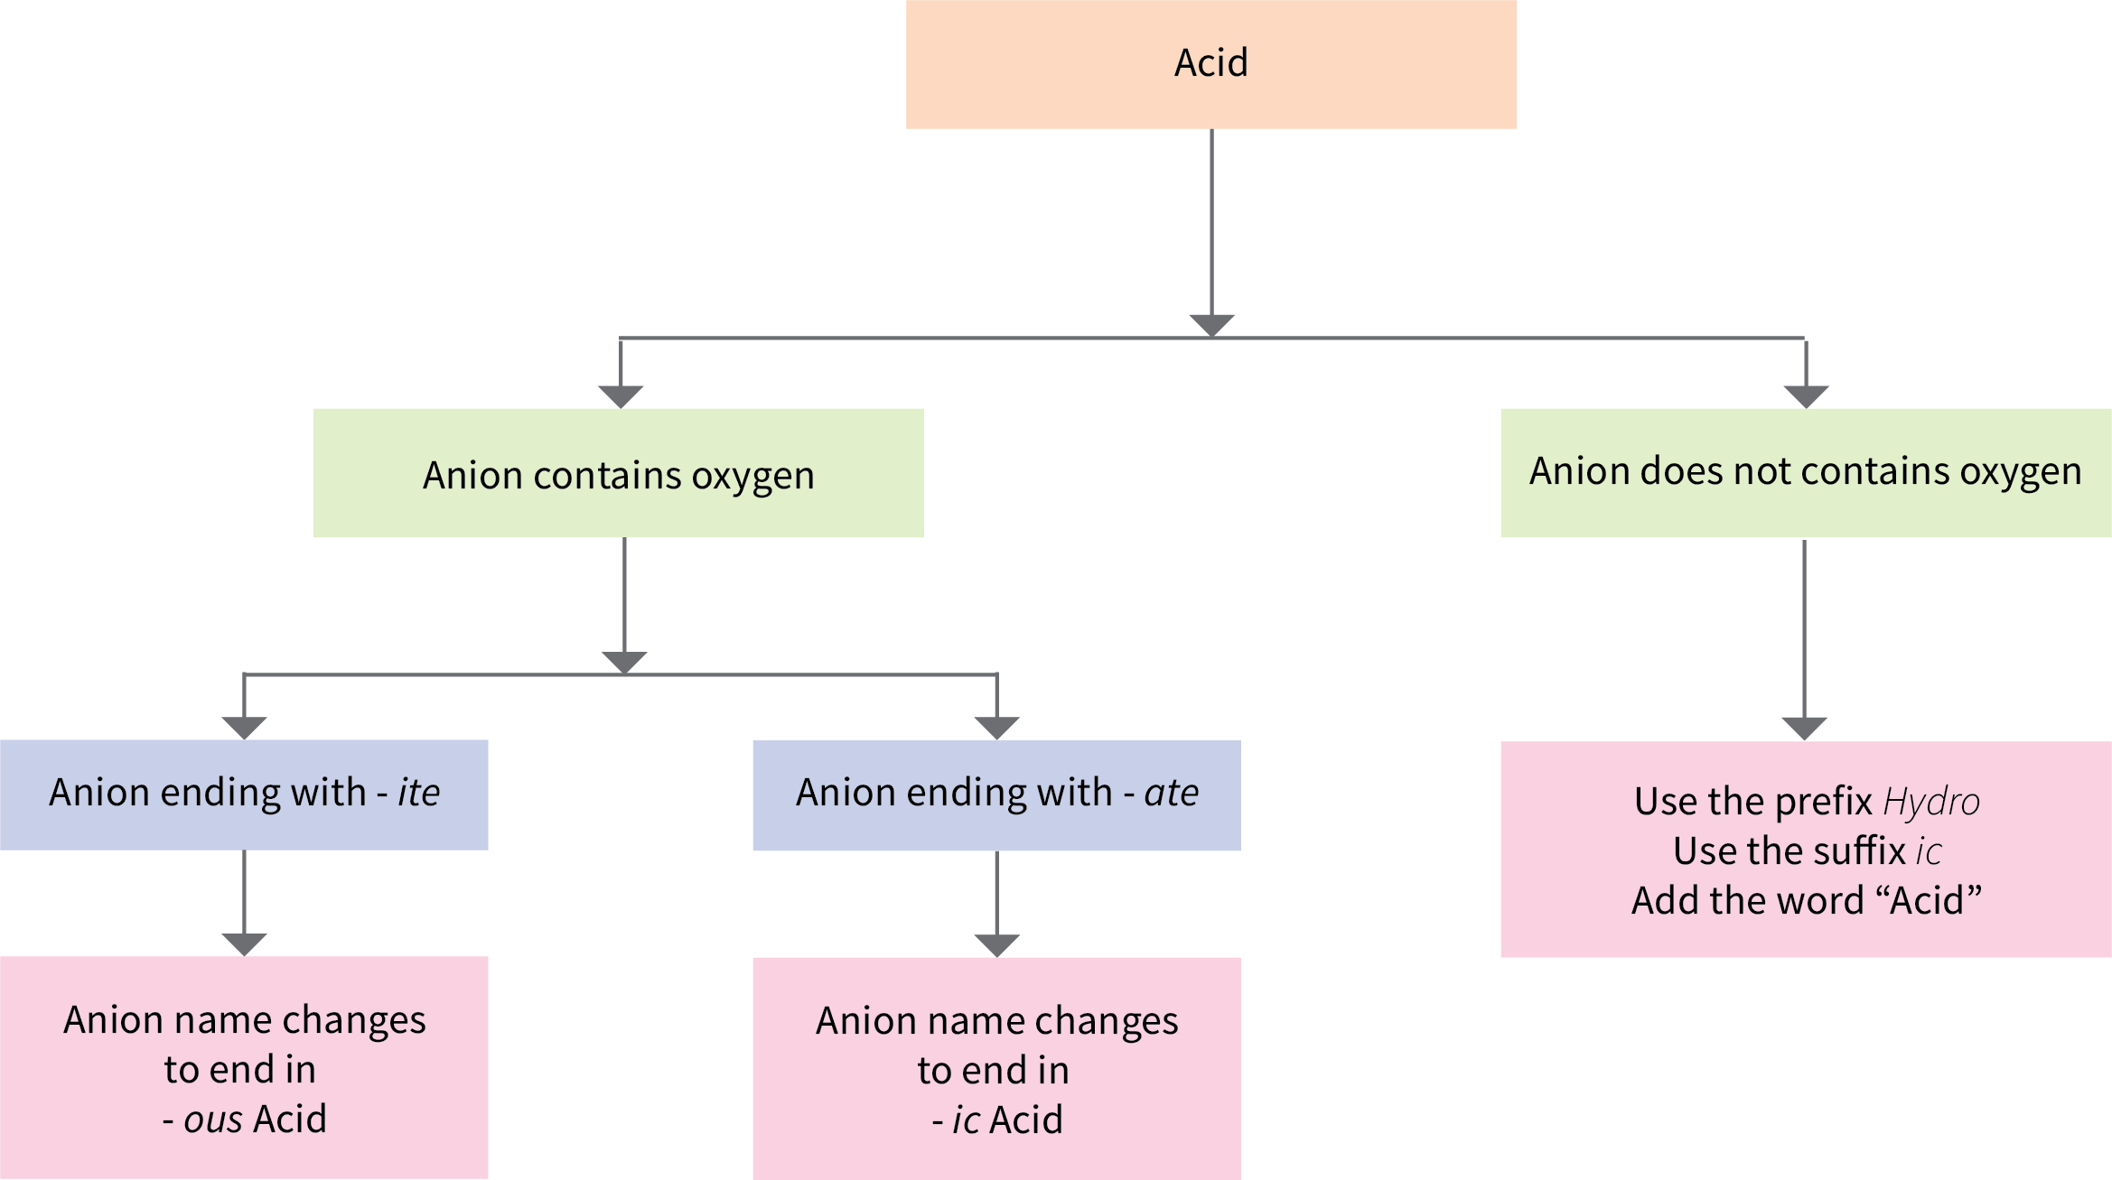
Figure 6.5a
Figure 6.5a Flowchart for naming acids. (credit: Chemistry (Open Stax) CC BY 4.0. / Adapted into a flow chart by Revathi Mahadevan.)

Slide 25
Table 6.5a
Table 6.5a Names of Some Simple Acids
Name of Gas | Name of Acid
HF(g), hydrogen fluoride | HF(aq), hydrofluoric acid
HCl(g), hydrogen chloride | HCl(aq), hydrochloric acid
HBr(g), hydrogen bromide | HBr(aq), hydrobromic acid
HI(g), hydrogen iodide | HI(aq), hydroiodic acid
H₂S(g), hydrogen sulfide | H₂S(aq), hydrosulfuric acid
(credit: Chemistry (OpenStax), CC BY 4.0.)

Slide 26
Table 6.5b
Table 6.5b Names of Common Oxyacids
Formula | Anion Name | Acid Name
HC₂H₃O₂ | acetate | acetic acid
HNO₃ | nitrate | nitric acid
HNO₂ | nitrite | nitrous acid
HClO₄ | perchlorate | perchloric acid
H₂CO₃ | carbonate | carbonic acid
H₂SO₄ | sulfate | sulfuric acid
H₂SO₃ | sulfite | sulfurous acid
H₃PO₄ | phosphate | phosphoric acid
(credit: Chemistry (OpenStax), CC BY 4.0.)

