Slide 1
Chapter 5 Introductory Atomic Theory And Structure
Slides to accompany Enhanced Introductory College Chemistry by Gregory Anderson, Caryn Fahey, J.R. van Haarlem, Jackie MacDonald, Adrienne Richards, Samantha Sullivan Sauer, and David Wegman
Slide design and template by Revathi Mahadevan
Except where otherwise noted, images, tables & diagrams are reused from Enhanced Introductory College Chemistry, a derivative of Chemistry (Open Stax) by Paul Flowers, Klaus Theopold, Richard Langley & William R. Robinson and is licensed under CC BY 4.0. ​Access for free at Chemistry (OpenStax)​
Slides are licensed under CC-BY 4.0, Except while otherwise noted

Slide 2
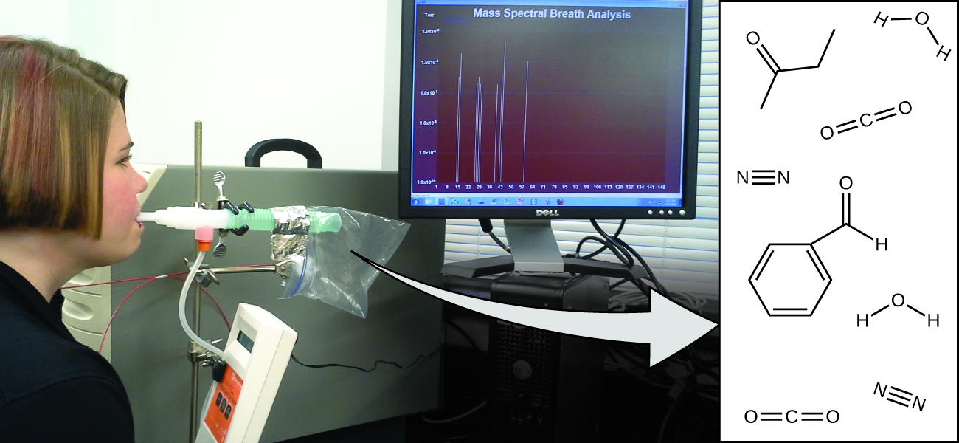
Figure 5a
Figure 5a Mass Spectral Breath Analysis: Analysis of molecules in an exhaled breath can provide valuable information, leading to early diagnosis of diseases or detection of environmental exposure to harmful substances. (credit: modification of work by Paul Flowers in Chemistry (OpenStax), CC BY 4.0.)

Slide 3
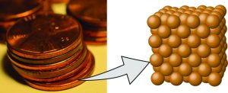
Figure 5.1a
Figure 5.1a Macroscopic vs Microscopic Visual the Element Copper: A pre-1982 copper penny (left) contains approximately 3 × 10²² copper atoms (several dozen are represented as brown spheres at the right), each of which has the same chemical properties. (credit: modification of work by slgc, CC BY 2.0; in Chemistry (OpenStax), CC BY 4.0).

Slide 4
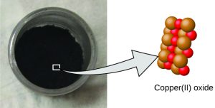
Figure 5.1b
Figure 5.1b Macroscopic vs Microscopic Visual of the Compound Copper(II) Oxide: Copper(II) oxide, a powdery, black compound, results from the combination of two types of atoms—copper (brown, larger spheres) and oxygen (red, smaller spheres)—in a 1:1 ratio. (credit: modification of work by Chemicalinterest, PD; in Chemistry (OpenStax), CC BY 4.0).)

Slide 5
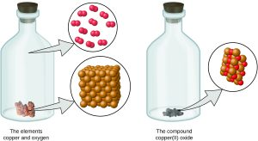
Figure 5.1c
Figure 5.1c Visual of Dalton's Theory - Atoms are neither created nor destroyed during a chemical change but are rearranged to yield new substances. When the elements copper (a shiny, red-brown solid, shown here as brown spheres shaped as a cube) and oxygen (a clear and colourless gas, shown here as red spheres that are present in pairs) react, their atoms rearrange to form a compound containing copper and oxygen (a powdery, black solid). (credit copper: modification of work by Anonymous, CC BY 3.0; in Chemistry (OpenStax), CC BY 4.0).

Slide 6
Table 5.1a
Table 5.1a Constant Composition of Isooctane
Sample | Carbon | Hydrogen | Mass Ratio
A | 14.82 g | 2.78 g | (14.82g carbon/2.78g hydrogen) = (5.33g carbon/1.00g hydrogen)
B | 22.33 g | 4.19 g | (22.33g carbon/4.19g hydrogen) = (5.33g carbon/1.00g hydrogen)
C | 19.40 g | 3.64 g | (19.40g carbon/3.64g hydrogen) = (5.33g carbon/1.00g hydrogen)
(credit: Chemistry (OpenStax), CC BY 4.0.)

Slide 7
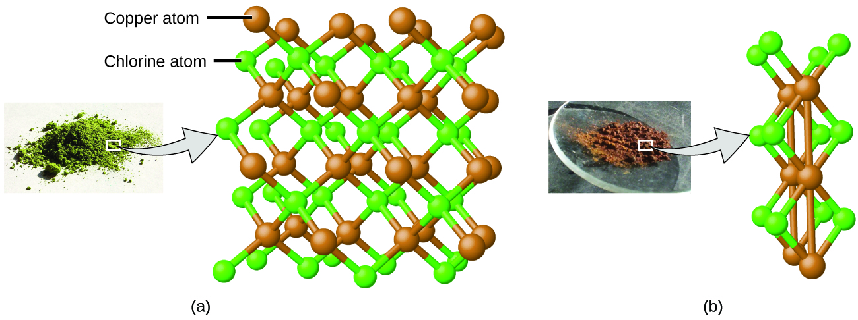
Figure 5.1d
Figure 5.1d Law of Multiple Proportions: Comparing two different compounds containing variable amounts of copper and chlorine atoms. Compared to the copper chlorine compound in (a), where copper is represented by brown, larger spheres and chlorine by green, smaller spheres, the copper chlorine compound in (b) has twice as many chlorine atoms per copper atom. (credit a: modification of work by Benjah-bmm27, PD; credit b: modification of work by Walkerma, PD; in Chemistry (OpenStax), CC BY 4.0).

Slide 8
Figure 5.2a
Figure 5.2a Electric Charge Real Life Example 1: An electrically charged comb attracts a stream of water from a distance. Note that the water is not touching the comb. (credit: Jane Whitney in University Physics Volume 2 (Open Stax), CC BY 4.0).

Slide 9
Figure 5.2b
Figure 5.2b Electric Charge Real Life Example 2: After being used to comb hair, this comb attracts small strips of paper from a distance, without physical contact. Investigation of this behavior helped lead to the concept of the electric force (credit: Jane Whitney in University Physics Volume 2 (Open Stax), CC BY 4.0).

Slide 10
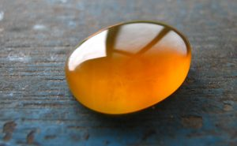
Figure 5.2c
Figure 5.2c Image of Borneo Amber: Borneo amber is mined in Sabah, Malaysia, from shale-sandstone-mudstone veins. When a piece of amber is rubbed with a piece of fur, the amber gains more negative charge, giving it a net negative charge. At the same time, the fur, having lost what we now know to be called electrons, becomes positively charged. (credit: work by Sebakoamber, PD)

Slide 11
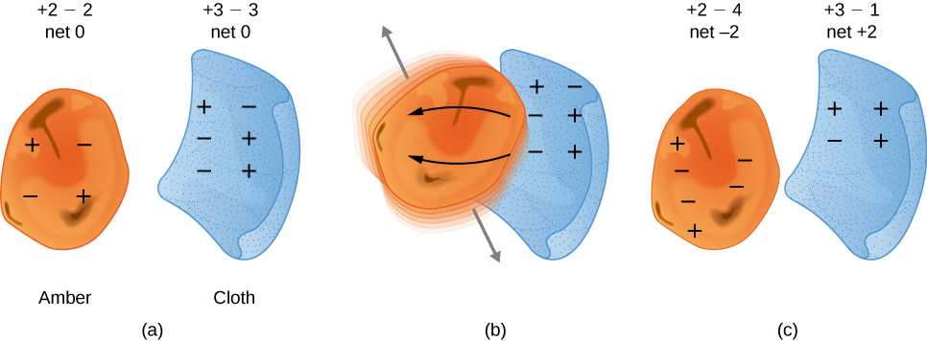
Figure 5.2d
Figure 5.2d Visual of Attractive Forces: When materials are rubbed together, charges can be separated, particularly if one material has a greater affinity for electrons than another. (a) Both the amber and cloth are originally neutral, with equal positive and negative charges. Only a tiny fraction of the charges are involved, and only a few of them are shown here. (b) When rubbed together, some negative charge is transferred to the amber, leaving the cloth with a net positive charge. (c) When separated, the amber and cloth now have net charges, but the absolute value of the net positive and negative charges will be equal. (credit: University Physics Volume 2 (OpenStax), CC BY 4.0.)

Slide 12
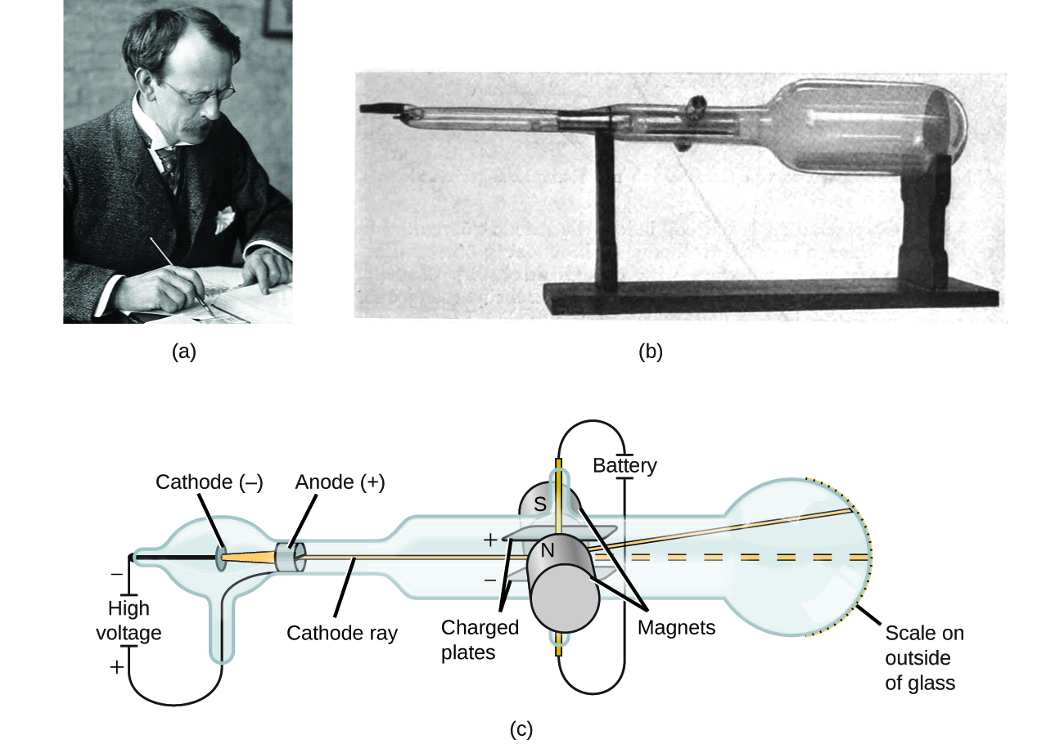
Figure 5.3a
Figure 5.3a Thomson Cathode Ray Experiments: (a) J. J. Thomson produced a visible beam in a cathode ray tube. (b) This is an early cathode ray tube, invented in 1897 by Ferdinand Braun. (c) In the cathode ray, the beam (shown in yellow) comes from the cathode and is accelerated past the anode toward a fluorescent scale at the end of the tube. Simultaneous deflections by applied electric and magnetic fields permitted Thomson to calculate the mass-to-charge ratio of the particles composing the cathode ray. (credit a: modification of work by Nobel Foundation, PD; credit b: modification of work by Eugen Nesper, PD; credit c: modification of work by Kurzon, PD).

Slide 13
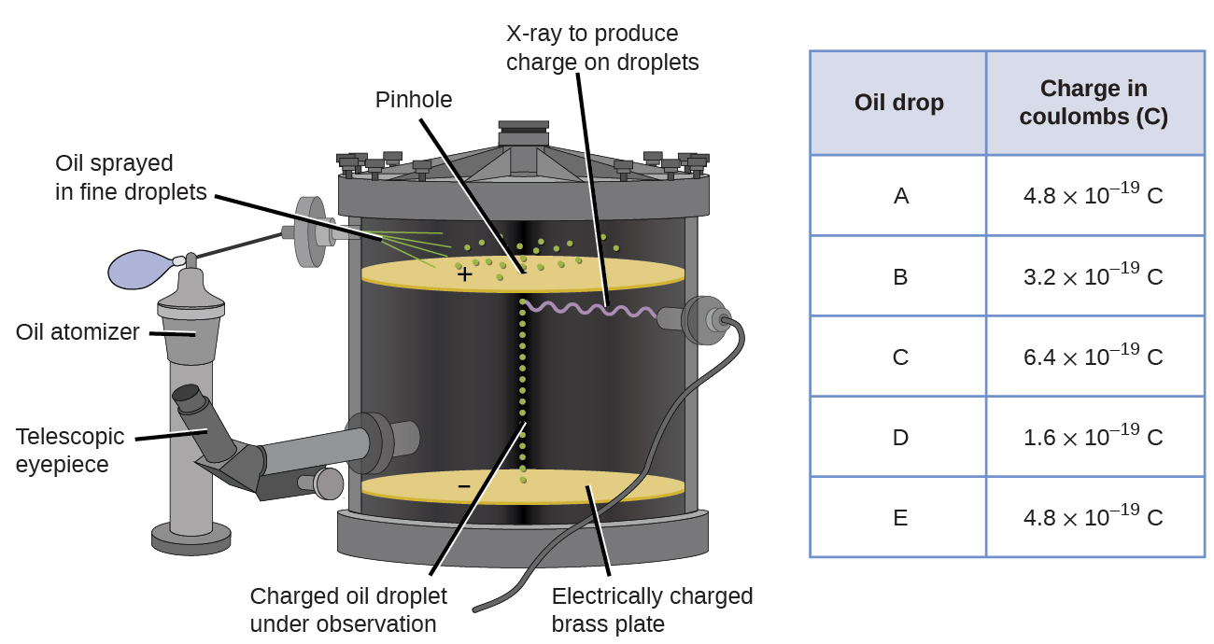
Figure 5.3b
Figure 5.3b Millikan’s Oil Drop Experiment: Millikan’s experiment measured the charge of individual oil drops. The tabulated data are examples of a few possible values. (credit: Chemistry (OpenStax), CC BY 4.0.)

Slide 14
Figure 5.3c
Figure 5.3c Early Models of the Atom and its Subatomic Parts. (a) Thomson suggested that atoms resembled plum pudding, an English dessert consisting of moist cake with embedded raisins (“plums”). (b) Nagaoka proposed that atoms resembled the planet Saturn, with a ring of electrons surrounding a positive “planet.” (credit a: modification of work by Man vyi, PD; credit b: modification of work courtesy of NASA/JPL-Caltech, JPL Image Policy; in Chemistry (OpenStax), CC BY 4.0).

Slide 15
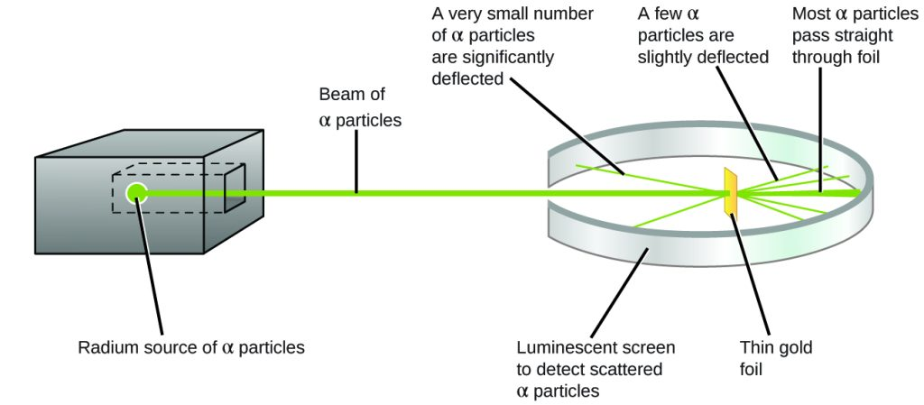
Figure 5.3d
Figure 5.3d Rutherford Gold Foil Experiment Schematic: Geiger and Rutherford fired α particles at a piece of gold foil and detected where those particles went, as shown in this schematic diagram of their experiment. Most of the particles passed straight through the foil, but a few were deflected slightly and a very small number were significantly deflected. (credit: Chemistry (OpenStax), CC BY 4.0.)

Slide 16
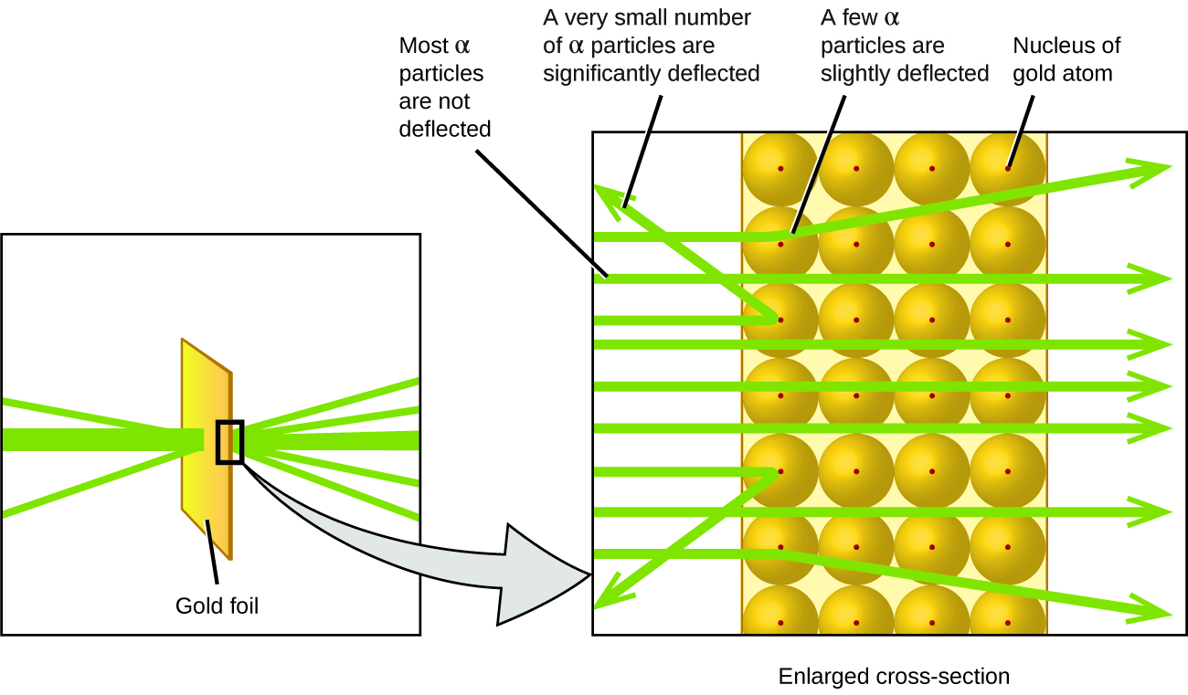
Figure 5.3e
Figure 5.3e Rutherford Gold Foil Experiment - Microscopic Visual. The α particles are deflected only when they collide with or pass close to the much heavier, positively charged gold nucleus. Because the nucleus is very small compared to the size of an atom, very few α particles are deflected. Most pass through the relatively large region occupied by electrons, which are too light to deflect the rapidly moving particles. (credit: Chemistry (OpenStax), CC BY 4.0.)

Slide 17
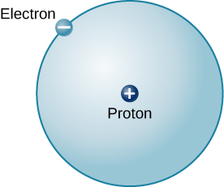
Figure 5.4a
Figure 5.4a Hydrogen-1 Atom: This is a schematic diagram of a hydrogen atom. The proton and electron have equal but opposite charges, which exert an electromagnetic force that binds the hydrogen atom together. In the illustration, the size of the particles is exaggerated so that you can see them; they are not to scale. They are also shown much closer than they would actually be as it would take more than an entire page to show their actual distance to scale (credit: Astronomy 2e (Open Stax), CC BY 4.0).

Slide 18
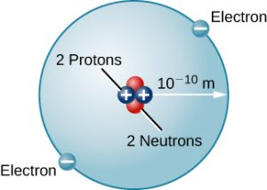
Figure 5.4b
Figure 5.4b Helium Atom. Here we see a schematic diagram of a helium atom in its lowest energy state. Two protons are present in the nucleus of all helium atoms. In the most common variety of helium, the nucleus also contains two neutrons, which have nearly the same mass as the proton but carry no charge. Two electrons orbit the nucleus (credit: Astronomy 2e (Open Stax), CC BY 4.0).

Slide 19
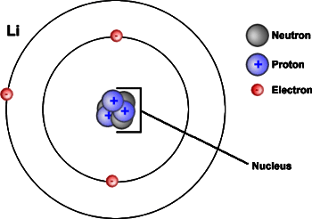
Figure 5.4c
Figure 5.4c Diagram of the Atom: Atoms contain protons (+) and neutrons, which are found in the nucleus (centre) of the atom. Atoms also contain electrons (-), which are found outside the nucleus. This is a model of a lithium atom. (credit: “Diagram of an Atom” from Introduction to Biology by Open Learning Initiative is licensed under CC BY-NC-SA 3.0).

Slide 20
Table 5.4a
Table 5.4a Summarizing Ion formation and Terminology
Starting Atom | Gain / Lose Electrons | More / Less Electrons than Protons | Type of Ion | Ion Classification | Determining Charge
Neutral Atom | loses electron(s) | LESS e⁻s | forms positive ion | cation | = # electrons lost to form ion
Neutral Atom | gains electron(s) | MORE e⁻s | forms negative ion | anion | = # electrons gained to form ion
(credit: table data summarized by Jackie MacDonald, CC BY-NC 4.0)

Slide 21
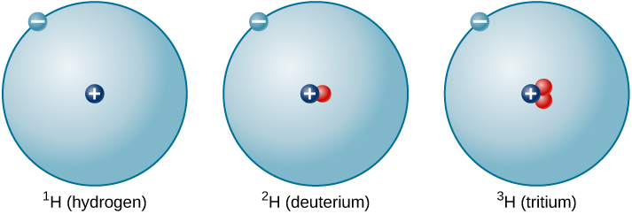
Figure 5.4d
Figure 5.4d Isotopes of Hydrogen: A single proton in the nucleus defines the atom to be hydrogen, but there may be zero, one, or two neutrons. The most common isotope of hydrogen is the one with only a single proton and no neutrons. (credit: Astronomy 2e (OpenStax), CC BY 4.0.)

Slide 22
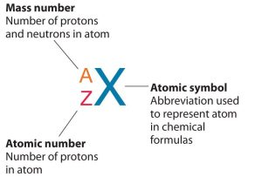
Figure 5.5a
Figure 5.5a Isotope Symbols of Elements: A symbol template is used to differentiate one isotope from another. The element symbol is written to identify the element. A represents the isotope’s mass number and symbol Z represents the isotope’s atomic number. All isotopes of an element have the same number of protons and electrons, which means they exhibit similar chemical properties. (credit: "1.6 Isotopes and Atomic Masses" In Principles of General Chemistry (v. 1.0) by Anonymous, CC BY-NC-SA 3.0./ Adapted by Jackie MacDonald.

Slide 23
Figure 5.5b
Figure 5.5b Atomic Symbols used to Represent Isotopes of Elements: The symbol for an atom indicates the element via its usual two-letter symbol, the mass number as a left superscript, the atomic number as a left subscript (sometimes omitted), and the charge of its ion as a right superscript. Isotopes for Helium-4 and Magnesium-24 are shown in this figure. (credit: Chemistry (OpenStax), CC BY 4.0.)

Slide 24
Table 5.5a
Table 5.5a Nuclear Compositions of Atoms of the Very Light Elements (modified by Jackie MacDonald to include "mass number" column)
Isotope Name | Symbol | Atomic Number | Number of Protons | Number of Neutrons | Mass Number | Mass (amu) | % Natural Abundance
hydrogen-1 (protium) | H | 1 | 1 | 0 | 1 | 1.0078 | 99.989
hydrogen-2 (deuterium) | H | 1 | 1 | 1 | 2 | 2.0141 | 0.0115
hydrogen-3 (tritium) | H | 1 | 1 | 2 | 3 | 3.01605 | — (trace)
helium-3 | He | 2 | 2 | 1 | 3 | 3.01603 | 0.00013
helium-4 | He | 2 | 2 | 2 | 4 | 4.0026 | 100
lithium-6 | Li | 3 | 3 | 3 | 6 | 6.0151 | 7.59
lithium-7 | Li | 3 | 3 | 4 | 7 | 7.0160 | 92.41
beryllium-9 | Be | 4 | 4 | 5 | 9 | 9.0122 | 100
boron-10 | B | 5 | 5 | 5 | 10 | 10.0129 | 19.9
boron-11 | B | 5 | 5 | 6 | 11 | 11.0093 | 80.1
(credit: Chemistry (OpenStax), CC BY 4.0.)

Slide 25
Table 5.5a (Continued)
Table 5.5a (continued) Nuclear Compositions of Atoms of the Very Light Elements (modified by Jackie MacDonald to include "mass number" column)
Isotope Name | Symbol | Atomic Number | Number of Protons | Number of Neutrons | Mass Number | Mass (amu) | % Natural Abundance
carbon-12 | C | 6 | 6 | 6 | 12 | 12.0000 | 98.89
carbon-13 | C | 6 | 6 | 7 | 13 | 13.0034 | 1.11
carbon-14 | C | 6 | 6 | 8 | 14 | 14.0032 | — (trace)
nitrogen-14 | N | 7 | 7 | 7 | 14 | 14.0031 | 99.63
nitrogen-15 | N | 7 | 7 | 8 | 15 | 15.0001 | 0.37
oxygen-16 | O | 8 | 8 | 8 | 16 | 15.9949 | 99.757
oxygen-17 | O | 8 | 8 | 9 | 17 | 16.9991 | 0.038
oxygen-18 | O | 8 | 8 | 10 | 18 | 17.9992 | 0.205
fluorine-19 | F | 9 | 9 | 10 | 19 | 18.9984 | 100
neon-20 | Ne | 10 | 10 | 10 | 20 | 19.9924 | 90.48
neon-21 | Ne | 10 | 10 | 11 | 21 | 20.9938 | 0.27
neon-22 | Ne | 10 | 10 | 12 | 22 | 21.9914 | 9.25
(credit: Chemistry (OpenStax), CC BY 4.0.)

Slide 26
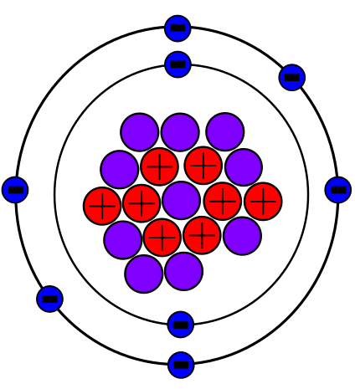
Figure 5.5c
Figure 5.5c Oxygen-18 Atom: The isotope, oxygen-18, includes 8 protons and 10 neutrons in the core nucleus, and 8 electrons around the nucleus. (credit: work by SM358, PD).

Slide 27
Figure 5.6a
Figure 5.6a Perspective about an Atoms Relative Size: If an atom could be expanded to the size of a football stadium, the nucleus would be the size of a single blueberry. (credit left: Chemistry (OpenStax), CC BY 4.0; credit middle: modification of work by babyknight, CC BY 2.0; credit right: modification of work by Paxson Woelber, CC BY 2.0)

Slide 28
Table 5.6a
Table 5.6a Properties of Subatomic Particles
Name | Location | Charge (C) | Unit Charge | Mass (amu) | Mass (g)
electron | outside nucleus | −1.602 × 10⁻¹⁹ | 1− | 0.00055 | 0.00091 × 10⁻²⁴
proton | nucleus | 1.602 × 10⁻¹⁹ | 1+ | 1.00727 | 1.67262 × 10⁻²⁴
neutron | nucleus | 0 | 0 | 1.00866 | 1.67493 × 10⁻²⁴
(credit: Chemistry (OpenStax), CC BY 4.0.)

Slide 29
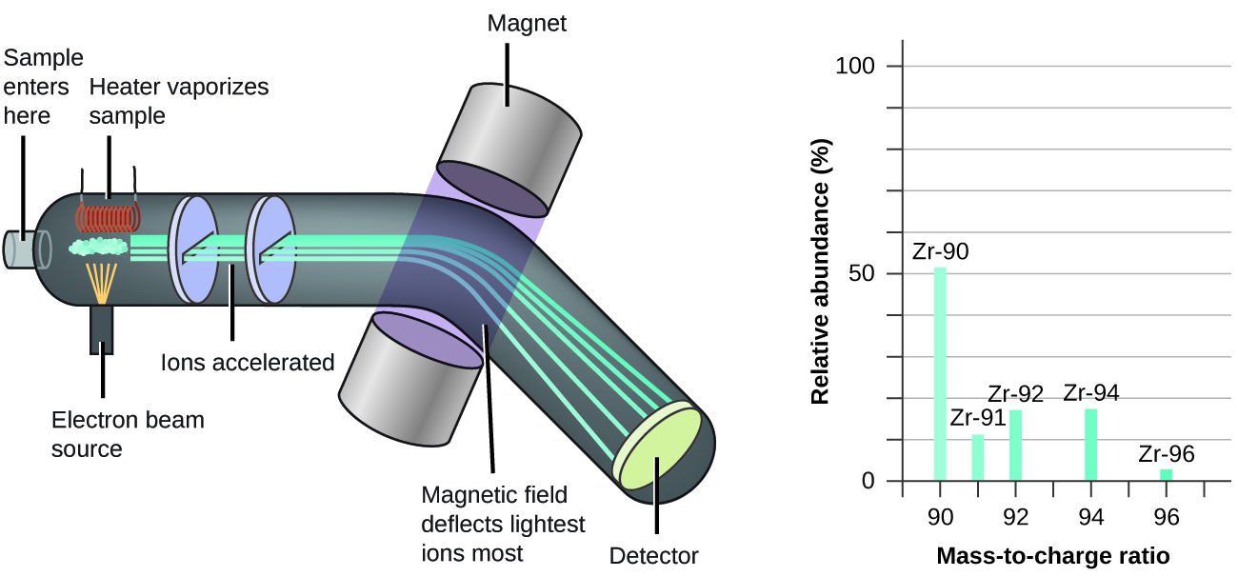
Figure 5.6b
Figure 5.6b A Typical Mass Spectrometer: Analysis of zirconium in a mass spectrometer produces a mass spectrum with peaks showing the different isotopes of Zr. (credit: Chemistry (OpenStax), CC BY 4.0.)

