Slide 1
Chapter 4 Matter And Its Properties
Slides to accompany Enhanced Introductory College Chemistry by Gregory Anderson, Caryn Fahey, J.R. van Haarlem, Jackie MacDonald, Adrienne Richards, Samantha Sullivan Sauer, and David Wegman
Slide design and template by Revathi Mahadevan
Except where otherwise noted, images, tables & diagrams are reused from Enhanced Introductory College Chemistry, a derivative of Chemistry (Open Stax) by Paul Flowers, Klaus Theopold, Richard Langley & William R. Robinson and is licensed under CC BY 4.0. ​Access for free at Chemistry (OpenStax)​
Slides are licensed under CC-BY 4.0, Except while otherwise noted

Slide 2
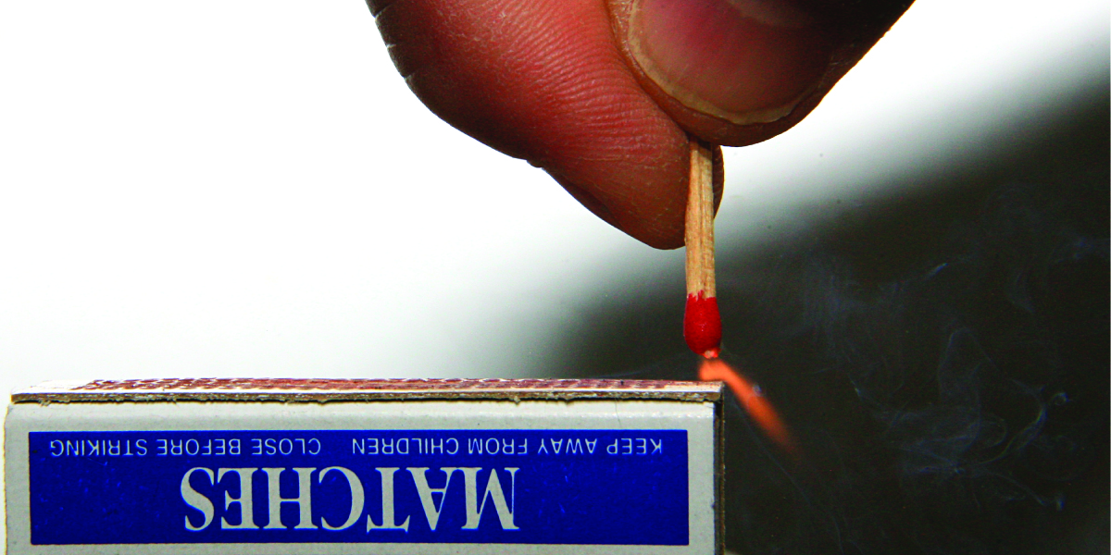
Figure 4a
Figure 4a Sliding a match head along a rough surface initiates a combustion reaction that produces energy in the form of heat and light. (credit: work by Laszlo Ilyes, licensed under CC BY 2.0)

Slide 3
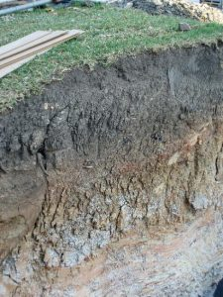
Figure 4b
Figure 4b Soil profile (credit: work by Science StockPhotos, CC BY 4.0)

Slide 4
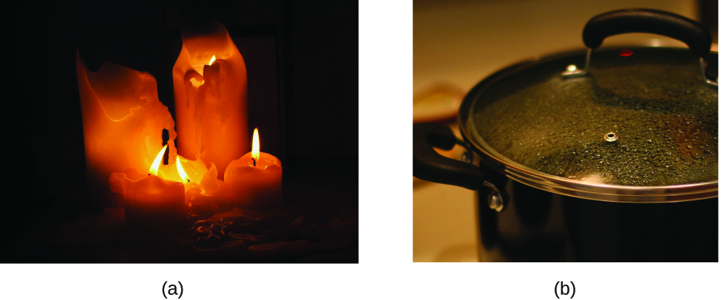
Figure 4.1a
Figure 4.1a (a) Wax undergoes a physical change when solid wax is heated and forms liquid wax. (b) Steam condensing inside a cooking pot is a physical change, as water vapour is changed into liquid water. (credit a: modification of work by 95jb14, PD; credit b: modification of work by mjneuby, CC BY 2.0)

Slide 5
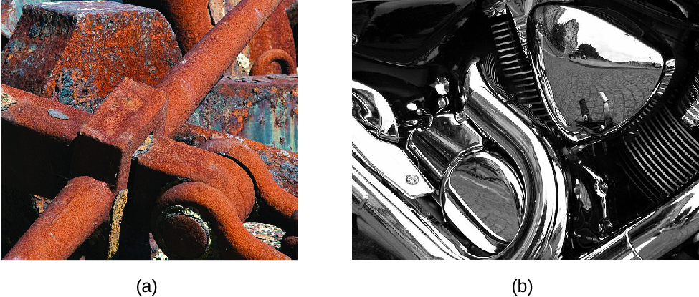
Figure 4.1b
Figure 4.1b (a) One of the chemical properties of iron is that it rusts; (b) one of the chemical properties of chromium is that it does not. (credit a: modification of work by Tony Hisgett, CC BY 2.0; credit b: modification of work by Atoma, CC BY 2.5)

Slide 6
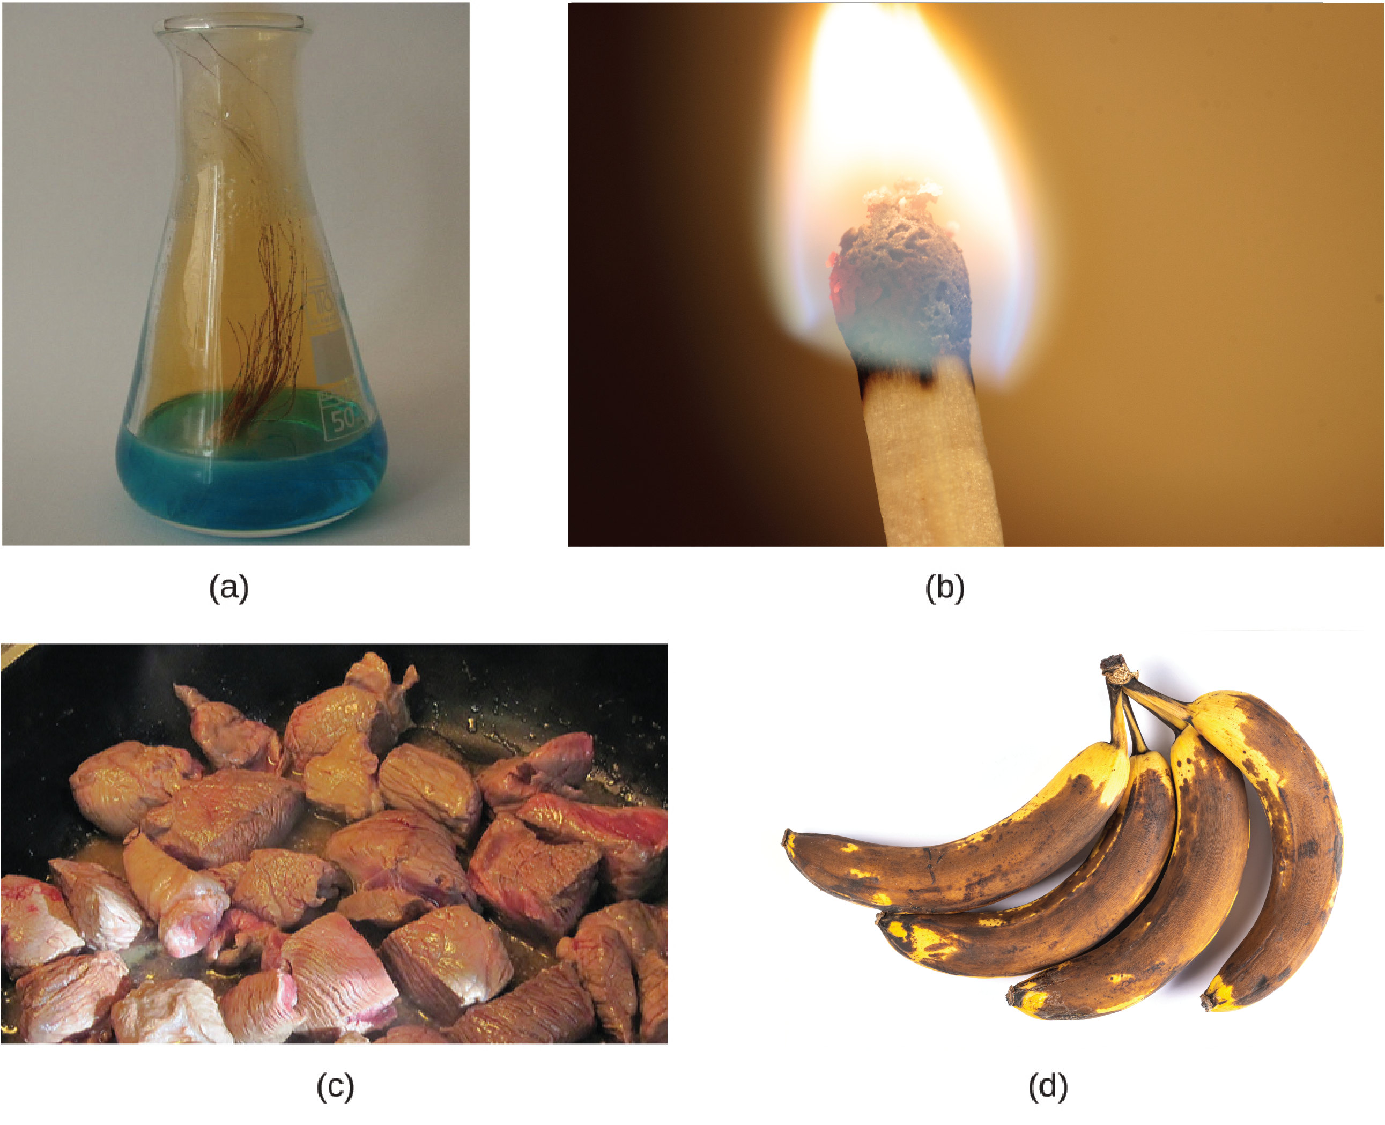
Figure 4.1c
Figure 4.1c (a) Copper and nitric acid undergo a chemical change to form copper nitrate and brown, gaseous nitrogen dioxide. (b) During the combustion of a match, cellulose in the match and oxygen from the air undergo a chemical change to form carbon dioxide and water vapour. (c) Cooking red meat causes a number of chemical changes, including the oxidation of iron in myoglobin that results in the familiar red-to-brown colour change. (d) A banana turning brown is a chemical change as new, darker (and less tasty) substances form. (credit a: work by The mad scientist, PD; credit b: work by Francesco Schiavone, CC BY 4.0; credit c: modification of work by Gloria Cabada-Leman, CC BY 2.0; credit d: work by Marco Verch, CC BY 2.0)

Slide 7
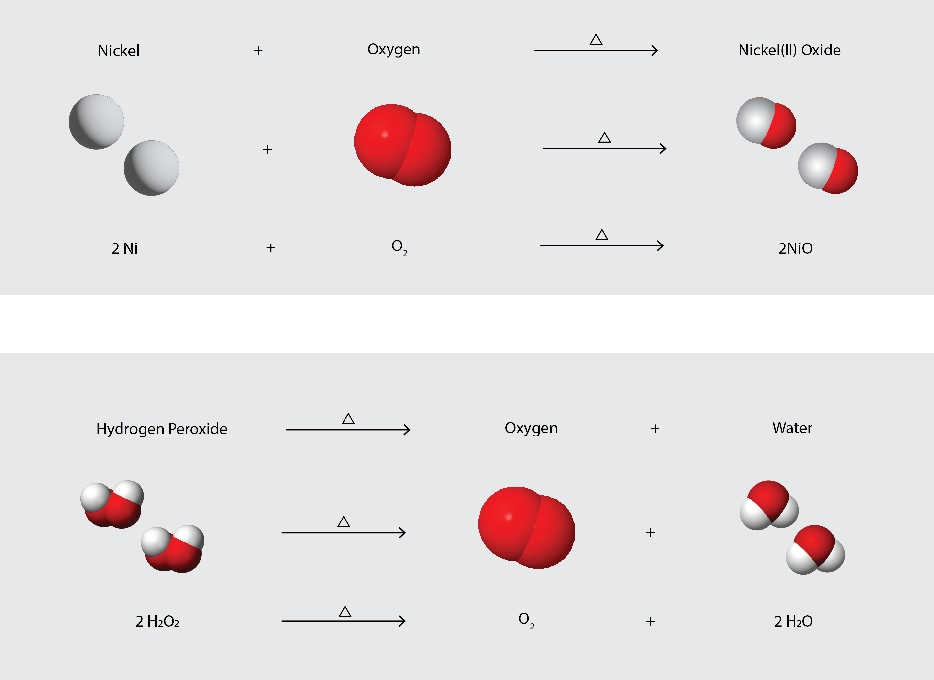
Figure 4.1d
Figure 4.1d The figure illustrates the example of chemical changes undergone to form Nickel(II) Oxide and the decomposition of hydrogen peroxide. (credits: modification of oxygen by Ulflund, CC0; hydrogen peroxide by Benjah-bmm27, PD; water by Dbc334 & Jynto (Water), PD. / Combined/Adapted by Revathi Mahadevan, CC BY 4.0)

Slide 8
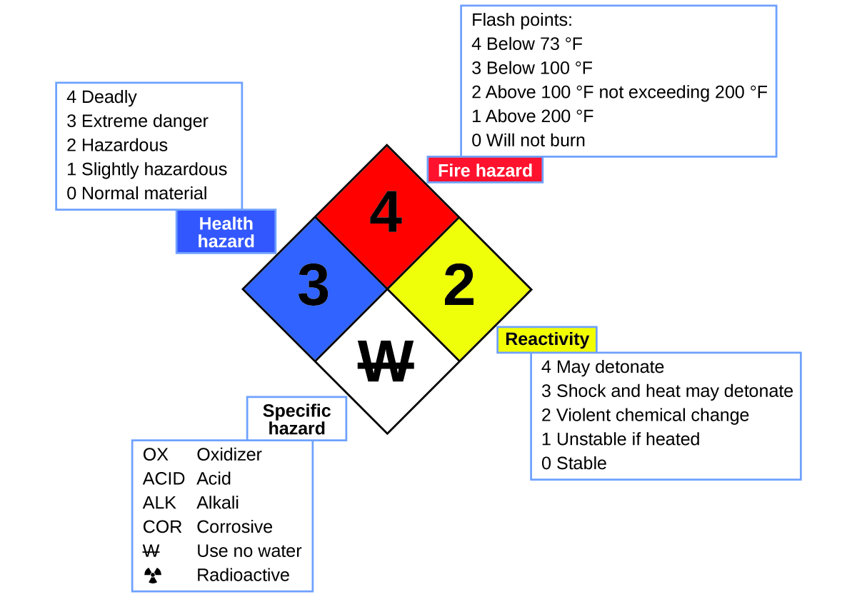
Figure 4.1e
Figure 4.1e The National Fire Protection Agency (NFPA) hazard diamond summarizes the major hazards of a chemical substance. (credit: Chemistry (OpenStax), CC BY 4.0.)

Slide 9
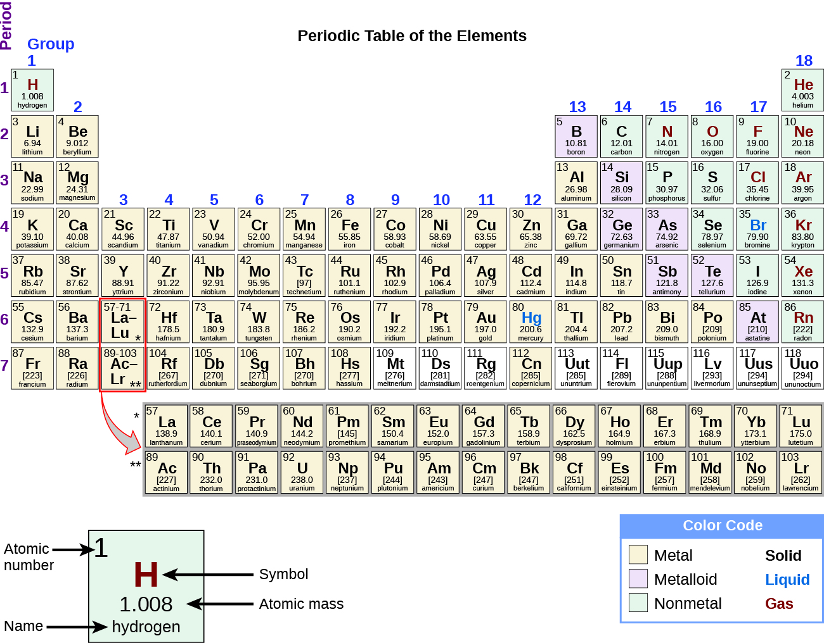
Figure 4.1f
Figure 4.1f The periodic table shows how elements may be grouped according to certain similar properties. Note the background colour denotes whether an element is a metal, metalloid, or nonmetal, whereas the element symbol colour indicates whether it is a solid, liquid, or gas. Review the Periodic Table of the Elements in other formats in Appendix A. (credit: Chemistry (OpenStax), CC BY 4.0.)

Slide 10
Figure 4.2a
Figure 4.2a The energy involved in chemical changes is important to our daily lives: (a) A cheeseburger for lunch provides the energy you need to get through the rest of the day; (b) the combustion of gasoline provides the energy that moves your car (and you) between home, work, and school; and (c) coke, a processed form of coal, provides the energy needed to convert iron ore into iron, which is essential for making many of the products we use daily. (credit a: modification of work by D Sharon Pruitt, CC BY 2.0; credit b: modification of work by Jeffery Turner, CC BY 2.0; credit c: work by Unknown, PD.)

Slide 11
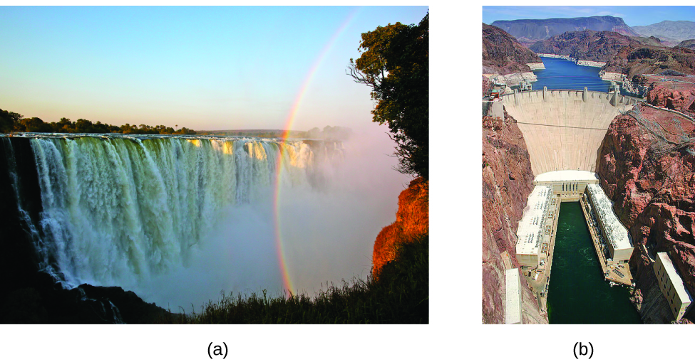
Figure 4.2b
Figure 4.2b (a) Water that is higher in elevation, for example, at the top of Victoria Falls, has higher potential energy than water at a lower elevation. As the water falls, some of its potential energy is converted into kinetic energy. (b) If the water flows through generators at the bottom of a dam, such as the Hoover Dam showed here, its kinetic energy is converted into electrical energy. (credit a: modification of work by Steve Jurvetson, CC BY 2.0; credit b: modification of work by curimedia, CC BY 2.0)

Slide 12
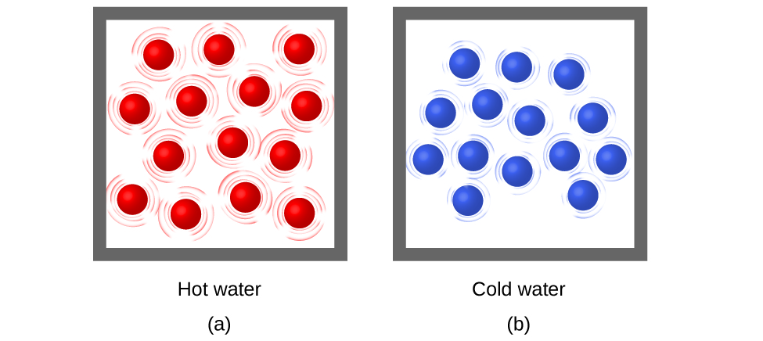
Figure 4.2c
Figure 4.2c (a) The molecules in a sample of hot water move more rapidly than (b) those in a sample of cold water. (credit: Chemistry (OpenStax), CC BY 4.0.)

Slide 13
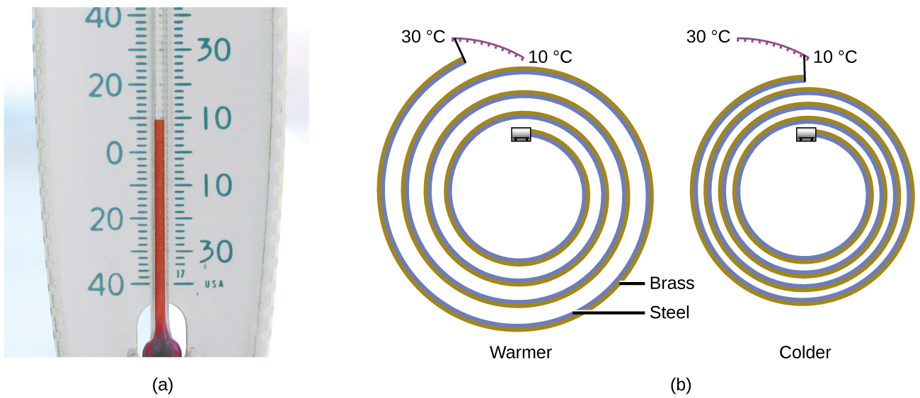
Figure 4.2d
Figure 4.2d (a) In an alcohol or mercury thermometer, the liquid (dyed red for visibility) expands when heated and contracts when cooled, much more so than the glass tube that contains the liquid. (b) In a bimetallic thermometer, two different metals (such as brass and steel) form a two-layered strip. When heated or cooled, one of the metals (brass) expands or contracts more than the other metal (steel), causing the strip to coil or uncoil. Both types of thermometers have a calibrated scale that indicates the temperature. (credit a: modification of work by dwstucke, CC BY 2.0, credit b: Chemistry (OpenStax), CC BY 4.0.)

Slide 14
Figure 4.2e
Figure 4.2e (a) Substances H and L are initially at different temperatures, and their atoms have different average kinetic energies. (b) When they are put into contact with each other, collisions between the molecules result in the transfer of kinetic (thermal) energy from the hotter to the cooler matter. (c) The two objects reach “thermal equilibrium” when both substances are at the same temperature, and their molecules have the same average kinetic energy. (credit: Chemistry (OpenStax), CC BY 4.0.)

Slide 15
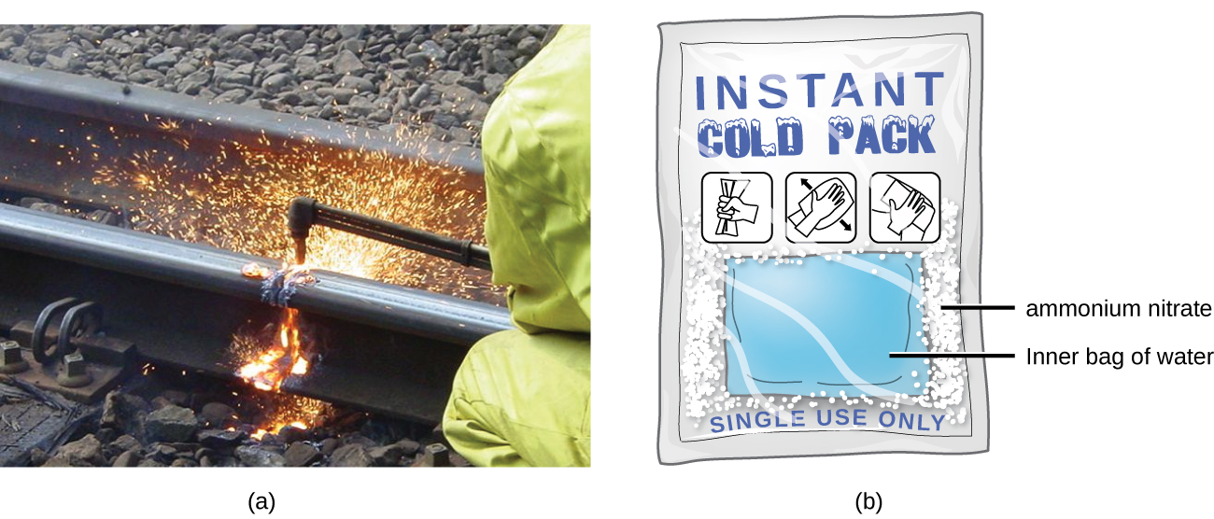
Figure 4.2f
Figure 4.2f (a) An oxyacetylene torch produces heat by the combustion of acetylene in oxygen. The energy released by this exothermic reaction heats and then melts the metal being cut. The sparks are tiny bits of molten metal flying away. (b) A cold pack uses an endothermic process to create the sensation of cold. (credit a: modification of work by Skatebiker, PD; credit b: Chemistry (OpenStax), CC BY 4.0.)

Slide 16
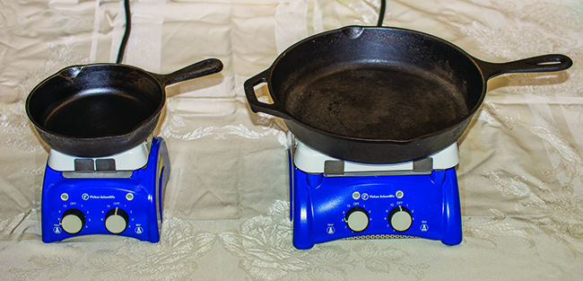
Figure 4.2g
Figure 4.2g Due to its larger mass, a large frying pan has a larger heat capacity than a small frying pan. Because they are made of the same material, both frying pans have the same specific heat. (credit: Mark Blaser in Chemistry (OpenStax), CC BY 4.0).

Slide 17
Table 4.2a
Table 4.2a Specific Heats of Common Substances at 25 °C and 1 bar
Substance | Symbol (state) | Specific Heat (J/g °C)
helium | He(g) | 5.193
water | H₂O(l) | 4.184
ethanol | C₂H₆O(l) | 2.376
ice | H₂O(s) | 2.093 (at −10 °C)
water vapour | H₂O(g) | 1.864
nitrogen | N₂(g) | 1.040
air
oxygen | O₂(g) | 0.918
aluminum | Al(s) | 0.897
carbon dioxide | CO₂(g) | 0.853
argon | Ar(g) | 0.522
iron | Fe(s) | 0.449
copper | Cu(s) | 0.385
lead | Pb(s) | 0.130
gold | Au(s) | 0.129
silicon | Si(s) | 0.712
(credit: Chemistry (OpenStax), CC BY 4.0.)

Slide 18
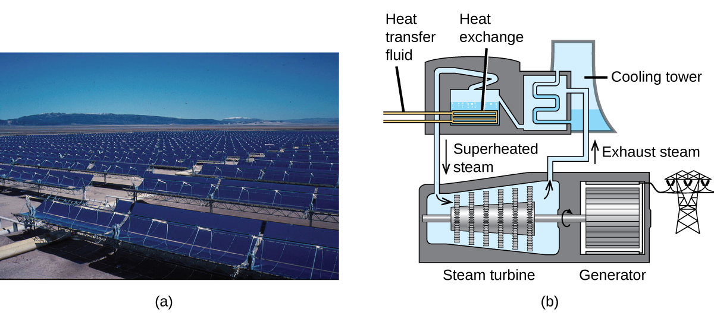
Figure 4.2h
Figure 4.2h This solar thermal plant uses parabolic trough mirrors to concentrate sunlight. (credit a: modification of work by Bureau of Land Management, PD, credit b: Chemistry (OpenStax), CC BY 4.0.)

Slide 19
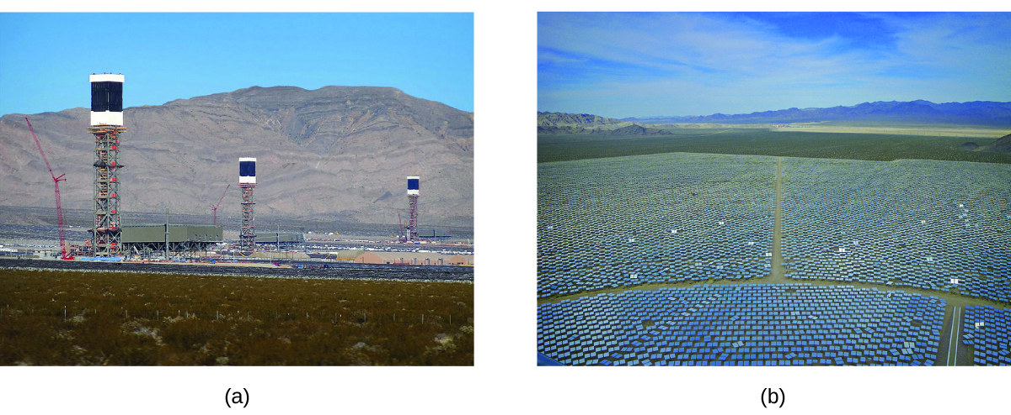
Figure 4.2i
Figure 4.2i (a) The Ivanpah solar thermal plant uses 170,000 mirrors to concentrate sunlight on water-filled towers. (b) It covers 4000 acres of public land near the Mojave Desert and the California-Nevada border. (credit a: modification of work by Craig Dietrich, CC BY 2.0; credit b: modification of work by USFWS Pacific Southwest Region, CC BY 2.0)

Slide 20
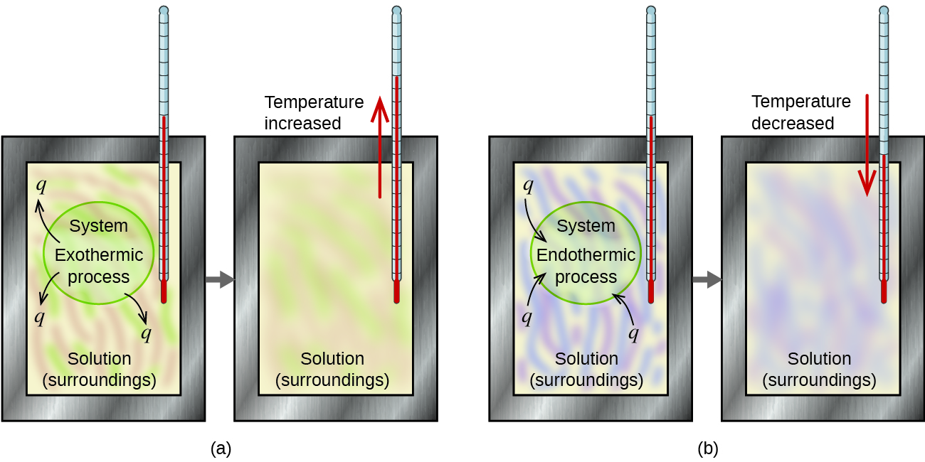
Figure 4.3a
Figure 4.3a In a calorimetric determination, either (a) an exothermic process occurs and heat, q, is negative, indicating that thermal energy is transferred from the system to its surroundings, or (b) an endothermic process occurs and heat, q, is positive, indicating that thermal energy is transferred from the surroundings to the system. (credit: Chemistry (OpenStax), CC BY 4.0.)

Slide 21
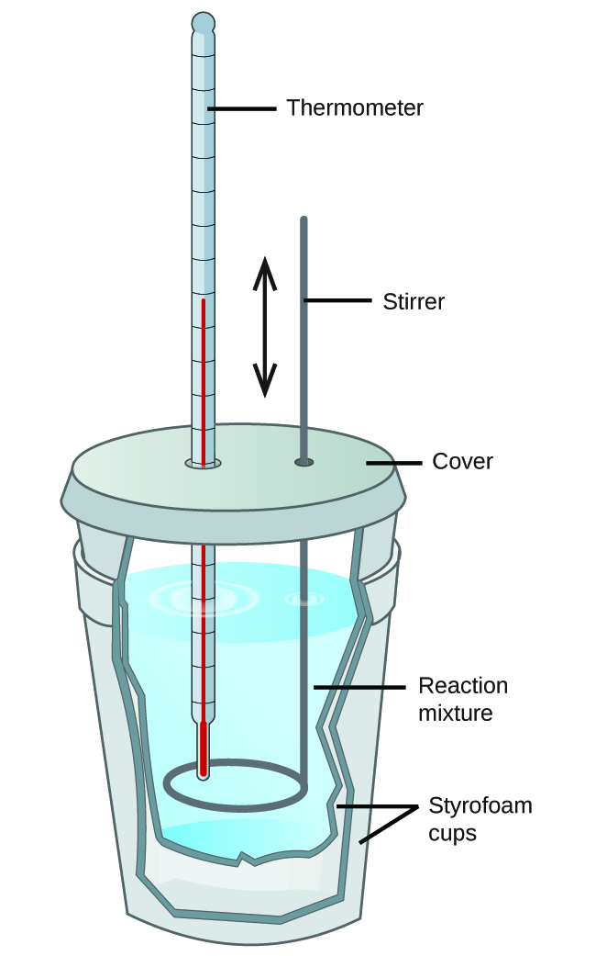
Figure 4.3b
Figure 4.3b A simple calorimeter can be constructed from two polystyrene cups. A thermometer and stirrer extend through the cover into the reaction mixture. (credit: Chemistry (OpenStax), CC BY 4.0.)

Slide 22
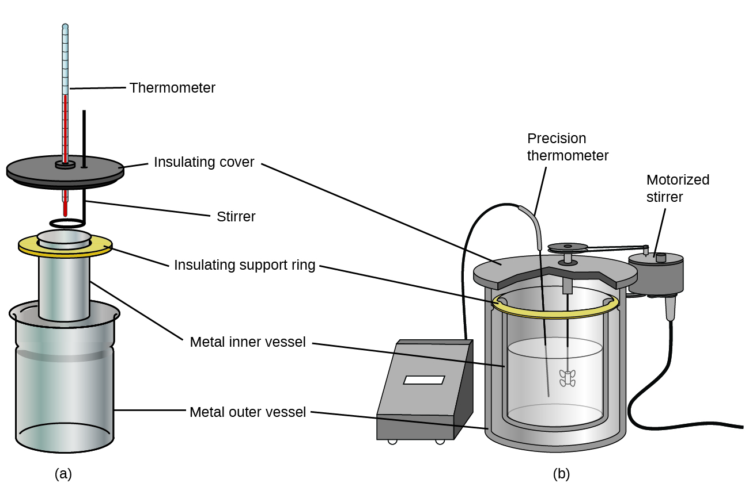
Figure 4.3c
Figure 4.3c Commercial solution calorimeters range from (a) simple, inexpensive models for student use to (b) expensive, more accurate models for industry and research. (credit: Chemistry (OpenStax), CC BY 4.0.)

Slide 23
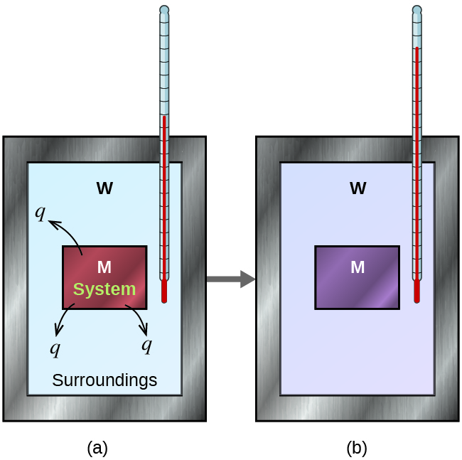
Figure 4.3d
Figure 4.3d In a simple calorimetry process, (a) heat, q, is transferred from the hot metal, M, to the cool water, W, until (b) both are at the same temperature. (credit: Chemistry (OpenStax), CC BY 4.0.)

Slide 24
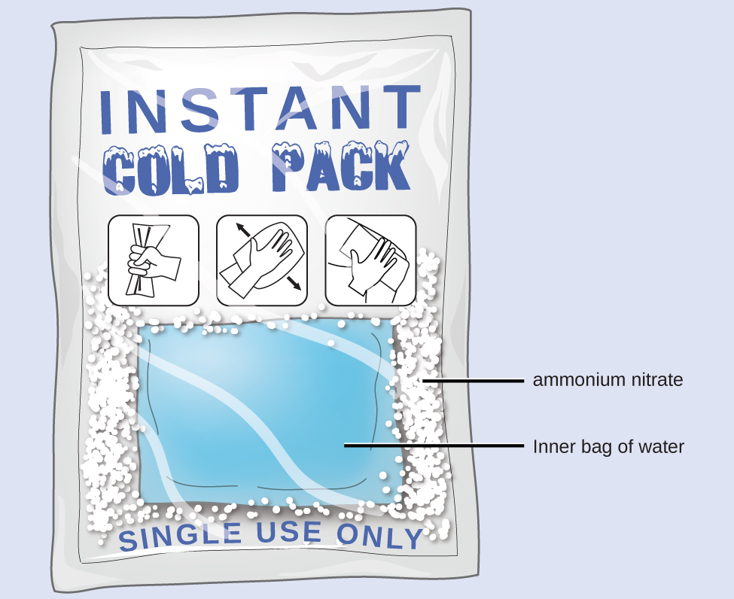
Figure 4.3e
Figure 4.3e An instant cold pack consists of a bag containing solid ammonium nitrate and the second bag of water. When the bag of water is broken, the pack becomes cold because the dissolution of ammonium nitrate is an endothermic process that removes thermal energy from the water. The cold pack then removes thermal energy from your body. (credit: Chemistry (OpenStax), CC BY 4.0.)

Slide 25
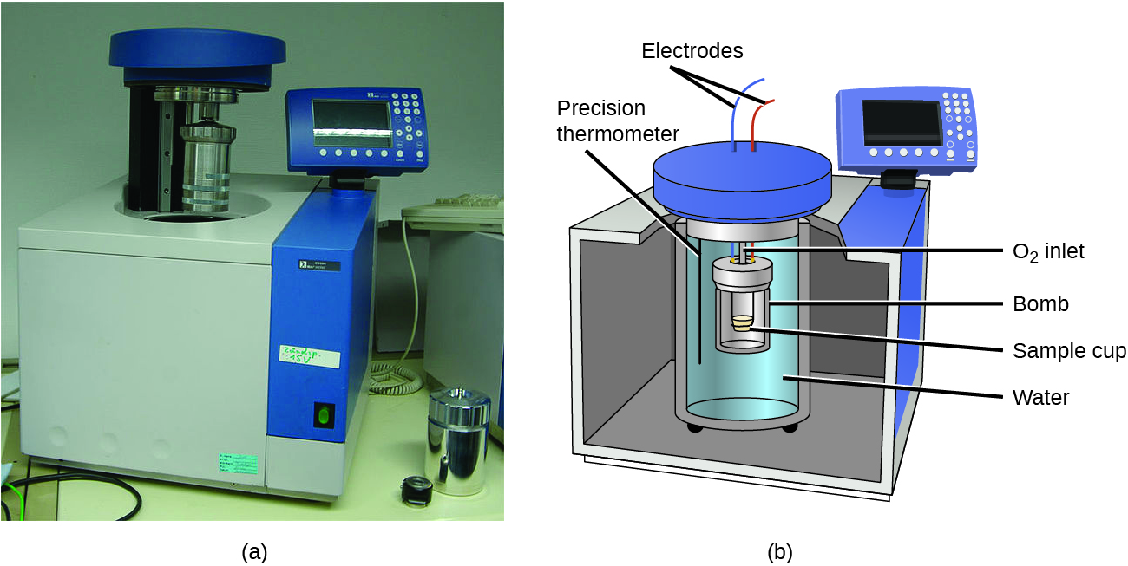
Figure 4.3f
Figure 4.3f (a) A bomb calorimeter is used to measure heat produced by reactions involving gaseous reactants or products, such as combustion. (b) The reactants are contained in the gas-tight “bomb,” which is submerged in water and surrounded by insulating materials. (credit a: modification of work by Harbor1, CC BY 3.0, credit b: Chemistry (OpenStax), CC BY 4.0.)

Slide 26
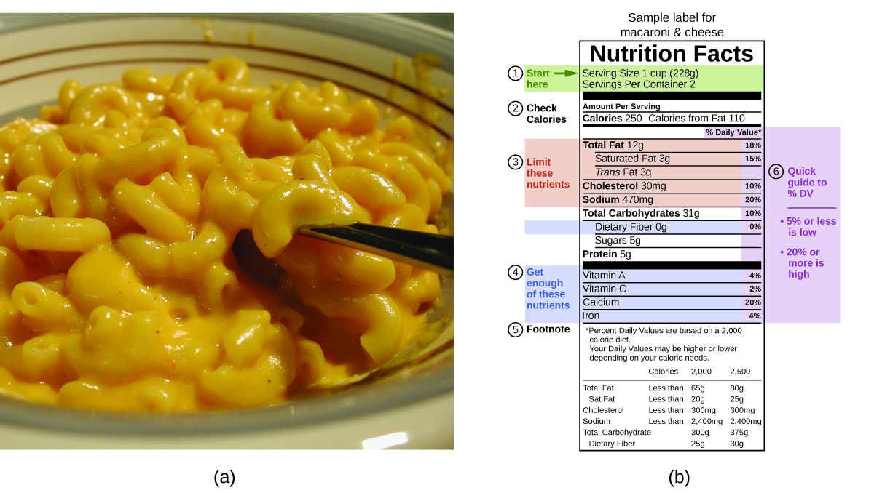
Figure 4.3g
Figure 4.3g (a) Macaroni and cheese contain energy in the form of the macronutrients in the food. (b) The food’s nutritional information is shown on the package label. In the US, the energy content is given in Calories (per serving); the rest of the world usually uses kilojoules. (credit a: modification of work by Rex Roof, CC BY 2.0; credit b: Chemistry (OpenStax), CC BY 4.0.)

Slide 27
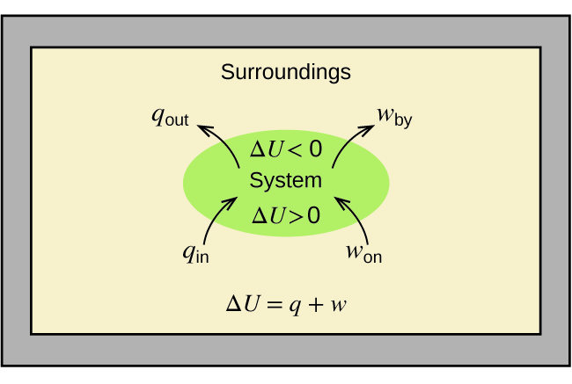
Figure 4.4a
Figure 4.4a Relationship between Internal energy, U, Work, w and Heat Flow, q. (credit: Chemistry (OpenStax), CC BY 4.0.)

Slide 28
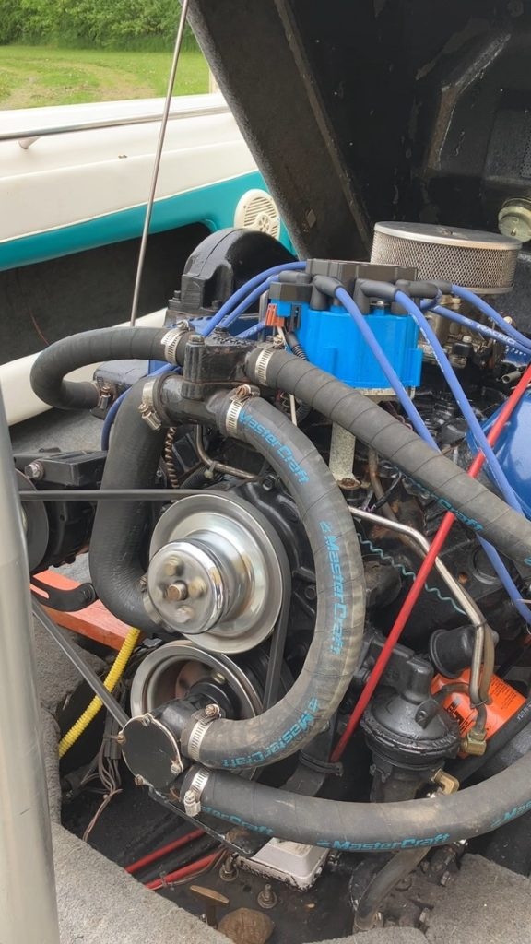
Figure 4.4b
Figure 4.4b An internal combustion engine converts chemical energy into mechanical energy through the breaking of chemical bonds. (credit: photo by J.R. van Haarlem, CC-BY 4.0)

Slide 29
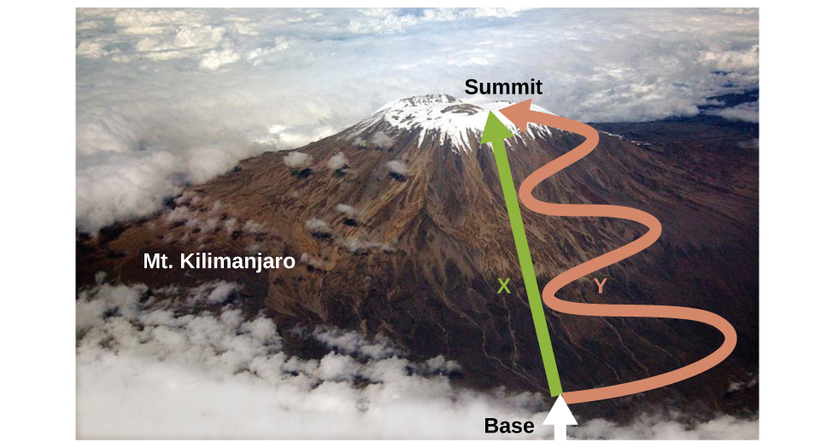
Figure 4.4c
Figure 4.4c Paths X and Y represent two different routes to the summit of Mt. Kilimanjaro. Both have the same change in elevation (altitude or elevation on a mountain is a state function; it does not depend on the path), but they have very different distances traveled (distance walked is not a state function; it depends on the path). (credit: modification of Mt. Kilimanjaro by Paul Shaffner, CC BY 2.0)

Slide 30
Table 4.4a
Table 4.4a Standard Molar Enthalpies of Combustion
Substance | Combustion Reaction | Enthalpy of Combustion, ΔH∘_{c}(kJ/mol at 25∘C)
carbon | C(s)+O₂(g)⟶CO₂(g) | −393.5
hydrogen | H₂(g)+1/2 O₂(g)⟶H₂O(l) | −285.8
magnesium | Mg(s)+1/2 O₂(g)⟶MgO(s) | −601.6
sulfur | S(s)+O₂(g)⟶SO₂(g) | −296.8
carbon monoxide | CO(g)+1/2 O₂(g)⟶CO₂(g) | −283.0
methane | CH₄(g)+2O₂(g)⟶CO₂(g)+2H₂O(l) | −890.8
acetylene | C₂H₂(g)+5/2 O₂(g)⟶2CO₂(g)+H₂O(l) | −1301.1
ethanol | C₂H₅OH(l)+3O₂(g)⟶2CO₂(g)+3H₂O(l) | −1366.8
methanol | CH₃OH(l)+3/2 O₂(g)⟶CO₂(g)+2H₂O(l) | −726.1
isooctane | C₈H₁₈(l)+25/2 O₂(g)⟶8CO₂(g)+9H₂O(l) | −5461
(credit: Chemistry (OpenStax), CC BY 4.0.)

Slide 31
Figure 4.4d
Figure 4.4d The combustion of gasoline is very exothermic. (credit: modification of work by AlexEagle, CC BY 2.0)

Slide 32
Figure 4.4e
Figure 4.4e (a) Tiny algal organisms can be (b) grown in large quantities and eventually (c) turned into a useful fuel such as biodiesel. (credit a: modification of work by Micah Sittig, CC BY 2.0; credit b: modification of work by Robert Kerton/CSIRO, CC BY 3.0; credit c: work by Sandia Labs, CC BY-NC-ND 2.0)

Slide 33
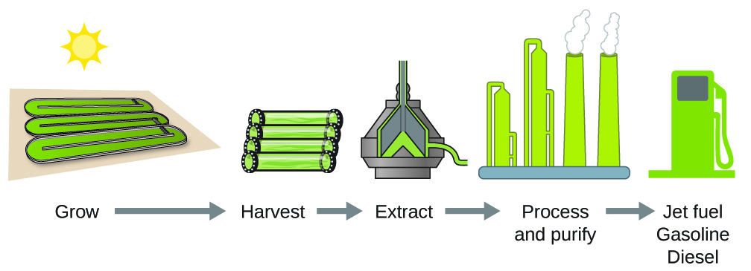
Figure 4.4f
Figure 4.4f Algae convert sunlight and carbon dioxide into oil that is harvested, extracted, purified, and transformed into a variety of renewable fuels. (credit: Chemistry (OpenStax), CC BY 4.0.)

Slide 34
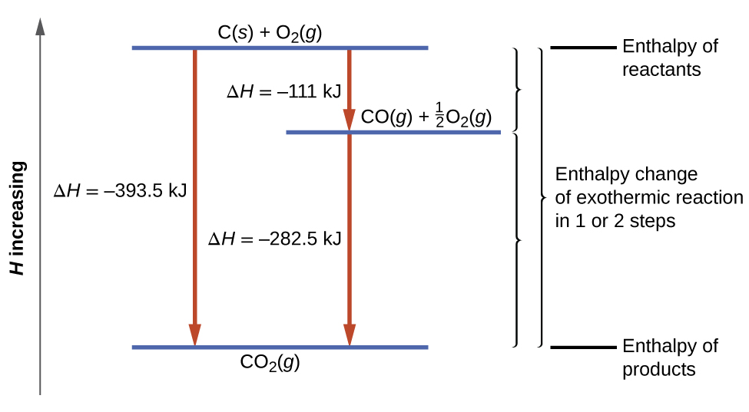
Figure 4.4g
Figure 4.4g The formation of CO₂(g) from its elements can be thought of as occurring in two steps, which sum to the overall reaction, as described by Hess’s law. The horizontal blue lines represent enthalpies. For an exothermic process, the products are at lower enthalpy than the reactants. (credit: Chemistry (OpenStax), CC BY 4.0.)

