Slide 1
Chapter 3 Building Blocks of Matter
Slides to accompany Enhanced Introductory College Chemistry by Gregory Anderson, Caryn Fahey, J.R. van Haarlem, Jackie MacDonald, Adrienne Richards, Samantha Sullivan Sauer, and David Wegman
Slide design and template by Revathi Mahadevan
Except where otherwise noted, images, tables & diagrams are reused from Enhanced Introductory College Chemistry, a derivative of Chemistry (Open Stax) by Paul Flowers, Klaus Theopold, Richard Langley & William R. Robinson and is licensed under CC BY 4.0. ​Access for free at Chemistry (OpenStax)​
Slides are licensed under CC-BY 4.0, Except while otherwise noted

Slide 2
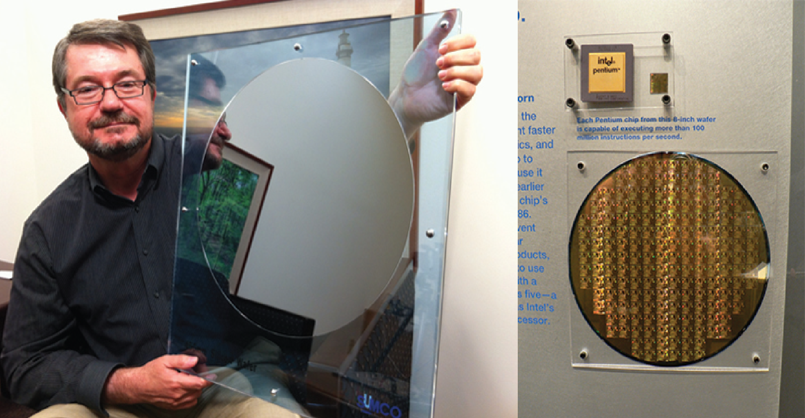
Figure 3a
Figure 3a Purity is extremely important when preparing silicon wafers. The CEO of VLSI Research, Don Hutcheson, shows off a pure silicon wafer (left). A silicon wafer covered in Pentium chips is an enlarged version of the silicon wafers found in many electronics used today (right). (credit left: modification of work by Intel Free Press, CC BY 2.0; credit right: modification of work by Naotake Murayama, CC BY 2.0)

Slide 3
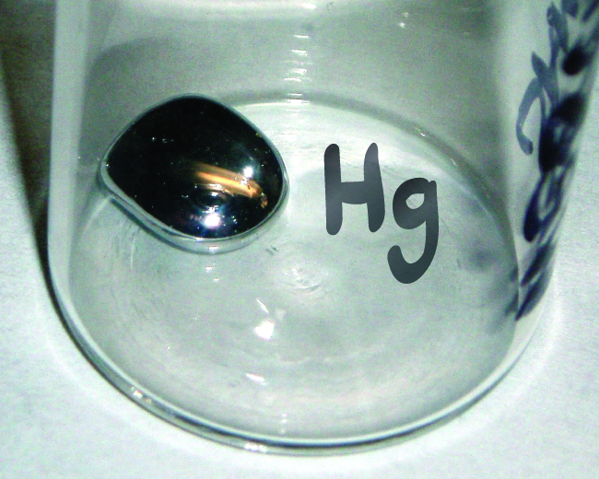
Figure 3.1a
Figure 3.1a The symbol Hg represents the element mercury regardless of the amount; it could represent one atom of mercury or a large amount of mercury. (credit: work by A, PD)

Slide 4
Table 3.1a
Table 3.1a Some Common Elements and Their Symbols
Element | Symbol | Element | Symbol
aluminum | Al | iron | Fe (from ferrum)
bromine | Br | lead | Pb (from plumbum)
calcium | Ca | magnesium | Mg
carbon | C | mercury | Hg (from hydrargyrum)
chlorine | Cl | nitrogen | N
chromium | Cr | oxygen | O
cobalt | Co | potassium | K (from kalium)
copper | Cu (from cuprum) | silicon | Si
fluorine | F | silver | Ag (from argentum)
gold | Au (from aurum) | sodium | Na (from natrium)
helium | He | sulfur | S
hydrogen | H | tin | Sn (from stannum)
iodine | I | zinc | Zn
(credit: Chemistry (OpenStax), CC BY 4.0.)

Slide 5
Figure 3.1b
Figure 3.1b Francium (credit: Image by Ahoerstemeier, CC BY-SA 3.0)

Slide 6
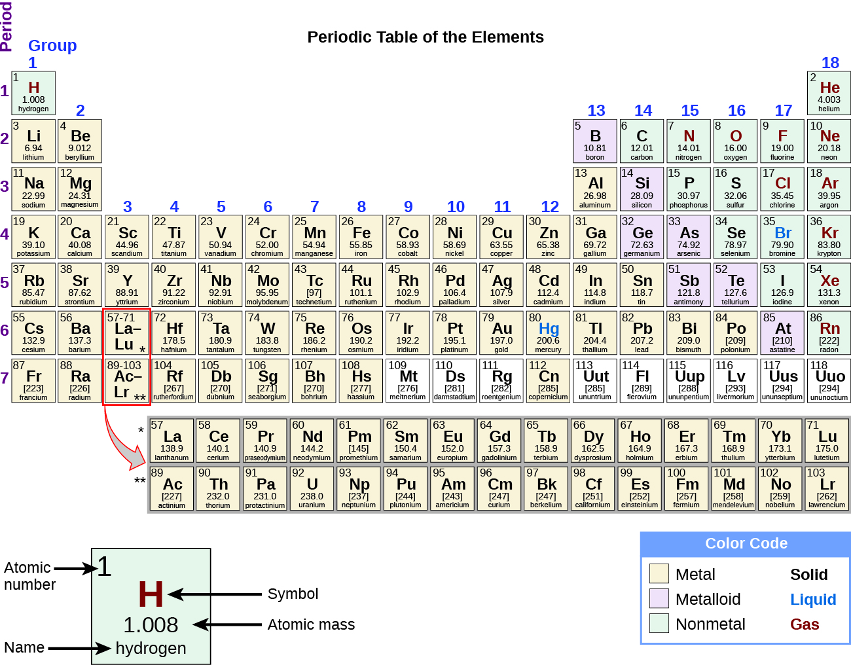
Figure 3.1c
Figure 3.1c Elements and their symbols in the periodic table. Review the Periodic Table of the Elements in other formats in Appendix A. (credit: Chemistry (OpenStax), CC BY 4.0.)

Slide 7
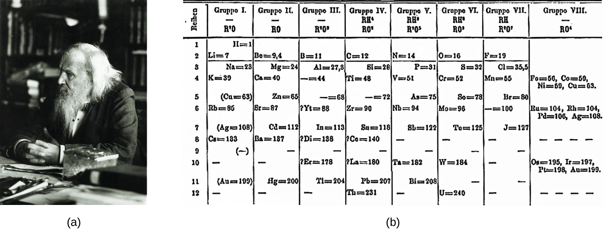
Figure 3.2a
Figure 3.2a (a) Dimitri Mendeleev is widely credited with creating (b) the first periodic table of the elements. (credit a: modification of work by Serge Lachinov, PD; credit b: modification of work by Den fjättrade ankan, PD)

Slide 8
Figure 3.2b
Figure 3.2b Elements in the periodic table are organized according to their properties. Review the Periodic Table of the Elements in other formats in Appendix A. (credit: Chemistry (OpenStax), CC BY 4.0).

Slide 9
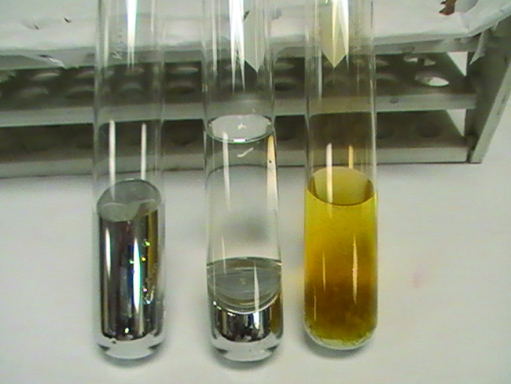
Figure 3.2c
Figure 3.2c From left to right: Hg(l), Hg + concentrated HCl, Hg + concentrated HNO₃. (credit: Sahar Atwa in Chemistry (OpenStax), CC BY 4.0.)

Slide 10
Figure 3.2d
Figure 3.2d (a) Diamond and (b) graphite are two forms of carbon. (c) In the crystal structure of diamond, the covalent bonds form three-dimensional tetrahedrons. (d) In the crystal structure of graphite, each planar layer is composed of six-membered rings. (credit a: modification of work by Fancy Diamonds, CC BY 2.0; credit b: modification of work by Anonymous, CC BY 3.0 credit c, d: Chemistry (OpenStax), CC BY 4.0.)

Slide 11
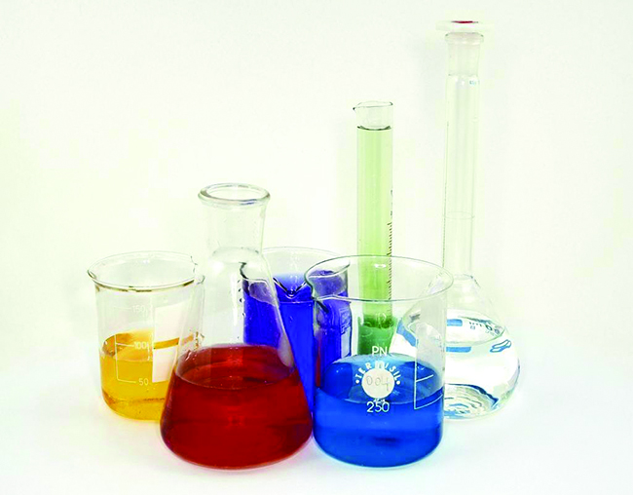
Figure 3.2e
Figure 3.2e Laboratory glassware, such as Pyrex and Kimax, is made of borosilicate glass because it does not break when heated. The inclusion of borates in the glass helps to mediate the effects of thermal expansion and contraction. This reduces the likelihood of thermal shock, which causes silicate glass to crack upon rapid heating or cooling. (credit: photo by Tweenk, CC BY 3.0)

Slide 12
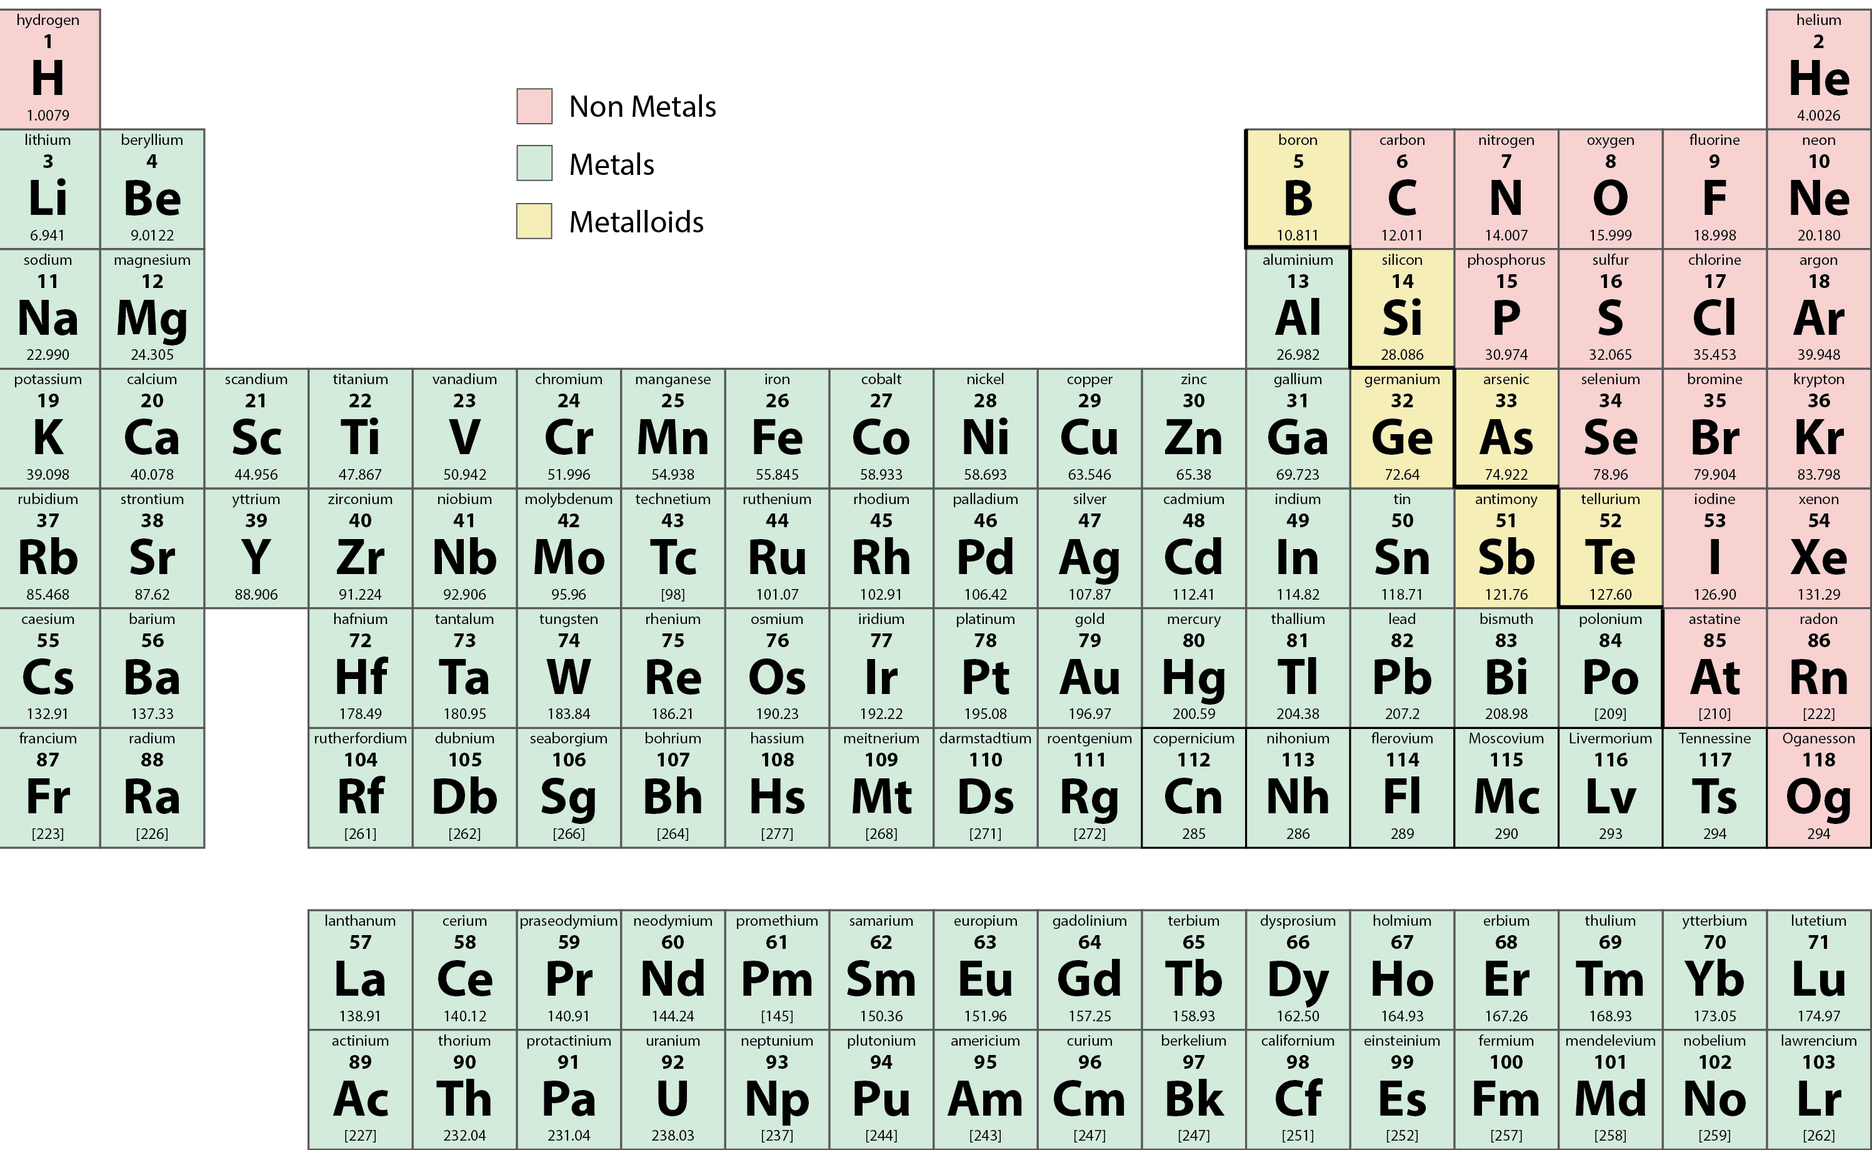
Figure 3.2f
Figure 3.2f Metals, non-metals, and metalloids in the periodic table. (credit: graphics by Revathi Mahadevan, CC BY 4.0) Review the Periodic Table of the Elements in other formats in Appendix A.

Slide 13
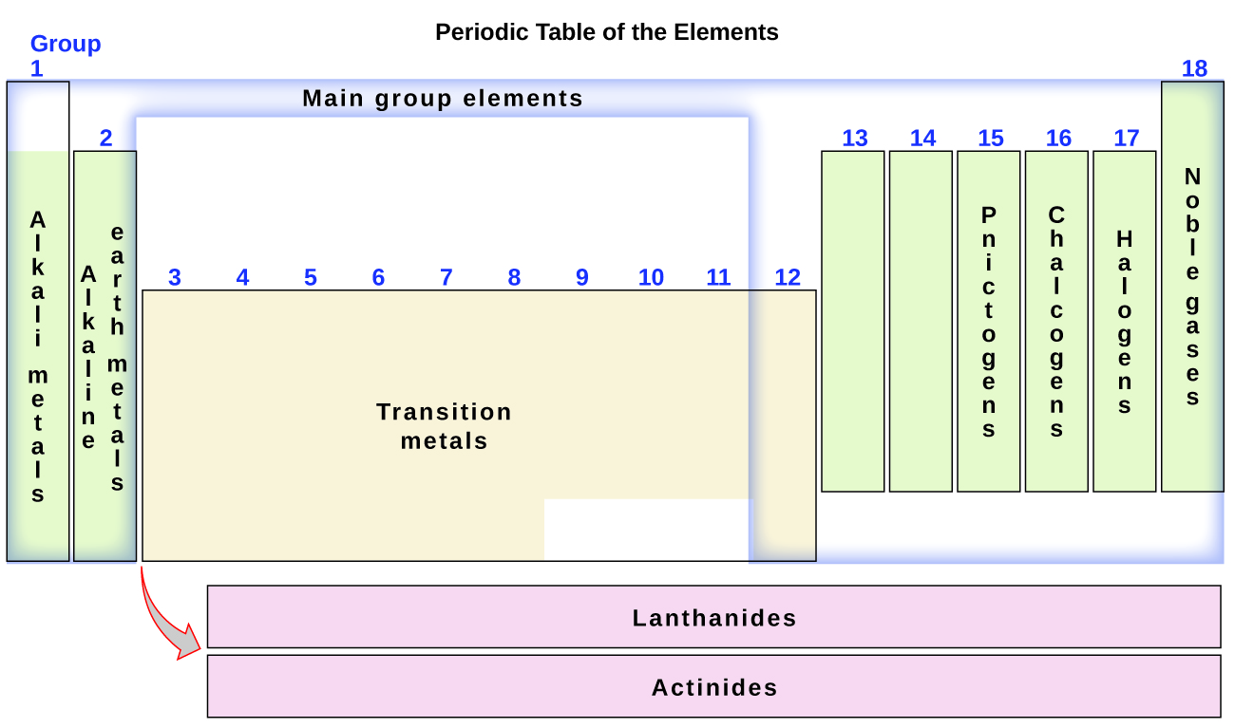
Figure 3.2g
Figure 3.2g The periodic table organizes elements with similar properties into groups. Review the Periodic Table of the Elements in other formats in Appendix A. (credit: Chemistry (OpenStax), CC BY 4.0.)

Slide 14
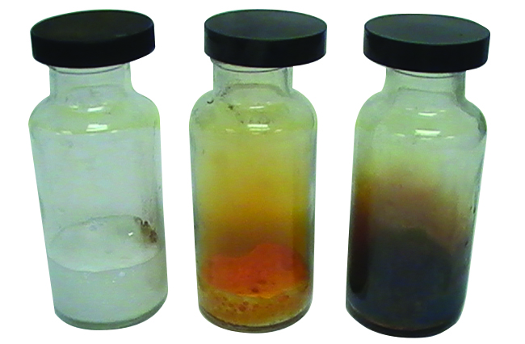
Figure 3.2h
Figure 3.2h Chlorine is a pale yellow-green gas (left), gaseous bromine is deep orange (centre), and gaseous iodine is purple (right). (Fluorine is so reactive that it is too dangerous to handle.) (credit: Sahar Atwa in Chemistry (OpenStax), CC BY 4.0.)

Slide 15
Figure 3.3a
Figure 3.3a Dr. Uma Chowdhry (credit: Photo by Science History Institute, CC BY-SA 3.0)

Slide 16
Figure 3.3b
Figure 3.3b A methane molecule can be represented as (a) a molecular formula, (b) a structural formula, (c) a ball-and-stick model, and (d) a space-filling model. Carbon and hydrogen atoms are represented by black and white spheres, respectively. (credit: Chemistry (OpenStax), CC BY 4.0.)

Slide 17
Figure 3.3c
Figure 3.3c A molecule of sulfur is composed of eight sulfur atoms and is therefore written as S₈. It can be represented as (a) a structural formula, (b) a ball-and-stick model, and (c) a space-filling model. Sulfur atoms are represented by yellow spheres. (credit: Chemistry (OpenStax), CC BY 4.0.)

Slide 18
Figure 3.3d
Figure 3.3d The symbols H, 2H, H₂, and 2H₂ represent very different entities. (credit: Chemistry (OpenStax), CC BY 4.0.)

Slide 19
Figure 3.3e
Figure 3.3e Benzene, C₆H₆, is produced during oil refining and has many industrial uses. A benzene molecule can be represented as (a) a structural formula, (b) a ball-and-stick model, and (c) a space-filling model. (d) Benzene is a clear liquid. (credit a, b, c: Chemistry (OpenStax), CC BY 4.0, credit d: modification of work by Sahar Atwa in Chemistry (OpenStax), CC BY 4.0.)

Slide 20
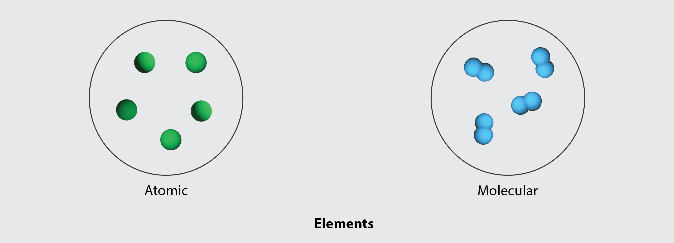
Figure 3.3f
Figure 3.3f The figure illustrates the difference in the atomic structure of an element. (credit: modification of work by Hoa112008, PD; / Adapted by Revathi Mahadevan, CC BY 4.0).

Slide 21
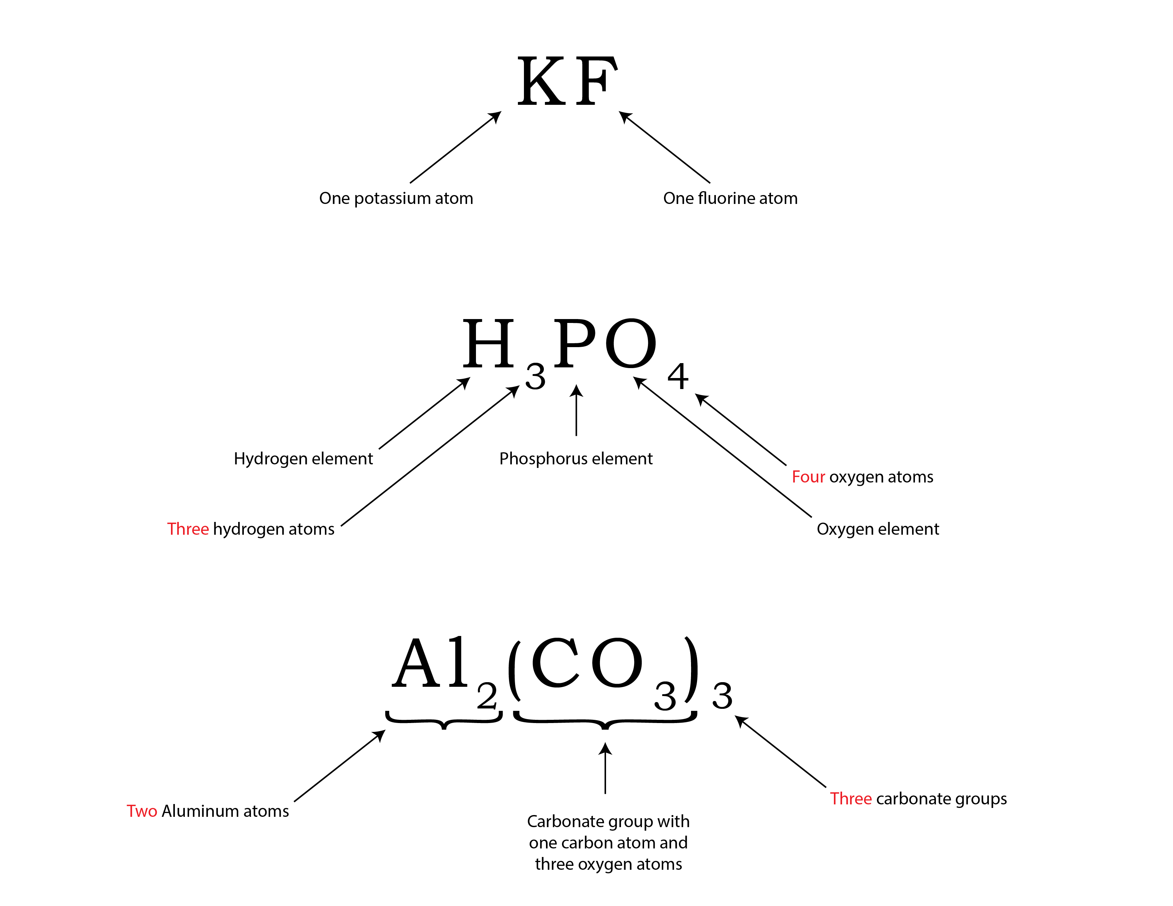
Figure 3.3g
Figure 3.3g Breakdown of compounds. (credit: graphic by Revathi Mahadevan, CC BY 4.0)

Slide 22
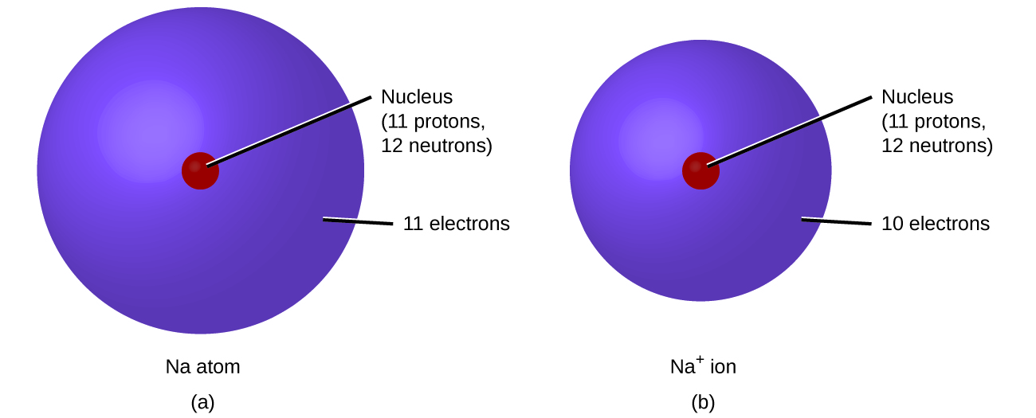
Figure 3.3h
Figure 3.3h (a) A sodium atom (Na) has equal numbers of protons and electrons (11) and is uncharged. (b) A sodium cation (Na+) has lost an electron, so it has one more proton (11) than electrons (10), giving it an overall positive charge, signified by a superscripted plus sign (credit: Chemistry (OpenStax), CC BY 4.0).

Slide 23
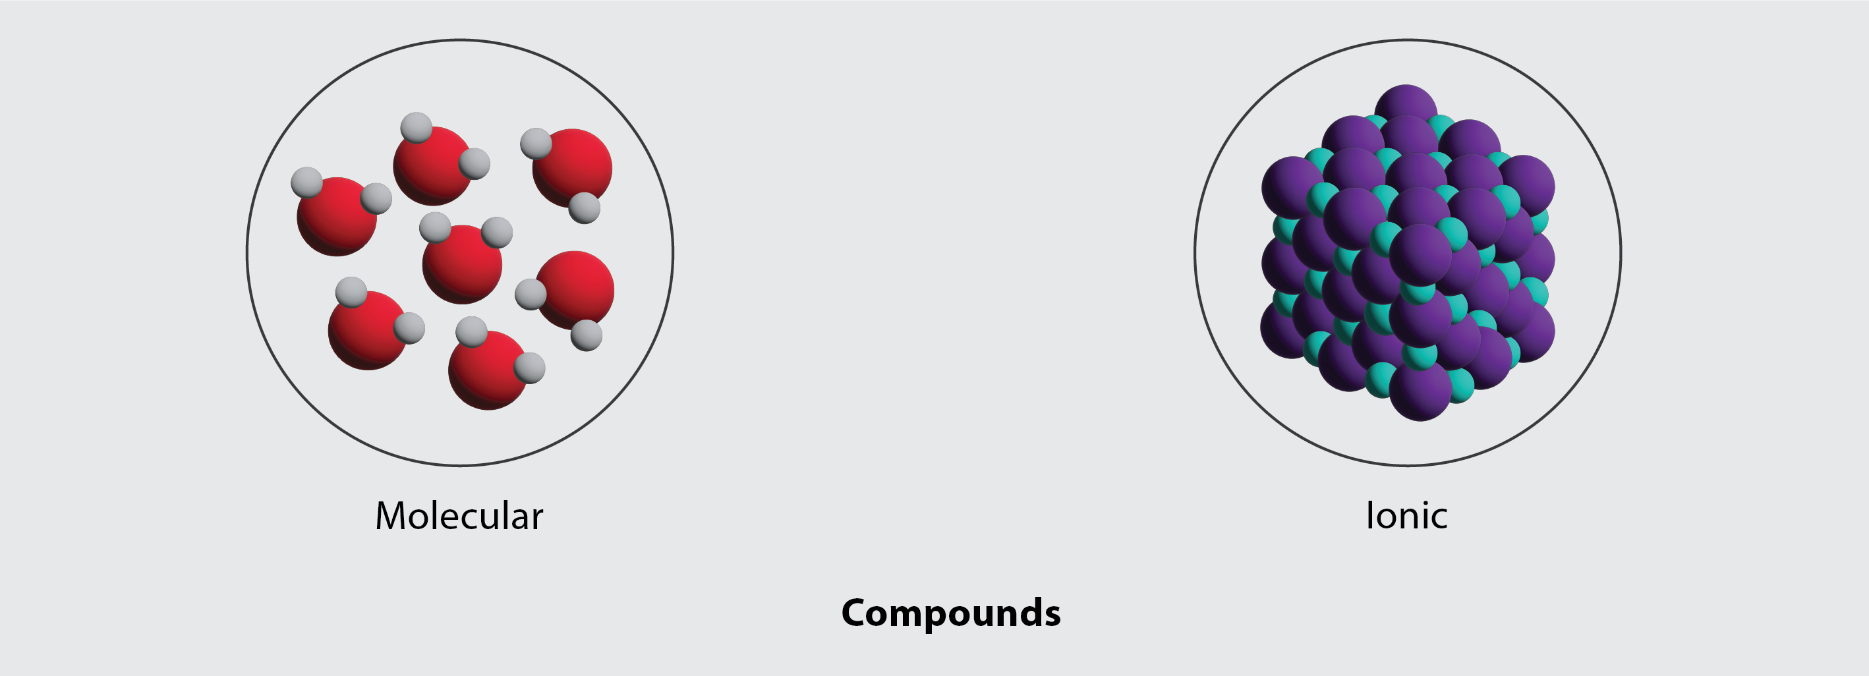
Figure 3.3i
Figure 3.3i The figure illustrates the difference in atomic structure in a compound. (credit: graphic by Revathi Mahadevan, CC BY 4.0)

