Slide 1
Chapter 2 Understanding Measurement
Slides to accompany Enhanced Introductory College Chemistry by Gregory Anderson, Caryn Fahey, J.R. van Haarlem, Jackie MacDonald, Adrienne Richards, Samantha Sullivan Sauer, and David Wegman
Slide design and template by Revathi Mahadevan
Except where otherwise noted, images, tables & diagrams are reused from Enhanced Introductory College Chemistry, a derivative of Chemistry (Open Stax) by Paul Flowers, Klaus Theopold, Richard Langley & William R. Robinson and is licensed under CC BY 4.0. ​Access for free at Chemistry (OpenStax)​
Slides are licensed under CC-BY 4.0, Except while otherwise noted

Slide 2
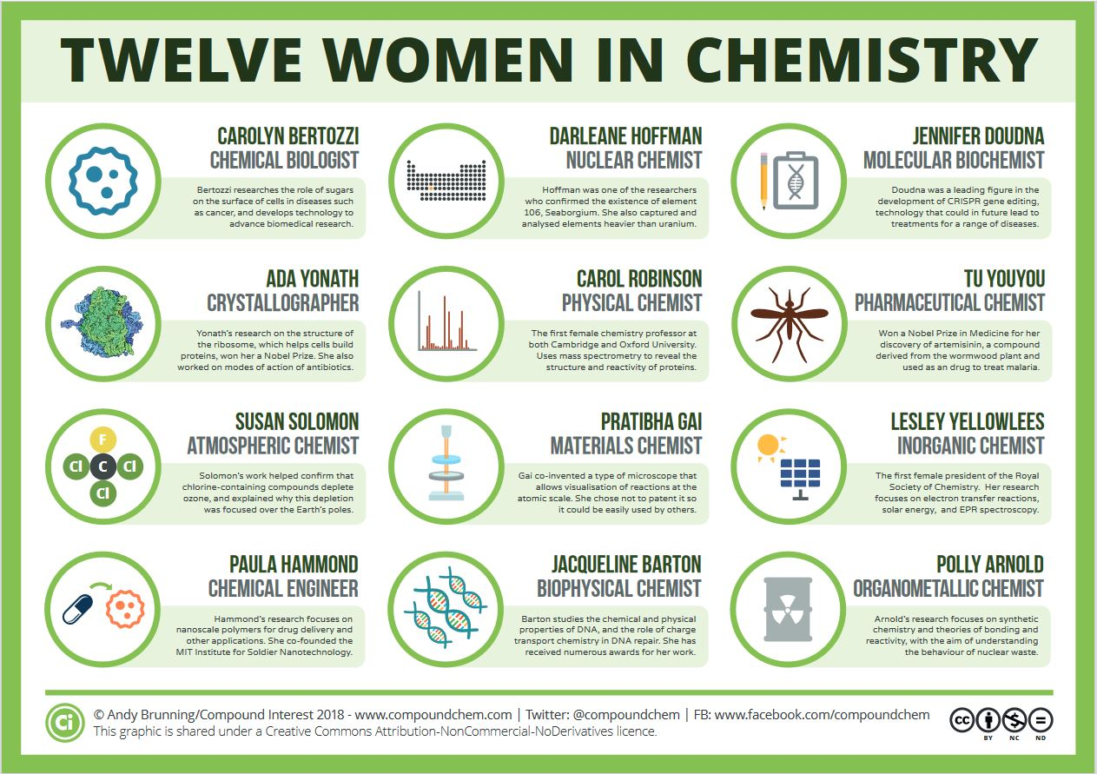
Figure 2a
Figure 2a "Twelve Women in Chemistry" by Andy Brunning/Compound Interest is licensed under CC BY-NC-ND 4.0.

Slide 3
Table 2.1a
Table 2.1a Base Units of the SI System
Property Measured | Name of Unit | Symbol of Unit
length | meter | m
mass | kilogram | kg
time | second | s
temperature | kelvin | K
electric current | ampere | A
amount of substance | mole | mol
luminous intensity | candela | cd
(credit: Chemistry (OpenStax), CC BY 4.0.)

Slide 4
Table 2.1b
Table 2.1b Common Unit Prefixes
Prefix | Symbol | Factor | Example
femto | f | 10⁻¹⁵ | 1 femtosec ond (fs) = 1 × 10⁻¹⁵ s (0.000000000000001 s)
pico | p | 10⁻¹² | 1 picometer (pm) = 1 × 10⁻¹² m (0.000000000001 m)
nano | n | 10⁻⁹ | 4 nanograms (ng) = 4 × 10⁻⁹ g (0.000000004 g)
micro | µ | 10⁻⁶ | 1 microliter (μL) = 1 × 10⁻⁶ L (0.000001 L)
milli | m | 10⁻³ | 2 millimoles (mmol) = 2 × 10⁻³ mol (0.002 mol)
centi | c | 10⁻² | 7 centimeters (cm) = 7 × 10⁻² m (0.07 m)
deci | d | 10⁻¹ | 1 deciliter (dL) = 1 × 10⁻¹ L (0.1 L )
kilo | k | 10³ | 1 kilometer (km) = 1 × 10³ m (1000 m)
mega | M | 10⁶ | 3 megahertz (MHz) = 3 × 10⁶ Hz (3,000,000 Hz)
giga | G | 10⁹ | 8 gigayears (Gyr) = 8 × 10⁹ yr (8,000,000,000 Gyr)
tera | T | 10¹² | 5 terawatts (TW) = 5 × 10¹² W (5,000,000,000,000 W)
(credit: Chemistry (OpenStax), CC BY 4.0.)

Slide 5
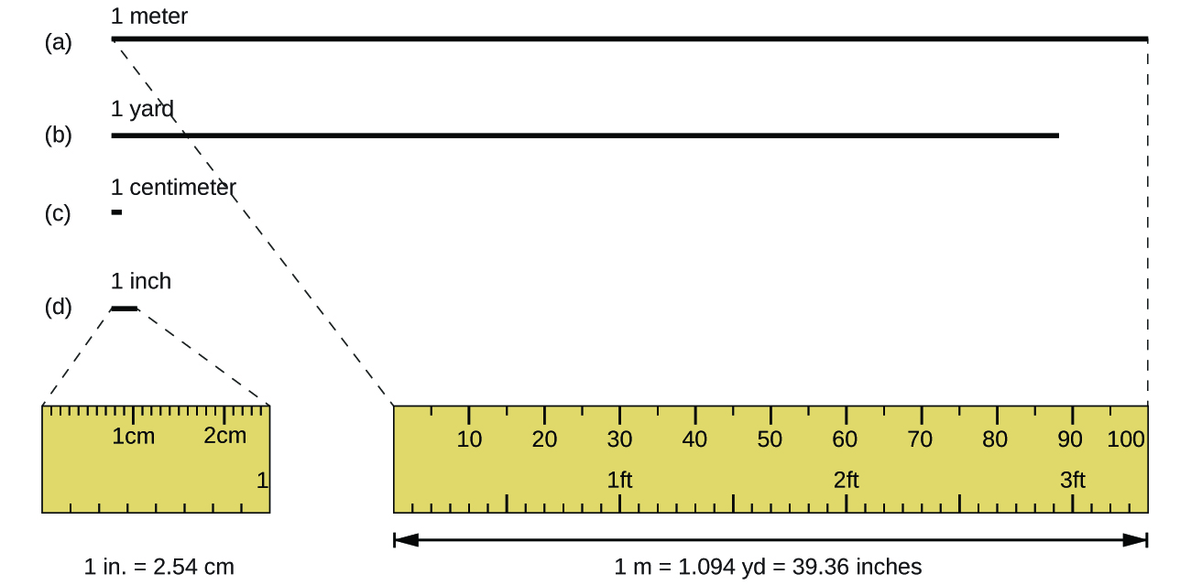
Figure 2.1a
Figure 2.1a The relative lengths of 1 m, 1 yd, 1 cm, and 1 in. are shown (not actual size), as well as comparisons of 2.54 cm and 1 in., and of 1 m and 1.094 yd. (credit: Chemistry (OpenStax), CC BY 4.0.)

Slide 6
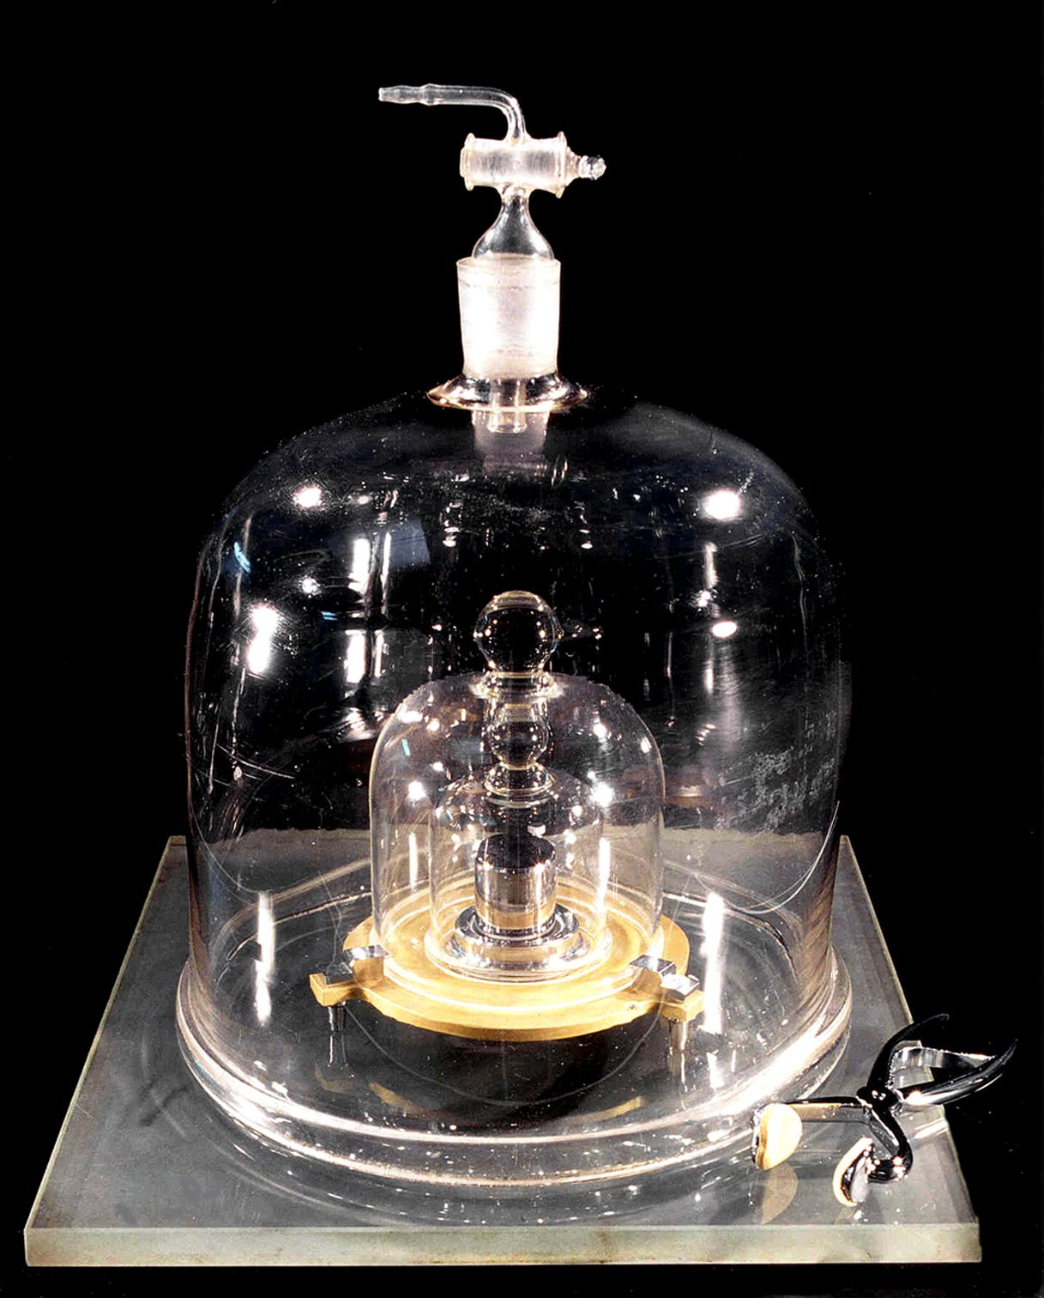
Figure 2.1b
Figure 2.1b This replica prototype kilogram is housed at the National Institute of Standards and Technology (NIST) in Maryland. (credit: photo by BIPM, CC BY-SA 3.0)

Slide 7
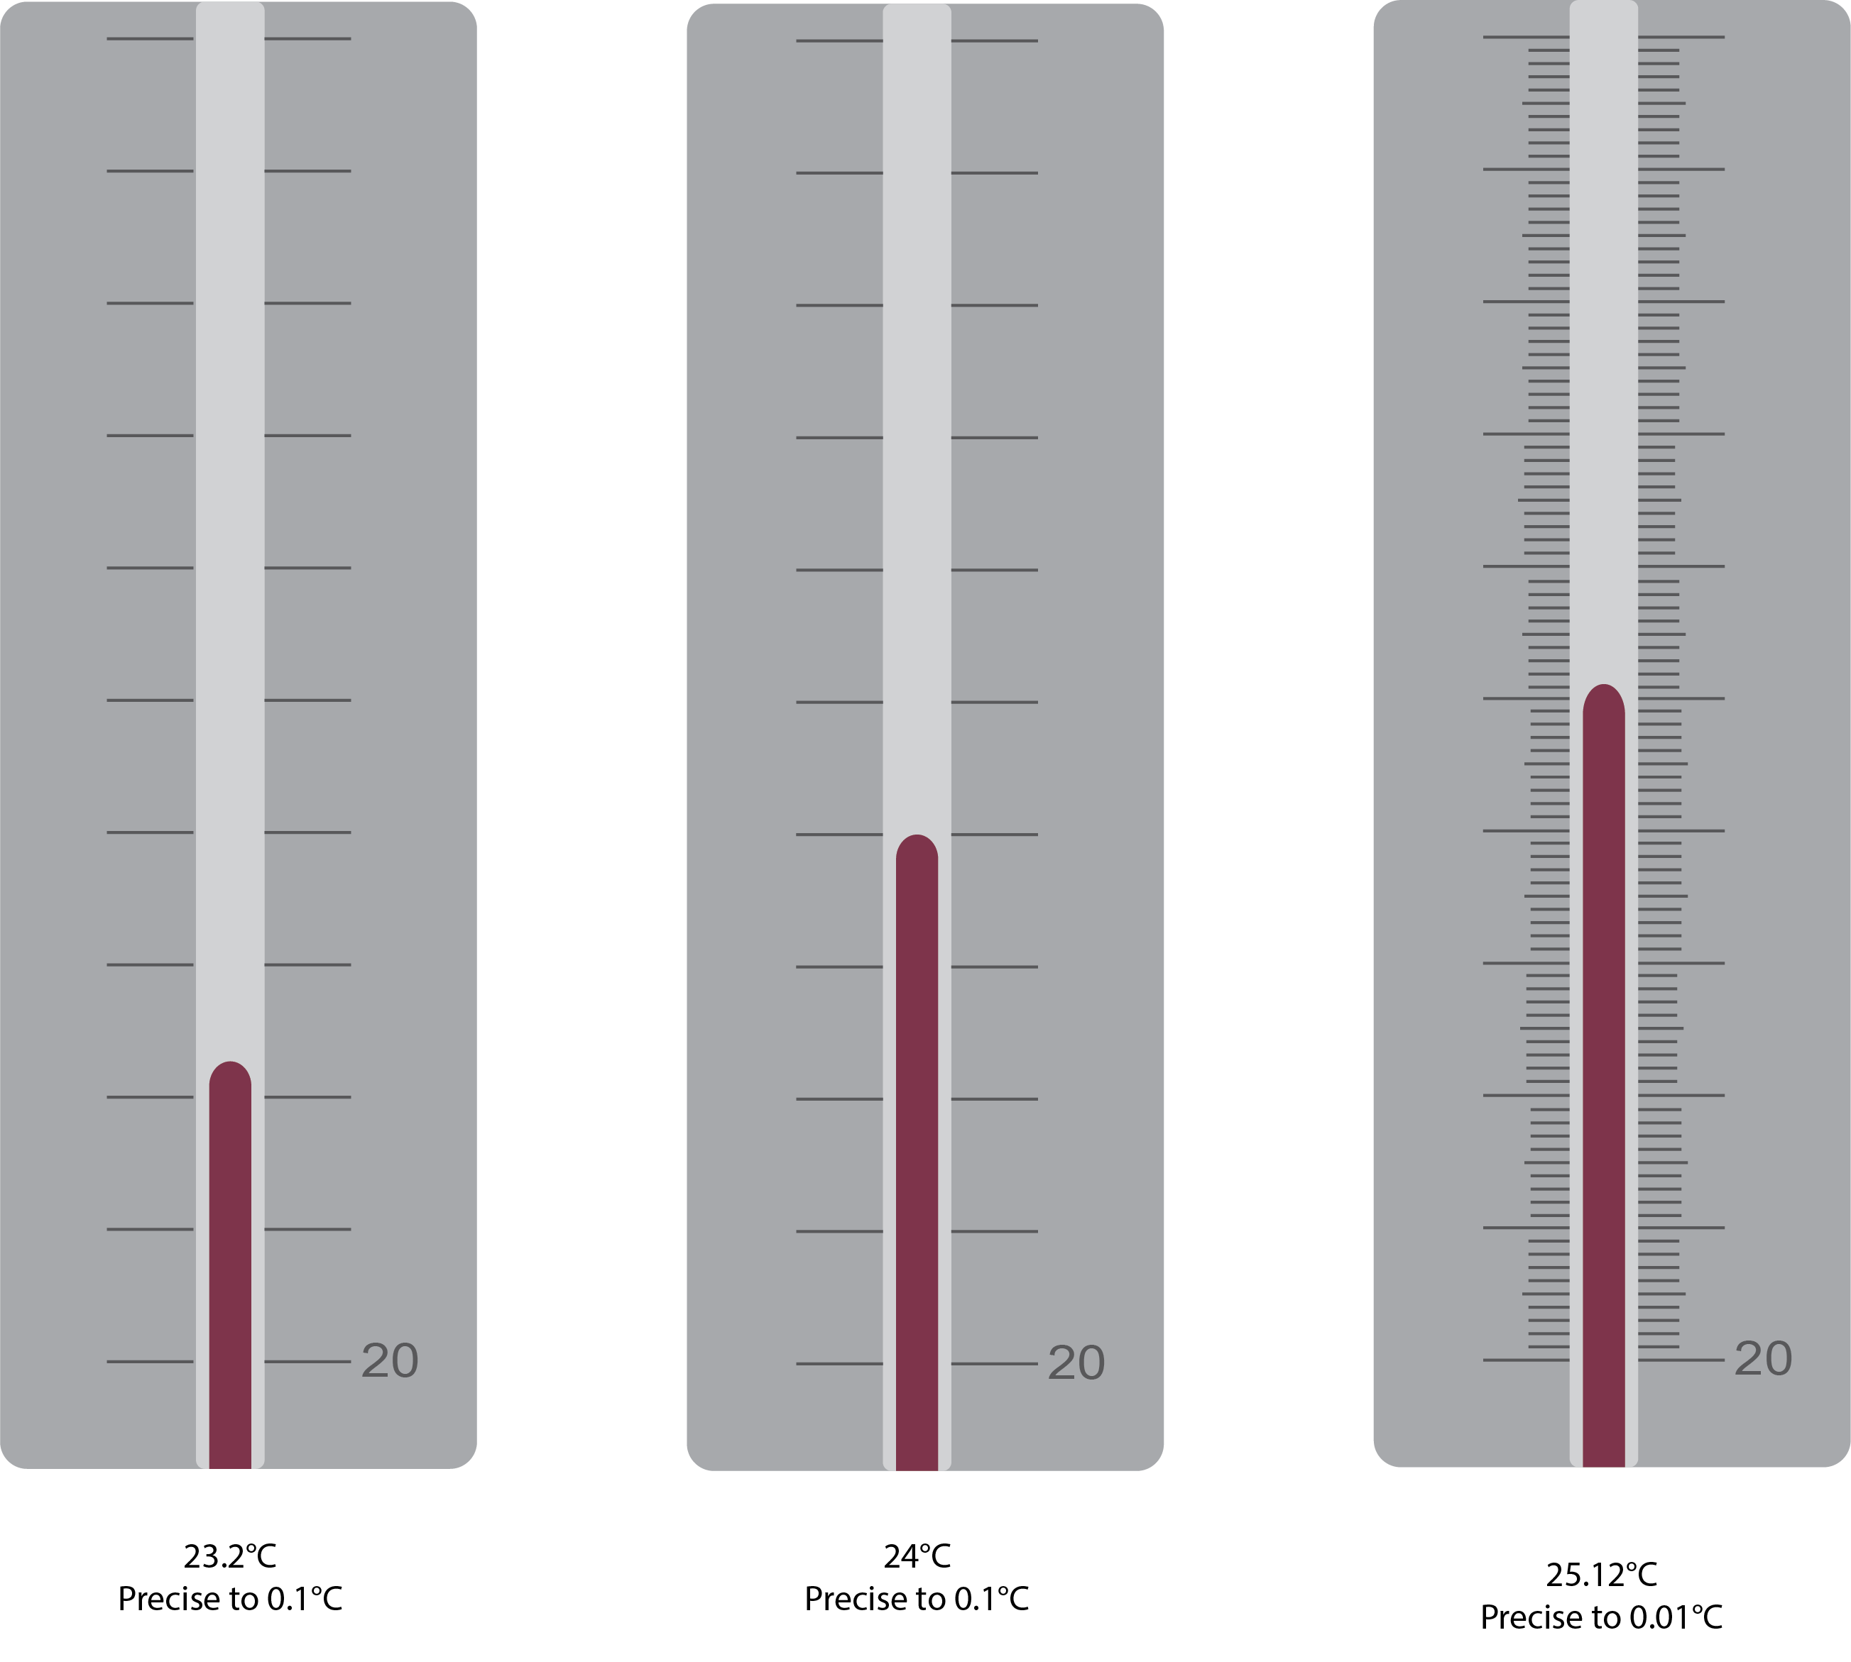
Figure 2.1c
Figure 2.1c Different degrees of precision while measuring temperature. (credit: graphics by Revathi Mahadevan, CC BY 4.0)

Slide 8
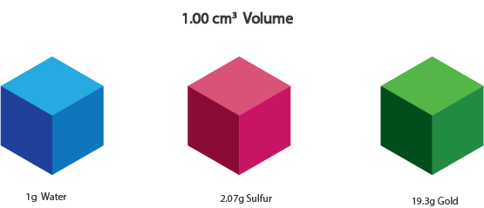
Figure 2.1d
Figure 2.1d The figure shows 3 cubes. Each of equal volume but with varying masses. (credit: graphics by Revathi Mahadevan, CC BY 4.0)

Slide 9
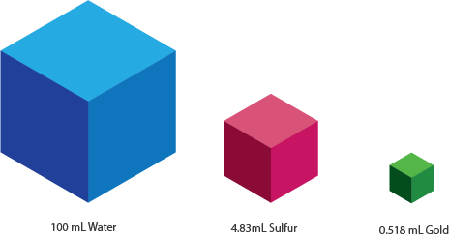
Figure 2.1e
Figure 2.1e The figure shows 3 cubes. Each of equal masses but with varying volumes. (credit: graphics by Revathi Mahadevan, CC BY 4.0)

Slide 10
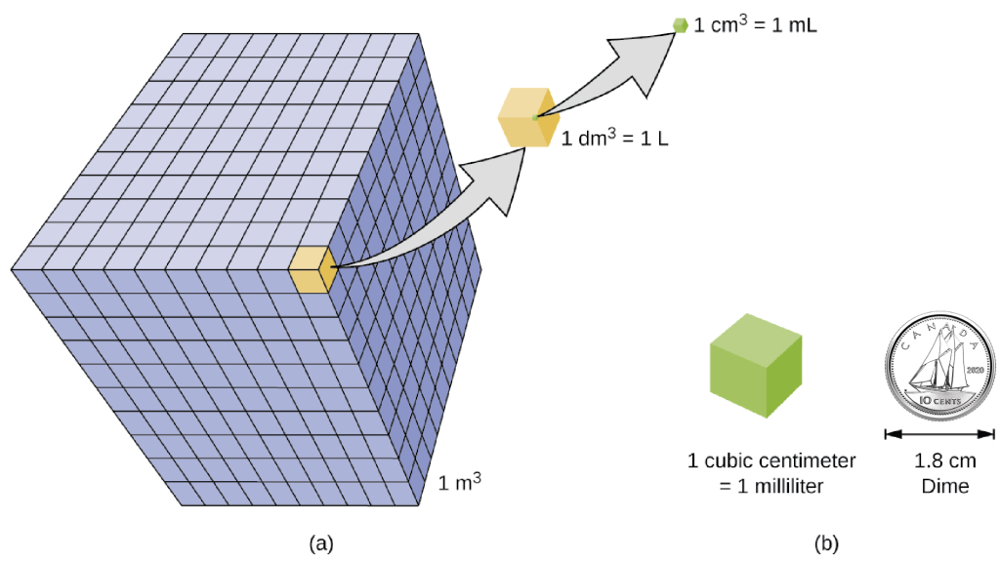
Figure 1.2b
Figure 2.1f (a) The relative volumes are shown for cubes of 1 m3, 1 dm3 (1 L), and 1 cm3 (1 mL) (not to scale). (b) The diameter of a dime is compared relative to the edge length of a 1-cm3 (1-mL) cube. (credit: Chemistry 2e (OpenStax), CC BY 4.0 . / Canadian dime added by Revathi Mahadevan.)

Slide 11
Table 2.1c
Table 2.1c Densities of Common Substances
Solids | Liquids | Gases (at 25 °C and 1 atm)
ice (at 0 °C) 0.92 g/cm³ | water 1.0 g/cm³ | dry air 1.20 g/L
oak (wood) 0.60–0.90 g/cm³ | ethanol 0.79 g/cm³ | oxygen 1.31 g/L
iron 7.9 g/cm³ | acetone 0.79 g/cm³ | nitrogen 1.14 g/L
copper 9.0 g/cm³ | glycerin 1.26 g/cm³ | carbon dioxide 1.80 g/L
lead 11.3 g/cm³ | olive oil 0.92 g/cm³ | helium 0.16 g/L
silver 10.5 g/cm³ | gasoline 0.70–0.77 g/cm³ | neon 0.83 g/L
gold 19.3 g/cm³ | mercury 13.6 g/cm³ | radon 9.1 g/L
(credit: Chemistry (OpenStax), CC BY 4.0.)

Slide 12
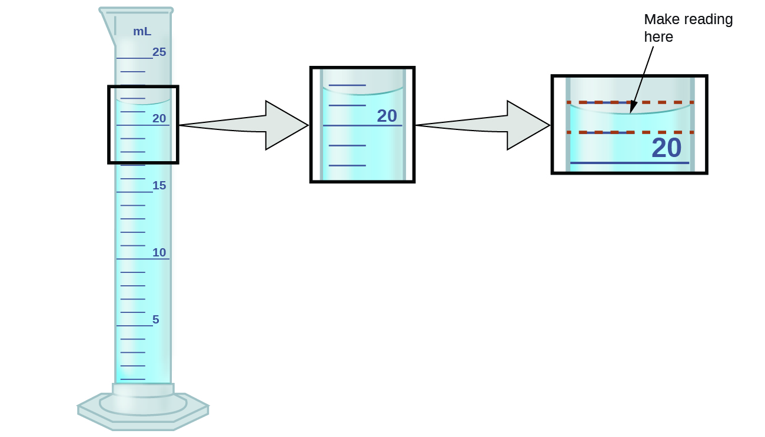
Figure 2.2a
Figure 2.2a To measure the volume of liquid in this graduated cylinder, you must mentally subdivide the distance between the 21 and 22 mL marks into tenths of a milliliter, and then make a reading (estimate) at the bottom of the meniscus. (credit: Chemistry (OpenStax), CC BY 4.0.)

Slide 13
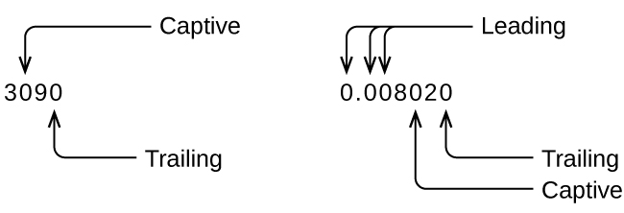
Figure 2.2b
Figure 2.2b Examples of captive, leading and training zeros in multidigit numbers. A captive zero appears between two non-zero digitals. A leading zero appears before any non-zero digits. A trailing zero appears after the last non-zero digit. (credit: Chemistry (OpenStax), CC BY 4.0.)

Slide 14
Figure 2.2c
Figure 2.2c All non-zero digits are significant. Zeros to the right of a decimal point after a non-zero digit are significant. (credit: Chemistry (OpenStax), CC BY 4.0.)

Slide 15
Figure 2.2d
Figure 2.2d Trailing zeros may or may not be significant when there is no decimal. Assume the trailing zeros are not significant when there is no decimal. (credit: Chemistry (OpenStax), CC BY 4.0.)

Slide 16
Figure 2.2e
Figure 2.2eThe zeros could be significant (measured) or placeholders depending on the measurement. (credit: Chemistry (OpenStax), CC BY 4.0.)

Slide 17
Figure 2.2f
Figure 2.2f (a) These arrows are close to both the bull’s eye and one another, so they are both accurate and precise. (b) These arrows are close to one another but not on target, so they are precise but not accurate. (c) These arrows are neither on target nor close to one another, so they are neither accurate nor precise. (credit: Chemistry (OpenStax), CC BY 4.0.)

Slide 18
Table 2.2a
Table 2.2a Volume (mL) of Cough Medicine Delivered by 10-oz (296 mL) Dispensers
Dispenser #1 | Dispenser #2 | Dispenser #3
283.3 | 298.3 | 296.1
284.1 | 294.2 | 295.9
283.9 | 296.0 | 296.1
284.0 | 297.8 | 296.0
284.1 | 293.9 | 296.1
(credit: Chemistry (OpenStax), CC BY 4.0.)

Slide 19
Table 2.3a
Table 2.3a Common Conversion Factors
Type of Unit | Unit | Equivalent Unit
length | 1 m | 1.0936 yd
length | 1 in. | 2.54 cm (exact)
length | 1 km | 0.62137 mi
length | 1 mi | 1609.3 m
volume | 1 L | 1.0567 qt
volume | 1 qt | 0.94635 L
volume | 1 ft³ | 28.317 L
volume | 1 tbsp | 14.787 mL
mass | 1 kg | 2.2046 lb
mass | 1 lb | 453.59 g
mass | 1 (avoirdupois) oz | 28.349 g
mass | 1 (troy) oz | 31.103 g
(credit: Chemistry (OpenStax), CC BY 4.0, modified by Enhanced Introductory College Chemistry, for accessibility, CC BY 4.0

Slide 20
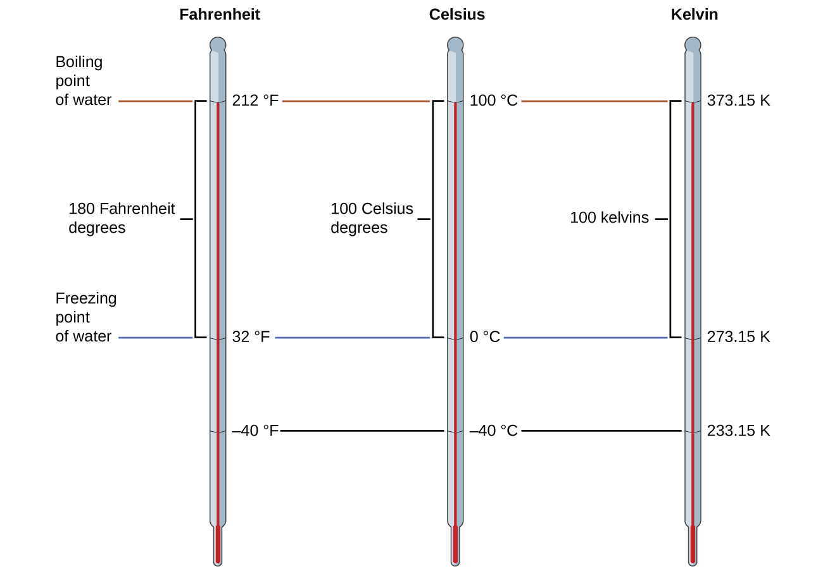
Figure 2.3a
Figure 2.3a The Fahrenheit, Celsius, and kelvin temperature scales are compared. (credit: Chemistry (OpenStax), CC BY 4.0.)

