Slide 1
Chapter 17 Welcome to Chemistry
Slides to accompany Enhanced Introductory College Chemistry by Gregory Anderson, Caryn Fahey, J.R. van Haarlem, Jackie MacDonald, Adrienne Richards, Samantha Sullivan Sauer, and David Wegman
Slide design and template by Revathi Mahadevan
Except where otherwise noted, images, tables & diagrams are reused from Enhanced Introductory College Chemistry, a derivative of Chemistry (Open Stax) by Paul Flowers, Klaus Theopold, Richard Langley & William R. Robinson and is licensed under CC BY 4.0. ​Access for free at Chemistry (OpenStax)​
Slides are licensed under CC-BY 4.0, Except while otherwise noted

Slide 2
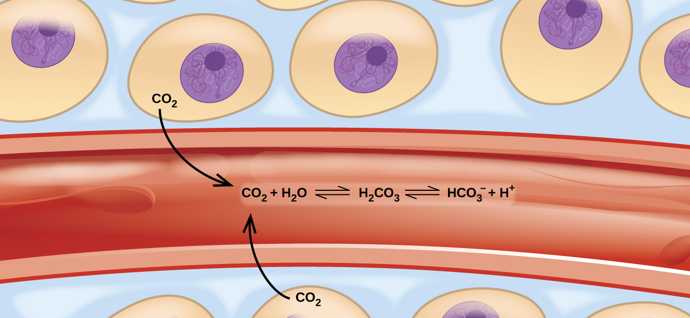
Figure 17a
Figure 17a Movement of carbon dioxide through tissues and blood cells involves several equilibrium reactions. (credit: Chemistry (OpenStax), CC BY 4.0.)

Slide 3
Figure 17.1a
Figure 17.1a The rate of decomposition of H₂O₂ in an aqueous solution decreases as the concentration of H₂O₂ decreases. (credit: Chemistry (OpenStax), CC BY 4.0.)

Slide 4
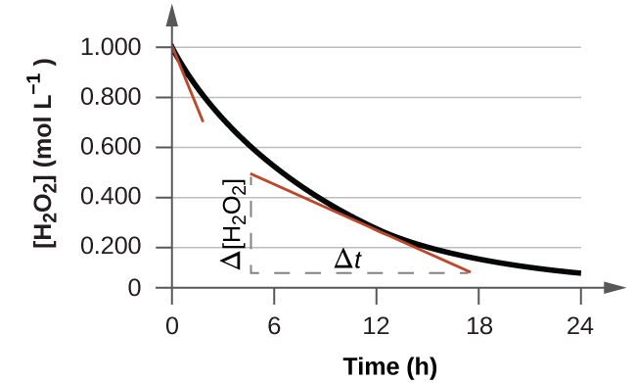
Figure 17.1b
Figure 17.1b This graph shows a plot of concentration versus time for a 1.000 M solution of H₂O₂. The rate at any instant is equal to the opposite of the slope of a line tangential to this curve at that time. Tangents are shown at t = 0 h (“initial rate”) and at t = 10 h (“instantaneous rate” at that particular time). (credit: Chemistry (OpenStax), CC BY 4.0.)

Slide 5
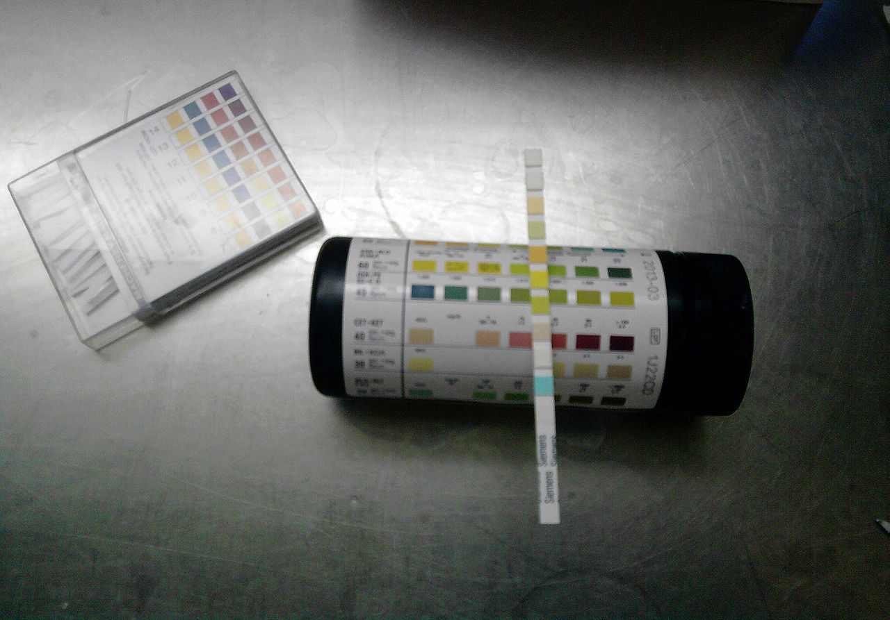
Figure 17.1c
Figure 17.1c Test strips are commonly used to detect the presence of specific substances in a person’s urine. Many test strips have several pads containing various reagents to permit the detection of multiple substances on a single strip. (credit: work by J3D3, CC BY-SA 3.0)

Slide 6
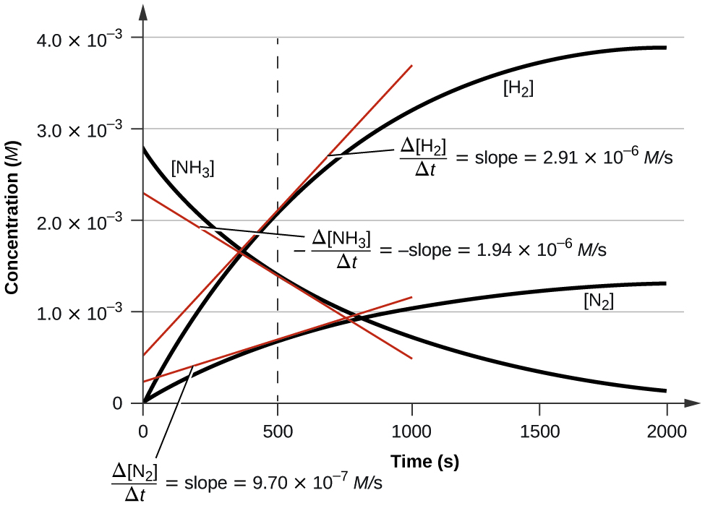
Figure 17.1d
Figure 17.1d This graph shows the changes in concentrations of the reactants and products during the reaction 2NH₃ → 3N₂ + H₂. The rates of change of the three concentrations are related by their stoichiometric factors, as shown by the different slopes of the tangents at t = 500 s. (credit: Chemistry (OpenStax), CC BY 4.0.)

Slide 7
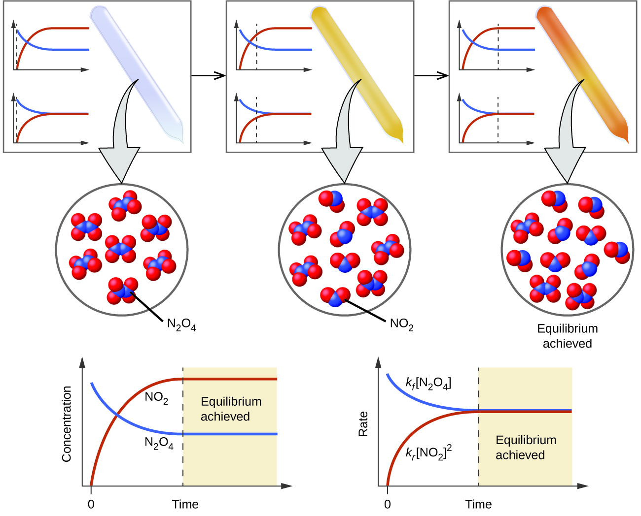
Figure 17.2a
Figure 17.2a A mixture of NO₂ and N₂O₄ moves toward equilibrium. Colourless N₂O₄ reacts to form brown NO₂. As the reaction proceeds toward equilibrium, the colour of the mixture darkens due to the increasing concentration of NO₂. (credit: Chemistry (OpenStax), CC BY 4.0.)

Slide 8
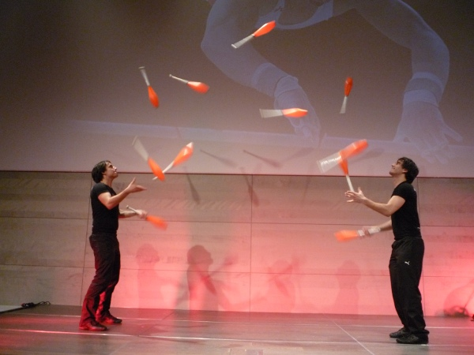
Figure 17.2b
Figure 17.2b These jugglers provide an illustration of dynamic equilibrium. Each throws clubs to the other at the same rate at which he receives clubs from that person. Because clubs are thrown continuously in both directions, the number of clubs moving in each direction is constant, and the number of clubs each juggler has at a given time remains (roughly) constant. (credit: work by Cmitasch, CC BY-SA 3.0)

Slide 9
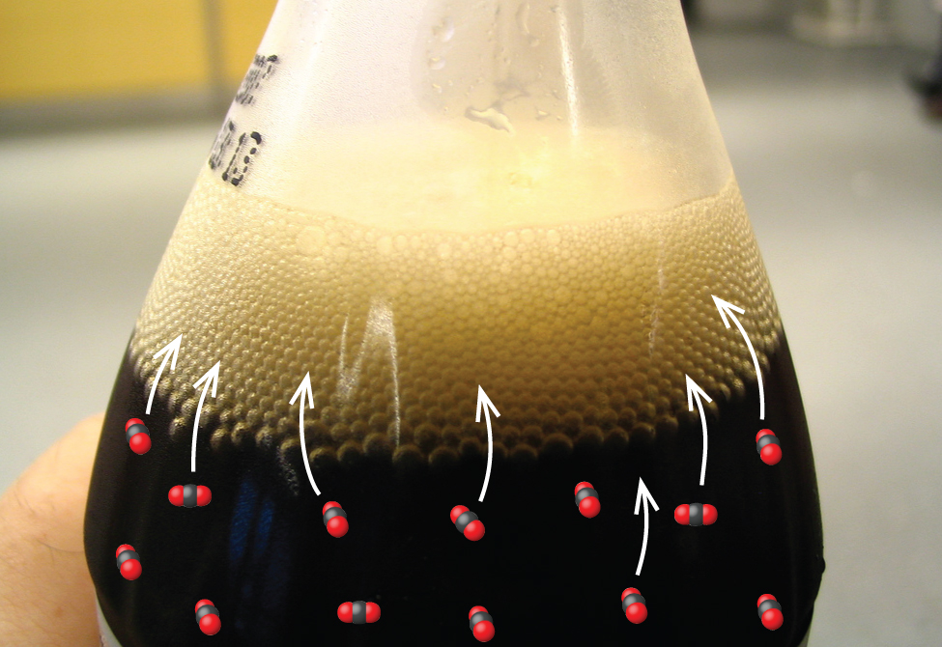
Figure 17.2c
Figure 17.2c When a soft drink is opened, several equilibrium shifts occur. (credit: modification of work by Chiara Cotzee, PD).; in Chemistry (OpenStax), CC BY 4.0).

Slide 10
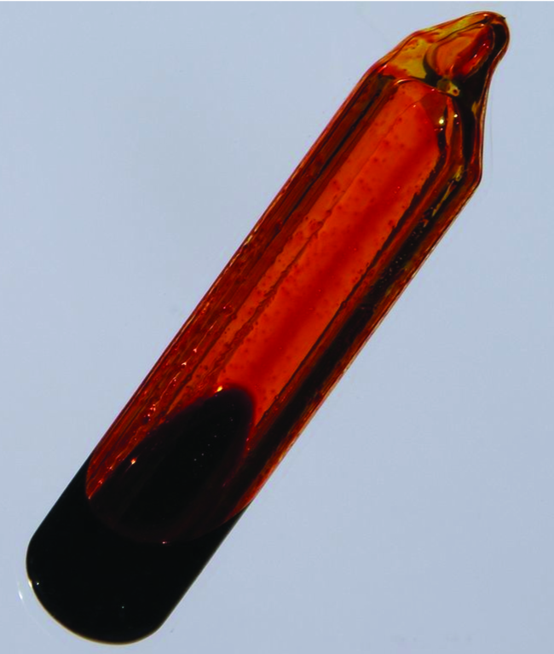
Figure 17.2d
Figure 17.2d An equilibrium is pictured between liquid bromine, Br₂(l), the dark liquid, and bromine vapour, Br₂(g), the orange gas. Because the container is sealed, bromine vapour cannot escape and equilibrium is maintained. (credit: work by Anonymous/Images of Elements, CC BY 3.0 )

Slide 11
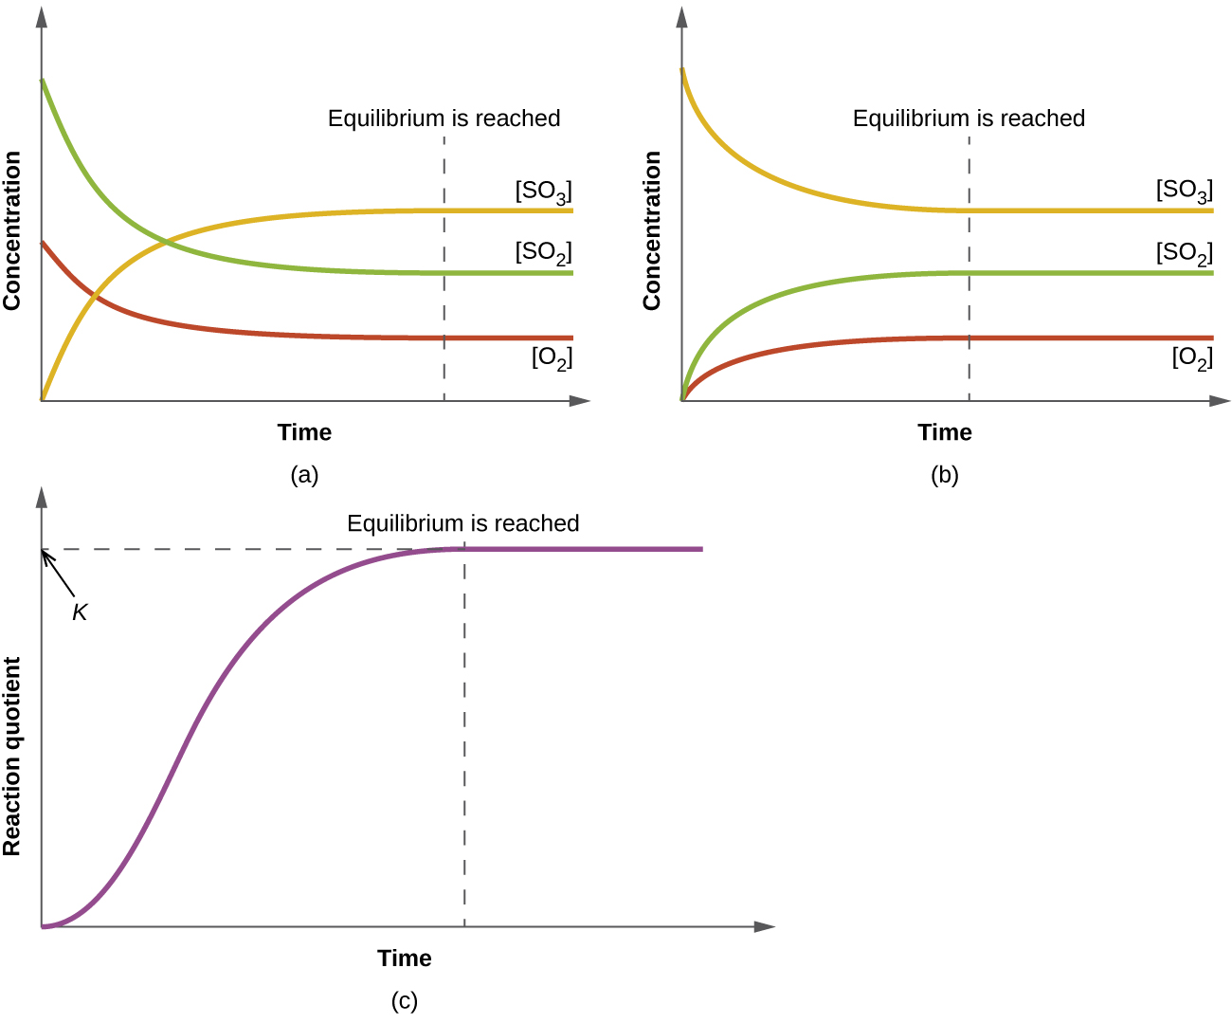
Figure 17.3a
Figure 17.3a (a) The change in the concentrations of reactants and products is depicted as the 2SO₂(g) + O₂(g) ⇌ 2SO₃(g) reaction approaches equilibrium. (b) The change in concentrations of reactants and products is depicted as the reaction 2SO₃(g) ⇌ 2SO₂(g) + O₂(g) approaches equilibrium. (c) The graph shows the change in the value of the reaction quotient as the reaction approaches equilibrium. (credit: Chemistry (OpenStax), CC BY 4.0.)

Slide 12
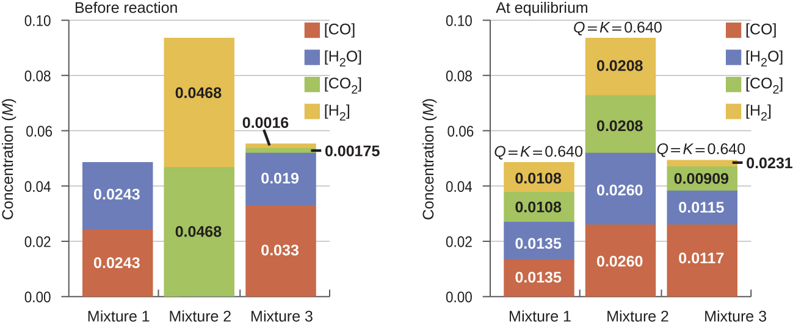
Figure 17.3b
Figure 17.3b Concentrations of three mixtures are shown before and after reaching equilibrium at 800 °C for the so-called water gas shift reaction: CO(g) + H₂O(g) ⇌ CO₂(g) + H₂(g). (credit: Chemistry (OpenStax), CC BY 4.0.)

Slide 13
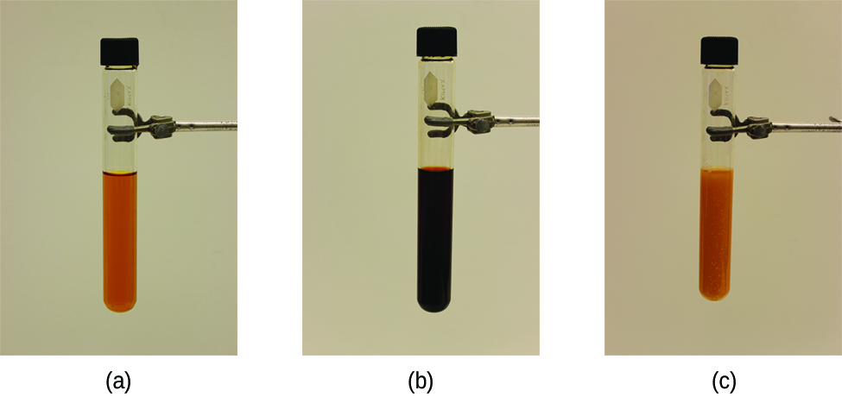
Figure 17.4a
Figure 17.4a (a) The test tube contains 0.1 M Fe³⁺. (b) Thiocyanate ion has been added to solution in (a), forming the red Fe(SCN)²⁺ ion. Fe³⁺(aq) + SCN⁻(aq) ⇌ Fe(SCN)²⁺(aq). (c) Silver nitrate has been added to the solution in (b), precipitating some of the SCN⁻ as the white solid AgSCN. Ag⁺(aq) + SCN⁻(aq) ⇌ AgSCN(s). The decrease in the SCN⁻ concentration shifts the first equilibrium in the solution to the left, decreasing the concentration (and lightening colour) of the Fe(SCN)²⁺. (credit: modification of work by Mark Ott in Chemistry (OpenStax), CC BY 4.0.)

Slide 14
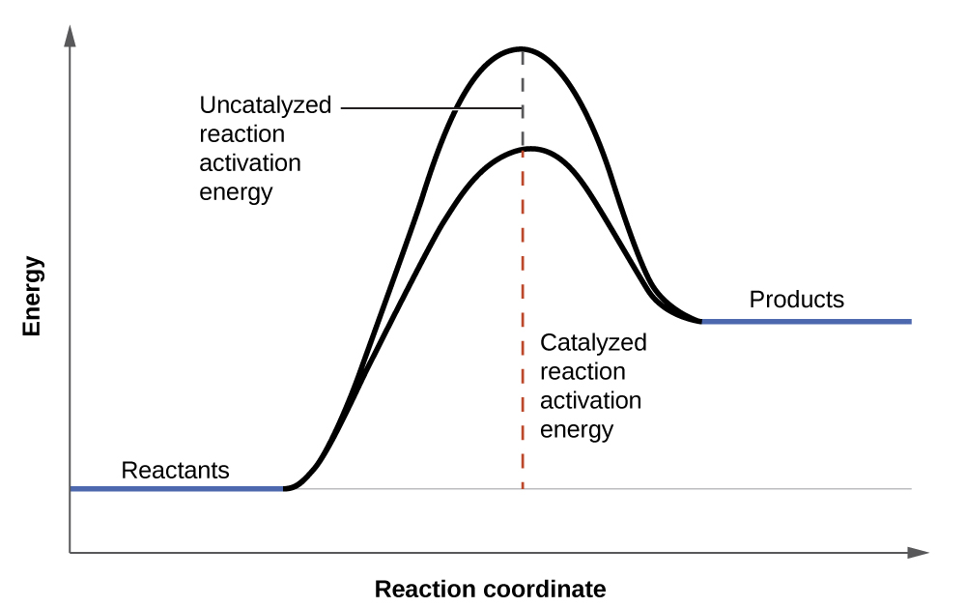
Figure 17.4b
Figure 17.4b The presence of a catalyst increases the rate of a reaction by lowering its activation energy. (credit: General Chemistry 1 & 2, CC BY 4.0)

Slide 15
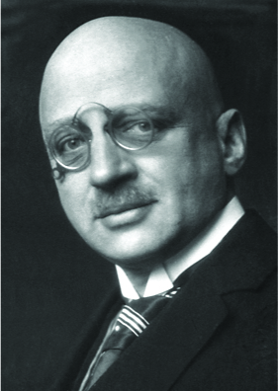
Figure 17.4c
Figure 17.4c The work of Nobel Prize recipient Fritz Haber revolutionized agricultural practices in the early 20th century. His work also affected wartime strategies, adding chemical weapons to the artillery. (credit: work by The Nobel Foundation, PD)

Slide 16
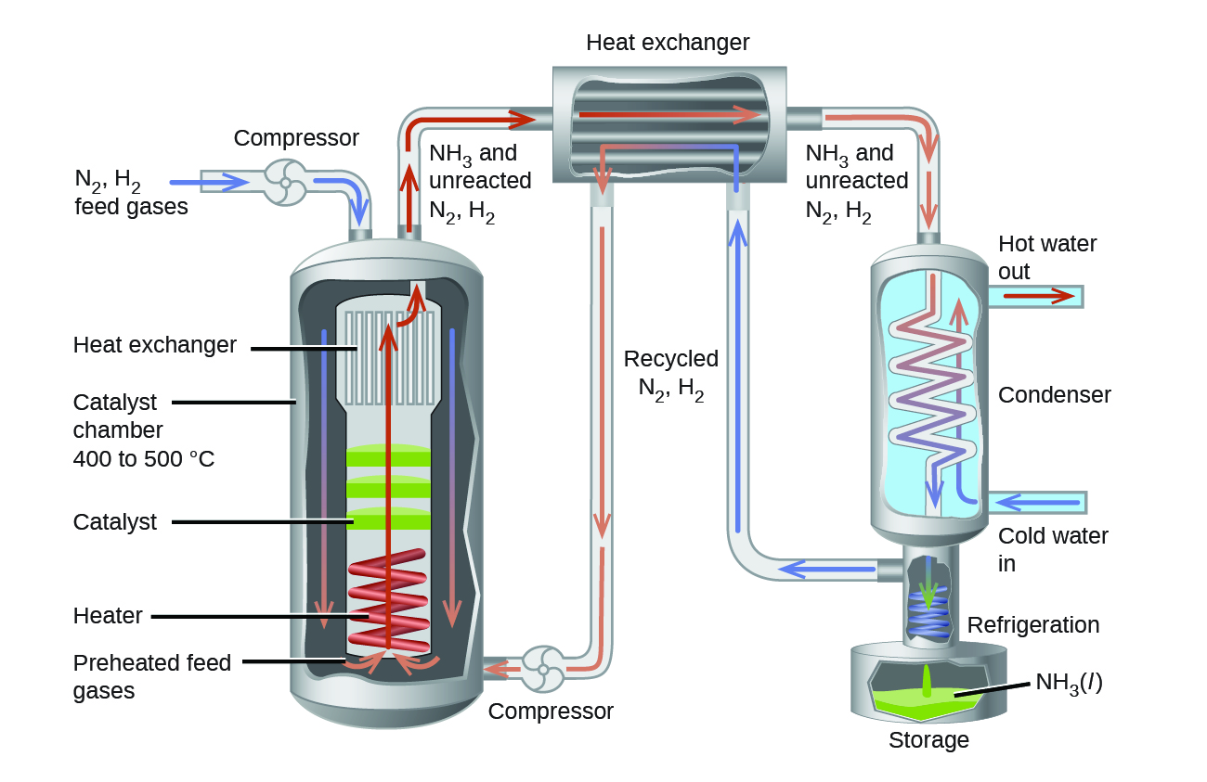
Figure 17.4d
Figure 17.4d Commercial production of ammonia requires heavy equipment to handle the high temperatures and pressures required. This schematic outlines the design of an ammonia plant. (credit: Chemistry (OpenStax), CC BY 4.0.)

Slide 17
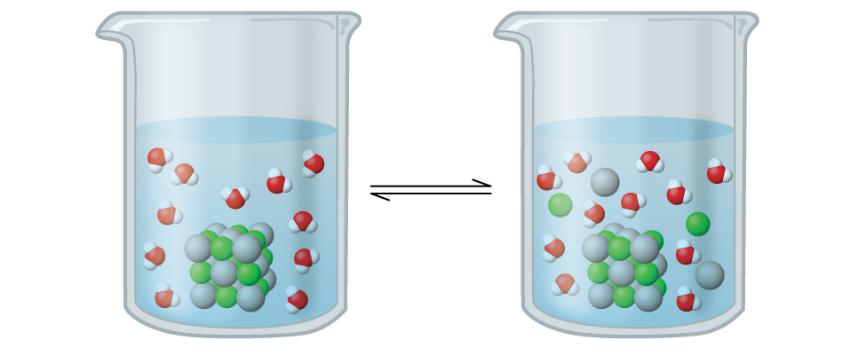
Figure 17.6a
Figure 17.6a Silver chloride is a sparingly soluble ionic solid. When it is added to water, it dissolves slightly and produces a mixture consisting of a very dilute solution of Ag⁺ and Cl– ions in equilibrium with undissolved silver chloride. (credit: Chemistry (OpenStax), CC BY 4.0.)

Slide 18
Table 17.6a
Table 17.6a Common Solubility Products by Decreasing Equilibrium Constants
Substance | K_{sp} at 25 °C
CuCl | 1.2 × 10^{–6}
CuBr | 6.27 × 10^{–9}
AgI | 1.5 × 10^{–16}
PbS | 7 × 10^{–29}
Al(OH)₃ | 2 × 10^{–32}
Fe(OH)₃ | 4 × 10^{–38}
(credit: Chemistry (OpenStax), CC BY 4.0.)

Slide 19
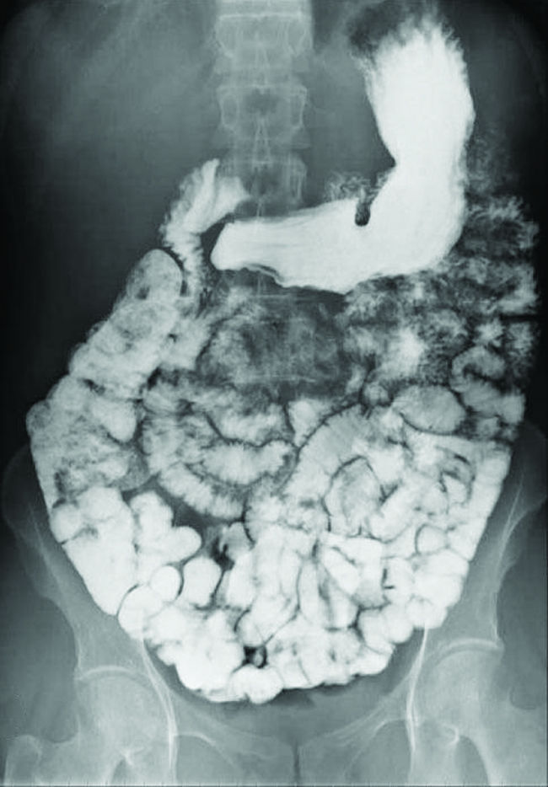
Figure 17.6b
Figure 17.6d The suspension of barium sulfate coats the intestinal tract, which allows for greater visual detail than a traditional X-ray. (credit modification of work by glitzy queen00, PD)

Slide 20
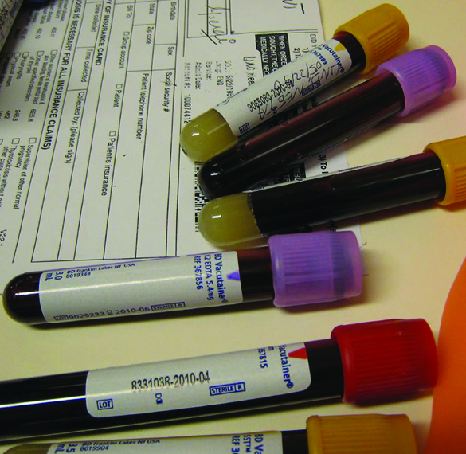
Figure 17.6c
Figure 17.6c Anticoagulants can be added to blood that will combine with the Ca²⁺ ions in blood serum and prevent the blood from clotting. (credit: modification of work by Neeta Lind, CC BY 2.0)

Slide 21
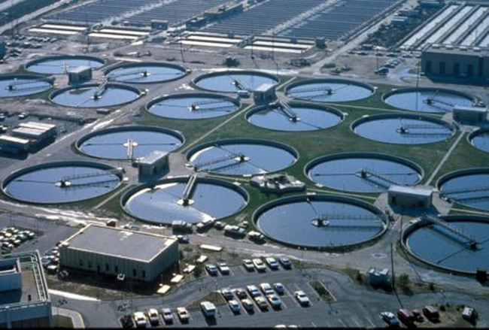
Figure 17.6d
Figure 17.6e Wastewater treatment facilities, such as this one, remove contaminants from wastewater before the water is released back into the natural environment. (credit: work by eutrophication&hypoxia, CC BY 2.0)

Slide 22
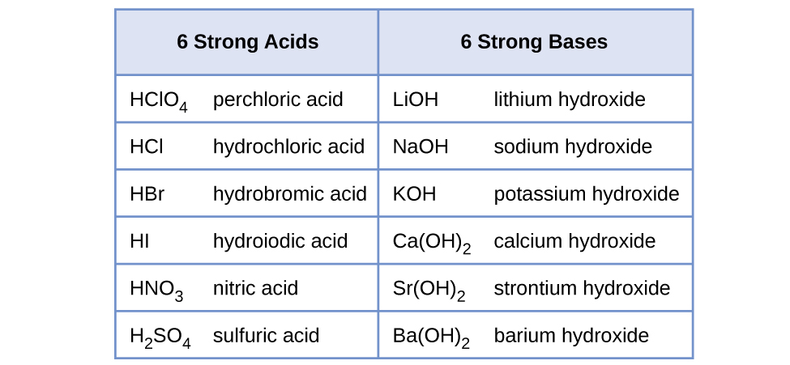
Figure 17.7a
Figure 17.7a Some of the common strong acids and bases are listed here. (credit: Chemistry (OpenStax), CC BY 4.0.)

Slide 23
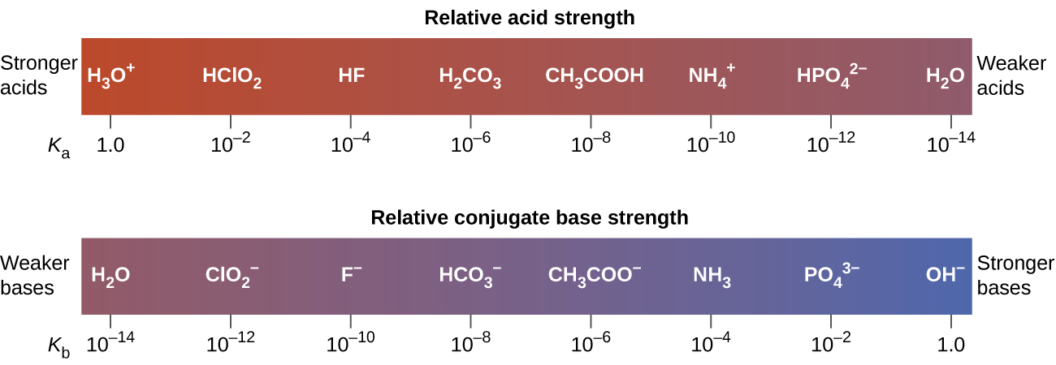
Figure 17.7b
Figure 17.7b This diagram shows the relative strengths of conjugate acid-base pairs, as indicated by their ionization constants in aqueous solution. (credit: Chemistry (OpenStax), CC BY 4.0.)

Slide 24
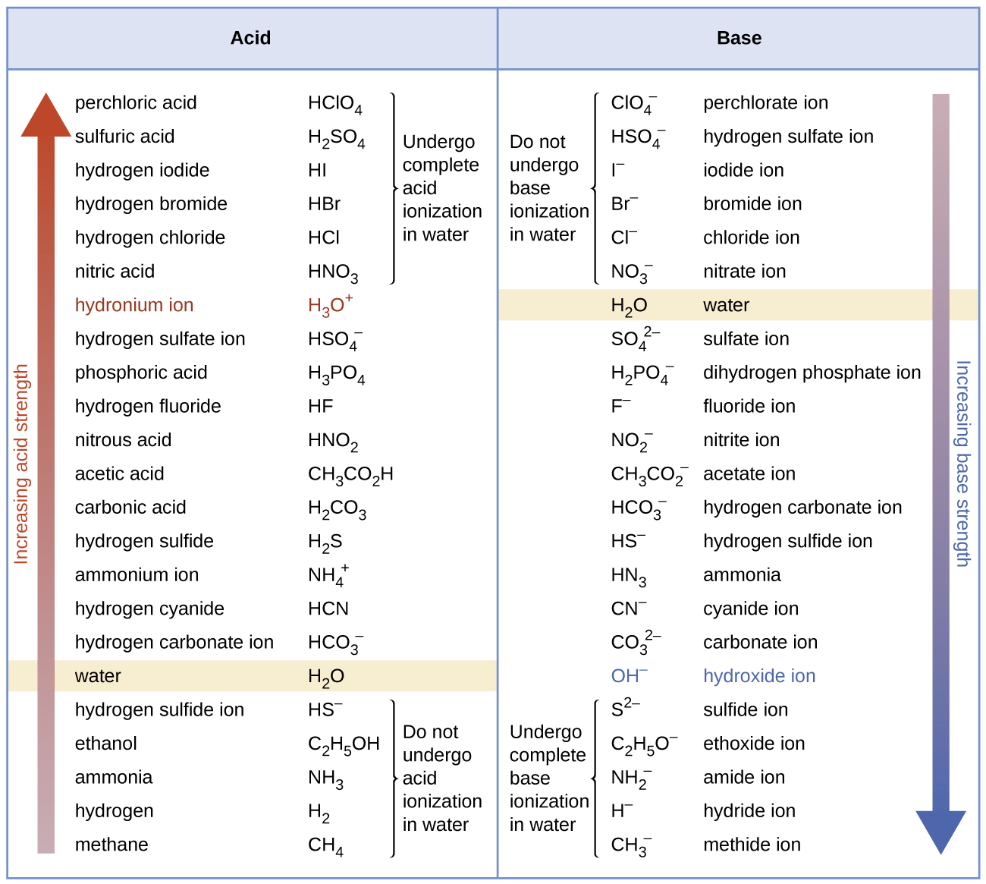
Figure 17.7c
Figure 17.7c The chart shows the relative strengths of conjugate acid-base pairs. (credit: Chemistry (OpenStax), CC BY 4.0.)

Slide 25
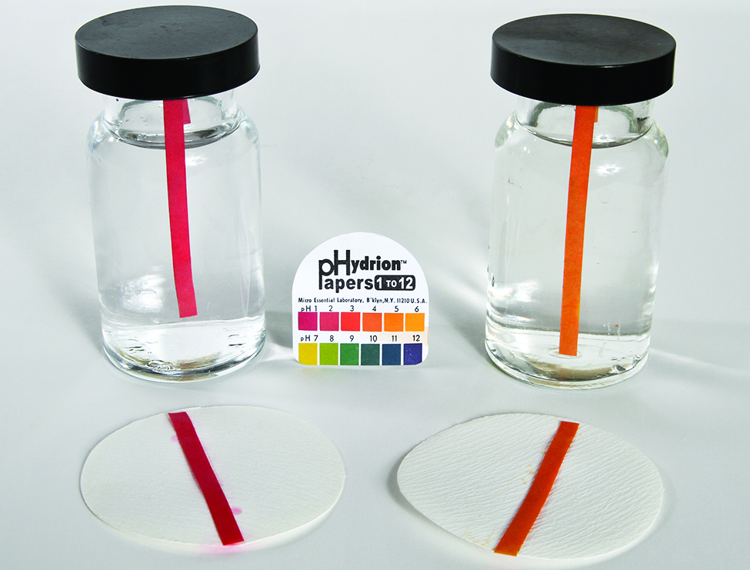
Figure 17.7d
Figure 17.7d pH paper indicates that a 0.1-M solution of HCl (beaker on left) has a pH of 1. The acid is fully ionized and [H₃O⁺] = 0.1 M. A 0.1-M solution of CH₃CO₂H (beaker on right) is a pH of 3 ([H₃O⁺] = 0.001 M) because the weak acid CH₃CO₂H is only partially ionized. In this solution, [H₃O⁺] < [CH₃CO₂H]. (credit: modification of work by Sahar Atwa in Chemistry (OpenStax), CC BY 4.0.)

Slide 26
Table 17.7a
Table 17.7a Ionization Constants of Some Weak Acids. gives the ionization constants for several weak acids; additional ionization constants can be found in Appendix I.
Ionization Reaction | K_{a} at 25 °C
HSO₄⁻ + H₂O ⇌ H₃O⁺ + SO₄²⁻ | 1.2 × 10⁻²
HF + H₂O ⇌ H₃O⁺ + F⁻ | 3.5 × 10⁻⁴
HNO₂ + H₂O ⇌ H₃O⁺ + NO₂⁻ | 4.6 × 10⁻⁴
HCNO + H₂O ⇌ H₃O⁺ + NCO⁻ | 2 × 10⁻⁴
HCO₂H + H₂O ⇌ H₃O⁺ + HCO₂⁻ | 1.8 × 10⁻⁴
CH₃CO₂H + H₂O ⇌ H₃O⁺ + CH₃CO₂⁻ | 1.8 × 10⁻⁵
HClO + H₂O ⇌ H₃O⁺ + ClO⁻ | 2.9 × 10⁻⁸
HBrO + H₂O ⇌ H₃O⁺ + BrO⁻ | 2.8 × 10⁻⁹
HCN + H₂O ⇌ H₃O⁺ + CN⁻ | 4.9 × 10⁻¹⁰
(credit: Chemistry (OpenStax), CC BY 4.0.)
Notes:
https://ecampusontario.pressbooks.pub/enhancedchemistry/chapter/electrode-cell-potentials/

Slide 27
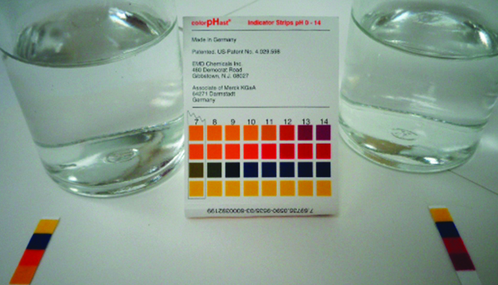
Figure 17.7e
Figure 17.7e pH paper indicates that a 0.1-M solution of NH₃ (left) is weakly basic. The solution has a pOH of 3 ([OH⁻] = 0.001 M) because the weak base NH₃ only partially reacts with water. A 0.1-M solution of NaOH (right) has a pOH of 1 because NaOH is a strong base. (credit: modification of work by Sahar Atwa in Chemistry (OpenStax), CC BY 4.0.)

Slide 28
Table 17.7b
Table 17.7b Ionization Constants of Some Weak Bases
Ionization Reaction | K_{b} at 25 °C
(CH₃)₂NH + H₂O ⇌ (CH₃)₂NH₂⁺ + OH⁻ | 5.9 × 10⁻⁴
CH₃NH₂ + H₂O ⇌ CH₃NH₃⁺ + OH⁻ | 4.4 × 10⁻⁴
(CH₃)₃N + H₂O ⇌ (CH₃)₃NH⁺ + OH⁻ | 6.3 × 10⁻⁵
NH₃ + H₂O ⇌ NH₄⁺ + OH⁻ | 1.8 × 10⁻⁵
C₆H₅NH₂ + H₂O ⇌ C₆N₅NH₃⁺ + OH⁻ | 4.3 × 10⁻¹⁰
(credit: Chemistry (OpenStax), CC BY 4.0.)

Slide 29
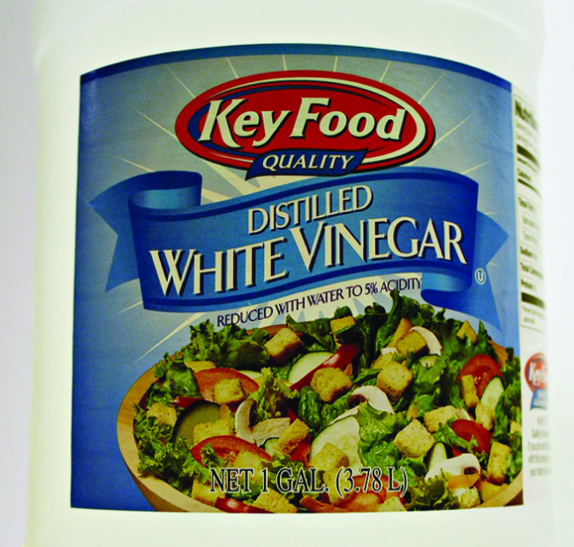
Figure 17.7f
Figure 17.7f Vinegar is a solution of acetic acid, a weak acid. (credit: modification of work by HomeSpot HQ, CC BY 2.0)

Slide 30
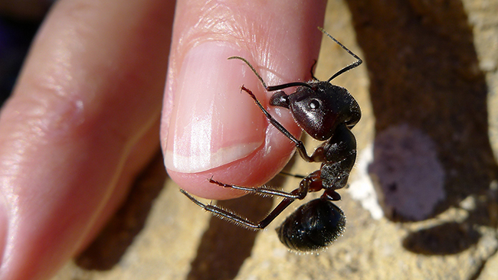
Figure 17.7g
Figure 17.7g The pain of an ant’s sting is caused by formic acid. (credit: work by John Tann, CC BY 2.0)

Slide 31
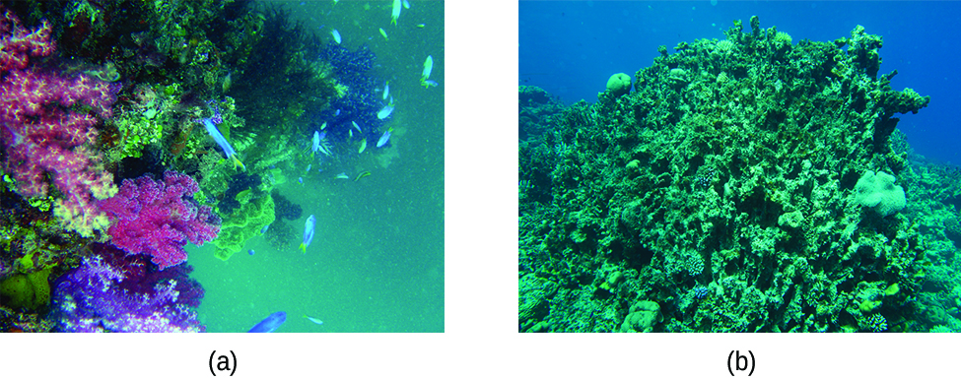
Figure 17.8a
Figure 17.8a Healthy coral reefs (a) support a dense and diverse array of sea life across the ocean food chain. But when coral are unable to adequately build and maintain their calcium carbonite skeletons because of excess ocean acidification, the unhealthy reef (b) is only capable of hosting a small fraction of the species as before, and the local food chain starts to collapse. (credit a: modification of work by NOAA Photo Library, CC BY 2.0; credit b: modification of work by prilfish, CC BY 2.0)

Slide 32
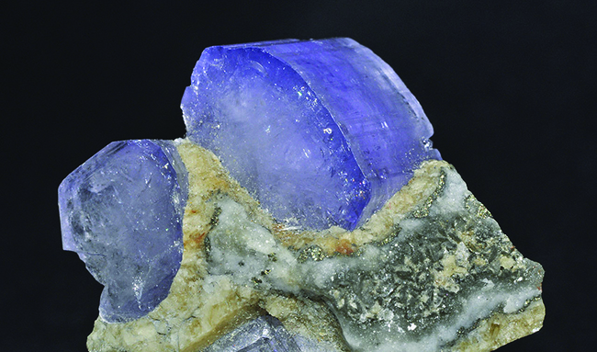
Figure 17.8b
Figure 17.8b Crystal of the mineral hydroxylapatite, Ca₅(PO₄)₃OH, is shown here. Pure apatite is white, but like many other minerals, this sample is coloured because of the presence of impurities. (credit: Chemistry (OpenStax), CC BY 4.0.)

Slide 33
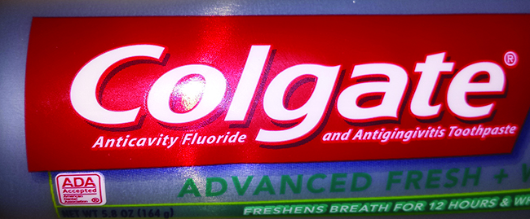
Figure 17.8c
Figure 17.8c Fluoride, found in many toothpastes, helps prevent tooth decay (credit: Kerry Ceszyk in Chemistry (OpenStax), CC BY 4.0.)

